Slide 1
Highway 14 – Owatonna to Dodge Center
District 6 Update
Highway 14 Partnership meeting
Owatonna, Jan. 12, 2017
J
Notes:
Thank you again for the invitation to meet with you and thank you for your continued work to find ways for funding transportation and educating decision makers on the needs that exist.

Slide 2
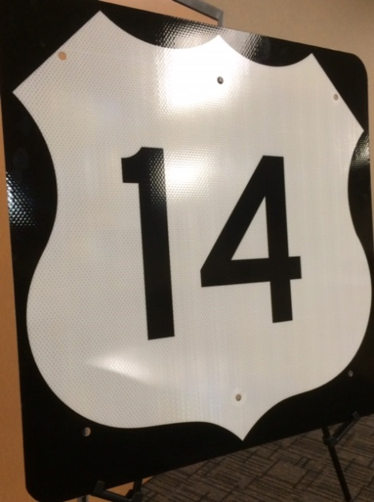
Hwy 14 Segment 1 expansion complete
Hwy 14 Expansion - Segment 1
  Completed in October 2015
    $12 million construction cost. Corridors of Commerce program
  Project limits were from Hwy 218 to Steele County Road 180
    Expanded 2.5 miles of Hwy 14 from 2-lanes to 4-lanes
    Improved intersections with longer turn lanes, access closures.
Notes:
It’s still relatively new, but our most recent construction to expand Hwy 14 in District 6 was the $12 million project just east of Owatonna that was completed in fall of 2015. It was a Corridors of Commerce project that began in 2014. It was accomplished so quickly, in part, because the right of way was already acquired.
The celebration that many of your attended for this opening reflected its importance. Both Governor Dayton and Commissioner Zelle attended and offered congratulations on the work, while still noting the job was not done.

Slide 3
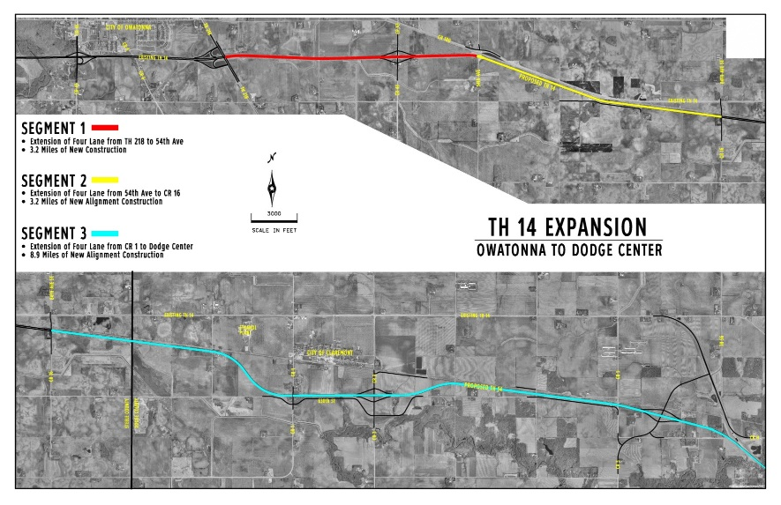
Hwy 14 expansion, Segments 2 & 3
  R/W Activities
    R/W acquisition has been partially funded through Corridors of Commerce.
        $8.8 million has been received from Corridors of Commerce
        $17 million is still needed
    Segment 2
      All offers (20) have been made to property owners.
      All 3 relocations have been acquired.
    Segment 3
      5 of 9 relocations have been acquired
      2 additional relocations are being processed but offers haven’t been given.
      50 additional property owners will be affected through partial acquisition.
Notes:
The Highway 14 Partnership was helpful in its supportive efforts to provide meaningful information to legislators that showed how if Corridors of Commerce was adjusted to include right of way dollars, we could maintain momentum and get additional segments closer to shovel ready. District 6 has benefited from the awarding of right of way dollars to help with Segments 2 & 3.

Slide 4
Hwy 14 expansion, Segments 2 & 3 (continued)
  Layout Activities
    Preliminary Bridge Design is being advanced to:
      Identify structure length and type
      Have background information required for negotiating RR and Utility agreements.
    Layout approved at the District
      District is working with MnDOT Geometrics Unit for concurrence and approval
  Environmental Document Status
    FEIS approved in 2010
      Is considered active until Fall 2018 due to use of federal funds on a contract to advance hydraulic design.
      Hydraulic contract concluded in Fall 2015.
Notes:
Additionally, here’s more work that’s been occurring for the remaining segments to get them closer to being ready, while funding discussions continue at the Legislature.
The estimated cost to construct Highway 14 between Owatonna and Dodge Center is $163-166.2 million, for a total project cost estimate of $180-183.2 million.

Slide 5
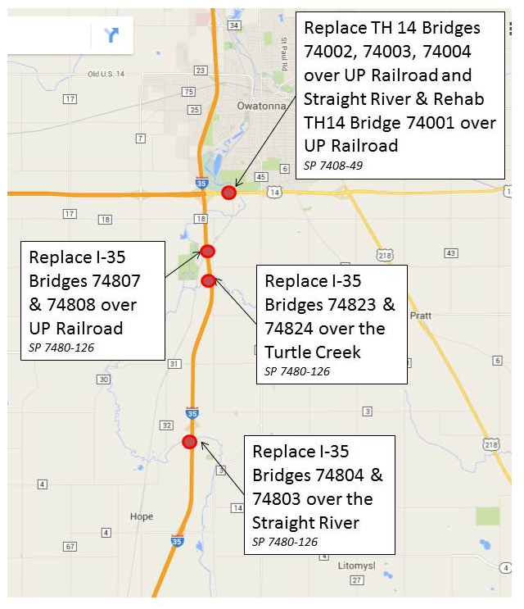
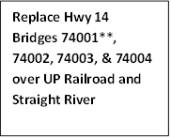
Bridge work on and near Hwy 14
I-35/Hwy 14 Bridge Project Update
  Bridge Locations:
    6 bridge replacements on I-35
      Straight River, Turtle Creek and UP Railroad
    4 bridge replacements on Hwy 14
      EB & WB Hwy 14 over UP Railroad
      EB & WB Hwy 14 over Straight River
Notes:
Work continues on Hwy 14 to maintain and preserve. This spring Hwy 14 and I-35 at the south of Owatonna are part of a bridge replacement project that will replace 10 bridges in two years near this key intersection of two busy highways.

Slide 6
Bridge replacement construction schedule
I-35/Hwy 14 Bridge Project Update
    Spring 2016
      Let as a design-build contract
      Awarded to Lunda Construction
    Fall 2016
      Crossovers built
    April-November 2017-
      EB Hwy 14 and SB I35 bridge construction to begin
    April-November 2018
      WB Hwy14 and NB bridge construction to begin
    November 2018
      Construction completed on all 10 bridges
Notes:
Dynamic warning systems will be in place on Interstate 35 and Hwy 14 in both directions warning travelers of stopped traffic, and travelers are encouraged to use the late zipper merge.
The Southbound Straight River Rest Area will be closed once traffic is switched in 2018 and remain closed for the duration of that construction year.

Slide 7
Questions?
Thank you!
Partnerships are valuable and we appreciate the work that continues to tell the story of transportation and its vital role in our state and local economies.
Long-term, sustainable funding will help us achieve expansion projects.
Safety is also a key message.
Notes:
I’ll conclude my remarks here, but I do want echo others and say thank you for all of your work and your interest in finding a long-term, sustainable funding plan that will serve our state and region.
Currently, there are no resources for meaningful expansion. Without significant new revenue MnDOT will focus on preservation and maintenance work to keep the system operating. Highly traveled roads will be prioritized.
Safety is one of your messages and it’s part of MnDOT’s daily culture.
Thank you.
Any questions?

