Slide 1
TRB International Partnership Meeting
EPD and CO₂
Requirements in pavement contracts
Wednesday January 10, 2024
Jan-Erik Lundmark
Konfidentialitet: Nivå 1-extern

Slide 2
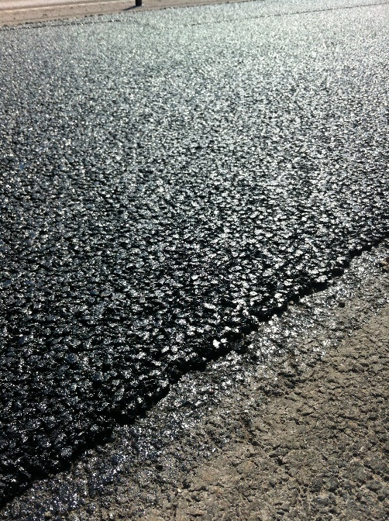
Outline
Swedish Road Network
Historical requirements CO2
Requirement max CO2 Pavements
Requirement zero emission for vehicles
Summary and questions

Slide 3
Map
Notes:
Quick facts: 100,000 km of state roads, where 80% is paved. 41,000 km of municipal streets and roads
76,100 km of private roads with state grant
The volume of the Swedish Transport Administration activity is approximately 5 billion EUR per year, of which
Investments – approximately 3 billion EUR
Operations and maintenance – approximately 2 billion EUR

Slide 4
100 000 km (80 000 km roads with pavement)
  about 5 % is High Traffic Roads > 7 500 ÅDT
  over 50 % is Low Traffic Roads < 2 500 ÅDT
  Big variation in climate South-North
Short paving season for quality pavements ( May-October)
Swedish Transport Administration have maintenance focus last years on high traffic roads and important roads for the industry.
Budget pavement maintenance 300 million $/year
Total production of asphalt 8,2 million MT
Notes:
HMA=Hot Mix Asfalt

Slide 5
Historical requirements CO₂
2017: EKA (”PCR” CO₂ tool for calculation), replace HMA with LTA
2020: 100% EPD, HMA Climatintencetive, bonus
2024, 100% EPD, maximum CO₂ , no bonus.
EPD requirement, A1-A3……
Comparison year for improvement 2015

Slide 6
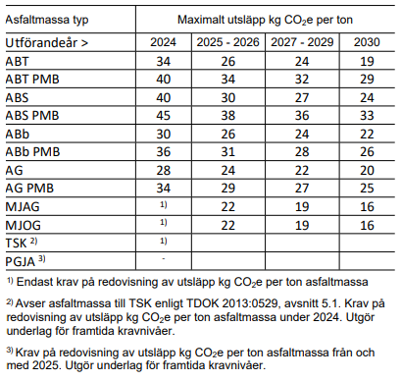
Requirement max CO₂ Pavements

Slide 7
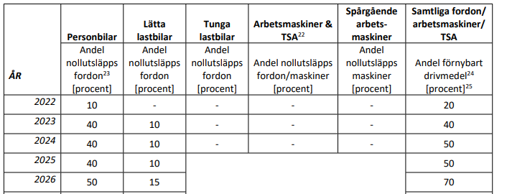
Requirement zero emission for vehicles/trucks
Procurements 2024 & 2025
  40% Zero CO2 emission cars
  10% Zero CO2 emission light trucks
  Heavy trucks and machines?

Slide 8

Tack så mycket!
Frågor?
Contact information:
Jan-Erik Lundmark, jan-erik.lundmark@trafikverket.se

