Slide 2
TRB 2024
Sandra Bårdén
Analyst- digitalization of the transportation system
The Swedish Transport Administration

Slide 3

Agenda
A changing landscape
Decling values of current and future measurs
Three examples of digital measurs tested in Sweden

Slide 4
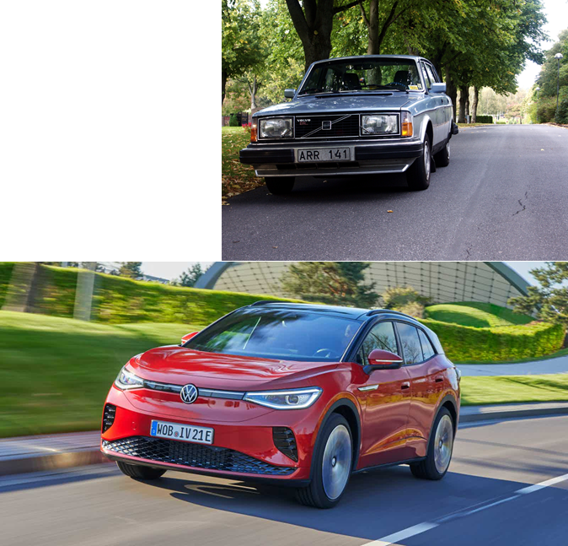
What and who are we planning for?
Notes:
Lägg till diagram här? Fordonsflottans utv.

Slide 5
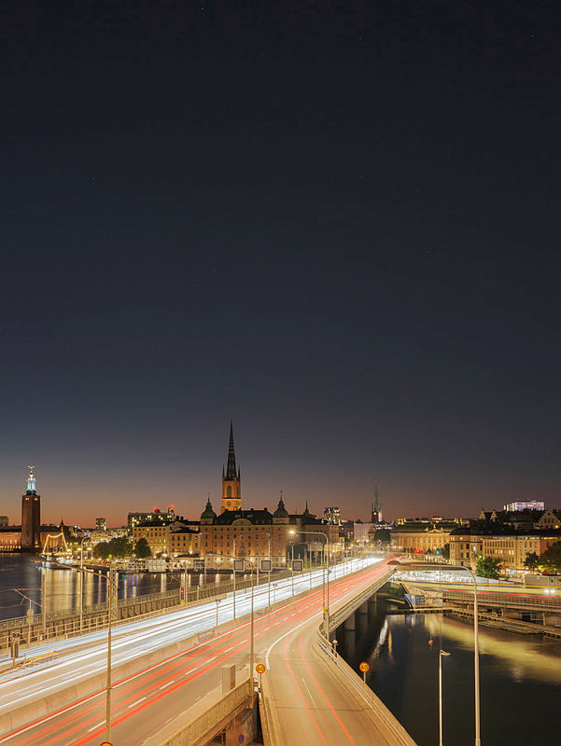
What does the introduction of these new vehicles mean?
Data produces can be used to better understand the system
Declining utility of measures in the infrastructure?
Replacing physical measures with digital?
New kind of measures or measures in places where it is not feasible today?
Notes:
More data means better understanding of usage and demand, historicial and real time, if we can recieve it and use it
Decling utility of measures due to ADAS?
Digital measures can replace physical measures
New kind of measures or measures in places where it is not feasible today

Slide 6
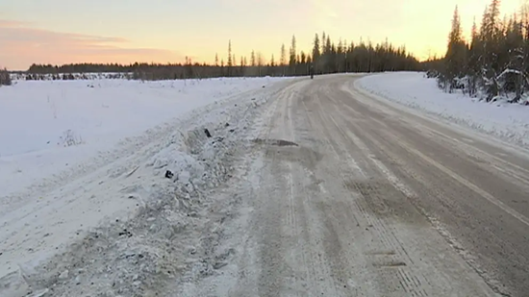
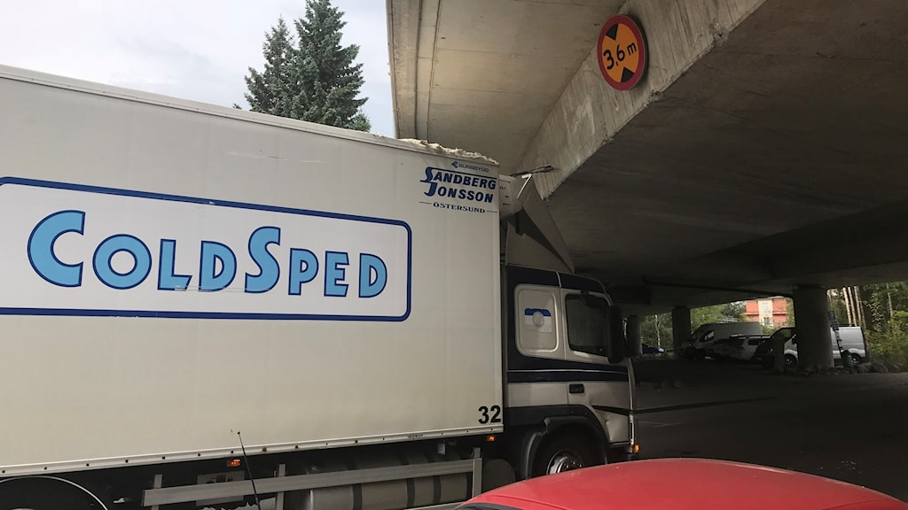
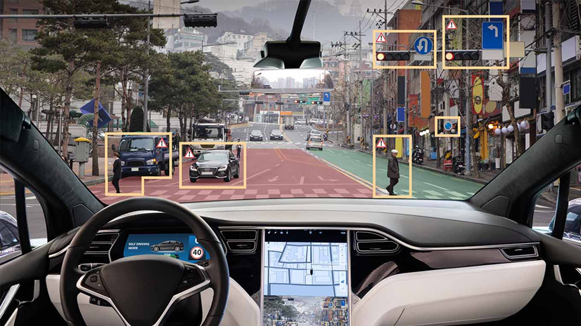
Declining value?
Traffic safety - fixing accident-prone curves?
  Lane Keeping Assist = See around corners (and crests) – predictive cruise control + road geometry + weather data = fewer run-offs
Lane separation?
  Lane keeping assist
Accidents due to lack of information, ignoring information
  Geofencing, emergency breaking, automatic adaption to digital traffic rules
General measures aimed at increasing capacity?

Slide 7
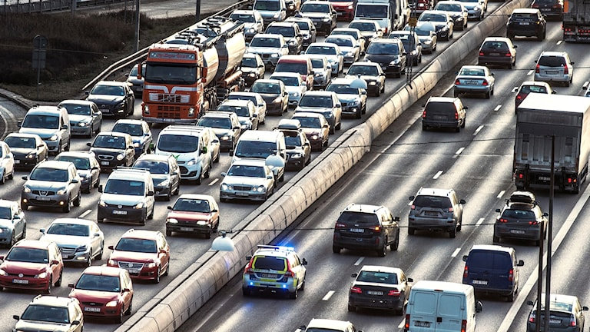
Potential
We can empty Stockholm in half an hour if all vehicles maintain a harmonized speed, now it takes two hours, what happens when all vehicles have ISA and we can convey digital speed limits?
A lot of the problems in the transport system is caused by human behavior and lack of information

Slide 8
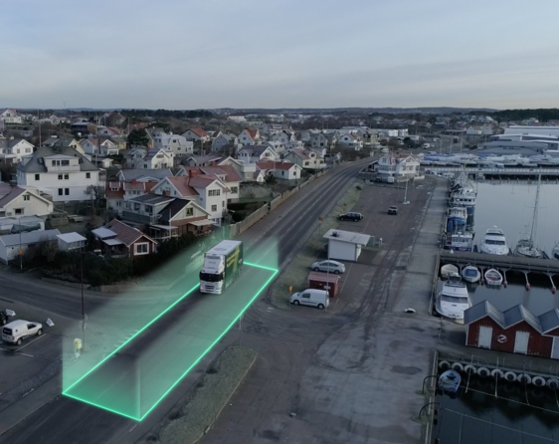
Some examples:
Projects where we exchange a physhical measurs to a digital:
Speed limiting geofencing in rural areas with passing timber trucks
More efficient usage of existing infrastructure
Distributing traffic between highway exisit

Slide 9
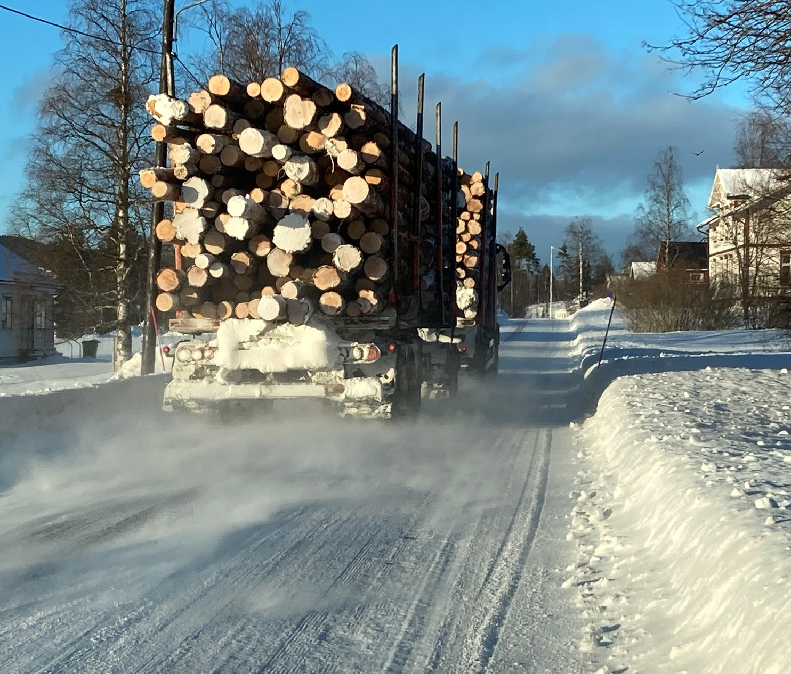
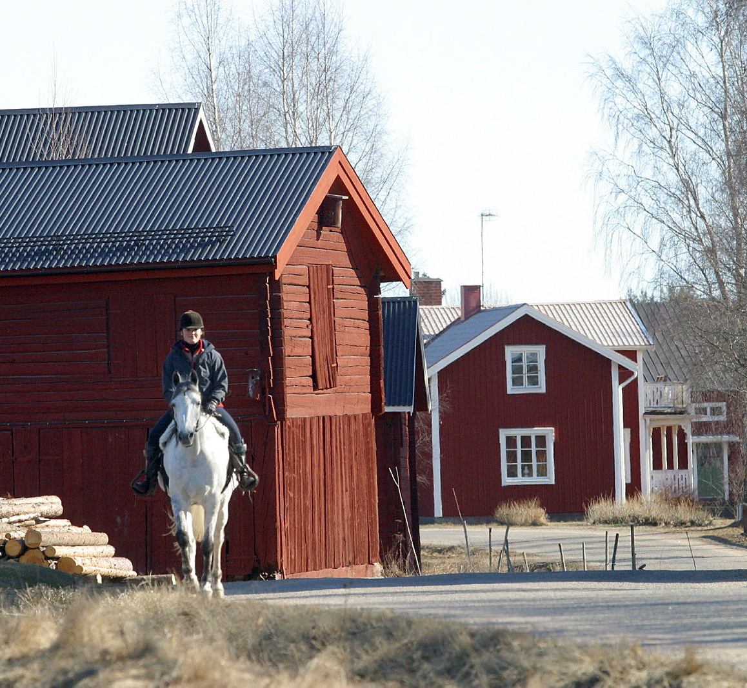
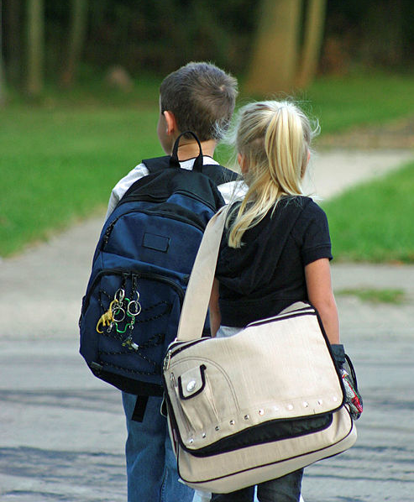
Speed limiting geofencing in rural areas with passing timber trucks
Limited means, or none to improve traffic saftey for villagers and continius accesability fo the industy
Using existing services to digitally limit timber trucks who are passing villages in rural areas.

Slide 10
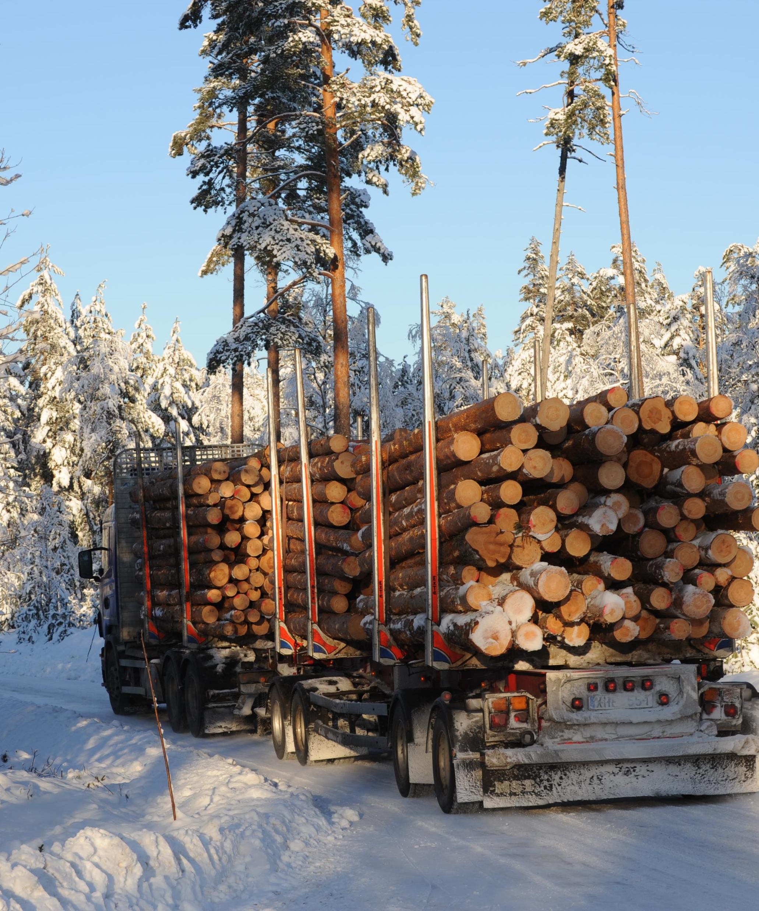
Frozen winter roads
When there is ground frost, heavy trucks are allowed access to low capacity bearing roads. Allowing for a temporary higher weight classification.
Accessibility often limited by bridges.
Using speed limiting geofencing to ensure a lower speed to minimize vibrations and wear on the bridges.
Other applications:
  Construction traffic – concrete transportation

Slide 11
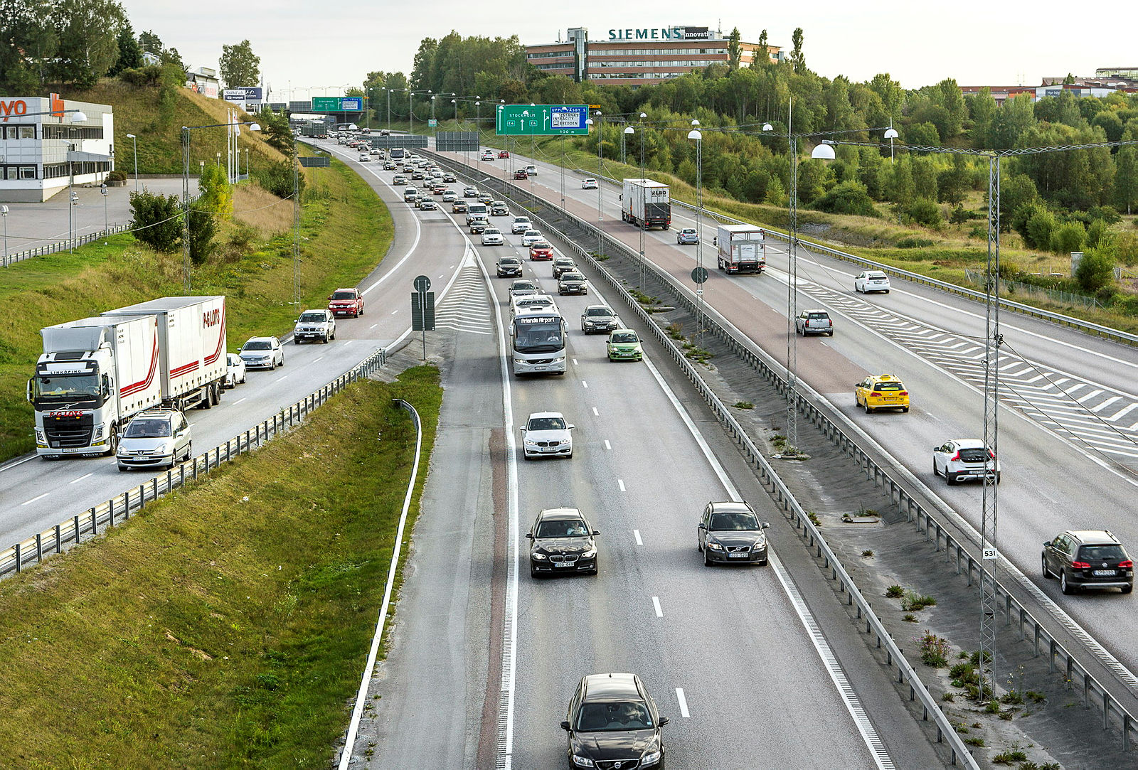
Distributing heavy traffic between highway exisit
No money to rebuild an exit ramp from the highway.
Two large industry actors exploited the land near the ramp
Not an ideal solution at the intersection at the top, resulting in freqvent ques that spill out on the highway
Trucks have a harder time, take up more space
Digitaly alert drives to take the next exit if a que is about too be created.

Slide 12
What can we do differently?
Functions that today require physical installations can be made completely digital with connected vehicles
Reduces costs – less need for physical installations
In the long term, fully digital MCS systems? e.g. lane closures such as LKA?
  Two PoC:s running

Slide 13
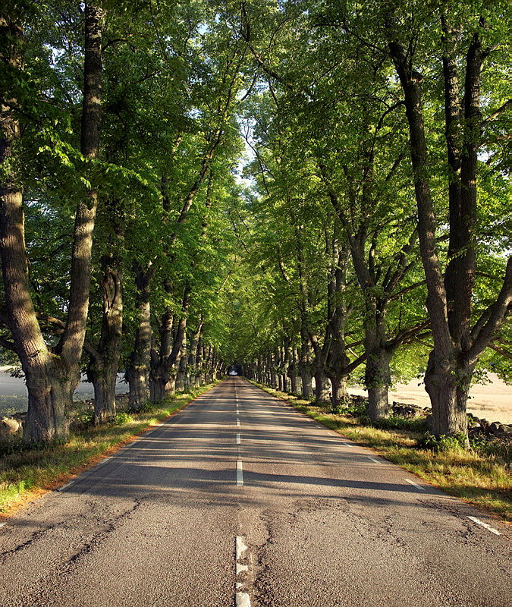
The future role
What would be required to fully utilize the potential of a new vehicle?
Reponsibility shifting from road operator to vehicles?
Possible huge savings but comes with the price of losing full control
Need more cooperation with service providers as well as other road operators – new ecosystem developing
What digital infrastructure is needed?

Slide 14
Hard to predict the future

Slide 15
The prerequisites for a digitalized transport system (data)
WIFI
4G
TN-ITS
NAP
Classified data
Structured data
5G
Fiber
ETSI
DATEX 2
IC
DUP
Useable data
Connectivity
Standardized formats
Data exchange platforms
Predictability creates market

