Slide 1
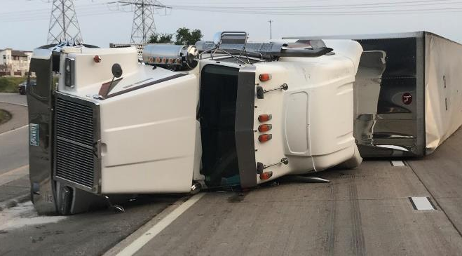
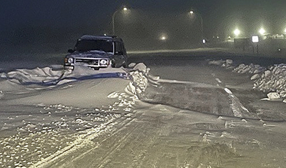
Wireless Emergency Alerts for Major Road Closures

Slide 2

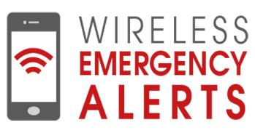
What is IPAWS?
Integrated Public Alert and Warning System
Managed by FEMA – Federal Emergency Management Agency
Provides emergency and life-saving information to the public
  Immediate threats
  Severe weather

Slide 3
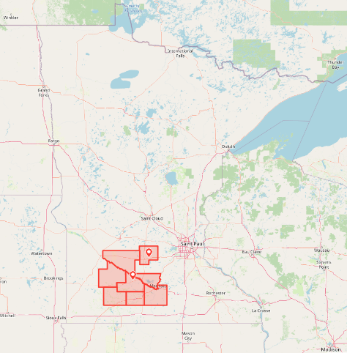
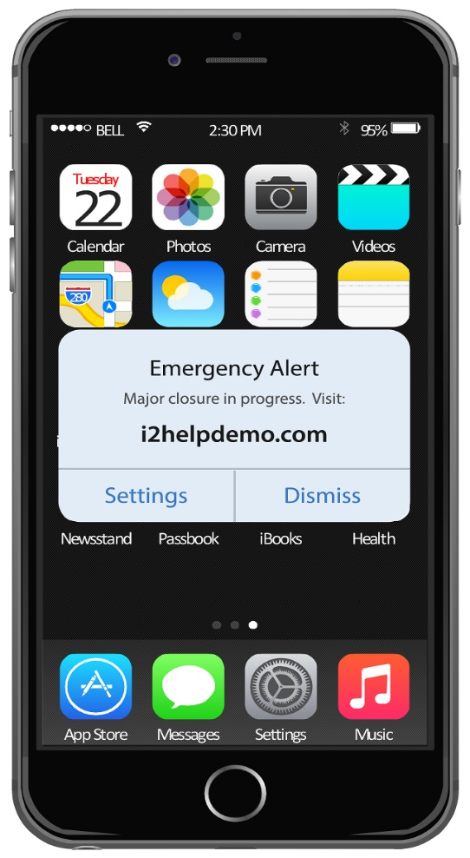
How are Wireless Emergency Alerts used?
Types of Messages
  Amber Alerts
  Immediate Threat
  Severe Weather
Targeted Audience
  Geofence location
Used by Other State DOTs
  Road Closures
  Pennsylvania, Texas, Georgia
Emergency Alert
CRASH closing all lanes of I-35 through downtown Austin. Go to
www.TxDOTAlerts.com

Slide 4
Why is MnDOT using it?
Improved Traveler Information
  Ability to push out alerts to a targeted audience
  Supplements our other tools: 511, Press Releases, Social Media
Improved Traffic Safety
  Warn of potential stopped traffic ahead
  Keep motorists off the roads in winter weather
Improved Freight Operations
  Trucks have more opportunity to find parking

Slide 5
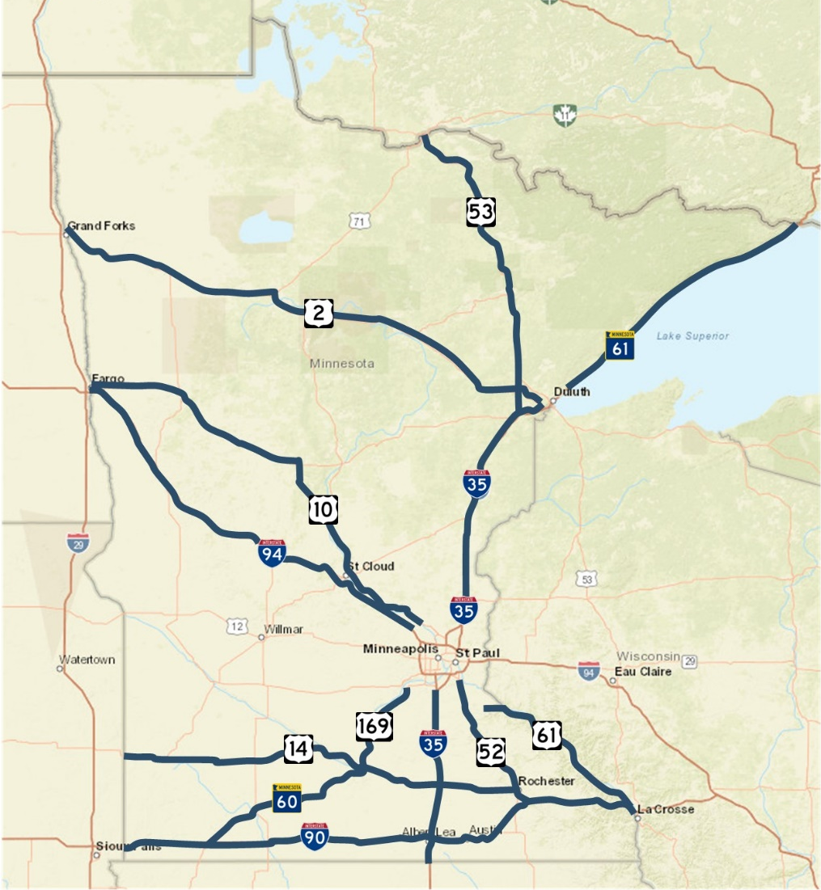
How is MnDOT using it?
Type of Events
Incident Road Closures (crash, flood, etc.)
Winter Road Closures
Expected duration greater than 4 hours
Roadways
Interstates and Major Corridors

Slide 6
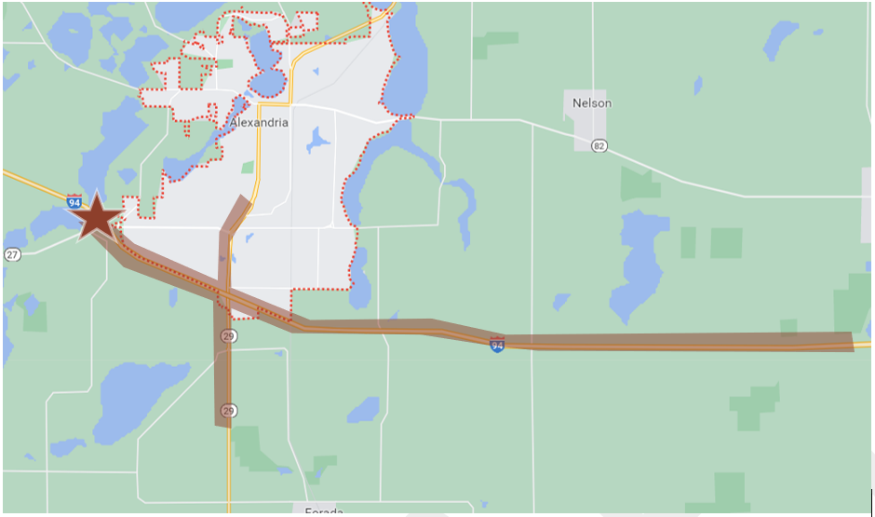
How is MnDOT using it?
Deployment Area
Corridor Polygon
Time of Day
6AM – 9PM to post message
Message can be active for longer period

Slide 7
How is MnDOT using it?
Sample messages
  Winter weather closure example message (123 characters): MnDOT advises the I-90 closed from the South Dakota border to Albert Lea due to blizzard conditions. Go to www.511mn.org
  Incident closure example message (102 characters): MnDOT advises northbound I-35 corridor is closed at Exit 53 near Faribault, MN. Go to www.511mn.org

Slide 8
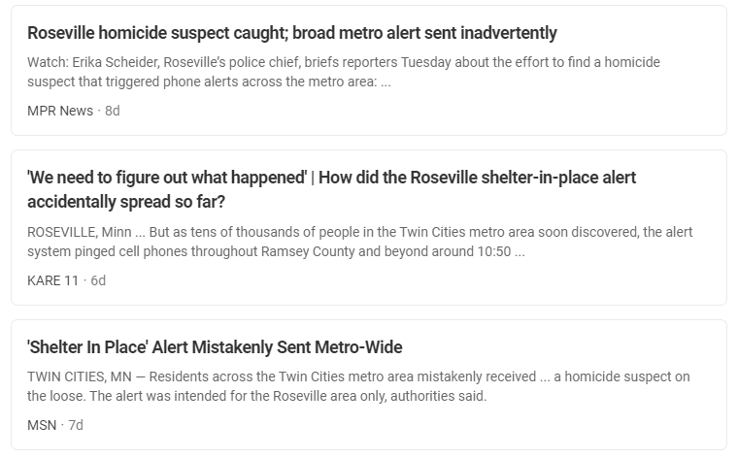
Issues We Are Addressing
Too Many Alerts
  Overuse, Could be ignored
  Opting Out
Text Message Concerns
Increased calls to 911 centers
Errors in Sending Alert
  Roseville Example

Slide 9
Questions? Comments?
Brian Kary
Transportation Systems Management and Operations (TSMO) Director
brian.kary@state.mn.us
651-755-4868

