Slide 1
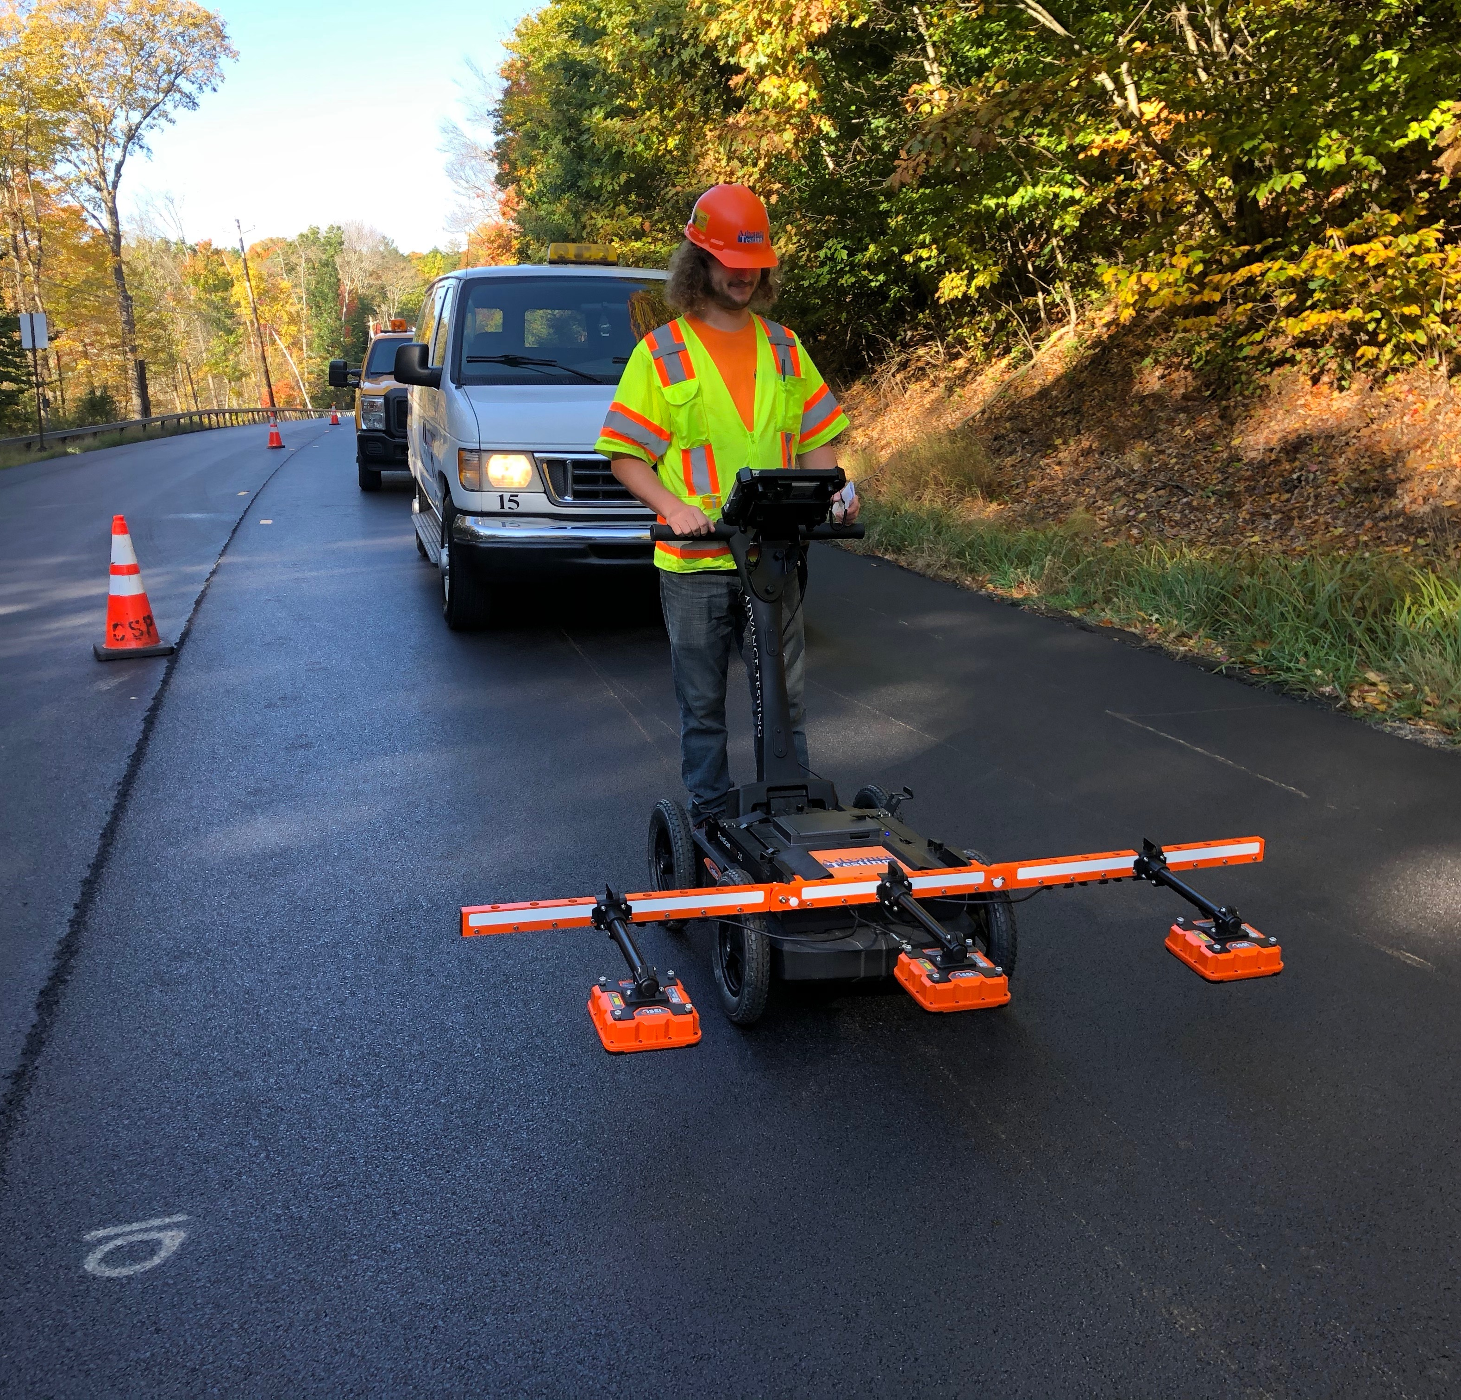
DPS in NYS
Richard Hamilton
Advance Testing Company

Slide 2
Testing to Date
16 paving days on Route 30A in Glen, NY
  8 miles long
  9 days 19mm <0.3
  7 days 9.5mm <0.3
1 paving day on Route 97 in Lordsville, NY
  9.5 mm <0.3
Zipper pattern with 3 ft and 9 ft offsets
Additional pass 2.5 ft where joint matching

Slide 3
Puck Correlations w/RDM 1.0

Slide 4
Data Analysis

Slide 5
Data Analysis

Slide 6
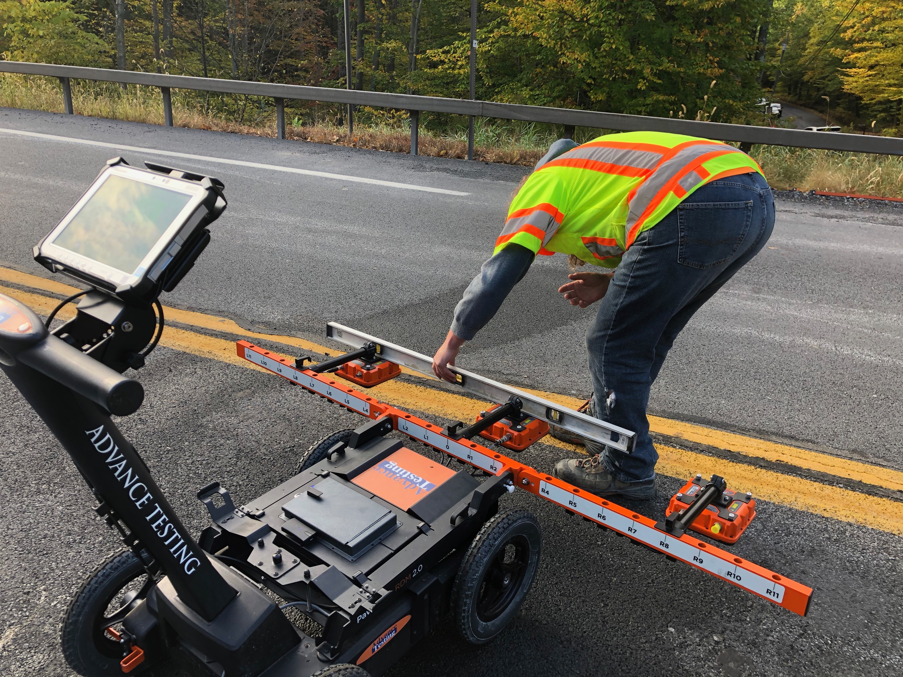
QA Procedures
Sensor leveling
HDPE Scans
Swerve testing

Slide 7
Data Analysis

Slide 8
Core Prediction

