Slide 1
2020 DPS Pooled Fund Meeting
• October 14, 2020

Slide 2
Asphalt density measurement with Dielectric Profile Method
Craig E. Landefeld, P.E.
ODOT Office of Pavement Engineering

Slide 3

Projects
2018 Projects
FRA 270
SAN 6
HAN 75/68
VIN 50
2019 Projects
WIL 191
GUE 77
FRA 71
ALL 75
ROS 35
2020 Projects
RIC 71
TUS 36
MAD 70
2020 Focus:
Machine Comparisons
Swerve Collection
Gyratory Procedures
Notes:
Locations tested.

Slide 4
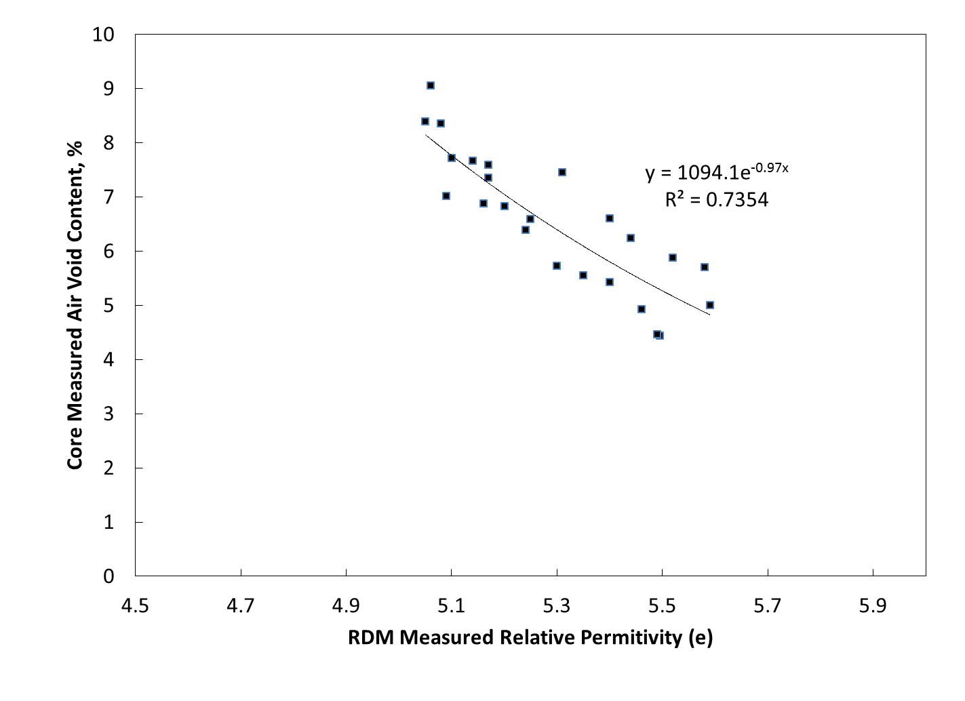
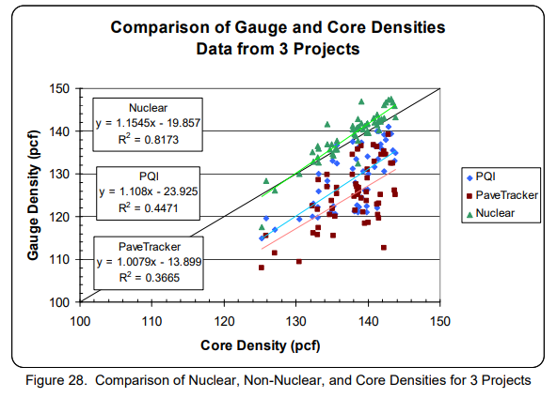
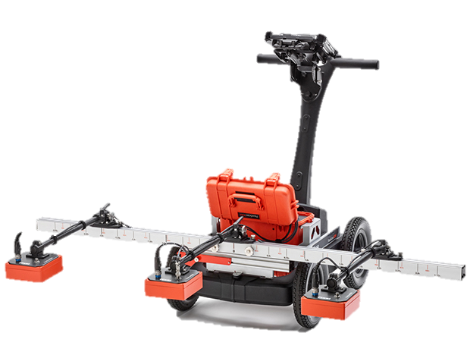
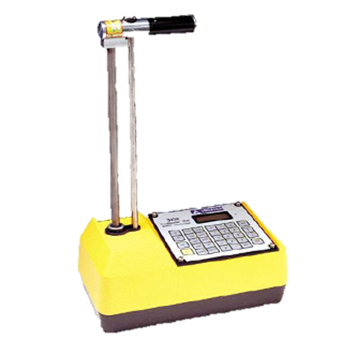
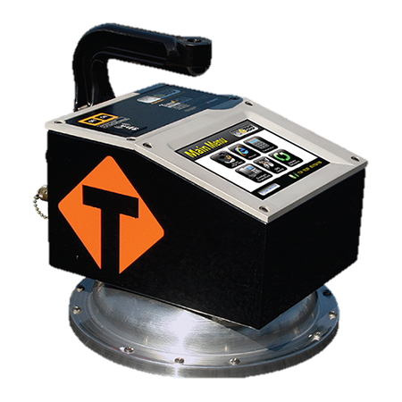
Core Correlation Results
RDM Correlation Comparison
Best R²= 0.99
Worst R²= 0.70
Avg. R²= 0.88
(Williams, 2008)
Notes:
Sargand Nuclear R2= 0.596, PQI R2= 0.590
ODOT performed 7 projects w. RDM Avg. R2 = .88

Slide 5
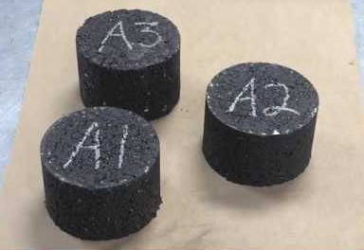
RIC I-71 Gyratory Sample Calibration Results
Notes:
Gyratory sample correlation was strong
Still validating with field core data
Appears to be a data shift from preliminary analysis.

Slide 6
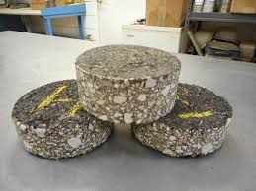
RIC I-71 Predicted vs. Core density
 | Mat Core | Average Dielectric | Core Density Prediction | Core Density Results | Difference
6152020 | 4 | 5.37 | 91.4% | 93.0% | 1.6%
 | 5 | 5.24 | 90.2% | 92.8% | 2.6%
 | 6 | 5.17 | 89.5% | 92.3% | 2.8%
6/17/2020 | 1 | 5.54 | 93.0% | 94.8% | 1.8%
 | 2 | 5.60 | 93.6% | 94.6% | 1.0%
 | 3 | 5.74 | 95.0% | 94.8% | 0.2%
 | 4 | 5.69 | 94.4% | 95.4% | 1.0%
 | 5 | 5.62 | 93.8% | 93.4% | 0.4%
 | 6 | 5.68 | 94.3% | 95.5% | 1.2%
6/23/2020 | 1 | 5.63 | 93.8% | 96.0% | 2.2%
 | 2 | 5.37 | 91.4% | 93.6% | 2.2%
 | 3 | 5.48 | 92.5% | 94.5% | 2.0%
 | 4 | 5.44 | 92.1% | 94.3% | 2.2%
 | 6 | 5.54 | 93.0% | 95.2% | 2.2%
 |  |  |  | Average: | 1.7%
Notes:
Gyratory sample correlation was strong
Still validating with field core data
Appears to be a data shift from preliminary analysis.

Slide 7

RIC I-71 Predicted vs. Core density
Notes:
Gyratory sample correlation was strong
Still validating with field core data
Appears to be a data shift from preliminary analysis.

Slide 8
TUS-US36 Gyratory Sample Calibration Results
Notes:
Gyratory sample correlation was low
Still validating with field core data
Appears to be a data shift from preliminary analysis.

Slide 9
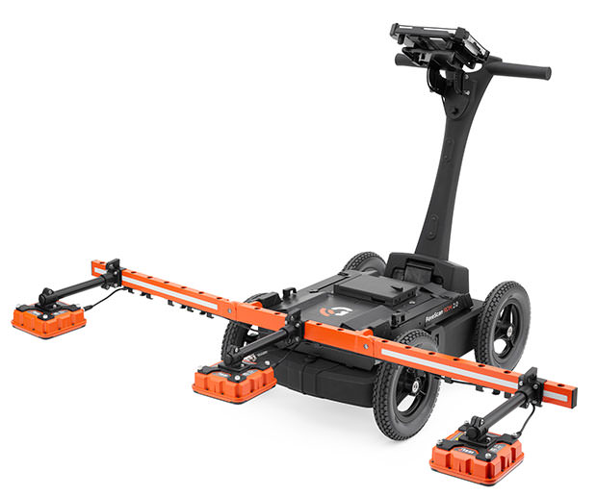
TUS-US36 Machine comparison Results
TUS-36 Machine Statistic Comparison
Machine | Day/Lot |  | Mean | Std. Dev | Range | Min | Max | Count
1.0 | 7082020 |  | 94.2% | 3.4% | 27.4% | 80.2% | 107.6% | 40566
2.0 | 7082020 |  | 94.1% | 2.9% | 272.6% | 71.2% | 343.8% | 74985
 |  | Difference | 0.1% | 0.4% | 245.3% | 9.0% | 2.36 | 34419
1.0 | 7092020 |  | 92.9% | 2.1% | 46.9% | 61.1% | 108.0% | 74985
2.0 | 7092020 |  | 94.2% | 2.3% | 64.2% | 80.1% | 144.3% | 66210
 |  | Difference | 1.3% | 0.2% | 17.3% | 19.1% | 36.4% | 8775
 | Dielectric |  | Air Voids
07/09/20 | Mean | Std. Dev | Mean | Std. Dev | Count
RDM 2.0 (13R) | 4.738 | 0.133181 | 92.12% | 1.43% | 297
RDM 1.0 (13R) | 4.775 | 0.119825 | 92.52% | 1.29% | 271
Diff | -0.037 | 0.013356 | -0.4% | 0.14% | 26
Notes:
Sargand Nuclear R2= 0.596, PQI R2= 0.590
ODOT performed 7 projects w. RDM Avg. R2 = .88

Slide 10
What’s next ???
Machine Comparisons
– Precision & Bias
- QC/QA Procedure & Tolerance
2. Gyratory Procedures
3. Collection Procedures (Swerve? Long. Joints?)
4. VETA for analysis
5. Specs for Pilot Projects
Notes:
Sargand Nuclear R2= 0.596, PQI R2= 0.590
ODOT performed 7 projects w. RDM Avg. R2 = .88

Slide 11
Questions
?
Last updated 10/13/2020

