Slide 1

Continuous Asphalt Mixture Compaction Assessment using Density Profiling System (DPS)
[Pooled Fund: TPF 5(443)]
(October 14, 2020)
Shongtao Dai
Office of Materials and Road Research
Minnesota Department of Transportation
Mn/DOT
Office of Materials and Road Research

Slide 2
Technical Advisory Committee
Financially Contributing Agencies:
FHWA, Idaho, Maryland, Mississippi, Missouri, Maine, New York, Ohio, Pennsylvania, Washington, North Dakota, Utah, Minnesota, Wisconsin?
Technically Contributing Agencies:
(A lot of experience, knows issues and needs)
Alaska; Florida and Nebraska (we can add as needed)
Objective
  A) Further advance and improve DPS system
  B) Support communication
  C) Provide training and technical assistance to states and others
  D) Promote DPS to other vendors, contractors, consultants and
  DOTs and local government, etc.

Slide 3
Project Status Update
Workplan developed around these objectives – March, 2020
Task 1: Software and Hardware Improvements
Task 2: Development of AASHTO Data Collection and Analysis Specification
Task 3: Precision and Bias Statement
Task 4: Equipment and Operator Certification
Task 5: Support Communication
Task 6: Provide Training and Technical Assistance
Task 7: Promote the technology
Notes:
In areas where performance is more critical (i.e. high traffic) higher fracture energy is required to ensure that thermal cracking is very minimal.

Slide 4
Task 1: Software and Hardware Improvements
  Developed a contract with GSSI: develop more user friendly software for the participates for easy implementation.
  The contract ends on March 31,2021
    Task A – Compatibility Improvements.
    Task B – GPS Processing Improvements
    Task C – Data Management Improvements
    Task D – Data Calculation Improvements
    Task E – Precision and Accuracy
    Task F – Dielectric to Air Void Software
    Task G – Data Quality Assurance Module
    Task H – Core Validation Module
    Task I – Daily Analysis and Reporting CSV Files
    Task J – System failure indication
Notes:
-(test configuration from steel ASTM E399)
-(preload no greater than 0.2 kN)
-Test is ended when post peak load reaches 0.1 kN
-DCT chose as the fracture test to use by MnDOT from 10+ year Pooled-fund study with WI, Illinois, Iowa State, and MN
- Easy specimen fabrication in both lab and field
- Standard fracture test configuration with an ASTM spec existing in 2007(originally a test for fatigue cracking)
- DCT test has shown to be a good indicator of field performance and resistance to cracking

Slide 5
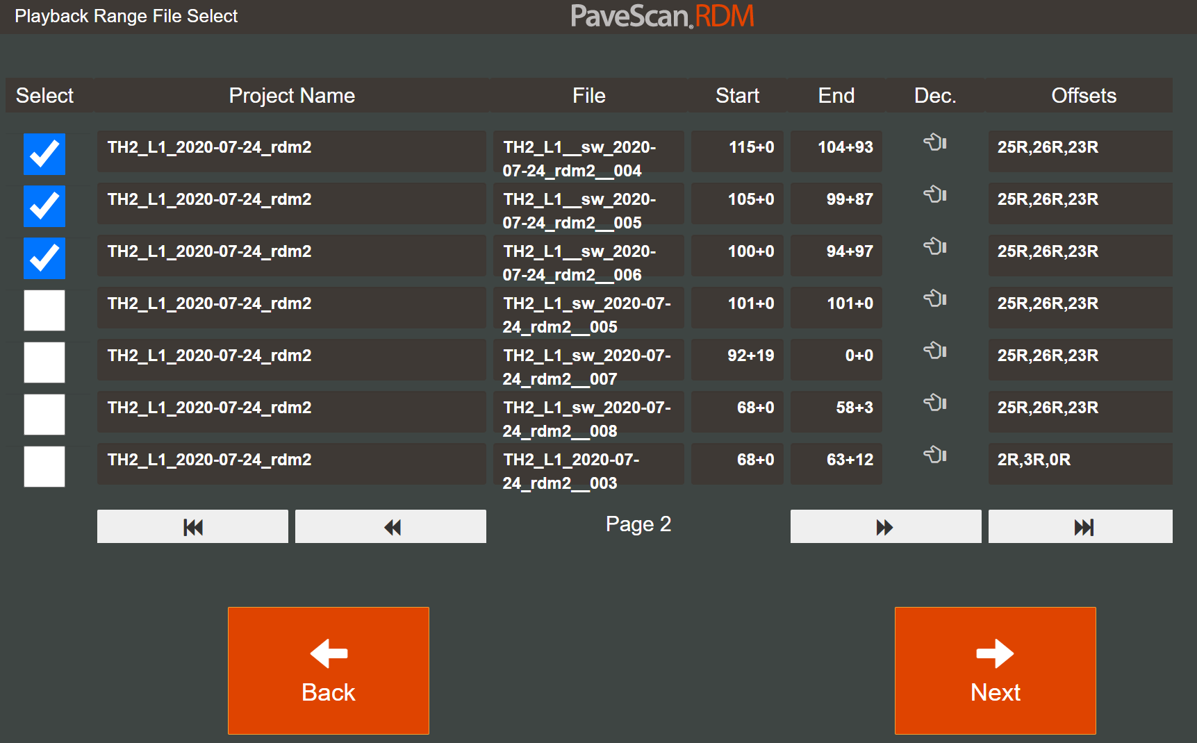
Task A – Compatibility Improvements
  Allow software to read input information from a file.
Task B – GPS Processing Improvements
  Issue: In 1.0, GPS has an offset in the direction of travel which is affected by speed.
Task C – Data Management Improvements
  Allow online transfer of field collected data in a user-friendly and timely manner -- Cloud
Notes:
-(test configuration from steel ASTM E399)
-(preload no greater than 0.2 kN)
-Test is ended when post peak load reaches 0.1 kN
-DCT chose as the fracture test to use by MnDOT from 10+ year Pooled-fund study with WI, Illinois, Iowa State, and MN
- Easy specimen fabrication in both lab and field
- Standard fracture test configuration with an ASTM spec existing in 2007(originally a test for fatigue cracking)
- DCT test has shown to be a good indicator of field performance and resistance to cracking

Slide 6
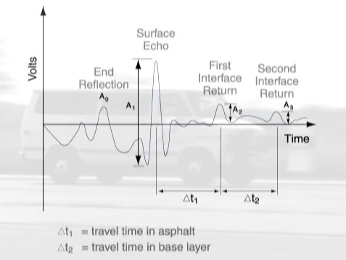
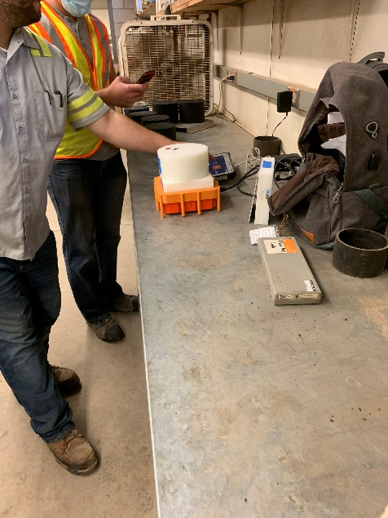
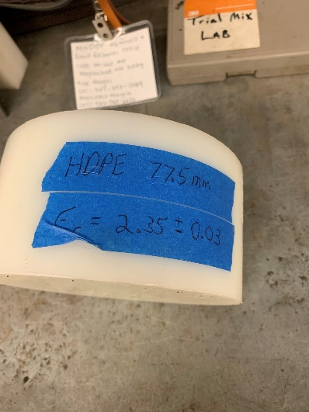
Task D – Data Calculation Improvements
  Issue: Underlying layer effect on dielectric calculation
  The issue should have been resolved in 2.0 – we will check.
Task E – Precision and Accuracy
  HDPE block and puck with accuracy provided with 2.0
  Roger is looking for another material with higher
  dielectric constant.
HMA
PCC
Notes:
-(test configuration from steel ASTM E399)
-(preload no greater than 0.2 kN)
-Test is ended when post peak load reaches 0.1 kN
-DCT chose as the fracture test to use by MnDOT from 10+ year Pooled-fund study with WI, Illinois, Iowa State, and MN
- Easy specimen fabrication in both lab and field
- Standard fracture test configuration with an ASTM spec existing in 2007(originally a test for fatigue cracking)
- DCT test has shown to be a good indicator of field performance and resistance to cracking

Slide 7
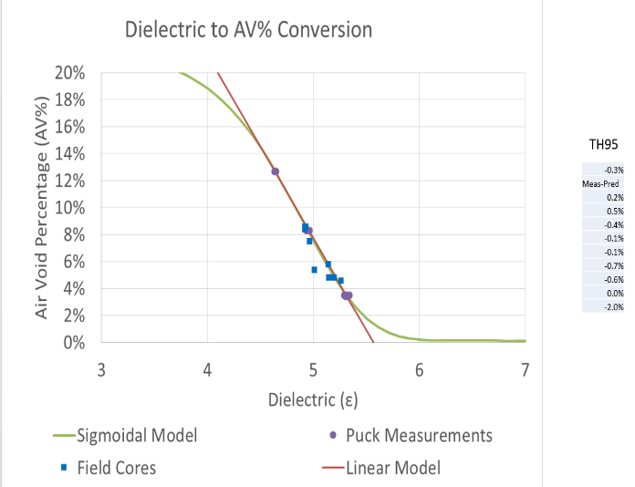
Task F – Dielectric to Air Void Software
  A stand-alone software (an additional icon) to allow user to input puck calibration data (dielectrics and density), perform regression and output calibration curve coefficients.
Task G – Data Quality Assurance
  Allow user to check consistency of 3 sensors by performing swerving or transverse line testing.
  Assess the data: pass, correction or fail.
Task H – Core Validation Module
  A part of 2.0 software to allow user to measure/store dielectric at core locations and core density test results
  Compare results with lab calibration.
Notes:
-(test configuration from steel ASTM E399)
-(preload no greater than 0.2 kN)
-Test is ended when post peak load reaches 0.1 kN
-DCT chose as the fracture test to use by MnDOT from 10+ year Pooled-fund study with WI, Illinois, Iowa State, and MN
- Easy specimen fabrication in both lab and field
- Standard fracture test configuration with an ASTM spec existing in 2007(originally a test for fatigue cracking)
- DCT test has shown to be a good indicator of field performance and resistance to cracking

Slide 8
Task I – Daily Analysis and Reporting CSV Files
  Provide user flexibility to review and output data: histogram; joint vs mat.
  PaveScan 2.0 has improved features
Task J – System Failure Indication
  During routine data collection, if the system fails (ex: a sensor suddenly gives very high or low value; or power outage; or sensor temperature is out of range, etc), the software should indicate the failure and record the time and date when the failure occurs to the data file. The failure should be documented in a stored file.
Notes:
-(test configuration from steel ASTM E399)
-(preload no greater than 0.2 kN)
-Test is ended when post peak load reaches 0.1 kN
-DCT chose as the fracture test to use by MnDOT from 10+ year Pooled-fund study with WI, Illinois, Iowa State, and MN
- Easy specimen fabrication in both lab and field
- Standard fracture test configuration with an ASTM spec existing in 2007(originally a test for fatigue cracking)
- DCT test has shown to be a good indicator of field performance and resistance to cracking

Slide 9
Task 2: Development of AASHTO Data Collection and Analysis Specification
  Drafted procedure of data collection and analysis for dielectric to AV% conversion using Gyratory Specimens.
  Drafted procedure of field data collection and analysis.
  Created training videos associated with these.
  http://www.dot.state.mn.us/materials/dps/index.html
  The website will be updated periodically to include any new information/materials
  Planning to replace the procedures and lab testing video
  with 2.0 by the end of Feb. 2021 and field testing video
  by May, 2021.
Notes:
-(test configuration from steel ASTM E399)
-(preload no greater than 0.2 kN)
-Test is ended when post peak load reaches 0.1 kN
-DCT chose as the fracture test to use by MnDOT from 10+ year Pooled-fund study with WI, Illinois, Iowa State, and MN
- Easy specimen fabrication in both lab and field
- Standard fracture test configuration with an ASTM spec existing in 2007(originally a test for fatigue cracking)
- DCT test has shown to be a good indicator of field performance and resistance to cracking

Slide 10
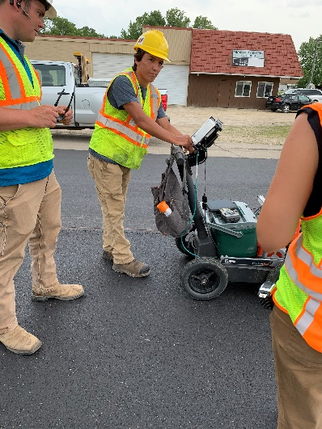
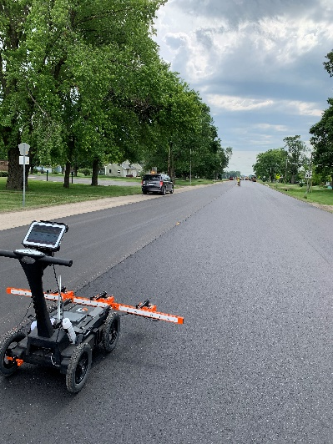
  Continue data collection to build up database needed to the specification development.
    Data collection this summer: Th251, Th2, Th30, Th95, Th25 and MnROAD.
    Hired contractors for data collection
      Get feedback from contractors: how to develop specifications that are acceptable for contractors to use.
      Promoting the technology.
Notes:
-(test configuration from steel ASTM E399)
-(preload no greater than 0.2 kN)
-Test is ended when post peak load reaches 0.1 kN
-DCT chose as the fracture test to use by MnDOT from 10+ year Pooled-fund study with WI, Illinois, Iowa State, and MN
- Easy specimen fabrication in both lab and field
- Standard fracture test configuration with an ASTM spec existing in 2007(originally a test for fatigue cracking)
- DCT test has shown to be a good indicator of field performance and resistance to cracking

Slide 11
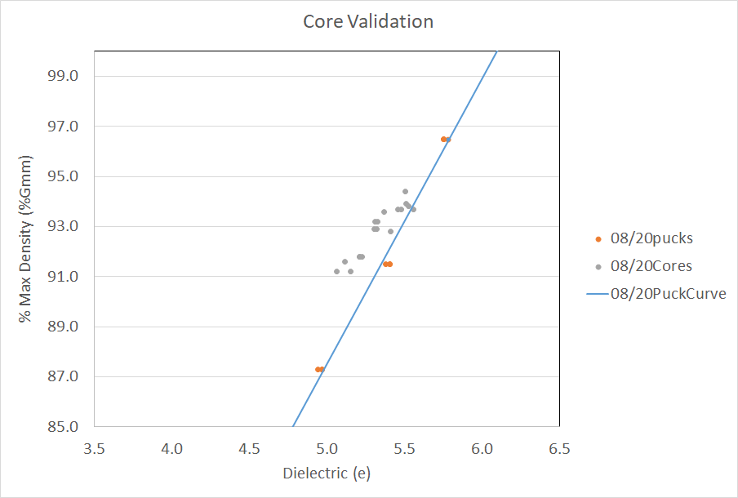
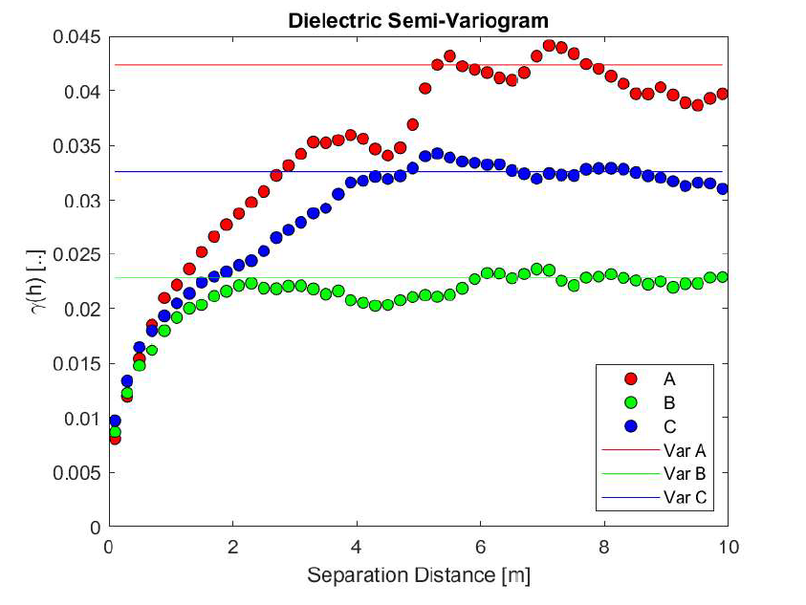
    Challenges and Observations in data analysis:
      Example: Bias and sensor variation
      Need statistic analysis to better understand physical meaning from collected data and incorporate to the specifications.
Notes:
-(test configuration from steel ASTM E399)
-(preload no greater than 0.2 kN)
-Test is ended when post peak load reaches 0.1 kN
-DCT chose as the fracture test to use by MnDOT from 10+ year Pooled-fund study with WI, Illinois, Iowa State, and MN
- Easy specimen fabrication in both lab and field
- Standard fracture test configuration with an ASTM spec existing in 2007(originally a test for fatigue cracking)
- DCT test has shown to be a good indicator of field performance and resistance to cracking

Slide 12
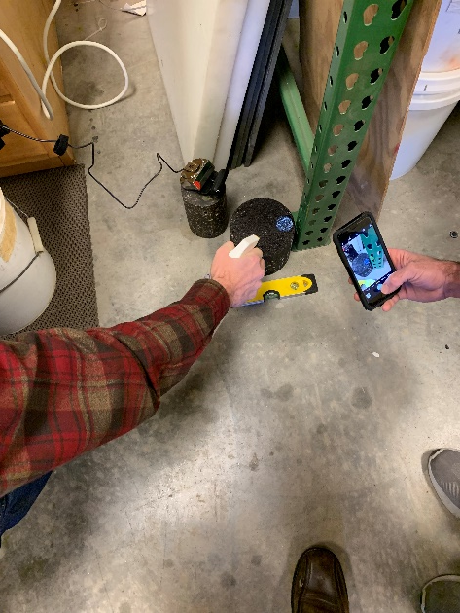
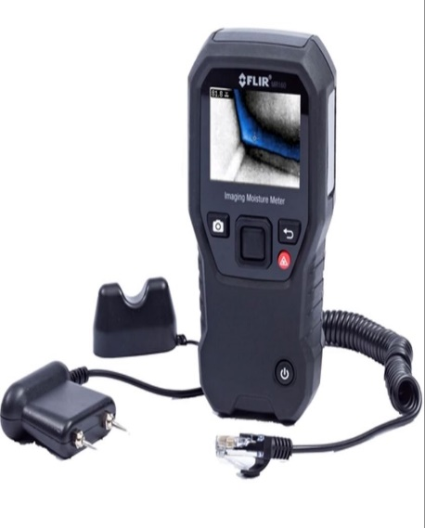
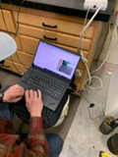
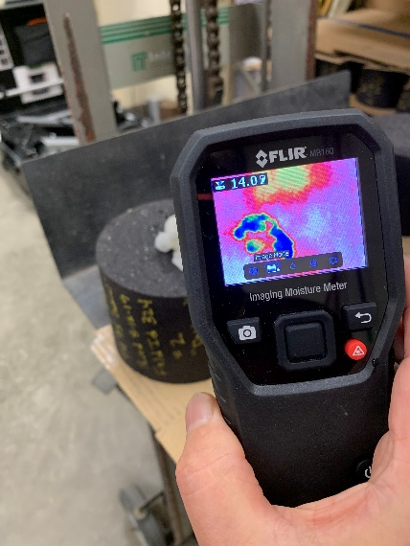
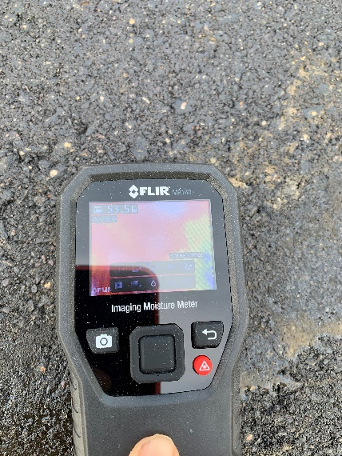
  Moisture measurement device
    Goal: a device that can go along with DPS system to continuously assess moisture on the pavement surface.
    Dr. David White from Ingios
    Demonstrated to us in Dec. 2019— promising
  Working on sensitivity
  Plan to invite him back for field testing
    FLIR MR160 Moisture Meter
      Mode: Image, contact and pin
      Good for core location: spot check
Notes:
-(test configuration from steel ASTM E399)
-(preload no greater than 0.2 kN)
-Test is ended when post peak load reaches 0.1 kN
-DCT chose as the fracture test to use by MnDOT from 10+ year Pooled-fund study with WI, Illinois, Iowa State, and MN
- Easy specimen fabrication in both lab and field
- Standard fracture test configuration with an ASTM spec existing in 2007(originally a test for fatigue cracking)
- DCT test has shown to be a good indicator of field performance and resistance to cracking

Slide 13
Task 3&4: Precision and Bias Statement & Equipment and Operator Certification
  Take Advantage of NCAT Test Track, New Construction, Laboratory and Expertise.
  NCAT manages one of the inertial profiling system certification centers.
  Promoting the technology to their sponsors.
  Please provide your comments on their proposal by Oct. 23.
Notes:
-(test configuration from steel ASTM E399)
-(preload no greater than 0.2 kN)
-Test is ended when post peak load reaches 0.1 kN
-DCT chose as the fracture test to use by MnDOT from 10+ year Pooled-fund study with WI, Illinois, Iowa State, and MN
- Easy specimen fabrication in both lab and field
- Standard fracture test configuration with an ASTM spec existing in 2007(originally a test for fatigue cracking)
- DCT test has shown to be a good indicator of field performance and resistance to cracking

Slide 14
Precision and Bias Statement
    In general, follow ASTM E691, “Standard Practice For Conducting an Interlaboratory Study To Determine The Precision Of A Test Method”
    Repeatability: Same test method on identical test items in the same laboratory by the same operator.
    Reproductively: Same test method on identical test items in different laboratories with different operators.
    Including (MnDOT will also provide data to NCAT)
      Lab Dielectric to AV% Conversion
        Produce pucks at 88%, 90%, 92% and 94% with fine and coarse mixtures and a HDPE specimen
        Round-robin testing among the participants
      Field Dielectric Data Collection
        At least 3 devices (9 sensors) will used
        New test sections (10-12) with fine and coarse mixtures and different thickness (1-3in)
Notes:
-(test configuration from steel ASTM E399)
-(preload no greater than 0.2 kN)
-Test is ended when post peak load reaches 0.1 kN
-DCT chose as the fracture test to use by MnDOT from 10+ year Pooled-fund study with WI, Illinois, Iowa State, and MN
- Easy specimen fabrication in both lab and field
- Standard fracture test configuration with an ASTM spec existing in 2007(originally a test for fatigue cracking)
- DCT test has shown to be a good indicator of field performance and resistance to cracking

Slide 15
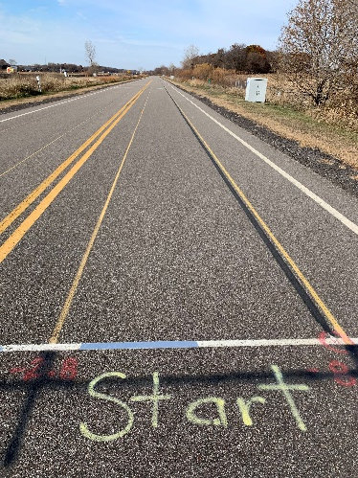
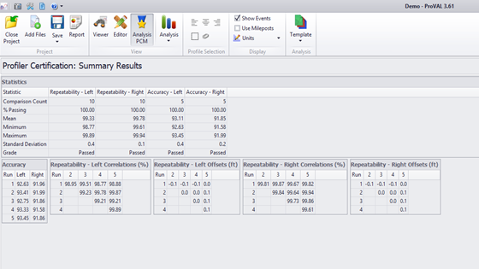
Equipment and Operator Certification
  In general, follow AASHTO R 56‑14 “Standard Practice for Certification of Inertial Profiling Systems”.
  NCAT manages one of the inertial profiling system certification centers.
    Including
      Lab Dielectric to AV% Conversion
        Lab testing on pucks with different density (88%, 90%, 92% and 94%)
        Find out critical steps to get consistent and accurate results
      Field Dielectric Data Collection
        Existing 4 test sections with 4 different density levels (from 88% to 94% by Gmm) + OGFC section will be used.
        Baseline density: unclear gauge testing at 1 ft interval on 4 lines (1 close to joint); cores will be taken on these locations later.
        Perform DPS testing on these lines
        MnDOT will also provide them data
      Operator Certification
        Develop online training and testing program.
Notes:
-(test configuration from steel ASTM E399)
-(preload no greater than 0.2 kN)
-Test is ended when post peak load reaches 0.1 kN
-DCT chose as the fracture test to use by MnDOT from 10+ year Pooled-fund study with WI, Illinois, Iowa State, and MN
- Easy specimen fabrication in both lab and field
- Standard fracture test configuration with an ASTM spec existing in 2007(originally a test for fatigue cracking)
- DCT test has shown to be a good indicator of field performance and resistance to cracking

Slide 16
Task 5: Support Communication
  Face to face in fall 2021
  Webinar in spring 2021 to review the data collected by states
    Please send data to Kyle if you collected
    Revise the draft procedures by May 2021
      Incorporate state and contractor’s comments/feedback
      Address issues identified from data analysis (ex. Puck vs core bias)
      Update procedures with 2.0 device
Notes:
-(test configuration from steel ASTM E399)
-(preload no greater than 0.2 kN)
-Test is ended when post peak load reaches 0.1 kN
-DCT chose as the fracture test to use by MnDOT from 10+ year Pooled-fund study with WI, Illinois, Iowa State, and MN
- Easy specimen fabrication in both lab and field
- Standard fracture test configuration with an ASTM spec existing in 2007(originally a test for fatigue cracking)
- DCT test has shown to be a good indicator of field performance and resistance to cracking

Slide 17
Task 6: Provide Training and Technical Assistance
  Have been providing online assistance and will continue to do so
  If needed, we can provide onsite training once we are allowed to travel.
Notes:
-(test configuration from steel ASTM E399)
-(preload no greater than 0.2 kN)
-Test is ended when post peak load reaches 0.1 kN
-DCT chose as the fracture test to use by MnDOT from 10+ year Pooled-fund study with WI, Illinois, Iowa State, and MN
- Easy specimen fabrication in both lab and field
- Standard fracture test configuration with an ASTM spec existing in 2007(originally a test for fatigue cracking)
- DCT test has shown to be a good indicator of field performance and resistance to cracking

Slide 18
Task 7: Promote the technology
  Conference call with GSSI to discuss potential implementation
    Looking at how they can better provide support to contractors in the future.
  Craig Landefeld from OHDOT made an excellent presentation at NRRA seminar
  Presentations at our biweekly bituminous meetings
  Collected data using Earth Science Pavement Density meter
  Promoted the technology to contractors
  Will make a brochure
Notes:
-(test configuration from steel ASTM E399)
-(preload no greater than 0.2 kN)
-Test is ended when post peak load reaches 0.1 kN
-DCT chose as the fracture test to use by MnDOT from 10+ year Pooled-fund study with WI, Illinois, Iowa State, and MN
- Easy specimen fabrication in both lab and field
- Standard fracture test configuration with an ASTM spec existing in 2007(originally a test for fatigue cracking)
- DCT test has shown to be a good indicator of field performance and resistance to cracking

Slide 19
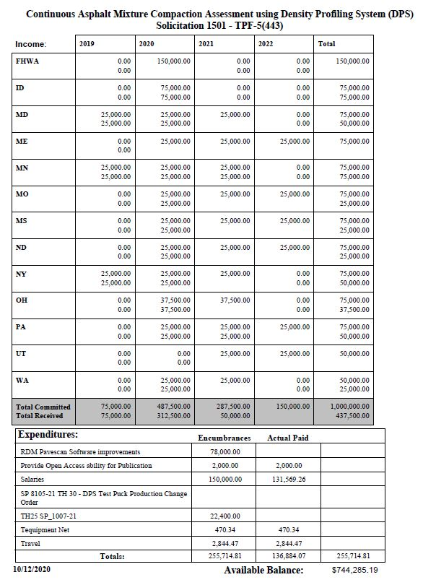
Budget
Notes:
-(test configuration from steel ASTM E399)
-(preload no greater than 0.2 kN)
-Test is ended when post peak load reaches 0.1 kN
-DCT chose as the fracture test to use by MnDOT from 10+ year Pooled-fund study with WI, Illinois, Iowa State, and MN
- Easy specimen fabrication in both lab and field
- Standard fracture test configuration with an ASTM spec existing in 2007(originally a test for fatigue cracking)
- DCT test has shown to be a good indicator of field performance and resistance to cracking

Slide 20

Thank you!

