Slide 1

Pooled Fund Tasks in PaveScan
Roger Roberts
GSSI
10/14/20

Slide 2
Developments June – October 2020
Task 6 - Puck Module Fully Implemented
  Beta-tested at MinnDOT
  Scheduled for Release this week
Task 7 – QA Module Fully Implemented
  Initial beta-testing inhouse scheduled for next week
Task 8 – Core Module 95% implemented
  Completion by end of week
  Initial beta-testing inhouse scheduled for next week

Slide 3
Puck Module
User-friendly interface for calculating dielectrics of pucks and cores
Generates equation relating compaction to dielectric
Saves calibration equation to file
  can be used by one or more projects
Accessed from desktop short-cut

Slide 4
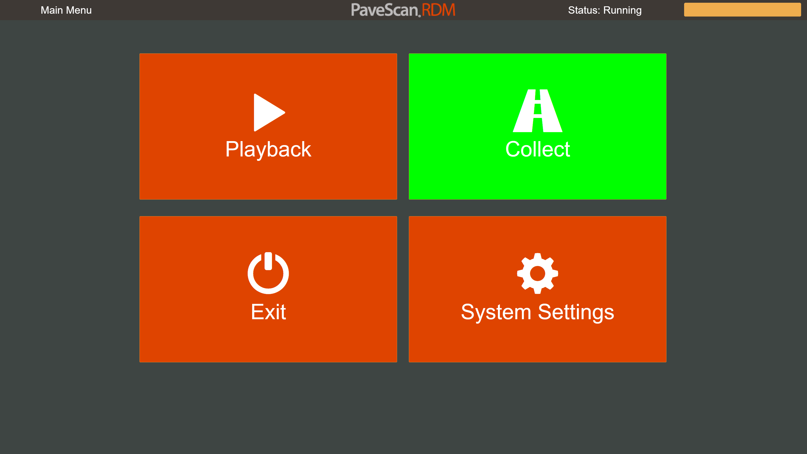
Puck Module Quick Walk-Through:
Start-up Display
Press Collect
Button

Slide 5
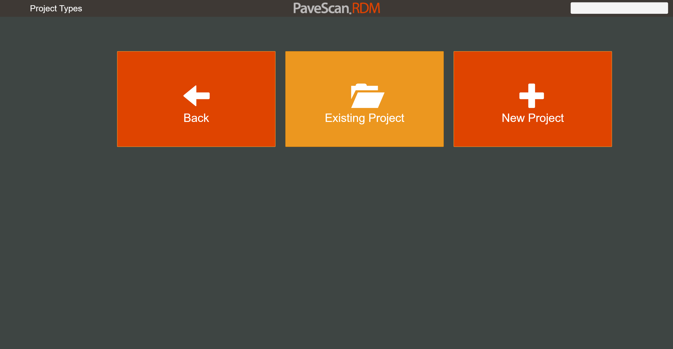
Select a Project
Typically
one project
per set of pucks

Slide 6
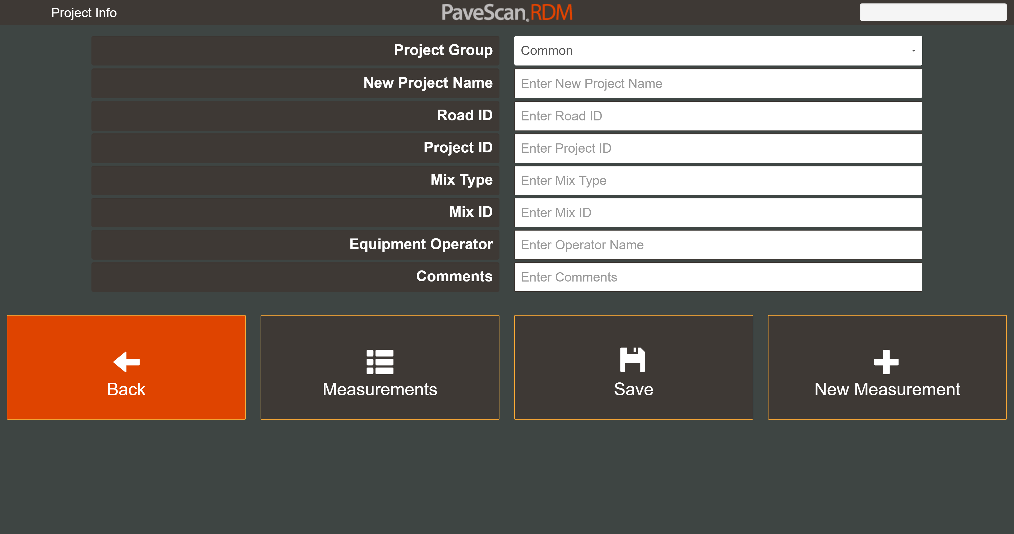
Project Info
Lots of Project
Information
Can be entered
here.

Slide 7
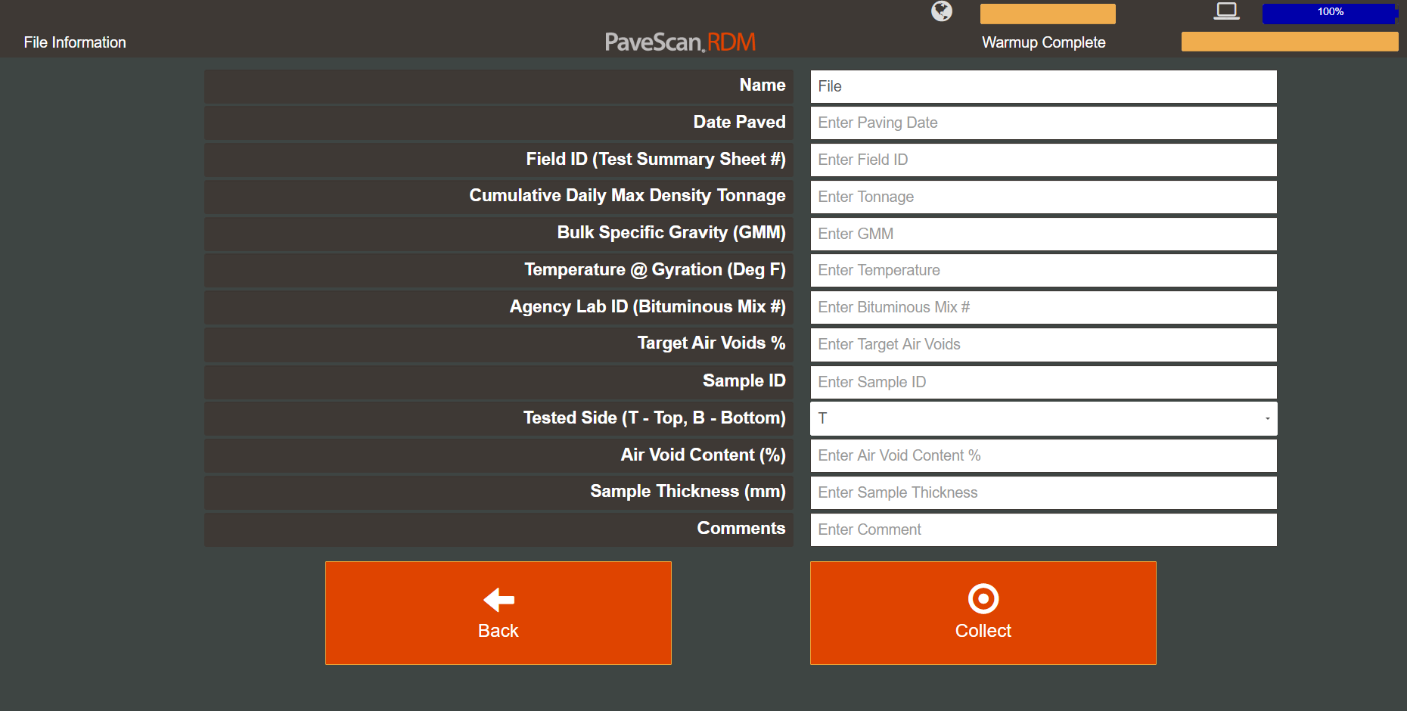
File Info
Lots of Puck-specific
Information
can be entered
here

Slide 8
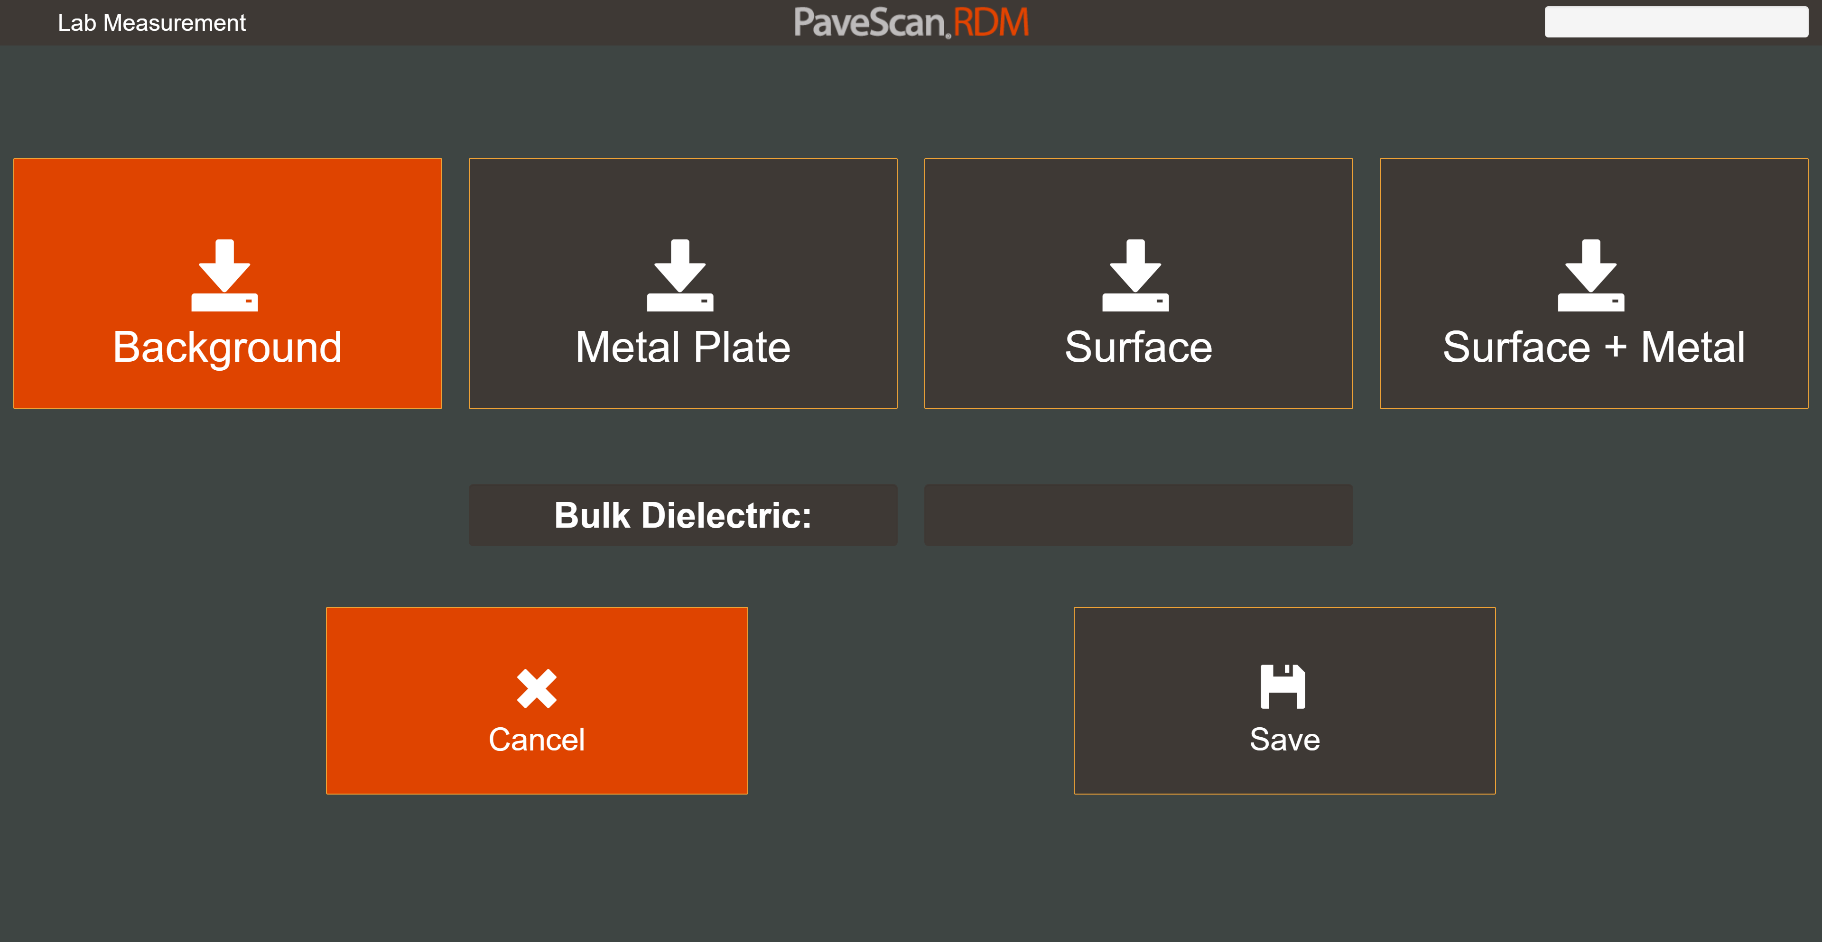
Collection
Puck dielectric
calculated from sequence of 4 separate measurements

Slide 9
Playback
Press Playback
Button

Slide 10
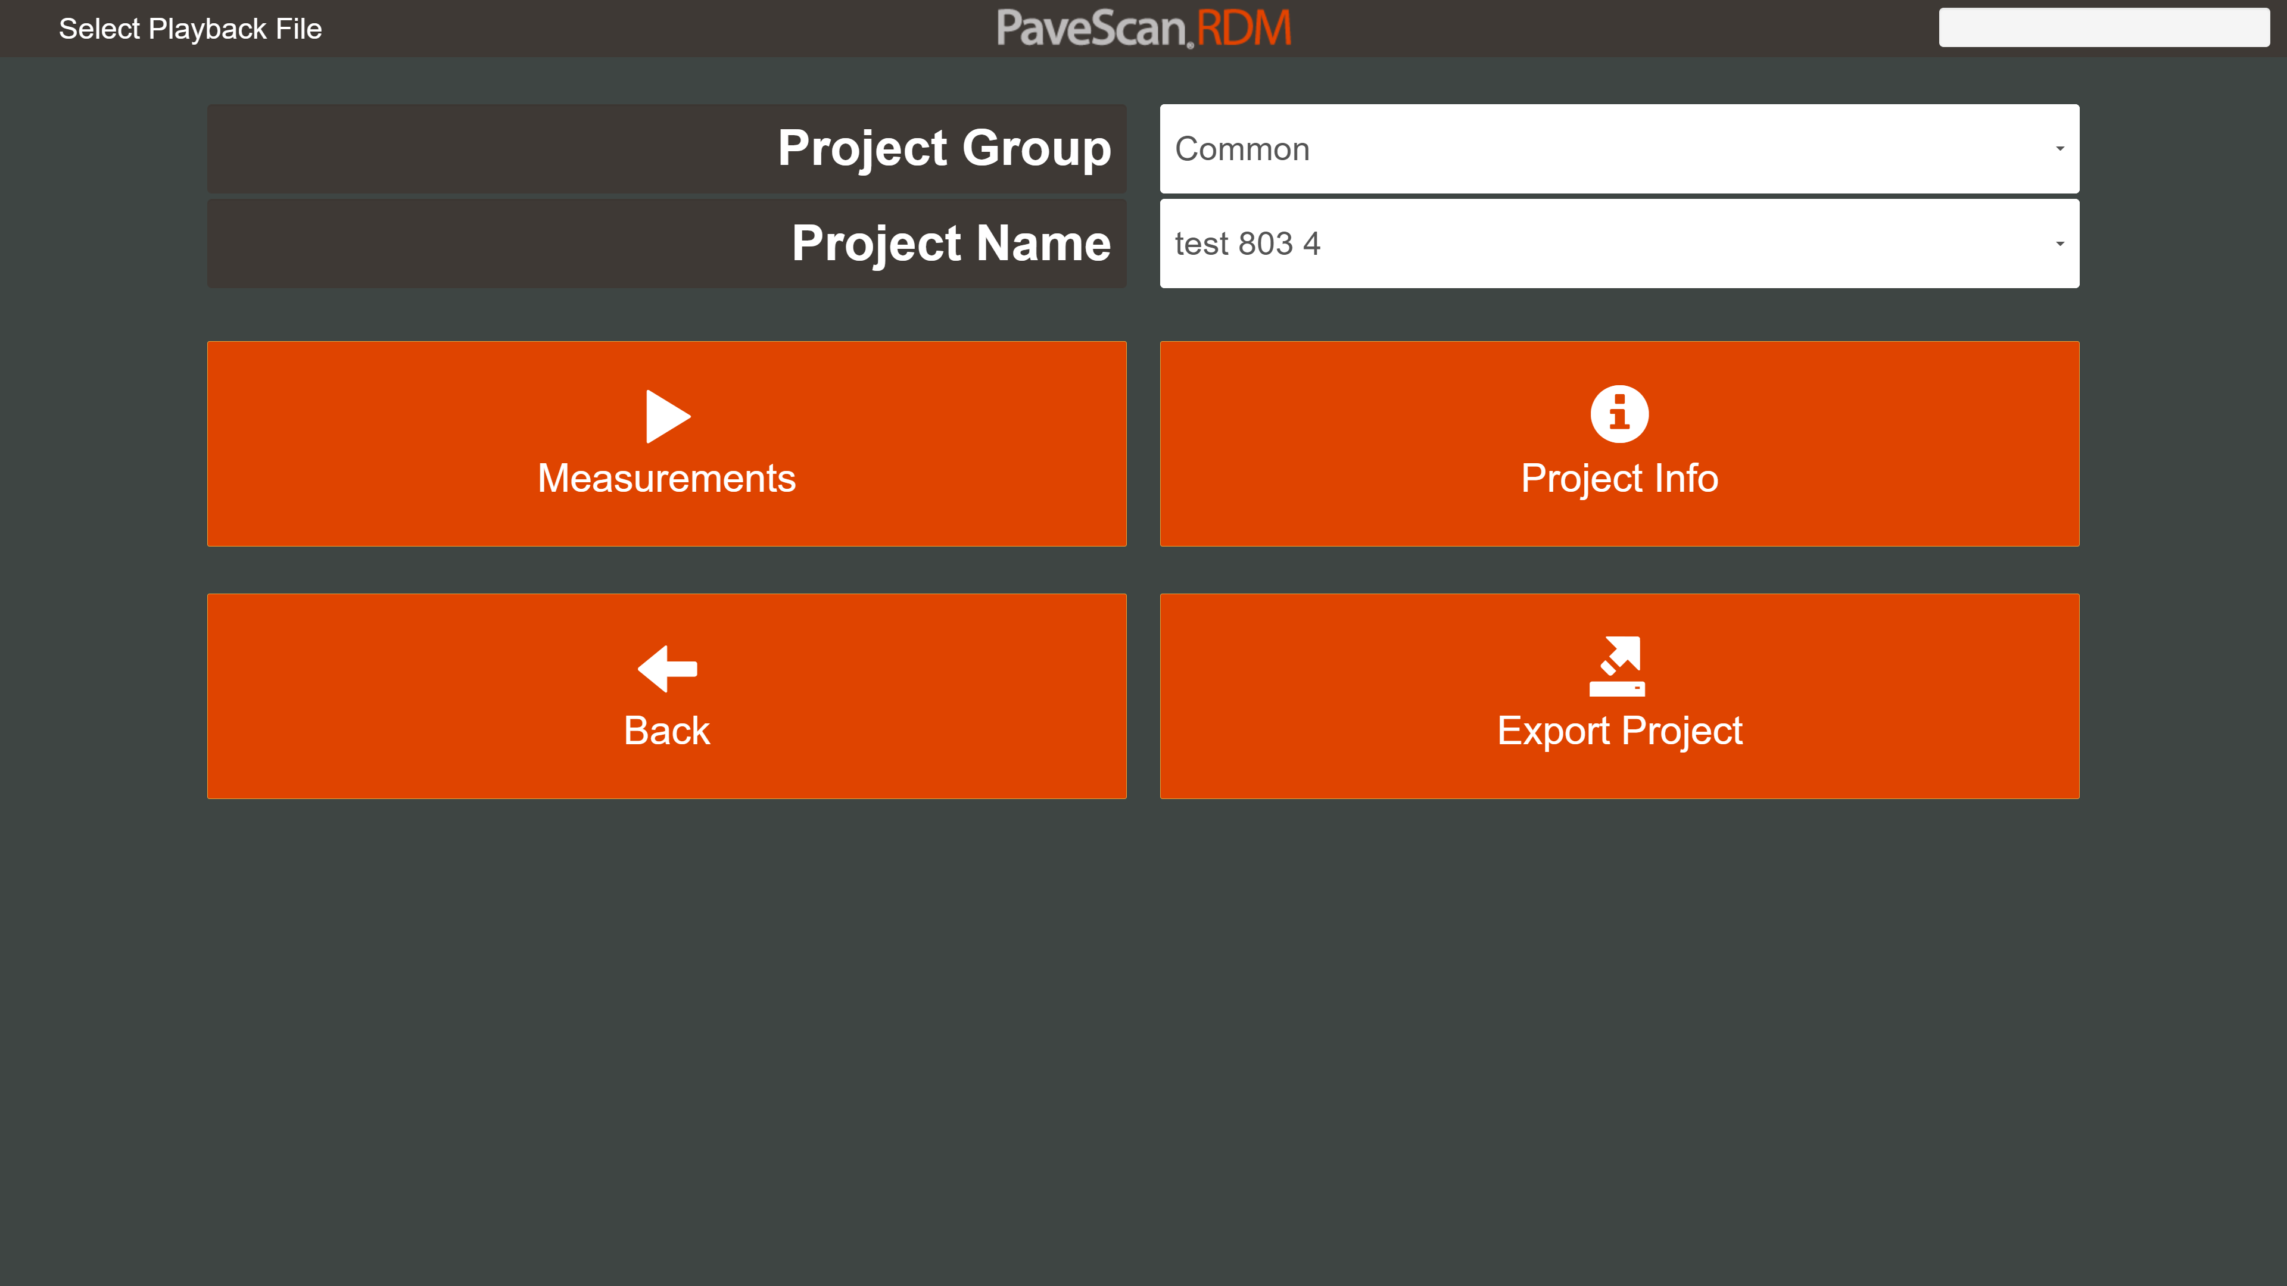
Viewing and Exporting Measurements
See all
measurements
together
Export measurements and all user-entered information

Slide 11
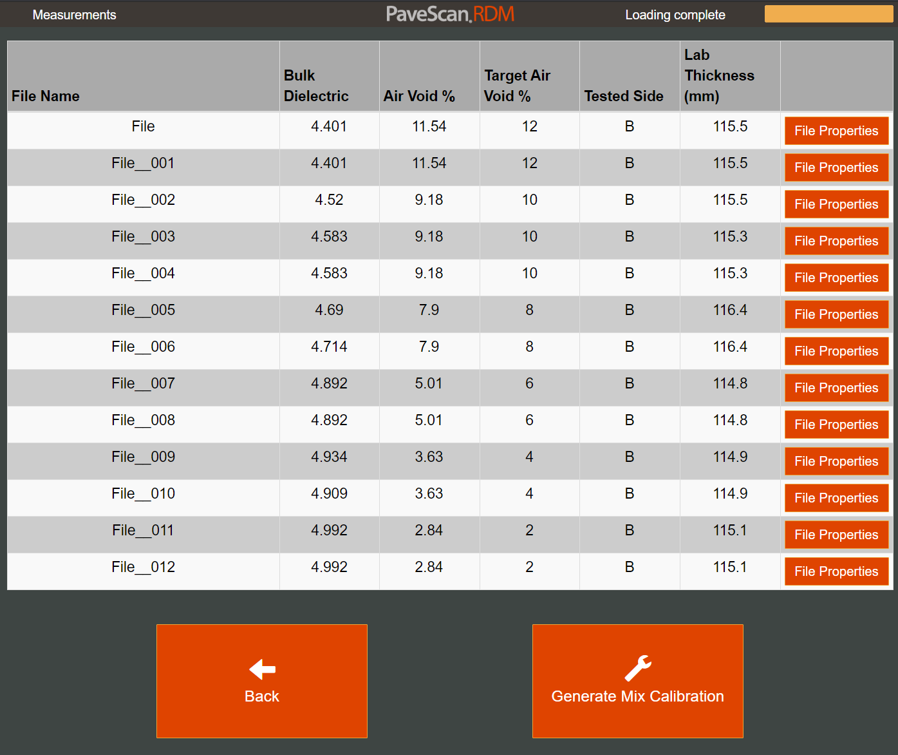
Viewing Measurements
Auto-loads values
so calibration equation
can be generated without
Manual entries.

Slide 12
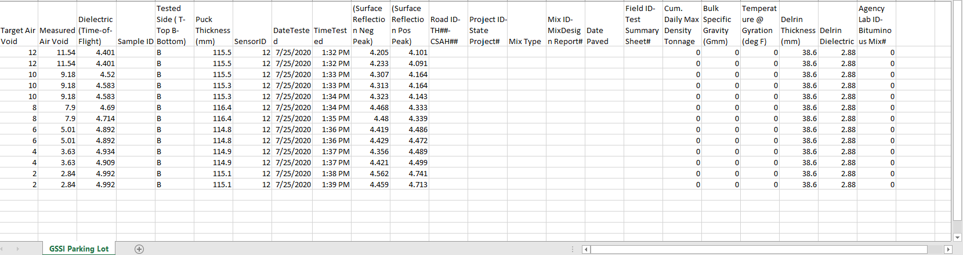
Exported Project

Slide 13
Quality Assurance Module
Used to:
  Verify antennas are working properly
  Apply dielectric correction to individual channels
3 Methods
  HDPE measurements
  Repeat Line
  Swerve
Integrated into Pavescan
  Collect QA files seamlessly without leaving project

Slide 14
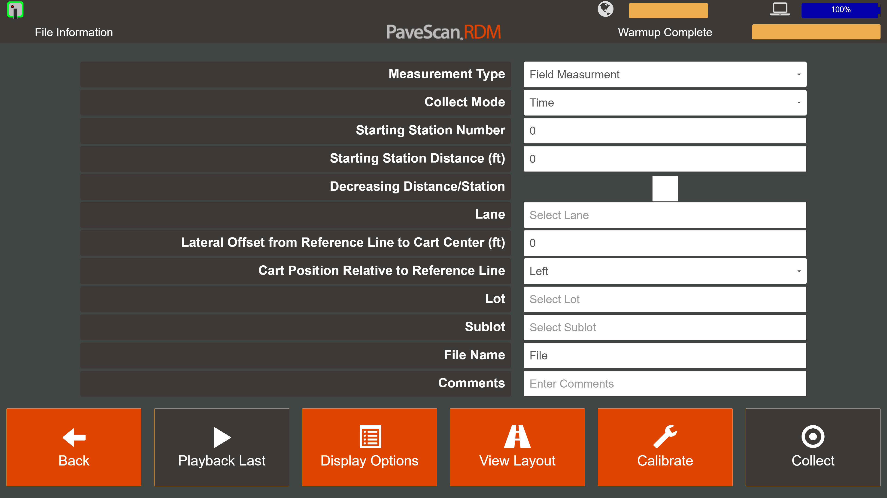
Data Collection
Select Measurement Type

Slide 15
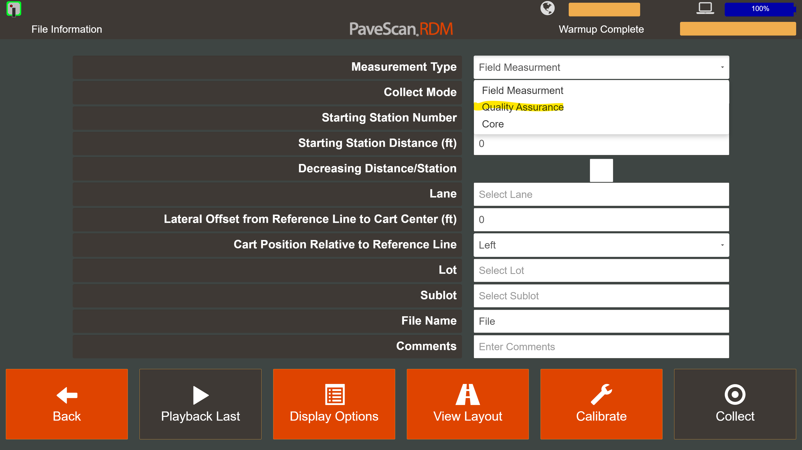
Accessing QA Collection
Quality Assurance Measurement Type

Slide 16
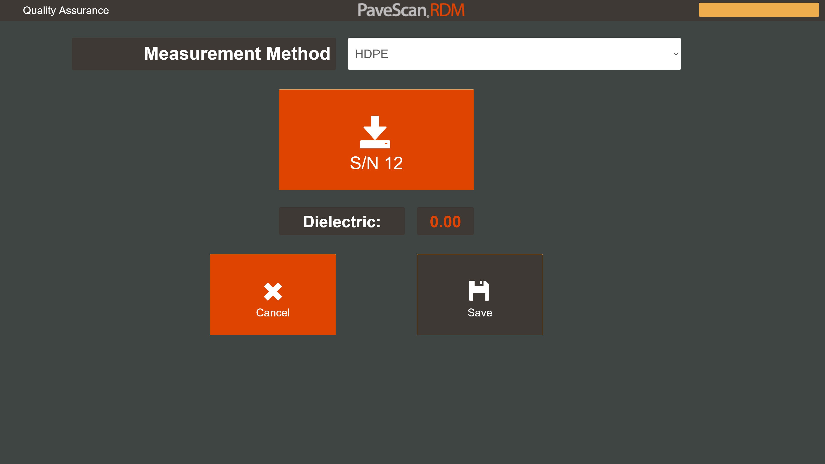
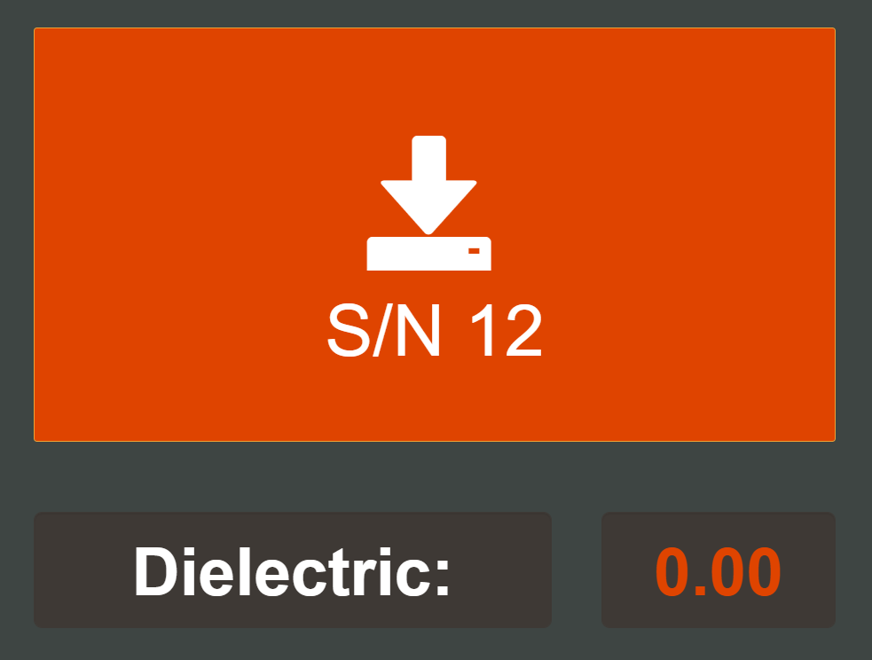
HDPE Measurement Method
HDPE Measurement Method
S/N 11
S/N 13
Press one button at a time to make
10 second measurement

Slide 17
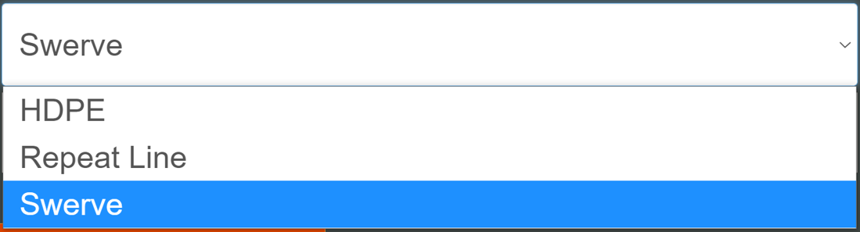
Other Measurement Methods
Selecting other measurement methods
S/N 11
S/N 13

Slide 18
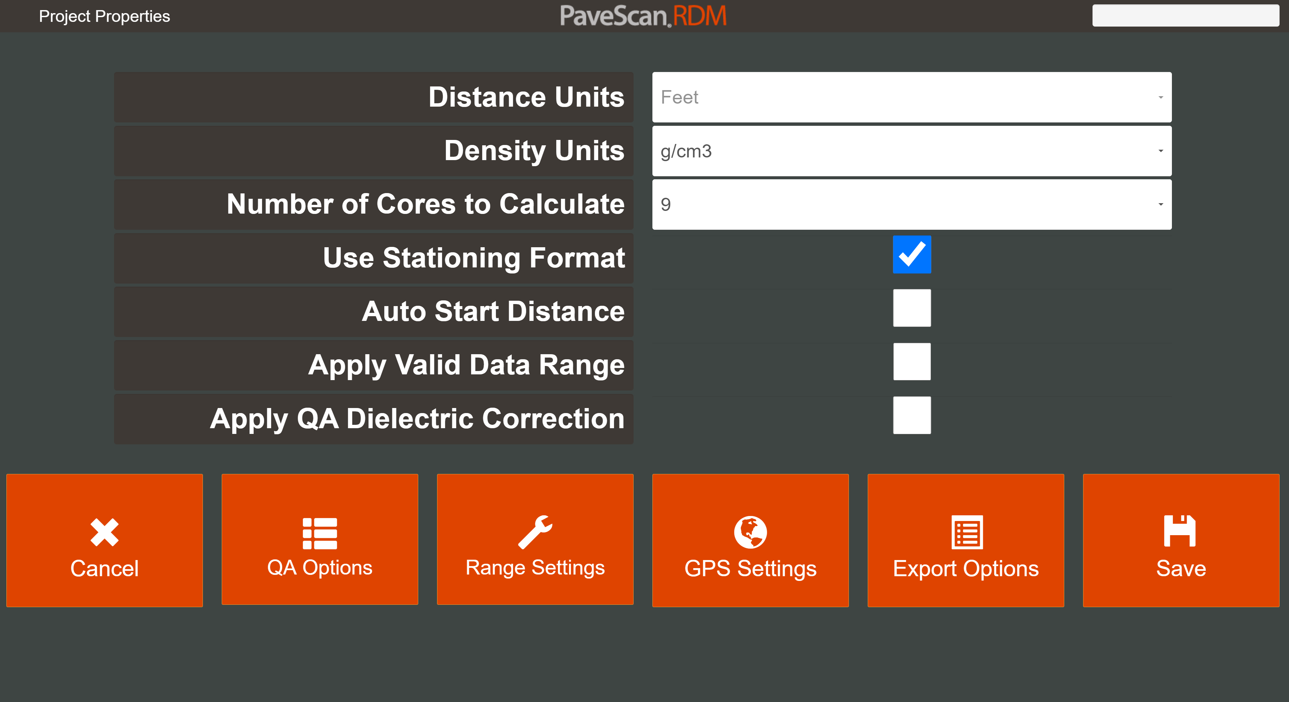
Accessing Collected Data
New QA Options
Button in Project
Properties

Slide 19
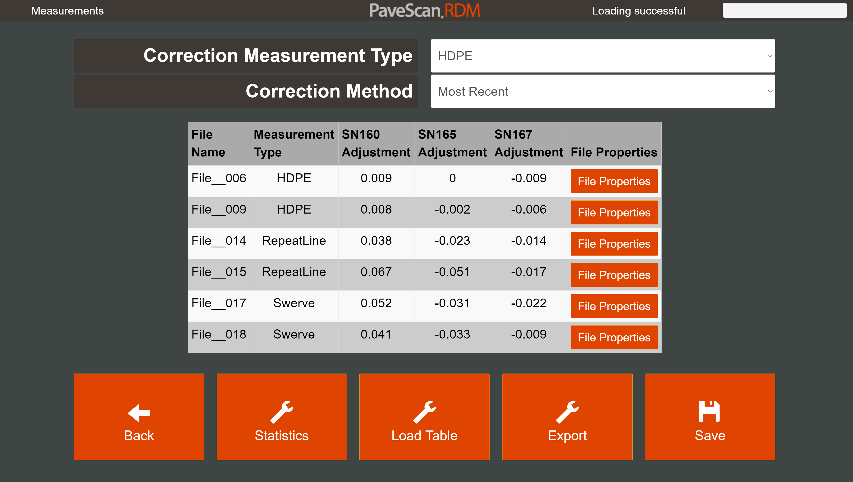
View and Apply Correction
Select Correction
Measurement Type
Select how it’s applied

Slide 20
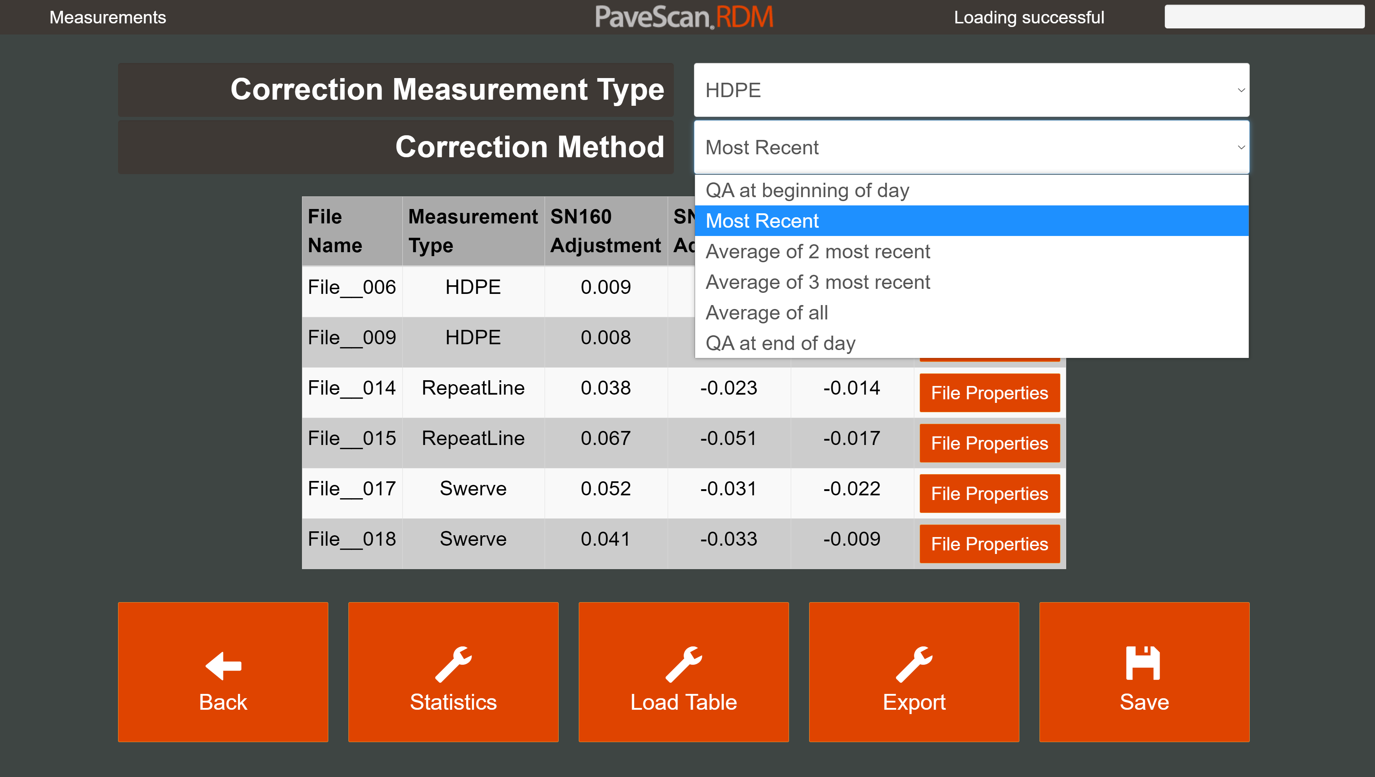
Multiple Correction Options
Applied in Realtime and Post-Processing

Slide 21
Core Module
Files specific to core locations
  10 second time file
  6” distance file collected at 40 scans/ft density
Preload core locations
Seamlessly collect files without leaving project
Generate Calibration Equation from collected core files.

Slide 22
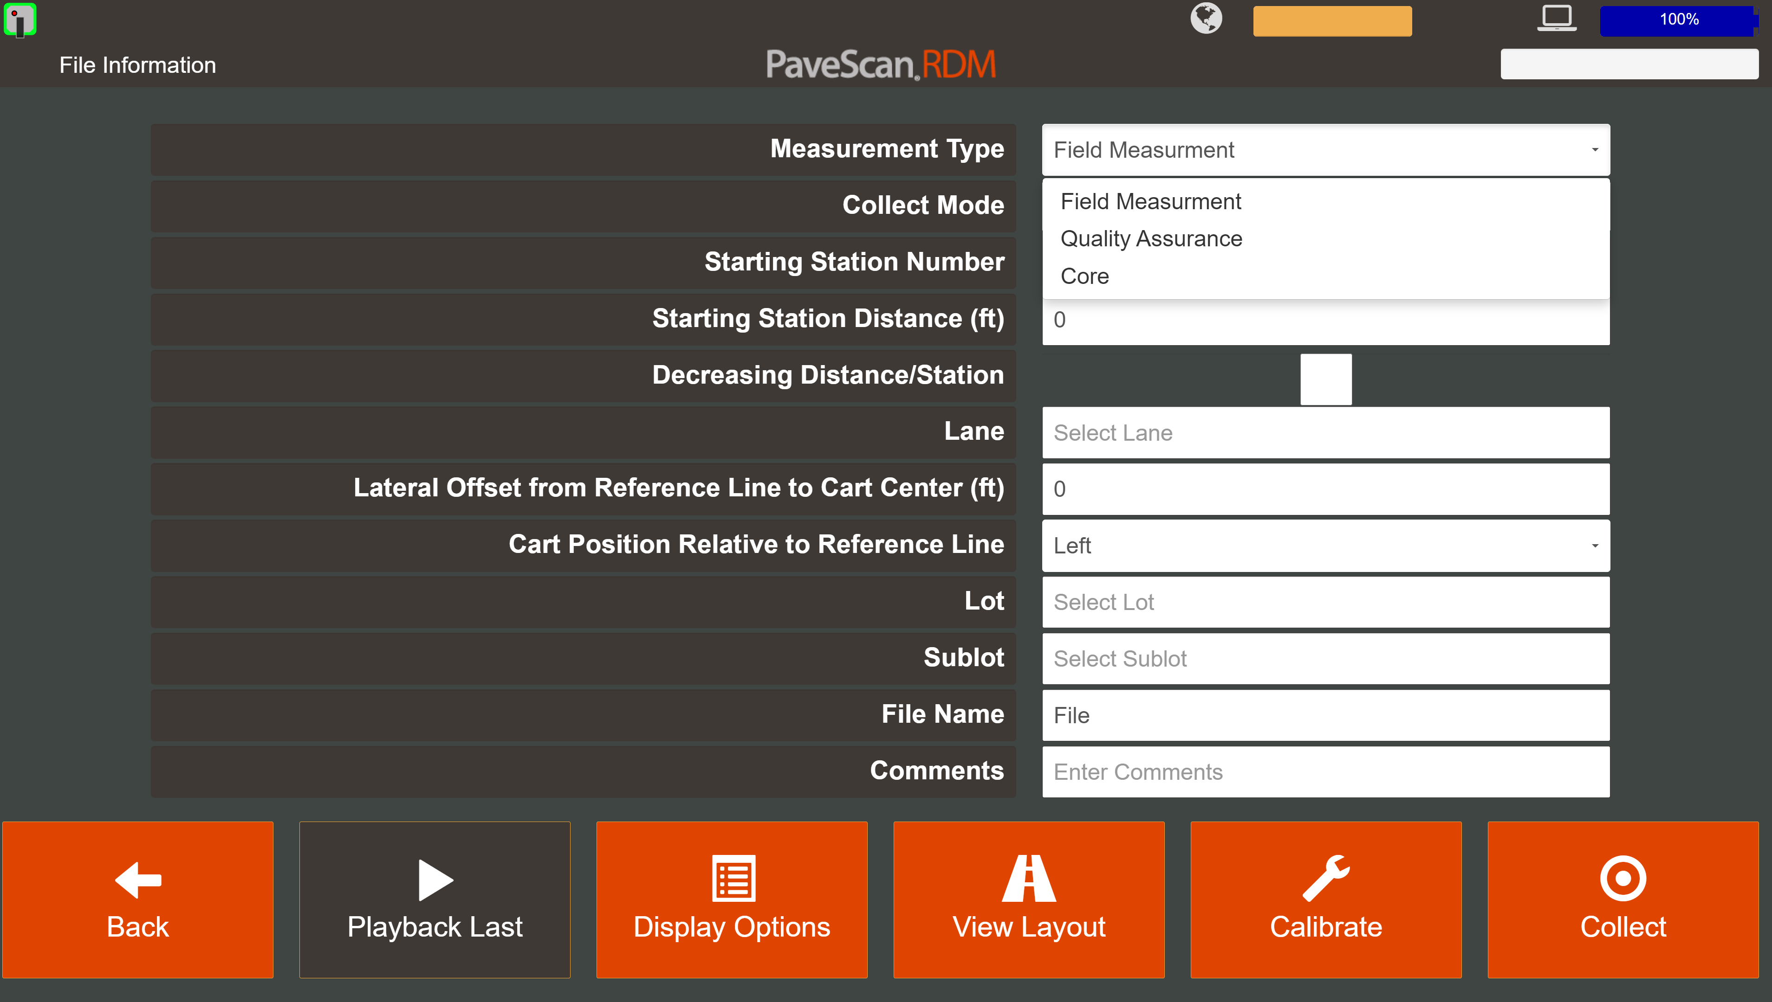
Selecting a Core Measurement
Select Core Measurement Type

Slide 23
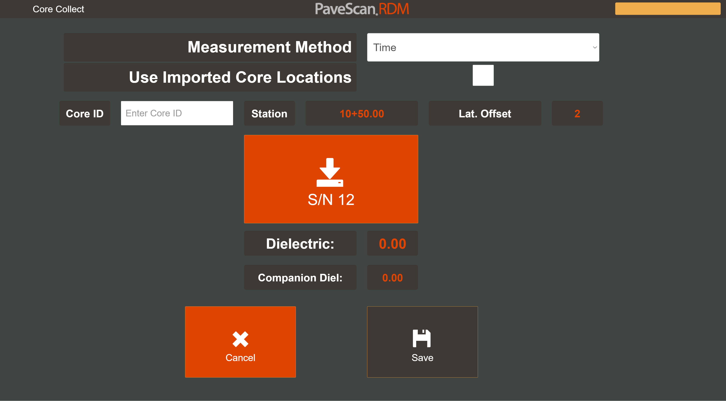
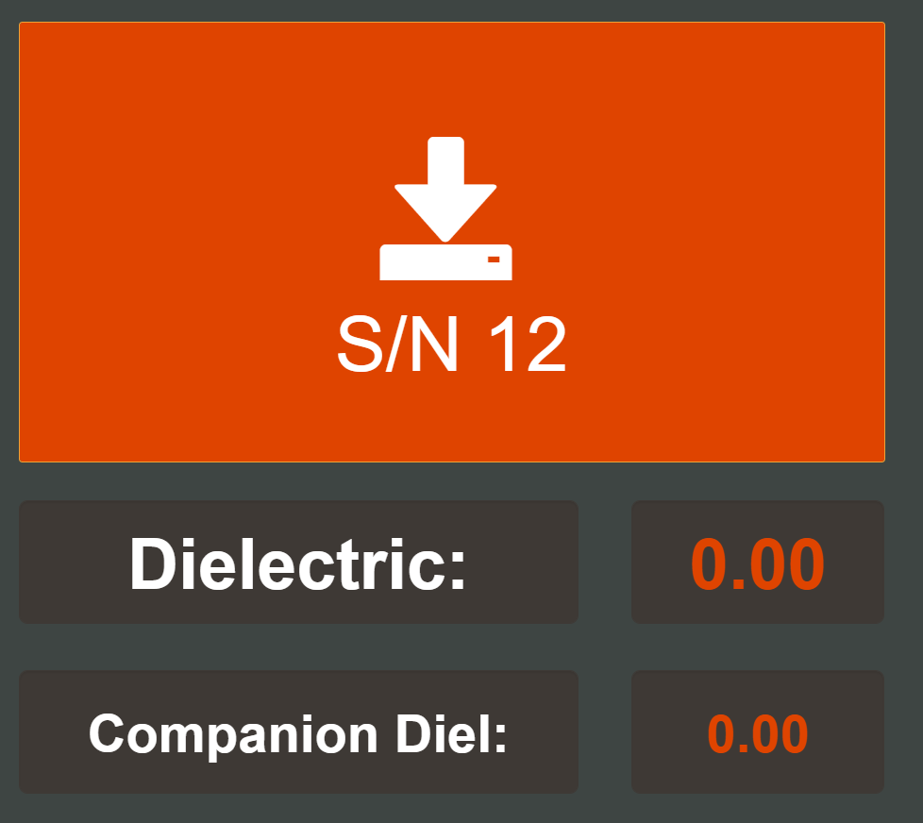
Collecting a Core File
Select Time or
Distance method
Press one button
to make 10 second
core measurement
S/N 11
S/N 13
Press button
Second time to make 10 second
companion core measurement

Slide 24
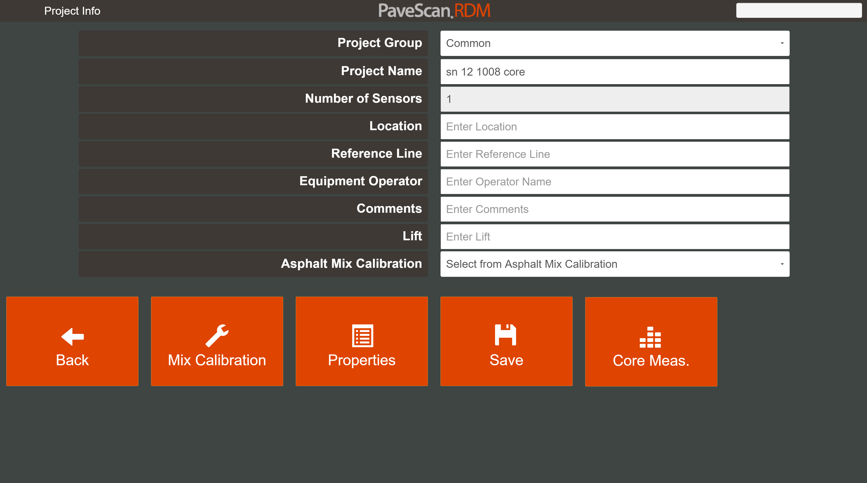
Accessing Core Files
New Core Measurement
Button in Project
Info

Slide 25
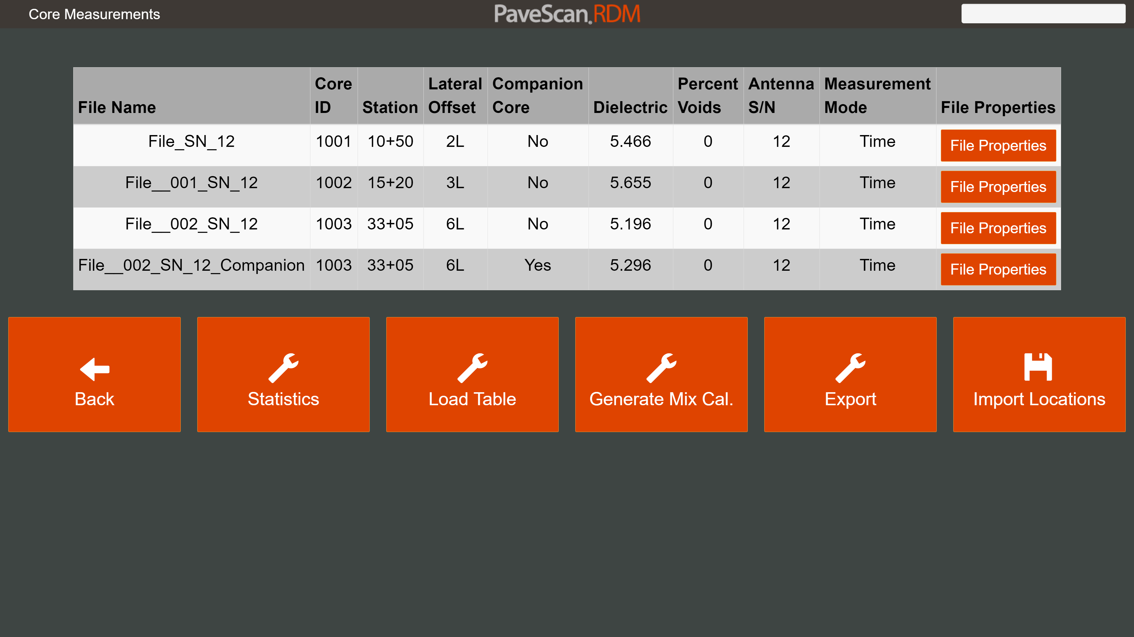
Core Measurement Options
Core Calibration
Equation Generation
Import Known Locations

