Slide 1
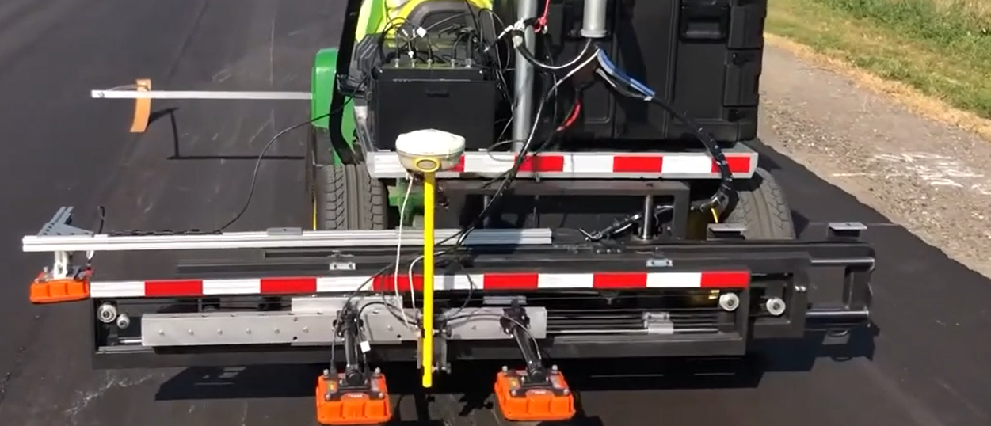
MnDOT DPS Data Management
Kyle Hoegh
Mercedes Maupin
Shongtao Dai

Slide 2
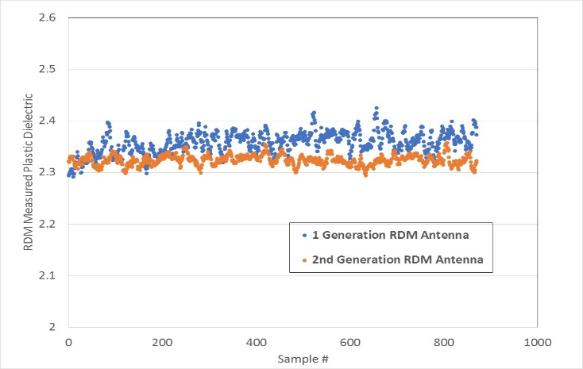

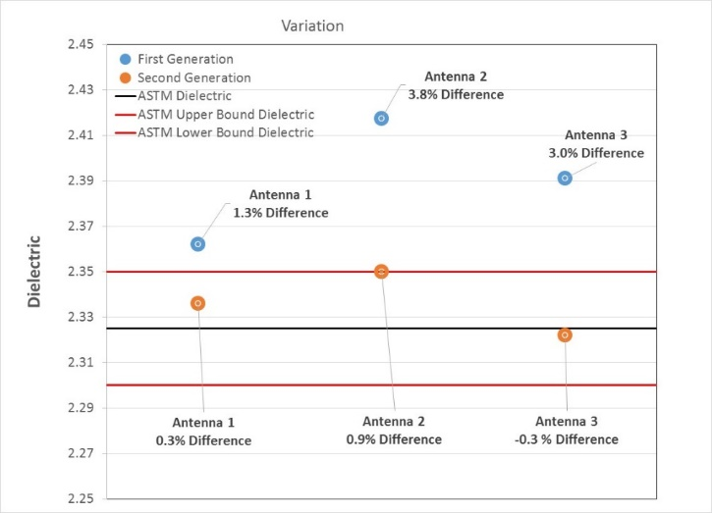
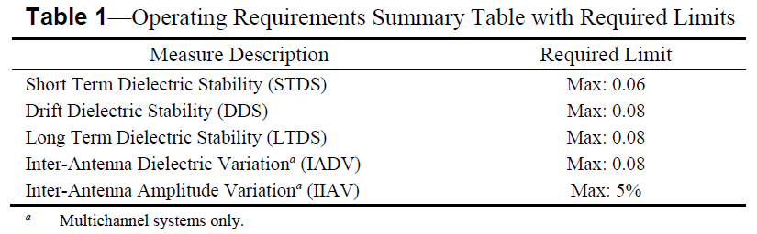
Ensure Equipment is Precise/Unbiased–
How can I make sure I am using the right equipment?
The method requires an instrument capable of
  Scanning at a rate that allows for continuous collection behind the paving operation
  Measuring an accurate dielectric
Developed method based on plastic with known dielectric constant (HDPE)

Slide 3
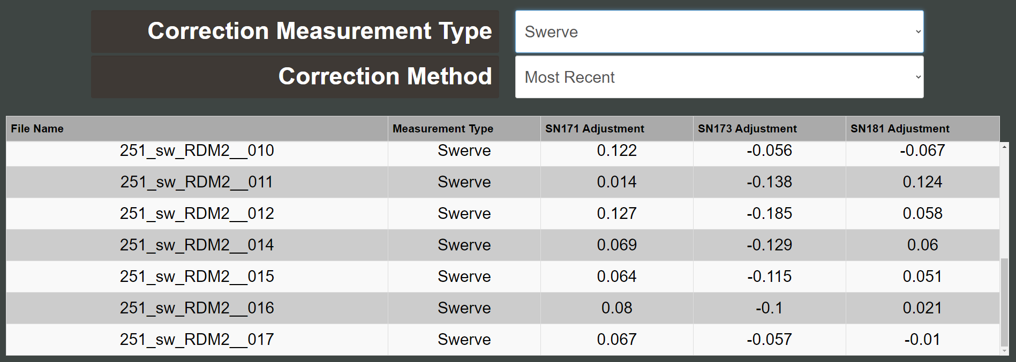
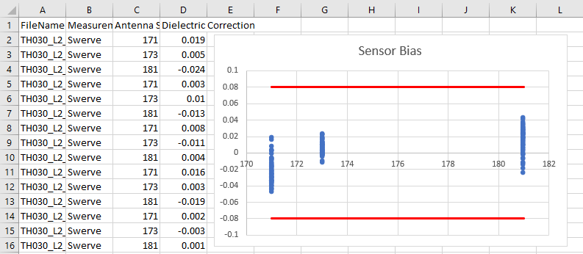
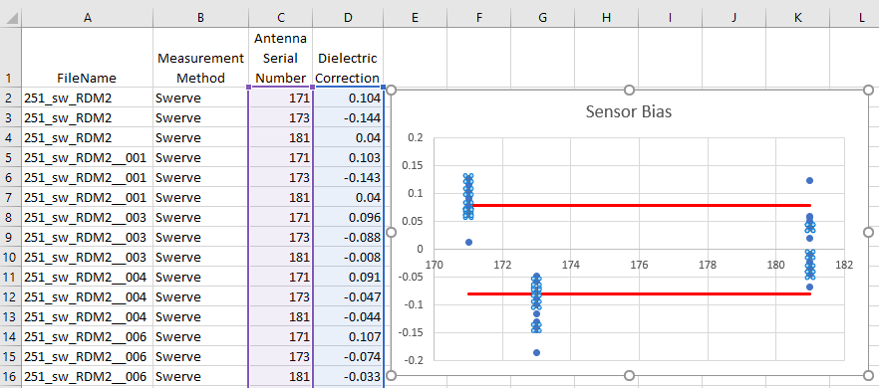
Ensure Field Collection is Precise/Unbiased–
How can I make sure my data is of the necessary quality?
First Make Sure Sensors are Working Properly
  Have data record showing good sensors

Slide 4
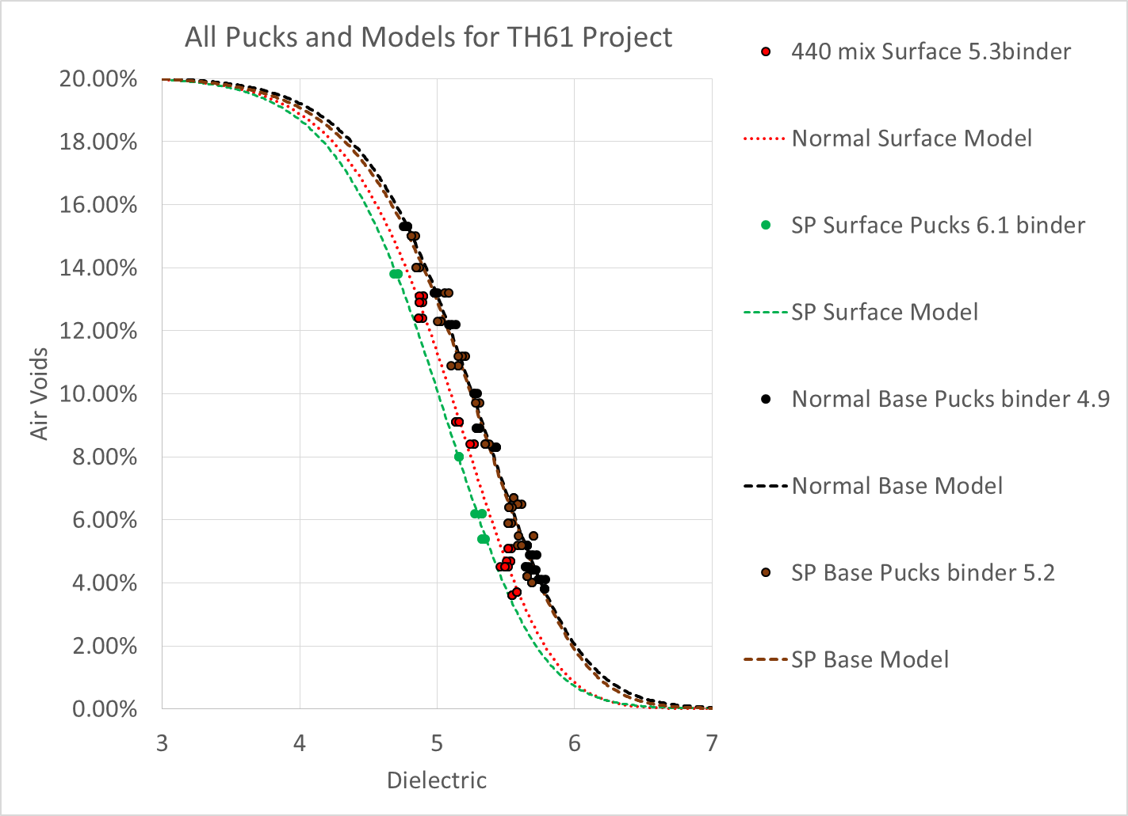
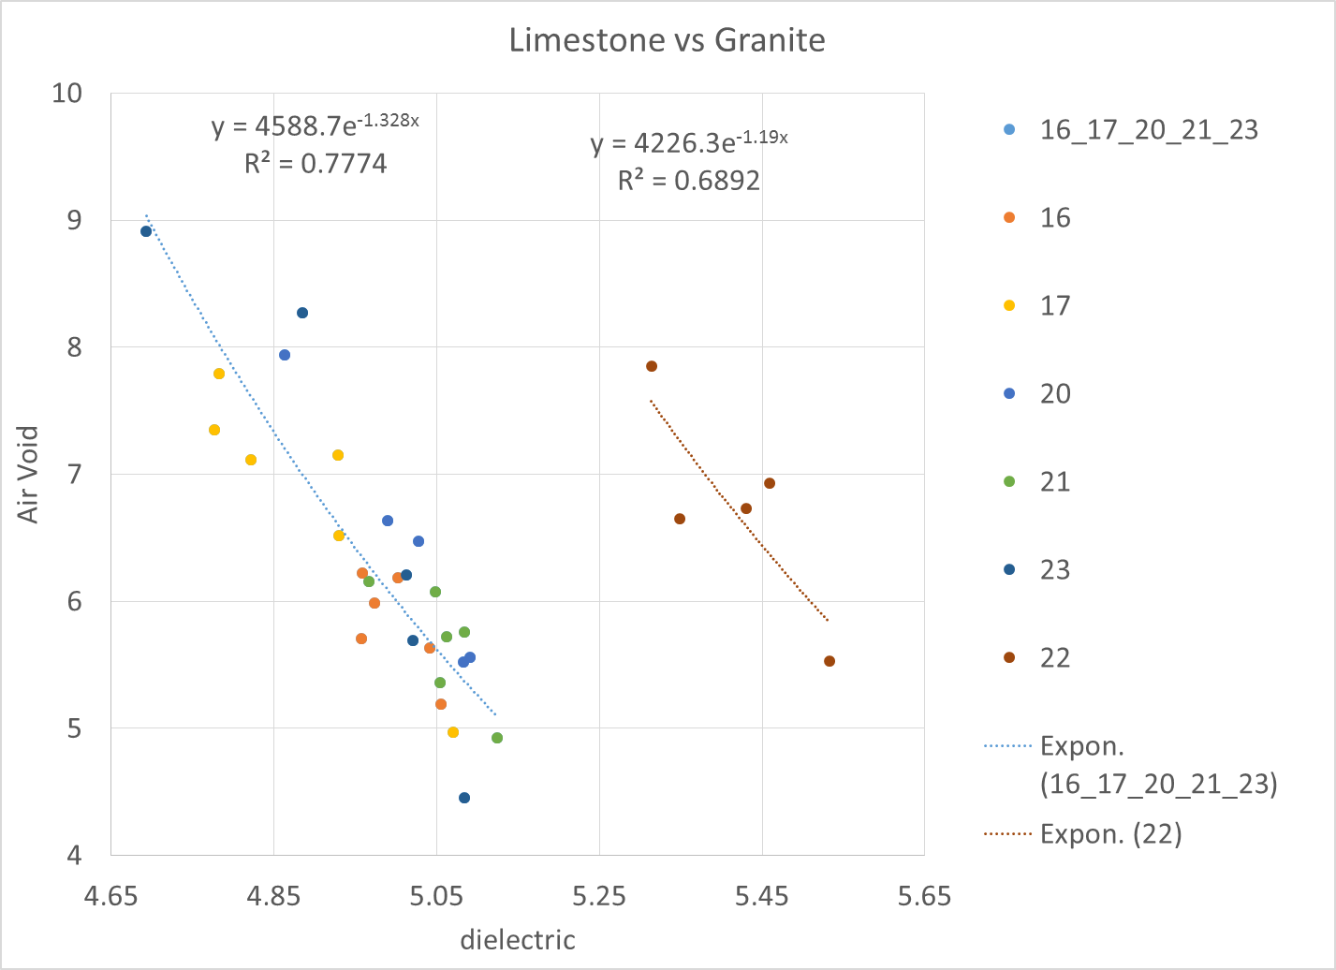
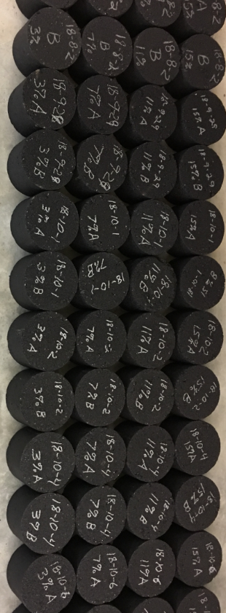
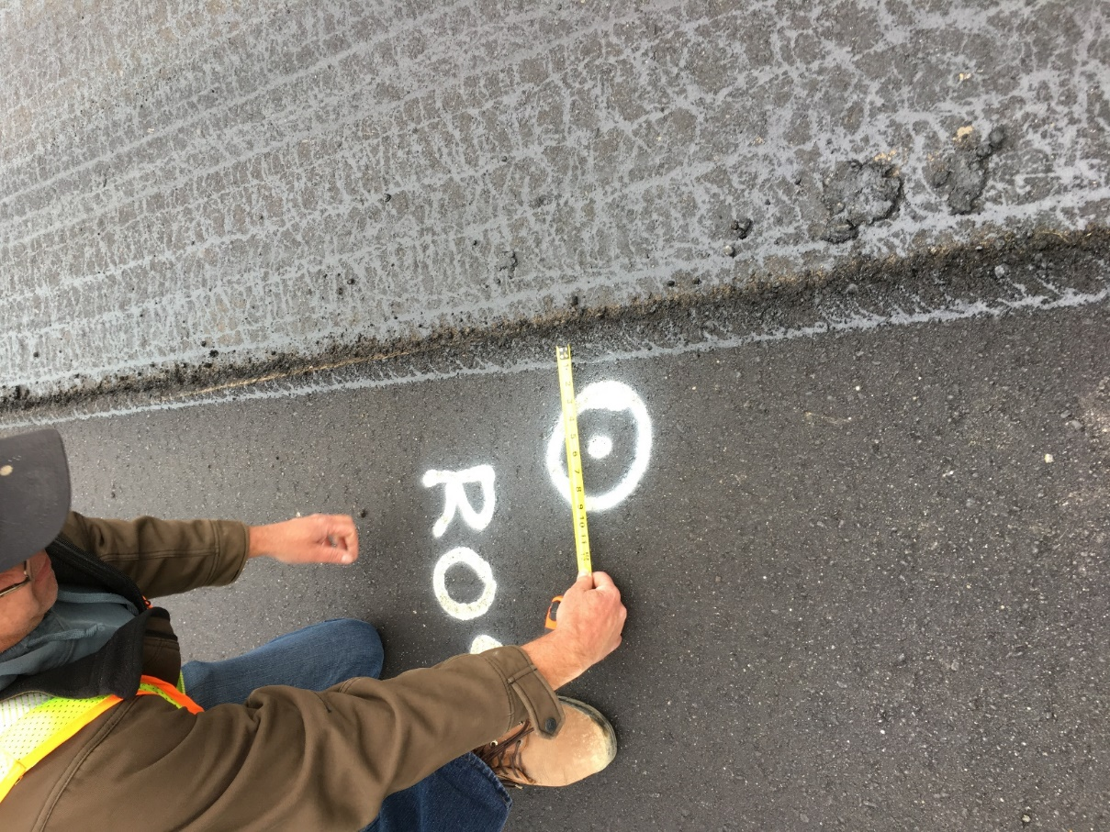
Ensure Dielectric to Void% Correlation is Accurate –
Converting what we measure to what we care about
New Way: Develop Correlation with Production Mix Gyratory Samples
Traditional Way:
Develop Correlation with Field Cores

Slide 5
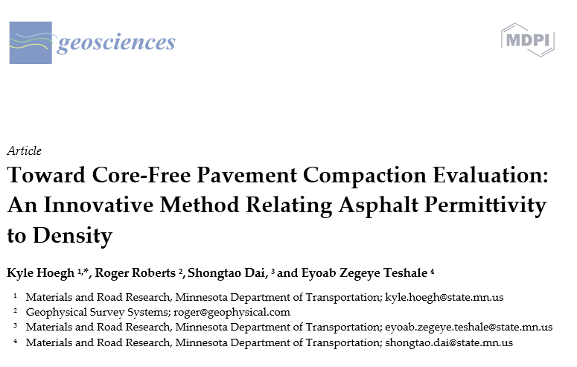
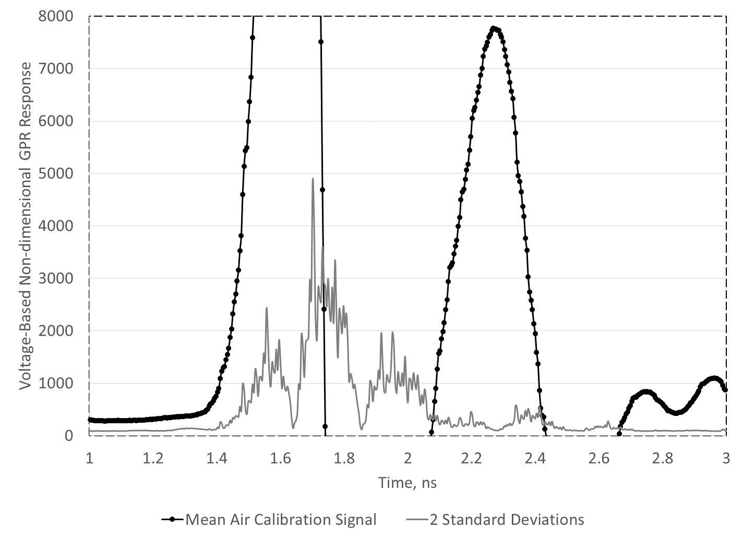
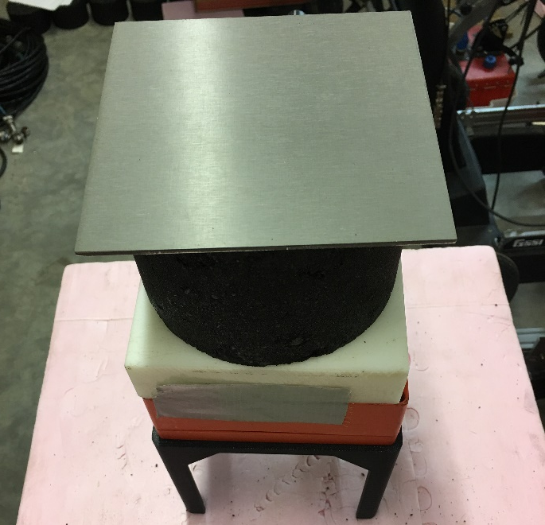
Ensure Dielectric to Void% Correlation is Accurate –
Converting what we measure to what we care about
http://www.dot.state.mn.us/materials/dps/publications.html
2020/21 Core Strategy
  ZERO extra cores taken!
  Cores used for accuracy check all from normal QA locations
  >50 unique paving days with validation cores
  >500 validation cores with dielectric values

Slide 6
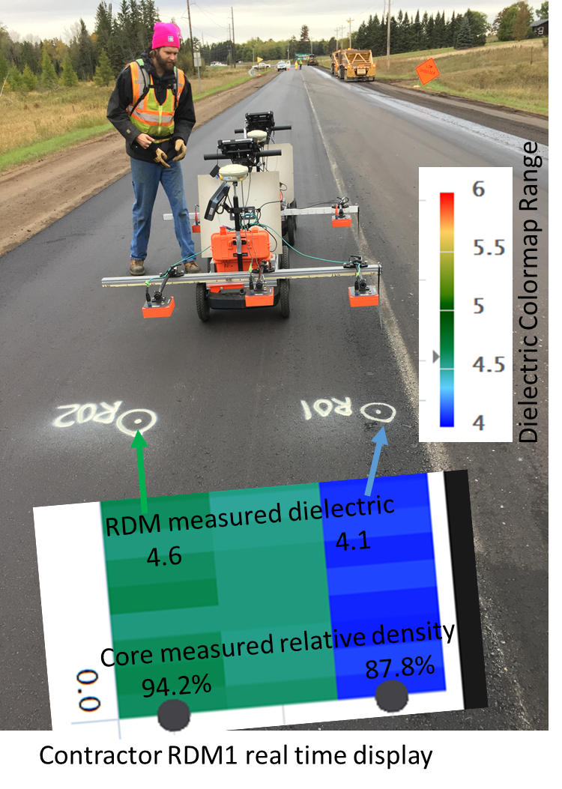
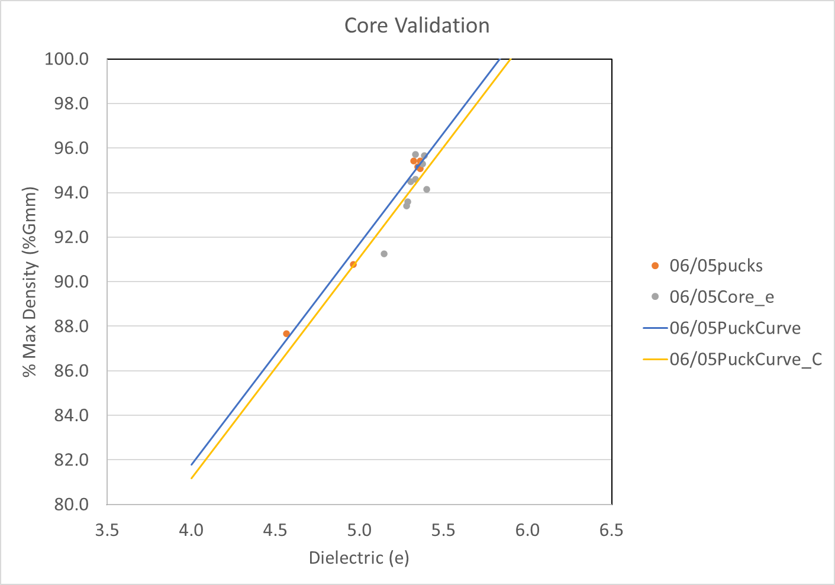
Core Accuracy Checks:
Ensure Predicted %Gmm based on production mix pucks matches actual core measured

Slide 7
Daily Checks Necessary for DPS Use in Compaction Assessment
Sensors unbiased and operating properly
E to %Gmm conversion is good for this specific mix
If these check out continuous %Gmm analysis can be performed!
Example Project Managing this Data

Slide 8
Thank you again!
Kyle Hoegh
kyle.hoegh@state.mn.us
507-398-2669

