Slide 1
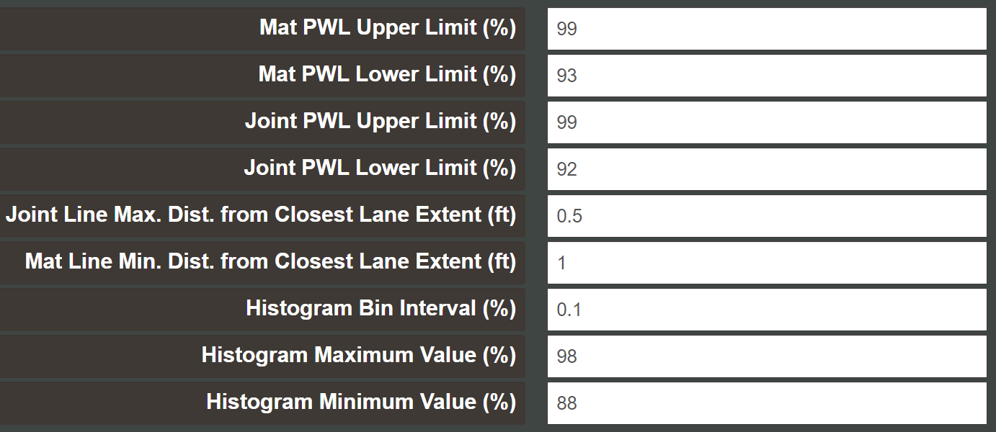
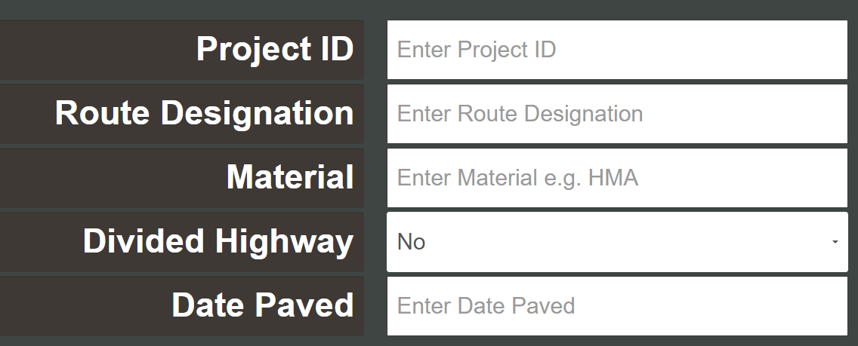

Project Information:
Ex: 052221 TH21-HMA-L1-12L-CL
Joint/Mat % conforming
Lane Extents

Slide 2
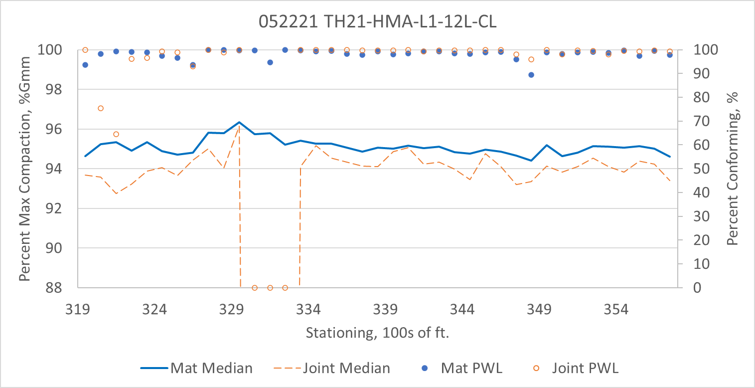
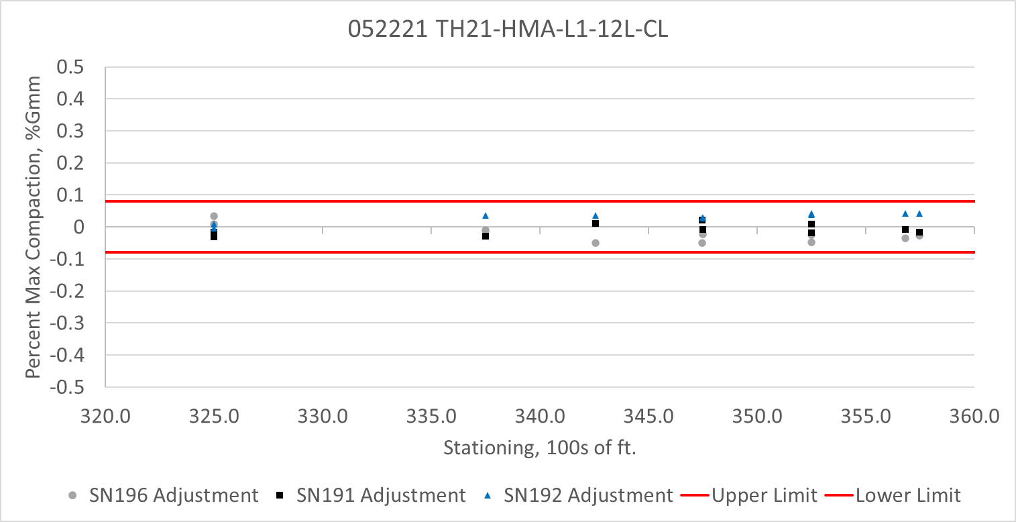
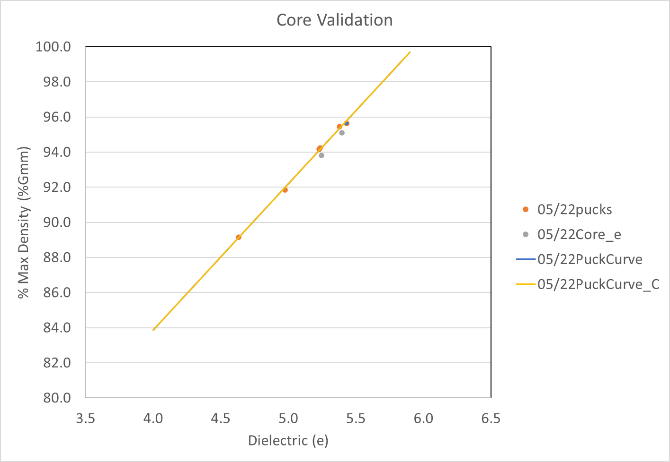
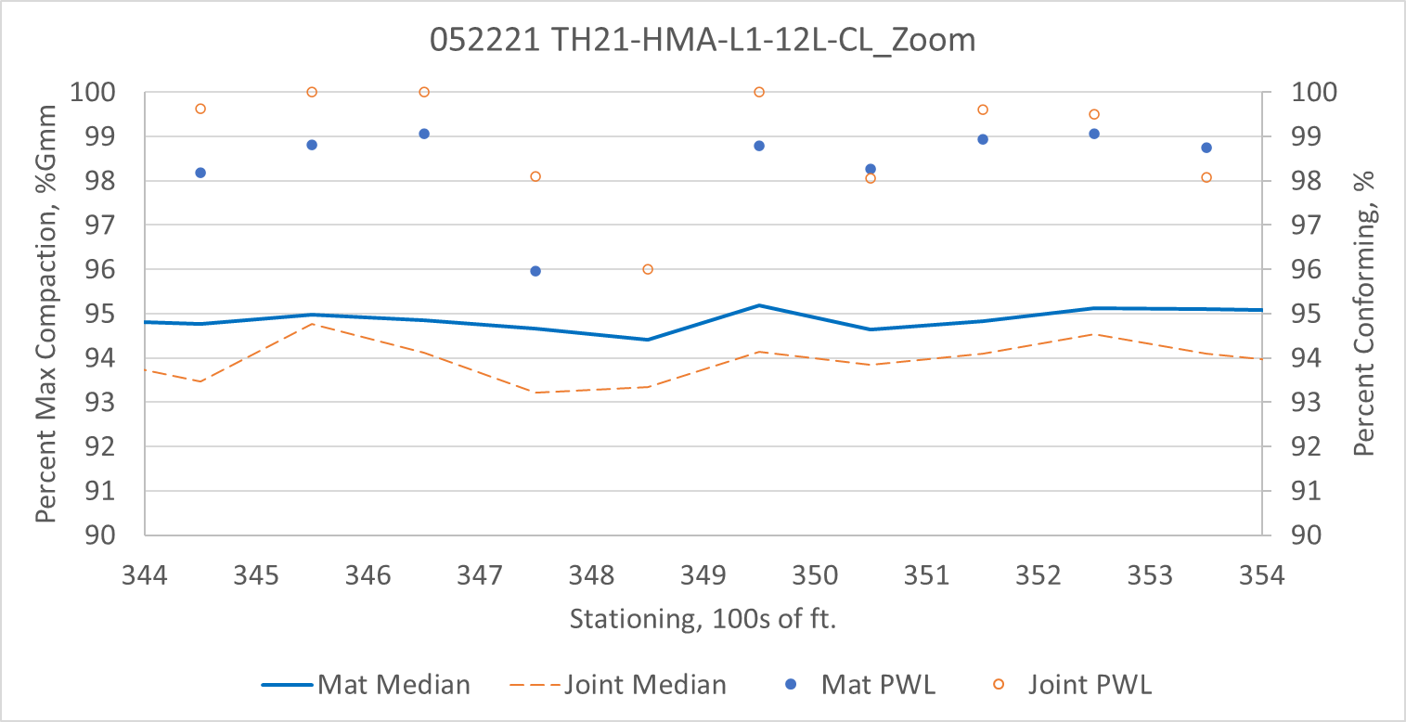
052221 TH21-HMA-L1-12L-CL
Summary Results
Sensor Check
Summary Results – Area of Interest

Slide 3
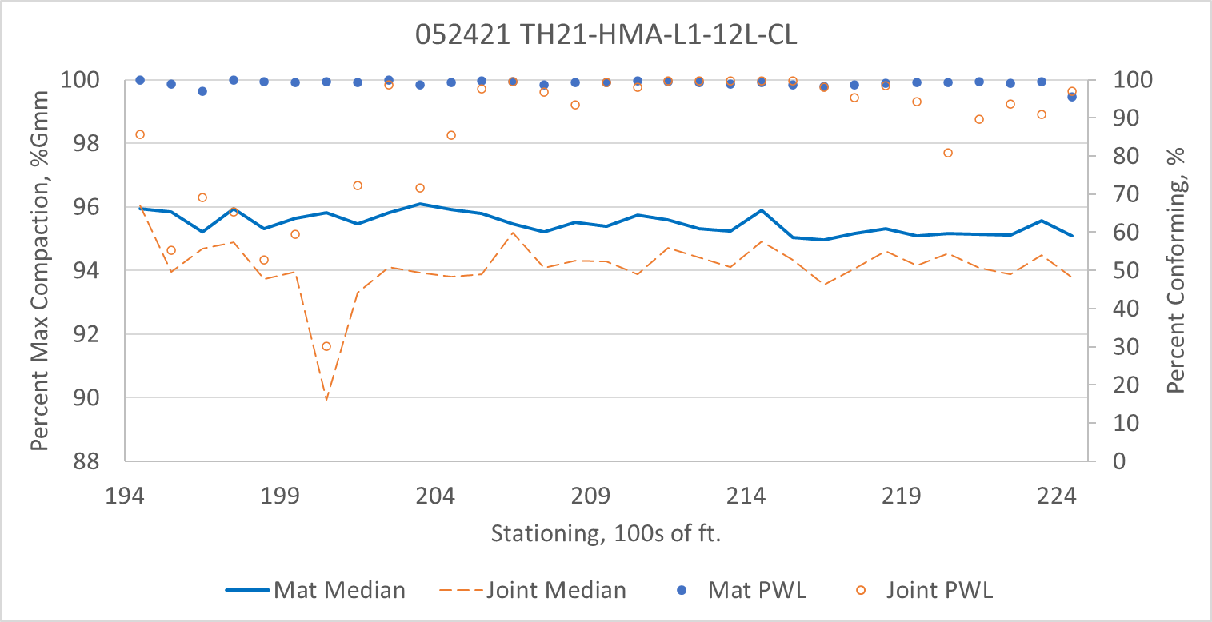
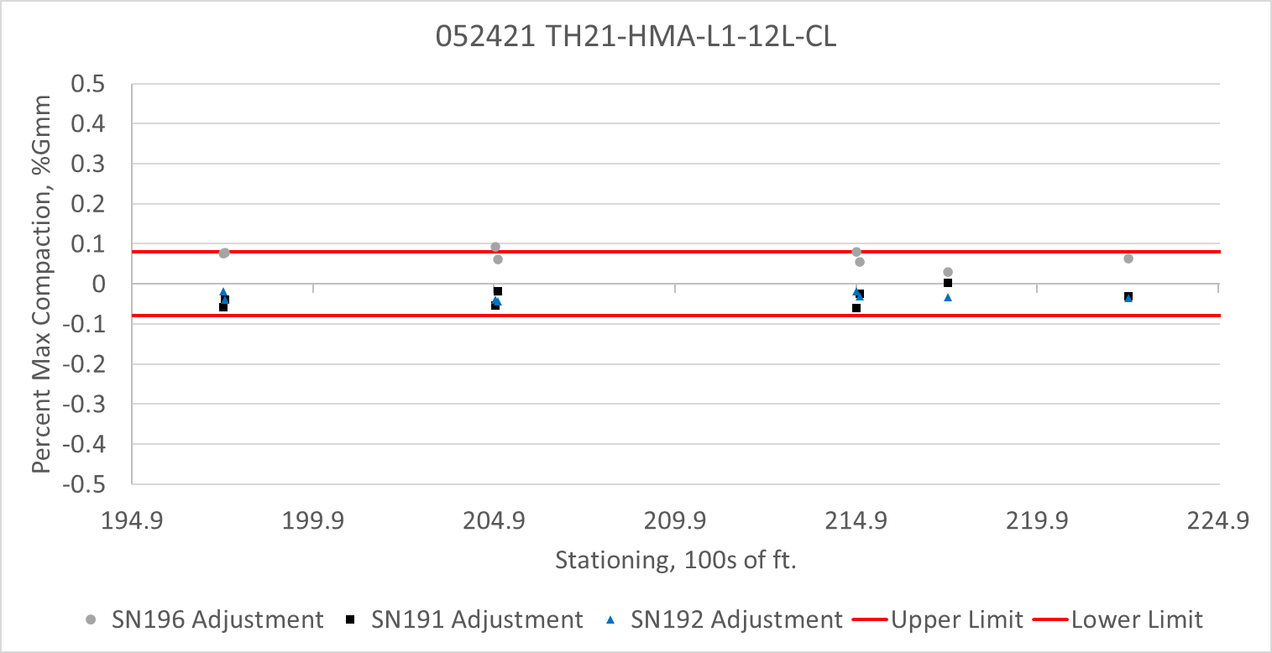
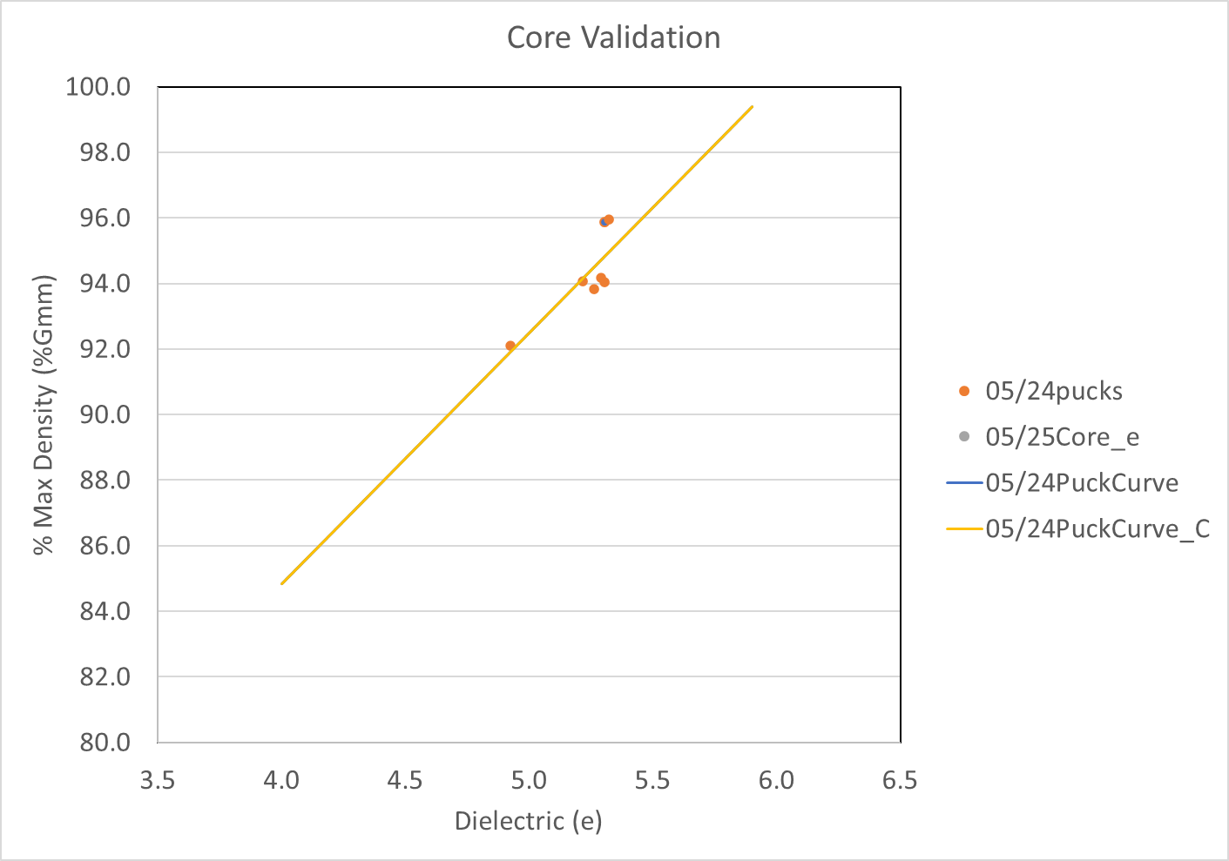
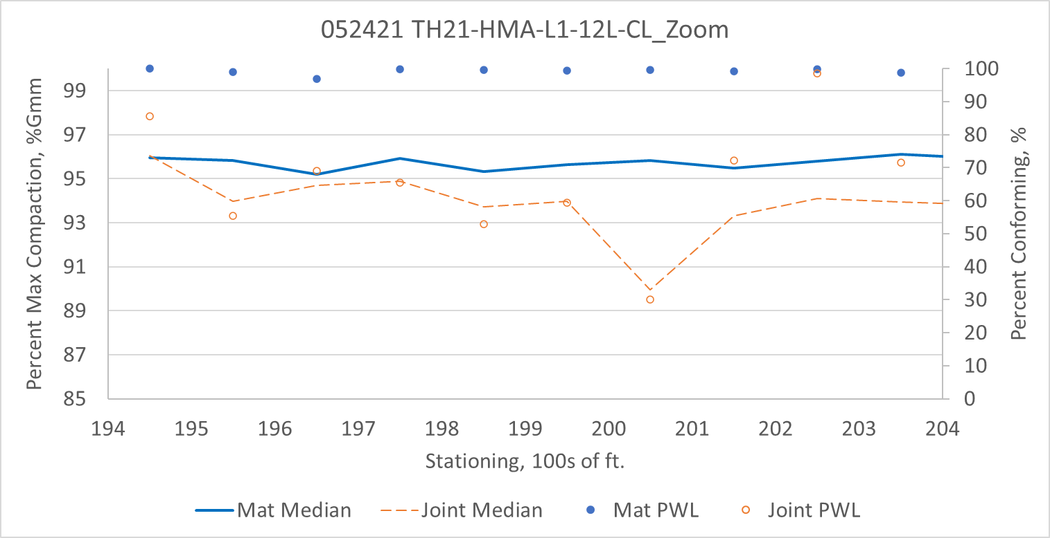
052421 TH21-HMA-L1-12L-CL
Summary Results
Sensor Check
Summary Results – Area of Interest

Slide 4
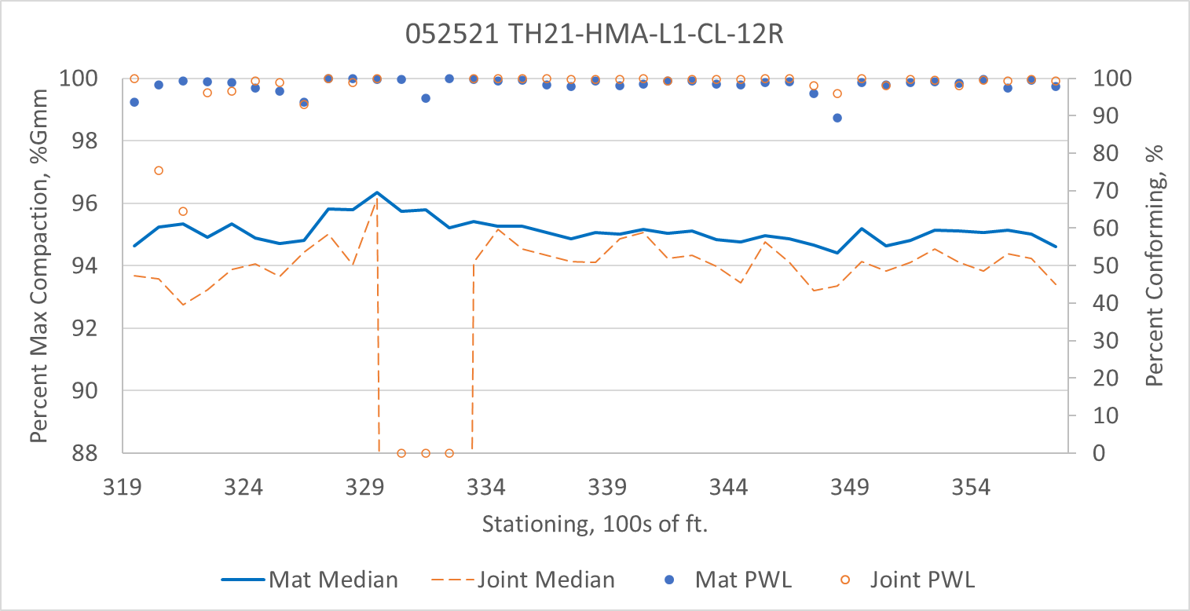
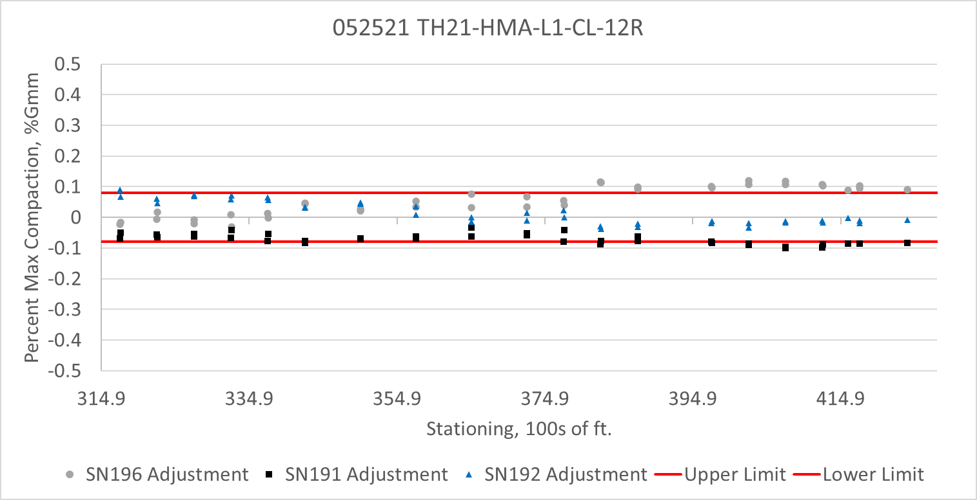
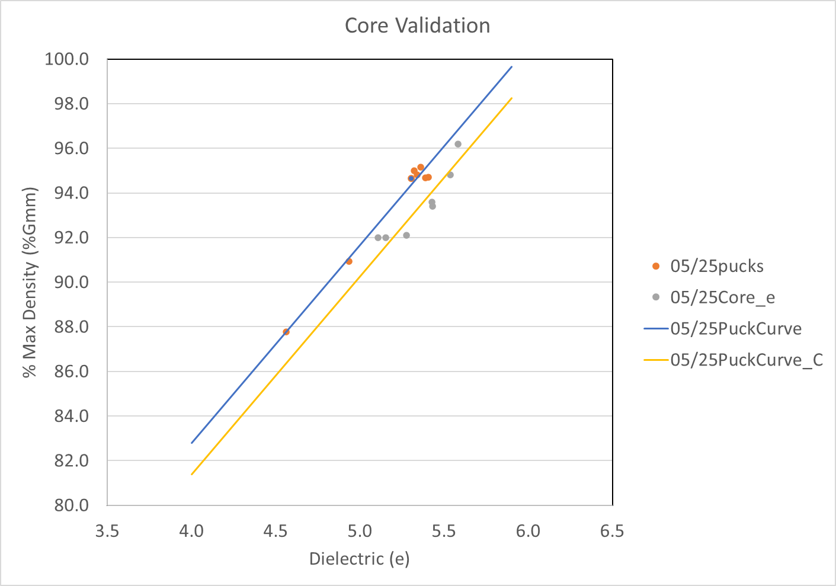

052521 TH21-HMA-L1-CL-12R
Summary Results
Sensor Check
Summary Results – Area of Interest

Slide 5
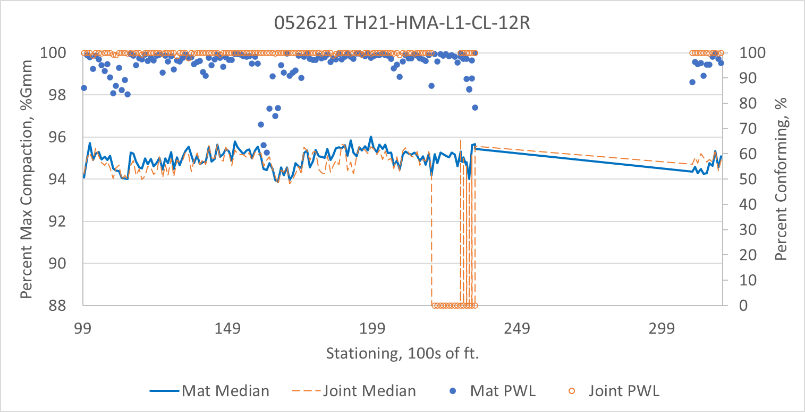
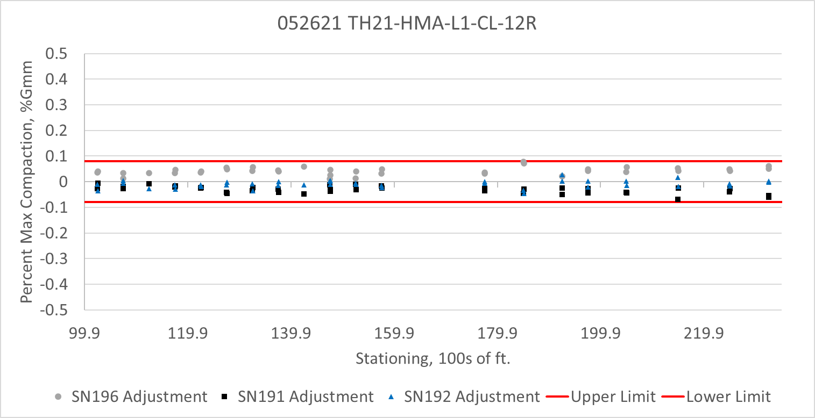
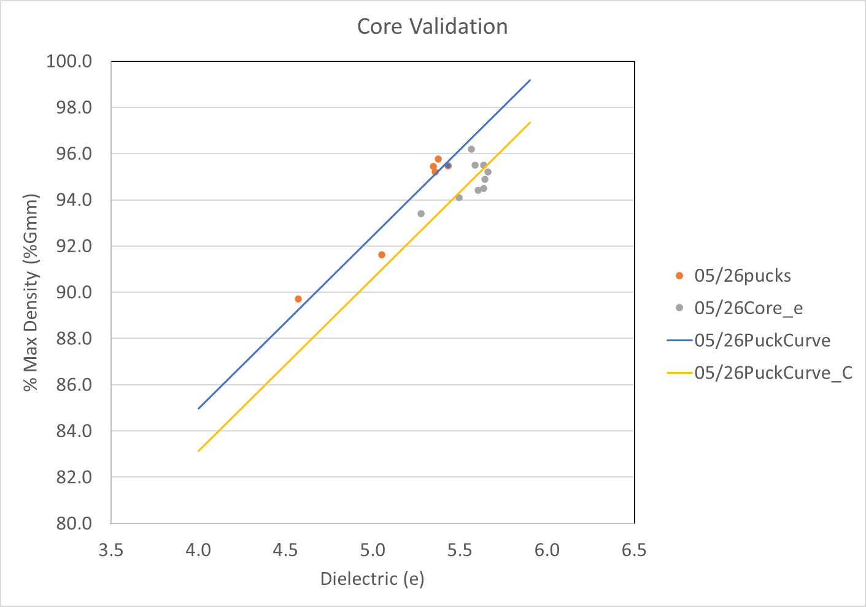
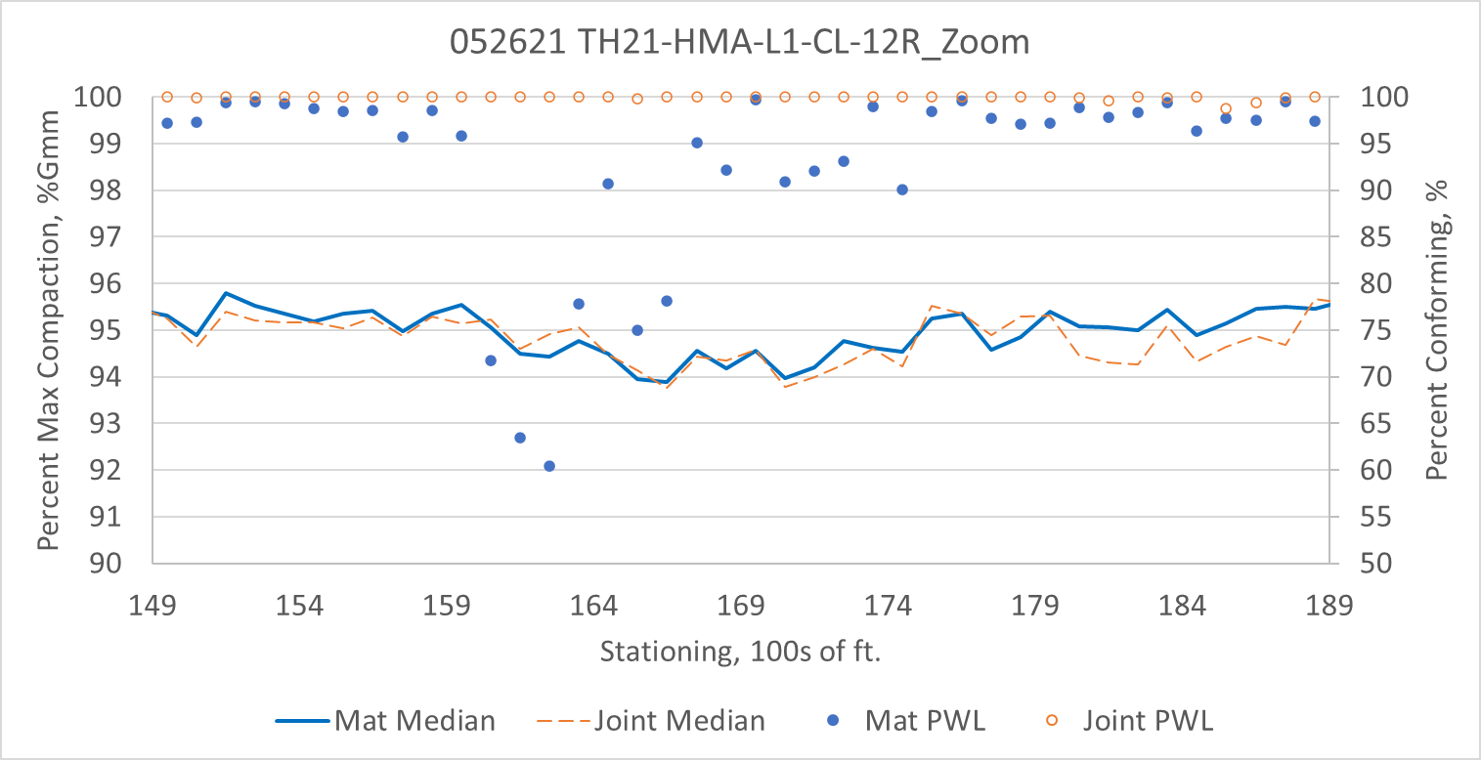
052621 TH21-HMA-L1-CL-12R
Summary Results
Sensor Check
Summary Results – Area of Interest

Slide 6
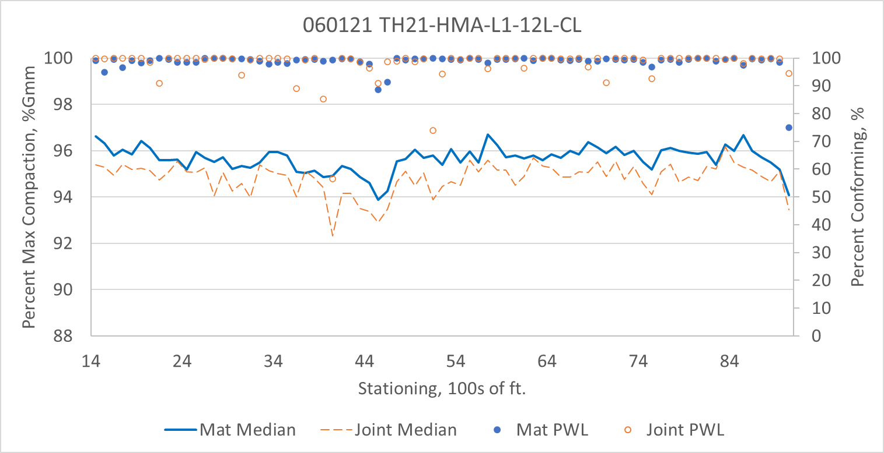
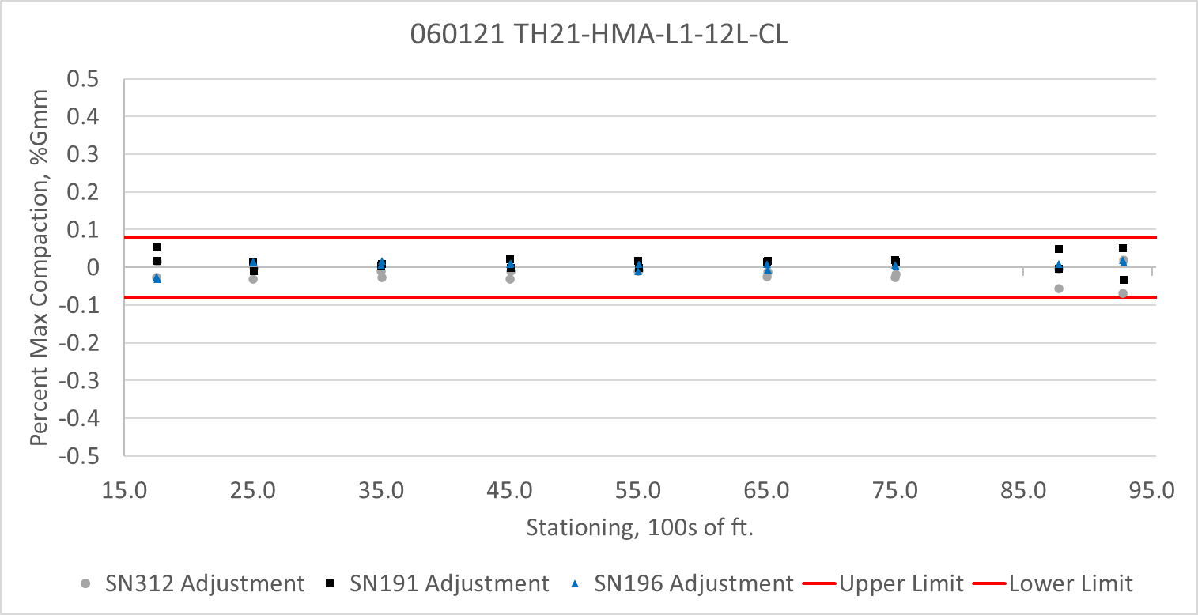
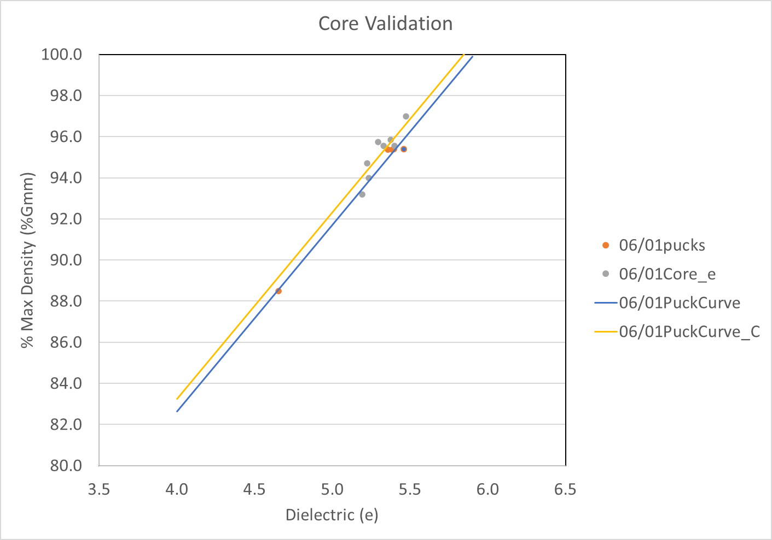
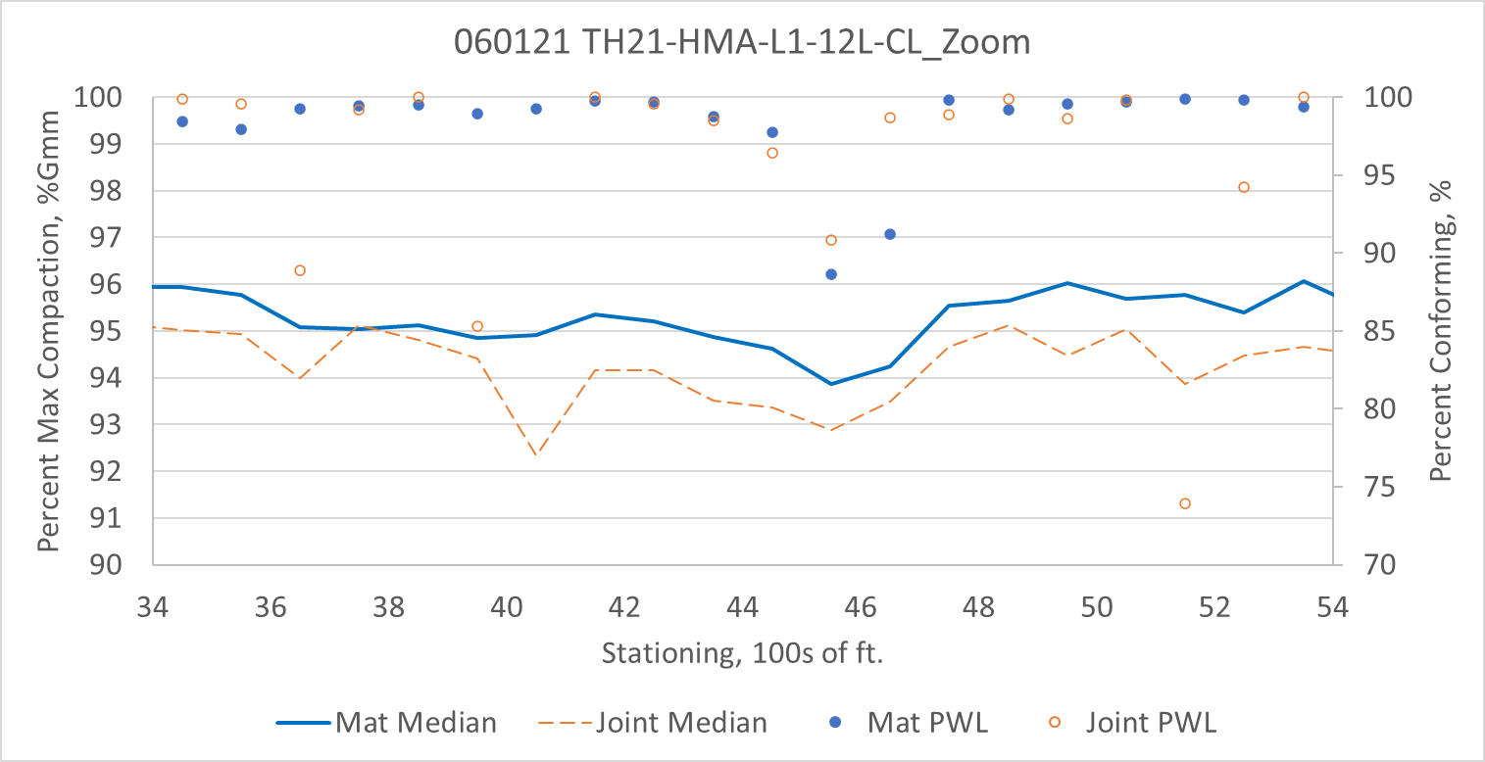
060121 TH21-HMA-L1-12L-CL
Summary Results
Sensor Check
Summary Results – Area of Interest

Slide 7
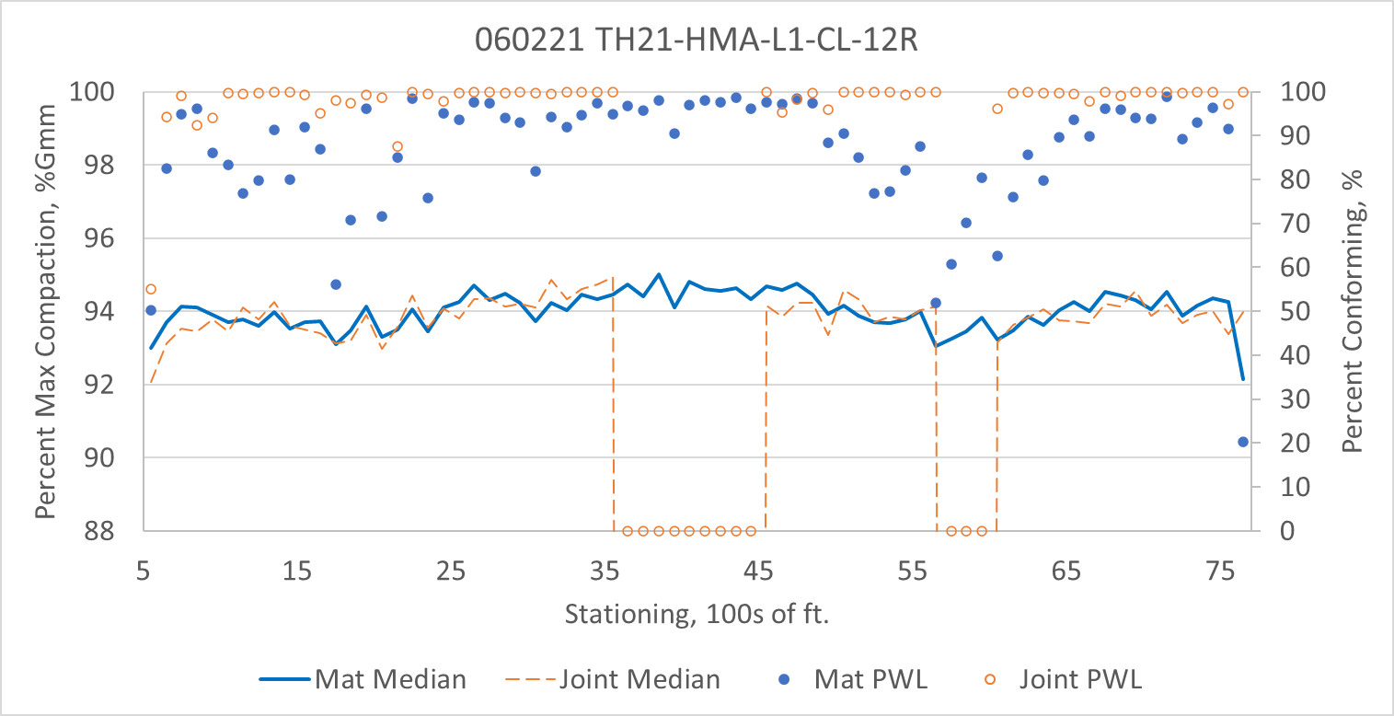
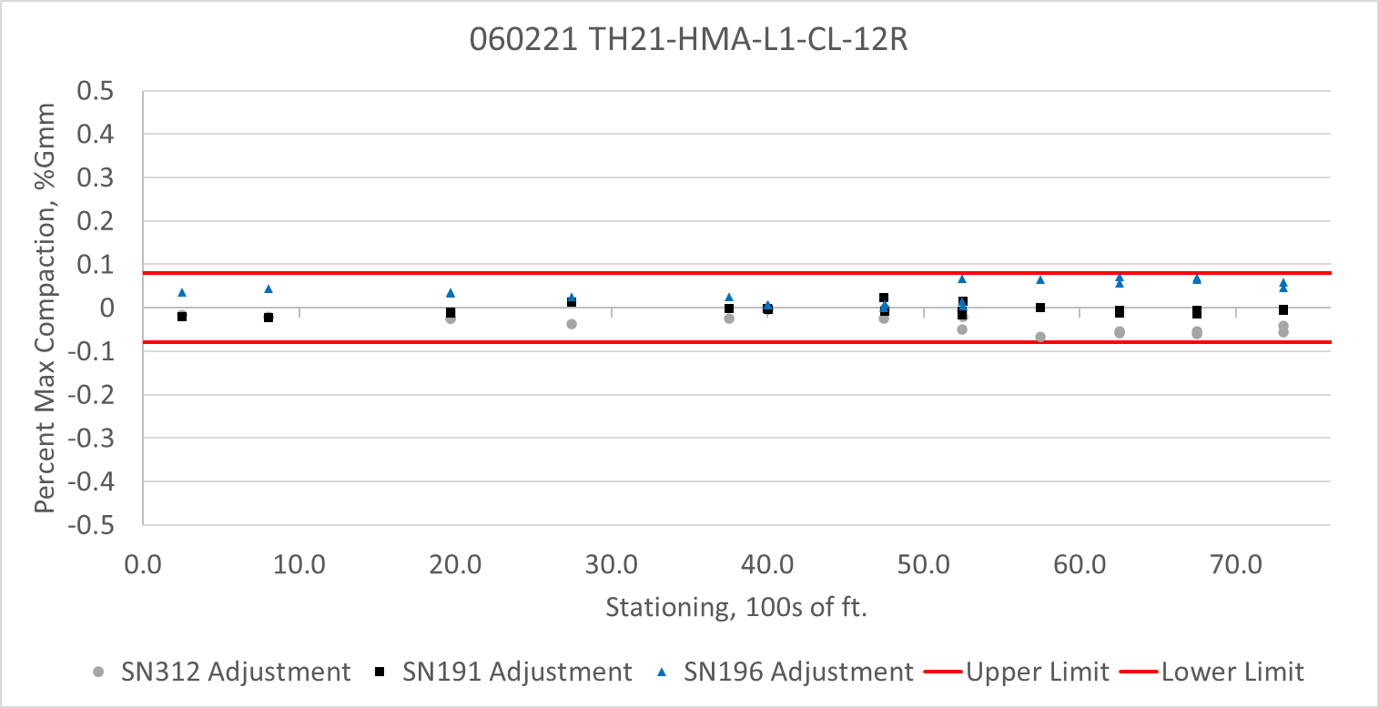
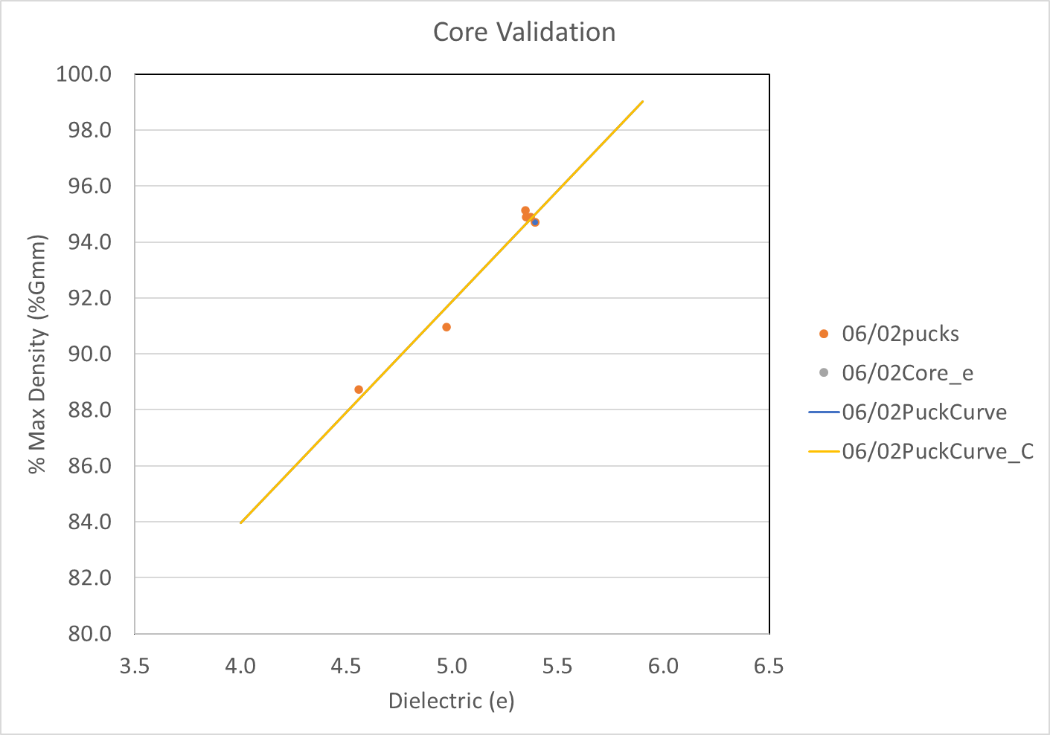
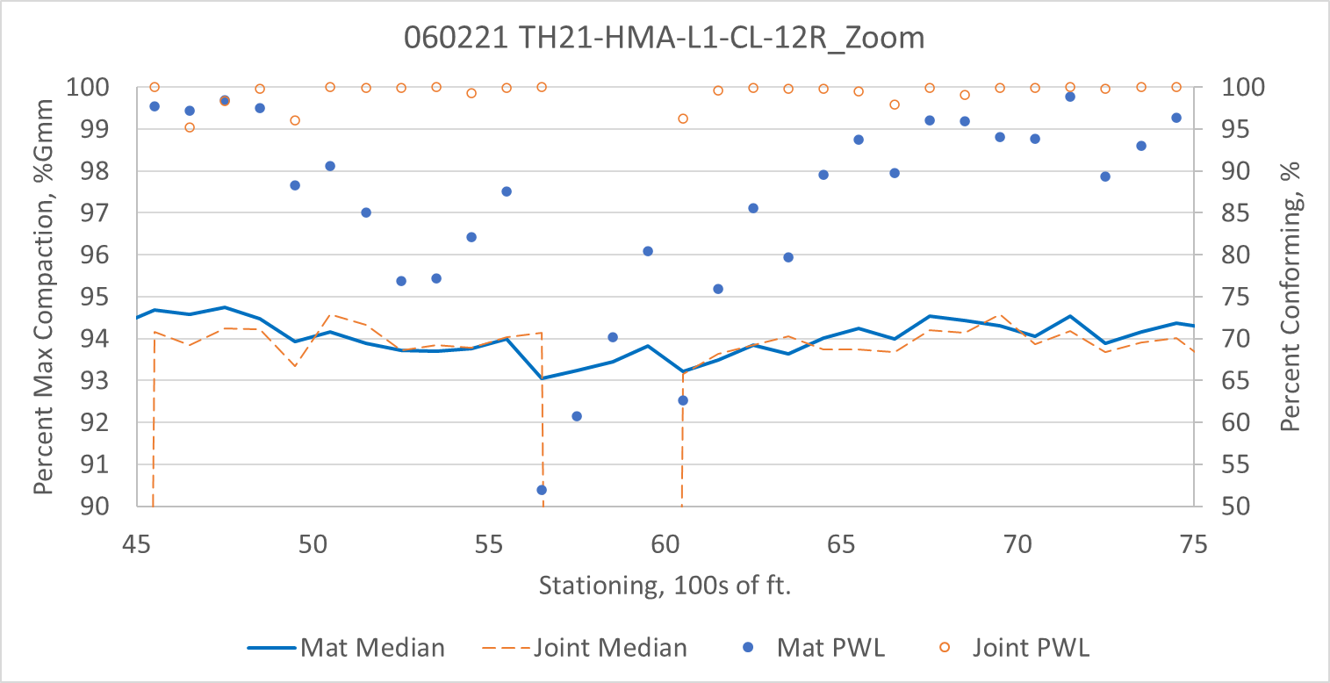
060221 TH21-HMA-L1-CL-12R
Summary Results
Sensor Check
Summary Results – Area of Interest

Slide 8
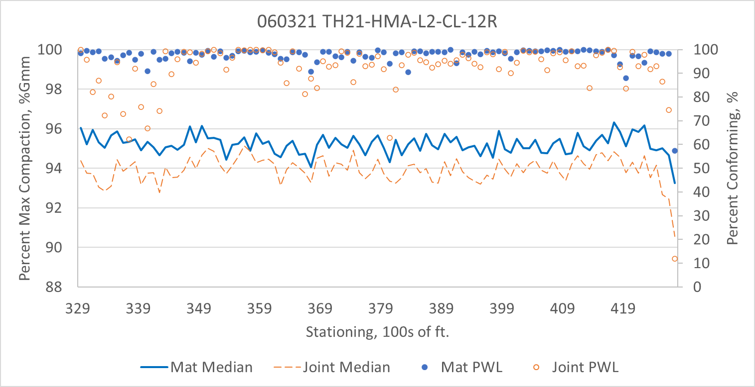
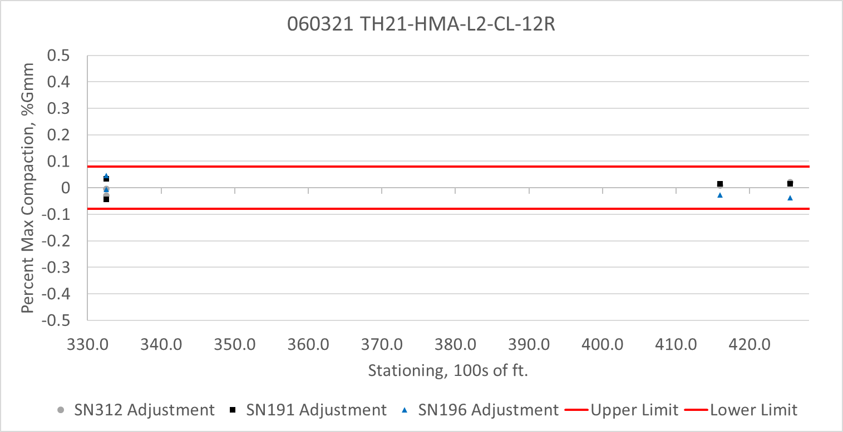
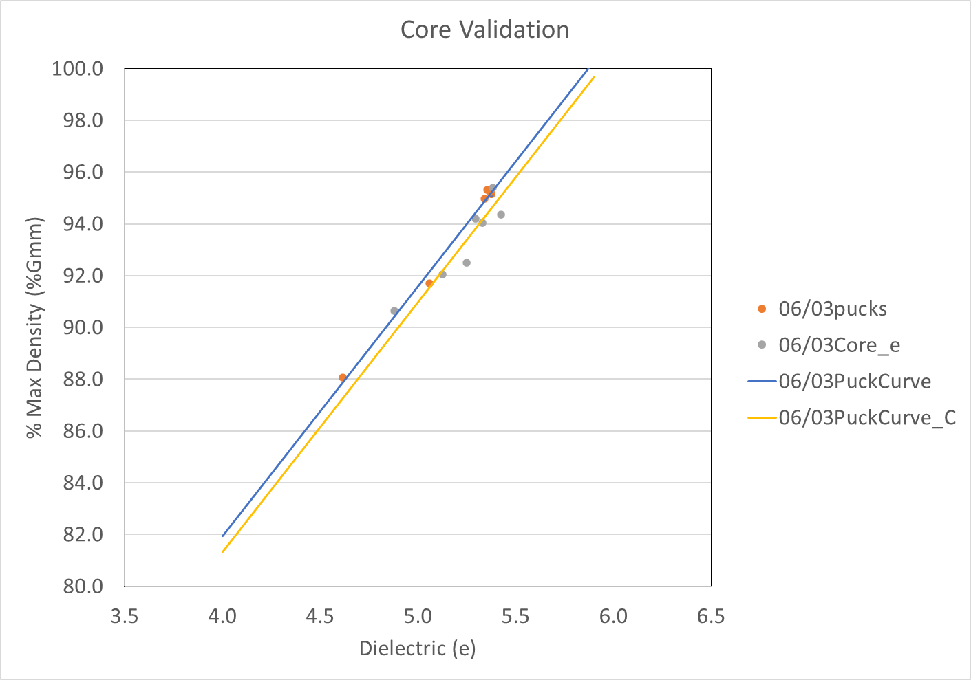
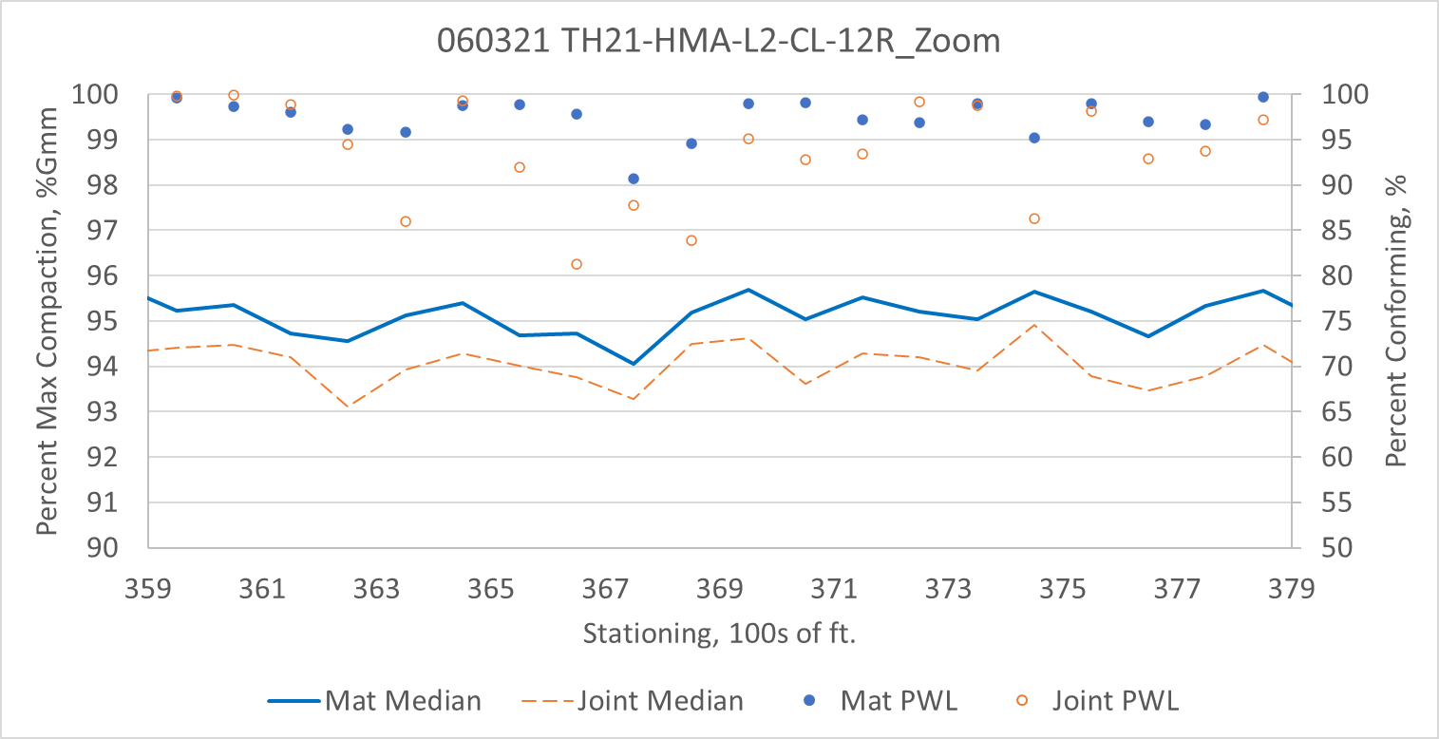
060321 TH21-HMA-L2-CL-12R
Summary Results
Sensor Check
Summary Results – Area of Interest

Slide 9
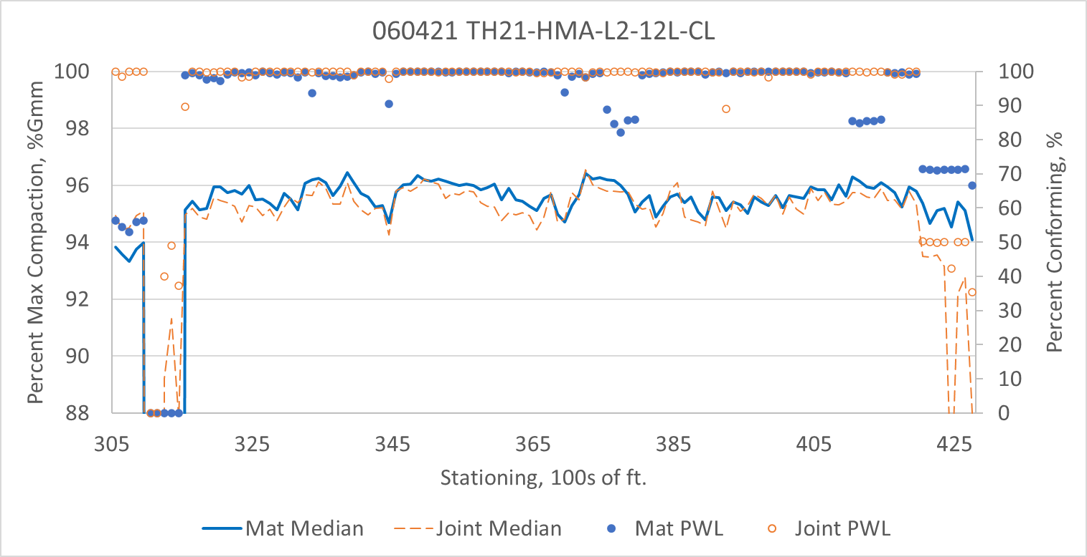
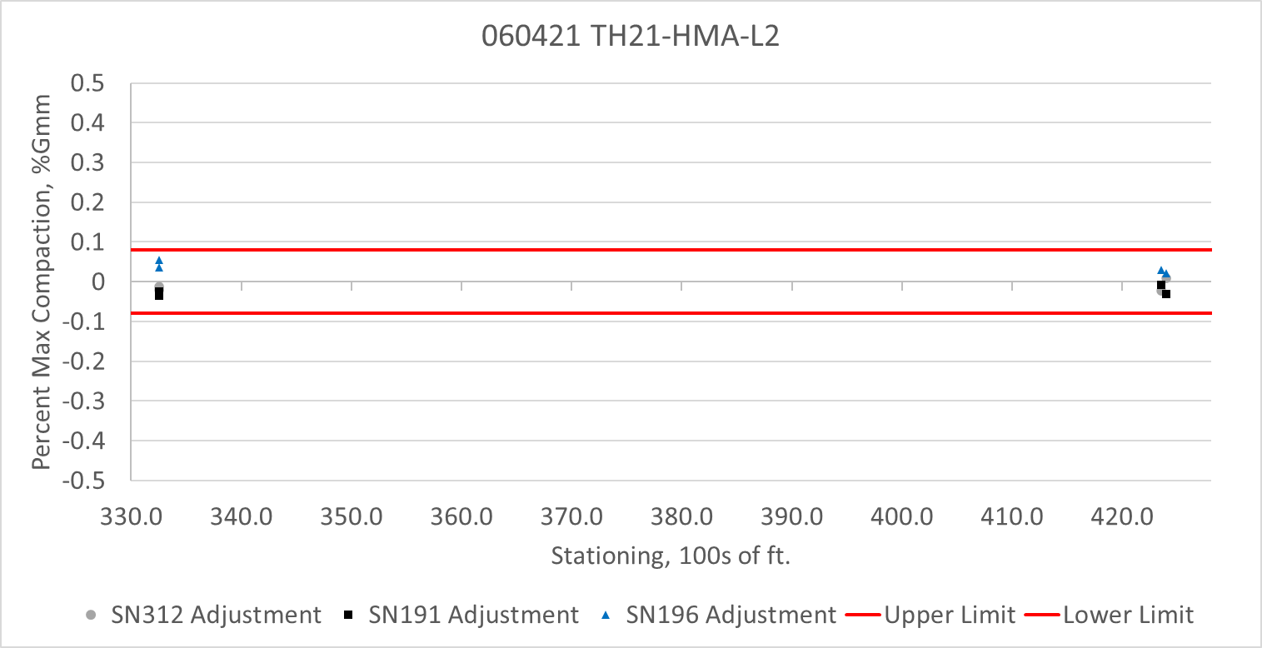
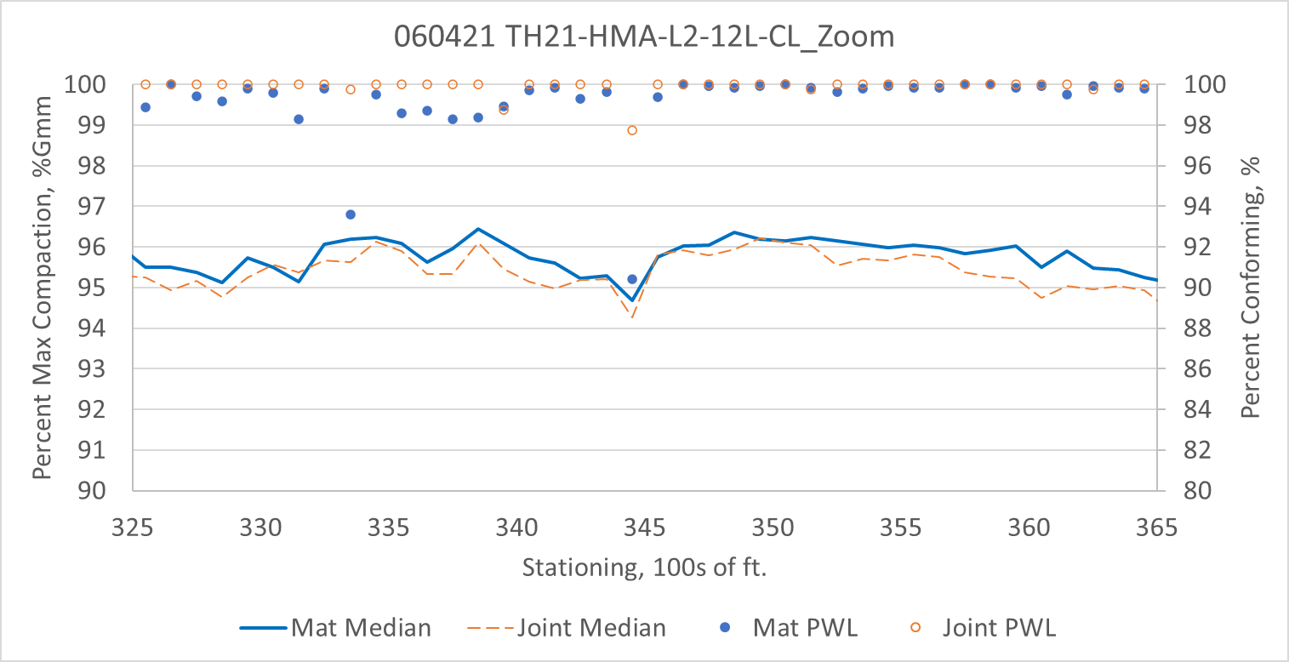
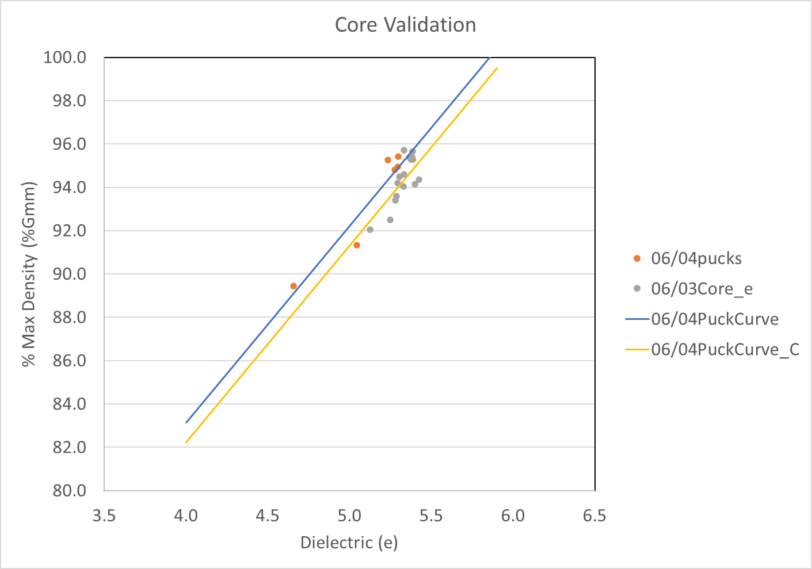
060421 TH21-HMA-L2-12L-CL
Summary Results
Sensor Check
Summary Results – Area of Interest

Slide 10
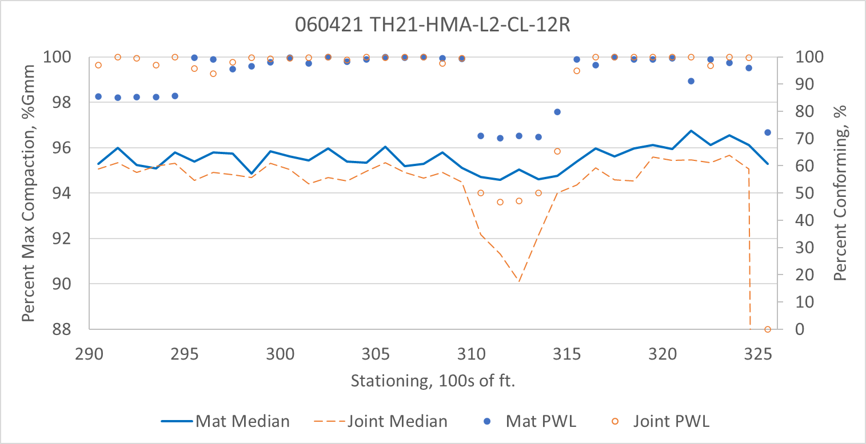
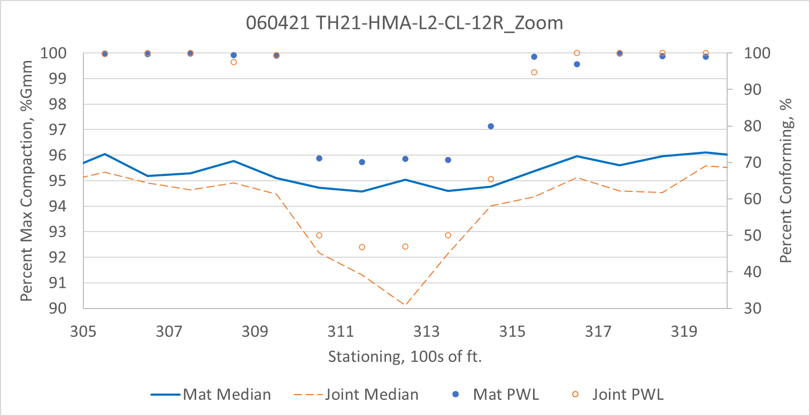
060421 TH21-HMA-L2-CL-12R
Summary Results
Sensor Check
Summary Results – Area of Interest

Slide 11
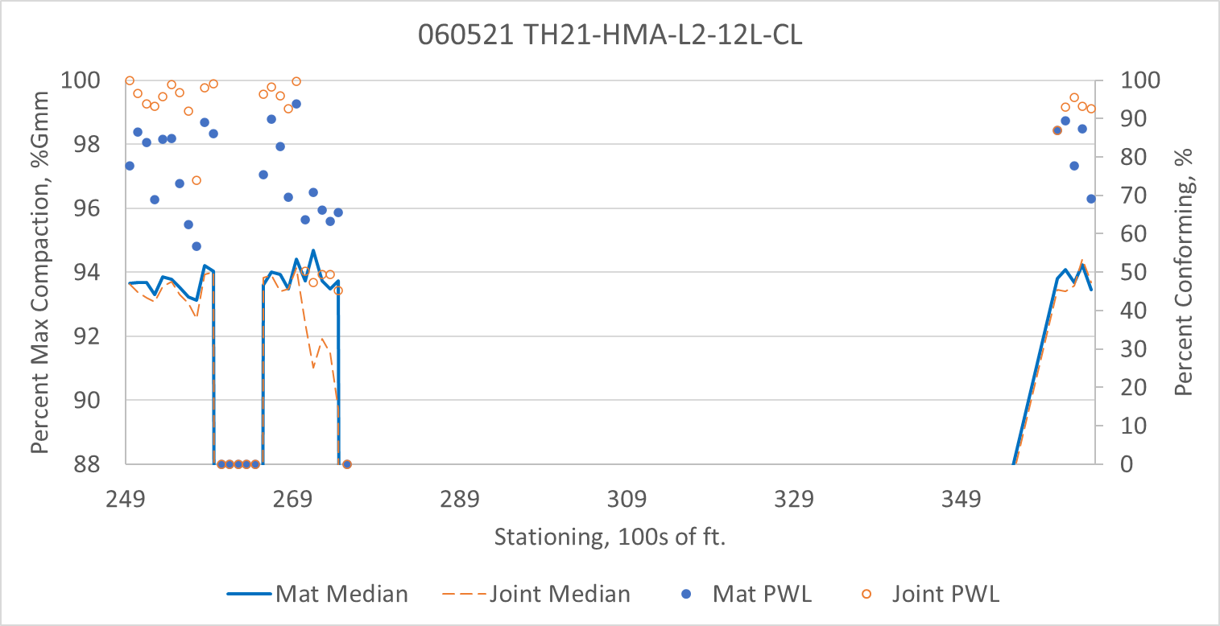
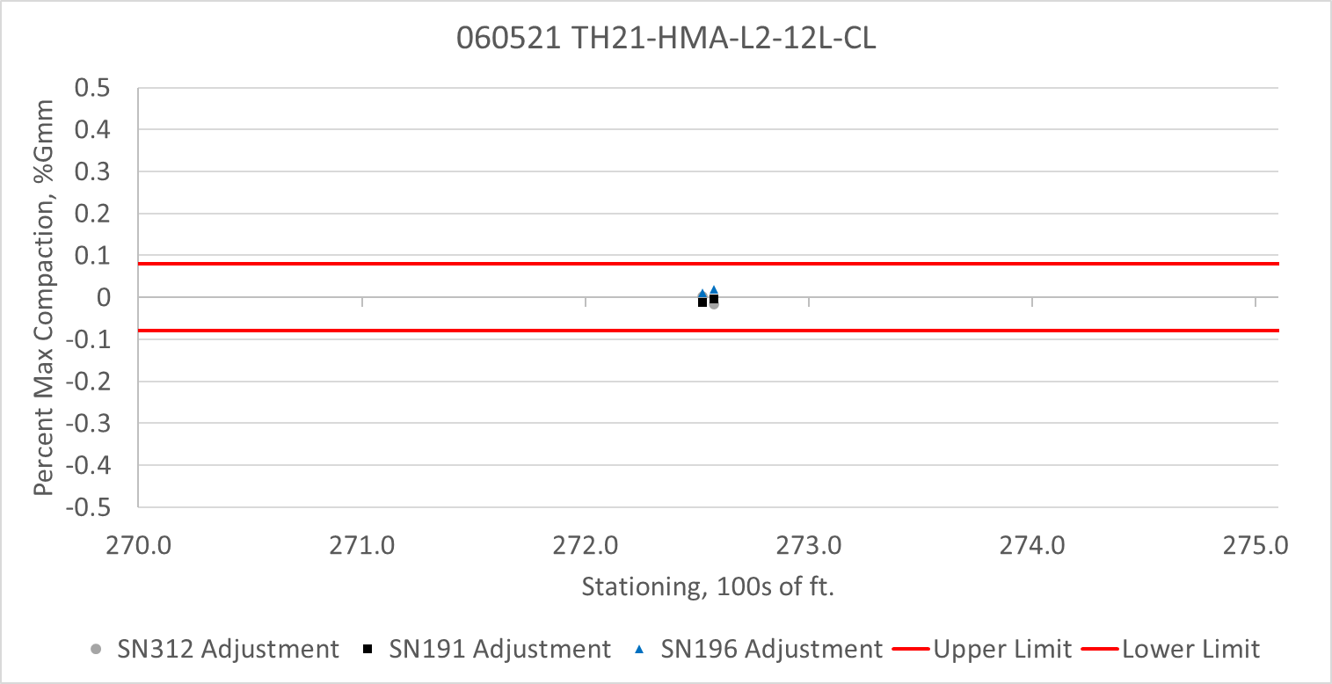

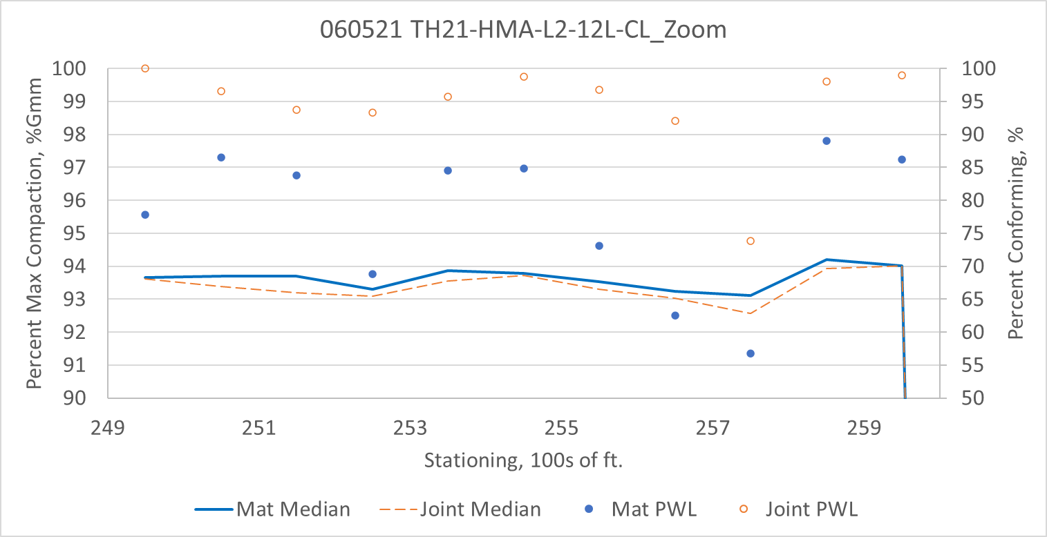
060521 TH21-HMA-L2-12L-CL
Summary Results
Sensor Check
Summary Results – Area of Interest

Slide 12
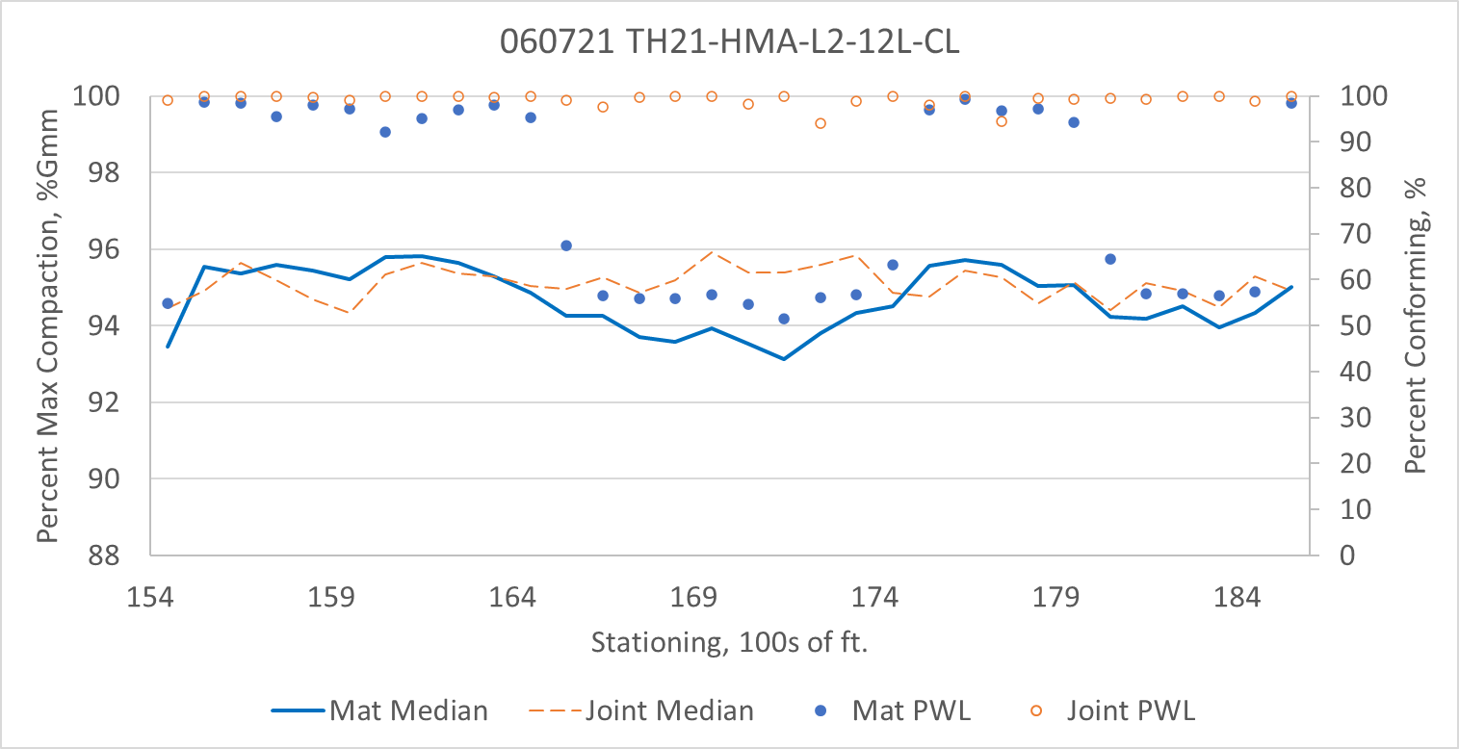
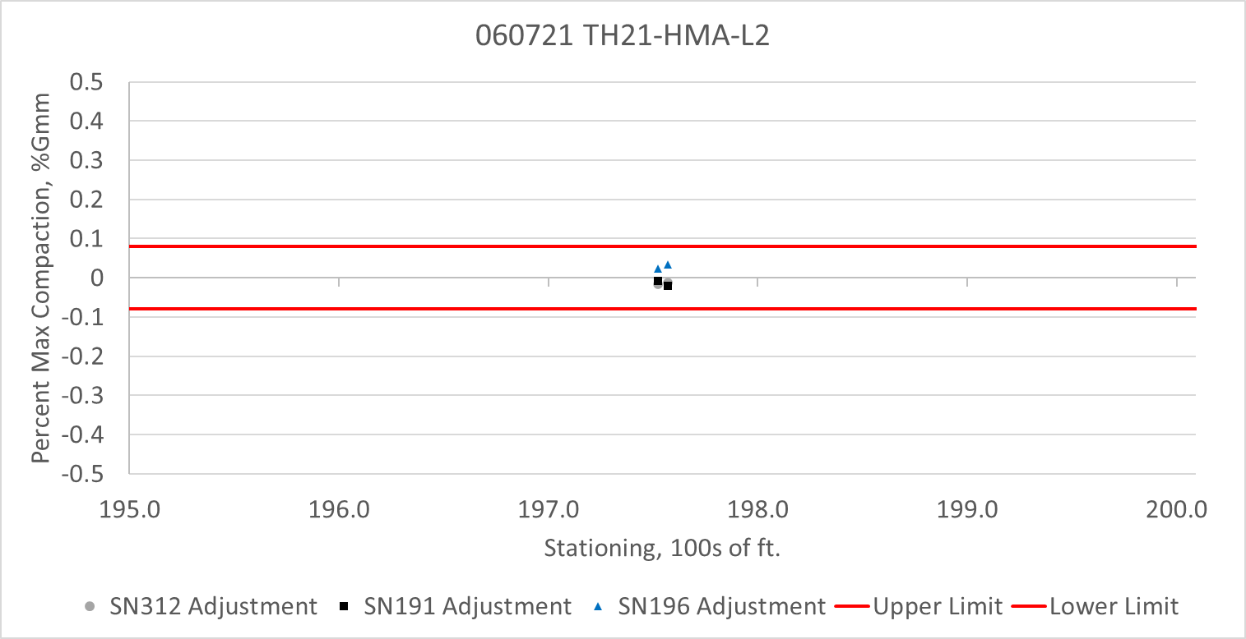
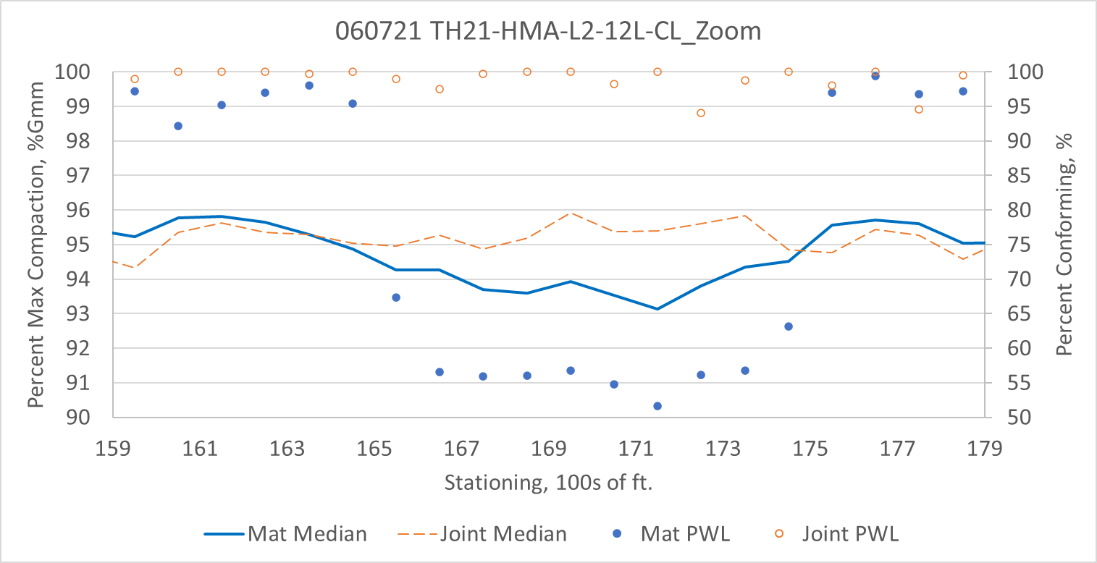
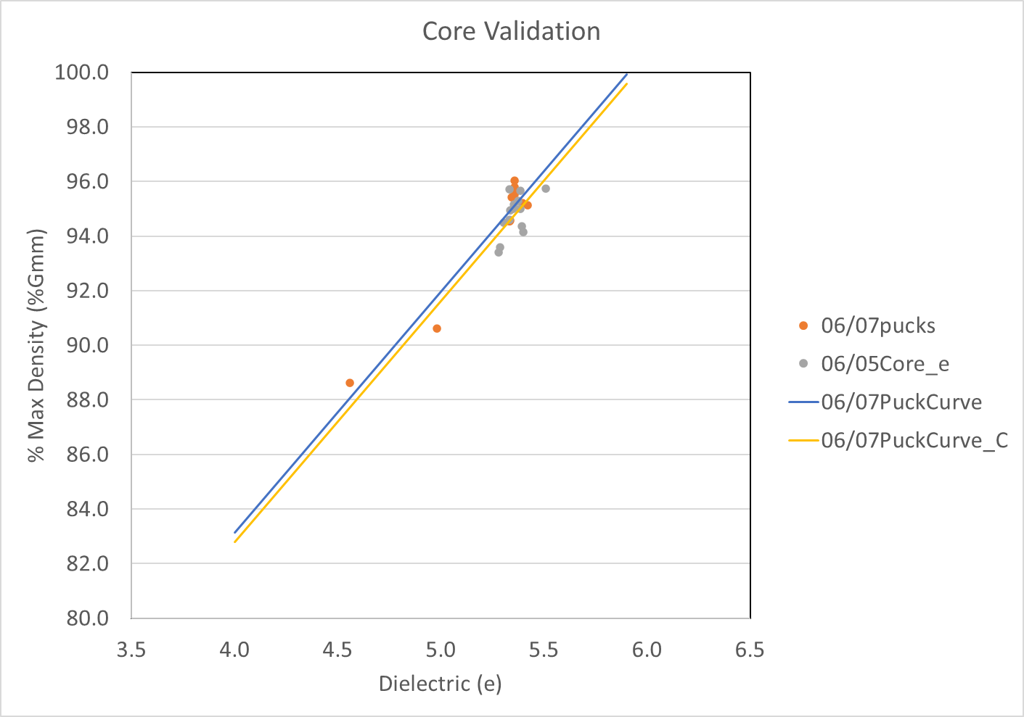
060721 TH21-HMA-L2-12L-CL
Summary Results
Sensor Check
Summary Results – Area of Interest

Slide 13
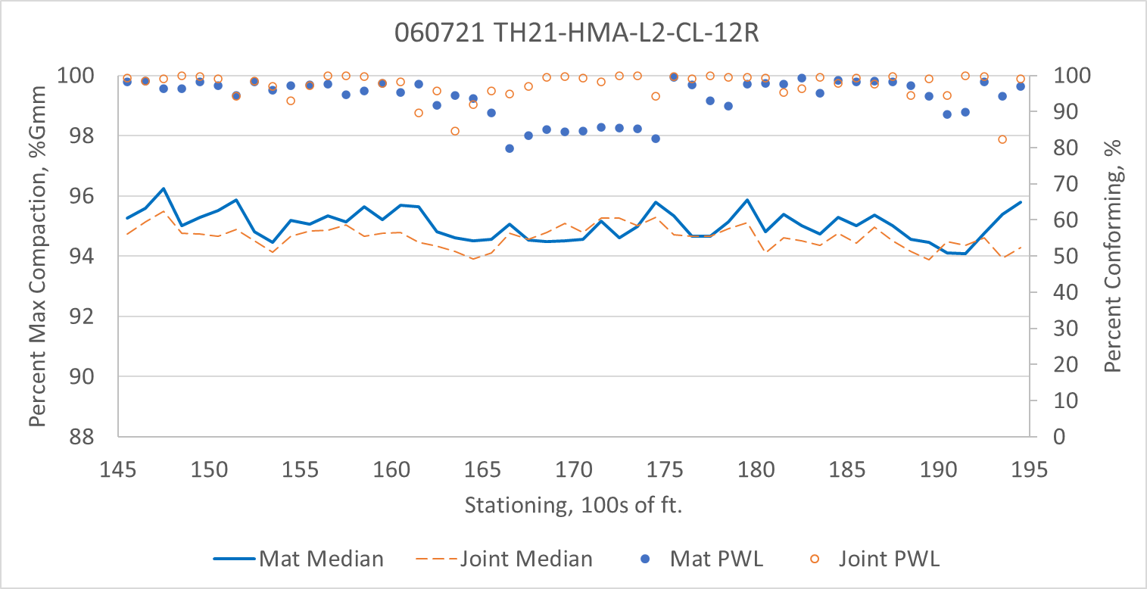
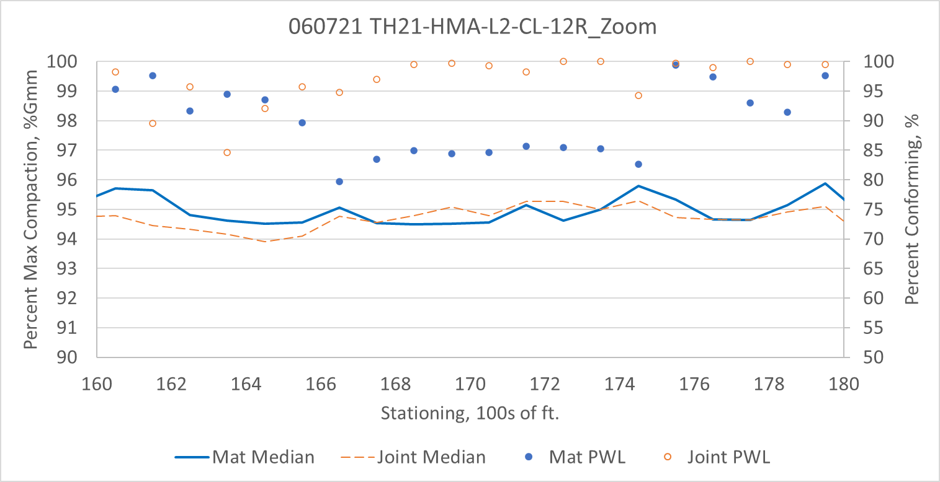
060721 TH21-HMA-L2-CL-12R
Summary Results
Sensor Check
Summary Results – Area of Interest

