Slide 1

Density Profiling System (DPS)—Research Efforts of the FHWA’s Nondestructive Evaluation (NDE) Lab
Hoda Azari, Ph.D.
NDE Program Manager
Federal Highway Administration (FHWA)
November 9, 2021
Density Profiling System “Virtual” User Group Peer Exchange
© 2011 Thomas Northcut / iStock.

Slide 2
Summary of Activities
Laboratory Assessment
Field Testing
Data Analysis
Meetings
Studied the effect of environmental conditions on measuring the dielectric constant of puck samples.
Investigated the potential source of bias between lab- and field-based calibration curves.
Attended 3 d of field testing in Maryland.
Provided the Eastern Federal Lands Highway Division with a report on the field measurements.
Looked into various Global Positioning Systems (GPS) for the PaveScan RDM 2.0 machine (particularly important for curvy roads).
Proposed a calibration model (Pearce model).
Compared the performance of various calibration curves.
Performed bias analysis using the model cross-validation technique.
Participated in several meetings and webinars to promote the DPS technology.
Held monthly peer exchange meetings with the Minnesota Department of Transportation (MnDOT).

Slide 3

Laboratory Assessment
Source: FHWA.

Slide 4
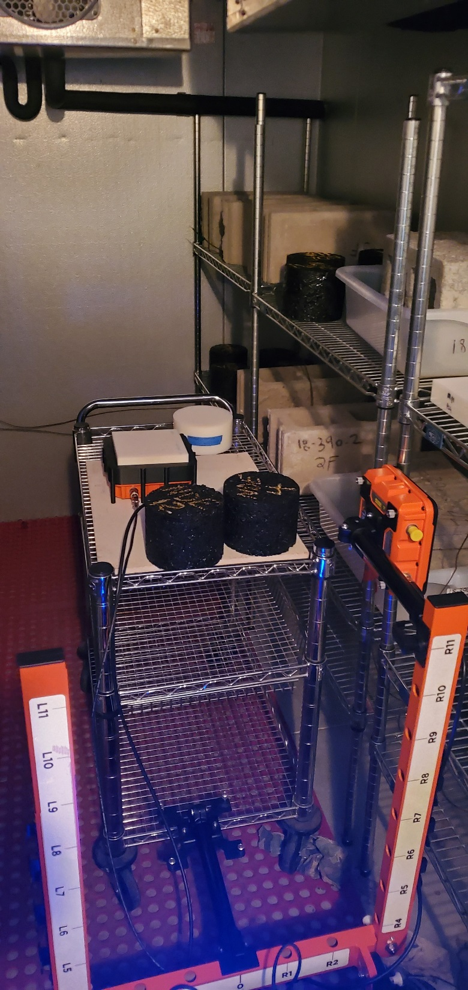
Investigating the Effect of Temperature on the DPS Results
  Exposing puck samples to high temperatures
  using an environmental chamber.
  Investigating the temperature effects on puck
  samples and the PaveScan RDM 2.0 machine.
  Remeasuring sample height after temperature changes is crucial.
  The results demonstrated that temperature does not play a significant role in the dielectric measurements of puck samples.
Source: FHWA.
Samples and PaveScan RDM 2.0 placed in an environmental chamber.

Slide 5
Investigating the Effect of Temperature on the DPS Results
Literature:
The dielectric constant of hot mix asphalt (HMA) slightly increases with temperature.
The maximum change in the dielectric constant of HMA varies between 0.08 and 0.2 as temperature increases from
75 ℉ to 200 ℉.
-Results at 100 ℉
The RDM exposed to the high temperature
Lab temperature
Source: FHWA.
The maximum increase in dielectric is 0.08
(within the AASHTO PP 98 requirements).

Slide 6
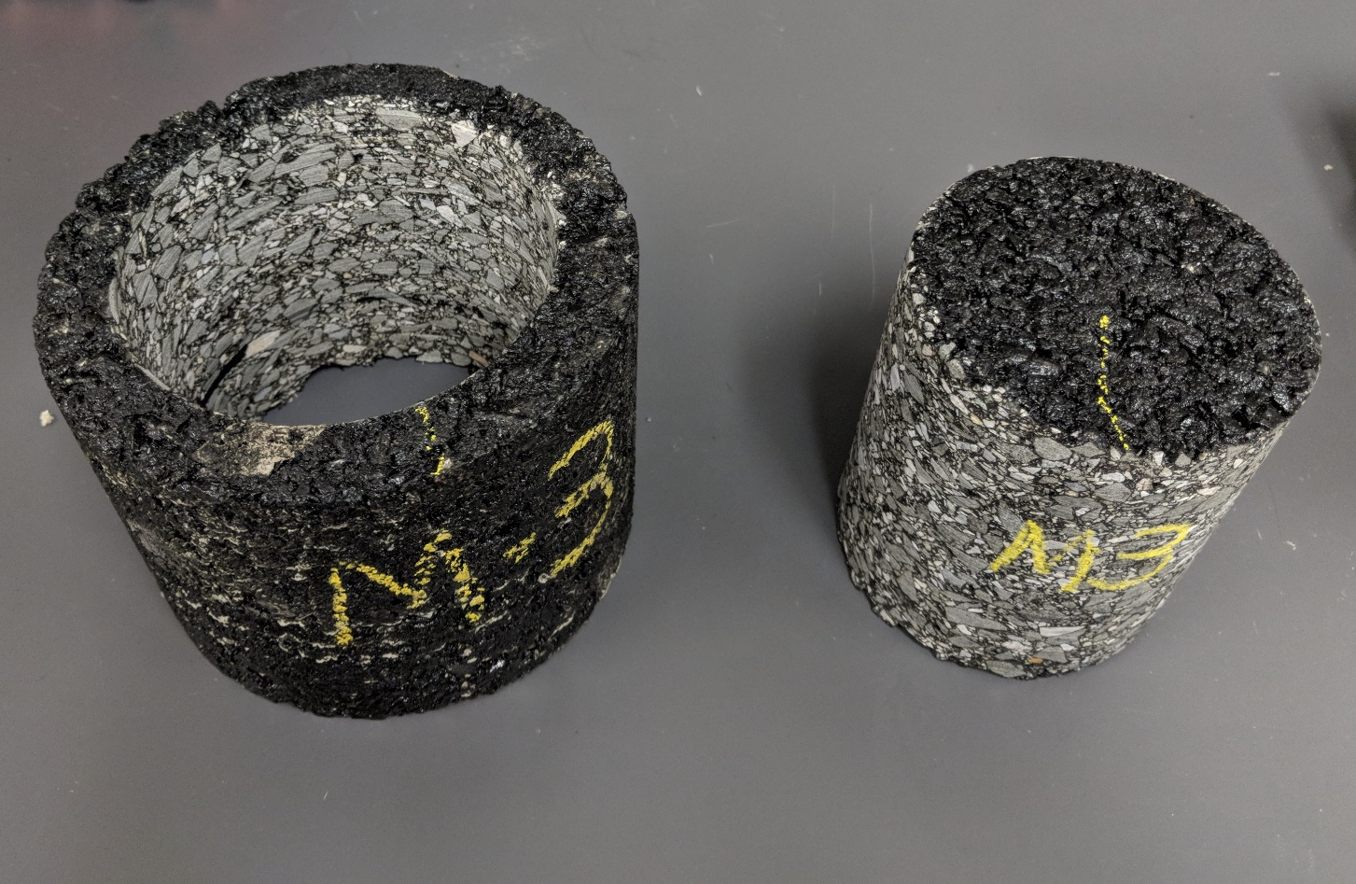
Investigating the Potential Source of Bias Between
Lab- and Field-Based Calibration Curves
Lab-based calibration curves use puck samples, while field-based calibration curves use core samples.
  Puck samples tend to show higher air void content near the edge.
Source: FHWA.
4-inch core taken from a 6-inch puck sample.

Slide 7
Field Testing
Source: FHWA.

Slide 8
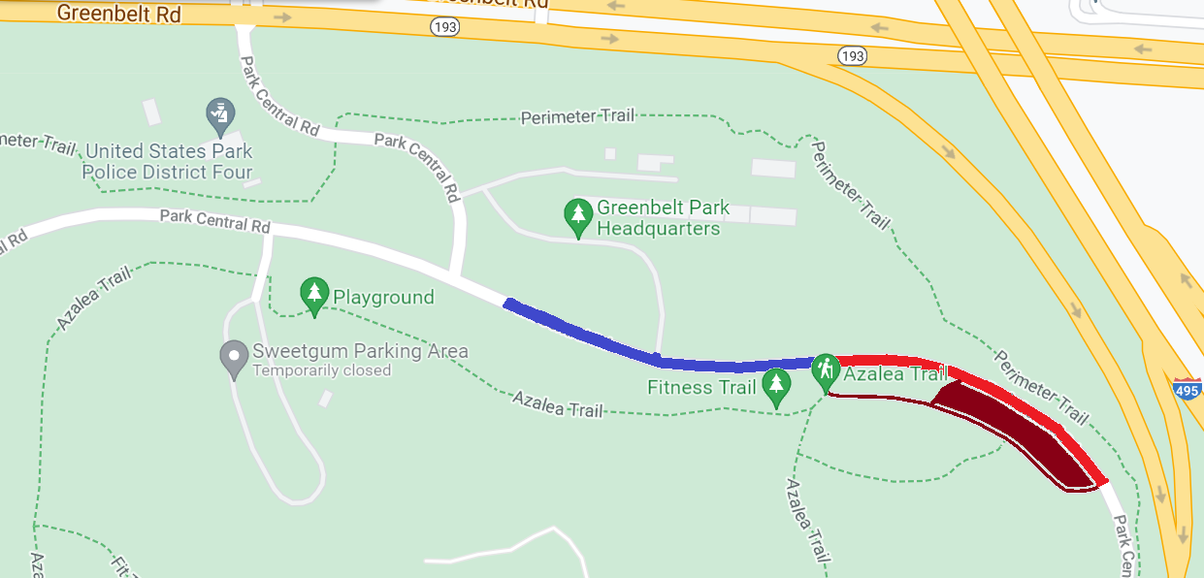
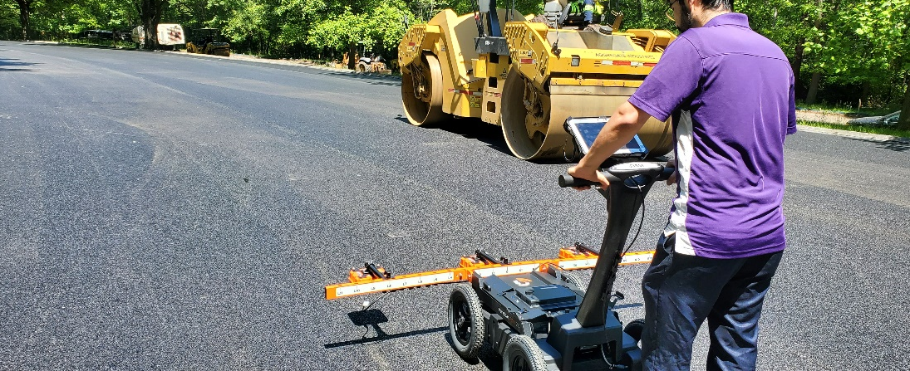
Field Testing
Sub lot 3
Used the following DPS field testing procedures:
  Pre- and post-paving protocol.
  Field dielectric sensor quality assurance protocol.
  Field routine collection protocol.
Fabricated puck samples using plant-mixed materials collected from the back of the finisher on each day of paving.
Developed the calibration curve using laboratory samples.
Prevented mapping the HMA compaction on scanned roads because the PaveScan RDM 2.0 was not equipped with GPS during this.
Sub lot 2
Sublot 1 (Holly picnic)
Source: FHWA.
Locations of field testing.
Source: FHWA.
DPS field testing using PaveScan RDM 2.0.

Slide 9
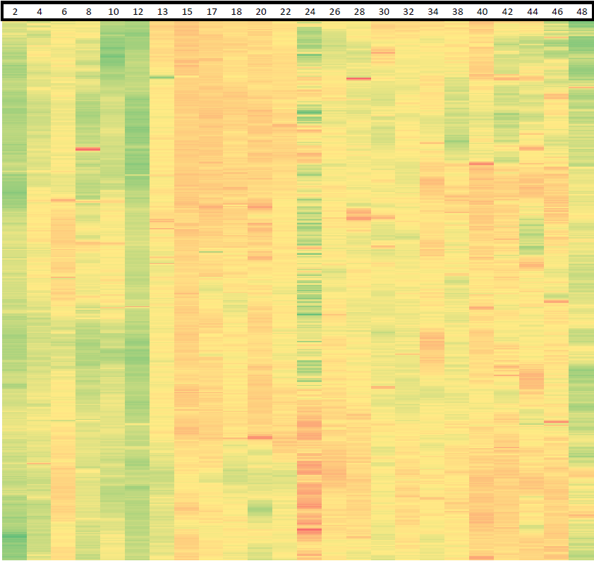

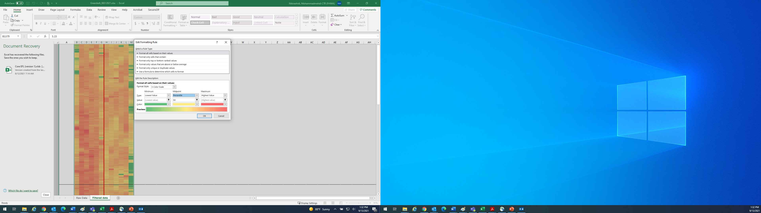
Field Testing
Dielectric
6.8
5.5
4.65
Distance (ft)
0
100
200
300
400
The dielectric of the placed mix in sub lots 1.
Source: FHWA.
Air void contents
0
7.7
14
0
100
200
300
400
Source: FHWA.
Distance (ft)
Calibration model from plant-mixed material samples collected from sub lot 1.
Source: FHWA.
Air void content of HMA in sub lot 1.

Slide 10
Data Analysis
Source: FHWA.

Slide 11
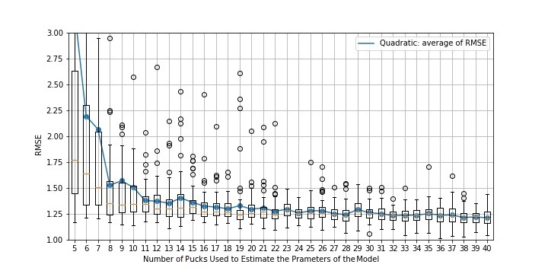
Data Analysis
Compared the performance of different calibration curves on field datasets available in the literature (300-plus core data).
Proposed a new calibration curve (Pearce model) for HMA applications. (Submitted to the International Conference on Bearing Capacity of Roads, Railways, and Airfields 2022.)
Performed bias analysis using the model cross-validation technique.
Source: FHWA.
HD = Hoegh-Dai; RMSE = root mean square deviation; SL = south lane.
Source: FHWA.

Slide 12
Meetings and Webinars
Participated in several meetings and webinars to promote DPS technology (i.e., DPS 101).
Held monthly peer exchange meetings with MnDOT.

Slide 13
Proposed Research Activities
Investigating the impact of aggregate source and aggregate gradation on the dielectric constant of HMA.
Investigating the application of DPS technology for warm mix asphalt, and mixes prepared with recycled materials
Identifying a time window for field measurements to verify contractor data to assure the quality of pavement.
Investigating the precision and bias between DPS units from the same manufacturer, and potentially in the future, between units from different manufacturers

Slide 14
Disclaimer
The U.S. Government does not endorse products or manufacturers. Trademarks or manufacturers’ names appear in this presentation only because they are considered essential to the objective of the presentation. They are included for informational purposes only and are not intended to reflect a preference, approval, or endorsement of any one product or entity.

Slide 15
CONTACT
Hoda Azari , Ph.D.
NDE Lab Manager
Hoda.Azari@dot.gov

