Slide 1

Project Updates
[Pooled Fund: TPF 5(443)]
(Nov 9, 2021)
Shongtao Dai
Kyle Hoegh
Mercedes Maupin
Office of Materials and Road Research
Minnesota Department of Transportation
Mn/DOT
Office of Materials and Road Research

Slide 2
Project Tasks
Task 1: Software and Hardware Improvements
Task 2: Development of AASHTO Data Collection and Analysis Specifications
Task 3: Precision and Bias Statement
Task 4: Equipment and Operator Certification
Task 5: Support Communication
Task 6: Provide Training and Technical Assistance
Task 7: Promote the technology
Notes:
In areas where performance is more critical (i.e. high traffic) higher fracture energy is required to ensure that thermal cracking is very minimal.

Slide 3
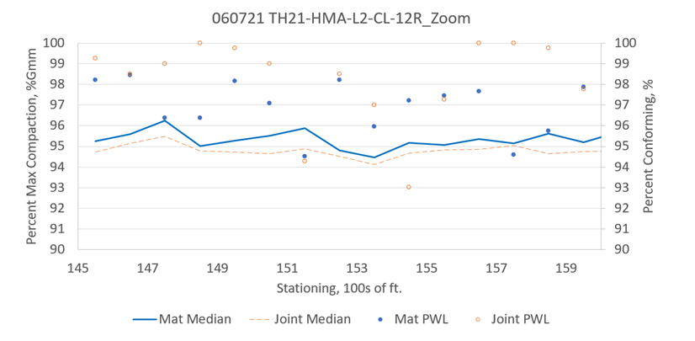
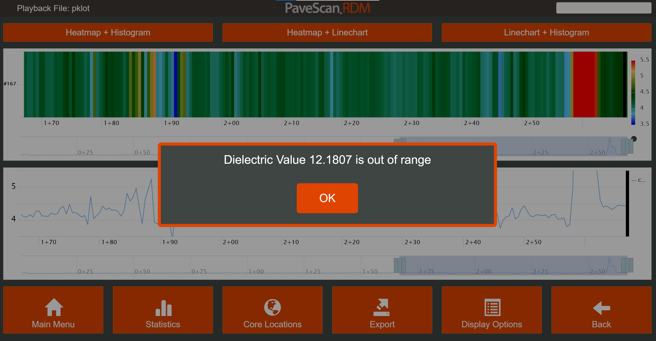
Highlights of Accomplishments Since Last Meeting
Task 1: Software and Hardware Improvements
  GSSI: Tasks 4, 9 and 10 are done
    Task 4: Data Calculation Improvements
      Removed underlaying layer effect
    Task 9: Daily Analysis and Reporting Module
      Report on Percent Conforming
    Task 10: Failure Indicator
    New Pavescan 2.0 version released June 2021
HMA
Concrete
Notes:
-(test configuration from steel ASTM E399)
-(preload no greater than 0.2 kN)
-Test is ended when post peak load reaches 0.1 kN
-DCT chose as the fracture test to use by MnDOT from 10+ year Pooled-fund study with WI, Illinois, Iowa State, and MN
- Easy specimen fabrication in both lab and field
- Standard fracture test configuration with an ASTM spec existing in 2007(originally a test for fatigue cracking)
- DCT test has shown to be a good indicator of field performance and resistance to cracking

Slide 4
    Remaining tasks: Task 2, 3 and 5 (Dec. 2021)
      Task 2: GPS Processing Improvements
      Task 3: Data Management Improvements
        Cloud data transfer
      Task 5: Precision and Accuracy
        Researching another material that could be used at potential Accuracy verification (1.25" thick with same lateral dimensions as HDPE block)

Slide 5
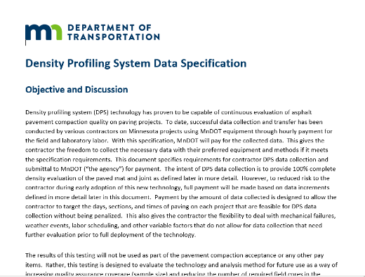
Task 2: Development of AASHTO Data Collection and Analysis Specification
  Updated field data collection and puck calibration training videos using 2.0 and workplan: http://www.dot.state.mn.us/materials/dps/index.html
  Developed field data collection specification
      2021 Summer: Hired 2 Contractors
* Ulland Brothers: Rented a DPS
* Mathy: Their own DPS
Feedback: * Like real-time density display
* Good potential and merit for a future acceptance tool
* More beneficial if every roller has DPS
* Safety concern: long time exposure to live traffic
* Turnaround time for equipment replacement
Notes:
-(test configuration from steel ASTM E399)
-(preload no greater than 0.2 kN)
-Test is ended when post peak load reaches 0.1 kN
-DCT chose as the fracture test to use by MnDOT from 10+ year Pooled-fund study with WI, Illinois, Iowa State, and MN
- Easy specimen fabrication in both lab and field
- Standard fracture test configuration with an ASTM spec existing in 2007(originally a test for fatigue cracking)
- DCT test has shown to be a good indicator of field performance and resistance to cracking

Slide 6
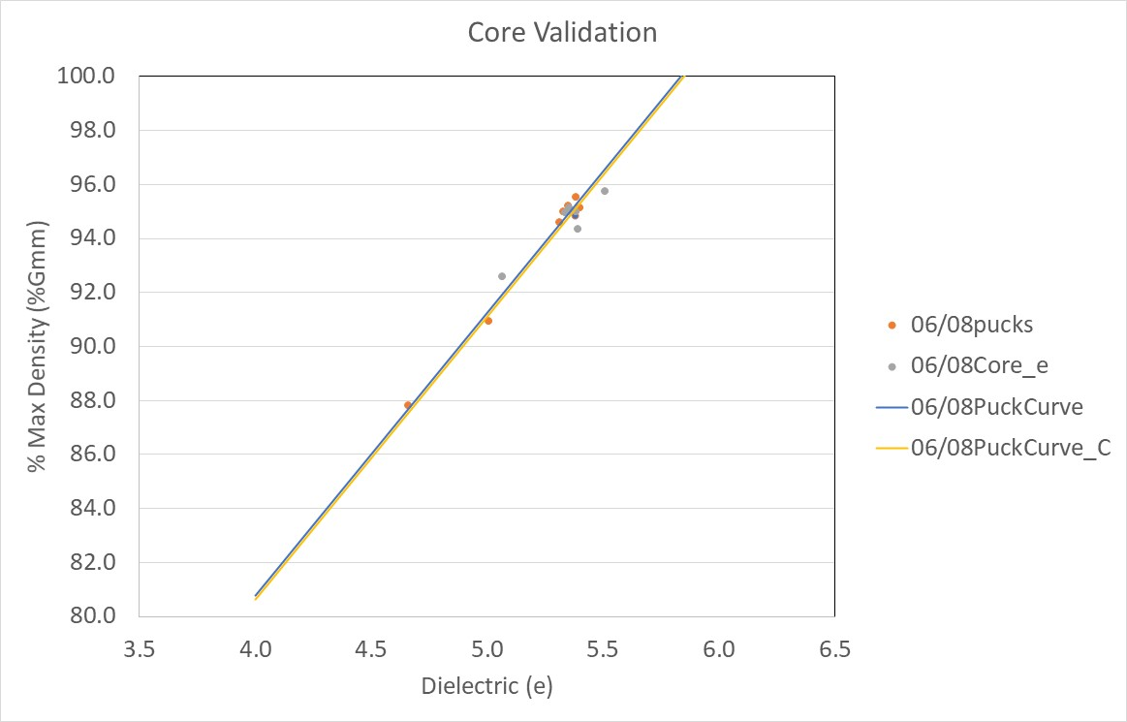
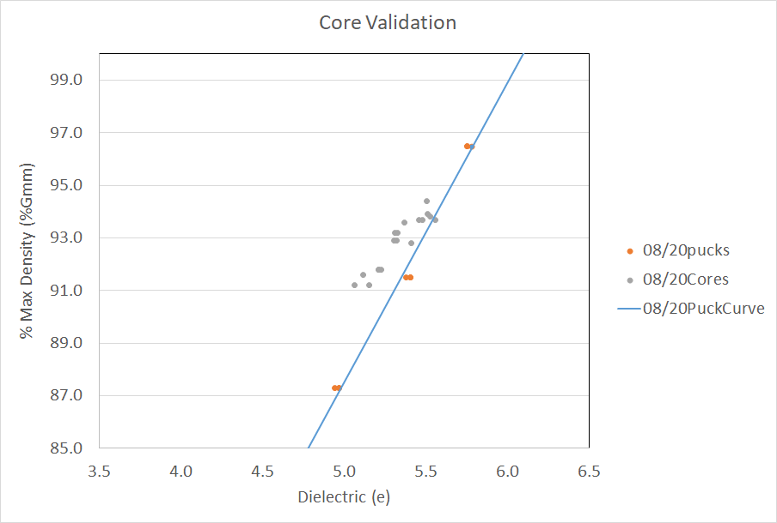
  Developing Contract to University of New Hampshire (UNH)
    Statistical analysis on collected data to make recommendations on current field data collection and laboratory testing protocols.
      Core verification bias
      Acceptance criteria
    UNH working on a NCHRP IDEA project
      develop a laboratory procedure for determining the bulk specific gravity of compacted asphalt specimens using dielectric constant measurements
Notes:
-(test configuration from steel ASTM E399)
-(preload no greater than 0.2 kN)
-Test is ended when post peak load reaches 0.1 kN
-DCT chose as the fracture test to use by MnDOT from 10+ year Pooled-fund study with WI, Illinois, Iowa State, and MN
- Easy specimen fabrication in both lab and field
- Standard fracture test configuration with an ASTM spec existing in 2007(originally a test for fatigue cracking)
- DCT test has shown to be a good indicator of field performance and resistance to cracking

Slide 7
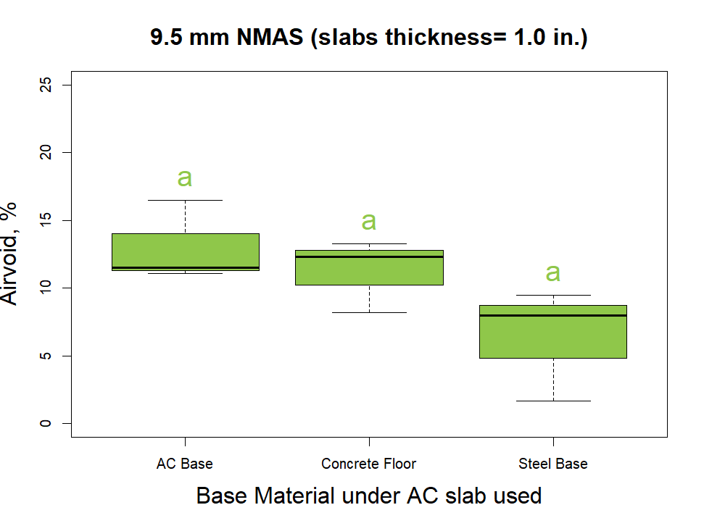
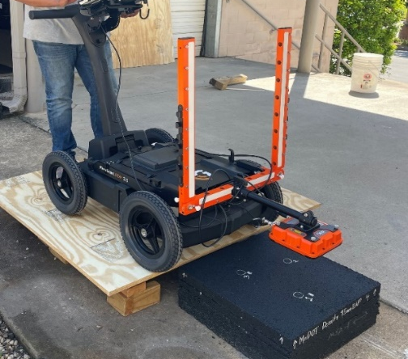
Task 3&4: Precision and Bias Statement & Equipment and Operator Certification (NCAT)
  Dr. Fabricio Leiva will give an update
  Minimum Lift Thickness
    Compacted slabs with different densities, thickness and mixtures (18”x18”)
    Preliminary results:
      > 2” lift thickness is fine
      < 2” depending on the underlying material
HMA
Notes:
-(test configuration from steel ASTM E399)
-(preload no greater than 0.2 kN)
-Test is ended when post peak load reaches 0.1 kN
-DCT chose as the fracture test to use by MnDOT from 10+ year Pooled-fund study with WI, Illinois, Iowa State, and MN
- Easy specimen fabrication in both lab and field
- Standard fracture test configuration with an ASTM spec existing in 2007(originally a test for fatigue cracking)
- DCT test has shown to be a good indicator of field performance and resistance to cracking

Slide 8
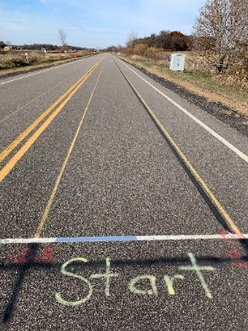
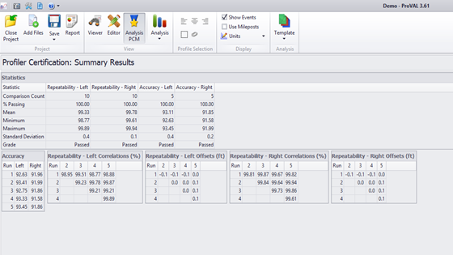
Equipment and Operator Certification
  Follow AASHTO R 56‑14 “Standard Practice for Certification of Inertial Profiling Systems”.
    Several test sections with different density levels.
    Baseline: Conducted nuclear and non-unclear gauge tests.
    Developed preliminary acceptance scores for accuracy
    and repeatability based on MEPDG.
      Statistical analysis: RMSPE (Root Mean Square Percent Error)
    Excel spreadsheet will be developed
Precision and Bias Statemen
    In general, follow ASTM E691, “Standard Practice For Conducting an Interlaboratory Study To Determine The Precision Of A Test Method”
    Repeatability & Reproductively Statements for lab and field data collection
    Started Round Robin
      Currently NCAT, MNDOT, FHWA
        Produced pucks at 88%, 91%, 94% and 97% and a HDPE specimen
Notes:
-(test configuration from steel ASTM E399)
-(preload no greater than 0.2 kN)
-Test is ended when post peak load reaches 0.1 kN
-DCT chose as the fracture test to use by MnDOT from 10+ year Pooled-fund study with WI, Illinois, Iowa State, and MN
- Easy specimen fabrication in both lab and field
- Standard fracture test configuration with an ASTM spec existing in 2007(originally a test for fatigue cracking)
- DCT test has shown to be a good indicator of field performance and resistance to cracking

Slide 9
Task 5: Support Communication
* Monthly meeting with FHWA/on-site visit
* Face to face meeting next spring
* Moving forward: Technical Working Group meetings every 2 months
Developing a contract to CTC to organize, facilitate the meetings & develop technical brochures.
Task 6: Provide Training and Technical Assistance
  * Continue to provide online assistance
  * If needed, we can provide onsite training.
  * FHWA mobile lab: loan program and provide training
  Massachusetts, South Carolina, Arizona, Missouri, Wisconsin
Notes:
In areas where performance is more critical (i.e. high traffic) higher fracture energy is required to ensure that thermal cracking is very minimal.

Slide 10
Task 7: Promote the technology
  * FHWA mobile lab loan program
  * Presentations: SEAUPG, NEAUPG, Utah DOT, MAPA, MnDOT biweekly meetings
  * Continue to promote the technology to contractors
  * Moving forward: CTC & UNH to develop brochures & process flowchart
Timeline and Budget:
* A 3-year project: Jan. 2020 to Jan. 2023
* Total Received Funds: $1,136,500
Expenditure (Expended, Encumbered and Future Plan): $1,104,550
Notes:
In areas where performance is more critical (i.e. high traffic) higher fracture energy is required to ensure that thermal cracking is very minimal.

Slide 11

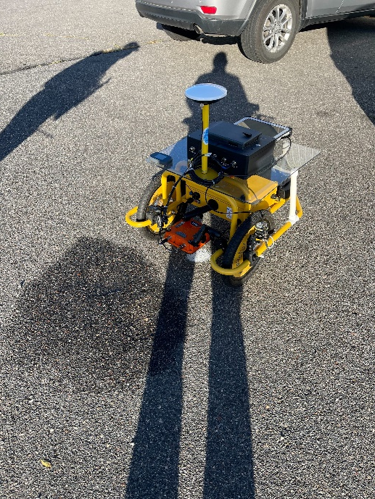
Data Collection Equipment Advancement (Beyond the Pooled Fund)
GSSI
Notes:
-(test configuration from steel ASTM E399)
-(preload no greater than 0.2 kN)
-Test is ended when post peak load reaches 0.1 kN
-DCT chose as the fracture test to use by MnDOT from 10+ year Pooled-fund study with WI, Illinois, Iowa State, and MN
- Easy specimen fabrication in both lab and field
- Standard fracture test configuration with an ASTM spec existing in 2007(originally a test for fatigue cracking)
- DCT test has shown to be a good indicator of field performance and resistance to cracking

Slide 12

Thank you!

