Slide 1



TPF 5(443) Continuous Asphalt Mixture Compaction Assessment using Density Profiling System:
Protocol Review, Statistical Analysis, and Technical Brief Development Workplan
Jo E. Sias, Eshan V. Dave and Anh Tran
University of New Hampshire
Adam Hand
University of Nevada, Reno

Slide 2
Motivation and Objectives
Substantial amount of data on field sections has been collected as part of the pooled fund effort
Data review and analysis to propose changes to the current protocols → Routine implementation as a quality assessment tool.
Objectives:
  Development of a master database of DPS field and lab measurements
  Development/refine protocol for determining the relationship between dielectric values and density for a mixture
  Recommended changes to the current DPS field measurement protocols to account for sensor bias and data variability
  Development of a data processing tool to process the field measured dielectric data gathered using the DPS equipment
  Develop materials to promote the implementation of DPS methods and protocols

Slide 3
Tasks (1/3)
Collection and Organization of DPS Data
  Database development
  Data quality checks
  Statistical checks on collected data (outlier analysis)
Evaluation of Sensor Bias for Field Dielectric Measurements
  Develop acceptance criteria and checks to address sensor bias
  Using statistical testing of data from swerve, transverse line and other strategies
  Outcomes to inform the field measurement protocol requirements

Slide 4
Tasks (2/3)
Correlations between lab and field dielectric measurements
  Correlate: Field (surface reflection) vs. Lab (time of flight)
  Multilevel analysis: Specimen, lot, project
  Protocol on laboratory procedure for developing dielectric vs. density curves (number of measurements, number of specimen etc.)
  Leverage on-going NCHRP IDEA study
Data Variability Analysis and Measurement Extent Recommendations
  Identify variables that can cause systematic differences (transverse vs. longitudinal direction, joint vs. middle of mat, moisture, sensor height..)
  Identify variables that require categorization prior to measurement and corresponding trigger points to require a core
  Statistical analyses (e.g. moving window averaging) to propose necessary extent of coverage for QA process use
  Required frequency of accuracy checks to validate calibration curve

Slide 5
Tasks (3/3)
Development of Data Processing Tool
  Formalize sensor bias detection, field data variability measures, accuracy check triggers into a single Excel based tool
Draft Specification and Implementation Tools
Final Report
Calendar Month | Jan | Feb | Mar | Apr | May | Jun | Jul | Aug | Sep | Oct | Nov | Dec
Task 1: Data Collection
Task 2: Sensor Bias
Task 3: Lab to Field Correlation
Task 4: Data Variability Analysis
Task 5: Data Processing Tool
Task 6: Draft Specification and Implement. Materials
Task 7: Final Report

Slide 6
NCHRP IDEA STUDY: Lab Dielectric Measurement System
Objectives:
  Impact of the specimen geometry, asphalt mixture variables, and surface conditions on the measured dielectric constant
  Repeatability of the measured dielectric constant in the laboratory
  Refine the calibration procedure and methodology for laboratory measurement
  Establish the relationship between laboratory measured dielectric constant and bulk specific gravity
  Develop a draft AASHTO test specification for laboratory dielectric measurement

Slide 7
Project Tasks
Stage 1: Establish measurement reliability and draft test procedure
  Task 1: Select study materials and gather mix information
  Task 2: Collect materials (16 mixtures)
  Task 3: Specimen fabrication and testing
  Task 4: Statistical analysis of results and draft procedure
Stage 2: Develop relationship between dielectric value and bulk specific gravity
  Task 5: Dielectric measurement of component materials
  Task 6: Develop relationship using machine learning
  Task 7: Reporting and final deliverables

Slide 8
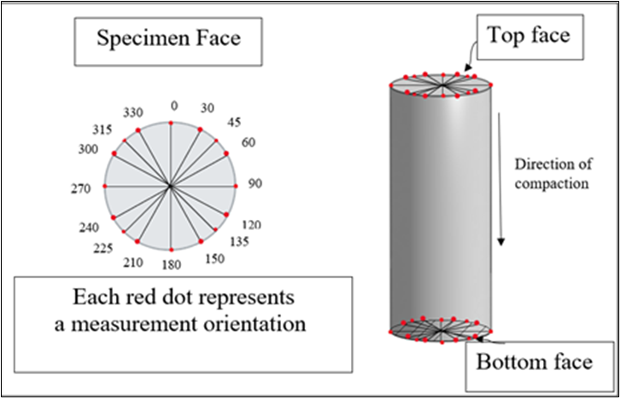
Extensive LDMS Testing
A total of 160 measurements collected at various orientations on both faces of each specimens
  5 measurements per orientation

Slide 9
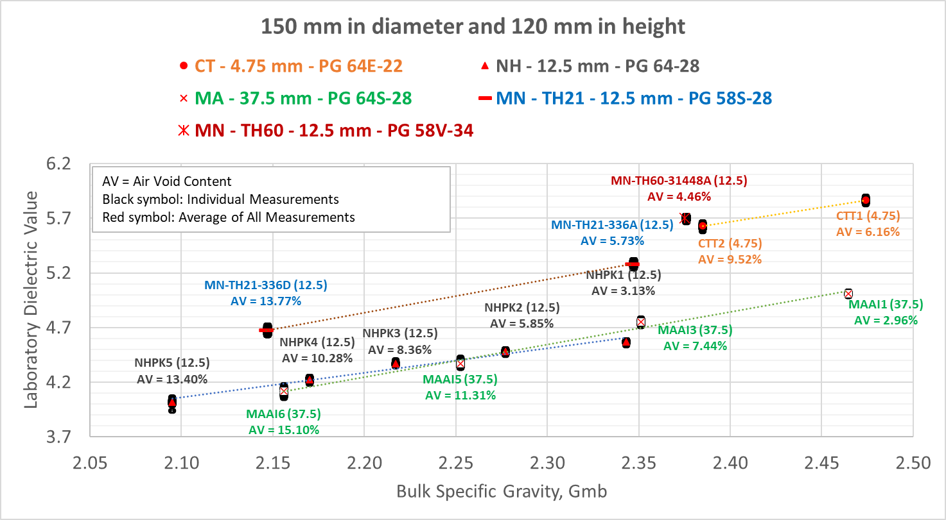
Preliminary Results

Slide 10
Preliminary Findings
As the air void content increases, dielectric measurement decreases, and measurement variability increases for tested mixture type
Statistical analysis to study measurement repeatability at different orientations and among grouping of measurements of various orientations
  Preliminary finding has shown that five measurements at each of any three orientations 120 degrees apart (15 measurements total) on any of the specimen face provide representative average of whole specimen for tested mixture type

Slide 11
Thank you for your attention!
Questions and Comments?

