Slide 1

NRRA Workshop
NRRA Team Meeting Activities
Ben Worel – May 2017
Notes:
Welcome to the webinar on the National Road Research Alliance “NRRA”
- Appreciate your valuable time today
– Please mute your phone/computer
~20-25 minutes presentation
+ questions (type in or verbal at the end of the presentation)

Slide 2
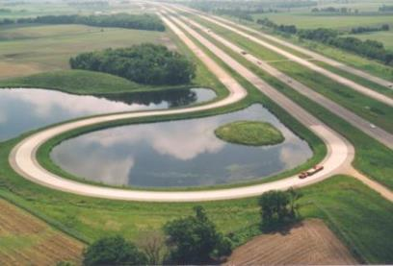
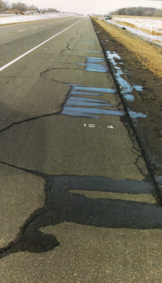
Today’s Agenda
Housekeeping
  Facilities
  Packets
  Members
Agenda
  NRRA Team Update
  Intelligent Compaction (HMA)
  In-Place Recycling
  Unbound Concrete Overlays
  Advanced Performance Monitoring
  MnROAD Tours / Dinner
Tomorrow → Conference

Slide 3
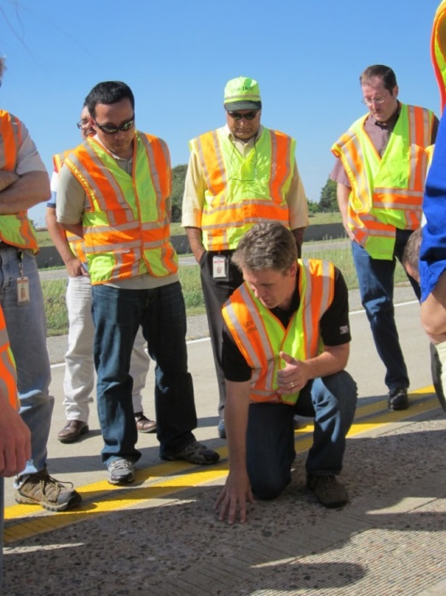
Presentation Outline
Introduction
Membership / Structure
Accomplishments
Expected Work
Discussion
Strategic Implementation through Cooperative Pavement Research

Slide 4
Introduction to NRRA
Non-traditional pooled fund
  Collaboration between transportation agencies, industry, and academia.
  Develop best use future of MnROAD research
  Focus on Implementation
  Multiple Projects / Long and Short term
  $3.3 million in MnDOT construction funding
Notes:
NRRA is a non-traditional Pooled Fund
Solve real problems identified by sponsors within one pooled fund
Members will determine what research is needed and act on the research needs
Quicker turnaround on project development (past experience with pooled funds)
State and Local agency participation
Seeking participation from local road agencies within each
Past - Multiple SPR studies worked well but could be streamlined
Phase – II 7 individual pooled funds
Each with individual budgets / meetings
Many had the same states → travel coordination
Overhead to administer
Need for collaboration not only with agencies but with key input from industry and academia
Industry –
Utilize MnROAD Facility as a National/Regional Shared Facility
MnDOT is providing 2.5 million dollars towards construction based on the recommendations of NRRA

Slide 5
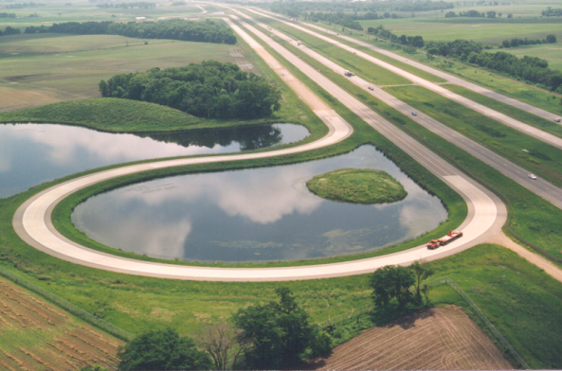
Resources Available
  MnROAD Facility
  Built in 1990’s at a cost of $25million ($76 million Today)
Nine miles of test pavements
  I-94 WB (Old Westbound/Mainline) & Low-Volume Road
50+ unique test cells open for future research
Instrumentation Network
Experienced technical staff

Slide 6
MnROAD Brief History
    Phase I (1994-2006)
      Focused on the structural design of concrete, bituminous and gravel pavement designs.
Phase II (2007-2016)
  Reconstruction of almost 40 test cells that supported over 20 different research projects.
Phase III (2017- )
  Expect the focus on maintenance and rehabilitation

Slide 7
Initial Development
2014 National Peer Exchange
Pavement experts focusing on
  Quantifying & Communicating the Value of Research
  Development of MnROAD’s Future Research
  +Ontario
  13 Participating Agencies
  +LRRB+FHWA+TRB
  + University of Washington

Slide 8
Mission Statement
Strategic Implementation Through Cooperative Pavement Research
Notes:
Building implementation, technology transfer, and training into research projects from the ground up.
Developing innovative technologies to improve pavement performance.
Fulfilling regional and national road research needs.
Examples
More can be done as a team
Practices should probably not changes as borders are crossed
States/Agencies projects are not unique
Effective solutions for common problems (more effective)
Foster innovation through membership from states, academia and industry

Slide 9







NRRA Agency Members
Interest from
NY and Texas

Slide 10































NRRA Associate Members
Add Your
Association Here

Slide 11
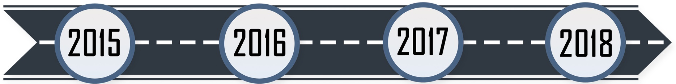
NRRA Schedule
2015 Schedule
Nov NRRA Pooled Fund Posted
Dec NRRA Development Meeting with former TERRA Members

Slide 12
NRRA Schedule
2016 Events
Jan National Webinar
Jan TRB Open House
Feb 17 All Members Meeting
Feb 18 NRRA Pavement Conference
May NRRA Pooled Fund Starts
Technical Committee Activity (April)
Monthly then 2X Meetings
Prioritize Short/Long Term Topics
Develop Need Statements
Develop Construction Details
MnDOT Develop Plans

Slide 13
NRRA Schedule
2017 Schedule
April Construction Letting
May NRRA Pavement Conference
June Phase-III Construction
Oct Construction Ends
Dec? NRRA Winter Meeting TBD
Technical Committee Activity
2X then Monthly Meetings
Long Term Research
Short Term Research
Technology Transfer

Slide 14
NRRA Schedule
2018 Schedule
May NRRA Pavement Conference
Dec NRRA Winter Meeting TBD
Dec NRRA Initial Cycle Proposed to End (3 years)

Slide 15
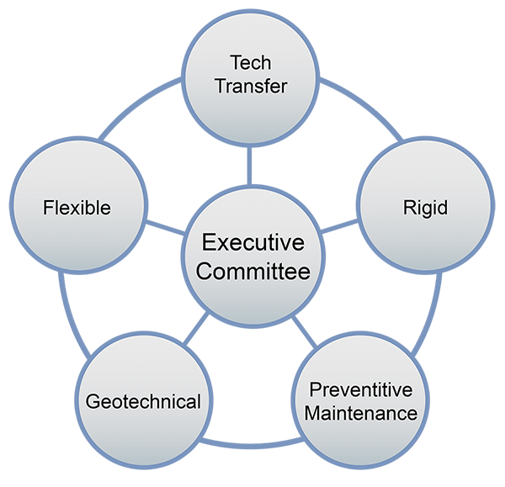
NRRA Participants/Structure
  Agencies and Minnesota LRRB
  Executive Committee
  $150,000/year
  Sets goals, prioritizes research objectives, and selects projects
Industry / Academia
  Associate Members
  $2,000/year
  Provide industry perspective and technical expertise

Slide 16
NRRA Participants/Structure
  Team Acknowledgment
  Executive Committee – Glenn Engstrom
  Tech Transfer – Steve Krebs
  Rigid – Brett Trautman
  Pavement Maintenance – Jerry Geib
  Geotechnical – Terry Beaudry
  Flexible – Barry Paye
Notes:
Teams stand up

Slide 17
NRRA Current Funding
Start NRRA => May 2016
(3 year cycle)
Funding through => Dec 2018
Pooled Funds => max 5 years
FHWA Pooled Fiscal Year Funds
FY16 → Nov 2015 to Oct 2016
FY17 → Nov 2016 to Oct 2017
FY18 → Nov 2017 to Oct 2018
Income
  6 Agencies = $2,600,000
  31 Associates = $186,000
  MnDOT = $3,3000,000
  FHWA = $10,000
Funding Splits
  65% Research = $1,690,000
  30% Tech Transfer = $780,000
  5% Administration = $130,000

Slide 18
Resources NRRA Approved
Marketing Efforts
  $130,000 → MnDOT Labor (Website, Newsletter, Coordination)
Tech Transfer Efforts
  $115,000 → Pooled Fund Travel/Meetings
  $40,000 → Communication Consultant (on hold)
  $25,000 → Equipment
  $160,000 + $30,000 (MnDOT Labor) → Short Term Research
FHWA will do final approvals on NRRA Spending Plans

Slide 19
Short Term Research Approved
Process
Collect Information
1st Effort – MnDOT
NRRA Feedback
2nd Effort – MnDOT/Consultant
Publish
Flexible
  Tack Coats (initial start)
  Longitudinal Joint Performance (initial start)
Geotechnical
  Larger Subbase Materials
  Subgrade Design for New and Reconstructed
Rigid
  Design and Performance of Concrete Unbonded Overlays
  Repair of Joint Associated Distress Pavements
Pavement Maintenance
  Surface Characteristics of Diamond Ground PCC Surfaces
  Pavement preservation approaches for lightly surfaced roadways

Slide 20
Resources NRRA Approved
Research Efforts
  $159,130 → Sensor Purchases
  $50,400 → MnDOT Labor Construction Monitoring
  $279,318 → MnDOT Labor Monitoring (Construct & Long Term)
  $20,000 → Development of a data web interface
  $1,235,000 → Long Term Research Topics
Remaining Funds
  ~ $200K SPR
  ~ $150K Partnerships
FHWA will do final approvals on NRRA Spending Plans

Slide 21
Long Term Research Topics
Team | Project
Flexible | HMA Overlay and Rehab of Concrete and Methods of Enhancing Compaction (2 studies Combined)
Flexible | CCPR Recycling
PM | Partial Depth Repair
PM | Maintaining Poor Pavements
Rigid | Early Opening Strength to Traffic
Rigid | Optimizing the Mix Components for Contractors
Rigid | Fiber Reinforced Concrete Pavements
Rigid | Long Term Effects of Diamond Grinding
Rigid | Compacted Concrete Pavement for Local Streets
Geotechnical | Recycled Aggregates in Aggregate Base and Larger Subbase Materials (2 studies Combined)
Notes:
See your brochure or website for more details

Slide 22
Long Term Research Process
University Master → Direct select master university that technically fits the research need for NRRA.
University Master → RFP will be done and the technical teams will select the best proposal (Open to the 11 master universities)
Consultant TRAP List → Direct select consultant that technically fits the research need for NRRA.

Slide 23
Long Term Research Process
Priority | Project | Team | ~Test Sections ~ Distance | LRRB Funds? | Contracting Process
7 | HMA Overlay and Rehab of Concrete and Methods of Enhancing Compaction | Flex | 12 - 7400’ | Yes | Master RFP
2 | Cold Central Plant Recycling | Flex | 4 Cells - 1500’ | Yes | TRAP Direct
8 | Fiber Reinforced Concrete Pavements | Rigid | 1 Cell - 500’ | Yes | Master Direct
9 | Long Term Effects of Diamond Grinding | Rigid | LVR Loop |  | Hold
1 | Early Opening Strength to Traffic | Rigid | 5 Cells - 500’ |  | Master Direct
4 | Optimizing the Mix Components for Contractors | Rigid | 2 Cells - 500’ |  | Master Direct
10 | Compacted Concrete Pavement for Local Streets | Rigid | 2 Cells - 500’ | LRRB | Master RFP
5 | Recycled Aggregates in Aggregate Base and Larger Subbase Materials | Geo Tech | 8 Cells - 1800’ |  | Master RFP
6 | Maintaining Poor Pavements | PM | 3 Cells - 1500’ | LRRB | TRAP Direct
3 | Partial Depth Repair | PM | 15 Locations |  | TRAP Direct
Long Term Research Less than 3 Year Duration

Slide 24

NRRA 2017 Construction
Mainline (I-94)
Maintaining HMA and PCC Roadways (3)
Fiber Reinforcement of PCC (3)
ByPass (I-94)
HMA Overlays of PCC (8)
Enhancing Compaction (4)
Partial Depth PCC Patches (3/panels/manufacture)

Slide 25
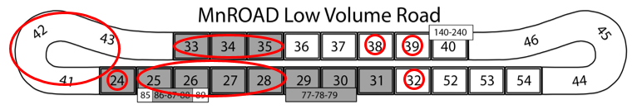
NRRA 2017 Construction
Low Volume Roadway
Diamond Grinding effects on ASR Acceleration (3)
Fiber Reinforcement City Street (1)
Compacted Concrete Pavement City Street (1)
Cold Central Plant Mix (4)
Recycled Base Effectiveness (4)
Use of Large Stone Subbases (4)
PCC Early Opening to Traffic (1)
PCC Optimized Mixes (2)

Slide 26
Discussion

Slide 27
Feedback so Far?
Time Commitment?
Topics Selection?
What is missing?
How to take better advantage of Tech Transfer?
Research Pays Off Seminar Series
Combining of Efforts
  Coordinated State Lead Research Projects?
  FHWA Coordination
MnROAD Push Non-Traditional Pavement Innovation?
MnROAD Push for Non-Pavement Innovation?
Notes:
Who is getting the research pays off
Automated vehicles
Environmental – Erosion Control

