Slide 1

Keys to a Successful In-Place Recycling Project
NRRA Workshop
May 23, 2017
Albertville, Minnesota
Stephen A. Cross, PhD, PE
ARRA Technical Director
Professor, Oklahoma State University

Slide 2

Advantages of In-Place
Pavement Recycling
Conserves Energy and Natural Resources
Reduces Construction Truck Traffic
Improves Mix Characteristics - Some of Our Best Aggregates are In-place
Cracking Eliminated/Reduced
May Be Performed Under Traffic
Saves Construction Time and Reduces User Delays
Cost Effective - 10% to 50% Cost Savings Over Traditional Methods

Slide 3
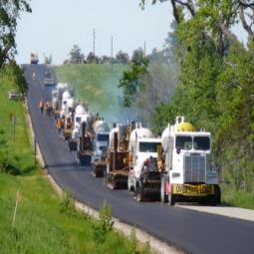
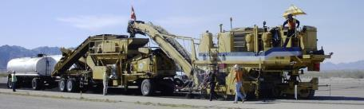
Keys to a Successful In-place Recycling Project
Proper Site Selection – Right Method, Right Road, Right Time
Good Communication and Education
Good Specifications

Slide 4
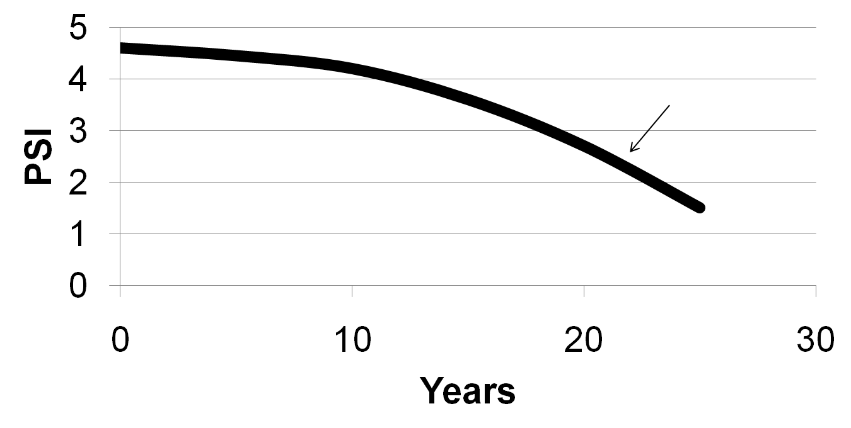
Pavement Management
Crack Sealing
Seal Coats
Slurry Seals
Hot In-Place Recycling (HIR)
Cold Recycling
(CIR & CCPR)
Full Depth
Reclamation (FDR)

Slide 5
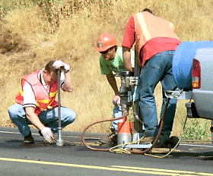
Sampling of In-place Materials & Conditions
Must Do’s
  Coring For Thickness
  Dynamic Cone Penetrometer (DCP)
Other Useful Information
  Ground Penetrating Radar
  FWD: Full and Hand

Slide 6
Hot In-Place Recycling
Three methods
  Surface Recycling
  Remixing – can add new aggregates or HMA
  Repaving – places integral HMA overlay
Typical depth: 0.6 to 2.0 inches
Immediate opening to traffic
Applicable for all traffic levels
Notes:
HIR uses applied heat to soften the existing HMA surface.
Milling depth depends on chosen process.
Scarifiers are used to remove the top layer of the existing HMA surface.
Scarifiers associated with surface recycling have a depth of impact in the range of 15 to 25 mm (0.6 to 1.0 in).
Hot milling equipment associated with remixing and repaving has a depth range of 25 to 50 mm (1 to 2 in).
The recycled material is typically mixed with some additives (i.e., rejuvenators, virgin aggregates, additional asphalt), then relaid and recompacted.

Slide 7
HIR Project Selection
Projects with excess base failures, full depth PCC patches may require an alternative treatment
Need 1 – 2 inch depth of HMA below the material planned for treatment
Stripping below surface may cause problems during compaction
Excess existing chip seals may pose problems
No geotextiles/geosynthetics within 1 inch of treatment depth
High production rates: 1.5 to 3 lane miles/day

Slide 8
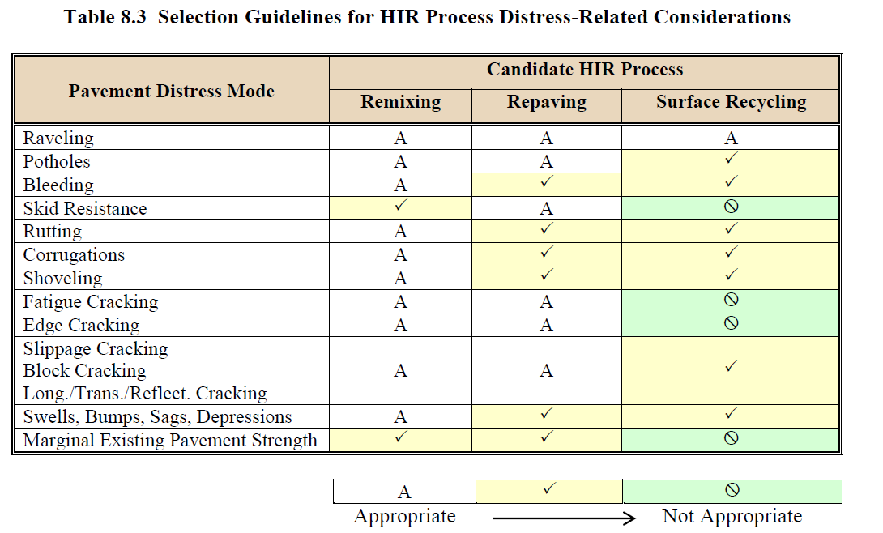
CHAPTER 8 PRINCIPALS OF DESIGN FOR PAVEMENT REHABILITATION WITH FLRXIBLE OVERLAYS.” 2017 Pavement Design Manual. Colorado Department of Transportation, Denver, CO, 2017.

Slide 9
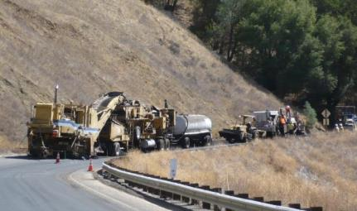
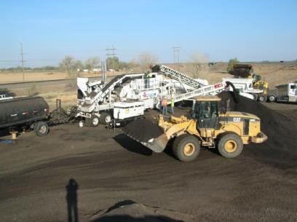
Types of Cold Recycling
Cold In-Place Recycling (CIR)
Cold Central Plant Recycling (CCPR)

Slide 10
CR Project Selection
Cracked pavements with stable bases are some of the best candidates for CR
Pavements with other than major or deep structural issues can be successfully rehabilitated with CR with a proper mix design and adequate overlay

Slide 11
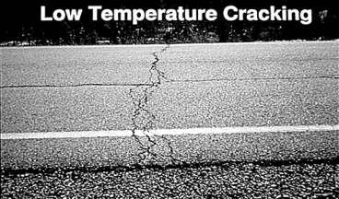

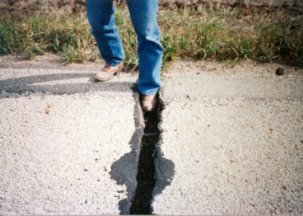
Good CR Candidates

Slide 12
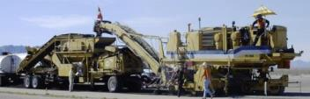
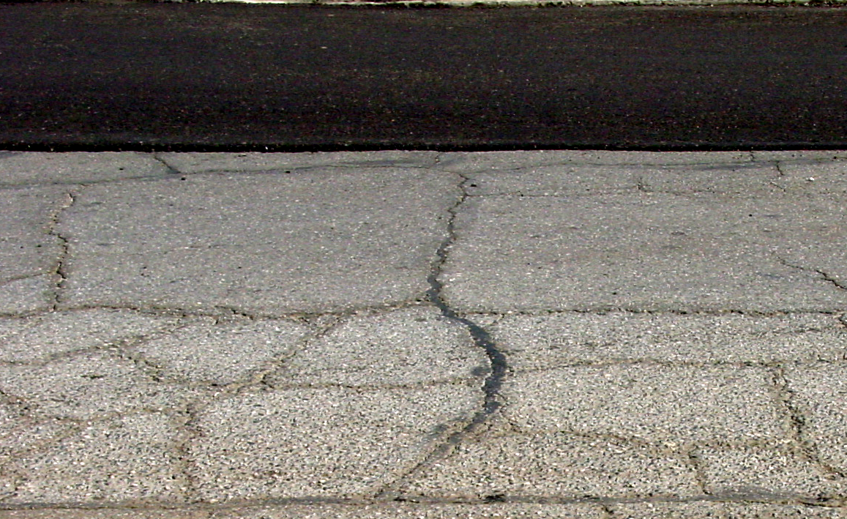


Cold In-place Recycling
Recycled AC
4” Distressed AC
>1”
Recycle AC to:
Within 1” of less
Supportive
Material
6” Stable Base
Native Soil

Slide 13
Milling to Top of AGG Base
Requires stable, uniform base layer of consistent thickness
Incorporating minor amounts of aggregate base can be done
Intermittently incorporating agg base results in over and under asphalted CR layer resulting in less than optimal performance
Supply patching material for areas of isolated base failures

Slide 14
CR Milling Depth
More of crack you remove less likely it will return
Rule of thumb: Remove 2/3 of existing crack it probably will not return
Mill through or 1” above geotextiles
Mill through poorly bonded or delaminated layers
Mill through or ½” above existing HMA layers

Slide 15

Cold In-place Recycling
4” CCPR
8+” Distressed AC
4” CIR
Stable Base
Native Soil

Slide 16
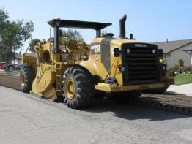
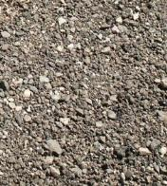

Full Depth Reclamation
Stabilized Base
Distressed AC
Base
Improves existing materials in-place to provide greater structural support and reduction of imported material.
Native Sub-base
Notes:
16

Slide 17
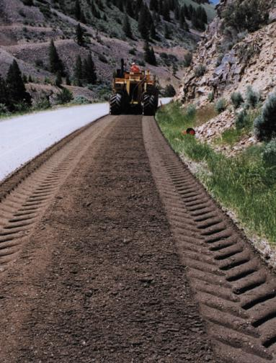
Types of FDR
  Pulverization
  Mechanical Stabilization
      Corrective Aggregate
      RAP
  Bituminous Stabilization
      Emulsified Asphalt
      Foamed Asphalt
  Chemical Stabilization
      Cement/ CKD
      Lime/LKD
      Type C Fly Ash
      Calcium Chloride

Slide 18

FDR Engineering Properties
Strength is built into a pavement structure with FDR
Corrects pavement defects
Increases structural capacity
SN_{FDR} =
0.25 x 6 = 1.5
SN_{a} =
0.11 x 7 = 0.77
SN_{t} =
2.3
3” worn HMA
SN_{h} =
0.2 x 3 = 0.6
SN_{a} =
0.11 x 10 = 1.1
SN_{t} =
1.7
6” FDR
10” aggregate base
7” aggregate base
Notes:
18
18
18

Slide 19
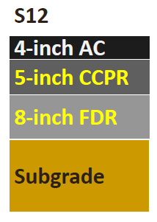
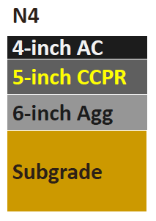
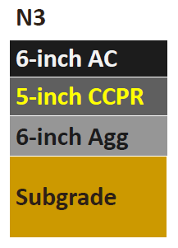
VDOT Sections with CR Base at NCAT Test Track
Basically same sections as on I-81
Over 15M ESALs, no distress

Slide 20
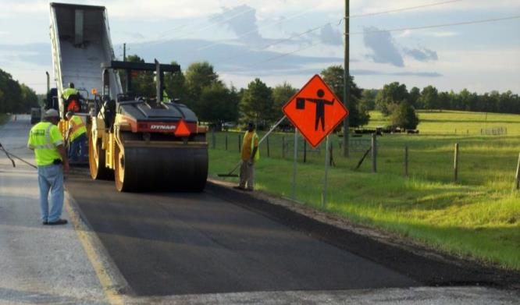
NCAT Lee Road CCPR Base in Section L20
3/4 inch, 4.75 mm HMA Thin Lay over 5 inch CCPR
0.7 MESALs, No Distress

Slide 21
Structural Design
HIR - Typically same AASHTO Layer Coefficient as HMA
CIR & CCPR
  Typically 0.30 – 0.35
  NCAT & I-81 say could be 0.36-0.44
FDR Bituminous Typically 0.20 – 0.30
NCHRP 9-51
  CR & FDR E* values approximately 50% lower than HMA and have similar behavior to HMA base (1” NMS) mixes.

Slide 22

Education
Sections on:
Cold Planing
Hot In-place Recycling
Cold Recycling
Full Depth Reclamation
FHWA –HIF-14-001

Slide 23

BARM II
For Each Part - Chapters on:
  Detailed Project Analysis
  Mix Design
  Construction
  Project Specifications and Inspection

Slide 24
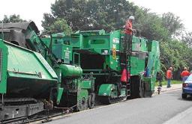
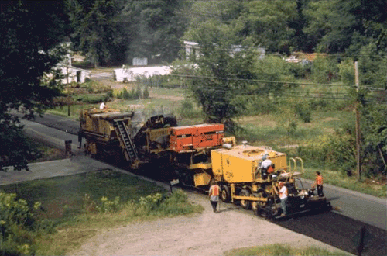


TC3 Web Based Courses on HIR, CR & FDR
Hosted by AASHTO
Free at Checkout
Module 1: Introduction to
Cold In-Place Recycling
The presentation is available as an attachment from the paperclip icon in the bottom right-hand part of the screen.
Notes:
Welcome to Inspection Training for Cold In-Place Recycling. This module will provide some basic introduction information before you get started.
The presentation is available as an attachment from the paperclip icon in the bottom right-hand part of the screen.
Image 1 description: Cold In-Place Recycling production.
Image 2 description: Workers demonstrate cold in-place recycling on a highway project in New York State.

Slide 25
TC3 Training Resources
Hot In-place Recycling (HIR): ID 2590
  https://training.transportation.org/item_details.aspx?ID=2590
Inspector Training for Cold In-place Recycling (CIR): ID 2509
  https://training.transportation.org/item_details.aspx?ID=2509
Full Depth Reclamation (FDR): ID 2593
  https://training.transportation.org/item_details.aspx?ID=2593

Slide 26
Good Specifications
There is a need for better QC testing of in-place recycled procedures
NCHRP 9-62 Quality Assurance and Specifications for In-Place Recycled Pavements Constructed Using Asphalt-Based Recycling Agents
Several agencies have good construction specifications
ARRA Best Practice Guidelines

Slide 27

ARRA Best Practice Guidelines
Series 100 Construction Best Practice Guidelines
  Suggested Specification Language
Series 200 Project Sampling & Mix Design Guidelines
Series 300 QC Guidelines
  Recommended Quality Control Checks and Remediation Actions
Series 400 Project Selection Guidelines
  Possible FHWA Tech Brief
All Provide User Notes for More Information

Slide 28
Status of ARRA Guidelines
 |  | 100 Series Const. | 200 Series Mix Design | 300 Series Quality Control | 400 Series Project Selection
Cold Planing | Milling | X
 | Micro Milling | X
Cold Recycling | Cold Central Plant | X | X | X | X
 | Cold In-Place | X | X | X | X
Full Depth Reclamation | Bituminous | X | X | X | X
 | Cementitious | X | X | X | X
 | Lime | X | X | X | X
X Available X Under Development

Slide 29
Word About Mix Designs
They tell you more than the recycling agent content
AASHTO Provisional CR Mix Design & Standards for emulsified asphalt based on ARRA CR201
NCAT developing CR Mix Design & Standards for foamed asphalt, based on ARRA and Wirtgen procedures

Slide 30
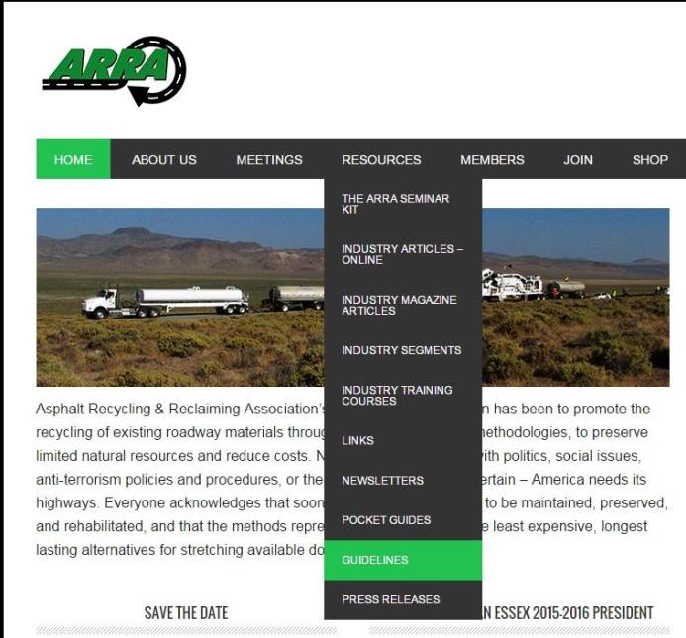
www.ARRA.org

Slide 31
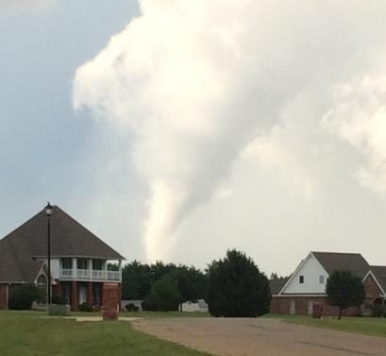
Thank You
Stephen A. Cross, PhD, PE
Technical Director, ARRA
steve.cross@okstate.edu
405-744-7200

