Slide 1


Nuggets from MnDOT’s Major Pavement Surface Properties Research:
Implications on Pavement Performance
Bernard Igbafen Izevbekhai, P.E., Ph.D.
Research Operations Engineer
Minnesota Department of Transportation
NRRA Pavement Conference May 24 2017

Slide 2
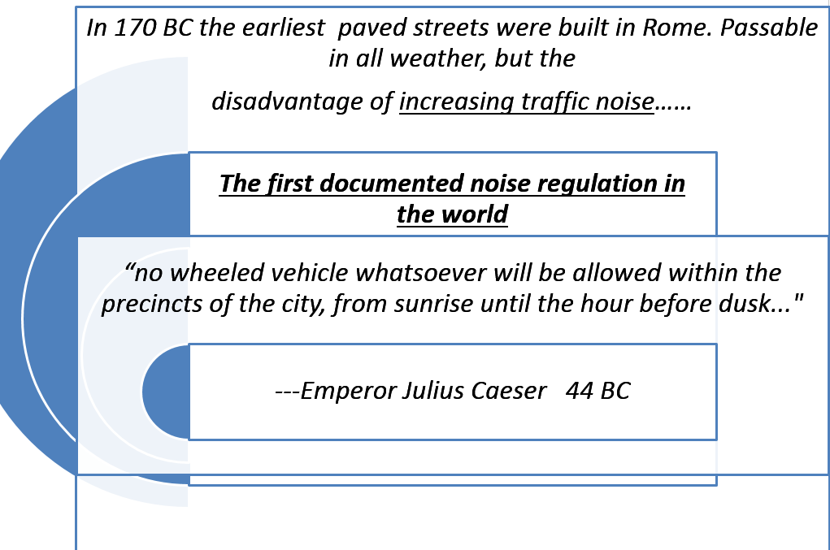
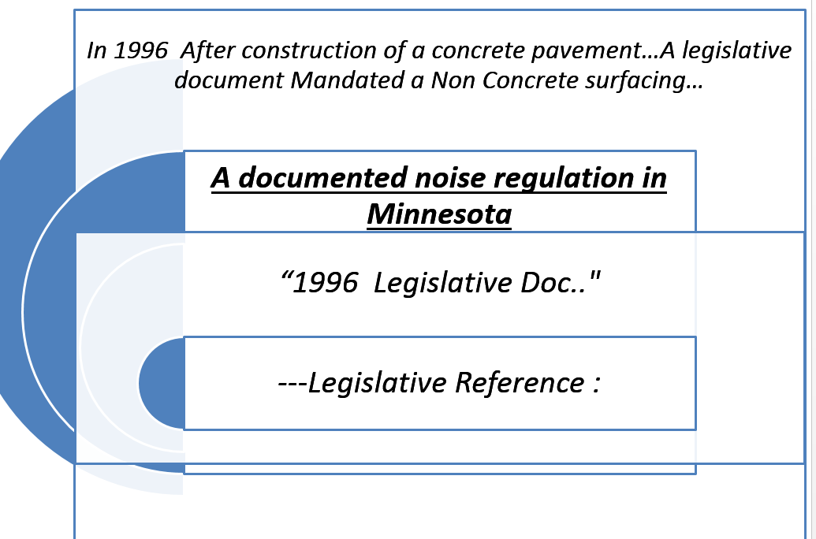
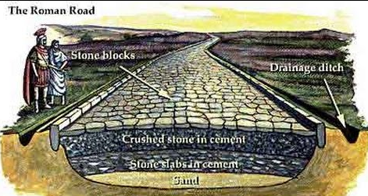
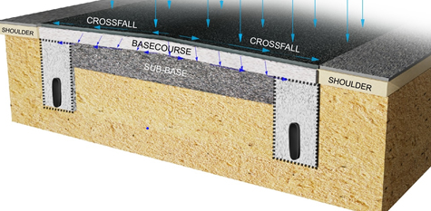
Functional Requirements are Timeless

Slide 3
Philosophy of Functional Requirements and Raison D’ Etre
Structural Requirements
Functional Requirements
Structural
  Cracking
  Faulting
  Deflection
  Drainage
Ride,
Skid Resistance
Low noise
Splash and Spray
Warp and Curl
Faulting
Aesthetics
Rolling Resistance
Sound Absorption
Surface Texture
Functional requirements tend to trigger rehab and replacement

Slide 4
LINKS TO PUBLISHED REPORTS FROM STUDY TPF 5-(134)
Title |  | Research Report / Selected Publication | Implementation
Development of Quiet Grind Configuration TPF 5-134 |  | http://www.lrrb.org/media/reports/201105.pdf http://www.lrrb.org/media/reports/201318.pdf http://www.lrrb.org/media/reports/201429.pdf | Yes
PSC Rigid pavement New Construction MPR 6(021) |  | https://www.lrrb.org/pdf/201539.pdf http://www.lrrb.org/media/reports/201040.pdf http://www.lrrb.org/media/reports/201316.pdf | In Progress
PSC Flexible MnROAD Studies |  | http://www.lrrb.org/media/reports/201428.pdf http://www.lrrb.org/media/reports/201428.pdf | Yes
Invention of Aggregate Avoidance Method |  | http://trrjournalonline.trb.org/doi/pdf/10.3141/2441-08 | HMA Validated
Warp and Curl and Effects on Pavement Performance |  | https://conservancy.umn.edu/handle/11299/132203 http://www.lrrb.org/media/reports/201116.pdf | In Progress
Pervious Concrete For Low Volume Roads |  | http://www.lrrb.org/media/reports/201123.pdf | Yes
Izevbekhai, Bernard Igbafen, and Lev Khazanovich. "Acoustic enhancement of concrete pavement surface through diamond grinding." International Journal of Pavement Engineering 14.6 (2013): 579-589. Izevbekhai, Bernard Igbafen, and Vaughan R. Voller. "Development and validation of a tenable process for quantifying texture spikiness for pavement noise prediction." International Journal of Pavement Engineering 14.2 (2013): 190-205. Izevbekhai, Bernard Igbafen, Jed Ohiremen Tamunodienye Ig-Izevbekhai, and Manshean Wong. "Roughness Index Measured with Triple-Point and Line Lasers in Textured and Nontextured Strips." Transportation Research Record: Journal of the Transportation Research Board 2523 (2015): 125-132. |  | Izevbekhai, Bernard Igbafen, and Lev Khazanovich. DEPLOYMENT OF THE NEXT GENERATION CONCRETE SURFACE IN MINNESOTA. No. 17-02540. 2017. Liu, Qingfan, et al. "Comparison of Pavement Texture Measurements from a Three-Dimensional Profiler and a Circular Track Meter at MnROAD Test Facilities." Transportation Research Record: Journal of the Transportation Research Board 2591 (2016): 121-129. Izevbekhai, Bernard, and Alexandra Akkari. "Performance of Exposed Aggregate Surface of Composite Pavements at MnROAD." Pavement Performance: Current Trends, Advances, and Challenges. ASTM International, 2012. izevbekhai B.I. Khazanovich L, Voller V.R. Deployment of NGCS. Transportation Research Board Compendium 2017. NASEM

Slide 5

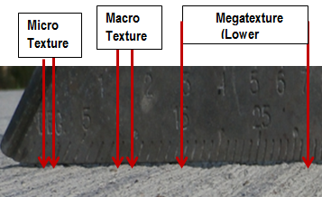
Texture Orders of Magnitude
Pictorial Depiction of Texture Categorization
Microtexture: Amplitude of deviation from a plane with wavelength 0 .02 inch (0.5 mm).
Macro-texture: Amplitude of deviation from a plane with wavelength 0.02-inch (0.5-mm) < T ≤ 2 inch (50 mm).
Mega-texture: Amplitude of deviation from a plane with wavelength 2-inch (50 mm) < T ≤20 inch (500-mm).
Gigatexture: Surface Irregularity or Roughness is characterized by amplitude of deviation from a plane with
wavelength 20-inch (500-mm) < T ≤ 166.7-ft (50-m).
Tera Texture: Very extensive road features including geodetics.

Slide 6
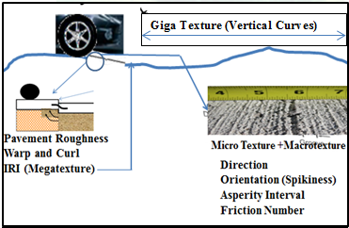
Implications of Texture Orders of Magnitude
Range | Texture Wavelength | Typical Amplitudes | Remarks
Micro | < 0.5 mm (<0.002”) | <0.001mm (<4.0E-5”) | Feels harsh but invisible to the naked eye necessary for adhesion friction
Macro | 0.5-50 mm (0.002” -2”) | 0.1-20 mm (0.004” -0.8”) | Important for tire interaction being of same order of magnitude as tire configurations
Mega | 50 mm-500 mm (2” -20”) | 0.1-50 mm (0.004”- 2”) | Wavelength similar to tire pavement contact patch and larger can cause wander
Giga | >500 mm (> 20 “) | >50 mm (> 2”) | Warp and Curl, Faulting interval Panel warp &Curl, vertical curves (Ride Quality)

Slide 7

Basic Micro – Giga Texture Technologies

Slide 8


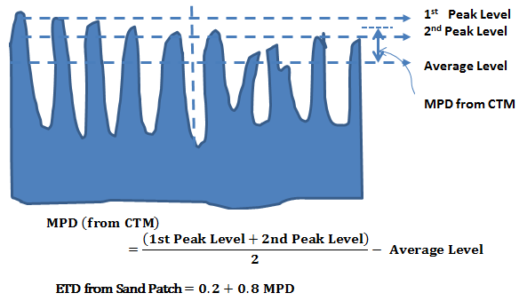
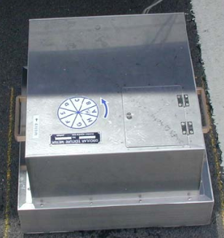
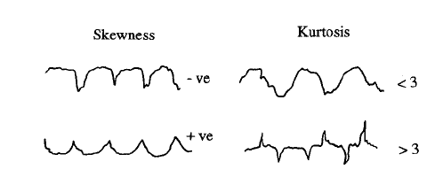

Micro Texture and Degree of Relevance
MTD= $\frac{4V}{{πd}_{everage}^{2}}$
Sand Patch ➔ MTD
V (beads) = --------CC
CTM ➔ MPD
⬇ PARSER ➔ Texture Orientation, Wavelength
Notes:
+ MTD=

Slide 9
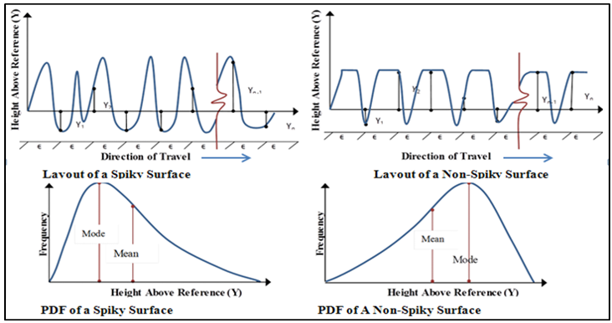
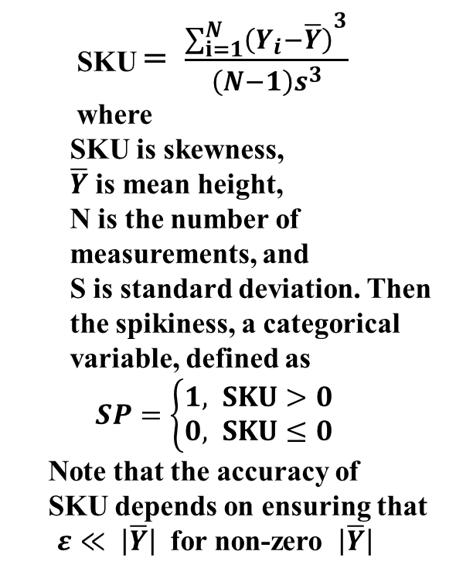
Definition of Texture Orientation (Spikiness)
SKU = $\frac{{\sum_{i=1}^{N}{\left(Y_{i}−\overline{Y}\right)}}^{3}}{\left(N−1\right)s^{3}}$
where
SKU is skewness,
$\overline{Y}$ is mean height,
N is the number of measurements, and
S is standard deviation. Then the spikiness, a categorical variable, defined as
$SP=\left\{\begin{aligned}1, &SKU>0 \\ 0, &SKU≤0\end{aligned}\right.$
Note that the accuracy of
SKU depends on ensuring that $ε≪ \left|\overline{Y}\right|$ for non-zero $\left|\overline{Y}\right|$
Notes:
Izevbekhai & Voller 2012;

Slide 10
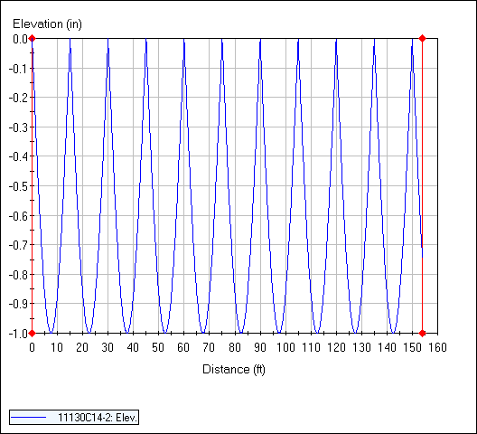
MEGA / GIGA TEXTURE WARP & CURL IN SUBGRADE DRAG
Y = - (ABS sin PI X/15) inches.
The surface generated was of the profile shown below. Based on the process developed and copiously described the effect of running the quarter car on this profile was simulated. This provided an ERD file that was analyzed. Results showed an IRI of 779 inches per mile.
(All 15 ft panels are warped I inch)
(Izevbekhai 2012)

Slide 11
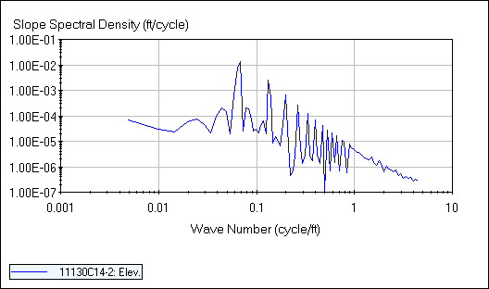
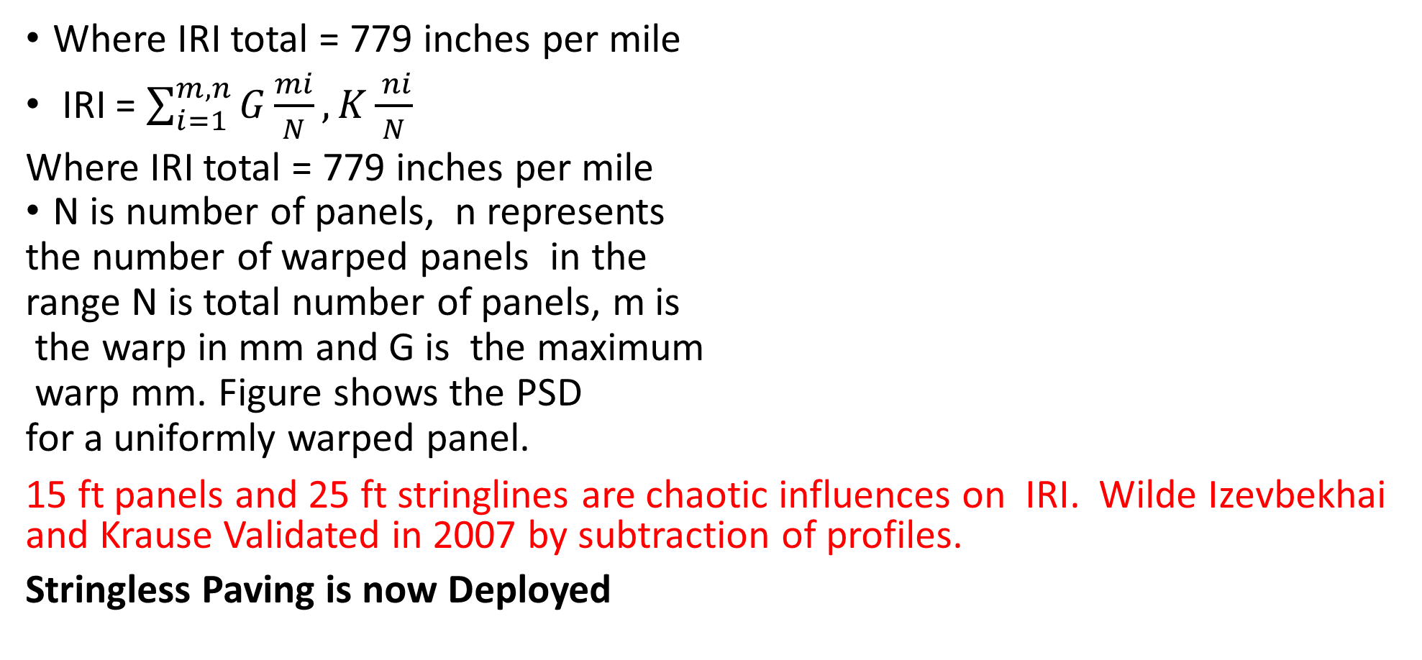
Curl/ Warp Superposition
Where IRI total = 779 inches per mile
IRI = $\sum_{i=1}^{m,n}{G\frac{mi}{N}}, K\frac{ ni}{N}$
Where IRI total = 779 inches per mile
N is number of panels, n represents
the number of warped panels in the
range N is total number of panels, m is
the warp in mm and G is the maximum
warp mm. Figure shows the PSD
for a uniformly warped panel.
15 ft panels and 25 ft stringlines are chaotic influences on IRI. Wilde Izevbekhai and Krause Validated in 2007 by subtraction of profiles.
Stringless Paving is now Deployed

Slide 12
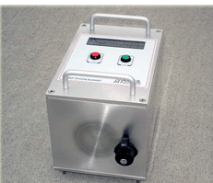
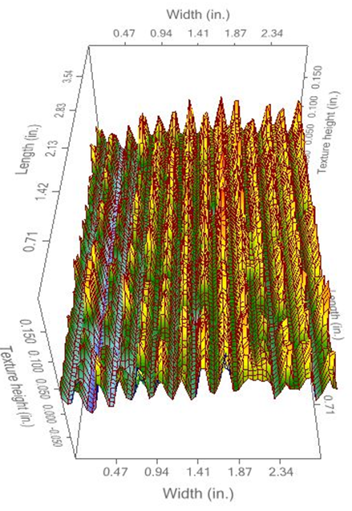
Miscellaneous Technologies : Texture Scanner
OUTPUT
OUTPUT: MPD SKEW KURTOSIS
TEXTURE SCANNER
Aggregate Avoidance Index (Akkari Izevbekhai & Olson 2014)
Finding:
Benefit of Recycled aggregates:
Enhancement of the Interfacial Transition Zone
Validated In Bituminous Pavements as well
Aggregate Avoidance Index Invention

Slide 13
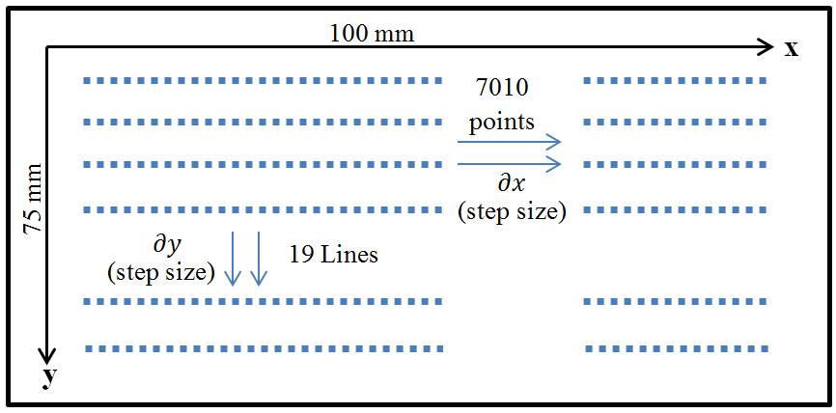
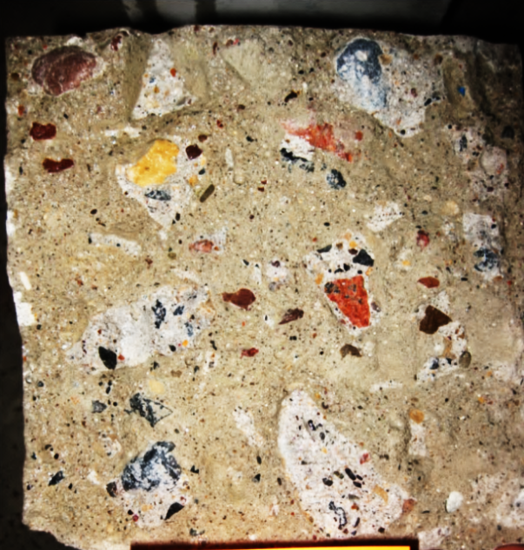
MEASUREMENT OF UNEVENNESS OF FRACTURED FACES

Slide 14
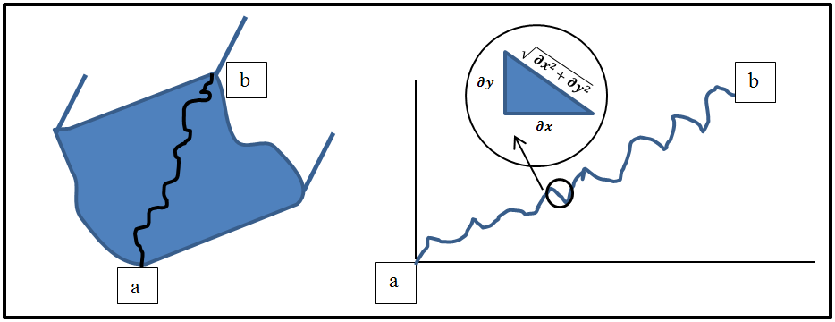
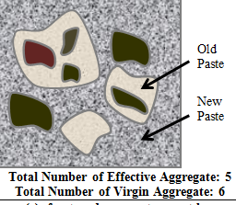
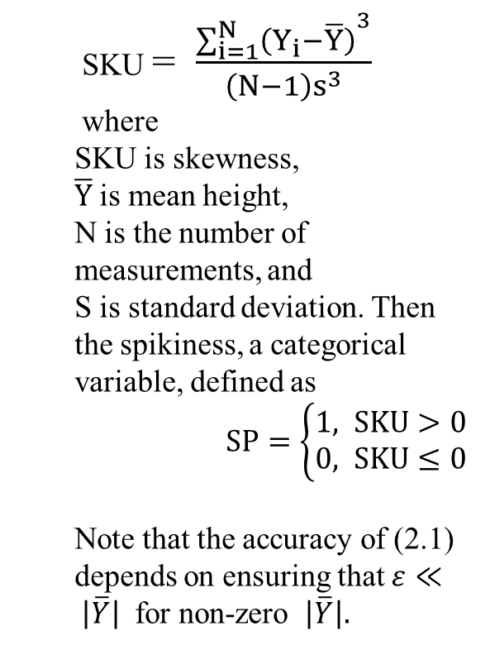
Aggregate Avoidance Index Invention
$$Aggregate avioidance index (AAI)= \frac{ length of fracture line}{absolute displacement }$$
Length of element ds = $\sqrt{{\left(∂x\right)}^{2}+{\left(∂y\right)}^{2}}$ ${=\left({\left(∂x\right)}^{2}\left(1+{\left(\frac{∂y}{∂x}\right)}^{2}\right)\right)}^{\frac{1}{2}}$
$$AAI= \frac{1}{b−a} \int_{a}^{b}{{ \left((1+{\left(\frac{∂y}{∂x}\right)}^{2}\right)}^{\frac{1}{2}}\left(∂x\right)}$$

Slide 15
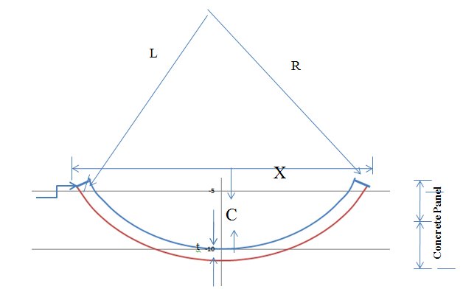
GIGA-TEXTURE WARP & CURL IN SUBGRADE DRAG
It can be shown that for an unrestrained slab on a base, with a temperature difference ΔT through the thickness t, If it is assumed that the pavement is homogenous unrestrained by mechanical devices and isotropic, It can be shown from geometry that
R= t/ αΔT
From properties of circles (X/2)² = (2R-C) C
Neglecting small terms X² ⁼2RC whence C = X²/8R)
C = αΔT X²/8t
In concrete pavements, there is an effective C which is calculated as the difference between C and w where w is the drop induced in C due to subgrade drag when the base is in continuous contact with the pavement. This is the error in FWD measurements due to built in warp and curl. There is a current study on Interface friction to address C.
Notes:
vv

Slide 16
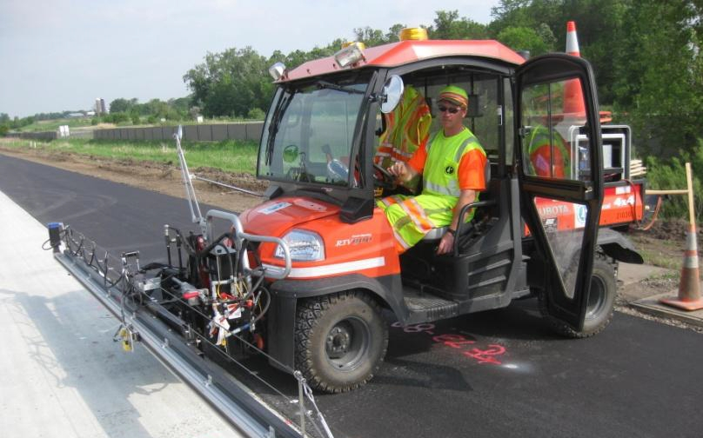
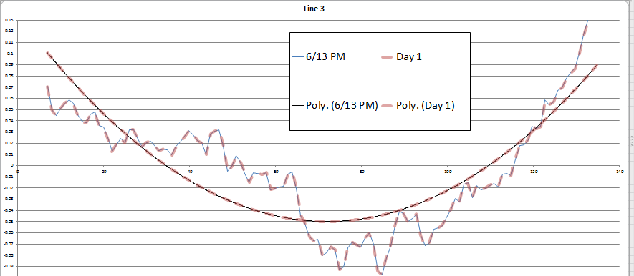
Miscellaneous Technologies Giga Texture
MnDOT ALPS 2 Built 2008-2010
Instant, Diurnal & Built In Warp n Curl
http://www.dot.state.mn.us/materials/geotechnologies/alps2013.xlsx

Slide 17
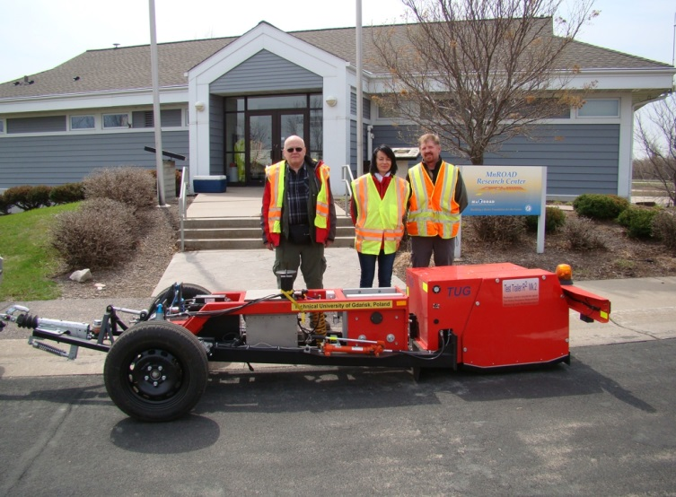
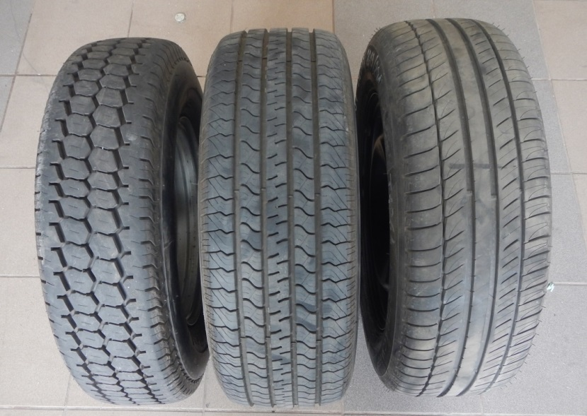
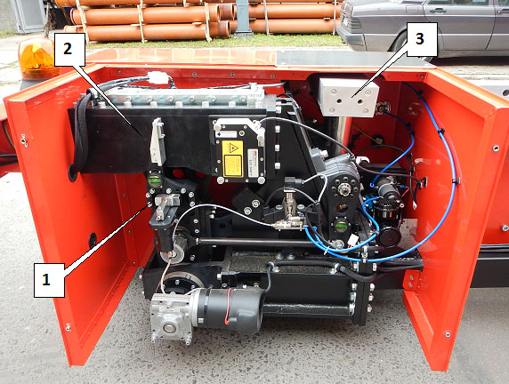
Miscellaneous Technologies Rolling Resistance)
Test Tires AAV4 (left), SRTT
(Center), MCPR (Right).
TUG MARK 4 USED AT MNROAD 2011 & 2014

Slide 18
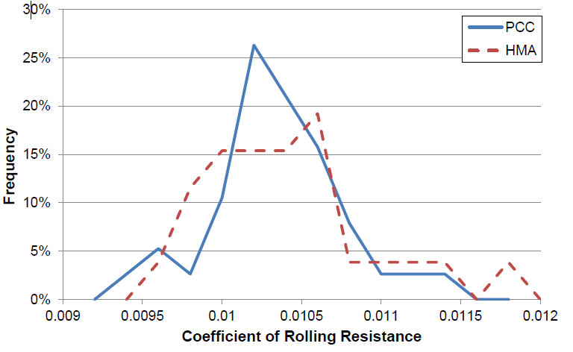
Coefficient of Rolling Resistance

Slide 19
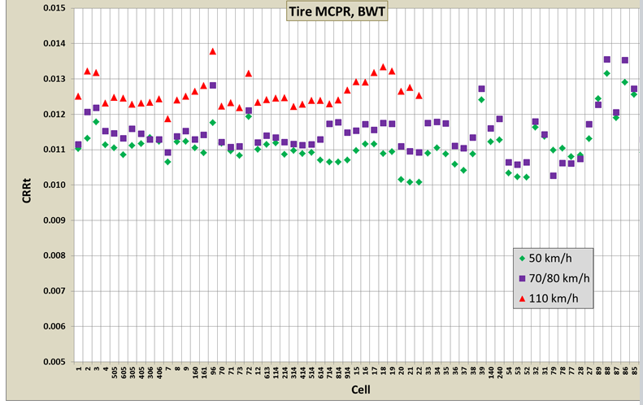
2013 RR RESULTS

Slide 20
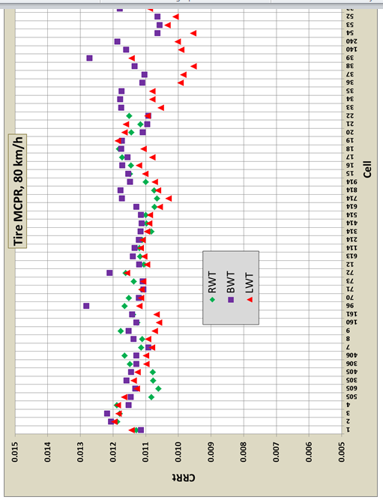
RR 2014 RESULTS (Effect of Tire contact)
Ejsmont, Sweiko Gregorrze &Wilkde 2014

Slide 21
Factors Driving Rolling Resistance
Concrete Excluding Diamond Grinding
𝐶𝑅𝑅𝑒𝑠𝑡𝑖𝑚𝑎𝑡𝑒 = 4.754 × 10⁻⁵ × (𝑇𝑒𝑥𝑡𝑢𝑟𝑒, 𝐿 50 𝑡𝑜 160 𝑚𝑚)
+ 9.313 × 10⁻⁴ × (50% 𝑇𝑟𝑆𝐾𝐸𝑊)+ 5.255 × 10⁻⁵ (𝑅𝑜𝑢𝑔ℎ𝑛𝑒𝑠𝑠, 𝐿 1.25 𝑚) + 1.249 × 10⁻³ + 2.641 × ⁻³ × 𝑅𝑜𝑎𝑑
Asphalt
𝐶𝑅𝑅𝑒𝑠𝑡𝑖𝑚𝑎𝑡𝑒 = 1.220 × 10⁻⁴ × (𝑇𝑒𝑥𝑡𝑢𝑟𝑒, 𝐿 3.15 𝑡𝑜 50 𝑚𝑚)
+ 4.290 × 10⁻³ + 9.552 × 10⁻⁴ × 𝑅𝑜𝑎𝑑
Sohaney 2014
Izevbekhai & Sohaney 2014

Slide 22
MNROAD & NETWORK SITE RR SUMMARY
Rolling Resistance
The coefficient of rolling resistance of the truck tires varied from 0.0044 to 0.0072 on the Mainline cells.
Fuel consumed by the rolling resistance force at 30 MPH varied between 0.006
liter and 0.009 liter per cell, for an average consumption of 5 liter/100 km.
Rolling resistance was 0.0072 on bituminous TH 66 and 0.0061 on concrete TH 10, for a vehicle speed of 55 MPH.
Pavement Condition
In particular, joints between concrete panels gave rise to vibrations at 2.9 Hz corresponding to panel length of 15’ on the Mainline or 27’ on TH 10.
The fuel consumption component attributed to dynamic rolling resistance was computed to be 0.3 liter/100 km higher on the TH 10 section Concrete compared to the TH 66 section Asphalt.
Paterlini et al 2015

Slide 23
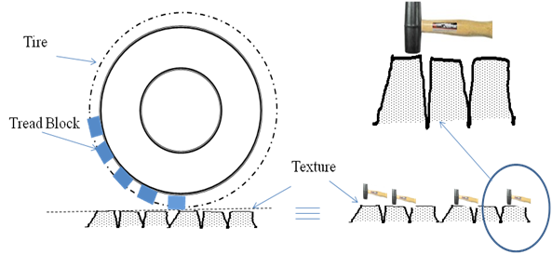
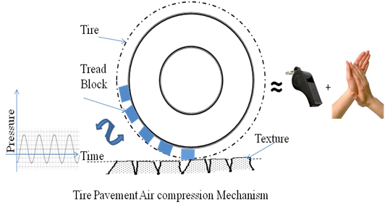
Tire Pavement Envelopment and Implications
Thread –Block Impact & Air Compression Relief Izevbekhai 2012

Slide 24
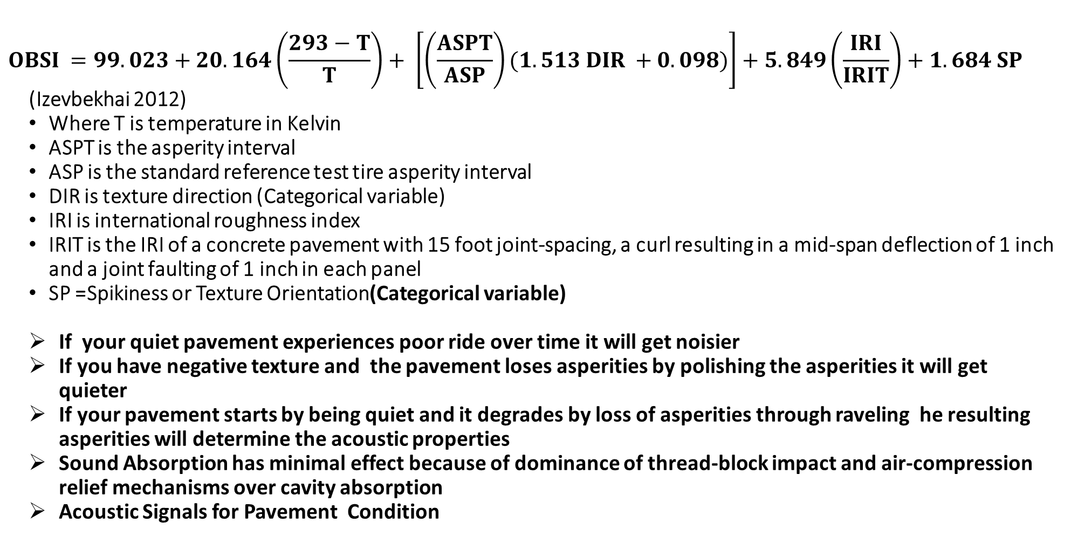
OBSI PREDICTIVE EQUATION
$$OBSI =99.023+20.164\left(\frac{293−T}{T}\right)+ \left[\left(\frac{ASPT}{ASP}\right)(1.513 DIR +0.098)\right]+5.849\left(\frac{IRI}{IRIT}\right)+1.684 SP$$
(Izevbekhai 2012)
Where T is temperature in Kelvin
ASPT is the asperity interval
ASP is the standard reference test tire asperity interval
DIR is texture direction (Categorical variable)
IRI is international roughness index
IRIT is the IRI of a concrete pavement with 15 foot joint-spacing, a curl resulting in a mid-span deflection of 1 inch and a joint faulting of 1 inch in each panel
SP =Spikiness or Texture Orientation(Categorical variable)
If your quiet pavement experiences poor ride over time it will get noisier
If you have negative texture and the pavement loses asperities by polishing the asperities it will get quieter
If your pavement starts by being quiet and it degrades by loss of asperities through raveling he resulting asperities will determine the acoustic properties
Sound Absorption has minimal effect because of dominance of thread-block impact and air-compression relief mechanisms over cavity absorption
Acoustic Signals for Pavement Condition

Slide 25
Validation of Izevbekhai’s Prediction Model

Slide 26
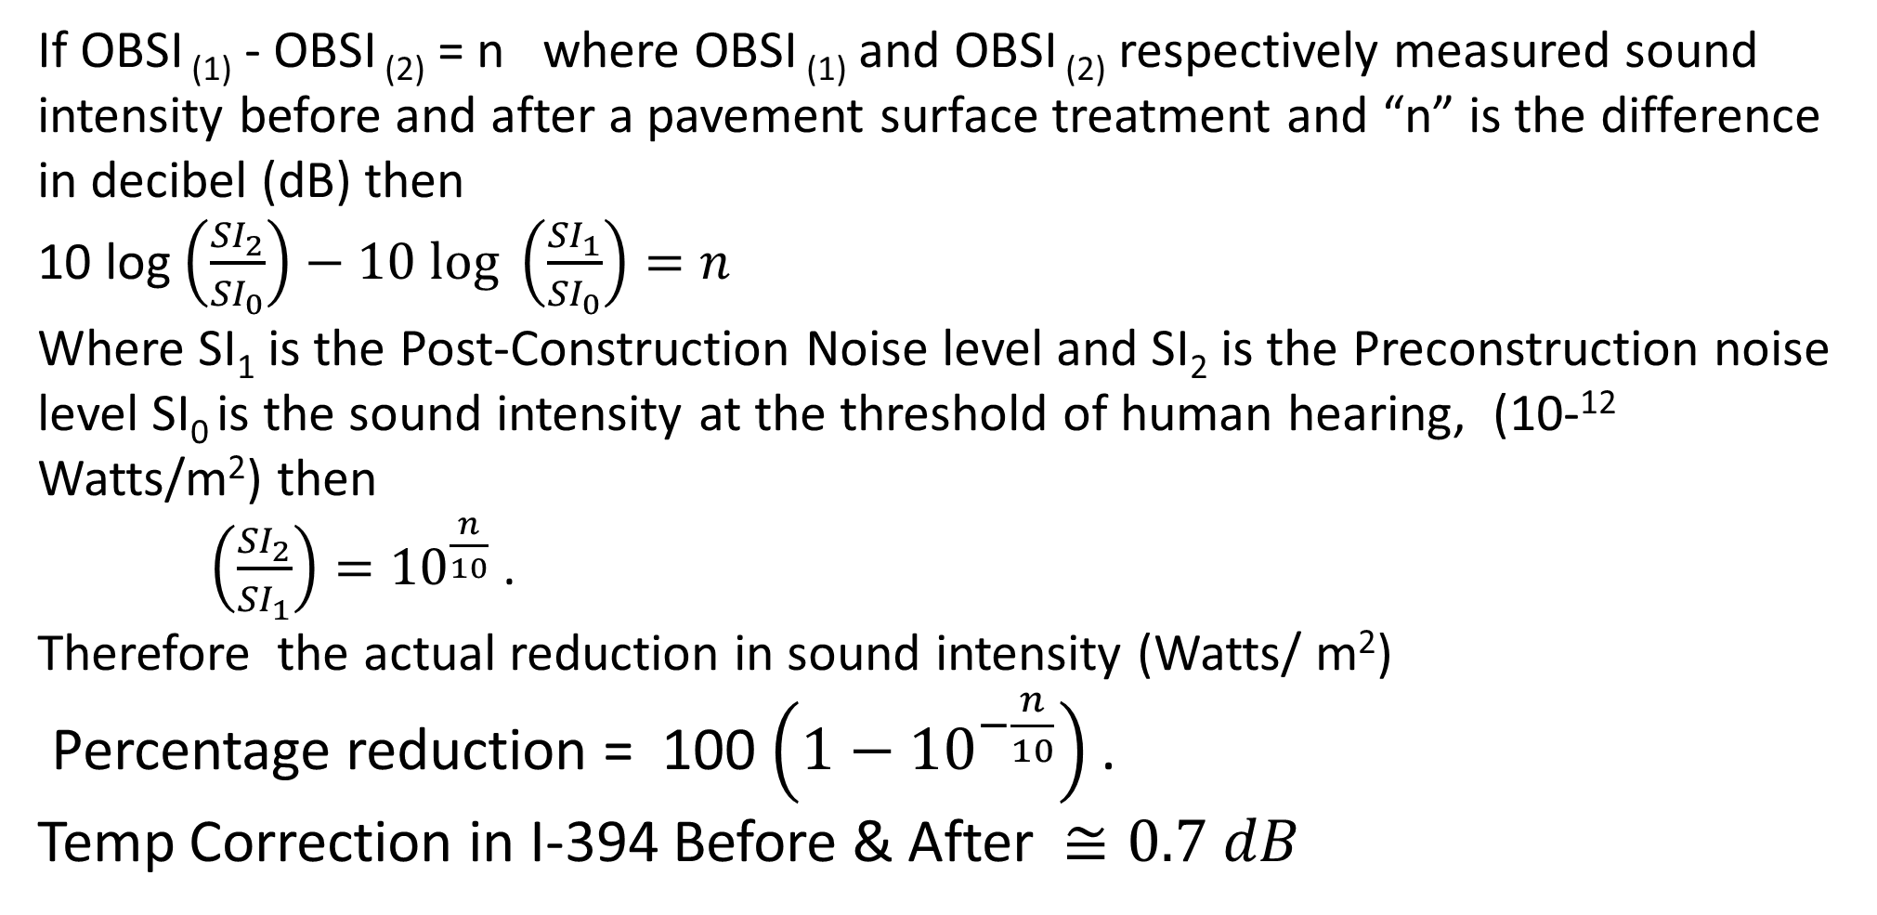
I-394 Temperature correction IN TPIN
If OBSI ₍₁₎ - OBSI ₍₂₎ = n where OBSI ₍₁₎ and OBSI ₍₂₎ respectively measured sound intensity before and after a pavement surface treatment and “n” is the difference in decibel (dB) then
10 log $\left(\frac{{SI}_{2}}{{SI}_{0}}\right)−10 log \left(\frac{{SI}_{1}}{{SI}_{0}}\right)=n$
Where SI₁ is the Post-Construction Noise level and SI₂ is the Preconstruction noise level SI₀ is the sound intensity at the threshold of human hearing, (10-¹² Watts/m²) then
$\left(\frac{{SI}_{2}}{{SI}_{1}}\right)={10}^{\frac{n}{10}}$ .
Therefore the actual reduction in sound intensity (Watts/ m²)
Percentage reduction = 100 $\left(1−{10}^{−\frac{n}{10}}\right)$ .
Temp Correction in I-394 Before & After $≅0.7 dB$

Slide 27
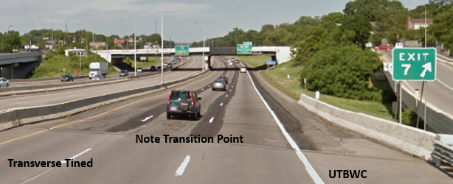
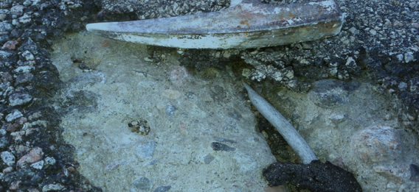
I-394 NGCS DEPLOYMENT
UTBWC

Slide 28
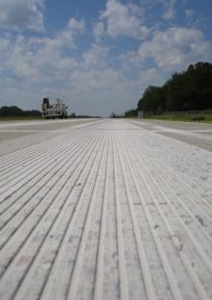
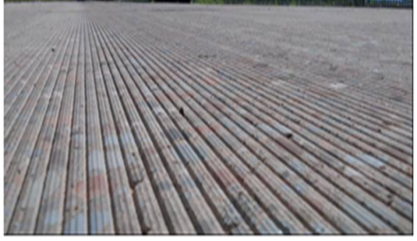
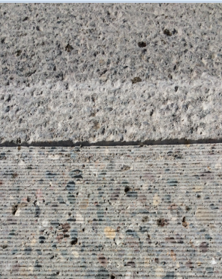
NGCS I-394 REMOVAL TO REPAIRS TO GRINDING
CONV
FLUSH
NGCS
NGCS

Slide 29
I-394 OBSI Before and After

Slide 30
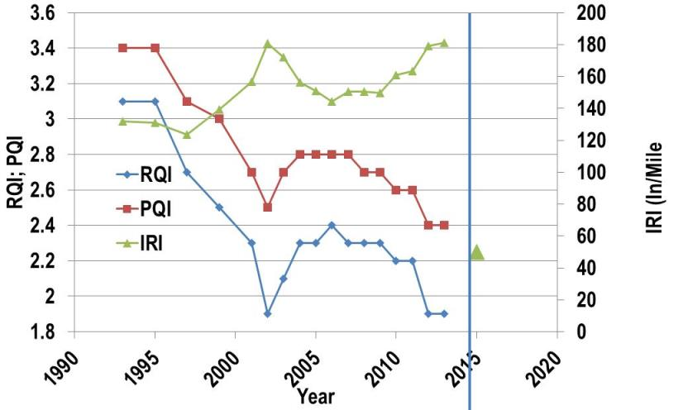

I-394 RIDE PERFORMANCE
NGCS
Friction and Smoothness not sacrificed at the altar of Acoustic Benefits
Many States have Obtained the NGCS Specs

Slide 31
Probabilistic Representation of Acoustic Levels

Slide 32
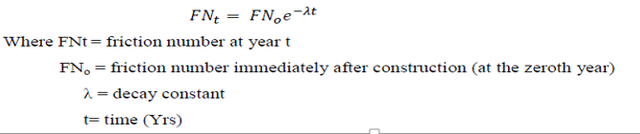
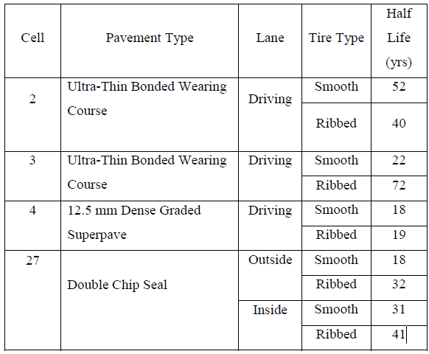
Skid Resistance of Bituminous Surface Properties Estimated half Life Ribbed Tire Friction

Slide 33
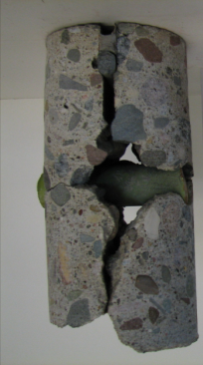
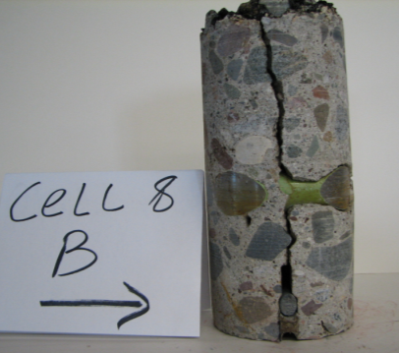
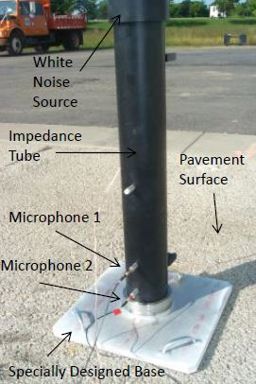
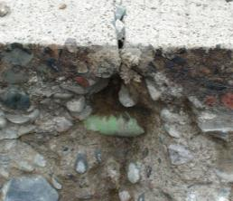
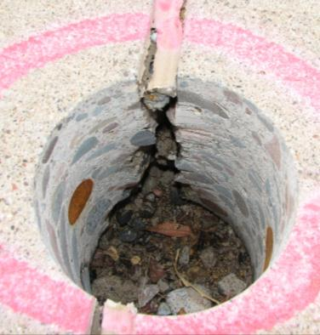
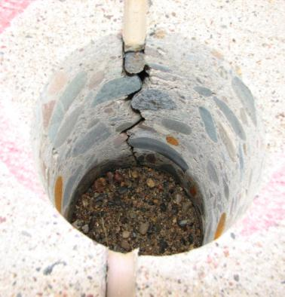
Deployment of Acoustic Impedance Tube
STUDY
Scouring
Draining
Base
Non Draining Base
STUDY DEPLOYMENT

Slide 34


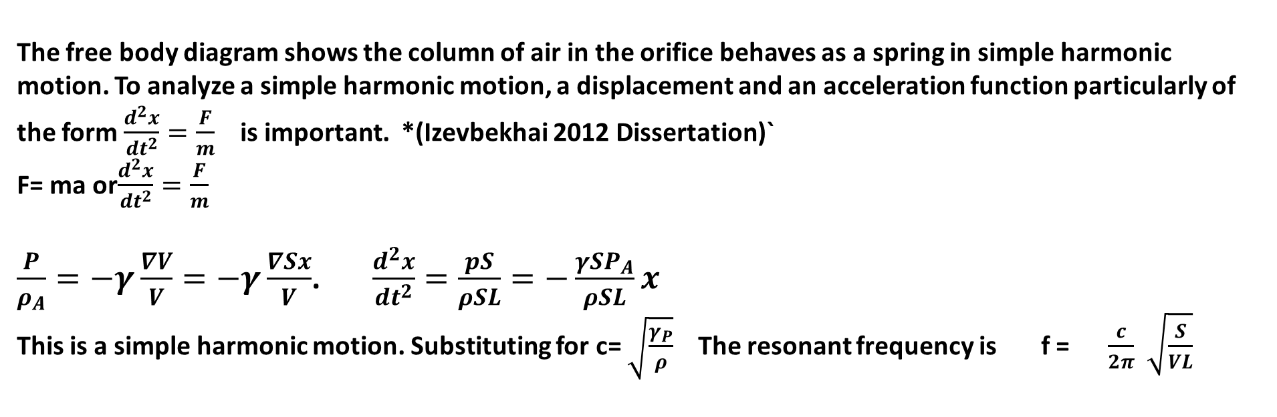
RESONANCE PHENOM:
L
V
HelmHoltz Phenomenon
When a fliud enters the cavity through the neck, the fluid in the neck has a total effective mass (m), it can be shown that
The free body diagram shows the column of air in the orifice behaves as a spring in simple harmonic motion. To analyze a simple harmonic motion, a displacement and an acceleration function particularly of the form $\frac{d^{2}x}{{dt}^{2}}=\frac{F}{m}$ is important. *(Izevbekhai 2012 Dissertation)`
F= ma or$\frac{d^{2}x}{{dt}^{2}}=\frac{F}{m}$
$\frac{P}{ρ_{A}}=−γ\frac{∇V}{V}=−γ\frac{∇Sx}{V}$. $\frac{d^{2}x}{{dt}^{2}}=\frac{pS}{ρSL}=−\frac{{γSP}_{A}}{ρSL}x$
This is a simple harmonic motion. Substituting for c= $\sqrt{\frac{γ_{P}}{ρ}}$ The resonant frequency is f = $\frac{c}{2π}$ $\sqrt{\frac{S}{VL}}$

Slide 35

Deployment of Acoustic Impedance Tube: Helmholtz Resonance
Consider an orifice of areas with a neck length L, fluid density is ρ and displacement of fluid in cavity is ξ. It can be shown that with spalling of the neck, effective neck length of tube is altered. As the joint deteriorates (assume wedge to be isosceles triangle of normal sides “a”, and volume V of cavity increases, the acoustic energy generated by a tire riding over the joint will increase.
Progression of Joint Deterioration Showing Dimensions of Acoustic Relevance

Slide 36




Deployment of Joint Evaluation Device 2015: Resonance
Cavity Orifice
The more the joint spalling (L’ increases) the lower the natural frequency.
The acoustic radiation resistance of an unspalled joint will reduce with subsequent spalling.
Cavity Volume:
For very small λ >> a the radiation resistance in the cavity is expressed as
Whence Natural frequency
The higher the volume of cavity of deterioration of an unspalled joint,
the lower the natural frequency
The higher the volume of cavity of deterioration of an unspalled joint, the lower the natural frequency.

Slide 37
Joint Evaluation Device 2015:Distress Models
Task 1: Concept: GPR , Impact Echo, MIRA, Rod Tamping, Chain Dragging: Why do we need the impedance Tube. What are the Features we would exploit. What Joint Conditions are being evaluated.
Task 2: Build Model Distressed Joints Deliverable) Model Distressed Joints
  Pristine joint
  Spalled Joint
  Scoured Joint
  Belled Bottom Joint
  Combinations
Task 3 Measurements of the various panel models
Task 4: Extract Data and plot all the 3rd Octaves OutPut Deliverable: Plotted data
Task 5 Data Analysis: Multiple regression, Stepwise regression
Task 6: Validation tests Cell 32: Validation Cores Deliverable : Validation (one Pager)
Task 7: Final Report: Identify Signatures of Various Distress Types and propose calibration of impedance Tube

Slide 38
Nuggets and Concomitants Asphalt PSC
Asphalt PSC
Texture Orientation is a significant Property important in Friction nand TPIN
UTBWC and Chip seals Improve Friction but Skid resistance degradation rate is a Function of Remaining Skid resistance (Half Life decay Equation)
Texture degradation Rate Appears to coincide with respective damage rate from 105K X1 Vs 85K X 5
Initial IRI is a Predictor of Service Life when Construction and initial Materials Mishaps are minimized. Otherwise rate of IRI degradation is the de-facto Predictor.
The 4.75 mm asphalt taconite thin Overlay was the quietest asphalt pavement ever measured at MnROAD
UTBWC and Chip seals Improve Friction but Skid resistance degradation rate is a function of remaining skid resistance (Half Life decay Equation)

Slide 39
Acoustic Impedance Spalled Joint

Slide 40
Impedance Tube Response For Multiple Degradation

Slide 41
Closing Nuggets
Development and Validation of a Sound Absorption Measurement Process: Testing revealed insignificant variation in sound absorption coefficient in non-pervious concrete and significant variation in pervious concrete pavements. It validated the hypothesis that pavement quietness relates more to how the textures facilitate air compression relief and minimize tire-tread- block impact in pavement interaction.
Time Series (ARIMA) and Statistical Representation: For example in a transverse tined cell (cell 36) the OBSI time series was of the form:
Y _{(t)} = μ + Y_{t-1} + ø₁ (Y_{t-1} - Y_{t-2}) + ø₂ (Y_{t-2} - Y_{t-3})
Where μ = 0.563, ø₁ =0.180 ø₂ = 0.413
Effect of Texture Direction and Texture Orientation:
Mann Whitney Wilcoxon method showed to a 95% confidence level
Texture direction did not seem to affect IRI significantly.
However, certain longitudinal textures exhibited anomalous

Slide 42

Closing Nuggets
Laser Induced Anomalies in Ride Measurements: The problem of laser induced anomalies is also prevalent in the ground textures which are outside the purview of this study.
Analysis of Investment in Surface Characteristics: Benefit-cost analysis X probability that each surface would be quieter than 100 dBA was applied to the benefit to give an adjusted benefit/cost ratio. Two ratios were computed from two scenarios: replacing a drag texture and replacing a transverse tined texture. In quiet surfaces may be cost saving in certain cases
Friction Survival Model with MnROAD Concrete Surface Textures: This study, DE is the number of Estimated Standard Axle Loads (ESALs) calculated for design year and FE represents the twentieth year projected ESALs
Ribbed$F=22.01\sin\left(kt\right)+29.21\cos\left(kt\right)\left[1+e^{−0.1t}\right]$
Mainline Smooth :$F=\left[\left(\frac{801000}{DE}\right)\left(\frac{FE}{DE}\right)\right]\left[\sin\left(kt\right)+18.36\cos\left(kt\right)\left[1+e^{−0.8t}\right]\right]$
Low Volume Road (Smooth) :$F=−4.56\sin\left(kt\right)+15.56\cos\left(kt\right)\left[1+e^{0.031t}\right]$
Relationship between Pavement Condition and Pavement Acoustics: The acoustic signal from a deteriorated joint is different from that of an undeteriorated joint. It also validated this lemma through the analysis of data and showed that there was a correlation between OBSI and IRI.

Slide 43

21st Century Use of Concrete
Truth be told: One of our most fashionable inventions is the use of concrete for selfie!!!

Slide 44


QUESTIONS
THE ENDLESS ROAD OF RESEARCH

