Slide 1
WisDOT Cold In-Place Recycling Pavement Rehabilitation
Barry Paye, PE
Chief Materials & Pavement Engineer
Wisconsin DOT

Slide 2
Presentation Outline
Introduction to Cold In-Place Recycling (CIR)
Types of CIR Equipment
Benefit of CIR
Pavement distresses addressed by CIR
Overview of WisDOT CIR Projects
CIR Projects Short Term Performance Data
Public Relations

Slide 3
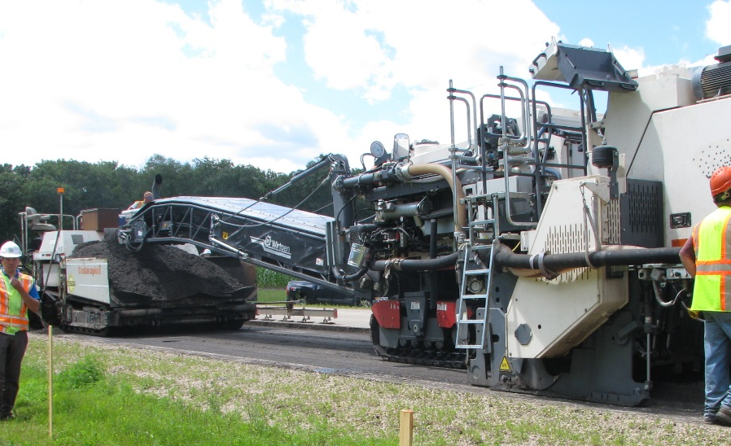
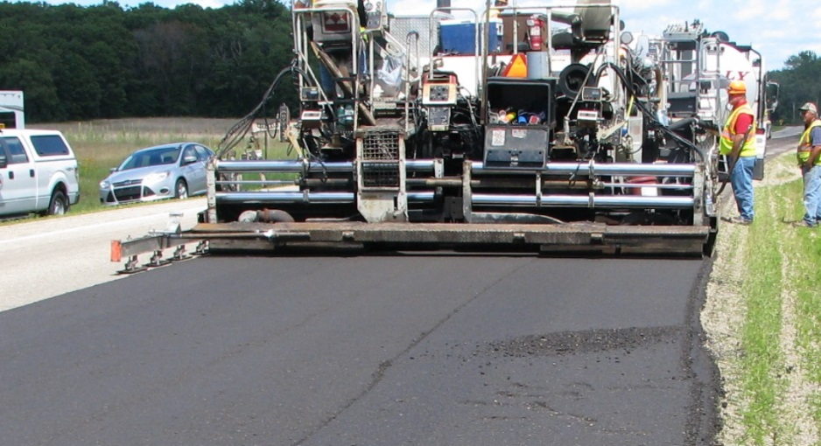
Cold In-Place Recycling (CIR)
CIR uses mechanical process to produce RAP from the existing pavement, add a stabilizing agent, relay & compact into a stabilized base.
Typical CIR process treatment depth - 3 to 4”

Slide 4
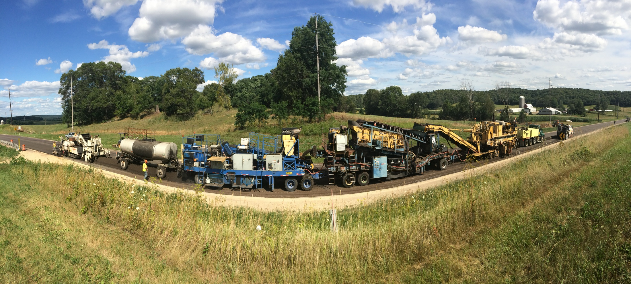
Types of CIR Equipment
Multi – Unit CIR Train
Pick Up Machine/Paver
Crushing/Sizing
Milling
Pug mill
AC Tank
Working Direction

Slide 5
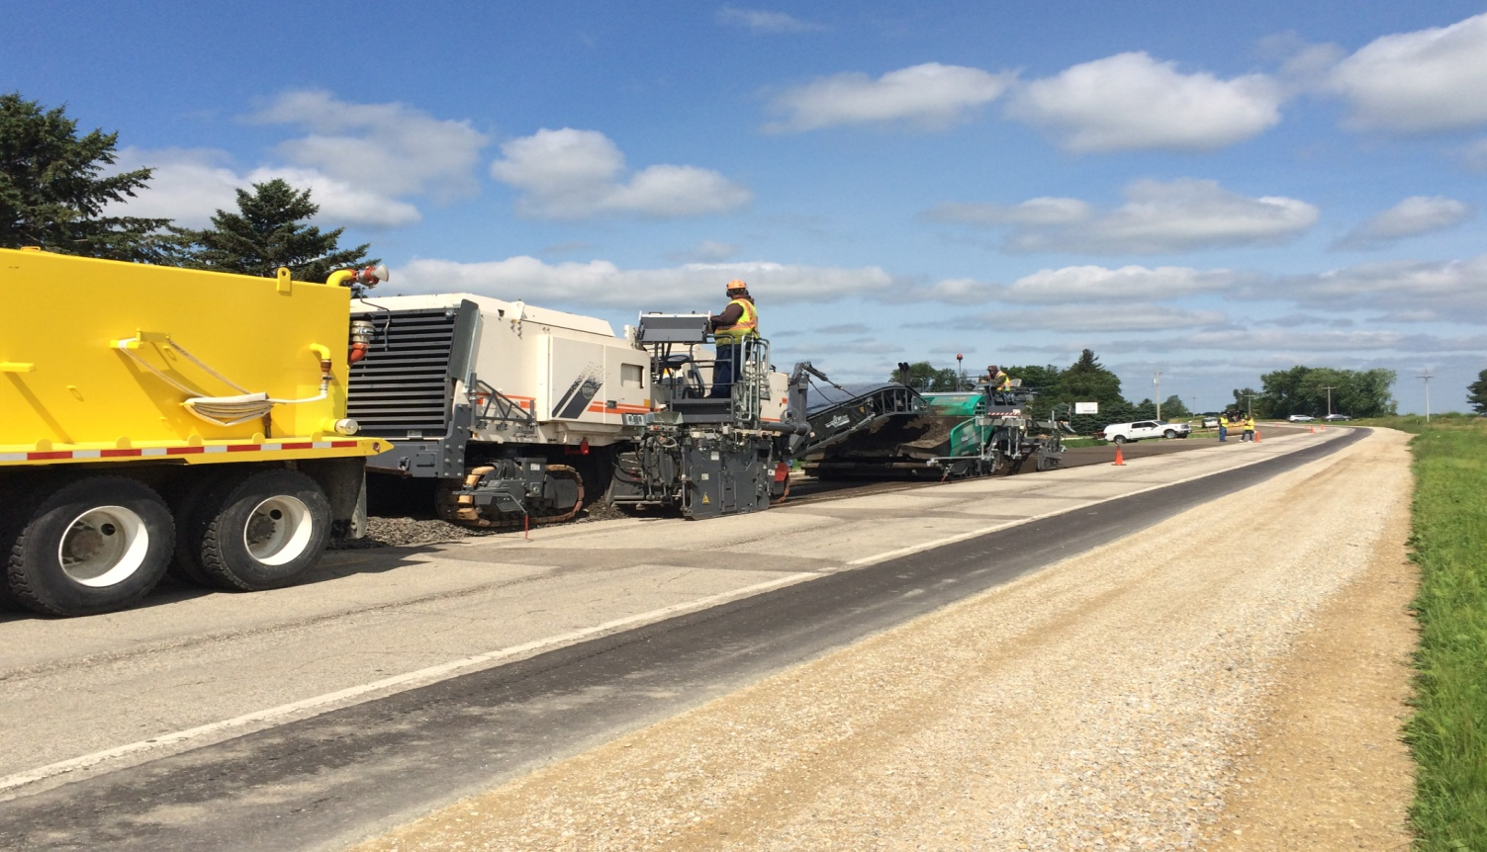
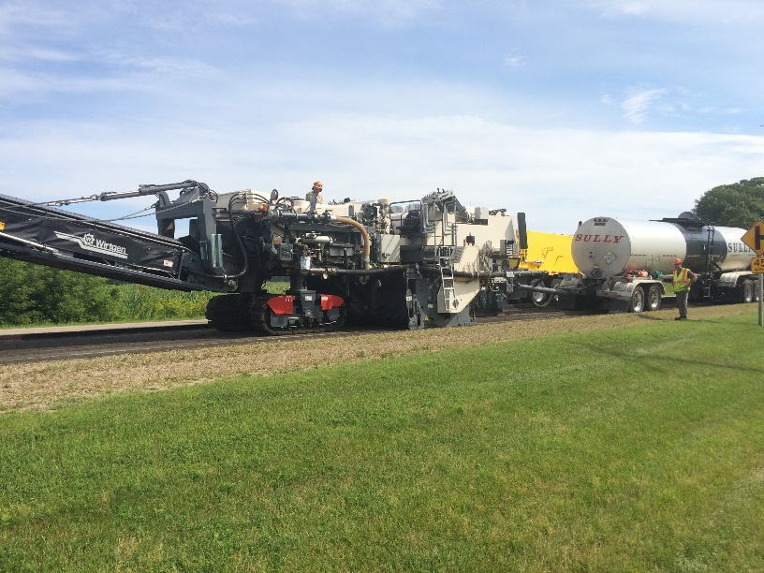
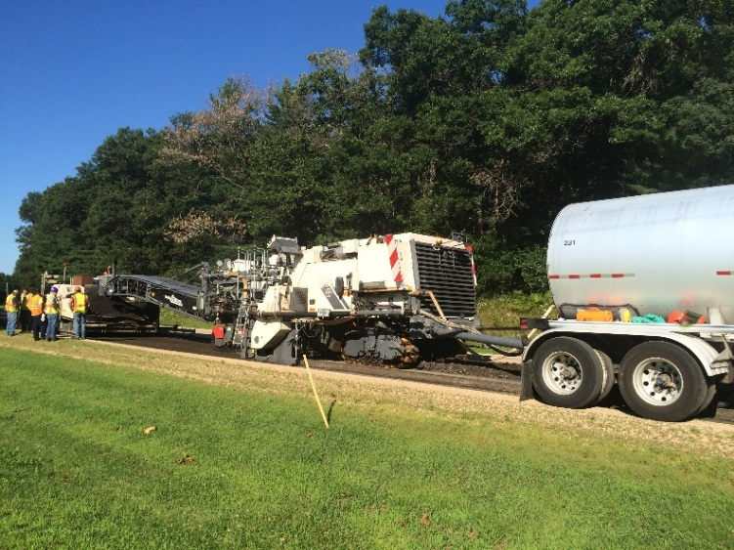
Types of CIR Equipment
Single-Unit CIR Train
Water
AC Tank
Cutting chamber

Slide 6
Benefit of CIR
Cost Savings
  Potential cost savings compared to equivalent
  mill/overlay rehabilitation methods.
Engineering
  Addresses actual distress rather than symptoms.
  Cracks eliminated/reduced – CIR act as crack relief layer.

Slide 7
Benefit of CIR
Construction Time
  CIR layer can be opened to traffic within a couple of
  hours.
  Minimal Traffic disruption and user delay.
Environmental Benefit
  Using in-place materials minimizes hauling cost & use
  of virgin material.
Notes:
.

Slide 8
Pavement Distresses addressed by CIR
Distresses addressed by CIR
Ruts < ½ in √
> ½ in ?¹
Crack Fatigue ?¹
Longitudinal √
Transverse √
Reflective √
Block √
Potholes (surface only) √
Poor Ride √
Poor Drainage no
Structural Deficiency ?²
Base/subgrade Failure no
Questions?
Provided not base, subbase or subgrade related.
In conjunction with
Overlay to increase
structural capacity

Slide 9
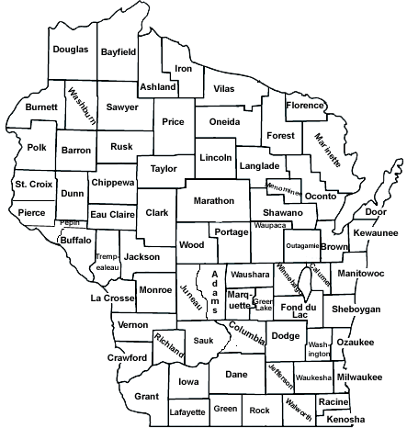
CIR Projects Map (Since 2012)
Construction Year | Project Length (Lane-Mile)
2012 | 26
2014 | 24
2015 | 50
2016 | 58
Total | 158

Slide 10
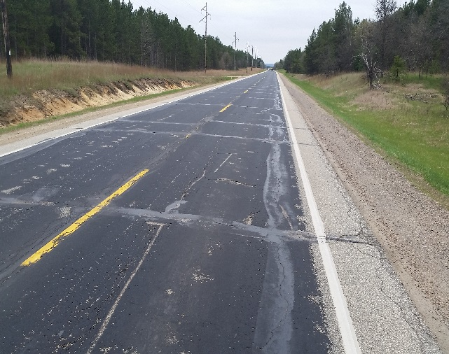
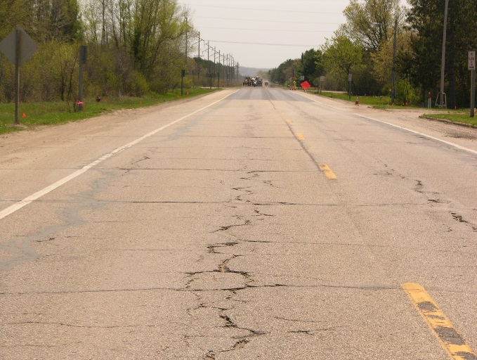
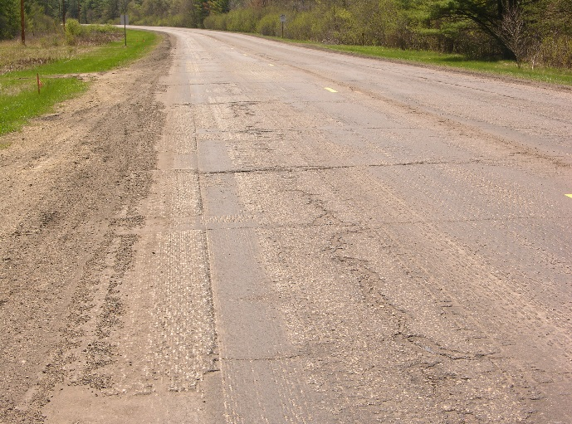
STH 27(Sparta – Black River Falls)
CIR Construction – 2016
Design AADT 11,000, 15.2% Truck
ESALs 20 years – 1,598,700
4” CIR Layer + 2.5” HMA Overlay
Project Length = 8.402 miles

Slide 11
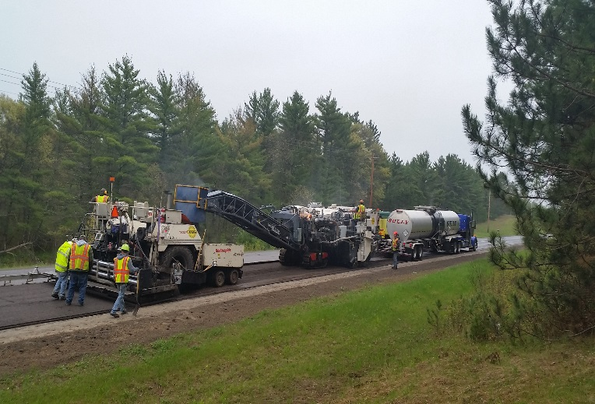
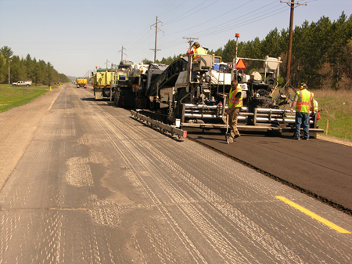
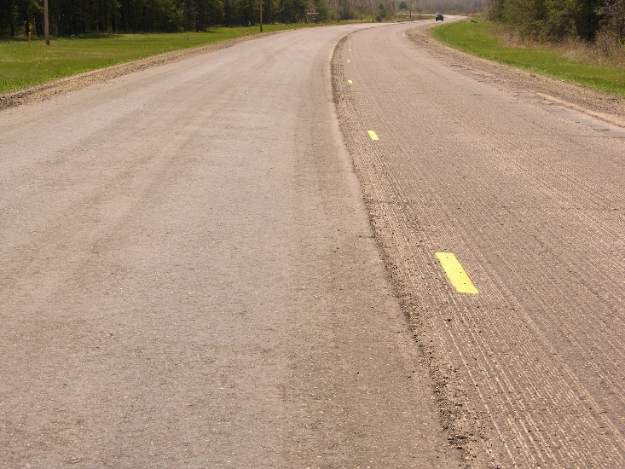
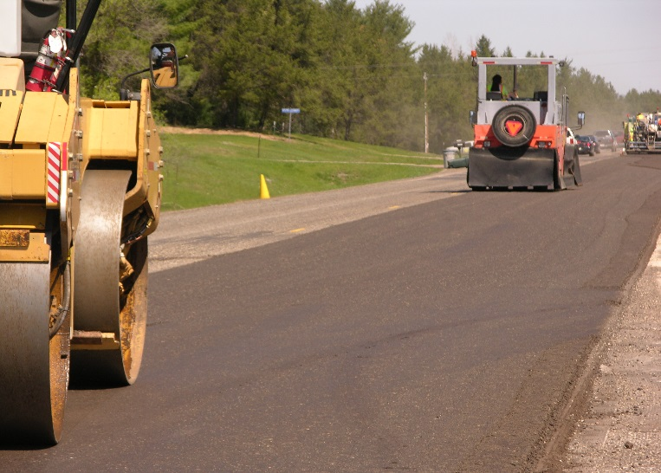
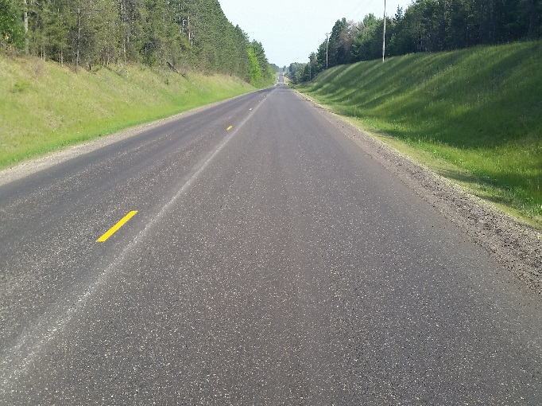
STH 27 - Placing/Compaction
CIR
Non-CIR
Finished CIR Layer

Slide 12
STH 48 (Grantsburg – Frederic)
Pavement History – Before CIR
Last Resurfaced 3”- 4” inch 1994
Various Maintenance activities
CIR Construction – 2012
      Design AADT 1,100, 5.2% Truck
      ESALs-20 years – 131,400
4” CIR + 2” HMA Overlay
Project Length = 12.56 Miles

Slide 13
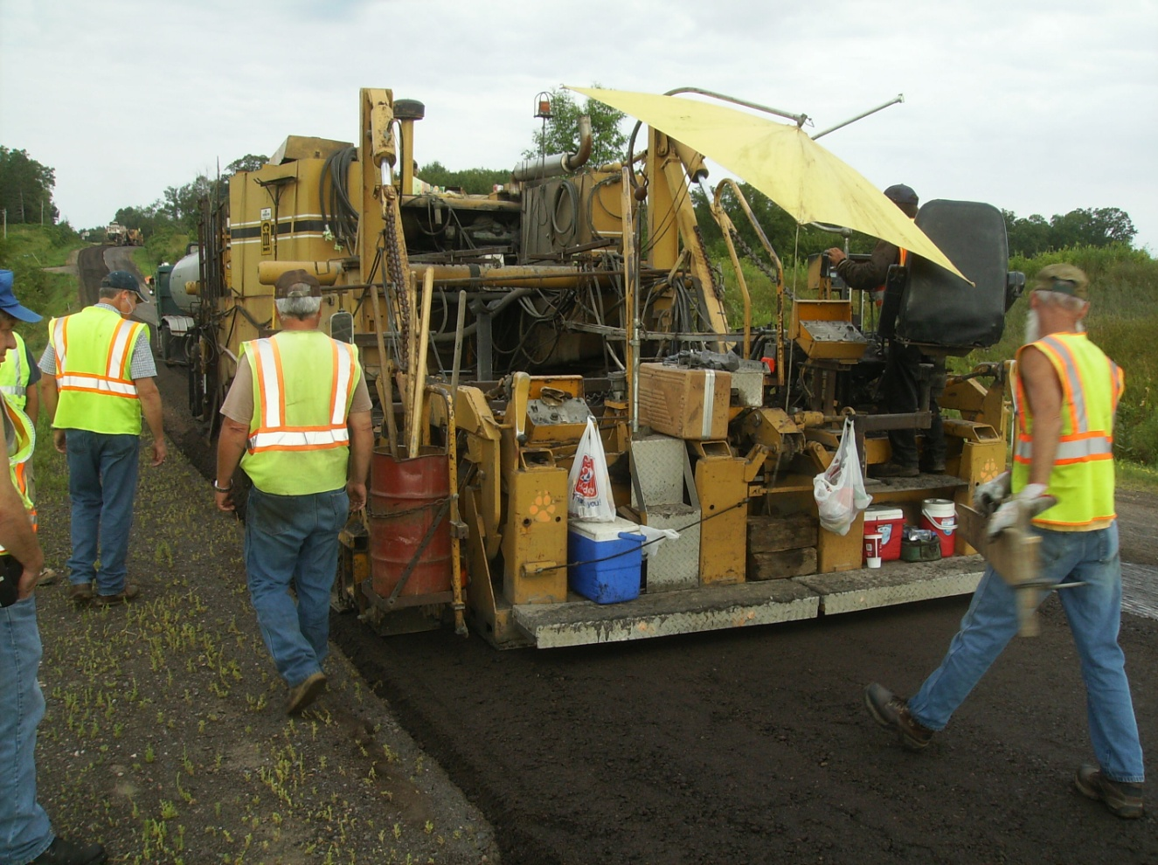
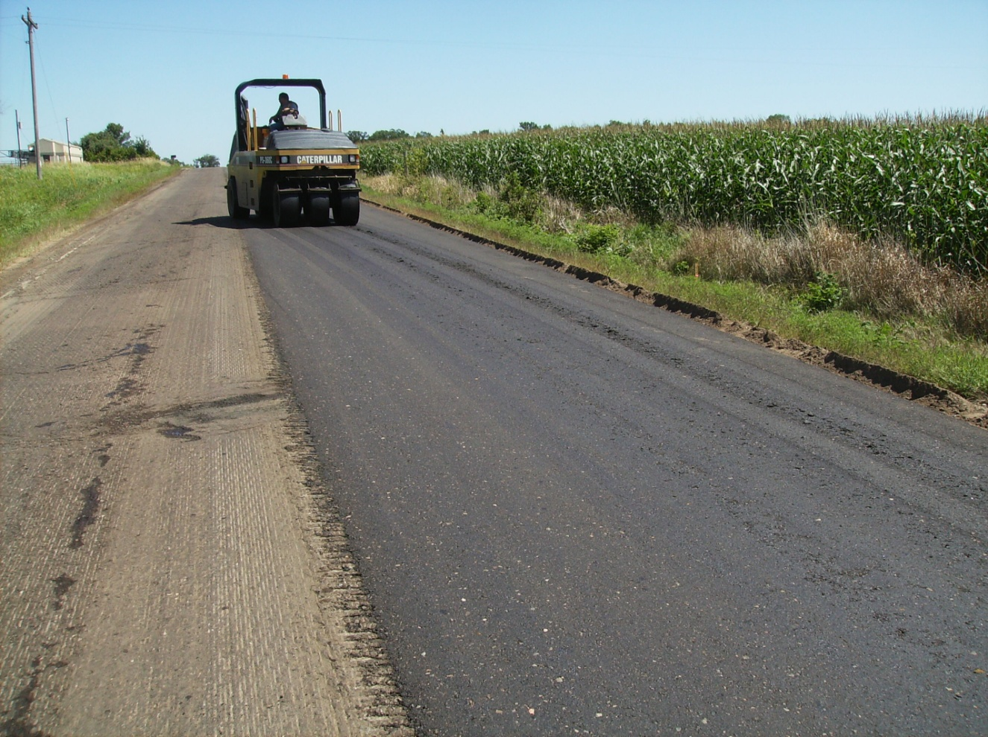
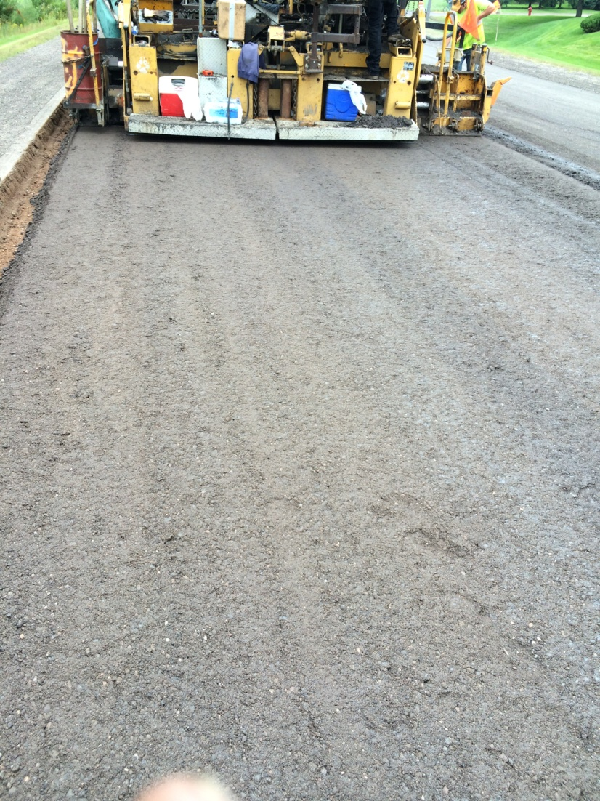
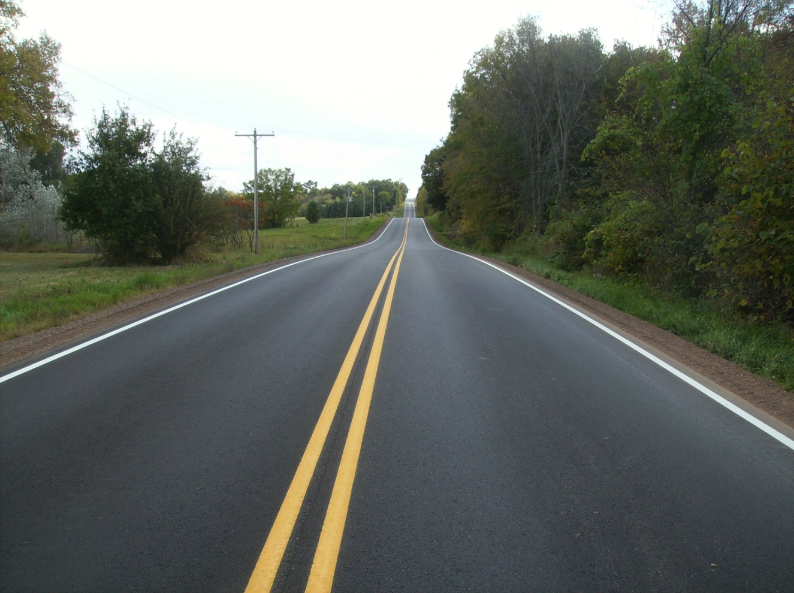
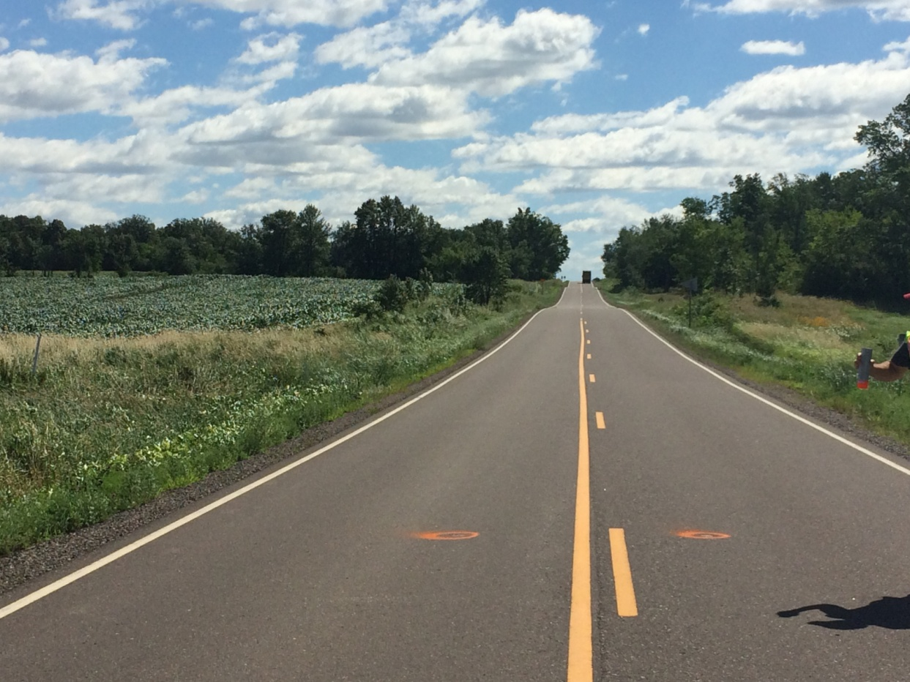
STH 48 (Grantsburg – Frederic)
After construction
After 3 Years

Slide 14
STH 48 (Grantsburg – Frederic) Performance Data
Four years in service
Transverse Cracking
Longitudinal Cracking
Non-CIR
CIR
CIR
Non-CIR
CIR
CIR
Roughness
Non-CIR
CIR
CIR
Non-CIR
CIR
CIR

Slide 15
STH 64 (Gilman-Medford)
CIR Construction – 2014
Design AADT 10,800, 17.5% Truck
ESALs = 1,708,200
4” CIR + 2” HMA Overlay
Initial Project Plan 13.3 miles (appr. 30% CIR
completed)

Slide 16
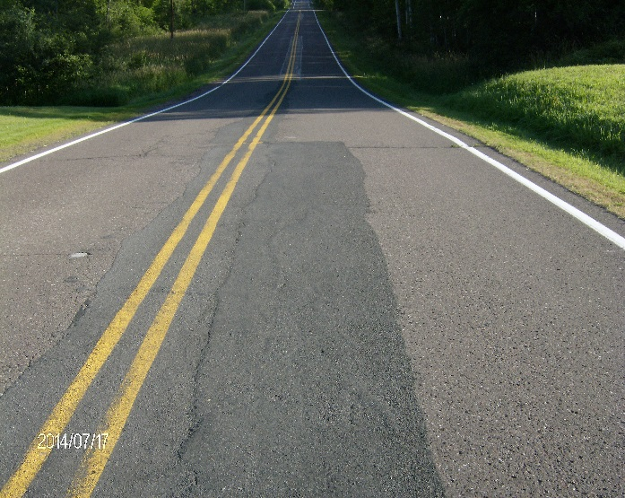
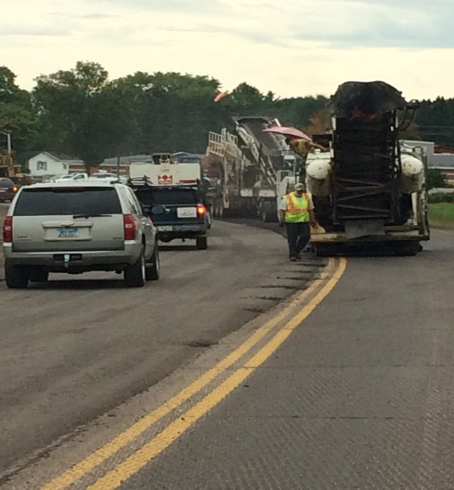
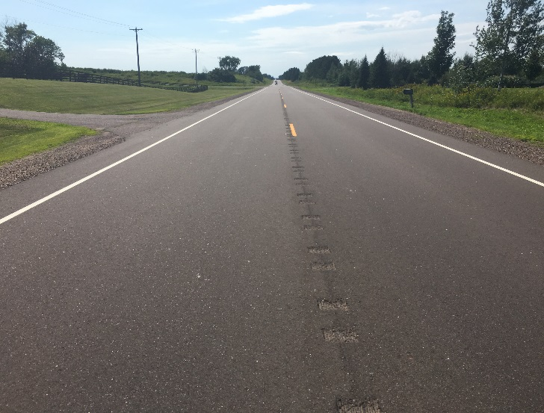
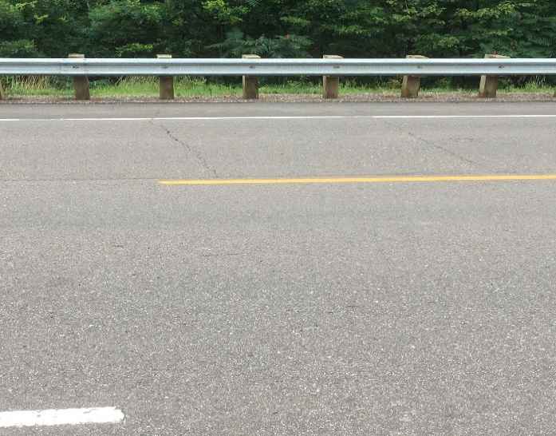
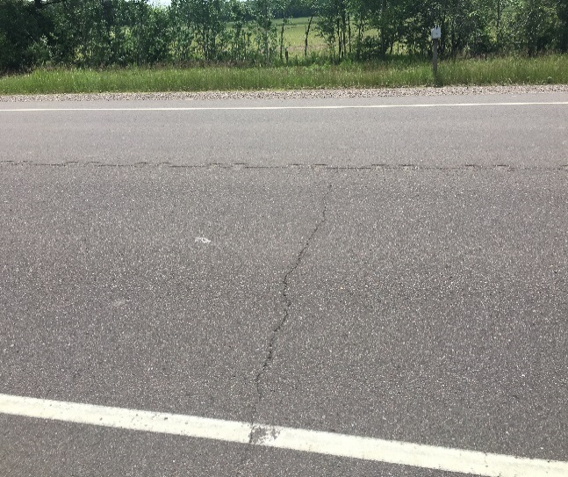
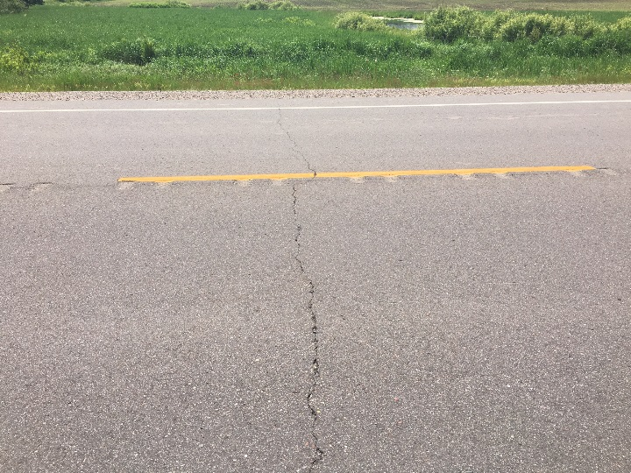
STH 64 (Gilman - Medford )
Before CIR
CIR Operation
CIR – Both Lanes
2016
WB Lane Mill&Overlay
EB Lane CIR
EB Lane CIR
WB Lane Mill&Overlay
Mill & Overlay – Both Lanes
2016
2016
2016
Finished CIR Layer

Slide 17
STH 64 (Gilman – Medford) Performance Data two year in service
Transverse Cracking
Non-CIR
CIR
Non-CIR
CIR
Roughness
Non-CIR
CIR

Slide 18
Summary of CIR Projects IRI and Rut Depth Values

Slide 19
Design Criteria & Considerations
Distressed Layer & Distress Types
Traffic Volume
Historical Information
Geometric Considerations
Roadway, Subgrade & Drainage
Layer Coefficient - 0.30-0.35
Mix Design Considerations
Curing Time

Slide 20
WisDOT Experience
17% Let savings vs 4” mill & overlay
10x reduction in cracking compared to mill & overlay
Minimal disturbance to traveling public

Slide 21
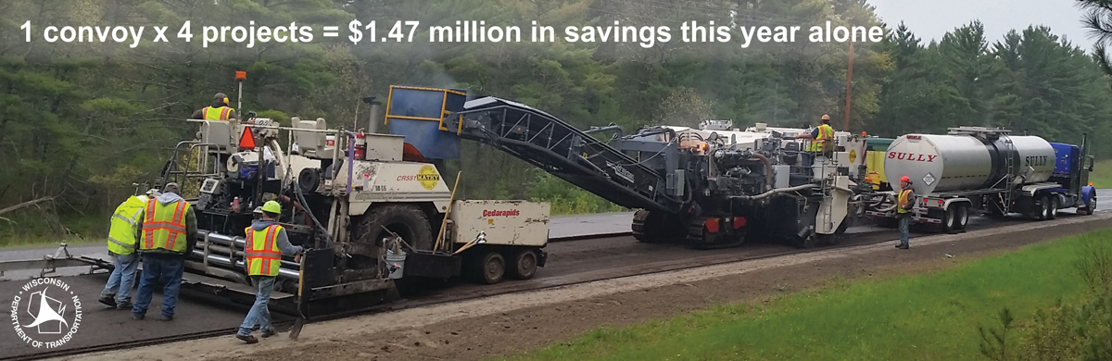
Public Benefits

Slide 22
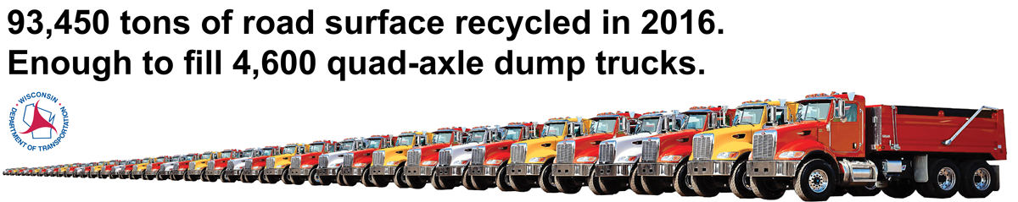
Public Benefits

Slide 23
Public Benefits

Slide 24
Questions/Contact
Barry Paye, PE
Materials Management Section
Phone: 608-246-7945
Email: Barry.paye@dot.wi.gov

