Slide 1
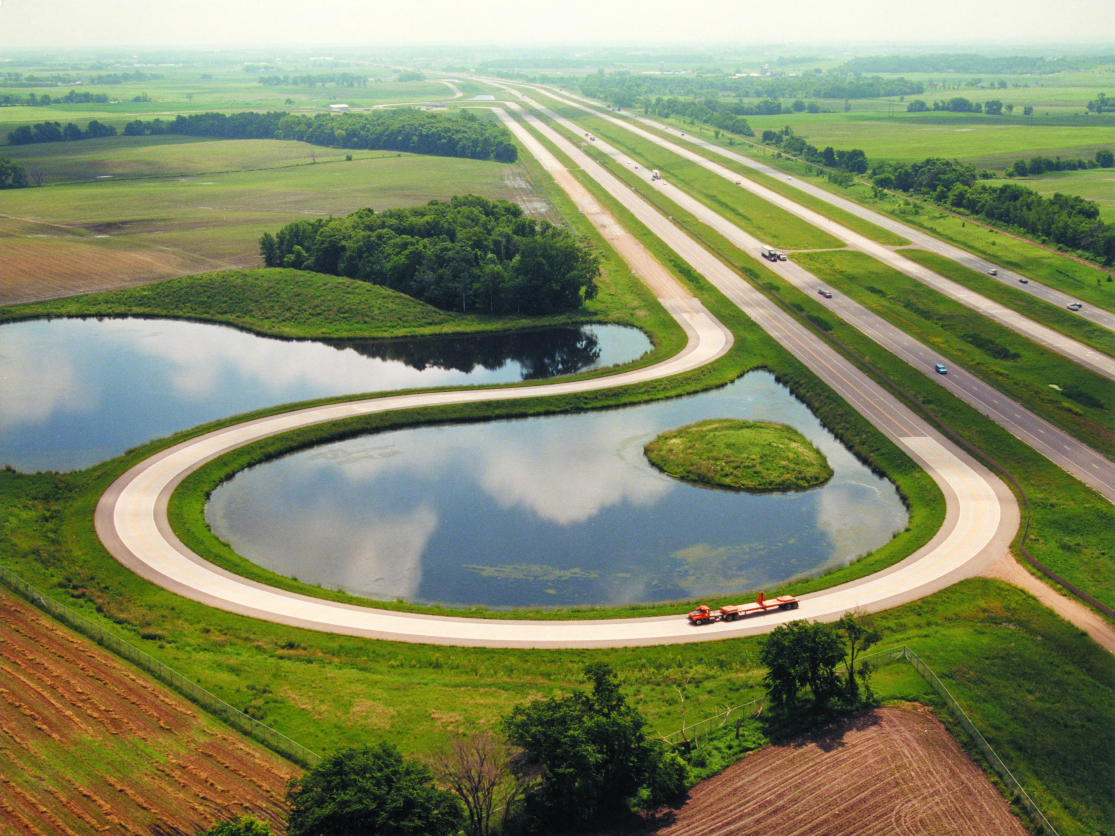
Some Thoughts on Improving
Pavement Research Implementation
Charles W. Schwartz
University of Maryland – College Park
NRRA Pavement Conference 2017
St. Paul, MN May 24, 2017

Slide 2
Topics
The Problem
The Research
The People
The “Industry”
Some Proposals

Slide 3
The Problem
Magnitude
Complexity

Slide 4
The Research
Scope
Impact

Slide 5
The People
Researchers
Graduates
Industry

Slide 6
The “Industry”
Contractors/Consultants
Academia
Agencies

Slide 7
Some Solutions

Slide 8
Association of Pavement
Scientists and Engineers (APSE)
Vision:
Strive to build save, secure and sustainable mobility
for people and goods through academic excellence.
Mission:
Serve the pavement science and engineering academic
community through education, research and
professional service.

Slide 9
Some Solutions
Focus on fundamentals over empiricism
Enhance education and training
Increase national standardization
Improve research programming
Change mix of research project deliverables
Continue performance monitoring research
Raise industry acceptance

Slide 10
10 Keys to Innovation Deployment
(Engineering Marketing 101)
The User is Always Right.
Overcommunicate the Why
Resistance to Change – Expect It!
Foster Champions/Engage Peer-to-Peer
Strive for Simplicity
Courtesy: Tom Harman, Director of FHWA Center for Accelerating Innovation

Slide 11
10 Keys to Innovation Deployment
(Engineering Marketing 101)
Network
Reinforce the How
Tell a Compelling Story
Manage Change
Celebrate and Learn from Mistakes
Courtesy: Tom Harman, Director of FHWA Center for Accelerating Innovation

Slide 12
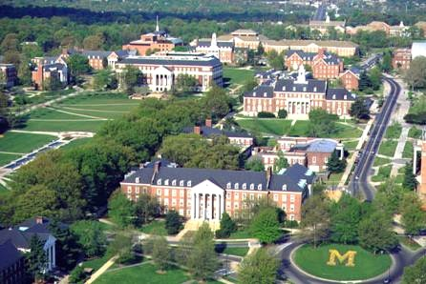
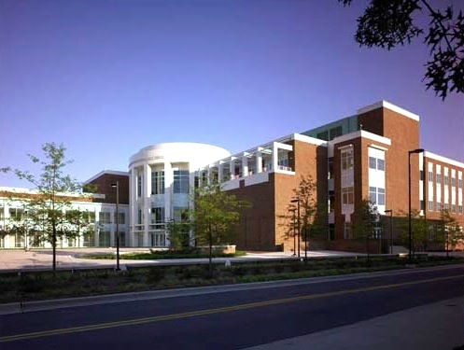

Contact Info:
Dr. Charles W. Schwartz
Professor and Chair
University of Maryland
schwartz@umd.edu
+1.301.405.1962

