Slide 1
Copyright Roadscanners Oy 2014. All Rights Reserved.

Slide 2
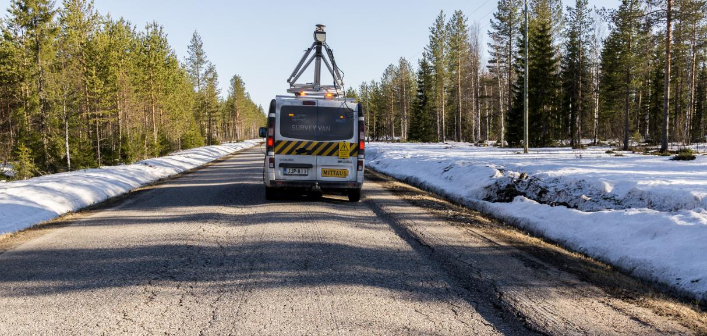
Workshop Topic #4--Advanced Performance Monitoring of Surface Condition
Timo Saarenketo, PhD, Adj.Prof.
CEO, Roadscanners Group
Finland, USA

Slide 3
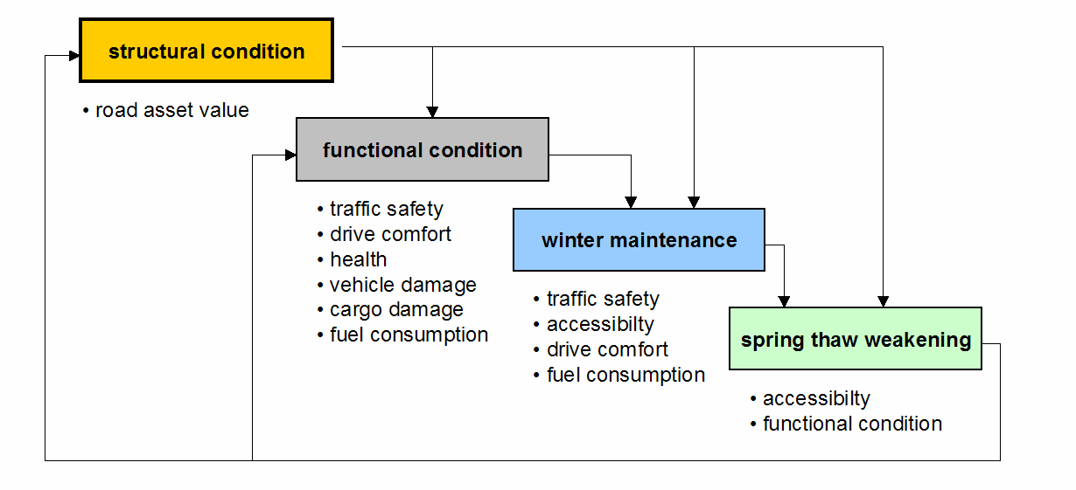
Road Condition Management Areas in Cold Climate Areas and Their Internal Relationship
environmental impact

Slide 4
Variables used in road condition monitoring
1. Ensuring adequate service level for the road users
2. Managing road infrastructure asset value
Functional Condition
Structural Condition
All roads
-longitudinal roughness (bumps etc)
-transverse roughness (rutting, warping, etc)
-cracks
-potholes
-friction
-snow smoke etc
Gravel roads
-washboarding
-dusting
-drainage
-deflections, strains
-frost heave
-cracking
-permanent deformations
-roughness
-geotechnical stability etc
Environmental Impact
-noise
-dust
-CO2 emissions etc

Slide 5
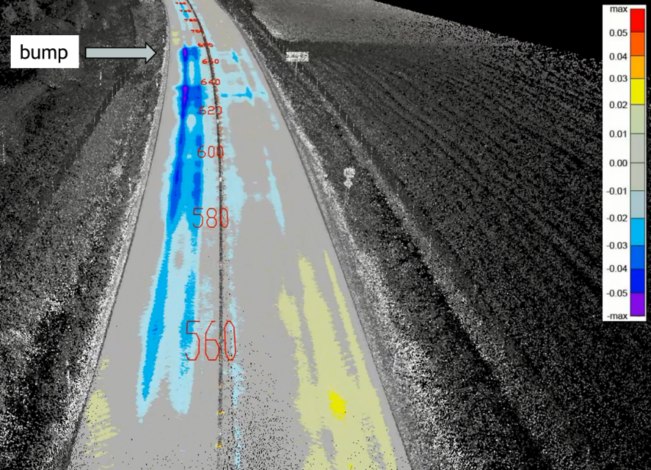
Factors Affecting Life Time of the Road
Structural condition
Functional condition
Road Width, Geometry, Visual Guidance
Heavy Vehicles Using the Road
Traffic Volume
Climatic Factors
Functional condition has a big effect on structural condition:
One bump has an effect to the pavement for almost 200 m within a speed of 80-100 km/h

Slide 6
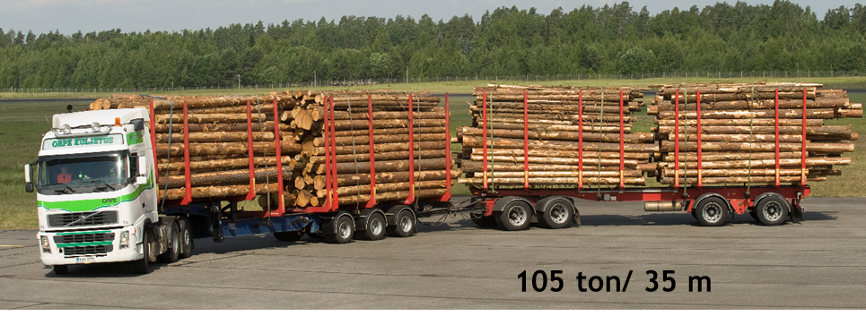
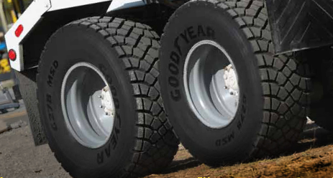
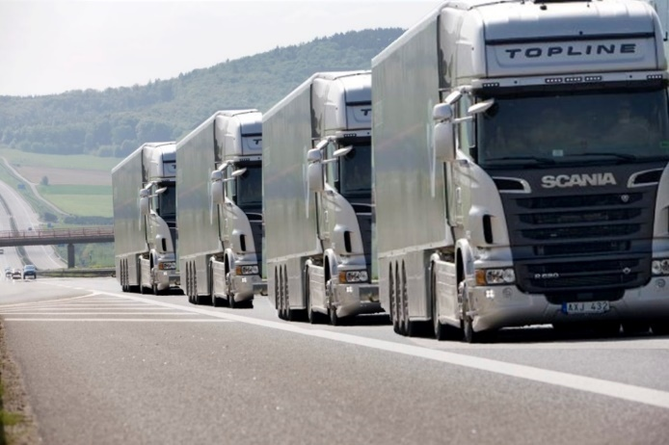
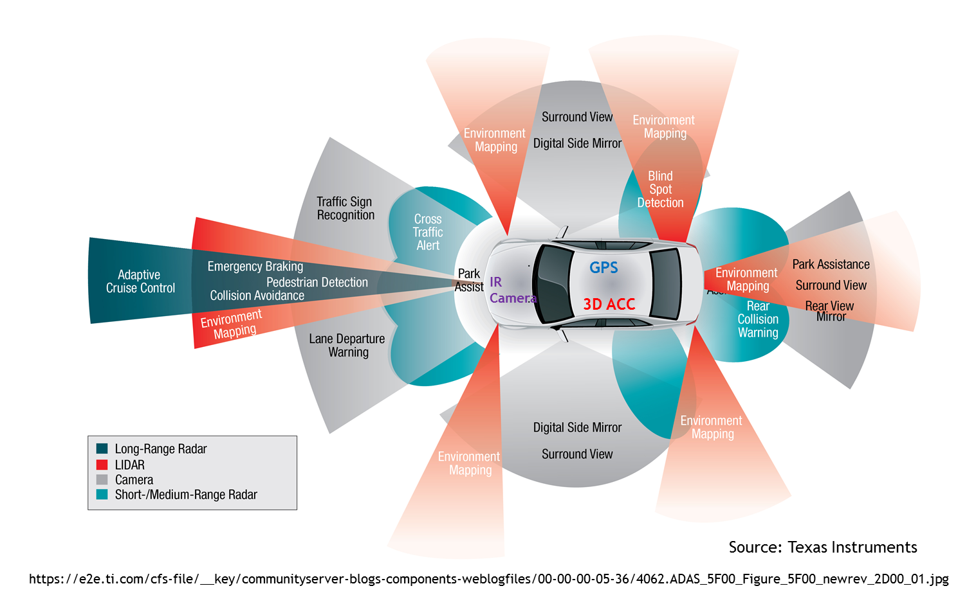
World is also changing: Heavier Trucks, New Tyres, Tyre Pressures, Autonomous Trucks and Platoon Driving, Climate Change

Slide 7
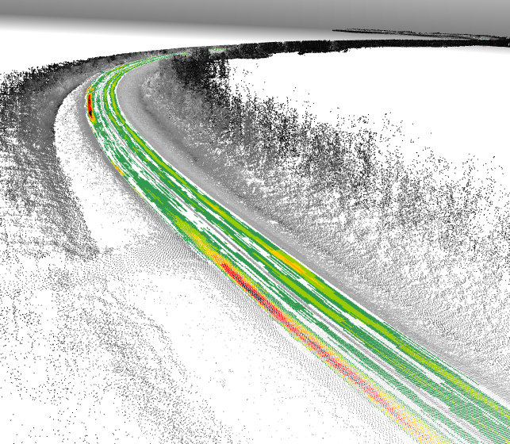
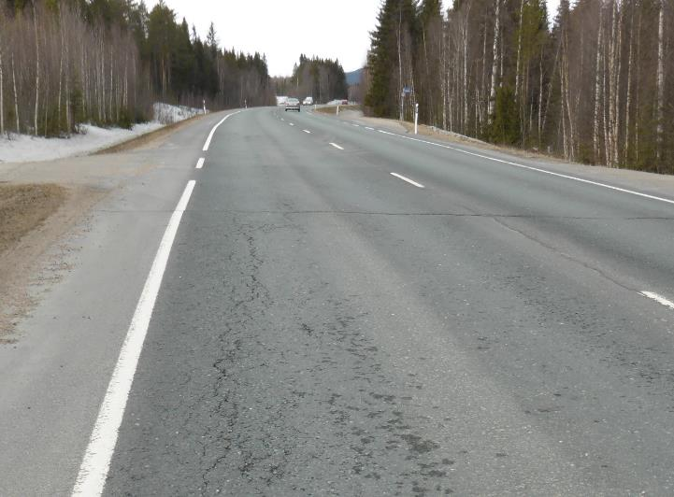
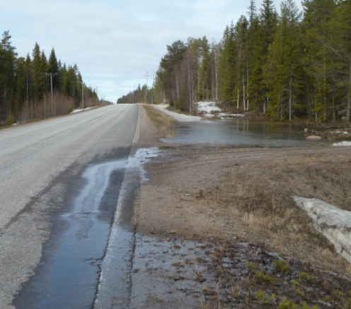
How to Monitor Road Surface Condition-
Options:
1. Should we monitor only surface condition (=symptoms)
2. Or should we monitor also root causes of the surface condition problems (diagnostics)

Slide 8
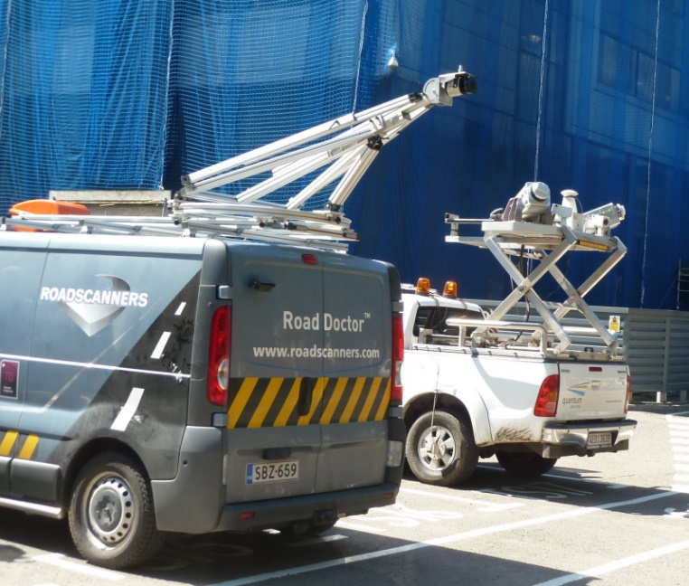
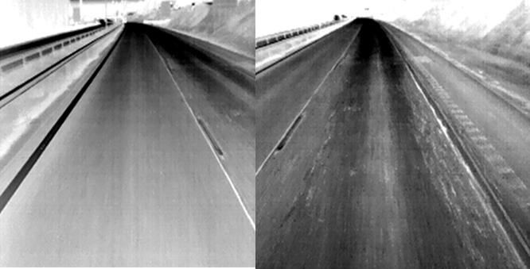
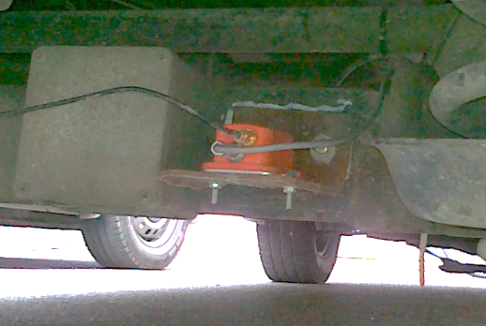
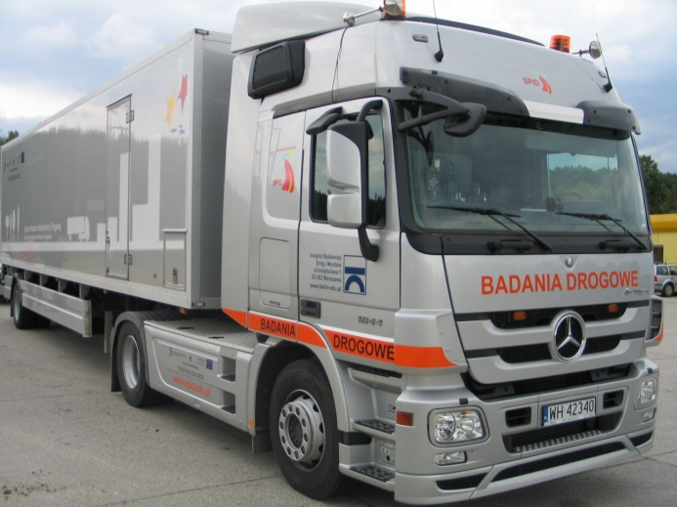
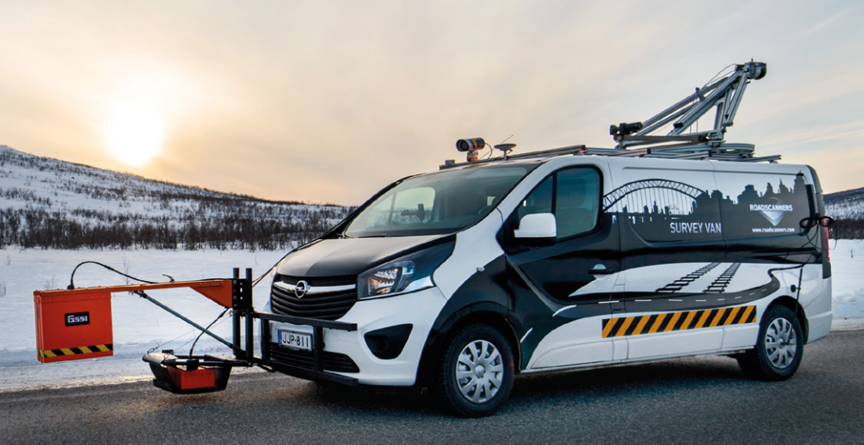
advanced road survey technologies currenlty used in finland
Laser scanner (lidar)
Digital video / IR techniques
3D accelerometers
Ground Penetrating Radar
Traffic Spped Deflectometer

Slide 9

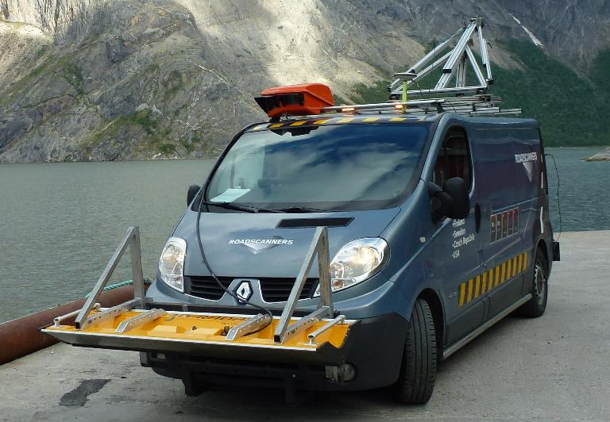
Survey methods and parameters/variables that is used/tested for road condition diagnostics
GPR
-thickness
-AC air voids content
-moisture (saturation degree)
-moisture susceptibility
-frost & ice lense detection
-cracking & microcracking
-delamination

Slide 10
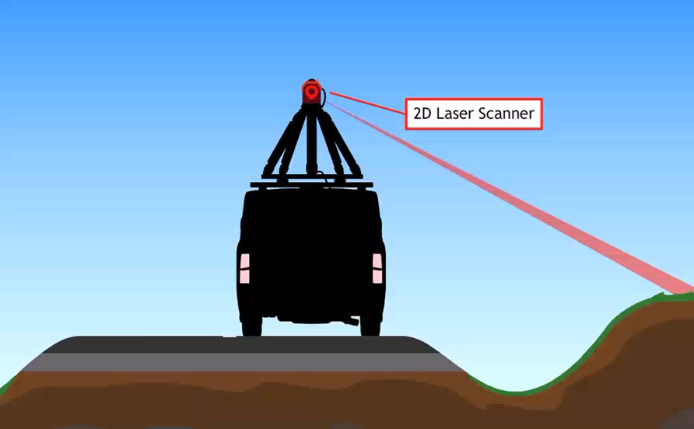
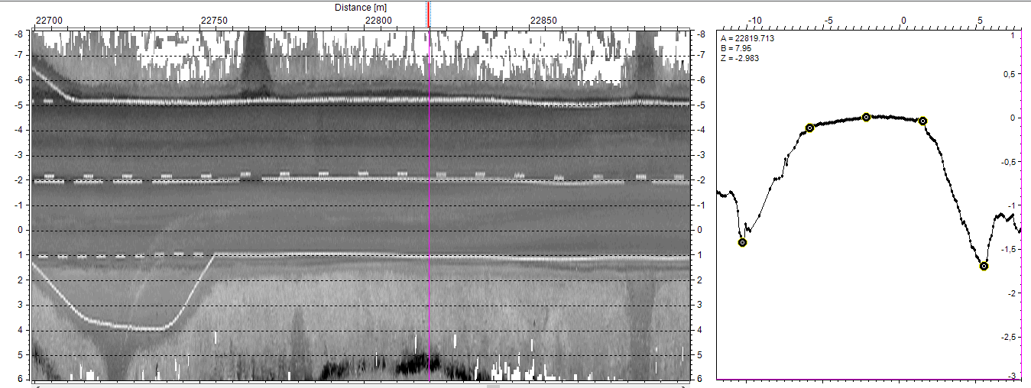
Survey methods and parameters/variables that is used/tested for road condition diagnostics
Laser Scanner (Lidar)
rut depth / rut depth increase
rutting mode
cracking (big cracks)
patches
road width / road widening
road paintings
verges & edge drops
ditch depths
clearance
winter maintenance monitoring
tunnel walls
design parameters for CAD

Slide 11
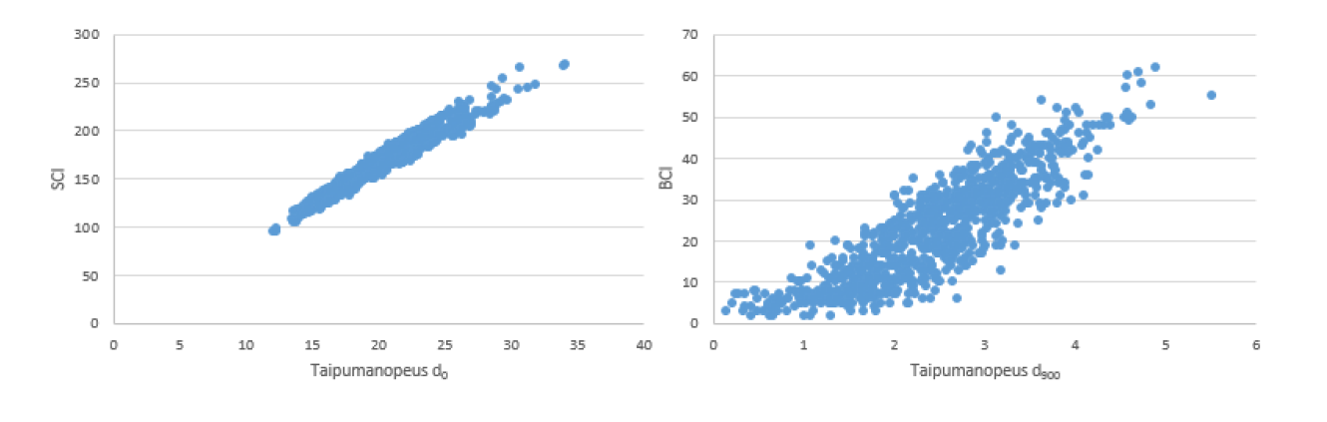
Survey methods and parameters/variables that is used/tested for road condition diagnostics
TSD
continuous deflections (10 m) intervals
Bearing capacity indexes (SCI, BCI, Strain)
Structure and subgrade moduli
values
Ville Mäki 2017
SCI
BCI
Deflection speed D0
Deflection speed D900

Slide 12
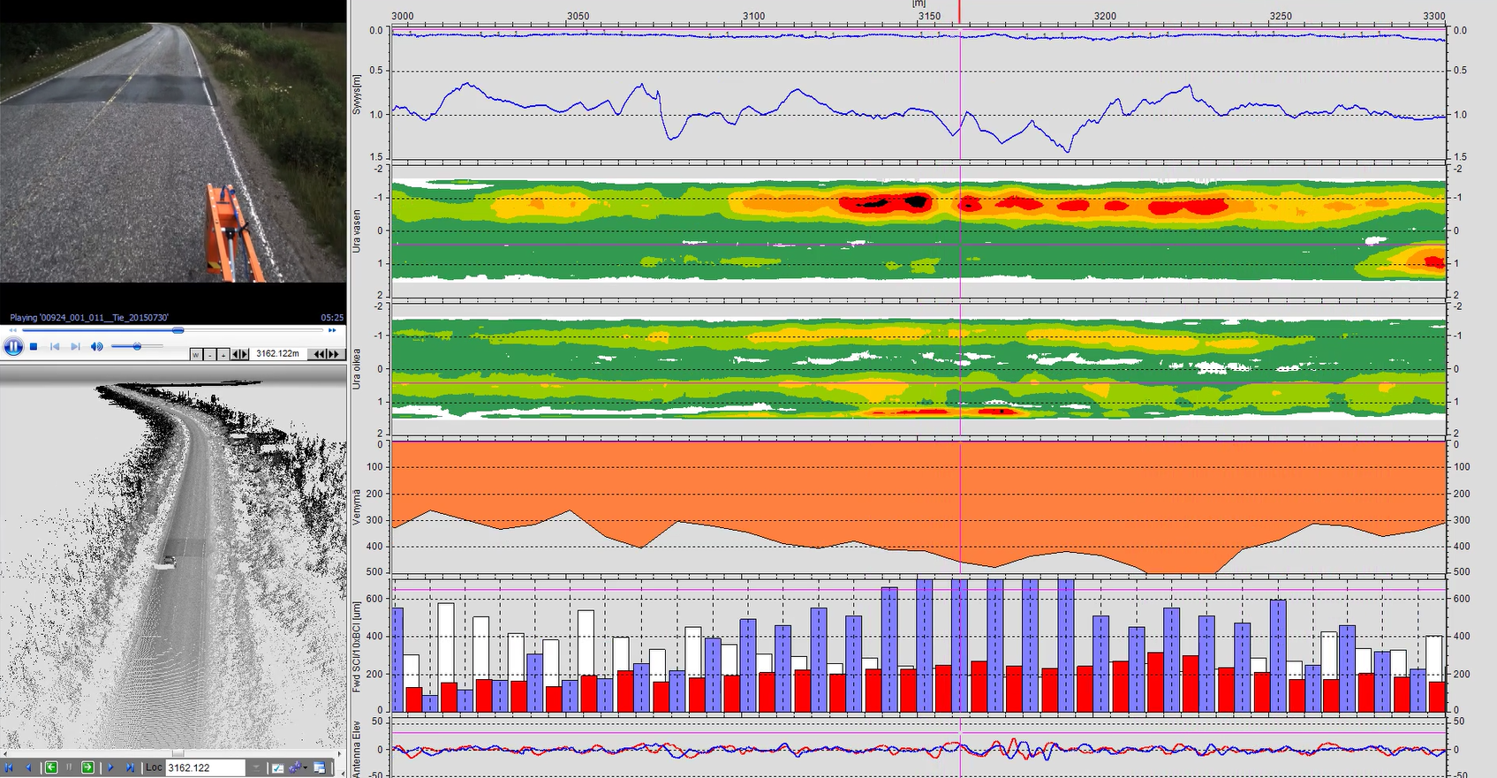
Tsd, laser scanner and GPR based rutting diagnostics
Pavement
Pavement structure
Loaded trucks
Rut Depth Maps
Empty trucks
Pavement Strain
10*BCI
Roughness

Slide 13
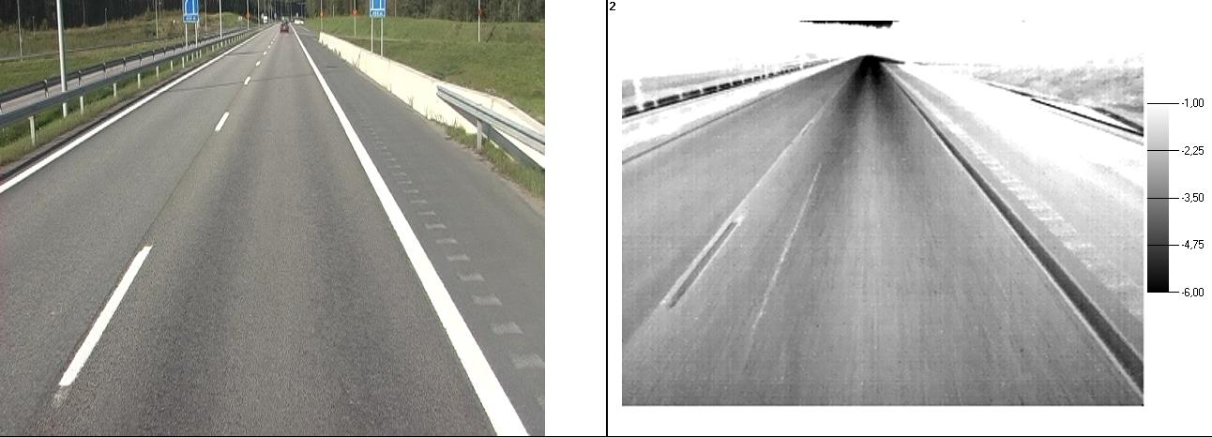
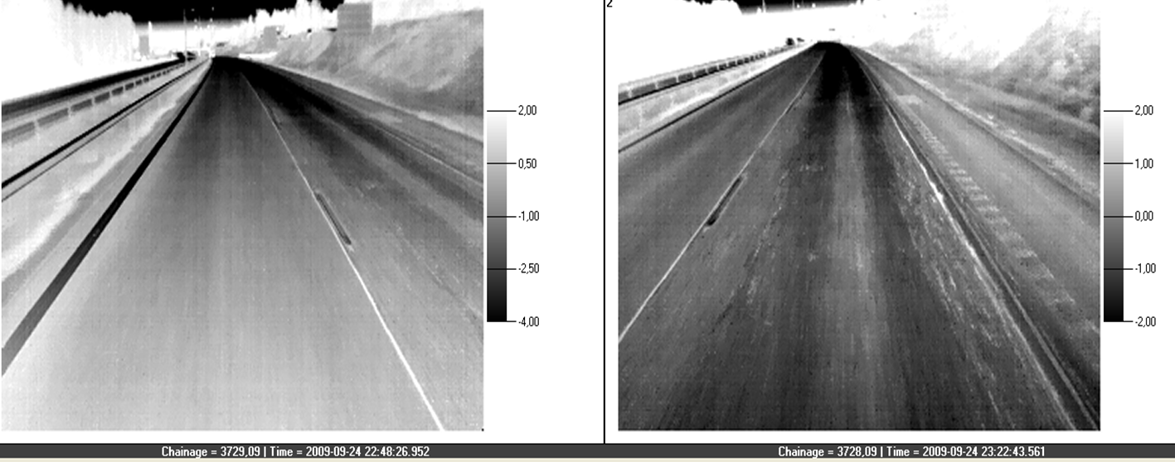
Survey methods and parameters/variables that is used/tested for road condition diagnostics
Thermal cameras
subsurface asphalt cracking
microcracking
crack healing monitoring
seggregation
monitoring pumping
bridge decks
moisture in concrete (tunnel walls)

Slide 14
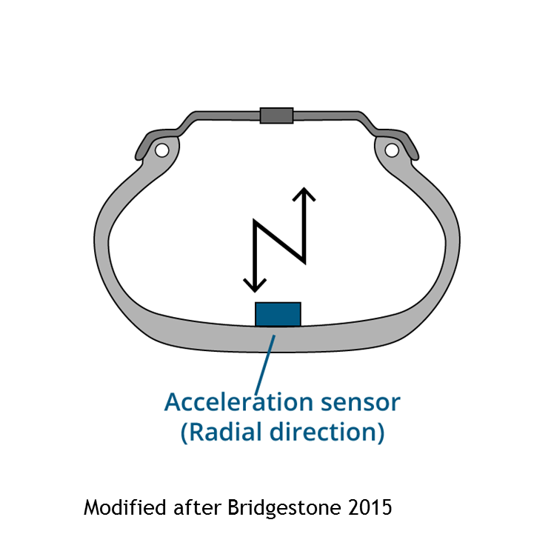
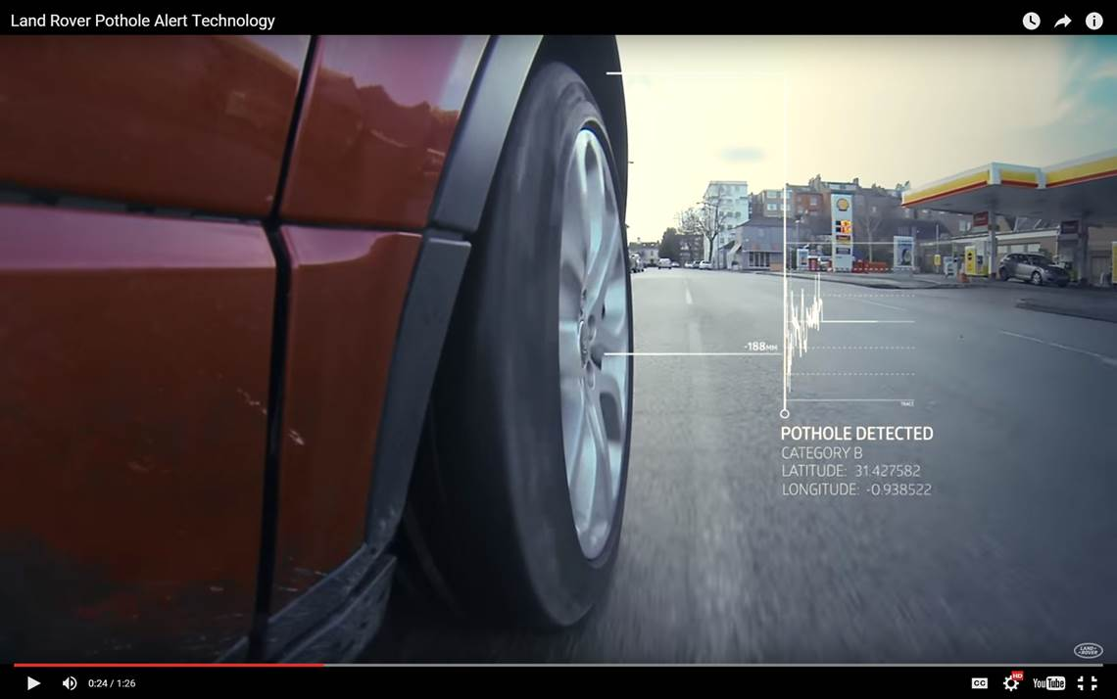
Future: vehicles monitoring road condition
Source: Land Rover Pothole Alert Technology
https://www.youtube.com/watch?v=NPiynbknYVE

Slide 15
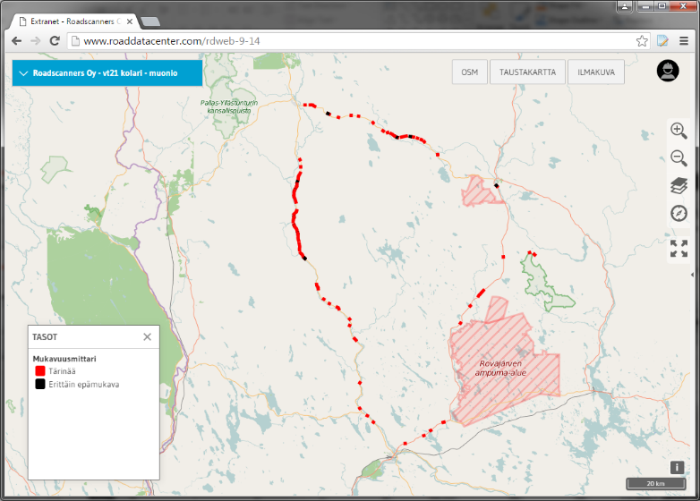



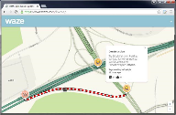




Road Asset Management with ITS
ITS service provider
Traffic centres
Open source data
Maintenance operating system

Slide 16
BENEFITS OF THE NEW POLICIES / TECHNOLOGIES
Better understanding of root causes of road damages
Better road maintenance management (new techniques)
Better pavement design practises:
  Heavier measures focused on exact problem locations
  Optimised pavement thickness
  New structural solution for road over weak subgrades (steel grids)
  Enabling monitoring performace of new structures (learning process)
Enabling proactive pavement maintenance policies
  Repaving before pavement looses its strenght
Longer pavement life times =>
  Better and safer roads and major savings with asset management costs

