Slide 1
Preserving Our Infrastructure for Renewable Energy
Chris DeDene, PhD, PE
Chunhua Han, PhD, PE

Slide 2
Why Should I Care?
Green energy construction projects often have road agreements with local road agencies
    Return the roads to the same condition
    -OR-
    pay the agency for the depreciation caused to the asset
It’s important to document your assets, in order to protect your assets
Notes:
This slide is to grab the attention of the audience – alternatively, we can say everything in this slide on the title slide, and remove this slide.
The presentation is for green energy, however all construction projects can benefit from this information

Slide 3
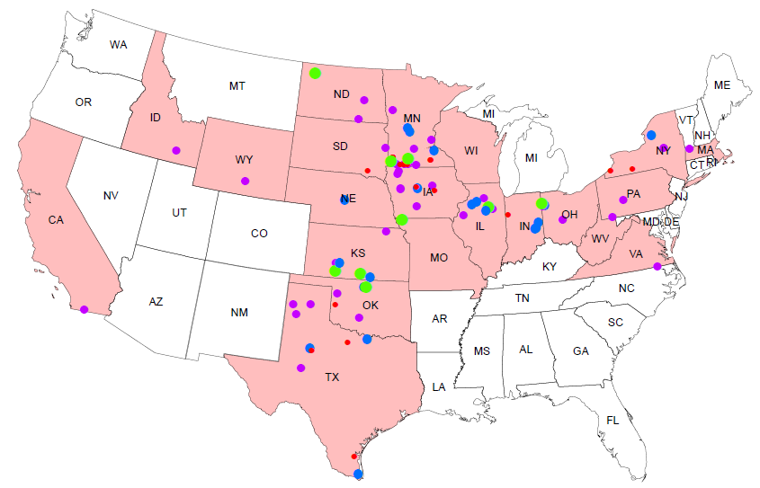
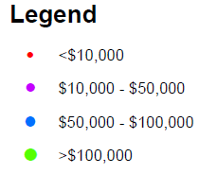
WHERE WERE WE?
: AET’s Fees
Notes:
This slide is to grab the attention of the audience – alternatively, we can say everything in this slide on the title slide, and remove this slide.
The presentation is for green energy, however all construction projects can benefit from this information

Slide 4
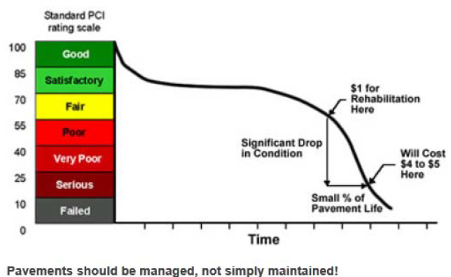
CONCEPTUAL APPROACH
Pavement Management
Inventory
Traffic/ Load
Pavement Condition Survey
Loads
Notes:
Only a snap-shot of the curve – curve is conceptual. We don’t track the pavement PCI over time.

Slide 5
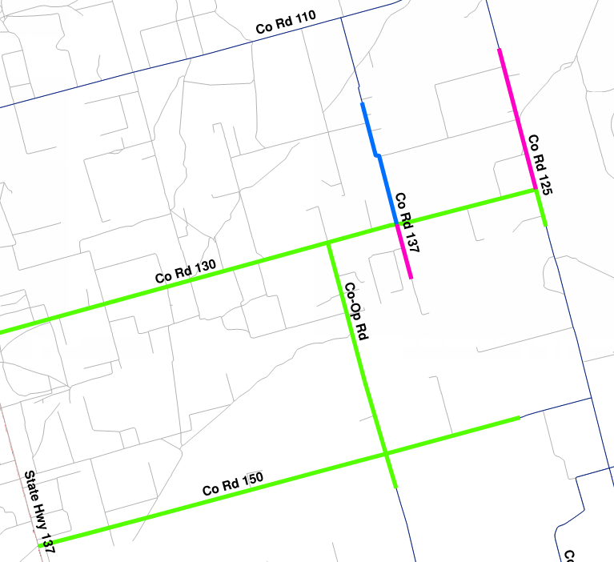
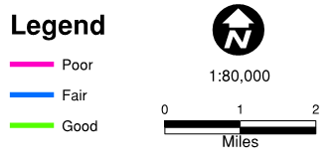
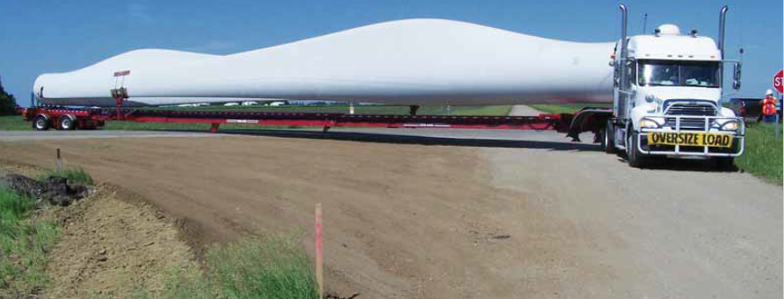
The Process AET Uses
Step 1 – Test and classify existing roads and traffic for maintenance and improvement plan

Slide 6
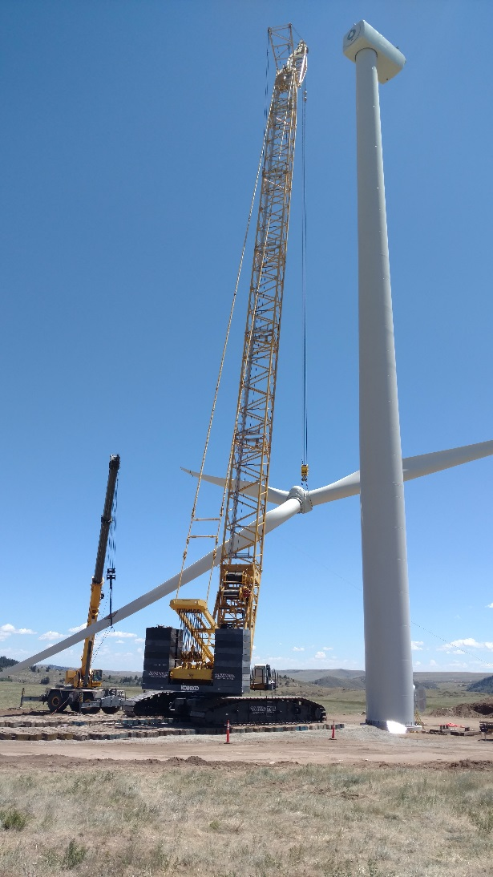
The Process AET Uses
Step 1 – Test and classify existing roads and traffic for maintenance and improvement plan
During Construction:
…provide construction testing…
-Or-
…wait for construction…

Slide 7
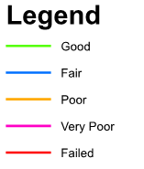
The Process AET Uses
Step 1 – Test and classify existing roadways and traffic for maintenance and improvement plan
Step 2 – Retest and classify the existing roadways
Step 3 – Tabulate the change in condition

Slide 8
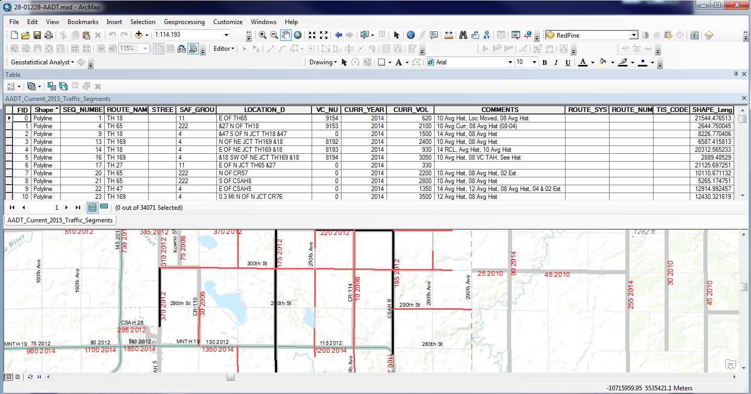
GEOGRAPHIC Information system Integration
Information Management
Integrated Data Gathered
Network Theme Maps
Impact Analysis
Condition Visualization
Improvement Identification
Cost Analysis
Construction Aid
Notes:
Integrate GIS mapping with pavement results. MnDOT AADT information is shown. We can combine that with PCI, or other collected data to map the network.
Many roads are township/gravel/low volume, so no records exist.

Slide 9
Tools AET uses
Ground Penetrating Radar (GPR)
Falling Weight Deflectometer (FWD)
Pavement Condition Index (PCI)
Inertial Profiler (Measures IRI)
Digital Video Logs (DVL)
Pavement Cores and Soil Borings
Construction Truck Counts
Notes:
The tools we recommend are project-specific, however some combination of these will meet most –if not all– project needs

Slide 10
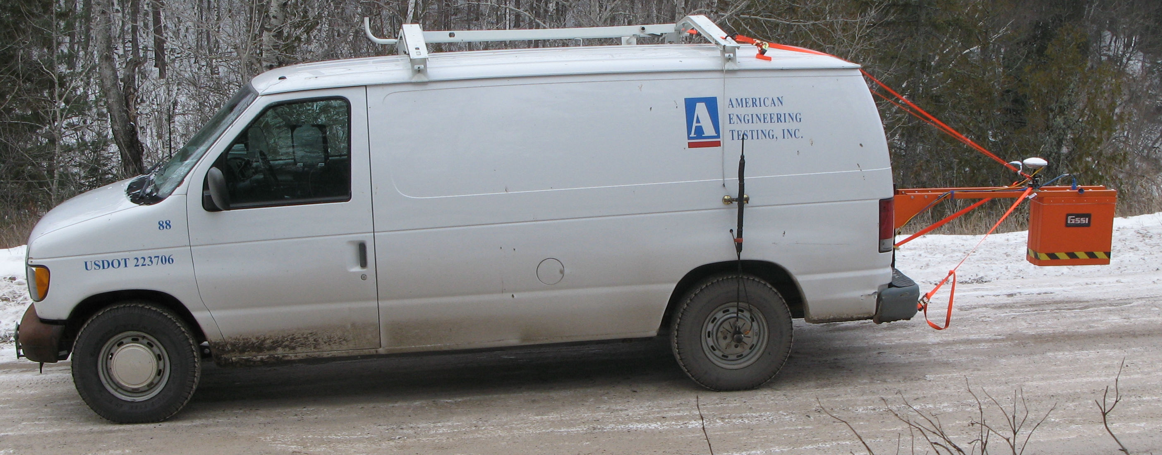
Ground Penetrating Radar (GPR)
Ground Penetrating Radar
Non-destructive test
Tells you how thick and uniform the pavement layers are
Pavement thickness + Strength => Structure Number
Notes:
We can get the capacity of a pavement from just the FWD, however the FWD only tests every tenth of a mile, using GPR, we can get a picture of the entire roadway. This is useful for finding thin areas between FWD drops.
GPR is accurate to 1/8 of an inch, with a core to calibrate. Otherwise, how accurate?

Slide 11
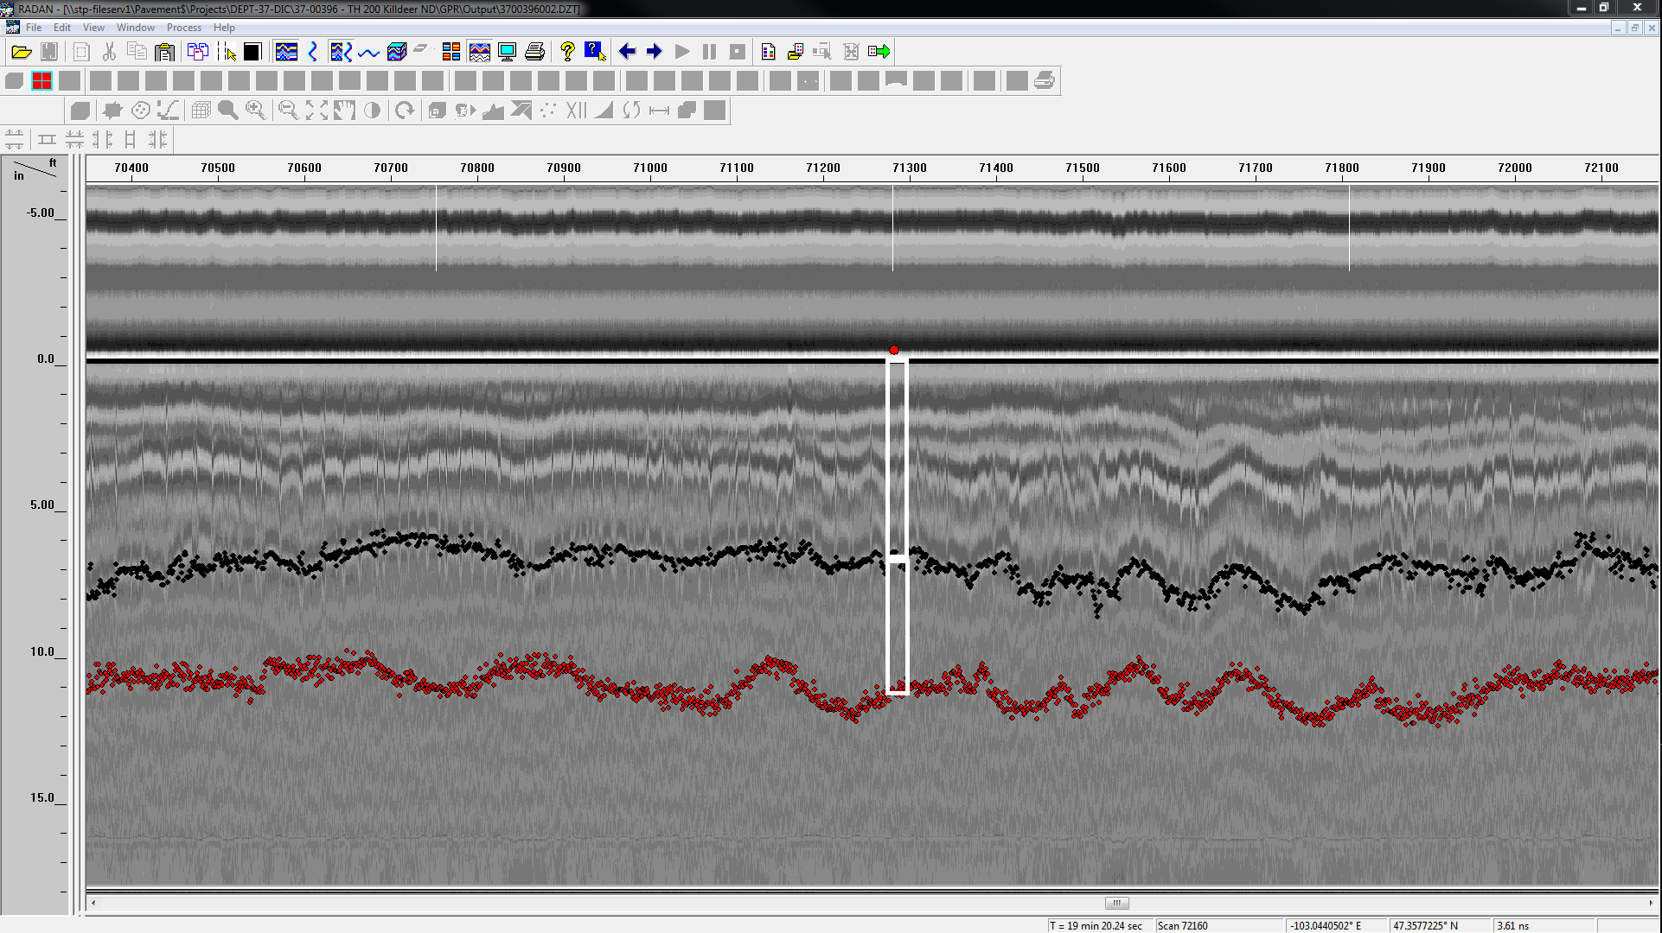
Sample GPR Results
Core thickness
Unverified Base Thickness
Notes:
Conceptual

Slide 12
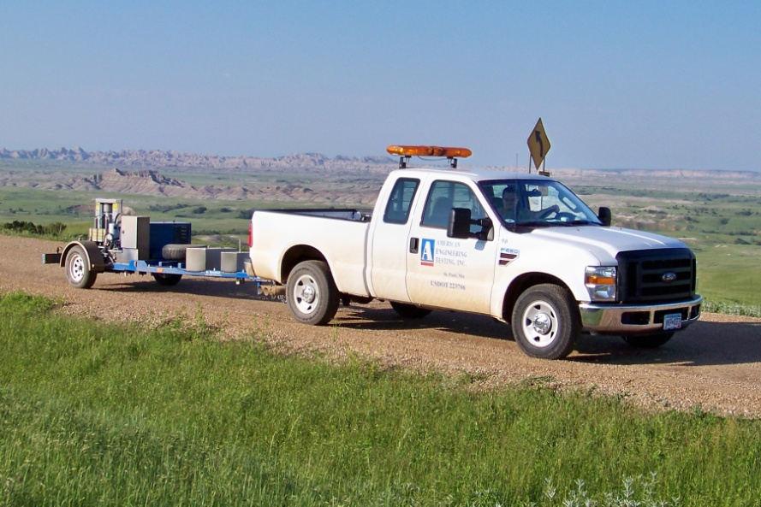
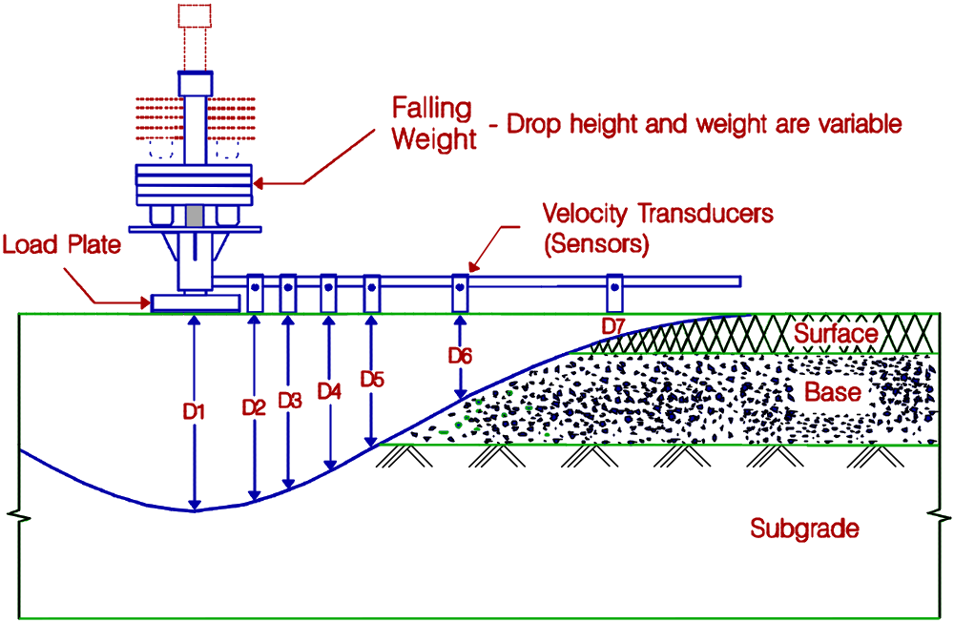
Falling Weight Deflectometer (FWD)
Falling Weight Deflectometer
Non-destructive test
Tells you how strong the pavement system is

Slide 13
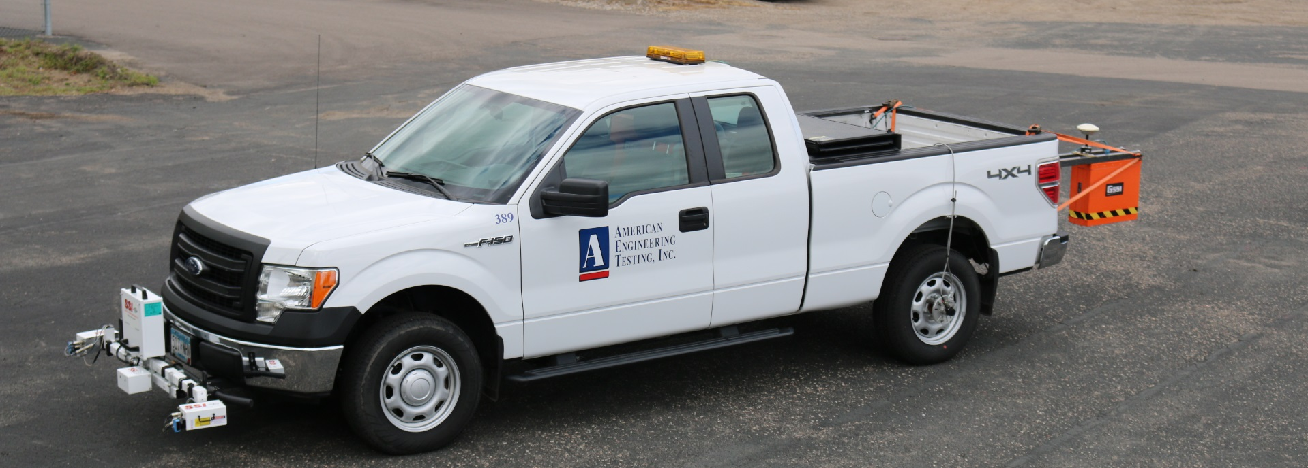
Profilometer
Inertial Profilier
Non-destructive test
Measures pavement smoothness
Used to evaluate ride-quality (IRI)
Notes:
Pictures are placeholders. To be replaced with AET images.
IRI is a measure of smoothness and ride comfort, not necessarily pavement structure.

Slide 14
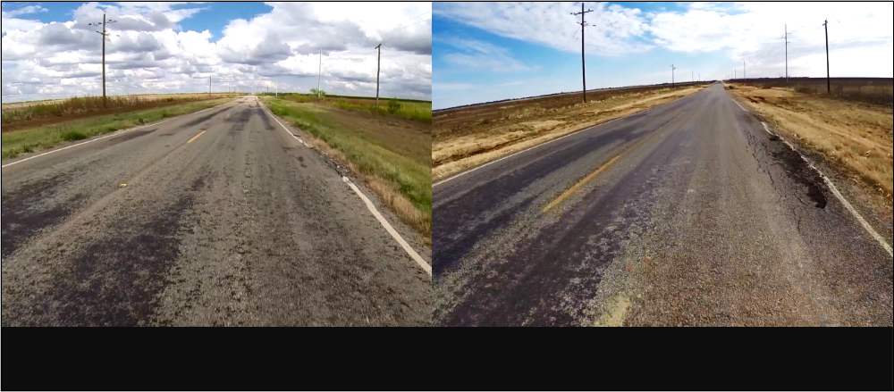
Digital Video Logs (DVL)
Digital Video Logs (DVL)
High-Definition images of pavement
Used in conjunction with field measurements to calculate Pavement Condition Index (PCI) of pavement surface
Typically bundled with GPR and/or IRI
Before
After
Notes:
PCI is rated on a 0-100 scale, and calculated from the video along with field measurements made by the operator. Follows ASTM D6433. I’d like to be a little vague on how we get the PCI number.
Processing the video is typically the most expensive part of this service, and we have collected and stored data to process later if the need ever arises.

Slide 15
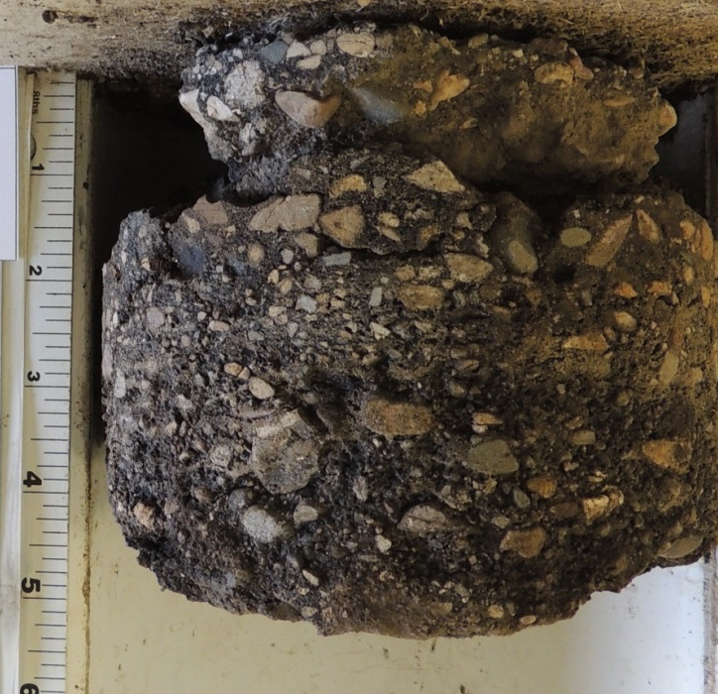
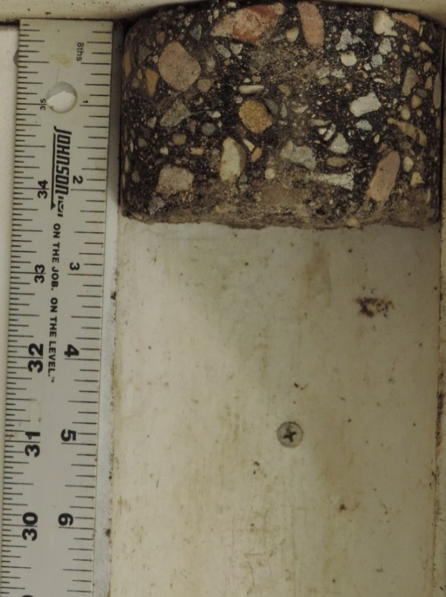
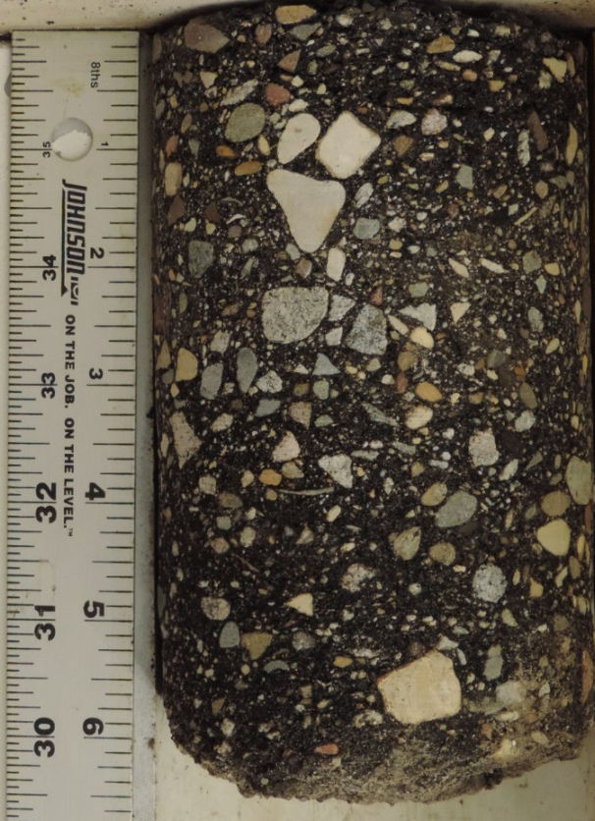
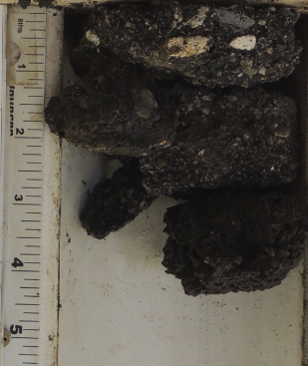
Pavement Cores / Soil Borings
Pavement Cores / Soil Borings
Verify layer thicknesses and calibrate GPR data
Analyze cores for stripping/delamination/deteriorated
Soil classification for strength determination, if desired
Deteriorated
Stripping
Core #2
Core #3
Notes:
Example of stripping on the left. On the right, cores from the same project, ~4” in pavement difference.

Slide 16
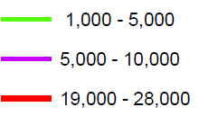
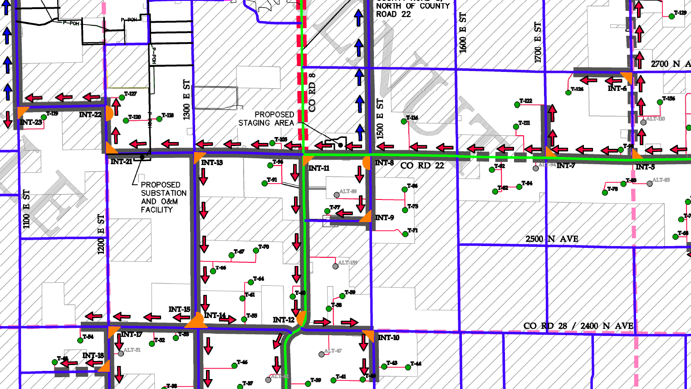
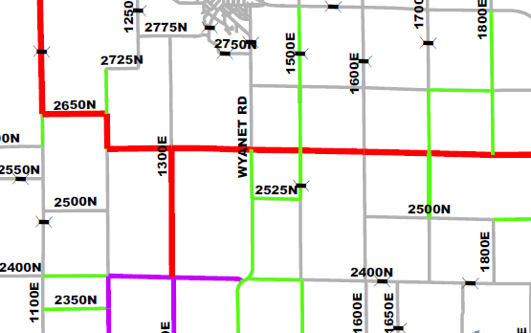
Construction Truck counts
Construction Traffic Loading
Construction Materials Requirements
Used in conjunction with truck types to calculate ESAL
Narrow Road ESAL
Legend: Haul ESALS
Notes:
PCI is rated on a 0-100 scale, and calculated from the video along with field measurements made by the operator. Follows ASTM D6433. I’d like to be a little vague on how we get the PCI number.
Processing the video is typically the most expensive part of this service, and we have collected and stored data to process later if the need ever arises.

Slide 17
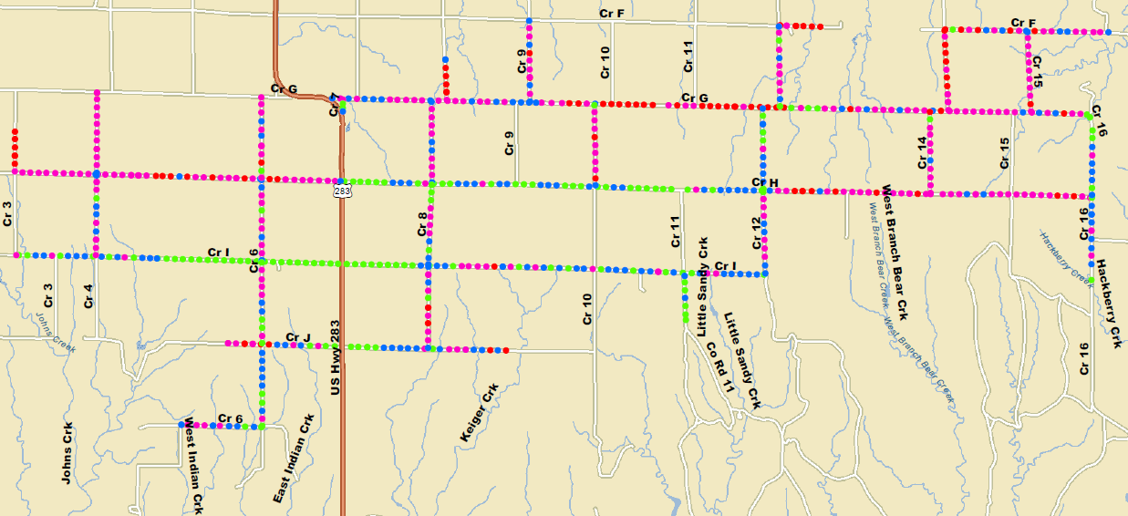
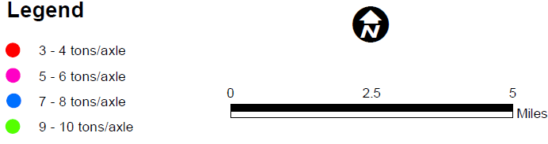
What we do with the Data
Pavement smoothness (IRI)
Pavement modulus (FWD)
PCI (DVL & Measurements)
Pavement Thickness (GPR)
Strength parameters (FWD&GPR)
  Load Capacity, Effective CBR
  Effective Structural Number (SN)
  Effective pavement modulus, Mr
Percentage of pavement life used by traffic
Improvement recommendations
Notes:
Any other results we provide?

Slide 18
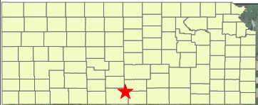
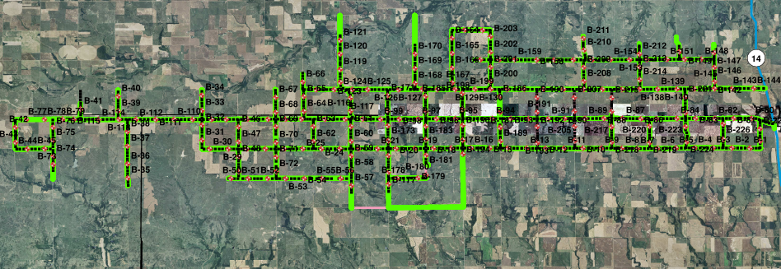

Project 1: Kansas
New wind farm construction
114 miles of roadway tested
In Sept. 2011, performed DVL, GPR, FWD, and 228 Soil Borings
User agreement for “as close as possible to the durability, quality, and drivability that they had prior…”

Slide 19
Project 1: Kansas
For all roadways, we provided
PCI
Surface layer thicknesses
Subsurface classification
Effective SN & load capacity
  Average SN was <2
  AET identified some weak roadways that were sand/oil mixture with chip seals
Recommendations included:
Based on the proposed haul-plan, 20% of roads tested had adequate strength
Recommended cement stabilization or an HMA overlay prior to construction, as roadway may not hold proposed construction activity
Notes:
Typical asphalt pavement SN is 4.

Slide 20
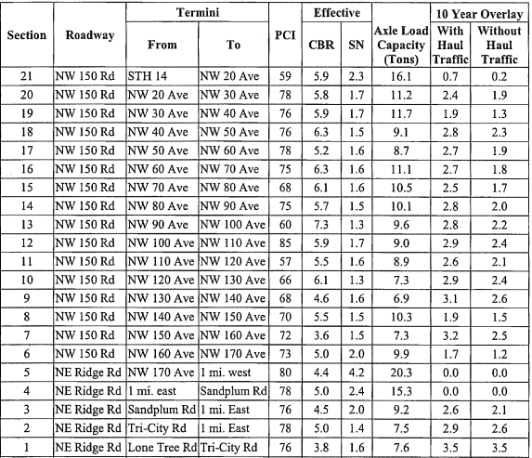
Project 1: Kansas
In February, 2012 the report was amended to account for the effects of unexpected local trucks
Pavement was already deficient at 10 years to handle current traffic
Structural impacts from hauling account for ~1” overlay needed
AET recommended 1.5” overlay, as the thinnest practical overlay
Notes:
Local trucks were from oil fields

Slide 21
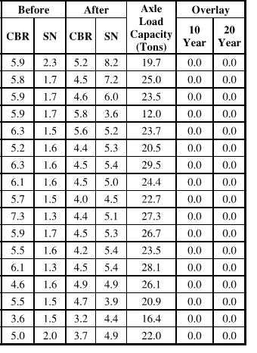
Project 1: Kansas
Post-Construction Analysis
In 2013, back on site to perform DVL, GPR, FWD
No improvements made prior to construction (into winter)
Had to cement stabilize during construction
Average SN is now > 4
Concluded the improved roadways will hold 20 year traffic without further improvement
Notes:
CBR was lower because we tested in the spring, during the spring thaw, previous test was performed in the fall

Slide 22
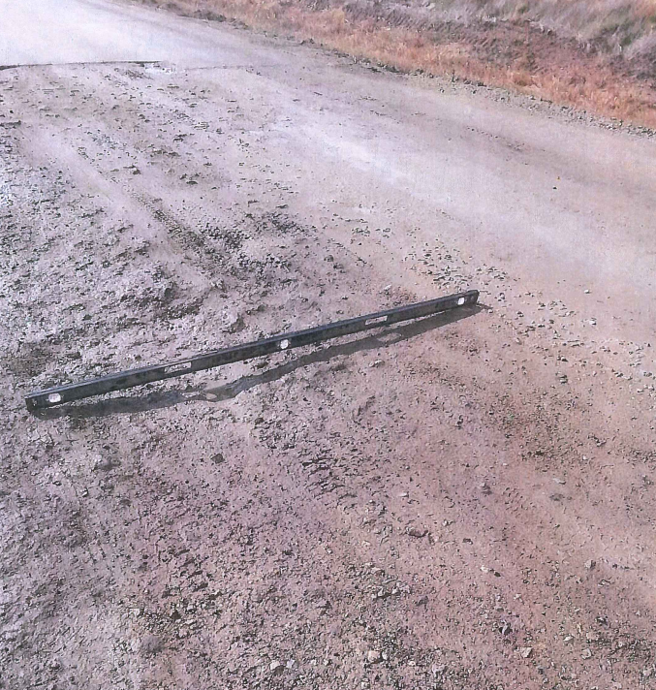
Project 1: Kansas
After construction, we were asked to preform IRI for comparison to pre-construction roadway
2015 – AET subpoenaed by an attorney
We are not privy to the ultimate outcome
Notes:
County and owner ~2 million apart in resolution

Slide 23
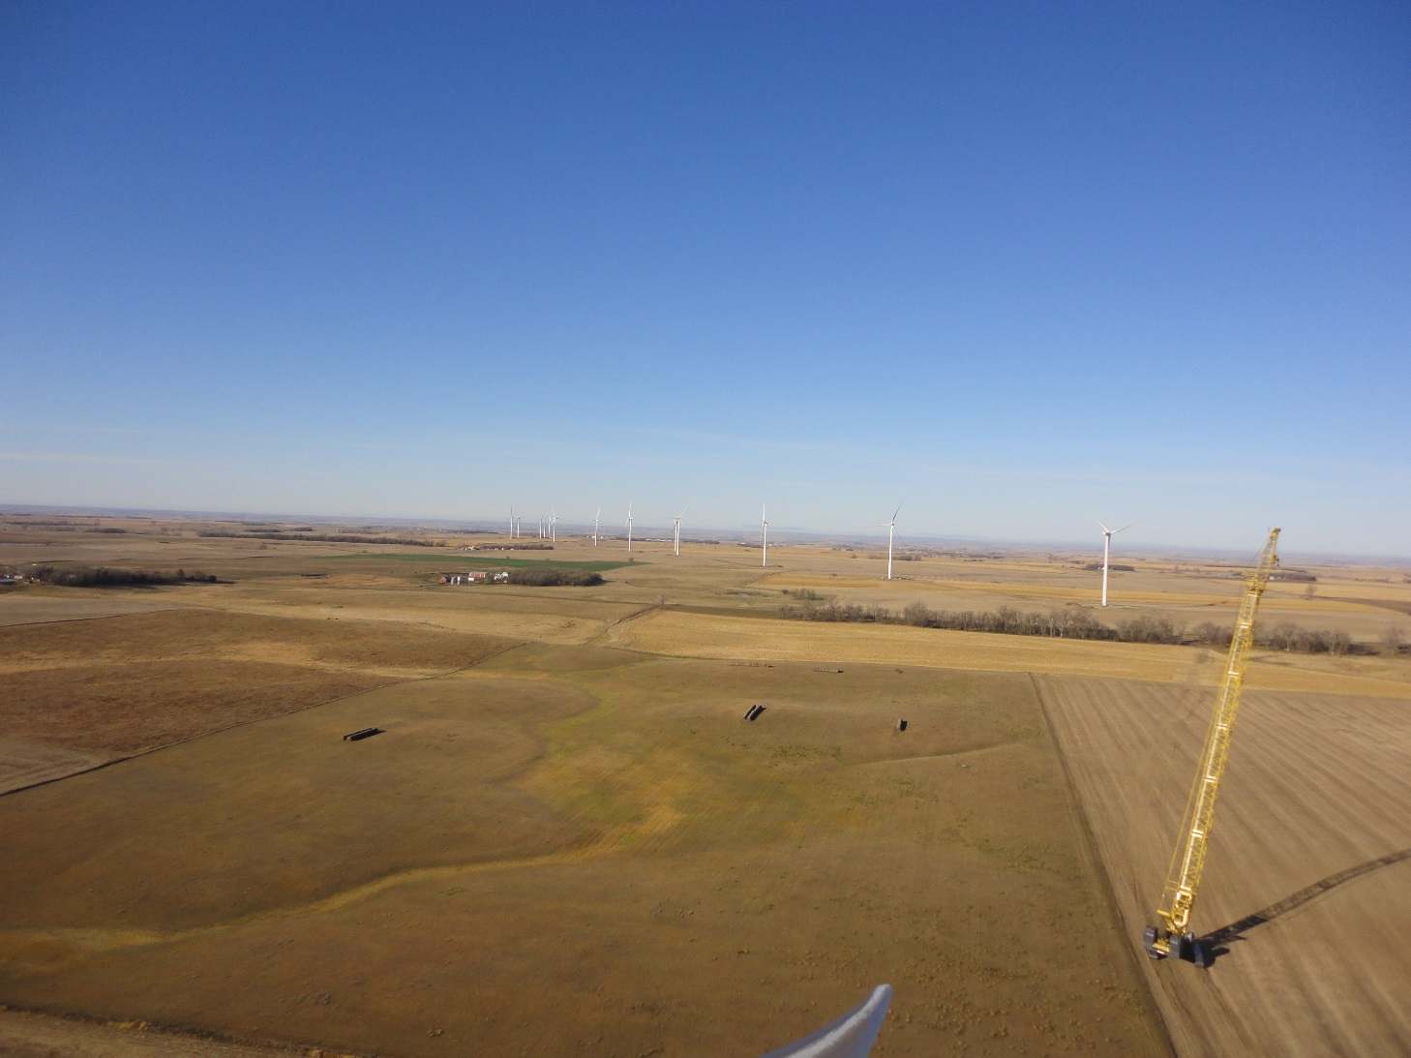
Project 1: Kansas - Conclusions
If followed, our recommendation of paving an overlay prior to construction may have prevented delays during construction
It’s very difficult to obtain pre-construction data AFTER construction

Slide 24
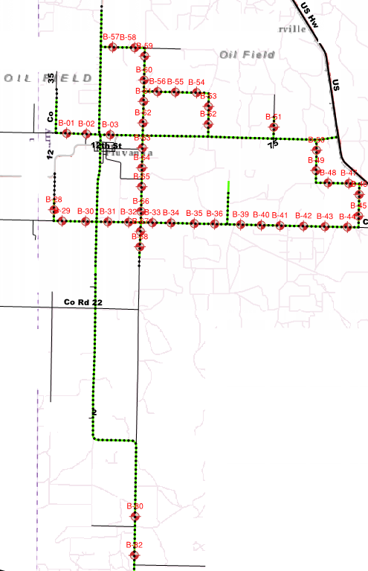
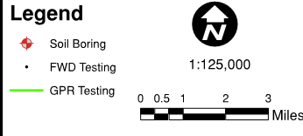
Project 2: Texas
New windfarm construction
43 miles of roadway tested
In September 2016 performed DVL, FWD, GPR, and 46 soil borings
Also provided recommendations to the proposed haul routes

Slide 25
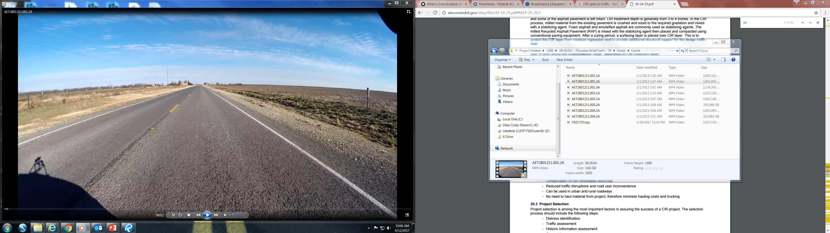
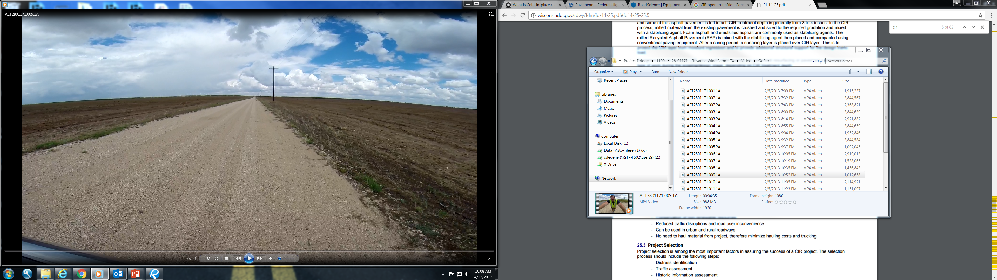
Project 2: Texas
Chip Sealed Roadway Results
Average pavement thickness 0.8”-2.8”
Average SN 1”-2.4”
The effect of hauling would account for <1” of overlay in 10 years of service
Gravel Roadway Results
Average pavement thickness 2.2”-8”
Average SN 0.4”-1.2”
The effect of hauling would account for ≤1” of overlay in 10 years of service
Notes:
Typical SN of 4 for HMA

Slide 26
Project 2: Texas
AET’s Recommendations
Upgrade gravel roadways with additional gravel prior to hauling to support the additional load
  2’-4” depending on the road
Roughly half of the bituminous roadways tested should be able to withstand construction traffic with no major maintenance
The rest have rutting issues, and may last up to 5 years before major rehabilitation is needed
  These roads require maintenance for existing traffic
Notes:
Half of chip sealed roads were “overbuilt”
Half of chip sealed roads were already deteriorated, it may not be the wind farms responsibility to fully repair them

Slide 27
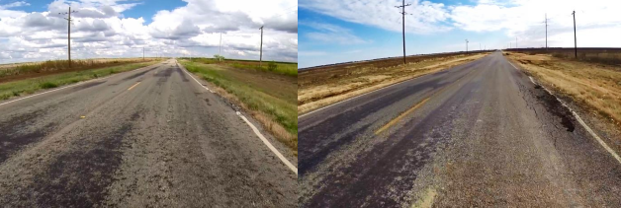
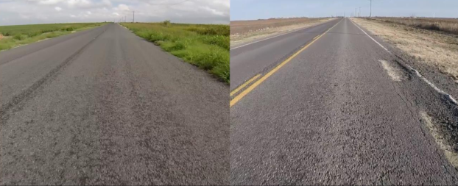
Project 2: Texas
AET returned to Texas in January 2017
DVL only
Overall loss in PCI, small
AET documented two areas of local failures
Recommended wind farm acknowledge these local failures
Before
After
Before
After
Notes:
Small is ~3.5 points per mile

Slide 28
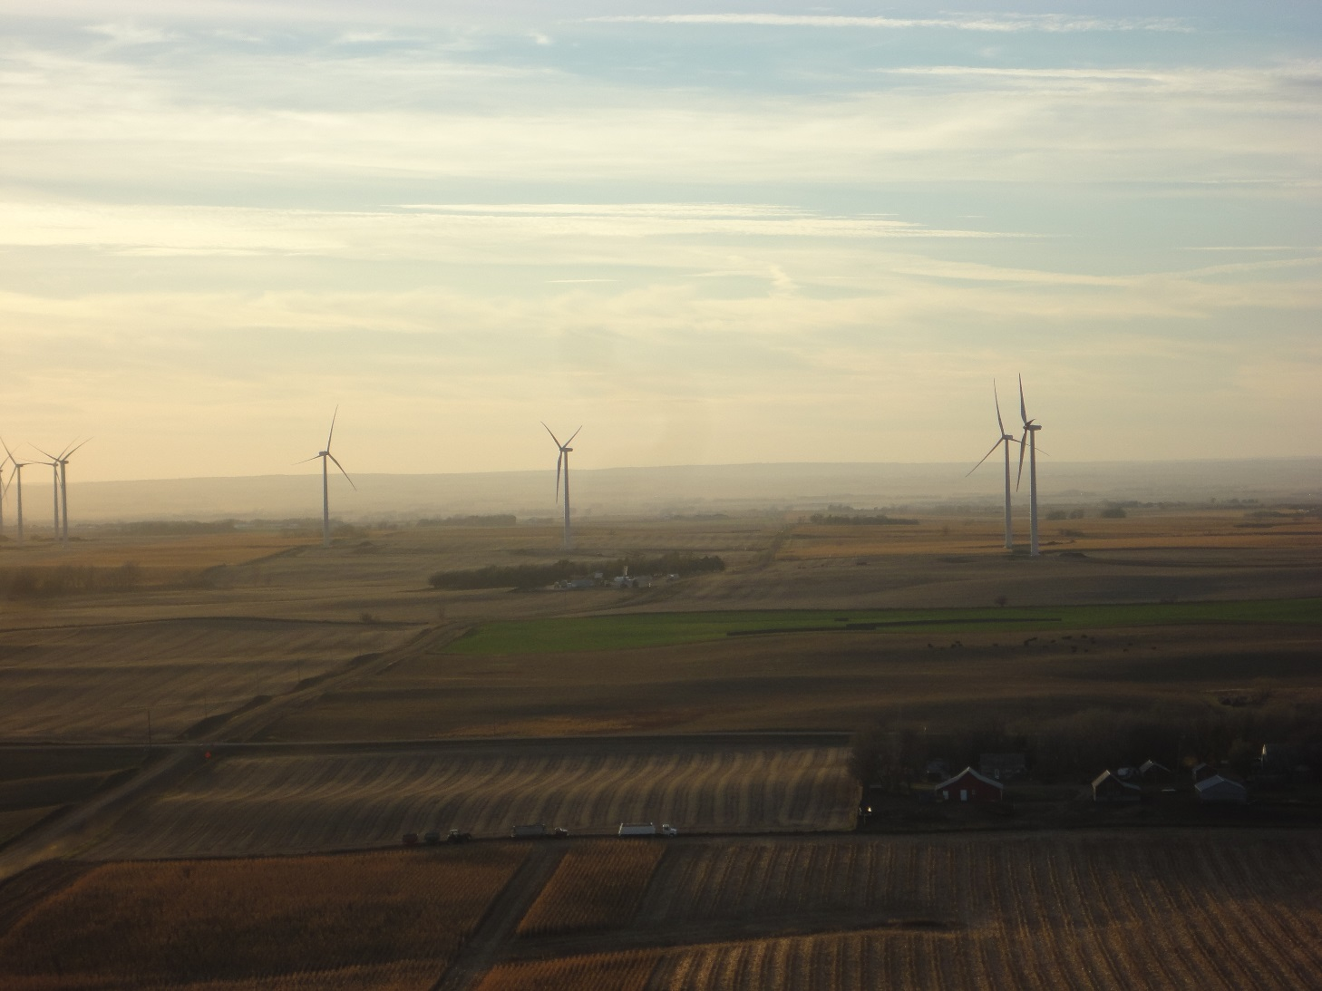
Project 2: Texas - Conclusions
Pavement investigations are a cost-effective way to document your assets
  This works for both municipalities and project owners

Slide 29
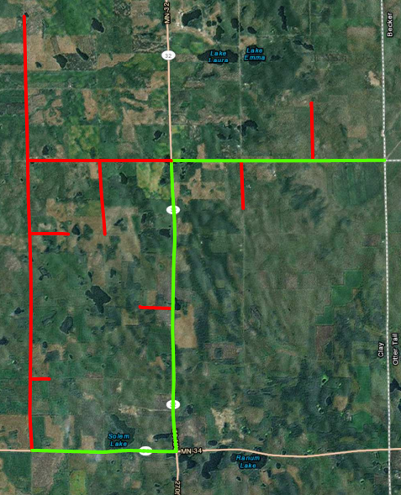
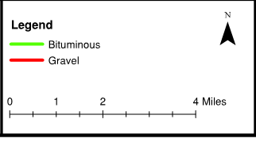
Project 3: Minnesota
New wind farm construction
21 miles of roadway tested
In August 2013, AET Performed
  DVL, GPR, FWD, and 19 Soil Borings
Windfarm agreed to maintain roads and pay for damages

Slide 30
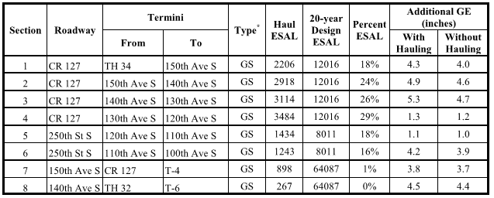
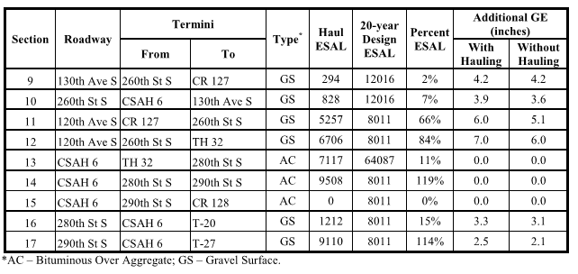
Project 3: Minnesota
AET calculated the additional Gravel Equivalence(GE) needed to support 10 years of traffic, and compared that to haul traffic
Less than 1” GE needed for haul traffic in all cases
AET recommended additional gravel, and surface repairs be performed, as needed.

Slide 31
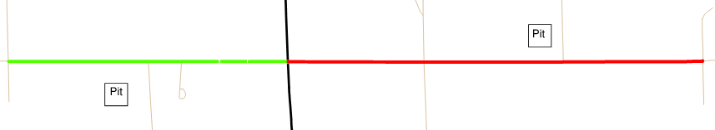
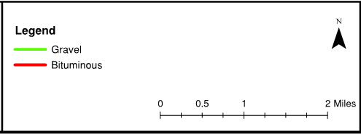
Project 3: Minnesota
Two aggregate pits, not associated with the wind farm began hauling on the analyzed roads after AET’s assessment
Therefore, AET remobilized to reassess the roadways
  Only performed PCI of the affected roadways

Slide 32
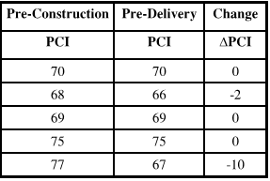
Project 3: Minnesota - Conclusions
One road changed significantly
Decrease in performance was likely from deterioration of recent crack repairs, rather than aggregate hauling
Reduced liability for our client

Slide 33
Final Thoughts
It’s important to document your assets, in order to protect your assets
The cost of a pre-construction survey is much less than the cost of a new roadway or a lawsuit
Roadway improvements are not a one-size-fits all solution
Maintenance is required throughout construction
Notes:
This isn’t limited to wind farm construction. I would add for anyone with a road agreement, the cost of a preconstruction survey is small, and will save you headaches down the road.

Slide 34
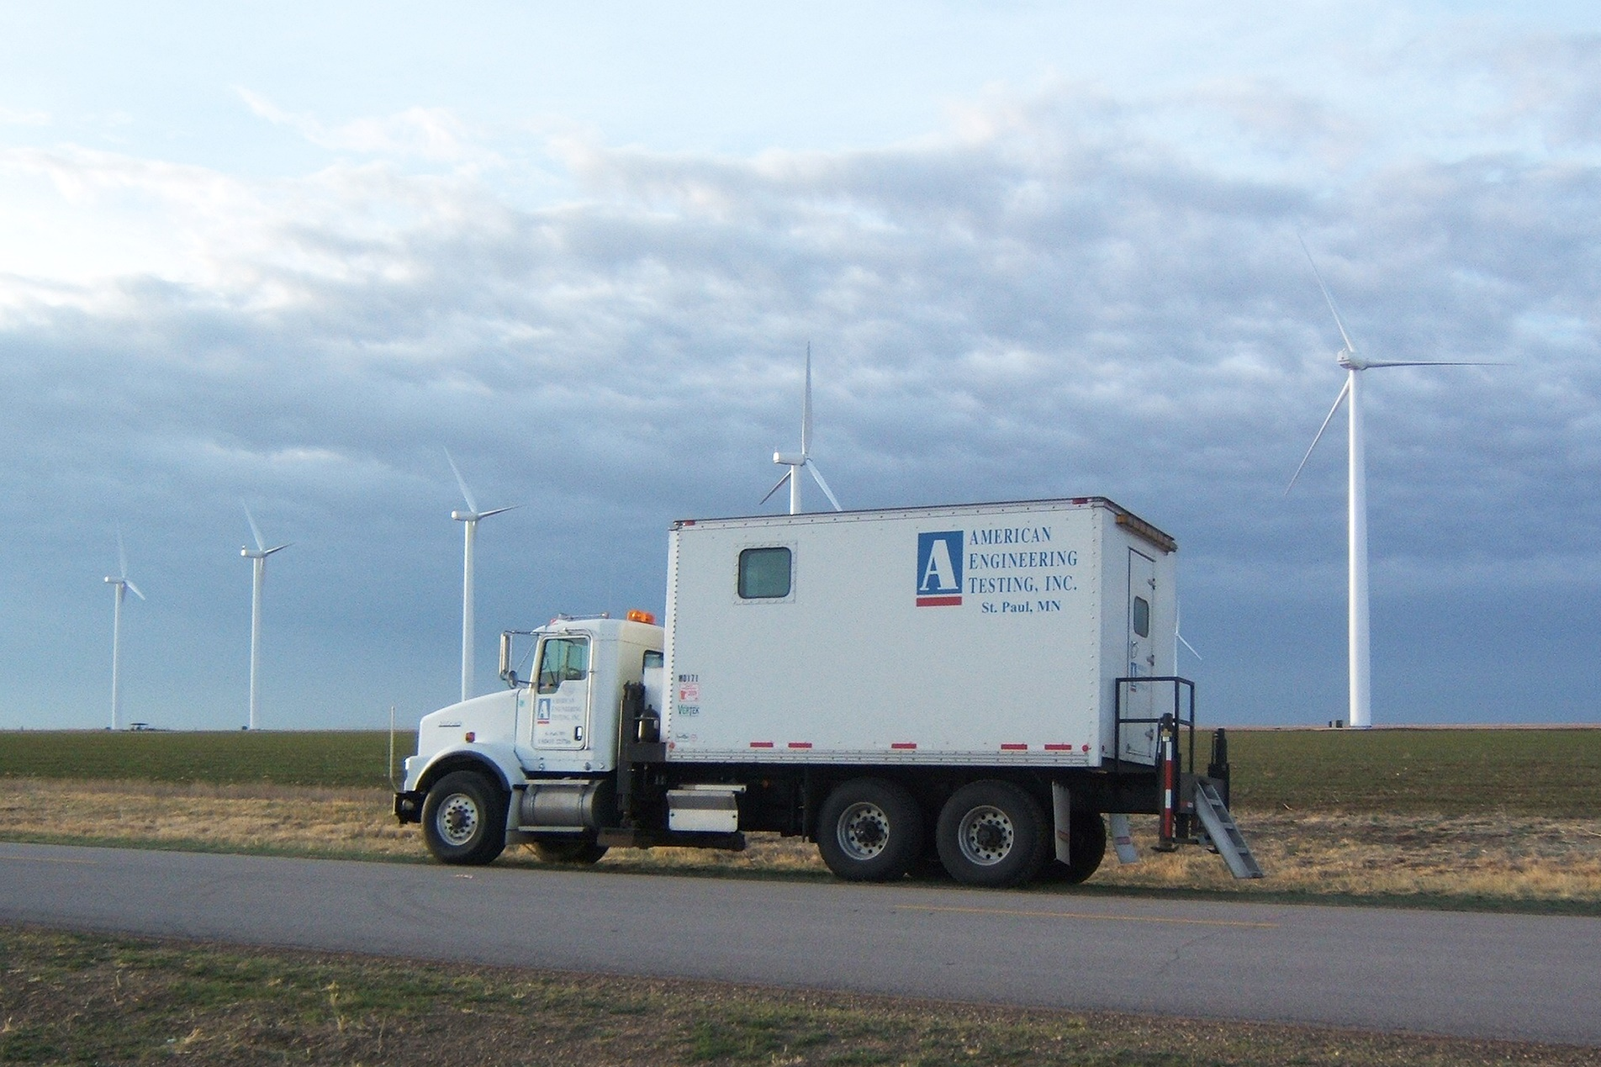

Chunhua Han, PhD, PE
Phone: 651-603-6631
E-mail: chan@amengtest.com
Chris DeDene, PhD, PE
Phone: 651-659-1304
E-mail: cdedene@amengtest.com
Questions?

