Slide 1
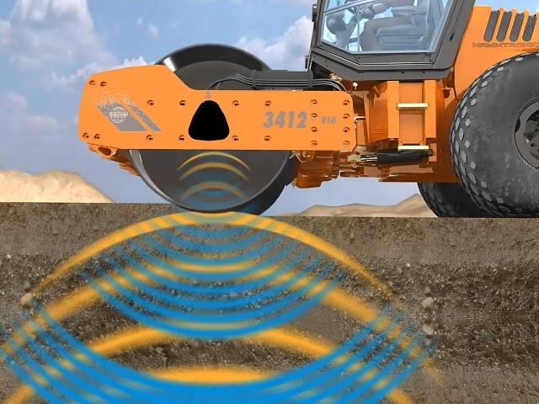
INTELLIGENT COMPACTION
NRRA Conference May 23-24, 2017
Presenter: Joseph Holland (Caltrans Research)
Prepared by: Ebi Fini, P.E (Caltrans Contruction)

Slide 2
Caltrans Asphalt Concrete Specification
Section 39 Standard Specification
HMA construction:
Method Compaction- Compaction of hot mix asphalt with thickness <0.15’ (46 mm). Density is not measured.
Density Requirement - Compaction of hot mix asphalt with thickness ≥0.15’ (46 mm). Density is measured.
.

Slide 3
Section 39-2.01C(15)(b)
Method Compaction
39-2.01C(15)(b) Method Compaction
Use method compaction for any of the following conditions:
1. HMA pavement thickness shown is less than 0.15 foot
2. Replace asphalt concrete surfacing
3. Leveling courses
4. Areas the Engineer determines conventional compaction and compaction measurement methods are impeded
HMA compaction coverage is the number of passes needed to cover the paving width. A pass is 1 roller's movement parallel to the paving in either direction. Overlapping passes are part of the coverage being made and are not a subsequent coverage. Do not start a coverage until completing the prior coverage.
Method compaction must consist of performing:
1. Breakdown compaction of each layer with 3 coverages using a vibratory roller. The speed of the vibratory roller in miles per hour must not exceed the vibrations per minute divided by 1,000. If the HMA layer thickness is less than 0.08 foot, turn the vibrator off.
2. Intermediate compaction of each layer of HMA with 3 coverages using a pneumatic-tired roller* at a speed not to exceed 5 mph.
Finish compaction of HMA with 1 coverage using a steel-tired roller.
* RHMA use steel roller for intermediate compaction.

Slide 4
Hot Mix Asphalt Intelligent Compaction Target Values Method Compaction
IC Requirements | HMA Type A Unmodified Asphalt Binder | HMA Type A PG-M Asphalt Binder | RHMA-G
Breakdown Compaction Minimum Surface Temperature °F 1st PASS | 250 | 240 | 285
Compaction Number of Breakdown passes | 3 | 3 | 3
Intermediate Compaction Minimum Surface Temperature °F Last Pass | 190 | 180 | 250
Intermediate Compaction Number of Passes | 3 | 3 | 3
Hot Mix Asphalt Open Graded Friction Course (OGFC) Intelligent Compaction Target Values Method Compaction
IC Requirements | OGFC Unmodified Asphalt Binder | OGFC PG-M Asphalt Binder | OGFC RHMA-O RHMA-HB
Breakdown Compaction Minimum Surface Temperature °F 1st PASS | 240 | 240 | 280
Complete Compaction Minimum Surface Temperature °F Last Pass | 200 | 180 | 250
Minimum Number of Passes | 2 | 2 | 2
Section 39 of CT Standard Specifications

Slide 5
Warm Mix Asphalt Intelligent Compaction Target Values Method Compaction
IC Requirements | HMA Type A Unmodified Asphalt Binder | HMA Type A PG-M Asphalt Binder | RHMA-G
Breakdown Compaction Minimum Surface Temperature °F 1st PASS | 240 | 230 | 260
Breakdown Compaction Number of Passes | 3 | 3 | 3
Intermediate Compaction Minimum Surface Temperature °F Last Pass | 190 | 170 | 230
Intermediate Compaction Number of Passes | 3 | 3 | 3
Warm Mix Asphalt Open Graded Friction Course (OGFC) Intelligent Compaction Target Values Method Compaction
IC Requirements | OGFC Unmodified Asphalt Binder | OGFC PG-M Asphalt Binder | OGFC RHMA-O RHMA-HB
Breakdown Compaction Minimum Surface Temperature °F 1st PASS | 230 | 230 | 270
Complete Compaction Minimum Surface Temperature °F Last Pass | 190 | 170 | 240
Minimum Number of Passes | 2 | 2 | 2
Section 39 of CT Standard Specifications

Slide 6
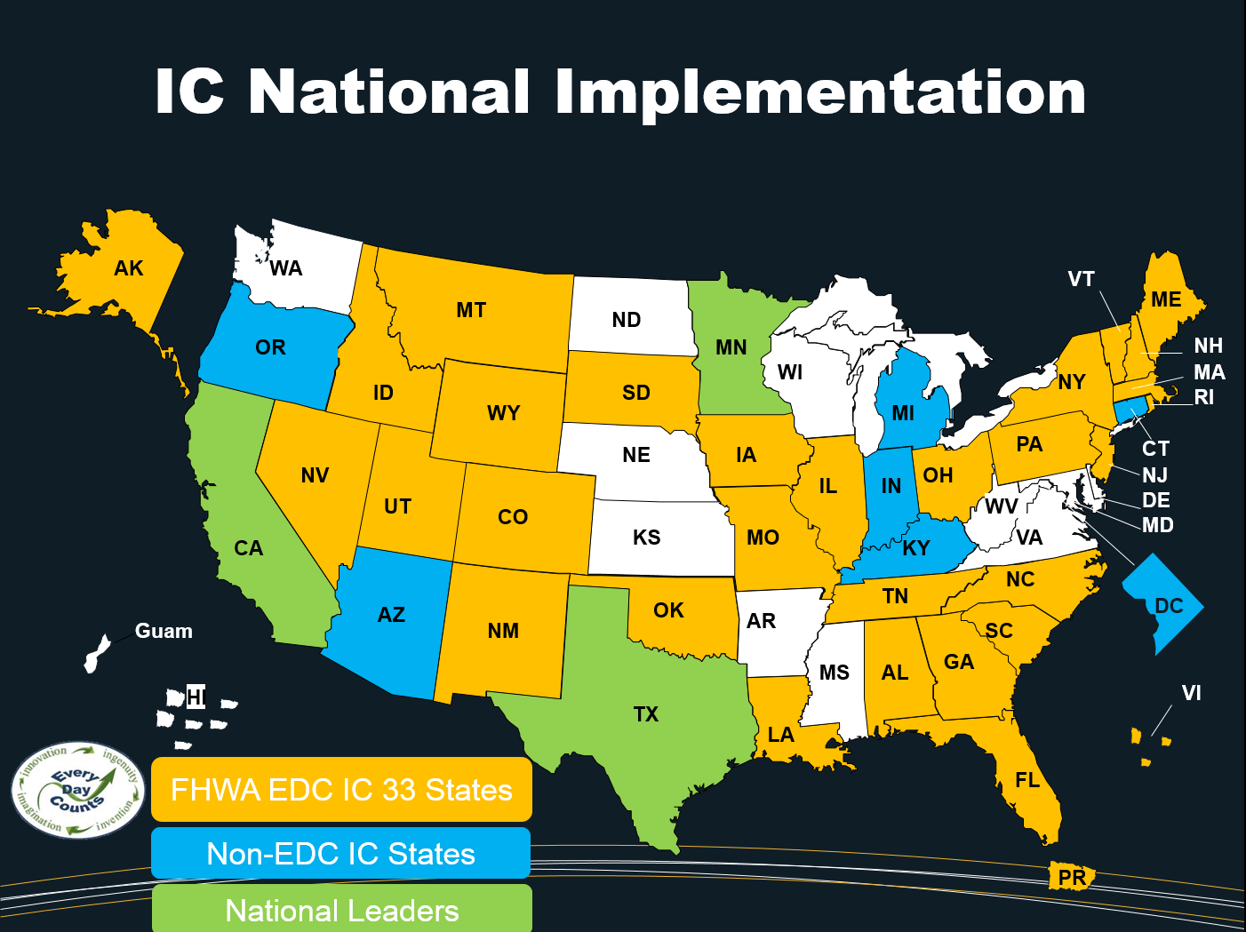

Slide 7
Premature Pavement Failure
Courtesy of Mark Woolaver, VAOT

Slide 8
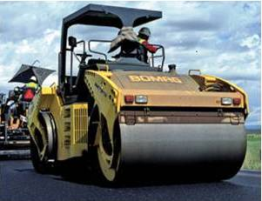

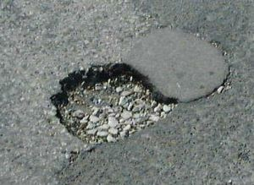
Why Intelligent Compaction (IC)?
Shortcomings in Conventional Compaction
Under-
Compaction
Leads to
Distresses
Limited
Feedback
Over-
Compaction

Slide 9
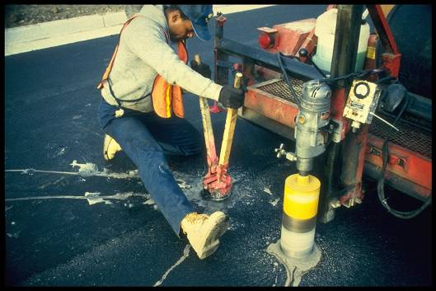
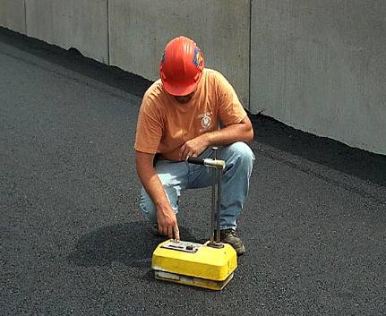
Why Intelligent Compaction?
Shortcomings in Conventional Acceptance
Limited Number
of Locations
After Compaction
is Complete

Slide 10
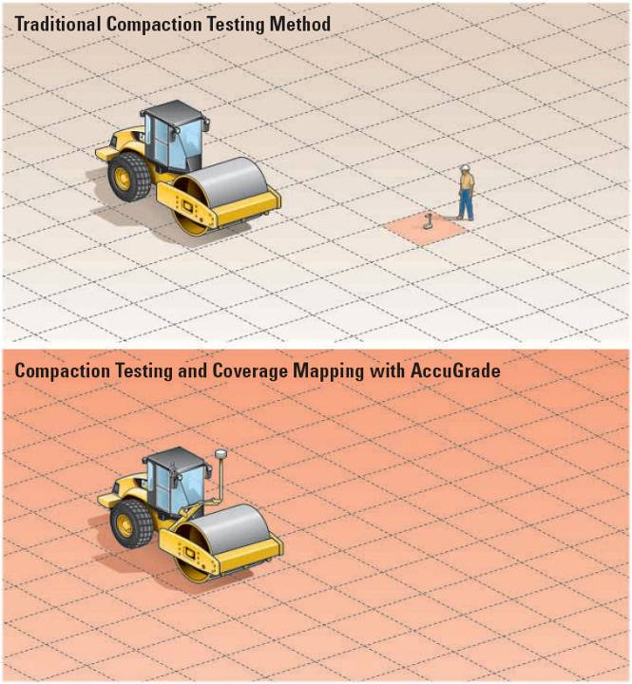
1 / 1,000,000
(IC)
100 % Coverage
Courtesy of Caterpillar

Slide 11
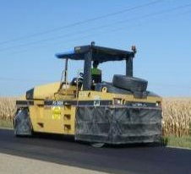
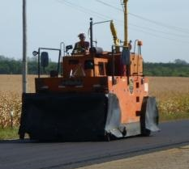
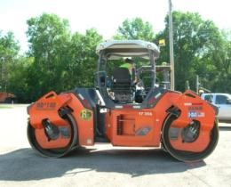
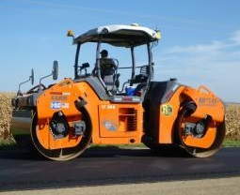
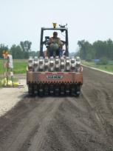
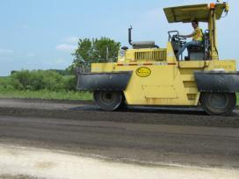
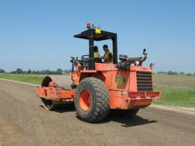
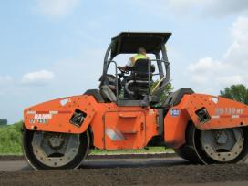
Instrumented Rolling Train
HMA Rolling Train
Stabilized / Un-stabilized Full Depth Reclamation (FDR)
Courtesy of Rebecca Embacher, MnDOT

Slide 12






IC Retrofit
Printer
GNSS Receiver
Control Box
Temperature
Sensor
Temperature
Sensor
Accelerometer
Courtesy of Trimble

Slide 13
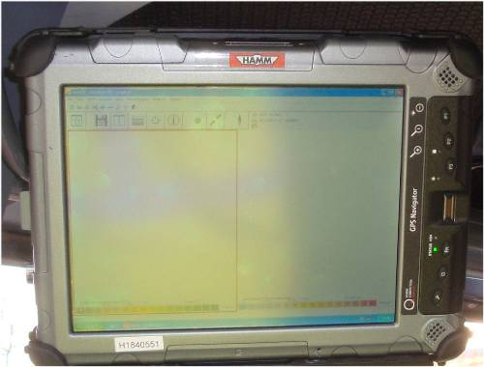
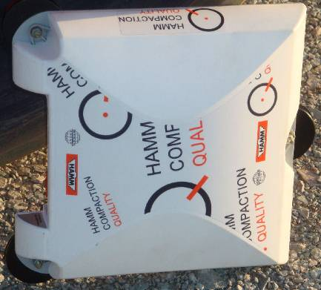
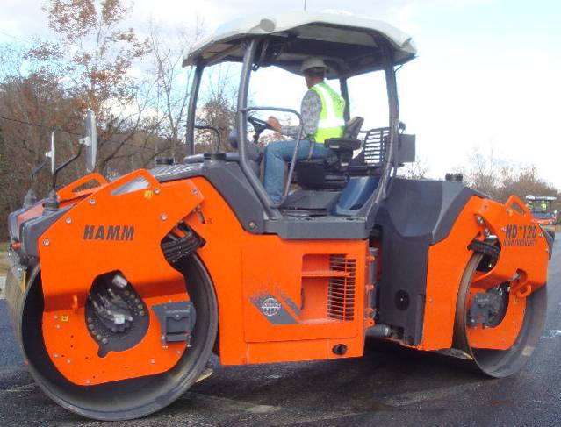
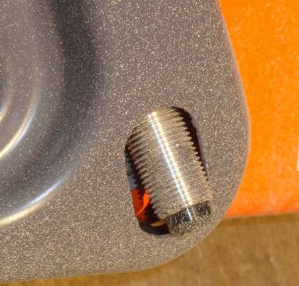
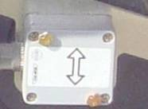
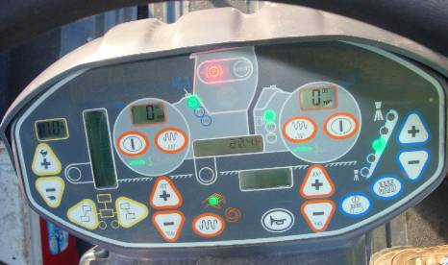
An Example IC System
HCQ GPS Navigator
GPS Receiver
Temperature Sensors
Accelerometer
Control Panel

Slide 14
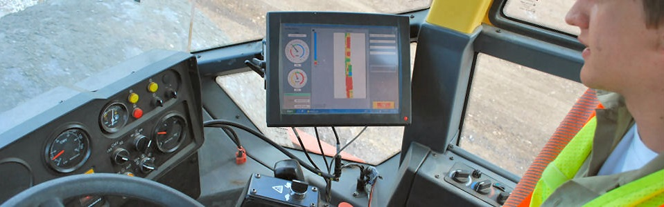

Slide 15

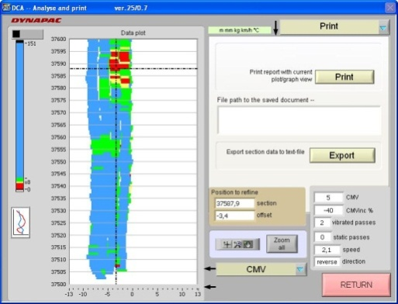
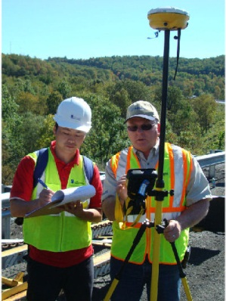
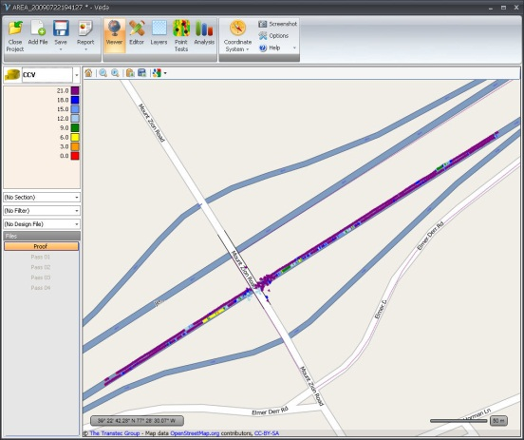

IC Data Flow
IC data
Vendor’s software
Point Tests and GPS data

Slide 16
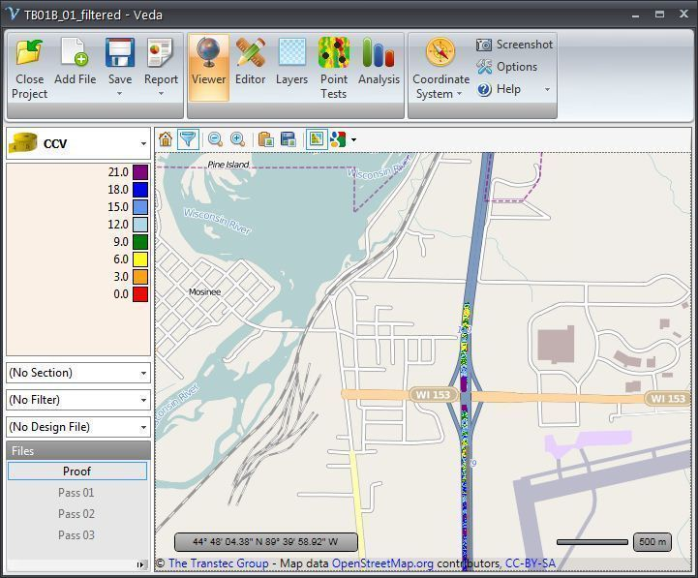
Veta Software
Developed by FHWA
Veta is a map-based tool for viewing and analyzing geospatial data.
Used to generate various IC reports

Slide 17
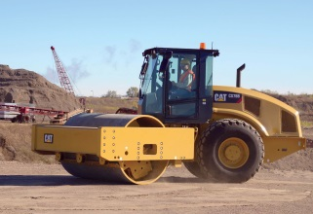

Many Systems …One Software

Slide 18
Why Using Veta
Critical for standardization
Included in Specs
  Caltrans
  AASHTO
  FHWA
  many States IC specs
Public domain -- Free

Slide 19
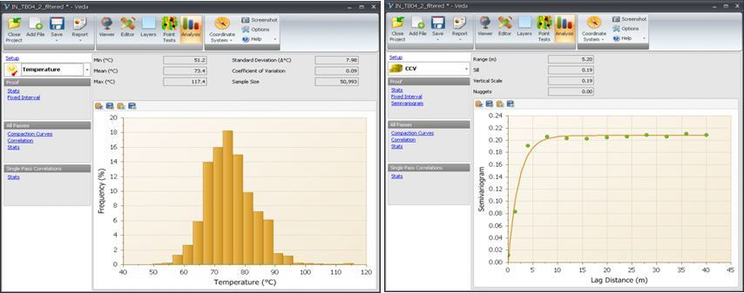
Veta Software

Slide 20
Benefits of IC
Reliable monitoring of compaction activities
    No. of Passes
    Coverage
    Temperature
    Stiffness
Improve compaction…
better performance
Improve efficiency…
cost savings
Increase information…
better QC/QA
Consistency & Uniformity

Slide 21
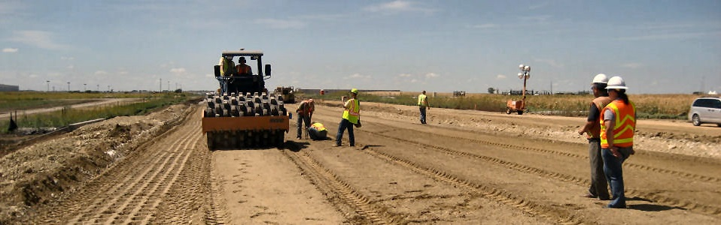
Implementation of Intelligent Compaction in California

Slide 22
CALTRANS
INTELLIGENT COMPACTION
Used as part of Contractor QC program
Not used as Acceptance
Used in Pilot Projects at this time
Cost of IC is about 3% to 5% of the bid item

Slide 23
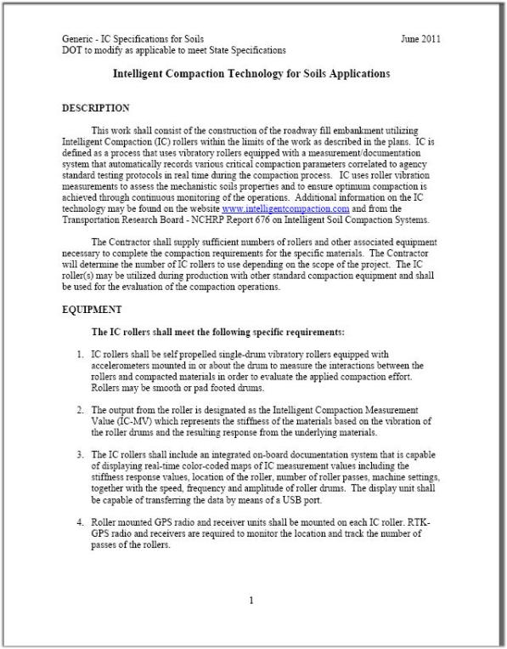
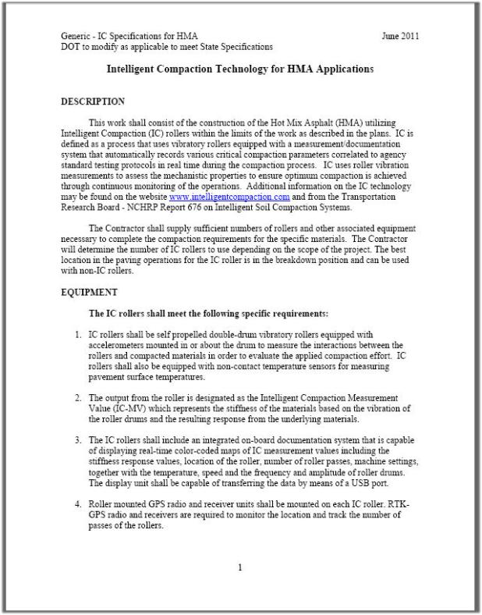
Caltrans IC Specs
HMA
Cold In Place Recycling

Slide 24
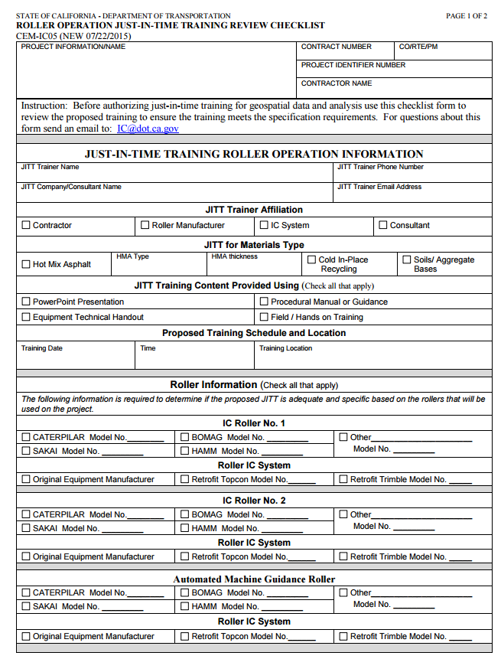
IC Specs Administration
Contractor is responsible for data collection, analysis, report preparation, and data upload
  14 Construction forms
  3 IC CIR construction reports
    Mapping existing pavement
    Test Strip
    Compaction Quality Control report
  2 IC HMA construction reports
    Test Strip HMA≥0.15’
    Compaction Quality Control report
  Information (Data) submittals
    Data uploading to DOT servers

Slide 25
CT IC Target Values
Intelligent Compaction Target Value: Compaction target values established at test strip (>0.15’) or specified that are used by roller operator to monitor compaction and in data analysis to generate compaction quality control report.
  No. of Passes
  Breakdown Compaction Temperature
  Intermediate Compaction temperature
  Intelligent Compaction Measurement Value (Pseudo Stiffness)

Slide 26
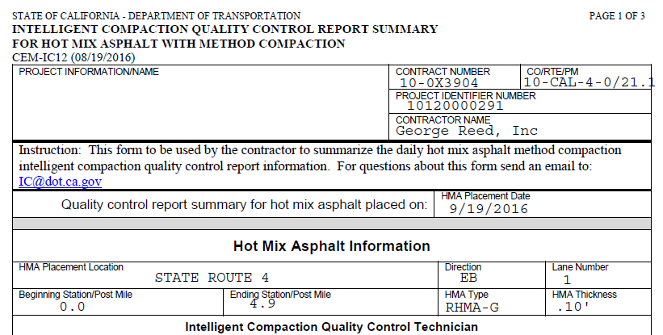
Case Study

Slide 27
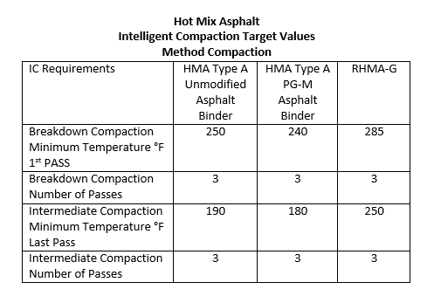
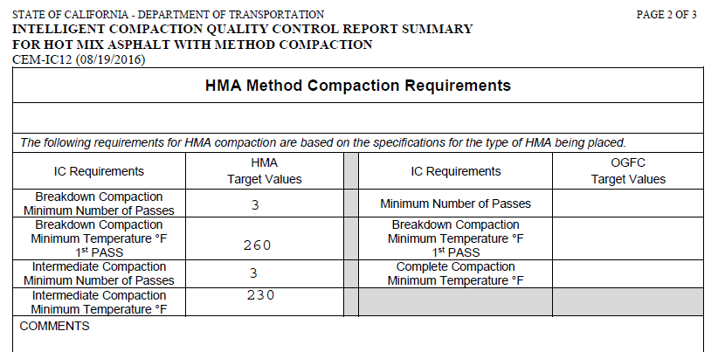
Section 39- Hot Mix Asphalt
Intelligent Compaction Target Values
Method Compaction

Slide 28
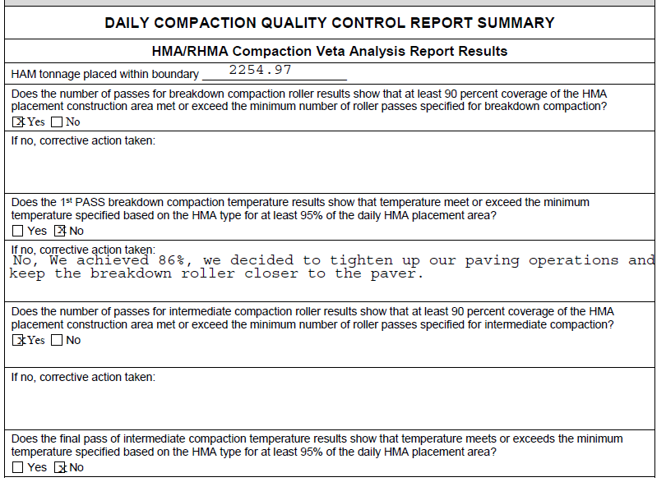

IC Quality Compaction Summary

Slide 29
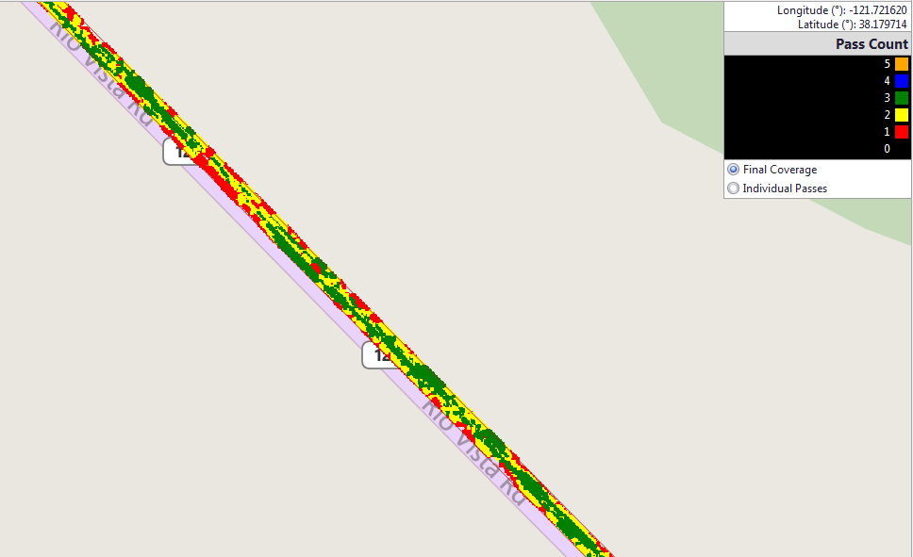
Veta Viewer

Slide 30
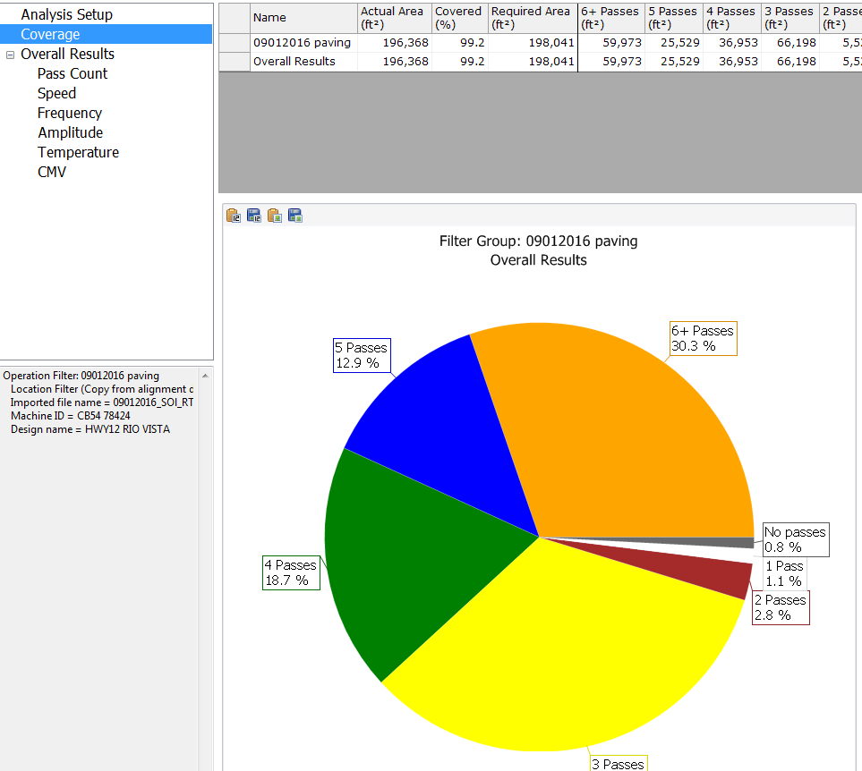
Coverage

Slide 31
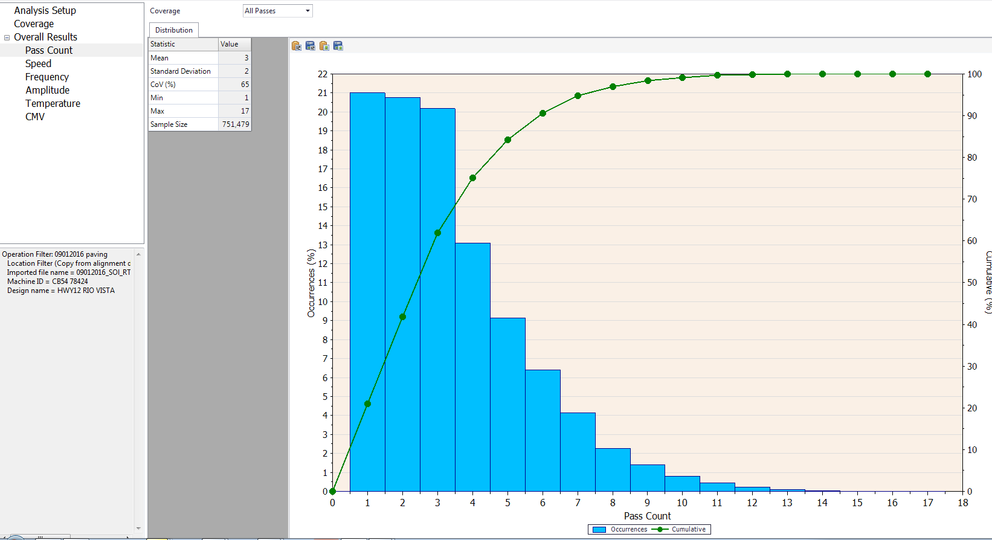
Pass Counts

Slide 32
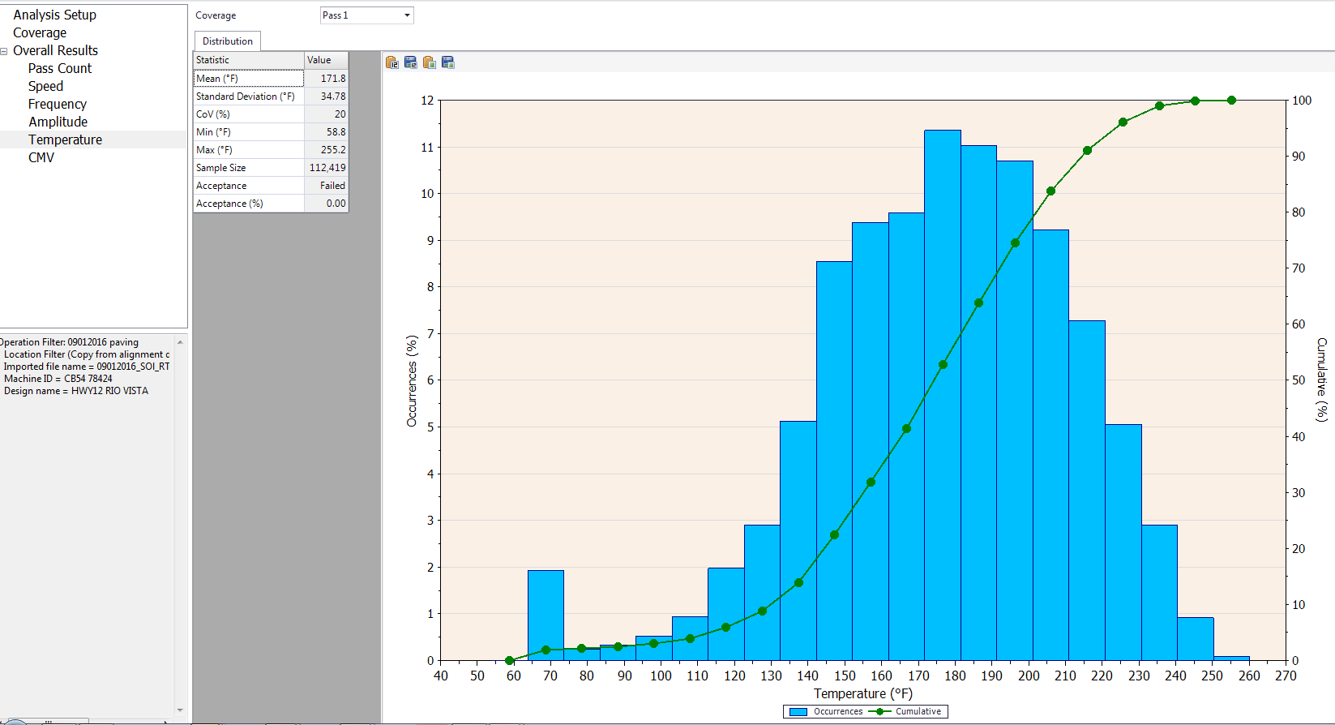
1st Pass Breakdown Temp.

Slide 33
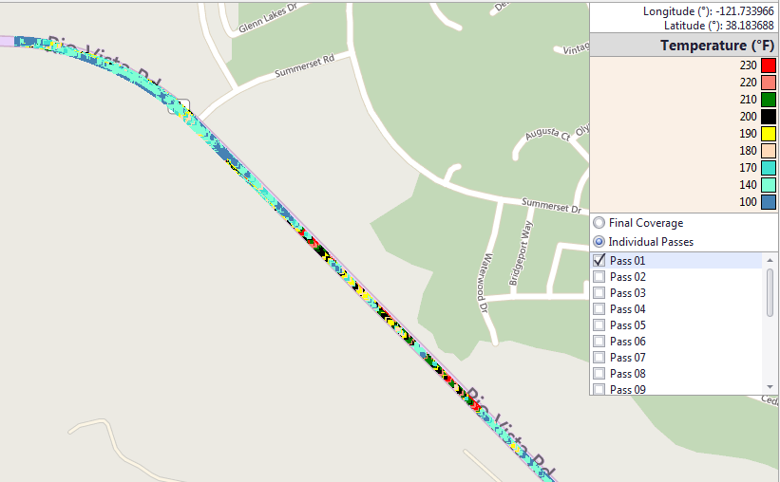
1st Pass Breakdown Temp.

Slide 34
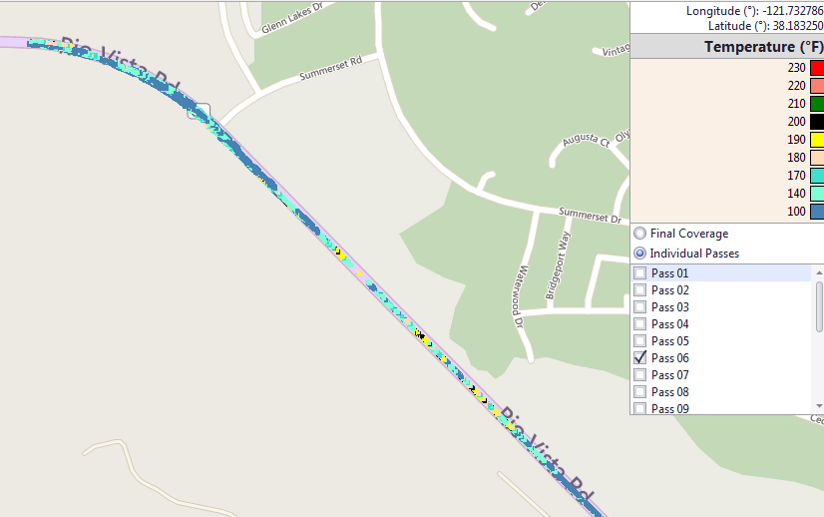
Last Pass Intermediate Compaction

Slide 35
Exploring Possible Density QA with Ground Penetrating Radar
(Ken Maser (Infrasense)

Slide 36



























































GPR Dielectric Map

Slide 37
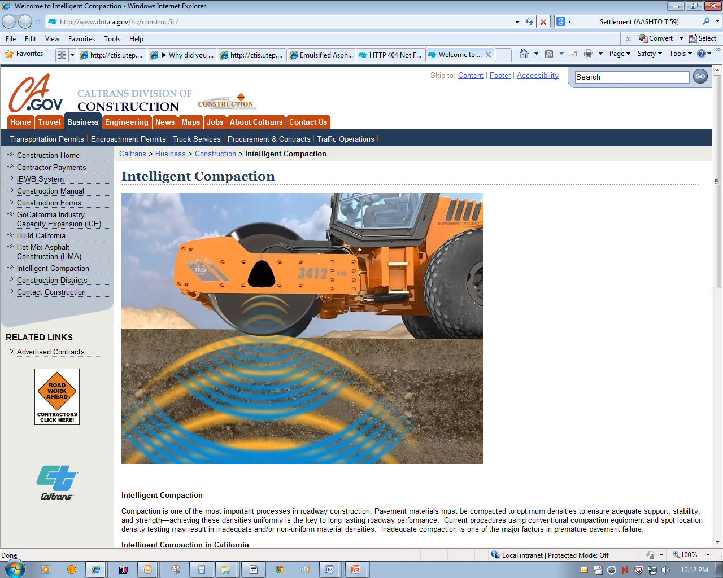
Caltrans Intelligent Compaction Webpage www.dot.ca.gov/hq/construc/IC

Slide 38
For More Info on IC
Website
http://www.dot.ca.gov/hq/construc/ic/
Email
Ebi.fini@dot.ca.gov
Phone
(916) 227-5396

Slide 39

Contact Ebi Fini 916-227-5396 ebi.fini@dot.ca.gov
IC@dot.ca.gov

