Slide 1
Integration of Traffic Speed Deflectometer (TSD) and Ground Penetrating Radar (GPR) for Network-Level Roadway Structure Evaluation
by
Ken Maser, Adam Carmichael,
Infrasense, Inc
Pete Schmalzer,
Nichols Consulting Engineers
Bill Shaw,
Idaho Transportation Department
NRRA 2017 Conference
May 24, 2017

Slide 2
Background
PMS assessments are based on surface distress
  Continuous distress survey systems are available
Remaining life depends on roadway structure
Continuous roadway structure data has been harder to get
  FWD testing requires closures, too much time, limited coverage
TSD and GPR combined can now provide continuous roadway structure data
  ~200 miles per day/no closures

Slide 3
Objectives of Idaho Pilot Project
Use TSD deflection data with GPR layer thickness data to calculate properties of the roadway structure continuously across the network
  Subgrade Modulus
  Effective Structural Number
  Remaining Life
Offer the data on a geospatial database platform usable to a wide audience
Demonstrate the use of the data at both network and project levels
Notes:
Mention level of detail useful at the project level

Slide 4
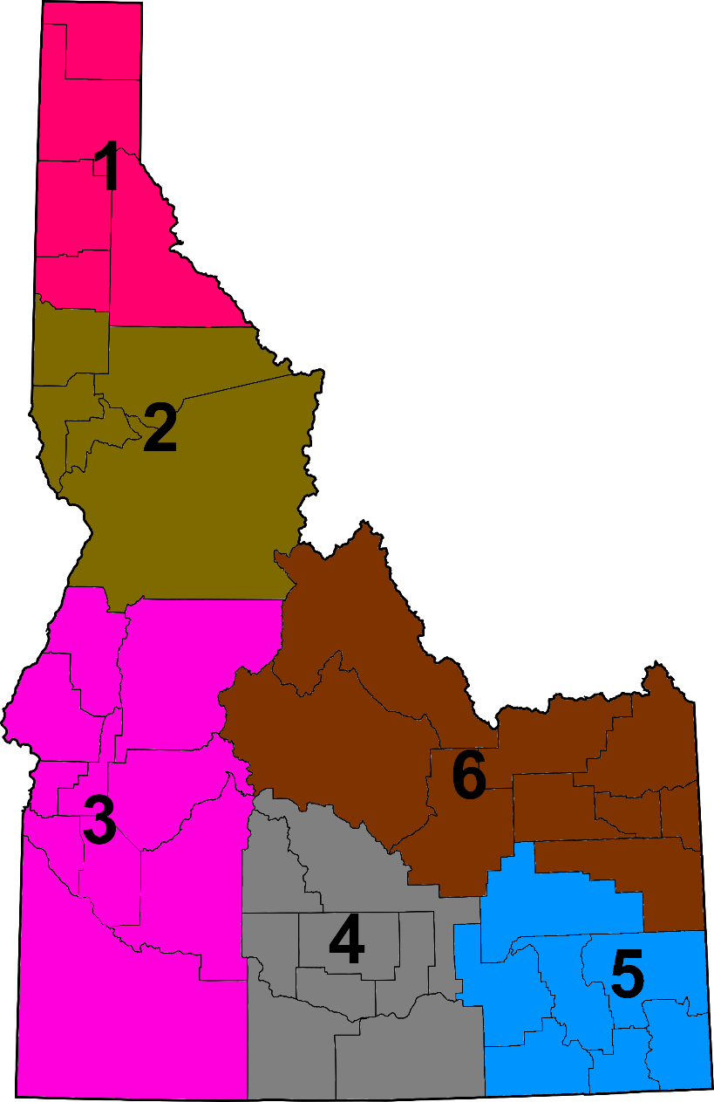
Pilot Project Scope – Idaho District 6
735 miles of roadway:
168 miles Interstate
567 miles primary roads

Slide 5
Data Collection
TSD continuous at 10m intervals
  Provides deflection slope at various offsets from load
FWD at 100 ft. intervals in selected 2-mile regions for calibration/verification
Ground Penetrating Radar (GPR)
  1 GHz Horn Antenna, continuous at 1 foot intervals
Selective coring for layer structure clarification
Notes:
Mention GPS and coordination

Slide 6


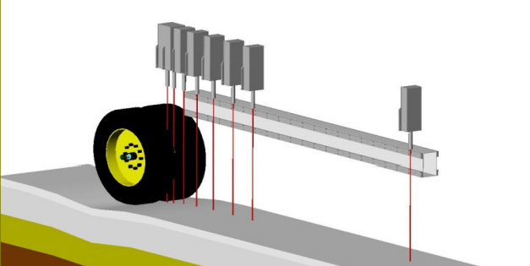
Traffic Speed Deflectometer (TSD)

Slide 7

Ground Penetrating Radar (GPR)
GPS
1 GHz Horn Antennas
DMI
1 GHz Horn Antenna

Slide 8
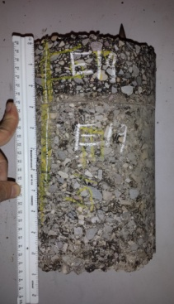
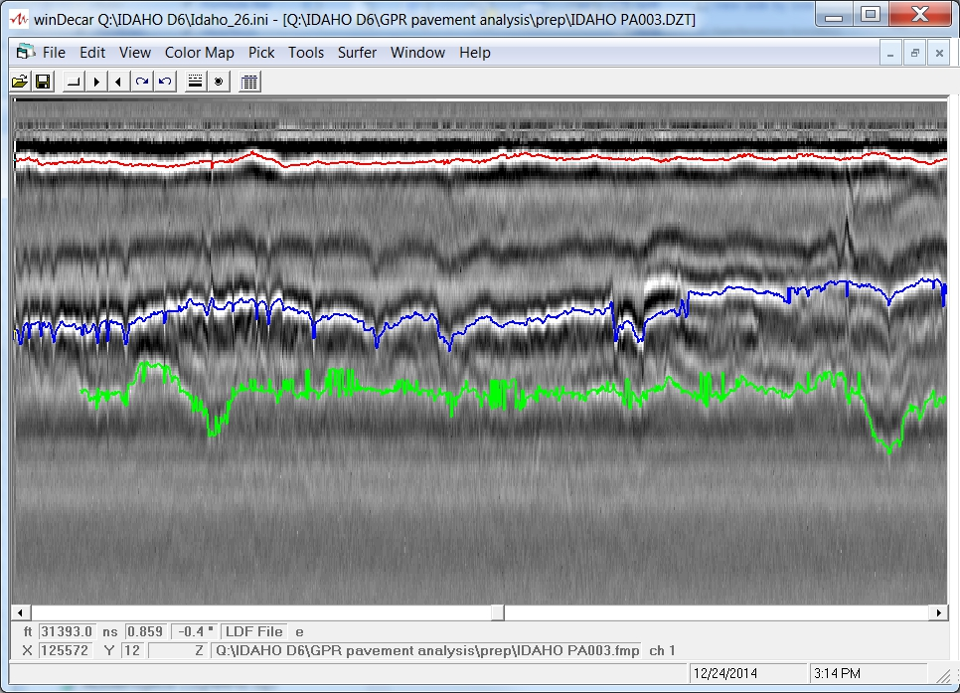
GPR Data Analysis
8" Diam.
Core
Increasing Milepost
Bottom of AC
Top of Pavement
Bottom of CRABS
Bottom of Base
Depth

Slide 9
TSD Data Analysis Procedure
Calculate subgrade modulus (Mr) directly from deflection slope of outer sensors
Compute deflections by integrating deflection slopes
Compute pavement modulus, Ep from deflections and layer thickness
Calculate SN_{eff} from Ep and thickness for each point

Slide 10
TSD vs. FWD – Maximum Deflection (D0)

Slide 11
TSD vs. FWD – Subgrade Modulus (M_{R})

Slide 12
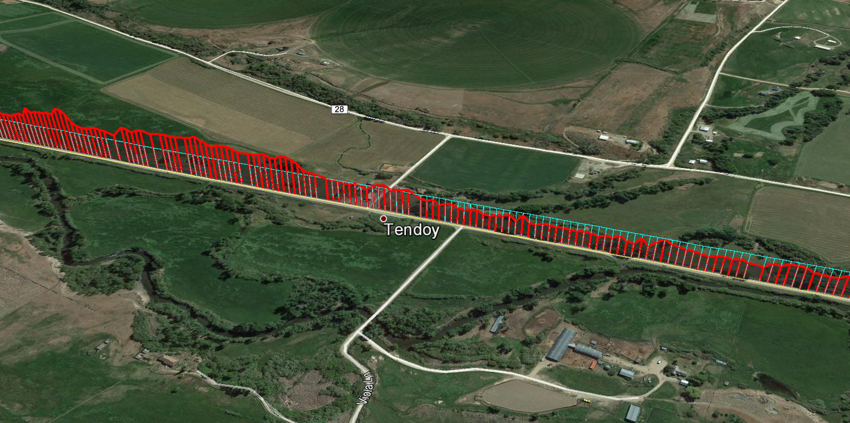
Sample Analysis Result (SNeff)
SNeff
SNeff=3

Slide 13
Remaining Life and Segmentation
Calculate remaining life at each point
  given SN_{eff} at each test point, compute ESALs
  using traffic projections convert ESALS to life
Segment the pavement based on remaining life
Targeted 1-6 mile segment length, based on typical rehab project length.

Slide 14
Segmentation and Remaining Life (SH 28)

Slide 15
Pavement Substructure GeoDatabase
Data is recorded in a series of tables
Data is displayed spatially using ArcGIS
Database is accessible through iPLAN
http://iplan.maps.arcgis.com/apps/webappviewer/index.html?id=36433c5e330e48378bca126af4920549

Slide 16
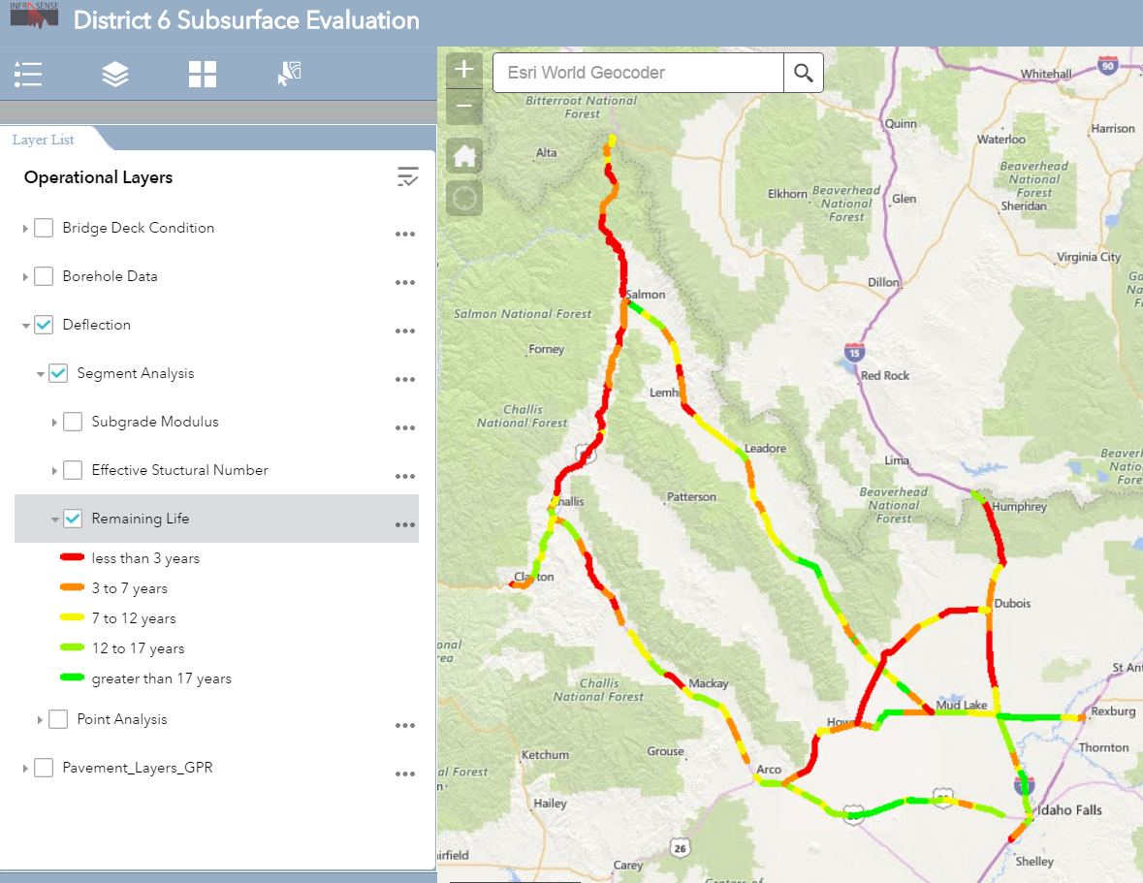
Segmented Remaining Life (years) in iPLAN

Slide 17

Segmented Remaining Life (years)
Notes:
Big picture condition of network – basis for priorities and budgeting. Data is available at a level of detail that supports project level decisionmaking

Slide 18
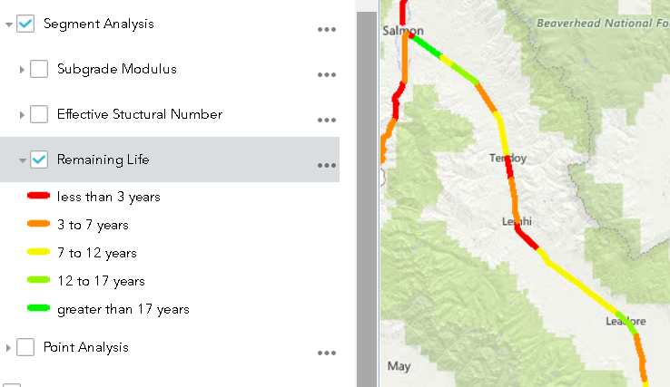
Example Segment Analysis – SH28
Remaining Life
SN_{eff}
M_{r}

Slide 19
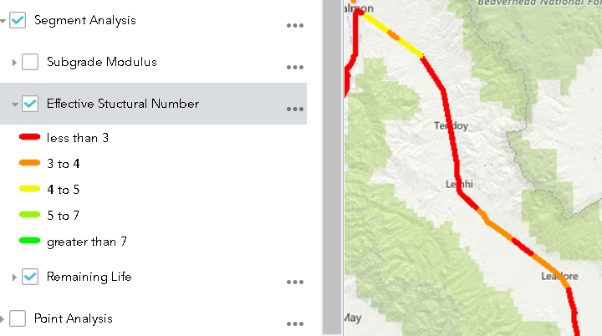
Example Segment Analysis – SH28
SN_{eff}
M_{r}

Slide 20
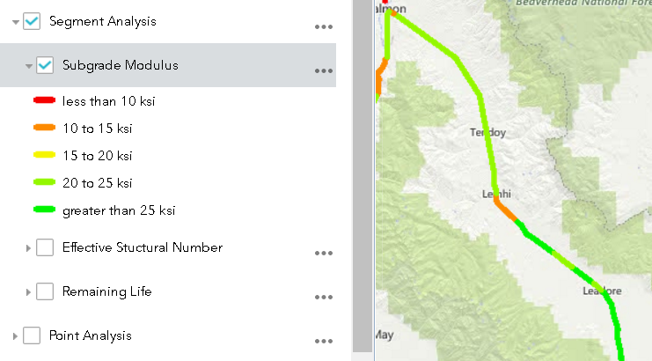
Example Segment Analysis – SH28
M_{r}

Slide 21
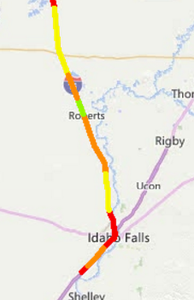
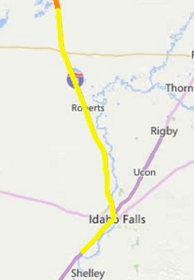
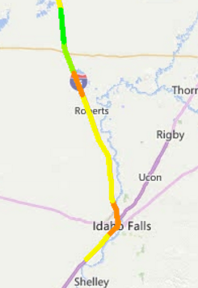
I-15 Southbound Segment Analysis
Remaining Life
SNeff
Mr

Slide 22
Current Effort –
Use of Structure Data in
Pavement Management
Incorporate roadway structure parameters into PMS database (TAMS)
Combine structure parameters with surface distress in decision rules
Evaluate changes in resource allocation and rehabilitation plans
Notes:
We have now shown how roadway structure can be used to project pavement life and rehab needs on a network level. These were two small corridors, but the approach can be extrapolated, and this is being done in a current project. ----Current effort will lead to what-if scenarios. Does the info make a difference

Slide 23
Summary
Combination of TSD and GPR has been demonstrated for determining network-level roadway structure data
Process has been applied to 735 miles of roadway
Resulting data is available via a statewide geodatabase
Results demonstrate potential impact on rehab design
Current work will complete remaining 340 miles of roads in the district and will investigate impact of results on pavement management

