Slide 1
Environmental Benefits of
Cold-in-Place Recycling
in Wisconsin
Presentation on May 24, 2017 at the
2017 National Roads Research Alliance Pavement Conference
University of Minnesota (St. Paul Campus)
Angela Pakes, P.E., LEED AP
Recycled Materials Resource Center
University of Wisconsin-Madison
Notes:
Introduce self
Introduce RMRC
Today we will be looking at the RMRC’s most recent research, which quantifies the environmental benefits of Cold In Place Recycling, or CIR, in Wisconsin. This research could also be applied to the other nearby states because of the variety of project locations within the state.

Slide 2
Agenda
Current Aggregate use in Road Construction
Conventional Mill and Overlay Method vs. Cold-in-Place Recycling
Research Methods
  Nine Case Studies
  Life Cycle Assessment
Individual Project Example: STH 13
Environmental Savings
  Percent Reductions
  Cumulative Savings
  Savings Predictions
Notes:
So, we will start by looking at current use of aggregate in road construction in the US.
We will then see how CIR compares to mill and overlay, the conventional method of road maintenance.
I’ll then explain our research methods, the environmental savings that we calculated for each project and how we used these to create a model for predicting savings for a particular project.

Slide 3
680 Mt/yr of
virgin aggregate used in
road construction
[a]
Mining
Transport
Construction
Transport
Disposal
Notes:
Currently in the United States, 1.3BT of aggregate is used every year, 2/3 of which is in road construction, and 90% of that is virgin aggregate. This equates to 680 Mt/yr of virgin aggregate used in road construction. This amount of virgin aggregate not only depletes a finite resource, but has environmental impacts throughout its life.

Slide 4
Recognized Qualitative benefits of CIR
Economical
Environmental
Social
Extends the life of the roadway
Reduces non-renewable, virgin materials and transportation
[b]
[b]
Notes:
CIR has been used for over a decade for it’s economic benefits, and it is thought that CIR extends the life of the roadway, which has social and economical benefits to the triple bottom line of sustainability. CIR is also known to reduce the consumption of non-renewable, virgin materials, which again yields economic and environmental benefits; however, these environmental benefits have not yet been quantified, so that was the purpose of this project.

Slide 5
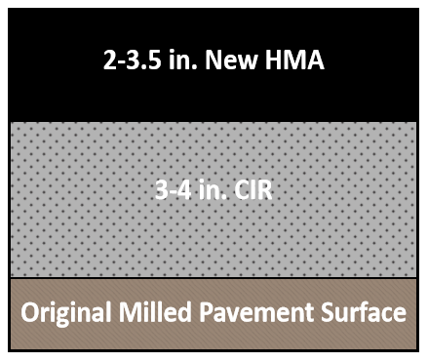
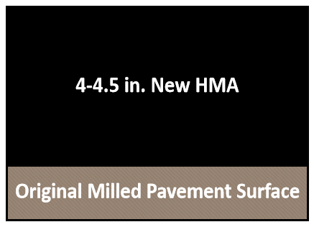
Construction Comparison
Conventional Mill and Overlay
Cold-in-Place Recycling
Mill existing roadway
Haul to nearest asphalt plant
Pave hot mix asphalt layer (4 in)
Mill existing roadway
Crush and sort recycled asphalt pavement
Mix with stabilizing agent
Pave CIR
CIR Cure (1-14 days)
Pave hot mix asphalt layer (2-3.5 in)
Notes:
Here we have a side-by-side comparison of the road profiles resulting from CIR and mill overlay construction. The CIR final product is a little bit thicker than with the conventional method and requires a few more steps in the construction process, but CIR requires less new HMA and therefore uses less virgin materials.

Slide 6
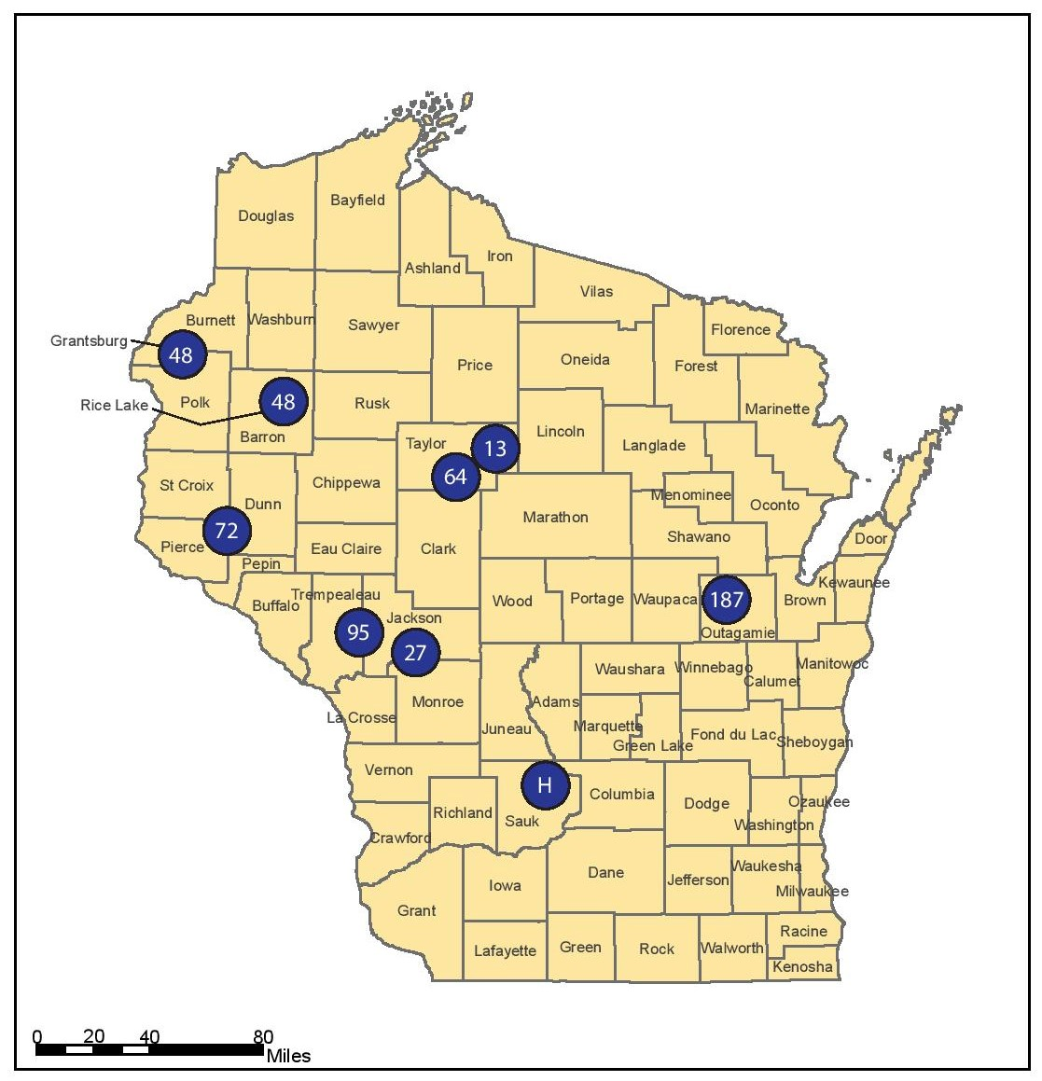
Case Studies
CTH H (Reedsburg to Wisconsin Dells)
STH 13 (Medford to Westboro)
STH 27 (Sparta to Black River Falls)
STH 48 (Grantsburg to Frederic)
STH 48 (Rice Lake to Birchwood)
STH 64 (Gilman to Medford)
STH 72 (Ellsworth to Elmwood)
STH 95 (Blair to Merrillan)
STH 187 (Shiocton to North County Line)
Notes:
The nine projects provided a diverse database. Each project was subject to different climates, loading patterns and traffic. The projects themselves were each different lengths and different hauling distances. This means our data is closer to being a fair representation of Wisconsin’s roads, and not just a particular county or area.

Slide 7
Summary of Project Information
Project | MOL HMA Thickness (inches) | CIR Base Thickness (inches) | CIR HMA Thickness (inches) | Road Width (ft) | Project Length (miles) | Hauling Distance (miles) | Single- or Multi-Unit Recycling Train
CTH H | 4.5 | 4 | 3.5 | 30 | 9.5 | 5.3 | Multi
STH 13 | 4 | 4 | 2.25 | 30 | 5.64 | 11.6 | Multi
STH 27 | 4 | 4 | 2.25 | 30 | 8.99 | 8.7 | Single
STH 48 (Rice Lake) | 4 | 3 | 2 | 30 | 8.10 | 10.3 | Multi
STH 48 (Grantsburg) | 4 | 4 | 2.25 | 24 | 12.5 | 4.3 | Multi
STH 64 | 4 | 4 | 2.25 | 30 | 4.46 | 3.7 | Multi
STH 72 | 4 | 4 | 2.25 | 30 | 4.63 | 18.3 | Multi
STH 95 | 4 | 4 | 2.5 | 30 | 4.42 | 24.4 | Multi
STH 187 | 4 | 3 | 2.5 | 30 | 9.84 | 21.3 | Multi
Notes:
Furthermore, these projects differed in length, distance to the nearest asphalt plant, mix design, and equipment.

Slide 8
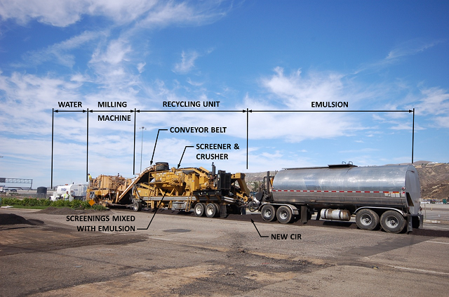
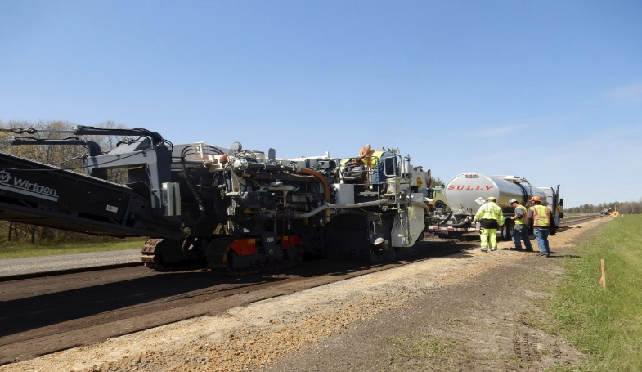
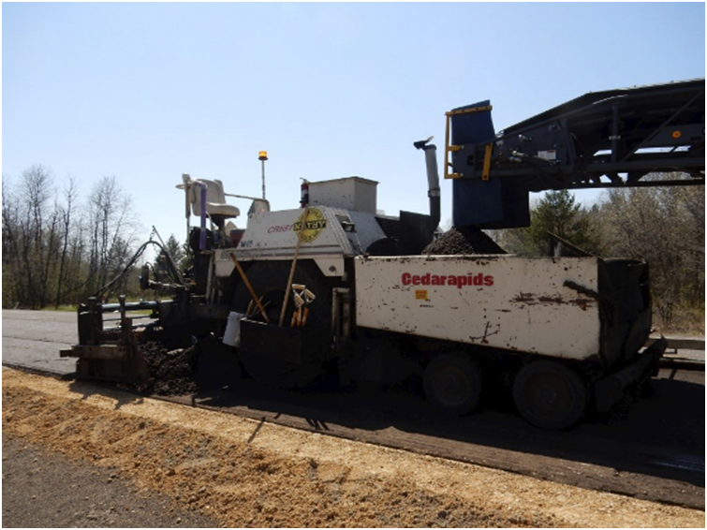
Multi-Unit Recycling Train (8 projects)
[LA County Department of Public Works]
Single-Unit Recycling Train (1 project)
[Mathy Construction, 2016]
Notes:
A multi-unit recycling train consists of a milling machine to mill the existing roadway, a screening and crushing machine to grade the milled material, a pug mill machine to add the stabilizing agent, and a paver to relay the modified RAP mixture. Then the RAP is compacted and left to cure before it can be paved with HMA. 8 of the 9 projects we studied used this method.
The single unit recycling train, instead has one recycling machine that does the milling, crushing and sizing, and adds the stabilizing agents in the cutting chamber. A paver then relays the modified RAP, and compaction rollers stabilize the base. A single unit recycling train was used in one project in particular, STH 27.

Slide 9
Life Cycle Assessment: PaLATE
Pavement Life-cycle Assessment Tool for Environmental and Economic Effects
Created by the Consortium on Green Design and Manufacturing from the University of California-Berkeley (2007), sponsored by RMRC
Scope of Impact Analysis
  Initial Construction
  Maintenance Construction
  End-of-life Analysis
Components of Impact Analysis
  Material Production
  Material Transportation
  Process (Construction)
The Wisconsin projects were evaluated as maintenance construction
Notes:
The tool we used to quantify the environmental benefits of CIR was PaLATE. This was created by the Consortium on Green Design and Manufacturing from the University of California-Berkeley (2007), sponsored by RMRC.
PaLATE is able to generate the environmental impacts from the perspective of initial construction, maintenance construction, or from the end-of-life perspective. The nine projects in this case study were evaluated as maintenance construction projects because they were resurfacing projects, therefore any construction prior to this resurfacing was not considered.
PaLATE analyzes the environmental impacts at the material production phase, material transportation phase, and the construction phase. From this, we were able to see at which phase the most environmental savings were achieved when using CIR instead of Mill and Overlay, and we will demonstrate this breakdown later on.

Slide 10
Life Cycle Assessment
Define Scope of Assessment
Carbon Dioxide Emissions (tons)
Water Consumption (tons)
Take Inventory
Quantity of Materials Used
Equipment and Equipment Specifications
Complete Impact Assessment
Mill and Overlay
Cold-in-Place Recycling
Interpret Results
Percent Reductions
Cumulative Savings
Energy Consumption (kWh)
Savings Predictions
Notes:
There are four steps in performing an LCA.
First is to define the scope of the assessment. The scope chosen for these LCAs was chosen to be the Energy Consumption, Carbon Dioxide Emissions, and Water Consumption associated with highway resurfacing for the two methods.
Next is to take an inventory of the materials quantities used and the type of equipment used in each project.
Then we ran two separate LCAs, one for the as-built CIR scenario and the hypothetical Mill and Overlay scenario, in order to compare them relative to each other for each project.
The results were interpreted on the basis of percent reductions, cumulative savings and then savings predictions.

Slide 11
Assumptions
MOL projects had 4-4.5 inches of HMA overlay.
Notes:
* All Mill and Overlay projects had 4-4.5 inches of milling and 4 inches of HMA overlay.

Slide 12
Assumptions
MOL projects had 4 inches of HMA overlay.
Mix design is the same for the MOL and CIR processes for each project.
Notes:
The mix design is assumed to be the same for the Mill and Overlay process and the CIR process for a given project; however, the HMA mix design varied between each project based upon asphalt binder percentages provided from the job mix formulas.

Slide 13
Assumptions
MOL projects had 4 inches of HMA overlay.
Mix design is the same for the MOL and CIR processes for each project.
Hauling distance from the midpoint of each project to the closest HMA plant.
Notes:
The hauling distances were assumed to be from the midpoint of each project to the closest HMA plant provided by each contractor.
Excess RAP was hauled to the HMA plant as provided by each contractor for each project, so hauling distances remain the same to material hauled to the project site and material hauled away from the project site.

Slide 14
Assumptions
MOL projects had 4 inches of HMA overlay.
Mix design is the same for the MOL and CIR processes for each project.
Hauling distance from the midpoint of each project to the closest HMA plant.
Water trucks were not included in analysis.
Notes:
* Water trucks were not included in the analyses because they were used in both the Mill and Overlay alternative and the CIR process.

Slide 15
Assumptions
MOL projects had 4 inches of HMA overlay.
Mix design is the same for the MOL and CIR processes for each project.
Hauling distance from the midpoint of each project to the closest HMA plant.
Water trucks were not included in analysis.
All projects using a multi-unit recycling train were assumed to use the same equipment.
Notes:
Much of the equipment used by the contractors in the multi-unit CIR process were old and so we went to great lengths to find the fuel consumption and productivity information about this machinery, including contacting the manufacturers. We then chose equivalent equipment pieces that had comparable fuel consumption and productivity specifications, and ended up with a multi-unit recycling train that was the same for each multi-unit project.

Slide 16
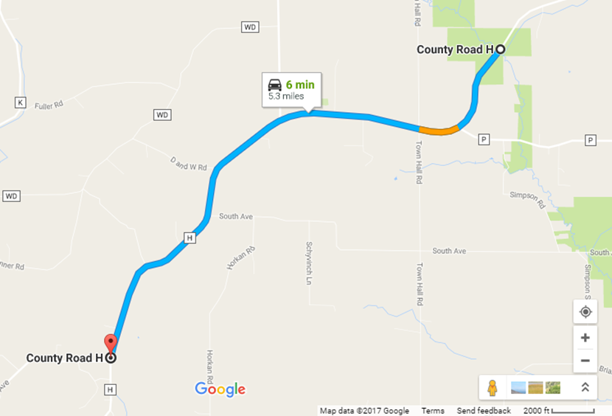
STH 13 (Medford to Westboro)
Project ID | 1610-03-62
Construction Year | 2016
County | Taylor
Contractor (CIR) | WK
Contractor (MOL) | Mathy
Project Length (miles) | 5.64
Hauling Distance (miles) | 11.6
Road Width (feet) | 30
Mill and Overlay HMA Thickness (inches) | 4
Cold In-Place Recycling Thickness (inches) | 4
Cold In-Place Recycling HMA Thickness (inches) | 2.25
RAP Hauled Away during CIR (CY) | 5,811
Binder (%) | 6.3
Notes:
Here is a quick example of one of the projects that we analyzed- STH 13 in Taylor County. The contractor provided the information in the table on the left, along with their equipment suite and material quantities used for both the real CIR scenario and the hypothetical Mill and Overlay scenario. The image on the left is the hauling distance which we found using Google Maps using the midpoint of each project and the nearest asphalt plant as provided by the contractor.

Slide 17
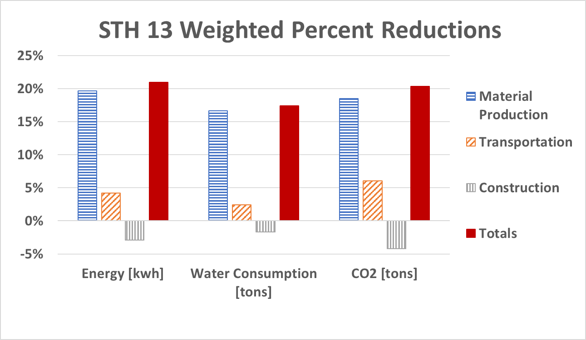
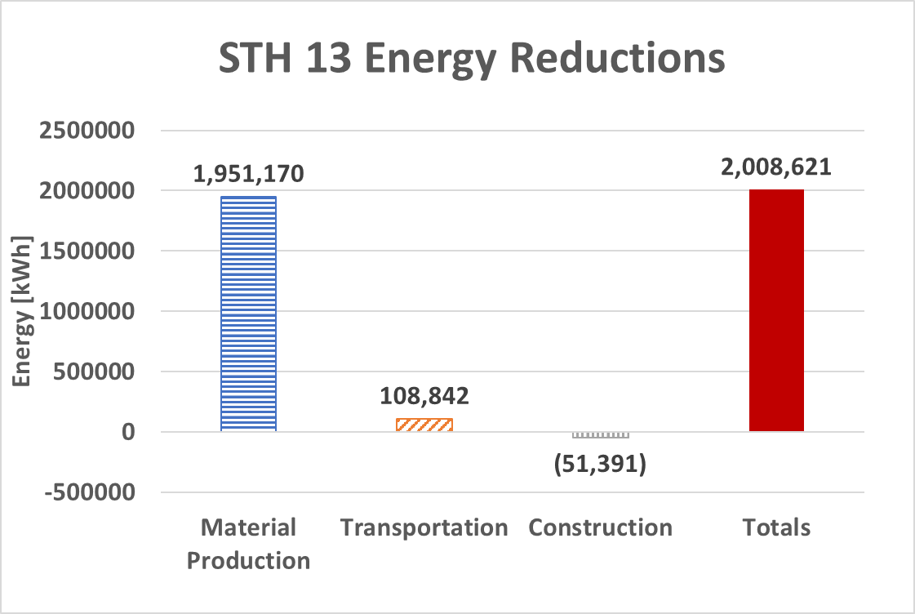
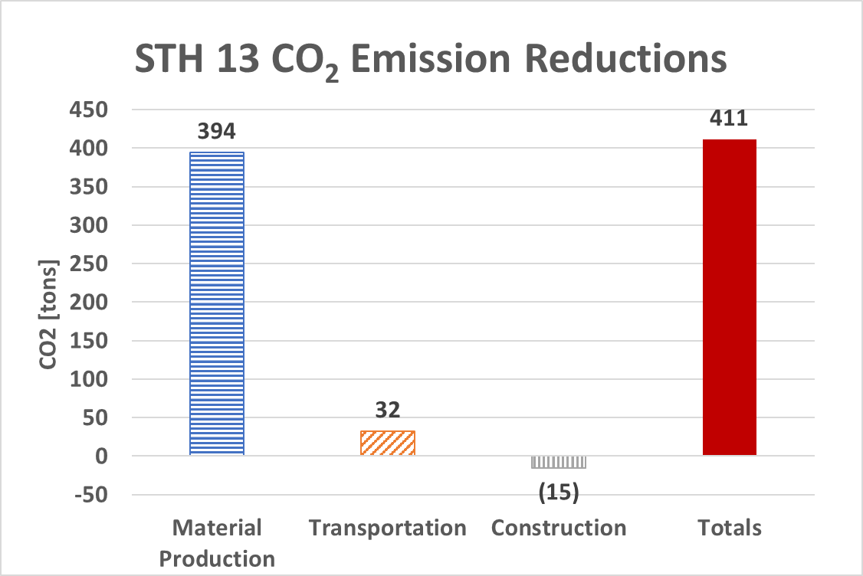
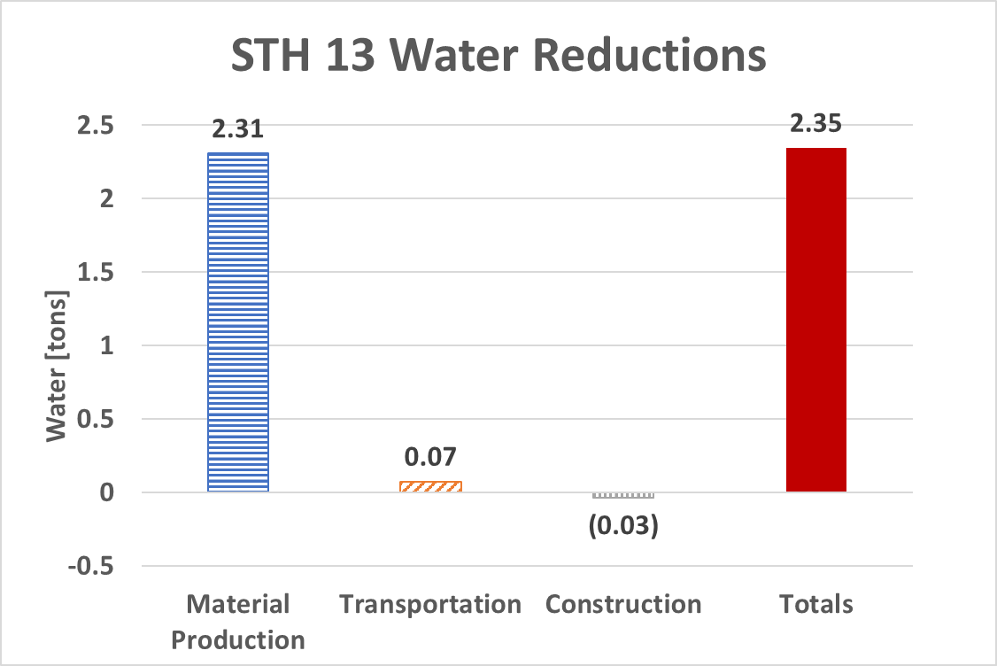
STH 13 in Taylor County
5.6-mile project from Medford to Westboro
Under construction in 2016 by WK and Mathy
4 inches of CIR under 2.25 inches of new HMA overlay
11.6-mile hauling distance
Multi-unit recycling train
Notes:
After we input these quantities into PaLATE, we compared the two LCAs to produce the graphs you can see here.
On the left we have the overall weighted percent reductions for the three savings parameters – energy consumption, water consumption and carbon dioxide emissions. Each parameter was broken down into the three phases of construction – Material Production in blue, Transportation in orange and Construction in grey. The total savings for each parameter are in red.
STH 13 shows the general trend of all of the 9 projects, in that most of the savings for each parameter came from the materials production phase. This can be explained by the significantly thinner layer of new HMA needed when CIR is used.
Savings can also be seen in the transportation phase. This is because we don’t need to transport as much new material to the site, so less gas is consumed by dump trucks.
You can see from the grey bars that the construction phase for implementing CIR actually more resource intensive than if Mill and Overlay was used. However, the vastly larger savings from transportation and materials production mean the net savings are still around 20%.

Slide 18
Environmental savings by project
Project | Energy Consumption [kWh] | Water Consumption [tons] | Carbon Dioxide Emissions [tons]
CTH H | 1,109,699 | 1.0 | 211
STH 13 | 2,008,621 | 2.4 | 411
STH 27 | 2,030,254 | 1.8 | 395
STH 48 Rice Lake | 3,930,466 | 5.1 | 820
STH 48 Grantsburg | 8,394,554 | 11.0 | 1,738
STH 64 | 3,013,623 | 5.2 | 676
STH 72 | 1,042,297 | 1.1 | 214
STH 95 | 1,200,412 | 1.2 | 250
STH 187 | 1,141,070 | 1.0 | 239
Total | 23,871,000 | 29.7 | 4,955
Notes:
* Similar analysis were performed for each project, so we could also study cumulative savings.

Slide 19
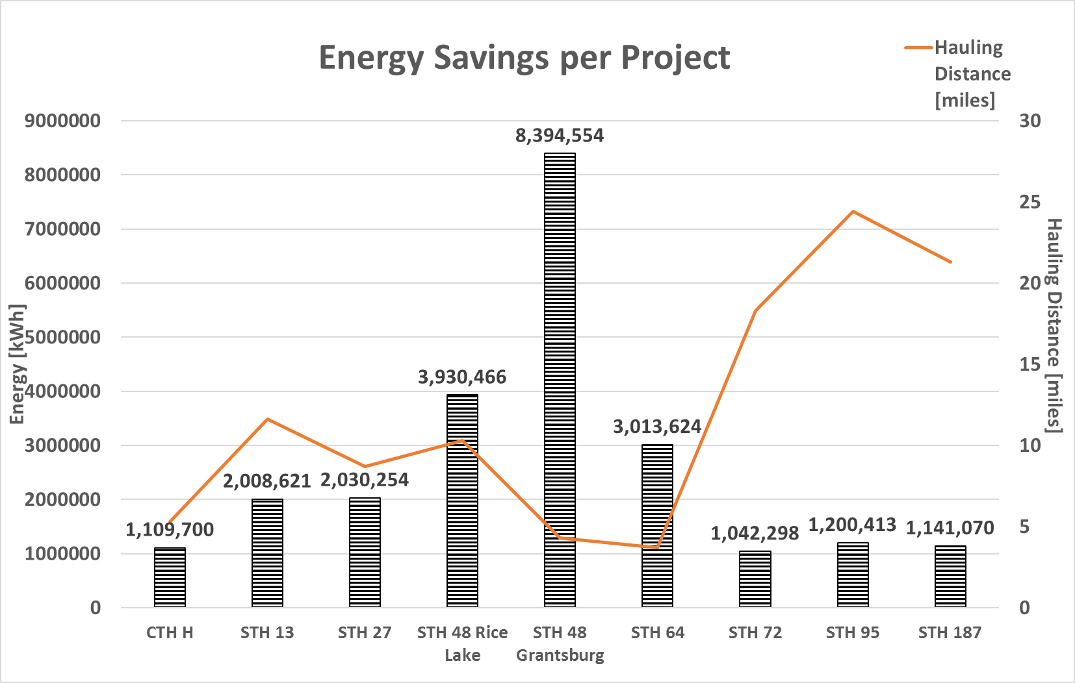
Notes:
This graph shows the cumulative energy savings in kWh for each of the 9 projects. The orange line represents hauling distance in miles. We noticed that there was some correlation between shorter hauling distance and larger energy savings. However, there is not a direct correlation, so there must be other factors at play, which we explore further on. State Highway 48 at Grantsburg had much larger cumulative savings, but this is mostly due to a longer project length.

Slide 20
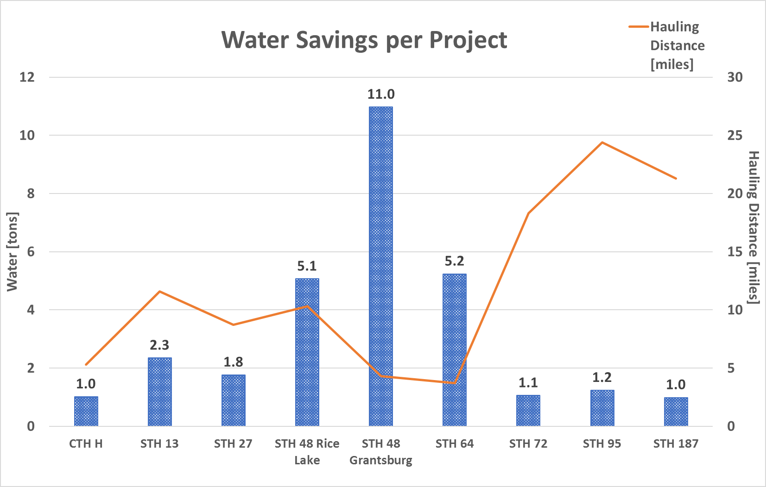
Notes:
Similar trends were seen for water savings, seen here in tons.

Slide 21
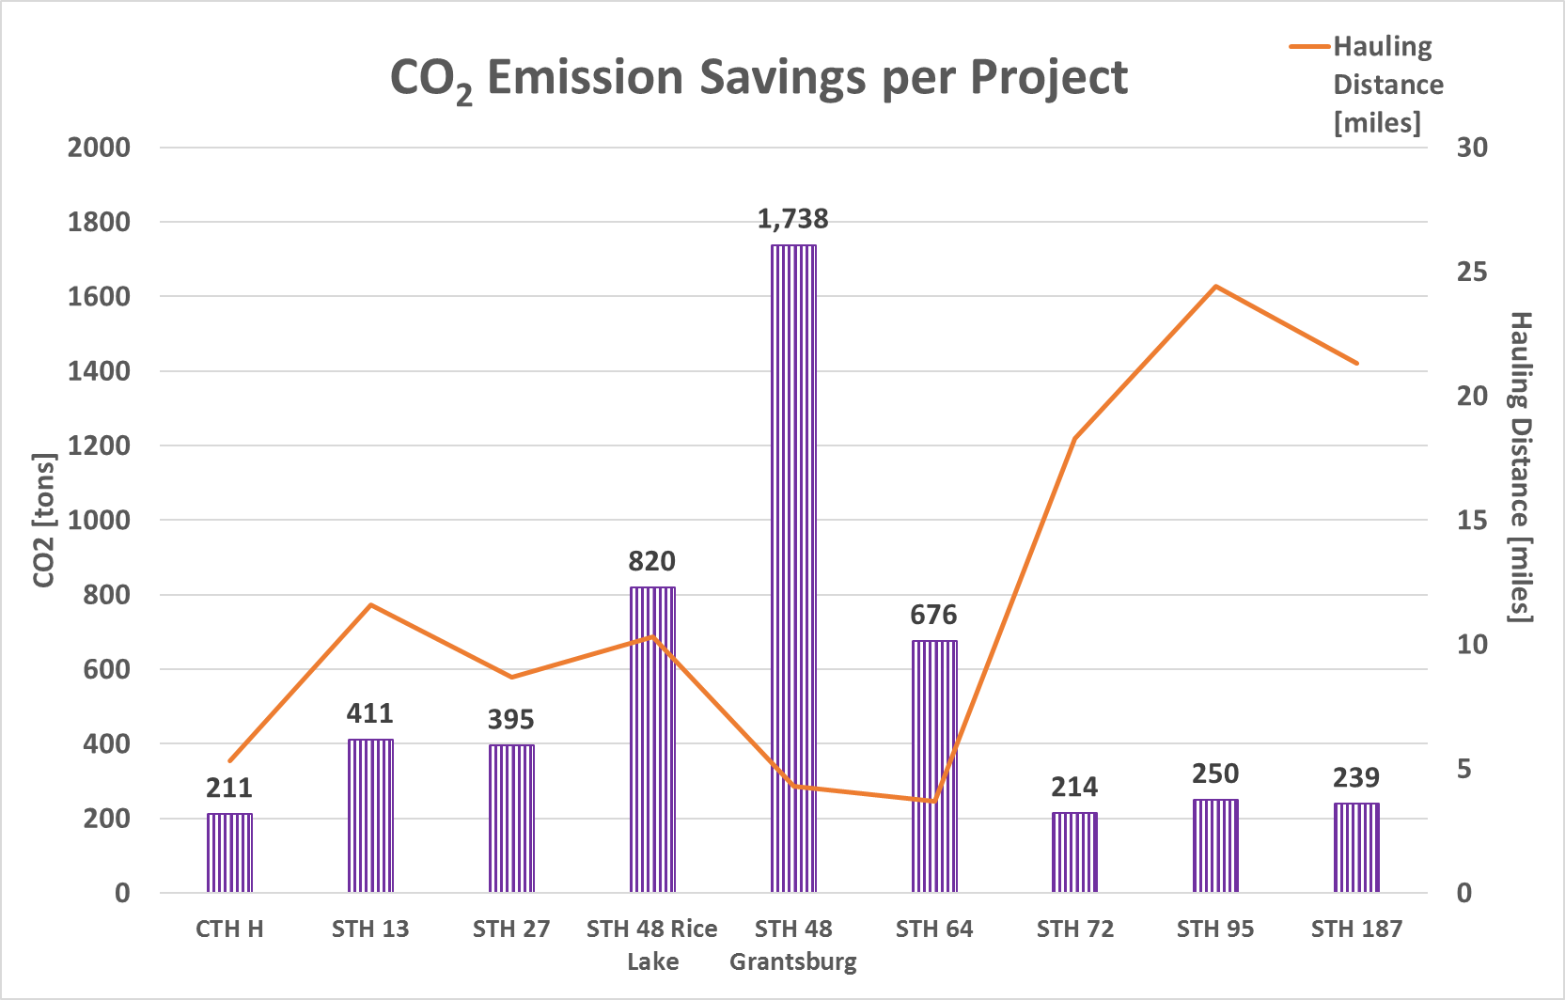
Notes:
And also in CO2 emission savings, also in tons.

Slide 22
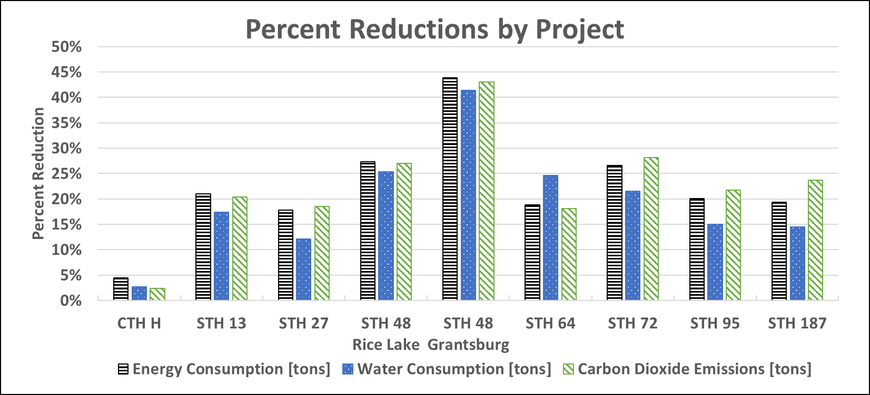
20-22% Reduction in Environmental Impacts
Notes:
Overall there was an average of 22% reduction in energy consumption and carbon dioxide emissions and a 20% reduction in water consumption when CIR was used in place of MOL.

Slide 23
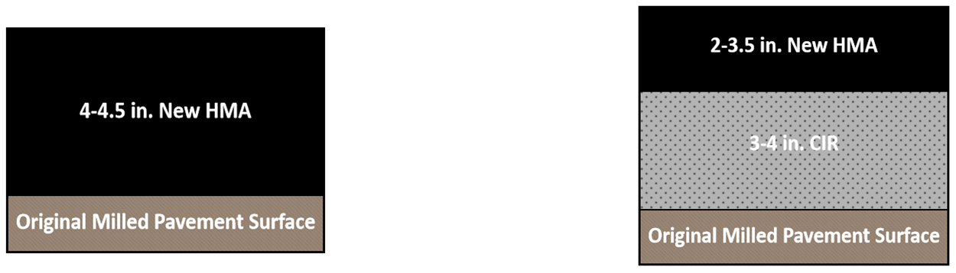
Project Savings Predictions
All Projects
27
27
27
H
H
H
Future predictions can be made with
road width, length, reduction in HMA and hauling distance
Notes:
To further demonstrate the factors that control environmental savings, the above graphs were generated.
Each of these graphs was created by reducing project specifications to one number, which we call “Normalized HMA Reduction.” This number is the volume of HMA saved in cubic yards, divided by the hauling distance of the project. This accounts for the variation in volume of HMA and hauling distance between projects.
This normalized number was plotted with the savings for each project to get these linear relationships between environmental savings and projects specifications. The idea is that future predictions can be made with the road width, length, reduction in HMA, and hauling distance.
The certainty improves when we remove 27, the only single unit project , and H, which had a particularly thick layer of HMA placed over the CIR base. This resulted in only a one inch reduction in HMA use when CIR was implemented, relative to traditional Mill and Overlay, whereas all other projects used 1.5 to 2 of inches less HMA.
The resource intensive nature of asphalt makes reduction of HMA a key factor in the environmental savings achieved by using CIR instead of Mill and Overlay. For that reason, the environmental savings achieved in CTH H are less significant than in other projects because there is a smaller reduction in the HMA profile.

Slide 24
Total Environmental Savings
68 Road Miles
2,183 U.S. Households
23,871,001 kWh
[c]
956 Cars
4,955 tons of CO₂
[d]
158 Bathtubs
30 tons of water
[e]
Notes:
Cumulatively, the nine projects resurfaced just 68 road miles, which is less than the distance from here in Duluth to Grand Rapids, MN.
In these 68 road miles, the energy savings achieved are equivalent taking 2183 U.S. Households off the grid for a year, carbon dioxide emission savings equivalent to taking 956 cars off the road for a year, and water savings equivalent to 158 bath tubs of water.
Implementing this over greater distances would lead to much larger savings.

Slide 25





Thank you!
Thank you!
Questions?
Angela.Pakes@wisc.edu
www.RMRC.wisc.edu

Slide 26
References
Asphalt Recycling and Reclaiming Association. (2001) Basic Asphalt Recycling Manual. U.S. Department of Transportation, 19-25.
Carpenter, C., Gardner, K. H., Fopiano, J., Benson, C. H., Edil, T. B. (2007) Life cycle based risk assessment of recycled materials in roadway construction. Waste Management, vol. 27, no. 10, 1458-1464.
U.S. Energy Information Administration. How much electricity does an American home use? [Online] Available: https://www.eia.gov/tools/faqs/faq.cfm?id=97&t=3.
United States Environmental Protection Agency. Transportation, Air Pollution, and Climate Change. [Online] Available: https://www.epa.gov/air-pollution-transportation
Portland Water Bureau. Shower and Bath Fact Sheet. [Online] Available: https://www.portlandoregon.gov/water/article/305153

Slide 27
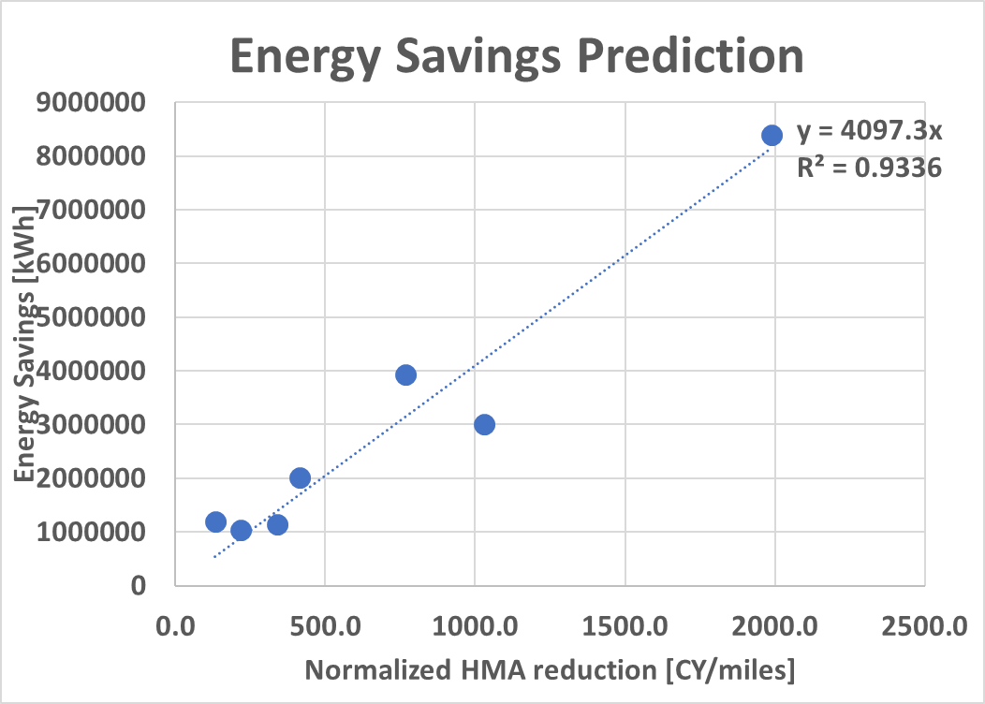
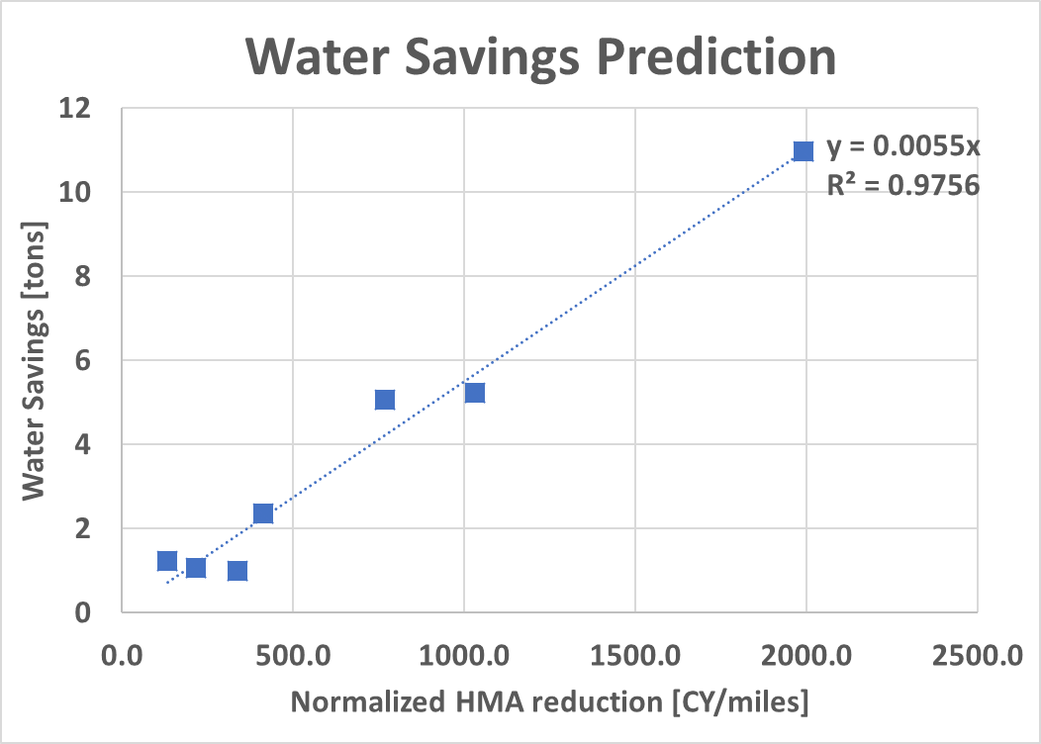
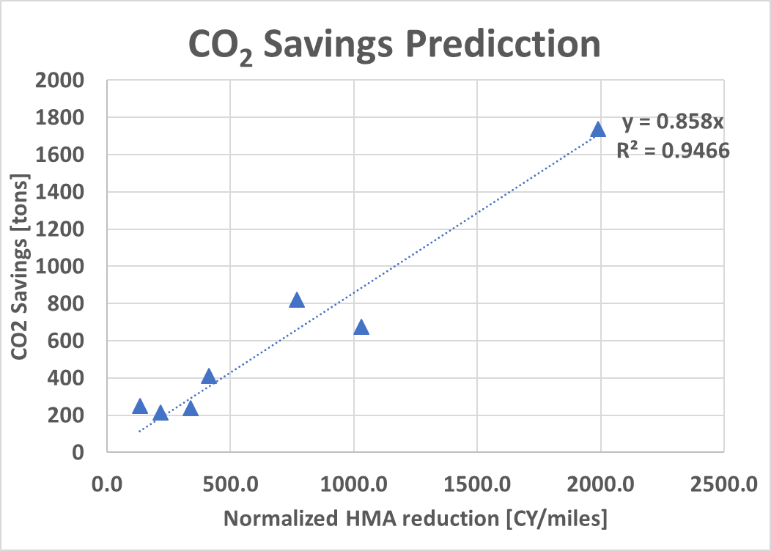
Project Savings Predictions
H and 27 removed
Notes:
* We can see that when these two outliers were removed, the r squared value improves dramatically.

Slide 28
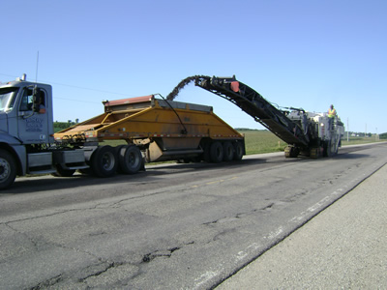
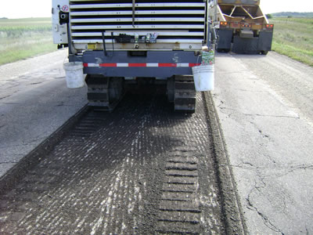
Milling
http://www.dot.state.mn.us/information/roads/mill-overlay.html

Slide 29
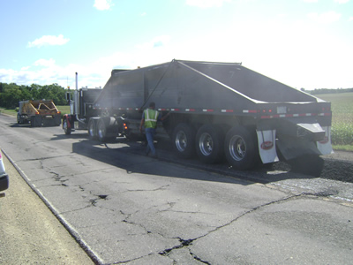
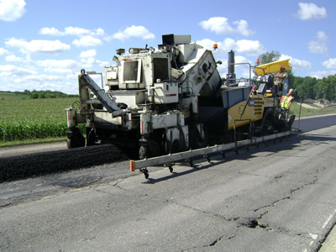
Lay and level new asphalt
http://www.dot.state.mn.us/information/roads/mill-overlay.html

Slide 30
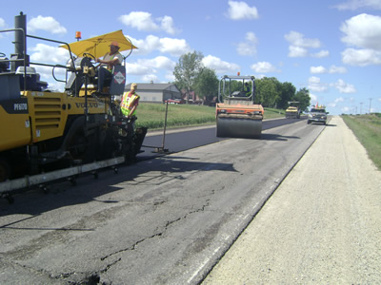
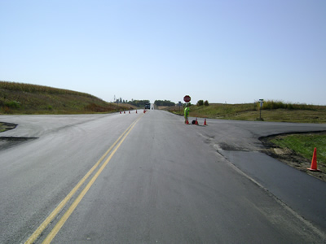
Paving
http://www.dot.state.mn.us/information/roads/mill-overlay.html

Slide 31
Densities provided by PaLATE
Material | Density [tons/CY]
Virgin Aggregate | 2.23
Bitumen | 0.84
RAP | 1.85
Milled | 1.83
Asphalt Stabilizing Agent | 0.84

Slide 32
PaLATE
Define the Scope of the Project
Criteria for Environmental Impact
PaLATE Environmental Impact Outputs
Energy consumption (MJ)
Water consumption (kg)
CO₂ emissions (kg)
NO_{x} emissions (kg)
PM₁₀ emissions (kg)
SO₂ emissions (kg)
CO emissions (kg)
Hg (g)
Pb (g)
RCRA hazardous waste generated (g)
Human Toxicity Potential (HTP)
The criterion for the Wisconsin projects were
Energy Consumption
Carbon Dioxide Emissions
Water Usage

Slide 33
Calculations
Inventory- Quantity of Materials Used
MOL Quantity Calculations:
Virgin Aggregate (CY)
([HMA Type E-3 (tons)]/[Virgin aggregate density(tons/CY)])*0.8
Bitumen (CY)
[(PG 58-28 (tons) or Binder(tons))]/[Bitumen density (tons/yd3)]+Tack Coat (CY)
RAP (CY)
([HMA Type E-3 (tons)]/[Virgin aggregate density(tons/CY)])*0.2
HIPR, CIR, and RAP from site to landfill (CY)
Pulverize and Relay or Surface Milling (SY)*Wearing Course 1 Depth (yd)

Slide 34
Calculations
Inventory- Quantity of Materials Used
CIR Quantity Calculations:
Virgin Aggregate (CY)
([HMA Type E-3 (tons)]/[Virgin aggregate density(tons/CY)])*0.8
Bitumen (CY)
[(PG 58-28 (tons) or Binder(tons))]/[Bitumen density (tons/yd3)]+Tack Coat (CY)
RAP (CY)
([HMA Type E-3 (tons)]/[Virgin aggregate density(tons/CY)])*0.2
HIPR (CY)
Pulverize and Relay or Surface Milling (SY)*Wearing Course 1 Depth (yd)
CIR (CY)- Also used in Full-depth Reclamation
CIR (SY)*Wearing Course 2 Depth (yd)
RAP from site to landfill (CY)
Pulverize and Relay or Surface Milling (SY)*Wearing Course 1 Depth (yd)
Calculation for projects where pavement was too distressed to reuse, otherwise value is 0

Slide 35
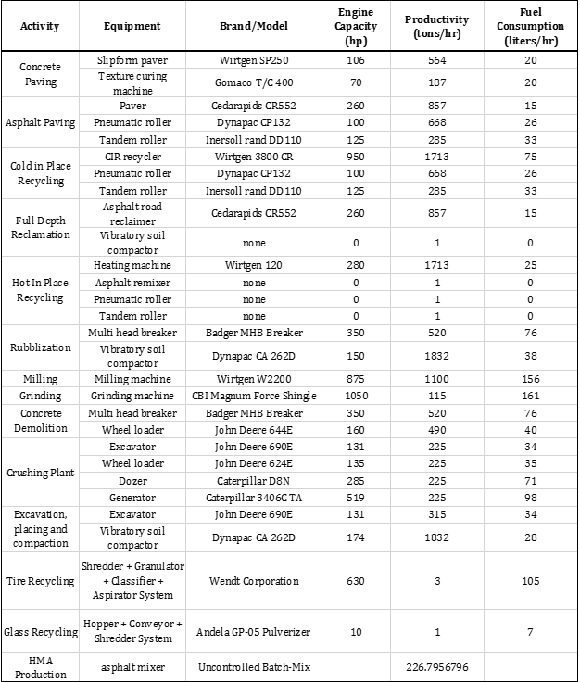
Single-unit recycling train PaLATE Equipment
Inventory- Equipment

Slide 36
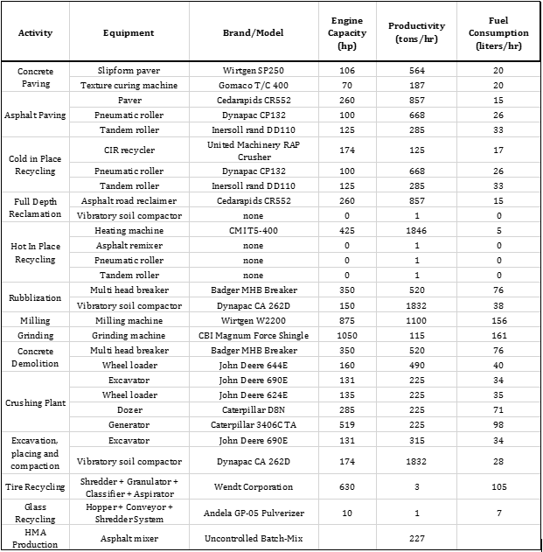
Multi-unit recycling train PaLATE Equipment Run 1
Inventory- Equipment

Slide 37
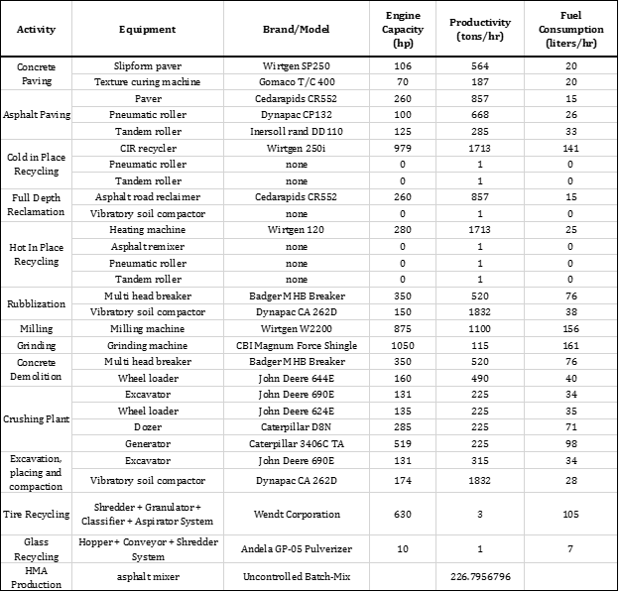
Multi-unit recycling train PaLATE Equipment Run 2
Inventory- Equipment

Slide 38
Weighted Percent Reduction Calculation
Step 1. Calculate the Weighted Overall impact of the Material Production savings
[Energy usage in Material Production (MOL)- Energy usage in Material Production (CIR)]/ (Total Energy Usage MOL - Total Energy Usage CIR)
= Weighted Overall Impact of Material Production Savings
Step 2. Calculate Weighted Percent Reduction for the Material Production Savings
Material Productions Energy usage
[Energy usage in Material Production (MOL)- Energy usage in Material Production (CIR)]*[Weighted Overall Impact of Material Production Savings]/[ Energy usage in Material Production (MOL)-]
Step 3. Repeat Steps 1 and 2 for Transportation Savings
Step 4. Repeat Steps 1 and 2 for Construction Savings
Step 5. Add the Weighted Percent Reductions to get the total Percent Reduction Savings for that environmental parameter (i.e. Energy Usage)
Step 6. Repeat Steps 1-5 for Water Usage, and Carbon Dioxide Emissions

Slide 39
Example Project Projections
Hauling Distance (miles) | Project Length (miles) | Road Width (ft) | MOL HMA Thickness (inches) | CIR HMA Thickness (inches)
10 | 5 | 30 | 4.5 | 2
N/A | 8800 | 10 | 0.125 | 0.0556 | Converted to yards
Volume of MOL HMA= Length*Width*Thickness
= (8800 yards)*(10 yards)*(0.125 yards)
= 11000 CY
Volume of CIR HMA= (8800 yards)*(10 yards)*(0.0556 yards)
= 4893 CY
Volume of HMA Avoided= (Volume of MOL HMA) - (Volume of CIR HMA)
= 11000-4893 = 6107 CY
X-variable= (Volume of HMA Avoided)/(Hauling Distance)
= (6107 CY)/(10 miles)
= 610.7 CY per mile
Estimated Energy Savings, using equations from All Projects Projections
Energy savings= 3620.6*X = 3620.6*(610.7) = 2,211,100 kWh
Estimated Water Savings.
Water savings= 0.0047*X = 0.0047*(610.7) = 2.9 tons
Estimated Carbon Dioxide Savings.
Carbon Dioxide savings= 0.7522*X = 0.7522*(610.7) = 459.4 tons

Slide 40
CTH H (Reedsburg to Wisconsin Dells)
CTH H Project ID | 8957-00-70
Construction Year | 2015
County | Sauk
Contractor | Mathy
Project Length (miles) | 9.5
Hauling Distance (miles) | 5.3
Road Width (feet) | 30
Mill and Overlay HMA Thickness (inches) | 4.5
Cold In-Place Recycling Thickness (inches) | 4
Cold In-Place Recycling HMA Thickness (inches) | 3.5
RAP Hauled Away during CIR (CY) | 0
Binder (%) | 5.2

Slide 41
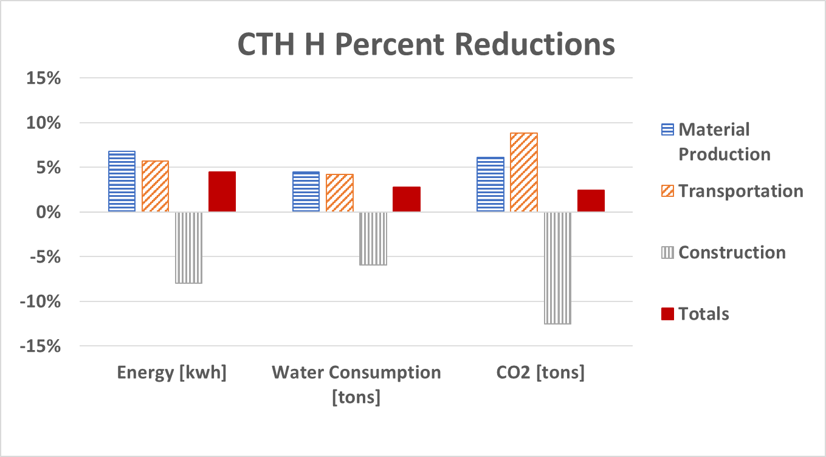
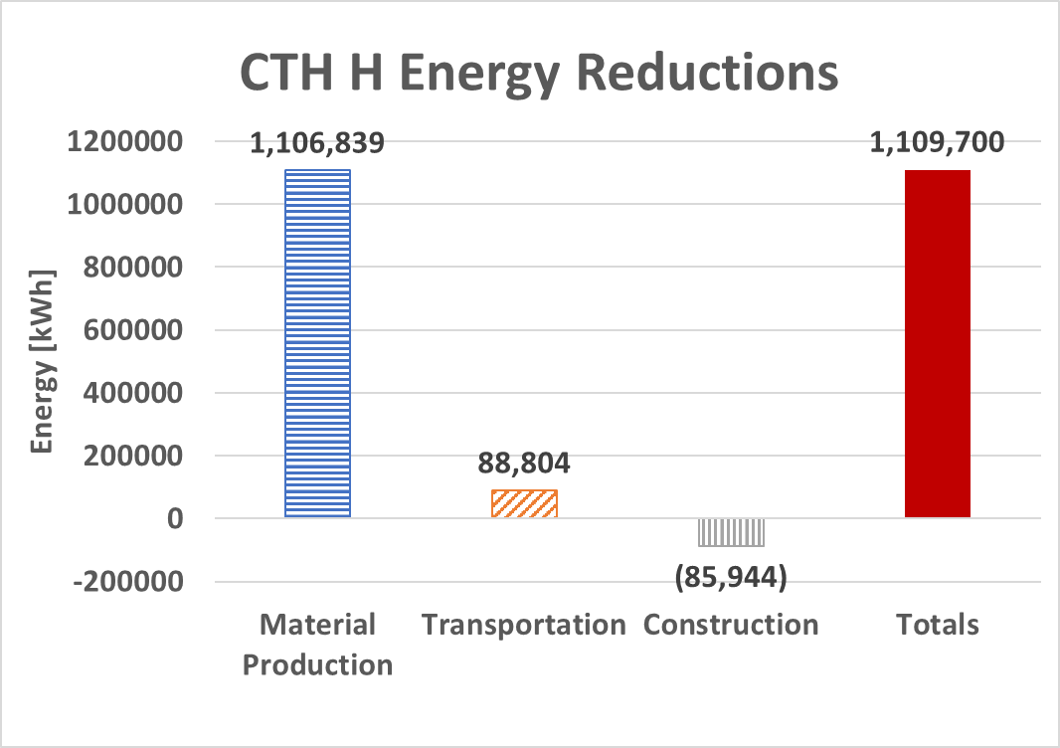
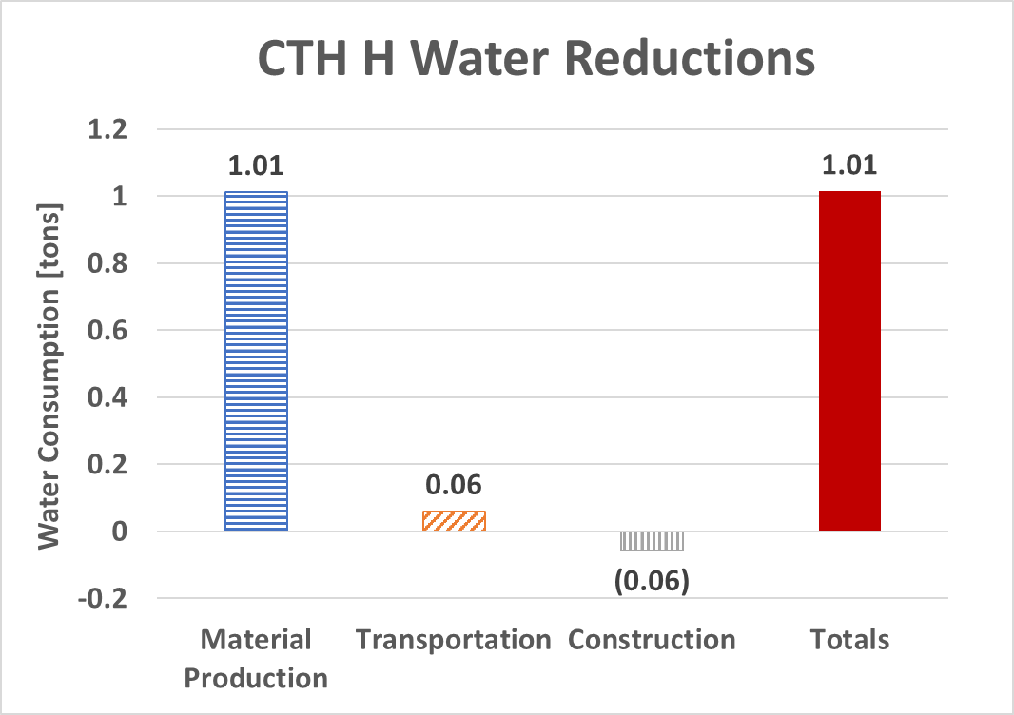
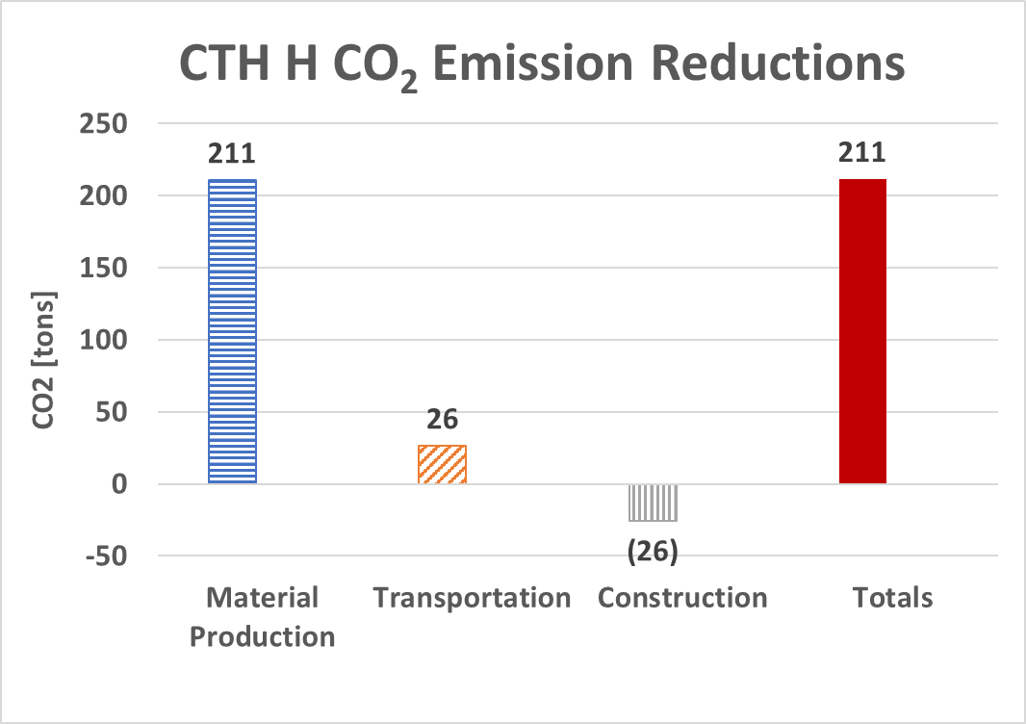
CTH H in Sauk County
9.5-mile project from Reedsburg to Wisconsin Dells
Completed in 2015 by Mathy
4 inches of CIR under 3.5 inches of new HMA overlay
5.3-mile hauling distance
Multi- and single-unit recycling train used, considered a multi-unit

Slide 42
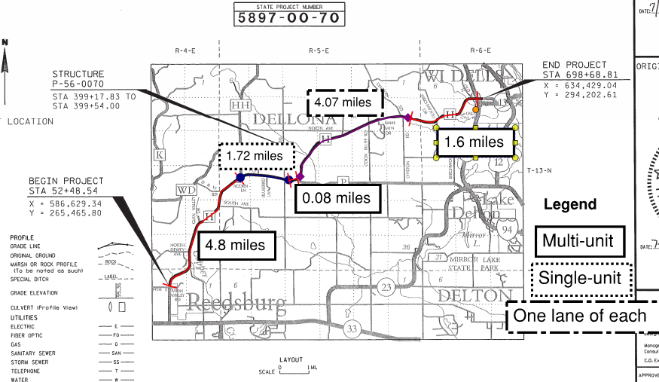
CTH H as a 9.5-mile Multi-unit recycling train project

Slide 43
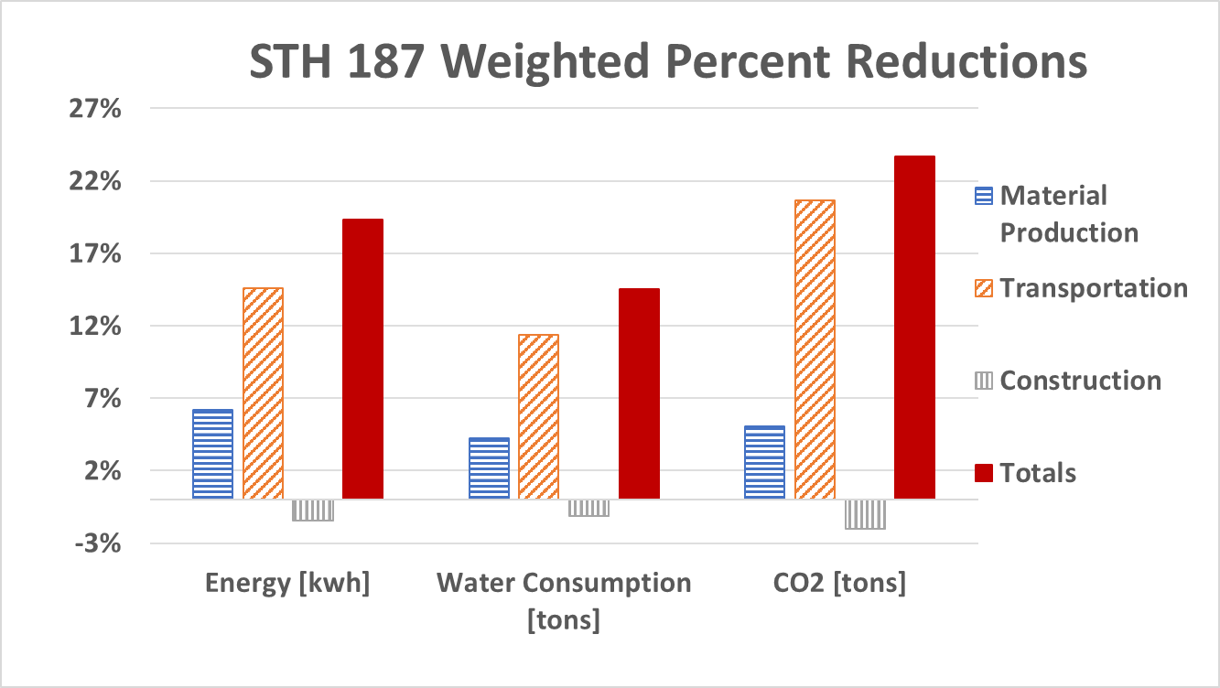
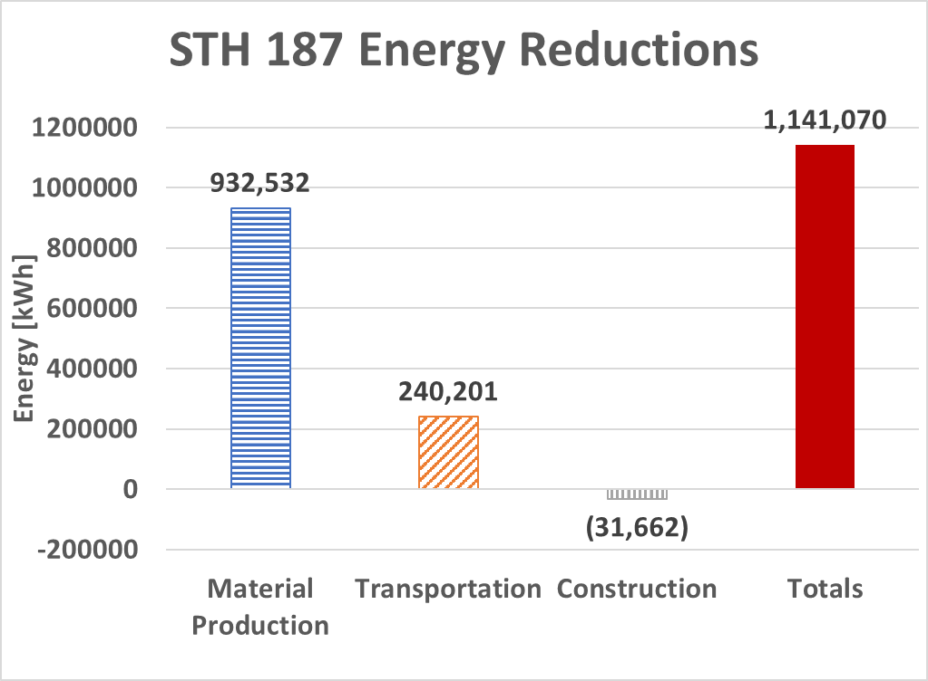
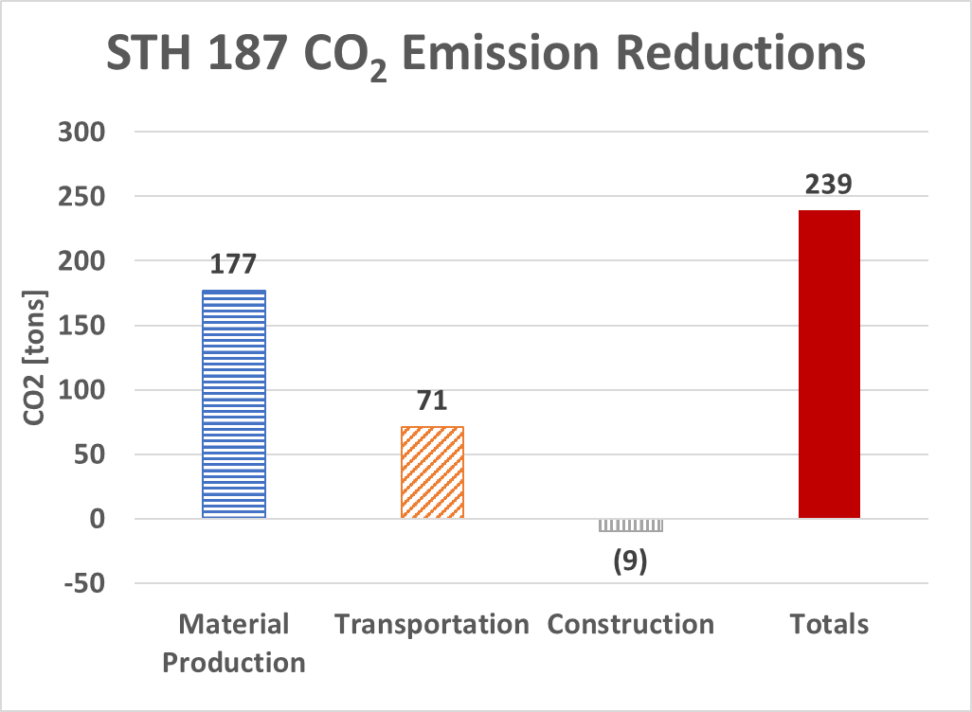
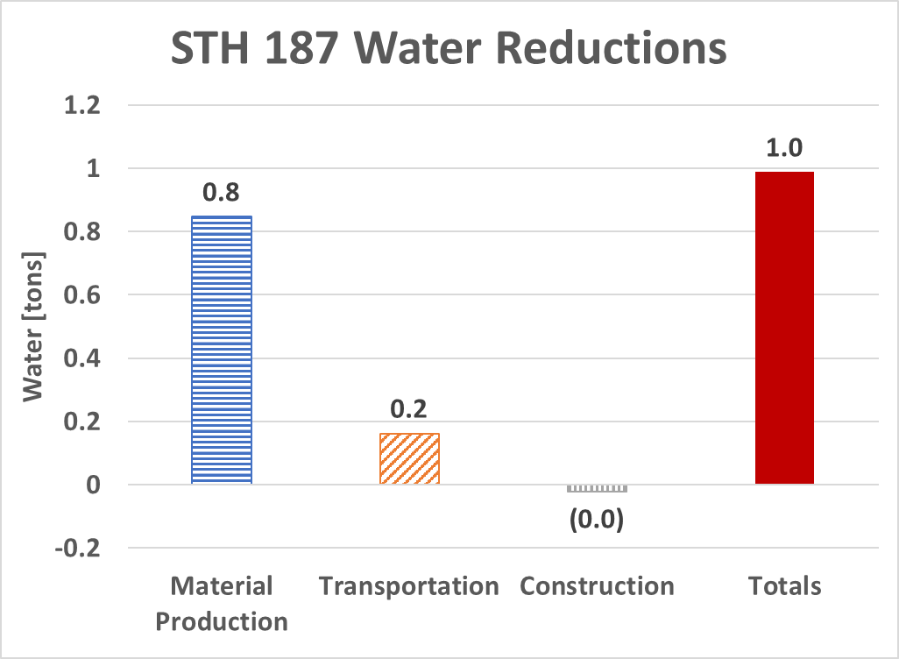
STH 187 in Outagamie County
9.84-mile project from Shiocton to the North County Line
Completed in 2016 by Mid States Reclamation and North East Asphalt
3 inches of CIR under 2.5 inches of new HMA overlay
21.3-mile hauling distance
Multi-unit recycling train

Slide 44
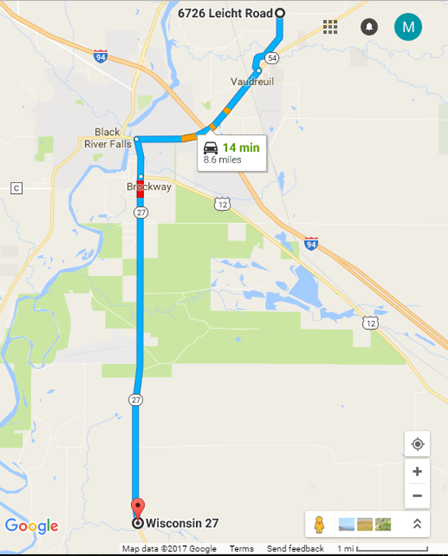
STH 27 (Sparta to Black River Falls)
Project ID | 7062-05-71
Construction Year | 2016
County | Jackson
Contractor | Mathy
Project Length (miles) | 9.00
Hauling Distance (miles) | 8.7
Road Width (feet) | 30
Mill and Overlay HMA Thickness (inches) | 4
Cold In-Place Recycling Thickness (inches) | 4
Cold In-Place Recycling HMA Thickness (inches) | 2.25
RAP Hauled Away during CIR (CY) | 9,206
Binder (%) | 5.4

Slide 45
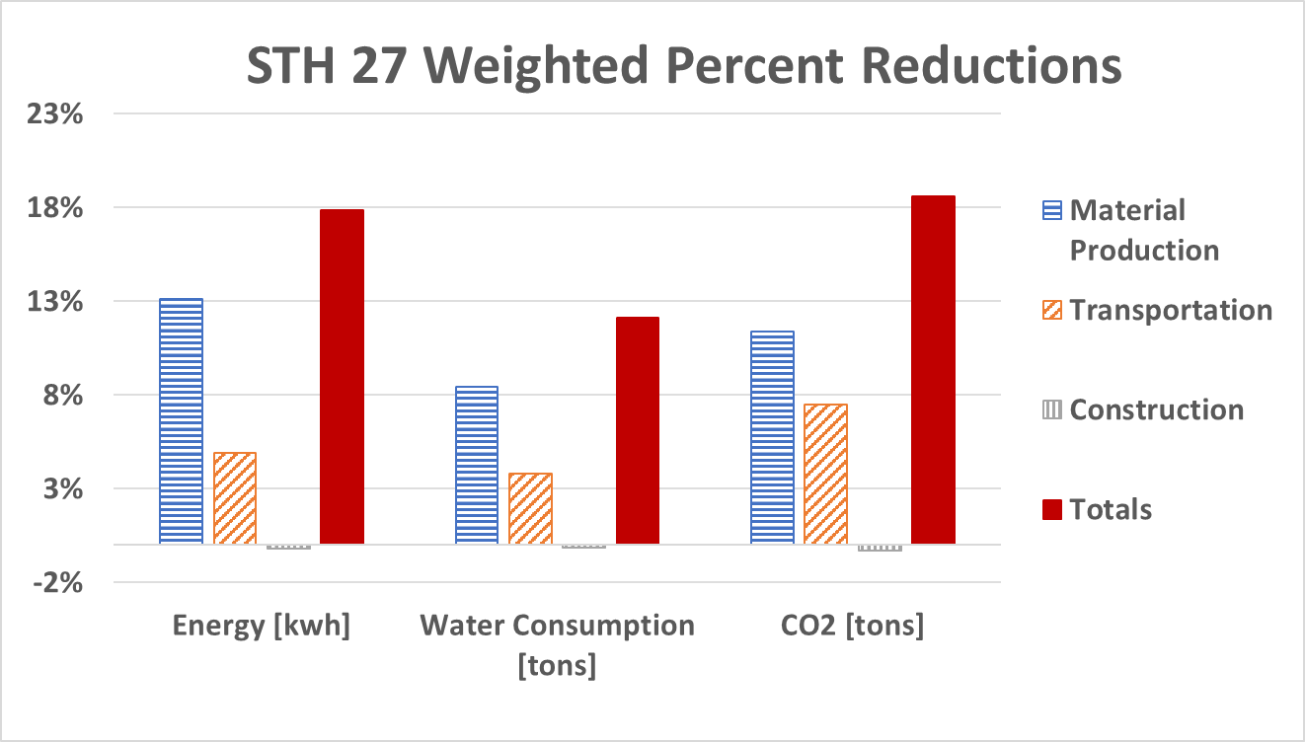
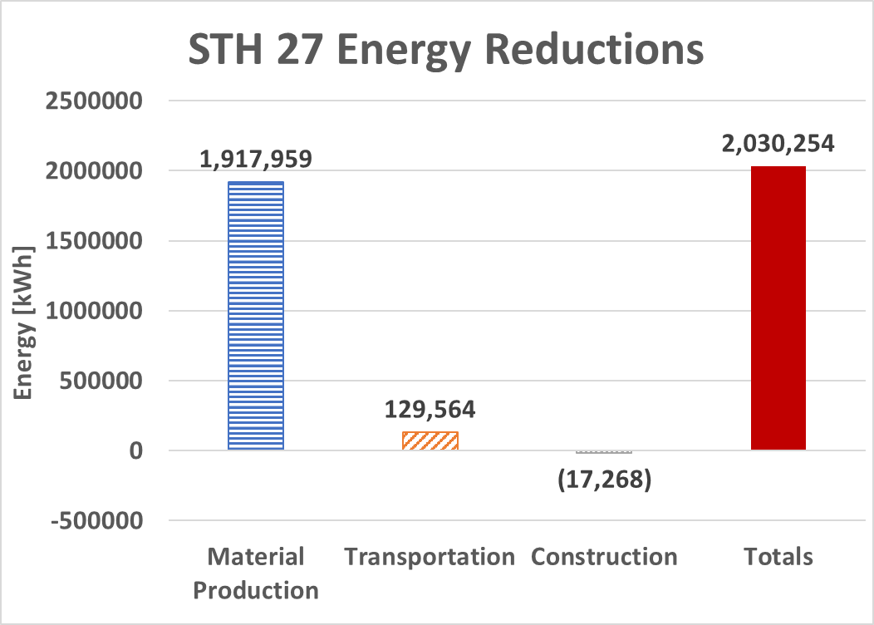
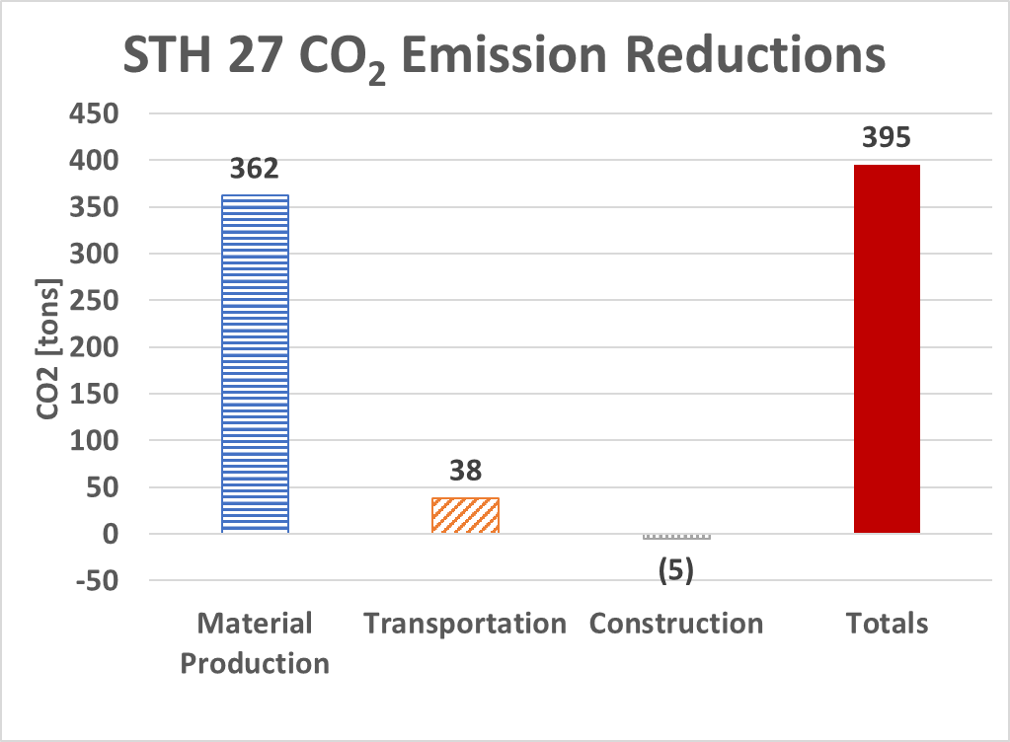
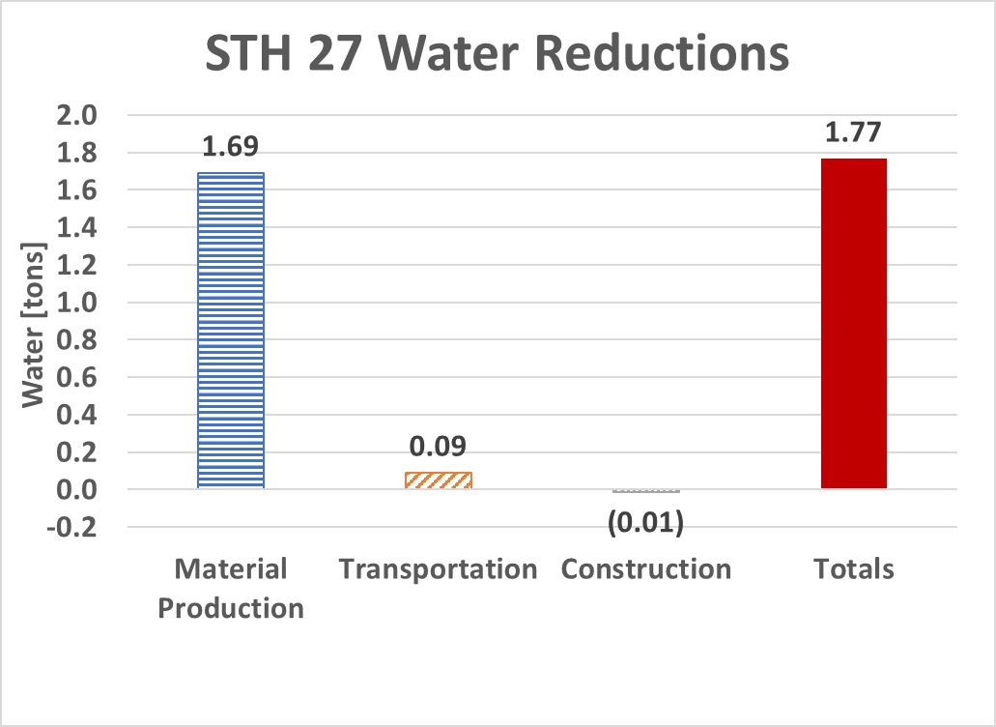
STH 27 in Jackson County
9.0-mile project from Sparta to Black River Falls
Completed in 2016 by Mathy
4 inches of CIR under 2.25 inches of new HMA overlay
8.7-mile hauling distance
Single-unit recycling train

Slide 46
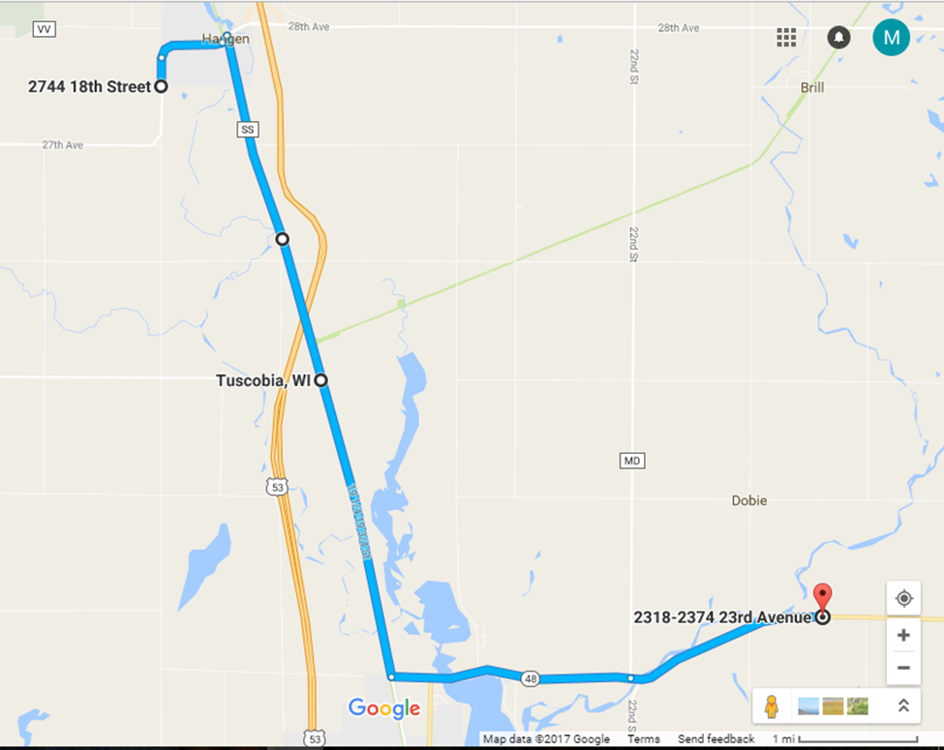
STH 48 (Rice Lake to Birchwood)
Project ID | 8570-03-70
Construction Year | 2015
County | Barron
Contractor (CIR | WK
Contractor (HMA) | HMA
Project Length (miles) | 8.1
Hauling Distance (miles) | 10.3
Road Width (feet) | 30
Mill and Overlay HMA Thickness (inches) | 4
Cold In-Place Recycling Thickness (inches) | 3
Cold In-Place Recycling HMA Thickness (inches) | 2
RAP Hauled Away during CIR (CY) | 8,898
Binder (%) | 5.6

Slide 47
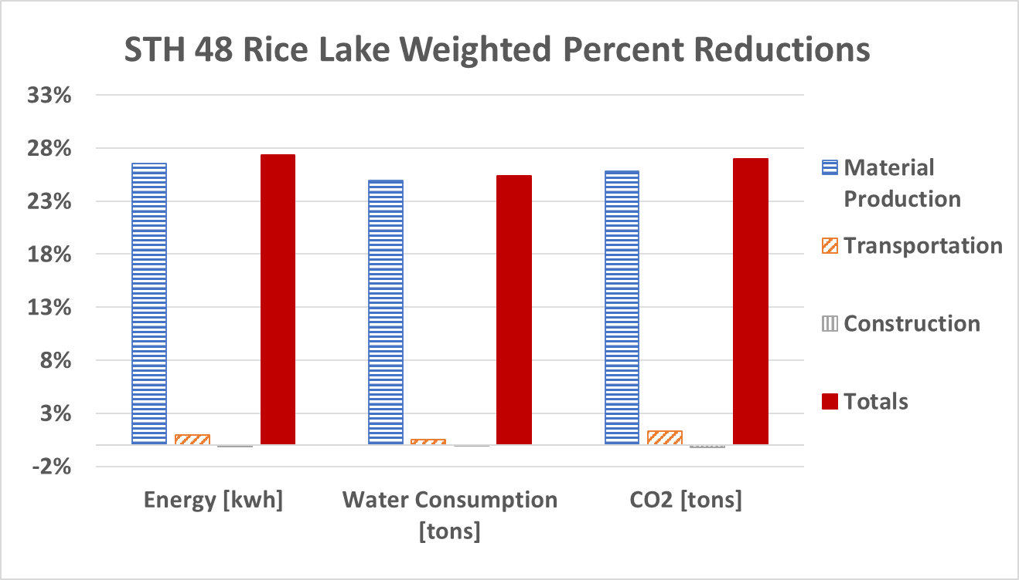
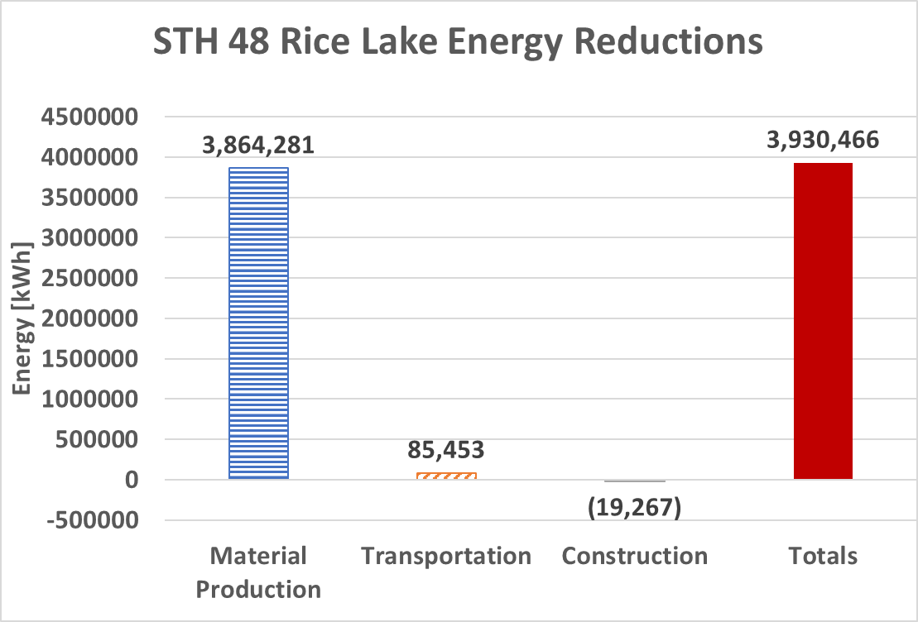
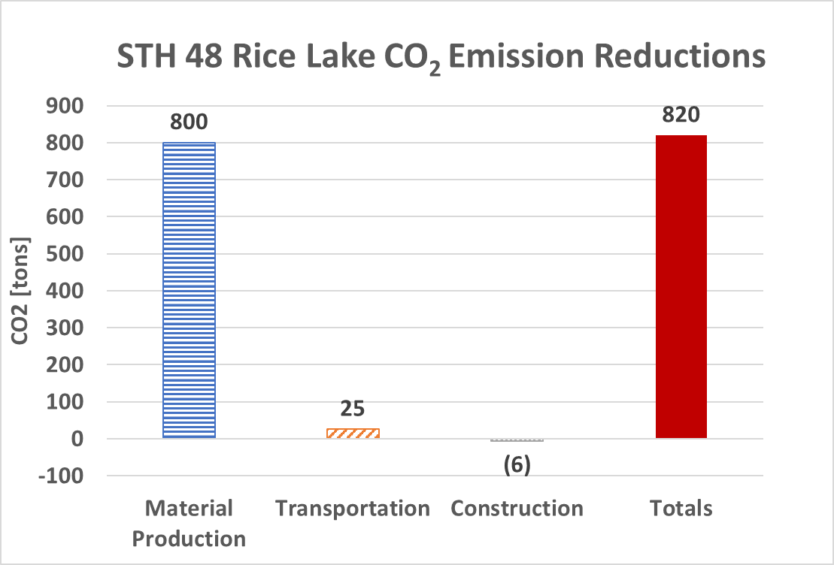
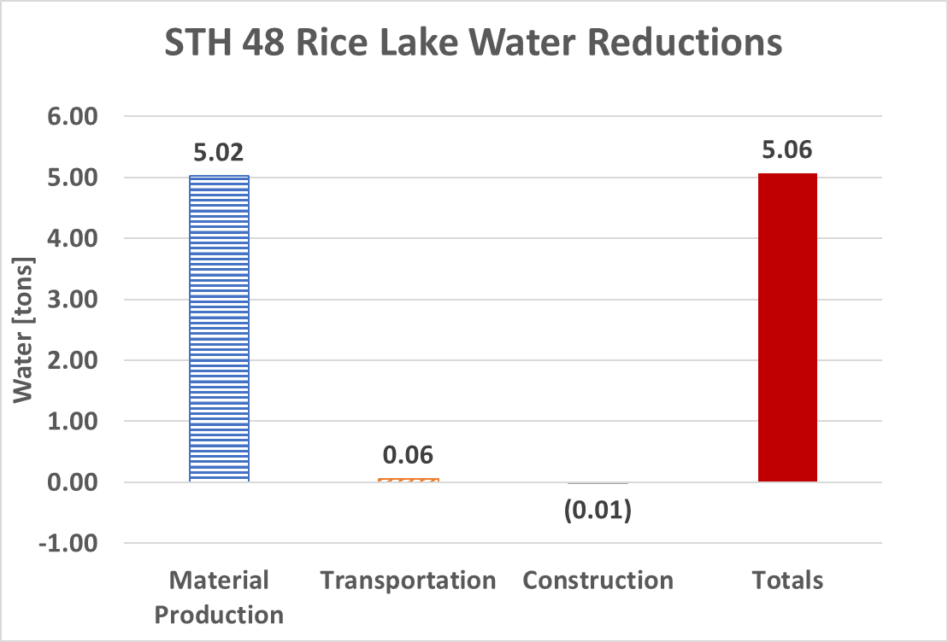
STH 48 Rice Lake in Barron County
8.1-mile project from Rice Lake to Birchwood
Completed in 2015 by WK and Mathy
3 inches of CIR under 2 inches of new HMA overlay
10.3-mile hauling distance
Multi-unit recycling train

Slide 48
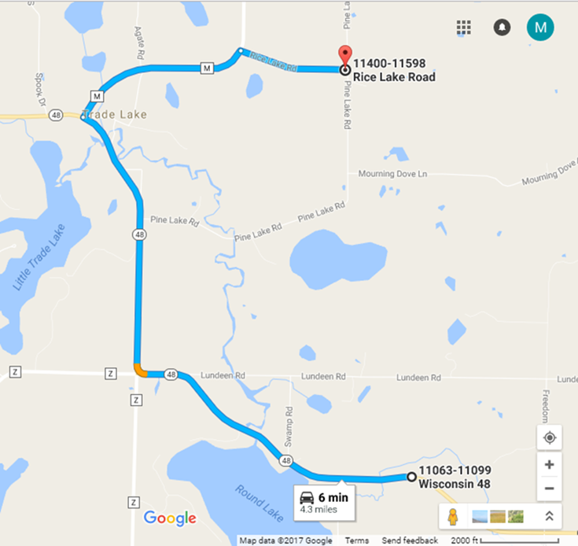
STH 48 (Grantsburg to Frederic)
Project ID | 8845-14-60
Construction Year | 2012
County | Burnett/Polk
Contractor (CIR | WK (CIR)
Contractor (HMA) | Mathy (HMA)
Project Length (miles) | 12.5
Hauling Distance (miles) | 4.3
Road Width (feet) | 24
Mill and Overlay HMA Thickness (inches) | 4
Cold In-Place Recycling Thickness (inches) | 4
Cold In-Place Recycling HMA Thickness (inches) | 2.25
RAP Hauled Away during CIR (CY) | 10,382
Binder (%) | 5.5

Slide 49
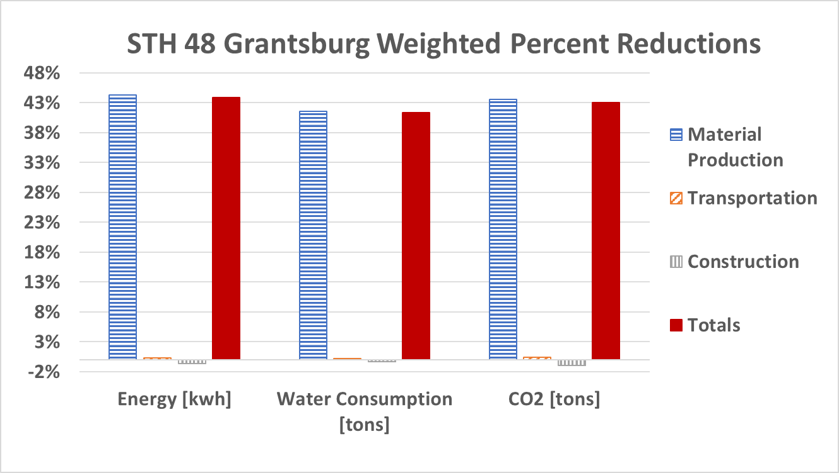
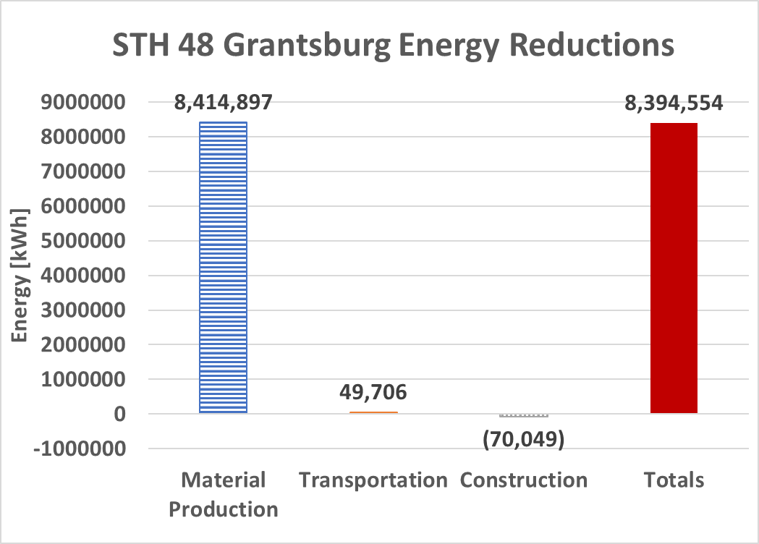


STH 48 Grantsburg in Burnett and Polk Counties
12.5-mile project from Grantsburg to Frederic
Completed in 2012 by WK and Mathy
4 inches of CIR under 2.25 inches of new HMA overlay
4.3-mile hauling distance
Multi-unit recycling train

Slide 50

STH 64 (Gilman to Medford)
Project ID | 8220-05-72
Construction Year | 2014
County | Taylor
Contractor (CIR | WK
Contractor (HMA) | Mathy
Project Length (miles) | 4.46
Hauling Distance (miles) | 3.7
Road Width (feet) | 30
Mill and Overlay HMA Thickness (inches) | 4
Cold In-Place Recycling Thickness (inches) | 4
Cold In-Place Recycling HMA Thickness (inches) | 2.25
HMA Hauled Away during CIR (CY) | 5,426
Binder (%) | 5.8

Slide 51




STH 64 Grantsburg in Taylor County
4.5-mile project from Gilman to Medford
Completed in 2012 by WK and Mathy
4 inches of CIR under 2.25 inches of new HMA overlay
3.7-mile hauling distance
Multi-unit recycling train

Slide 52

STH 72 (Ellsworth to Elmwood)
Project ID | 7105-06-70
Construction Year | 2016
County | Pierce
Contractor (CIR) | WK
Contractor (HMA) | Mathy
Project Length (miles) | 4.63
Hauling Distance (miles) | 18.3
Road Width (feet) | 30
Mill and Overlay HMA Thickness (inches) | 4
Cold In-Place Recycling Thickness (inches) | 4
Cold In-Place Recycling HMA Thickness (inches) | 2.25
HMA Hauled Away during CIR (CY) | 0
Binder (%) | 5.9

Slide 53




STH 72 in Pierce County
4.63-mile project from Ellsworth to Elmwood
Completed in 2016 by WK and Mathy
4 inches of CIR under 2.25 inches of new HMA overlay
18.3-mile hauling distance
Multi-unit recycling train

Slide 54

STH 95 (Blair to Merrillan)
Project ID | 7560-06-70
Construction Year | 2015
County | Trempealeau
Contractor (CIR) | WK
Contractor (HMA) | Mathy
Project Length (miles) | 4.42
Hauling Distance (miles) | 24.4
Road Width (feet) | 30
Mill and Overlay HMA Thickness (inches) | 4
Cold In-Place Recycling Thickness (inches) | 4
Cold In-Place Recycling HMA Thickness (inches) | 2.5
HMA Hauled Away during CIR (CY) | 0
Binder (%) | 5.8

Slide 55




STH 95 in Trempealeau County
4.42-mile project from Blair to Merrillan
Completed in 2015 by WK and Mathy
4 inches of CIR under 2.5 inches of new HMA overlay
24.4-mile hauling distance
Multi-unit recycling train

Slide 56

STH 187 (Shiocton to North County Line)
Project ID | 6520-03-60
Construction Year | 2016
County | Outagamie
Contractor (CIR) | Mid States Reclamation
Contractor (HMA) | North East Asphalt
Project Length (miles) | 9.8
Hauling Distance (miles) | 21.3
Road Width (feet) | 30
Mill and Overlay HMA Thickness (in) | 4
Cold In-Place Recycling Thickness (in) | 3
Cold In-Place Recycling HMA Thickness (in) | 2.5
RAP Hauled Away during CIR (CY) | 5,575
Binder (%) | 5.5

