Slide 1


Workshop #3 -
Unbonded Concrete Overlays
Brett Trautman, P.E.
Construction & Materials Div.
Missouri DOT
NRRA Pavement Conference
Albertville, MN
May 23, 2017

Slide 2
Overlay Types
Unbonded Concrete Overlays over Concrete Pavement
Unbonded Concrete Overlays over Asphalt Pavement
Bonded Concrete Overlays over Asphalt Pavement (BCOA)
Bonded Concrete Overlays over Concrete Pavement (BCOC)

Slide 3
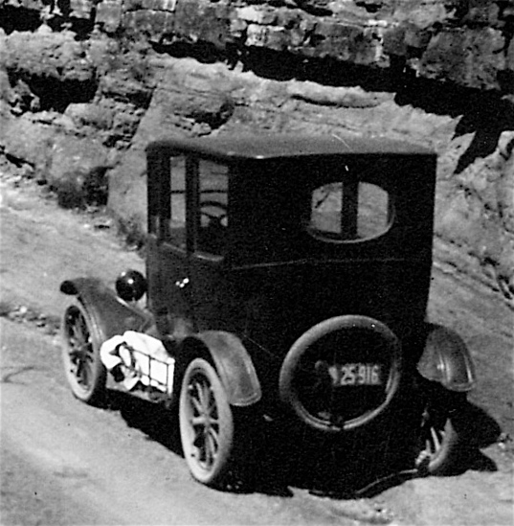
Early Beginnings
Missouri unbonded overlays date back to 1930s
21 projects from 1932 to 1970
First project on US 40 in Callaway County circa 1932

Slide 4
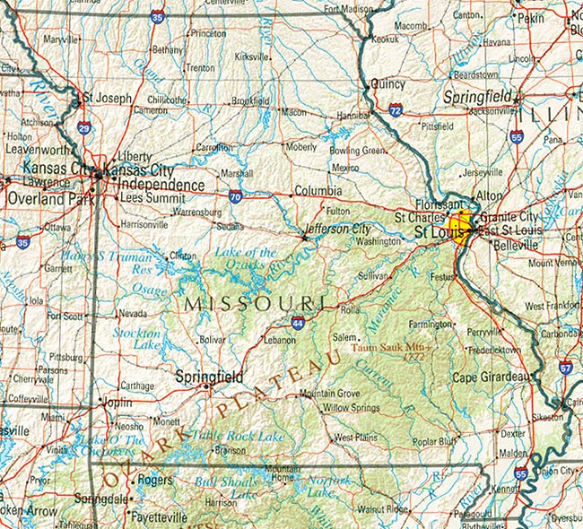
Early Beginnings
Over 12 miles paved on US 40 in Callaway and Montgomery Counties
Projects scattered all over the state

Slide 5

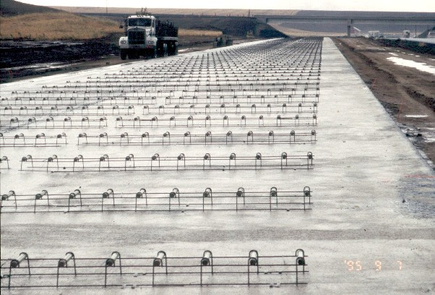
1981 Survey
Seven of 21 projects unsurfaced as of 1981
Overlay thickness from 4“ - 6“
Half doweled / half undoweled
Interlayer
Waterbound select material (1“ - 8“)
Cutback
Not sure

Slide 6
Current PCC Overlay
Generation
~ 20 conventional unbonded concrete overlay projects constructed since 1986 (all but 2 since 2000)
Primarily Interstate
Nearly all JPCP
Most ~ 8 inches thick
Placed over PCCP or composite pavement

Slide 7
Current PCC Overlay
Generation
Six ‘big block’ projects since 2006
Six ‘ultrathin’ (BCOA) projects since 1999
All have fibers
Four bonded PCC overlay (BCOC) projects since 1990
No fibers used

Slide 8
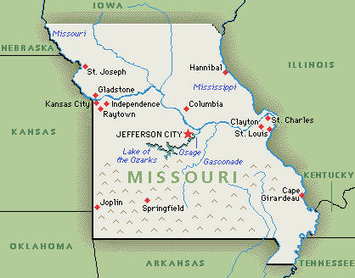

Slide 9
Approximately 5% of Missouri Interstate centerline miles have an unbonded concrete overlay.

Slide 10
Unbonded Concrete Overlays ‘Conventional’
Missouri Experience
I-55 in Pemiscot County
I-44 in Greene-Webster Counties

Slide 11
I-55 in Pemiscot County
First new generation
Constructed in 1986
Approximately 7.8 miles in SB lanes
9“ JRCP, 61.5’ joint spacing - Doweled
Milled existing AC overlay
No tied shoulders
Original PCC ~ 8“

Slide 12
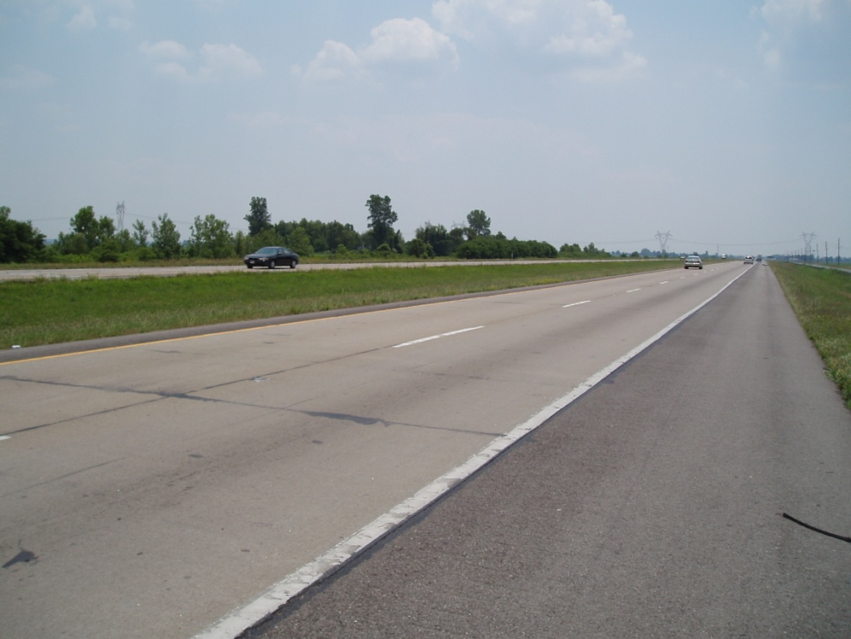
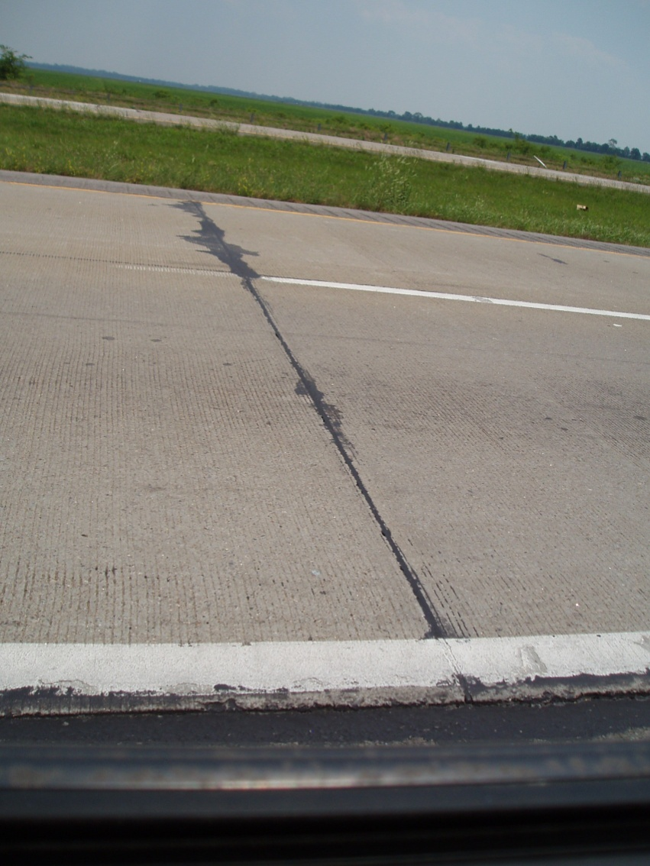
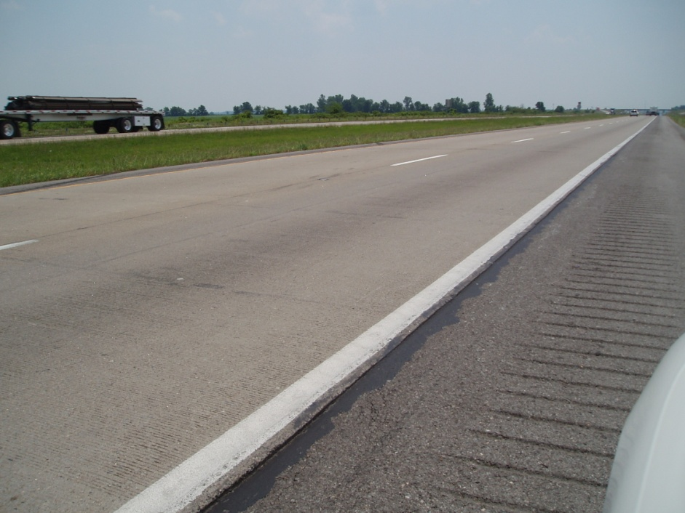
I-55 in Pemiscot County

Slide 13
I-55 in Pemiscot County
Overall Performance in 2004
  Ave. IRI = 110 (in/mile)
  Ave. Condition = 19.4 (out of 20)
Diamond ground in 2006
  Ave. IRI ~ 75 (in/mile)
Some full depth patching exists

Slide 14
I-44 in Greene-Webster Counties
First 8“ unbonded JPCP in Missouri
Constructed in 2000
Approximately 5.7 miles in WB lanes
15’ joint spacing - Doweled
Placed 1“ bondbreaker
Tied shoulders
Pavement diamond ground at time of construction

Slide 15
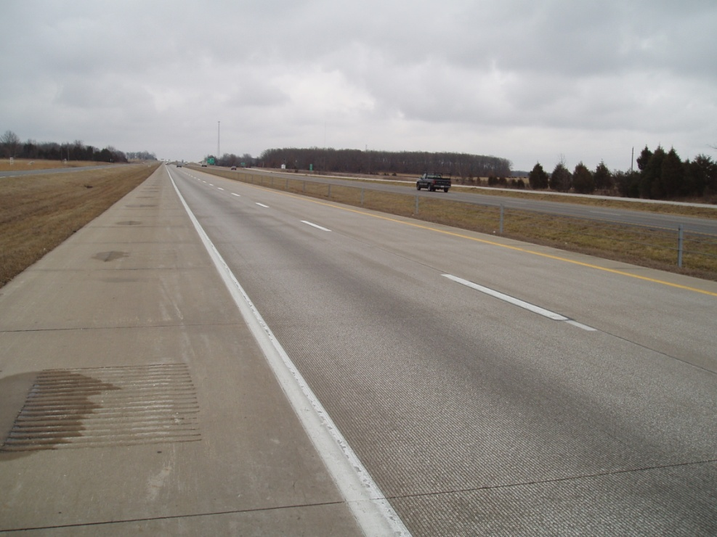
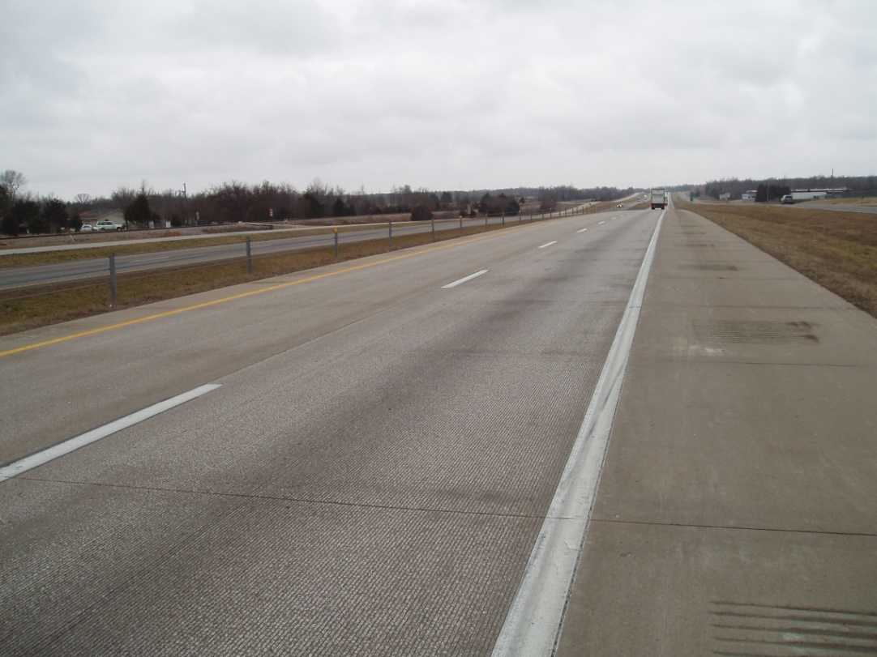
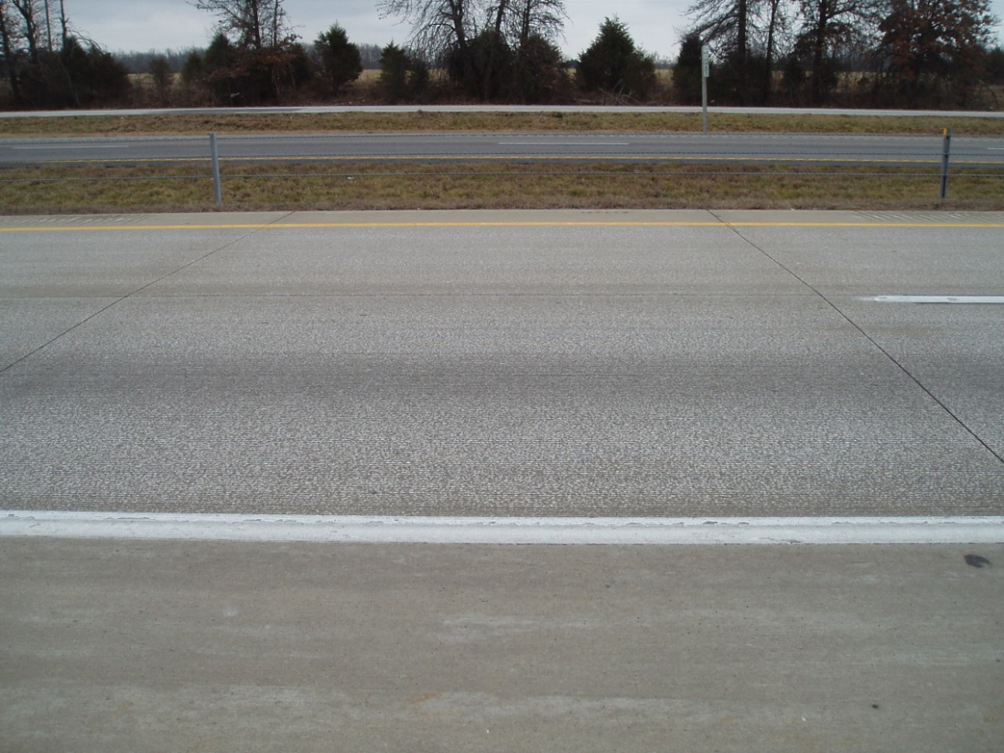
I-44 in Greene-Webster Counties

Slide 16
I-44 in Greene-Webster Counties
Ave. IRI after construction diamond grinding = 36.8 (in/mile)
Recent Performance
Ave. IRI = 38 (in/mile)
Ave. Condition = 19.9 (out of 20)
Very few patches
Grooved for skid resistance in 2010

Slide 17

Lessons Learned

Slide 18
Concrete Overlay Issues
Unbonded Concrete Overlay design thickness – Increase from 8” to 9” for high volume overlays is warranted

Slide 19
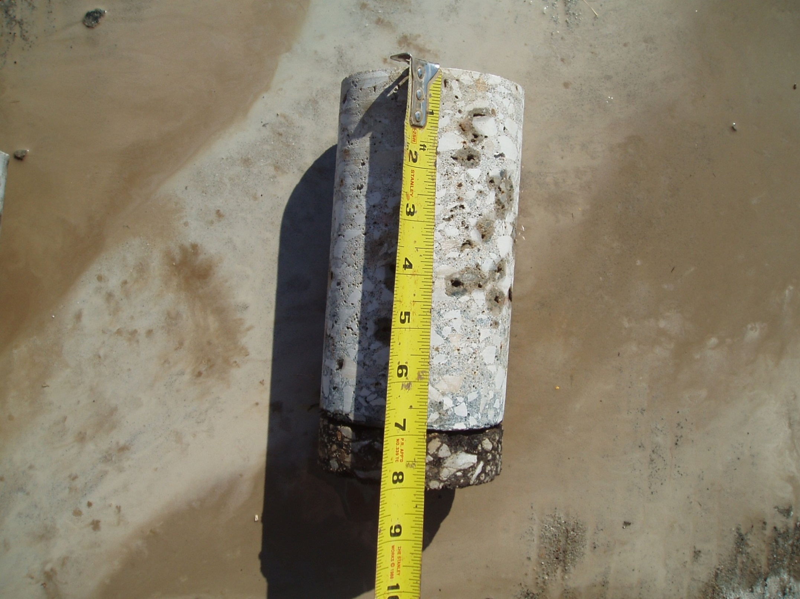

Slide 20
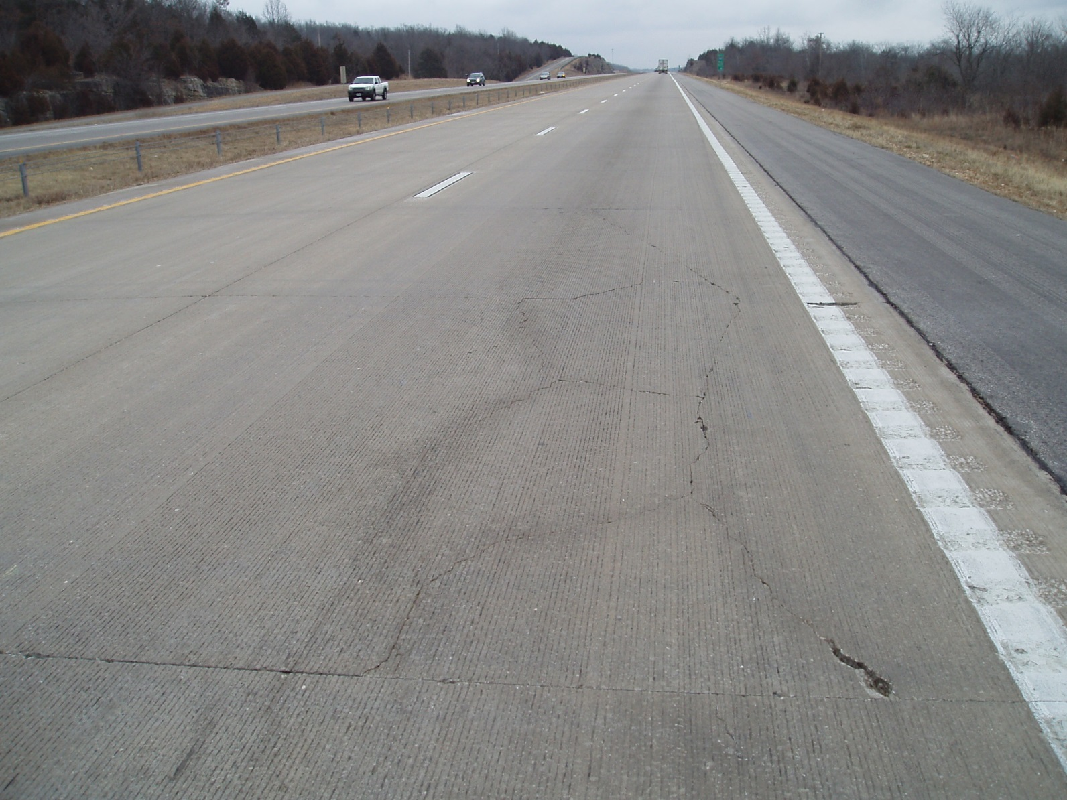

Slide 21
Thickness vs. % Cracking

Slide 22
Concrete Overlay Issues
Unbonded Concrete Overlay Interlayer – Stick with geotextile

Slide 23
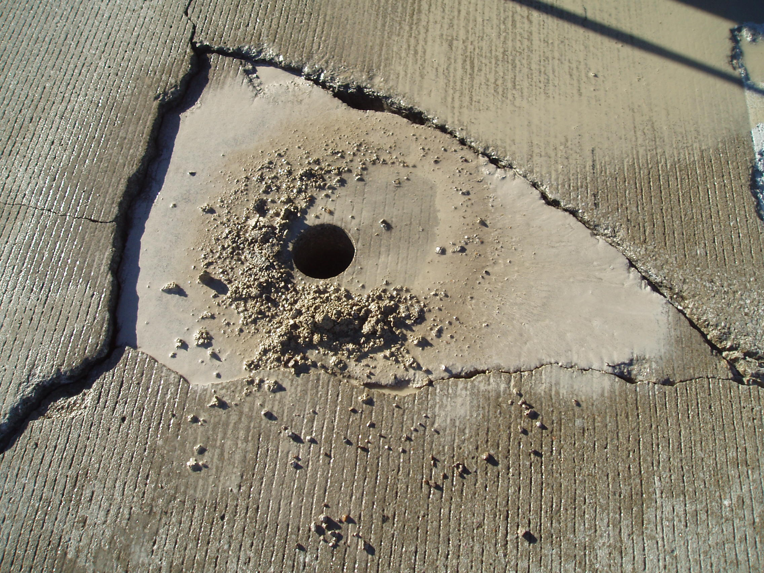

Slide 24
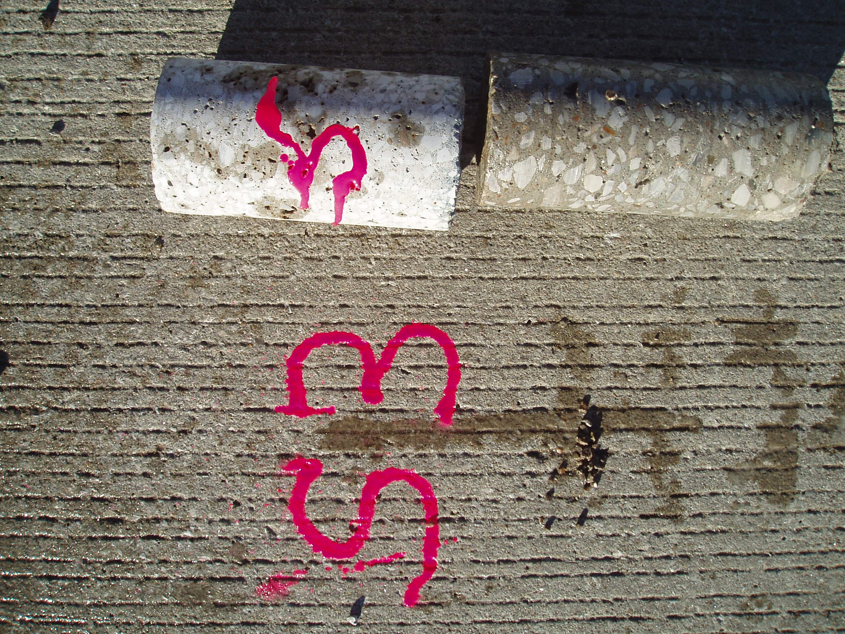

Slide 25
Concrete Overlay Issues
Widened slabs – Probably not a good idea

Slide 26
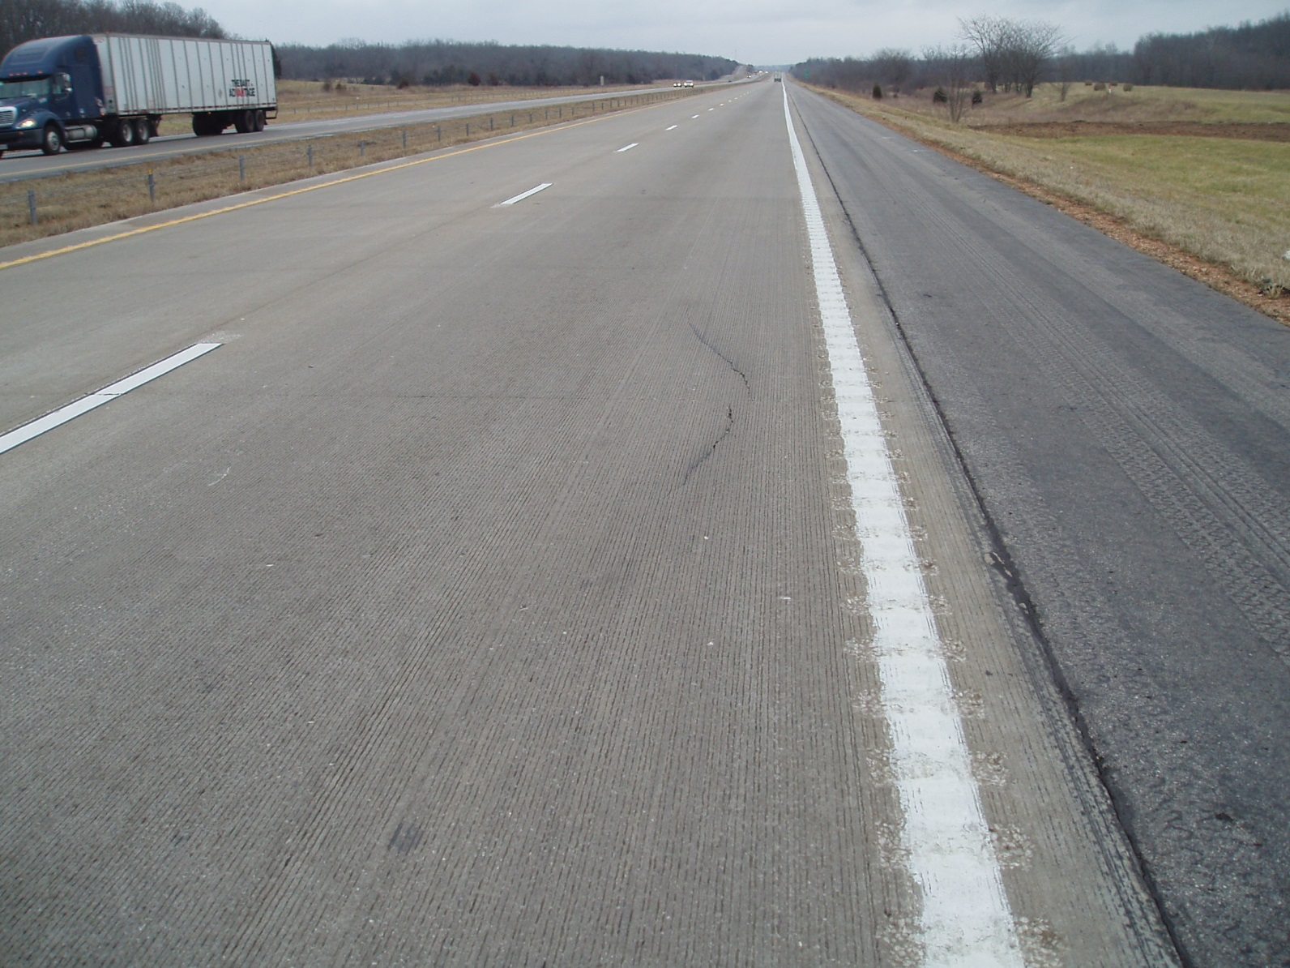
2’ widening

Slide 27
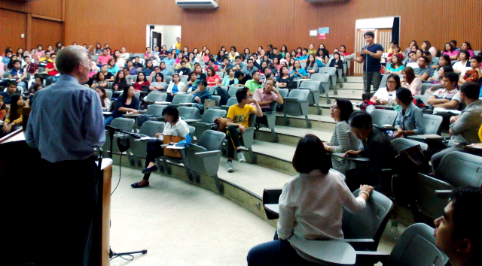
What experience have you had?

Slide 28
Unbonded Concrete Overlays
‘Big Block’
Missouri Experience
Route D in Cass County
- South of Kansas City
2) US 61 in Jefferson County

Slide 29
Route D in Cass County
9300 AADT (5 % trucks)
8-in PCC, 30-ft joints w/ 1-in dowels
Only 22 years old
  Severely deteriorated by D-cracking
  Estimated 25% of area required full depth repair prior to conventional HMA overlay

Slide 30
Route D in Cass County
5-inch minimum thickness
6-foot square panels
No steel
No fibers
Interlayer/Separation Layer Option
  Bituminous Layer
  Geotextile Fabric (selected – first in country - 2008)

Slide 31
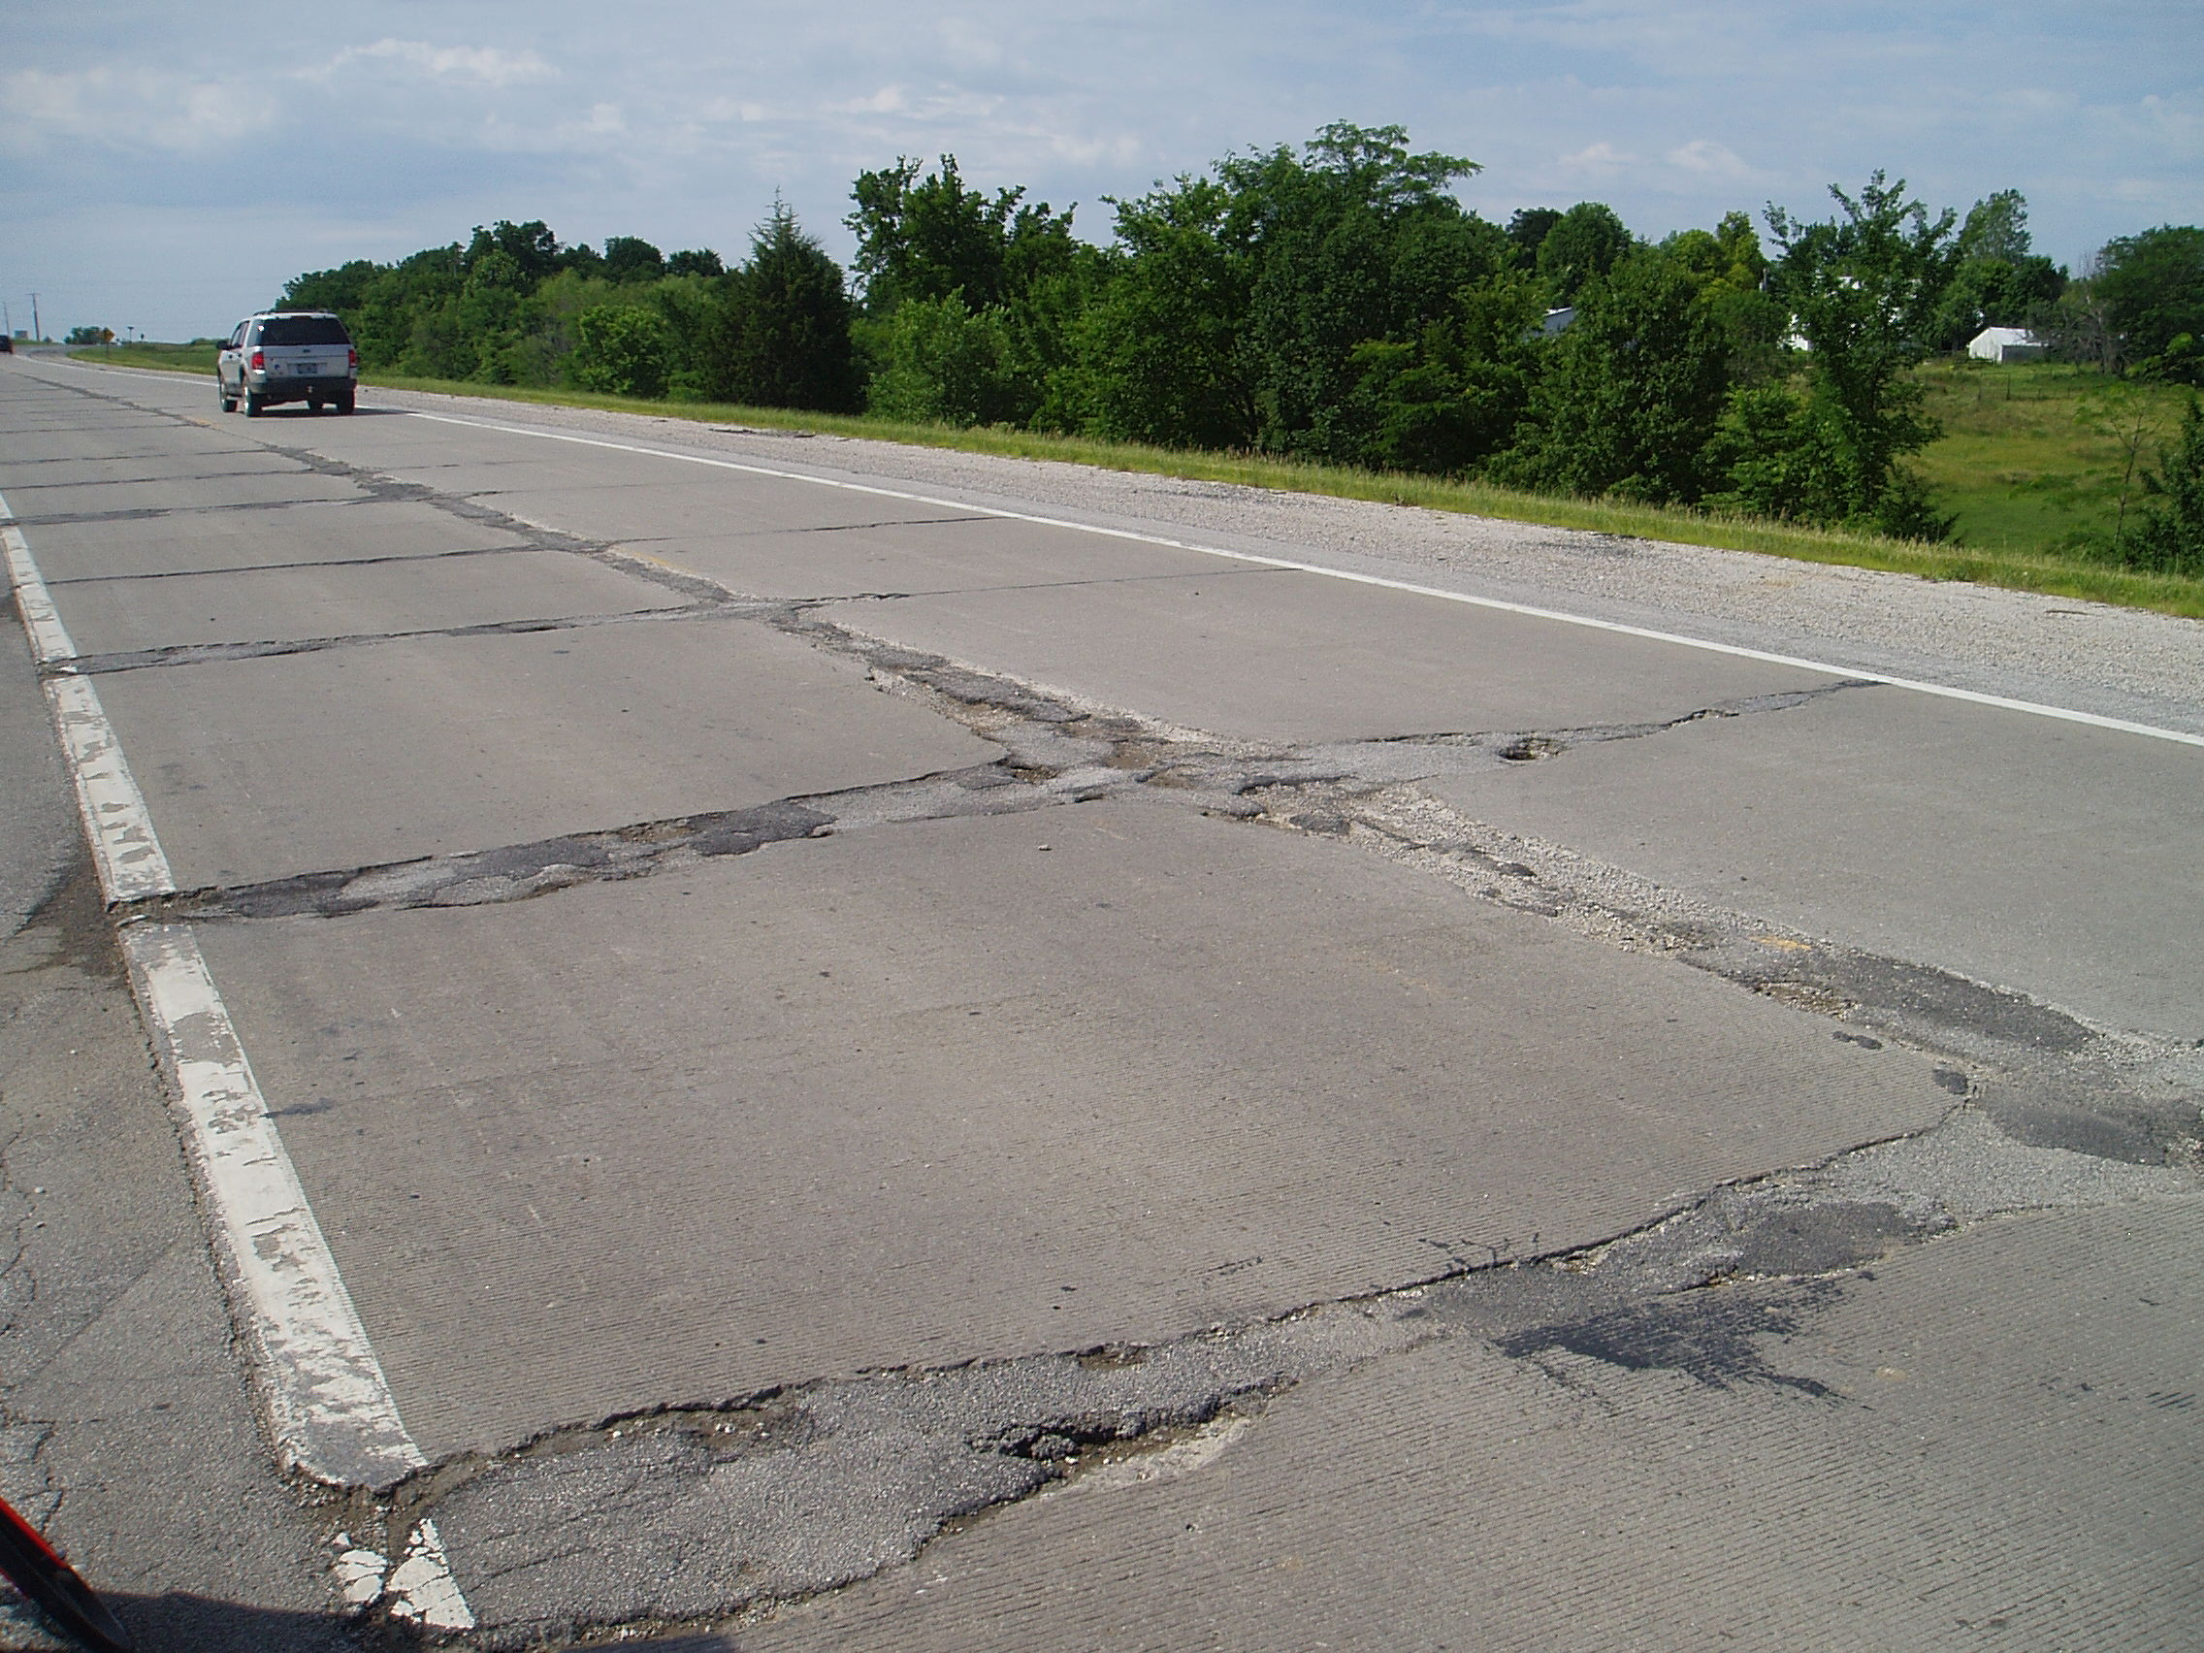
Existing Pavement Condition

Slide 32
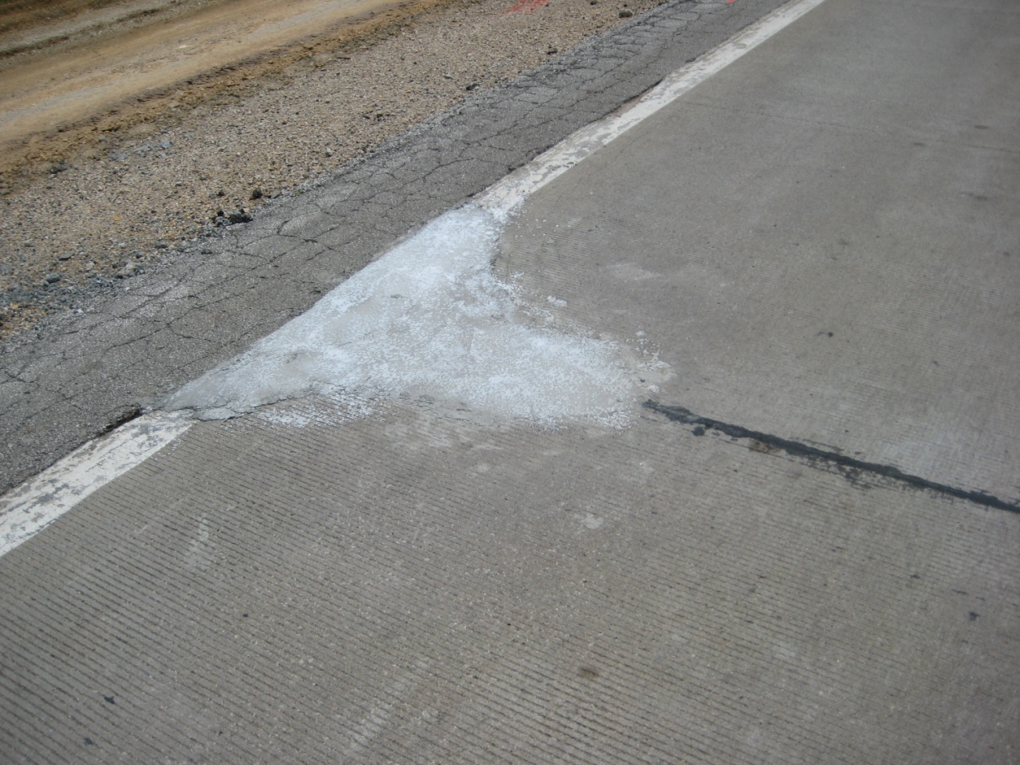
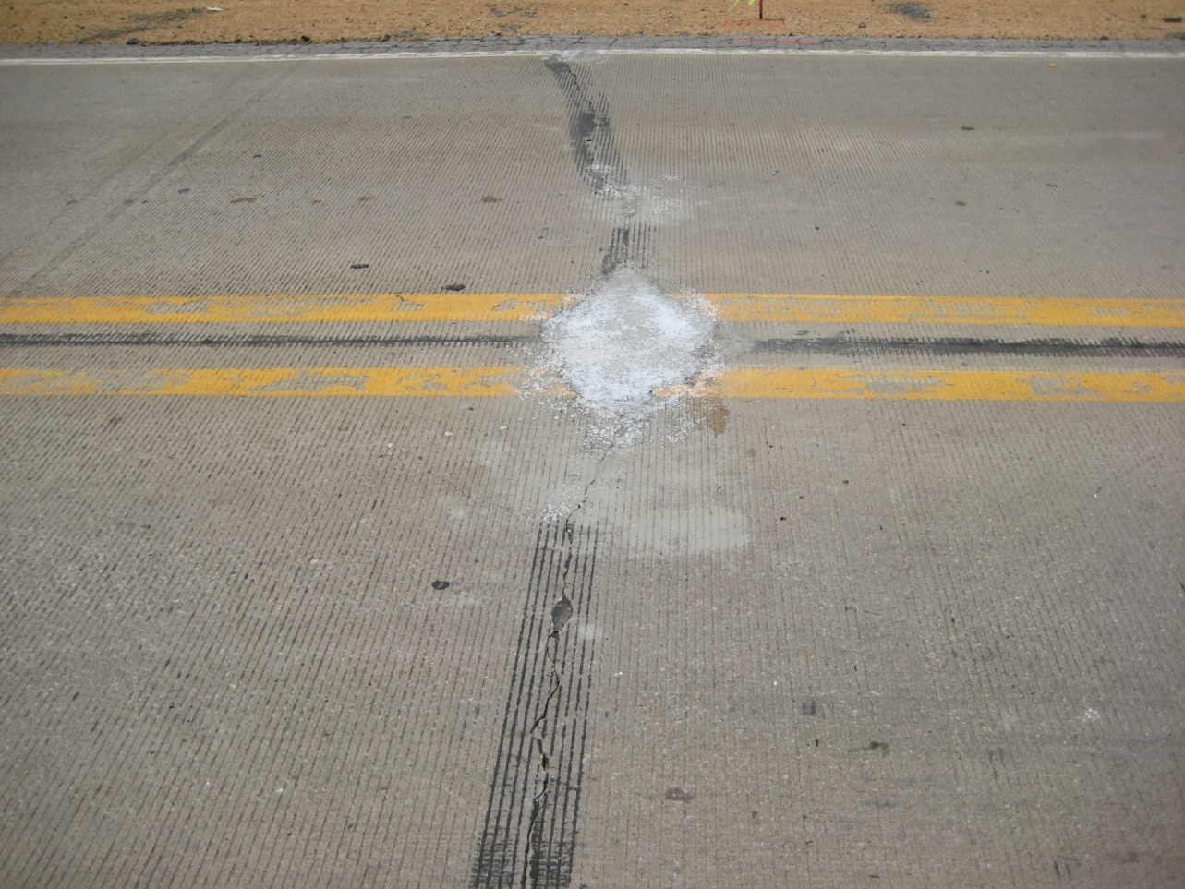
Pre-overlay repairs
Consist of bituminous, cementitious, or other materials meeting approval.

Slide 33
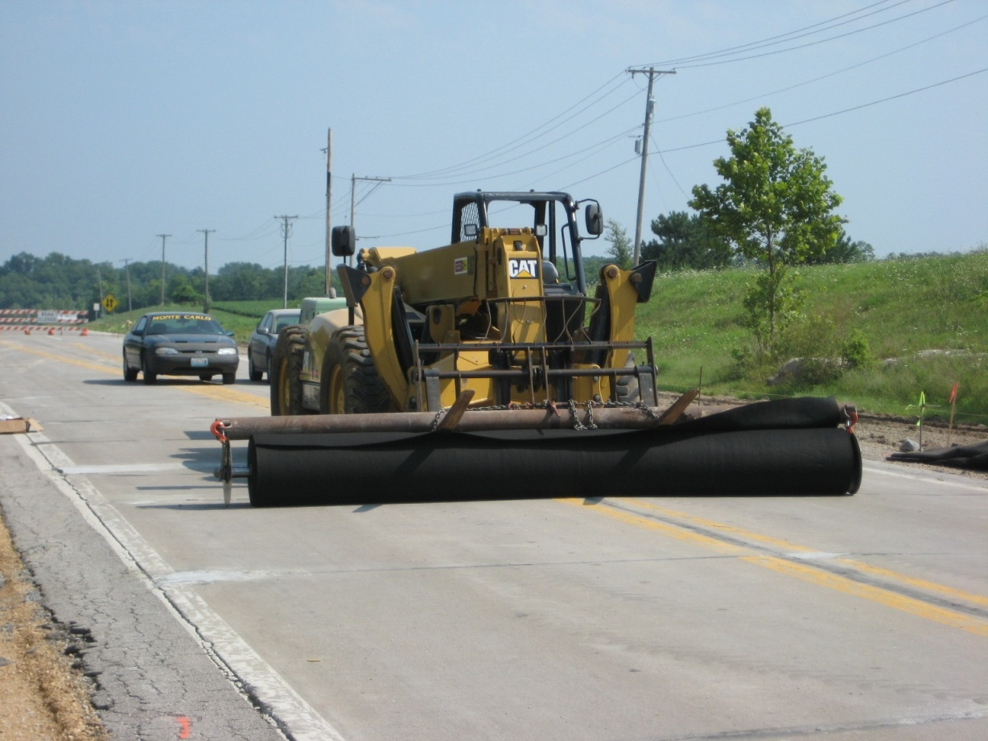
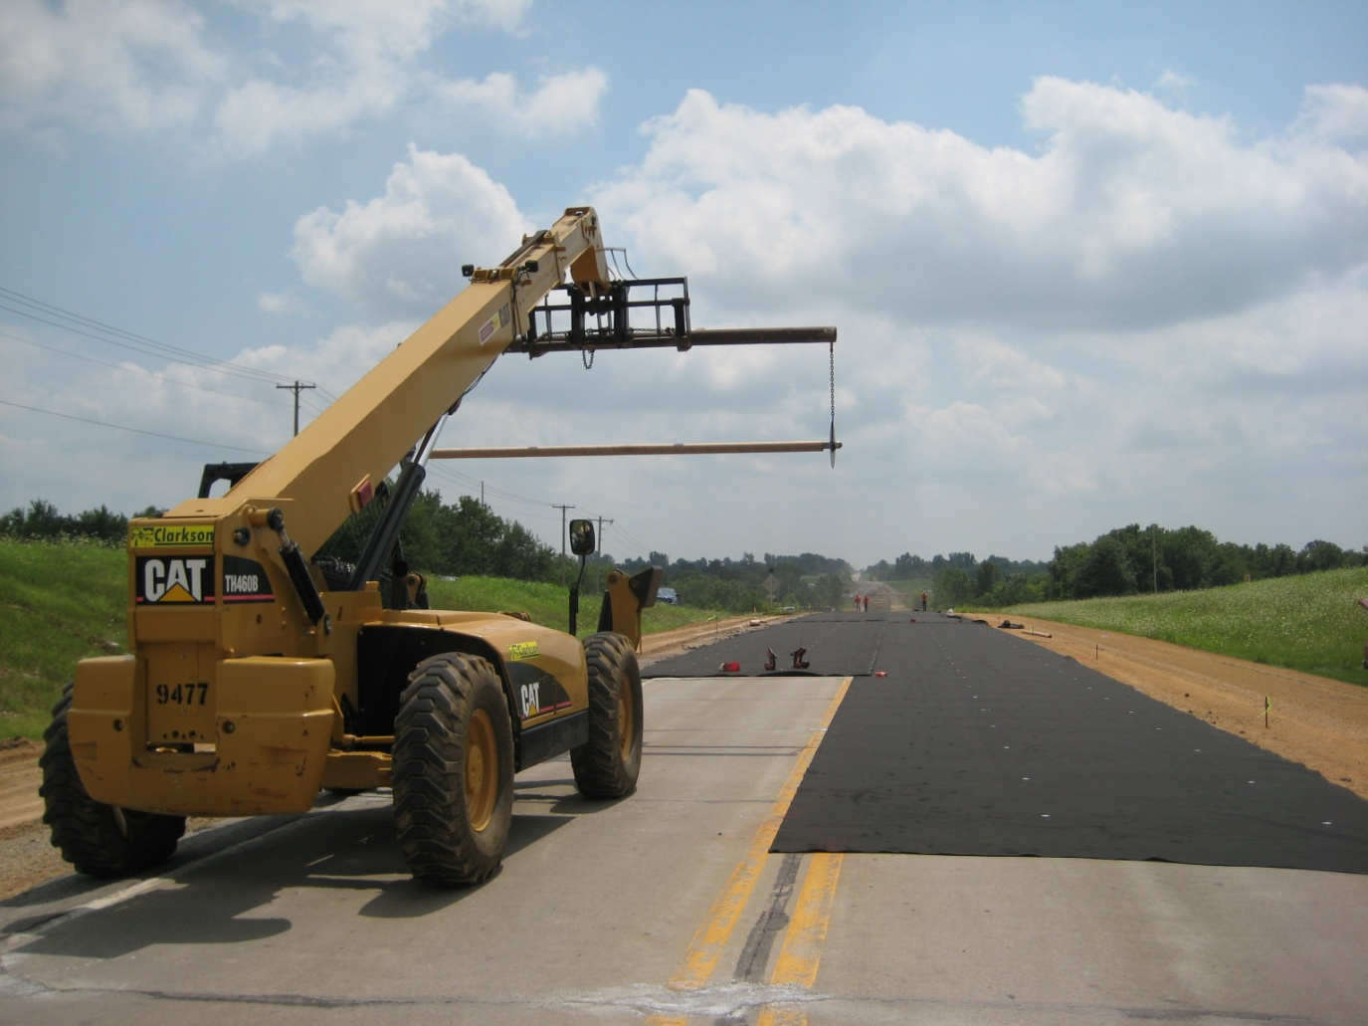
Fabric Placement

Slide 34
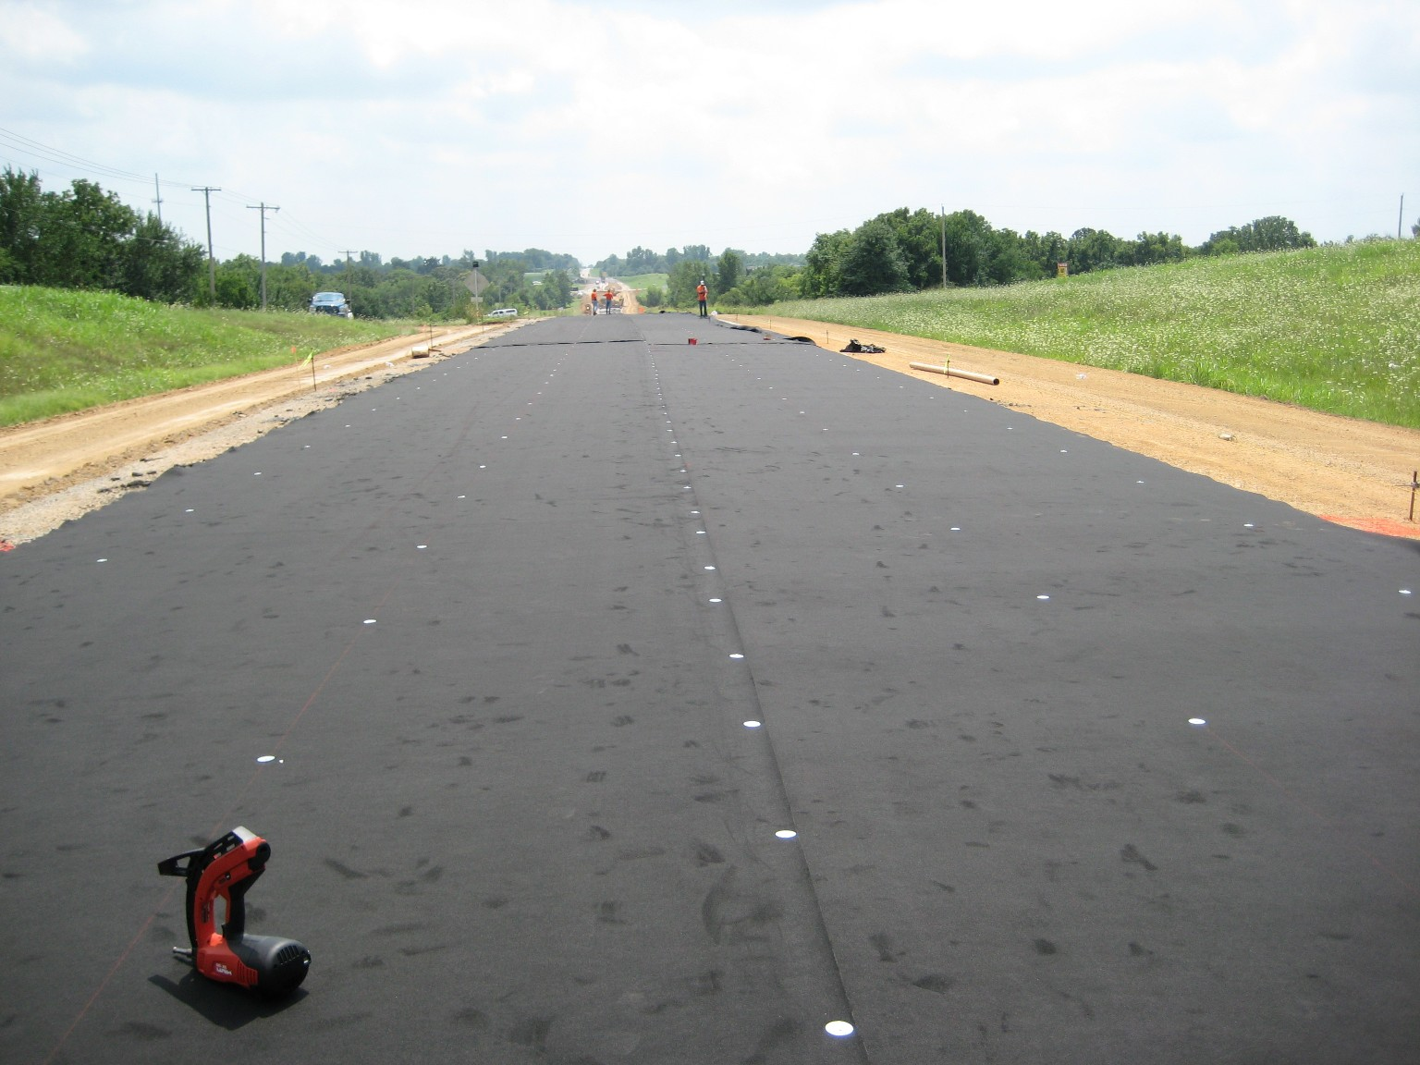
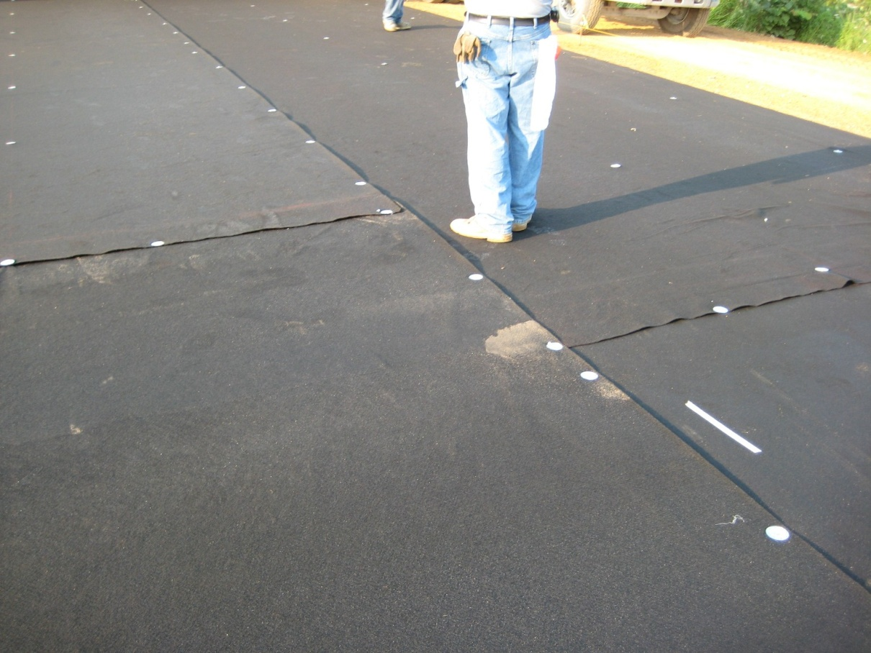
Securing Fabric

Slide 35
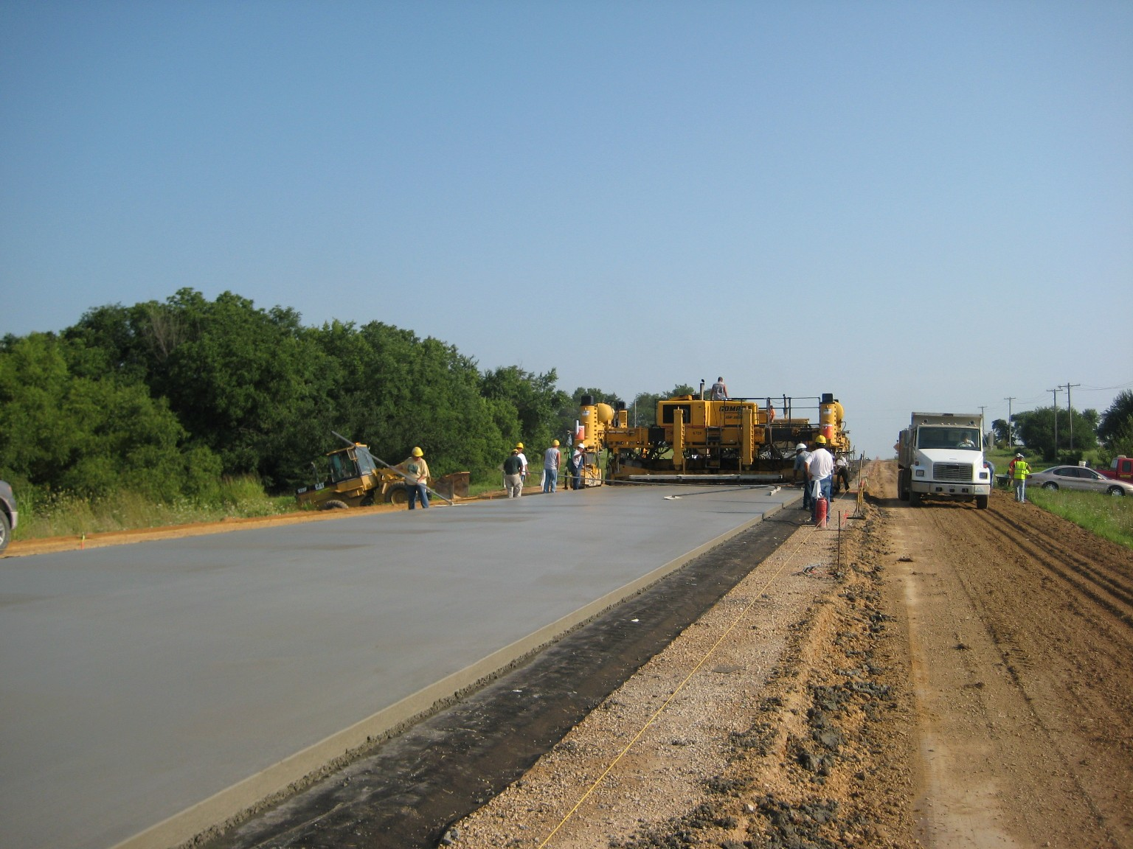
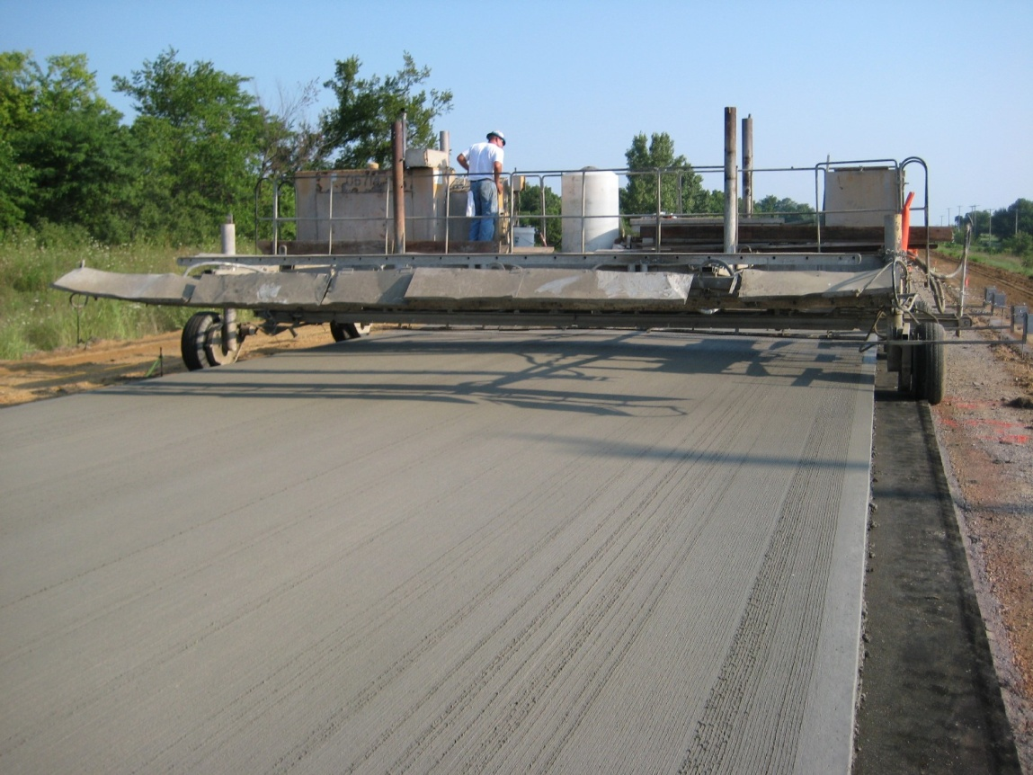
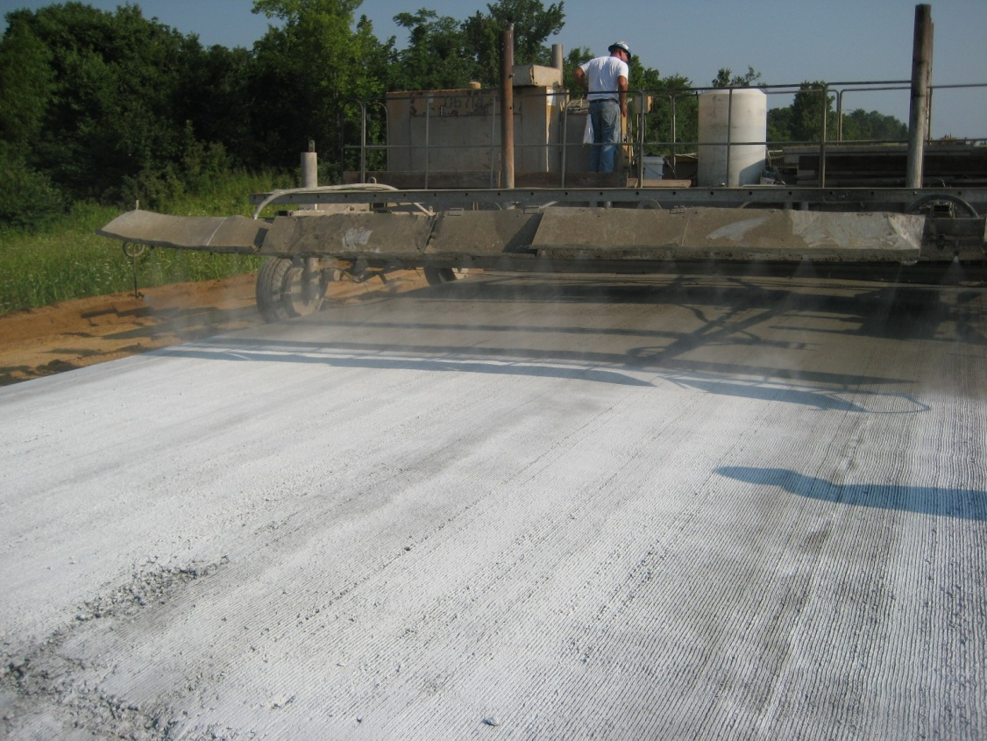
Placing and Finishing Surface

Slide 36
November 2015 Survey
First thorough visual distress survey
9768 panels total (3.47 centerline miles)
69 panels cracked or spalled for 0.7% failure rate
Most failures located near northern transition (@ Rte 150)

Slide 37
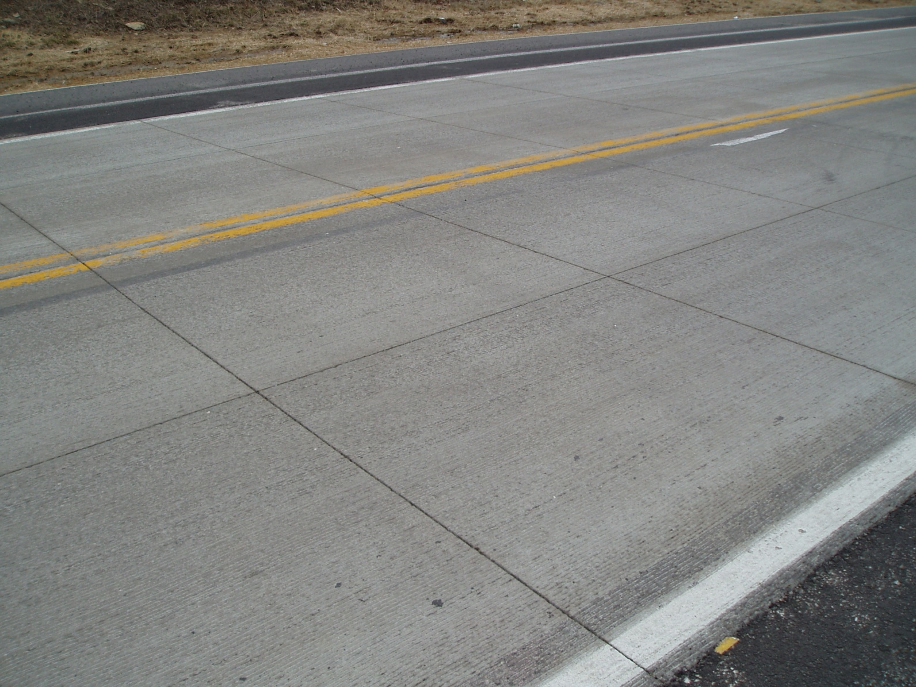
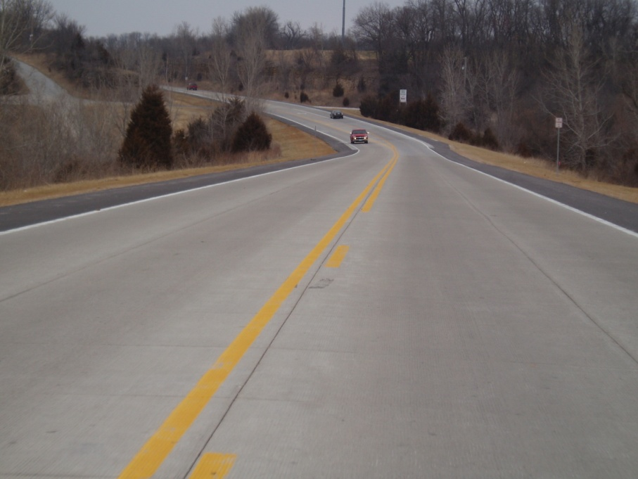
Route D in Cass County
November 2015

Slide 38
US 61 in Jefferson County
Composite pavement section south of St. Louis required rehab.
Originally scoped for 3 ¾ HMA overlay, but changed to 5-inch UBOL or ‘big block’
Constructed in 2009
6.5’ by 6.5’ joint spacing

Slide 39
US 61 ‘Big Block’
Primarily placed directly on existing composite pavement
Inlays constructed at transition areas near bridges and RR approaches and along side wide, new concrete entrances
220+ entrances in 12.7 miles!!!!

Slide 40
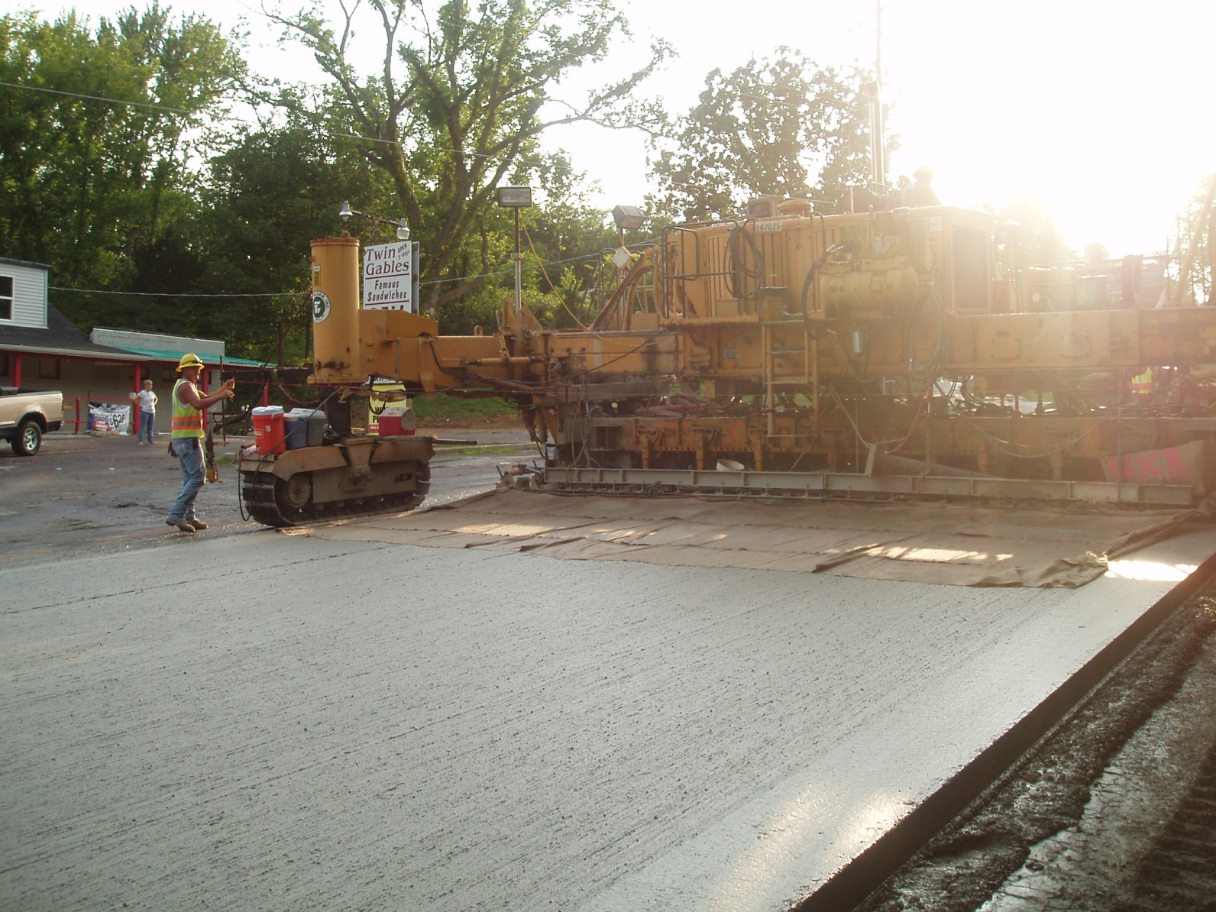

Slide 41
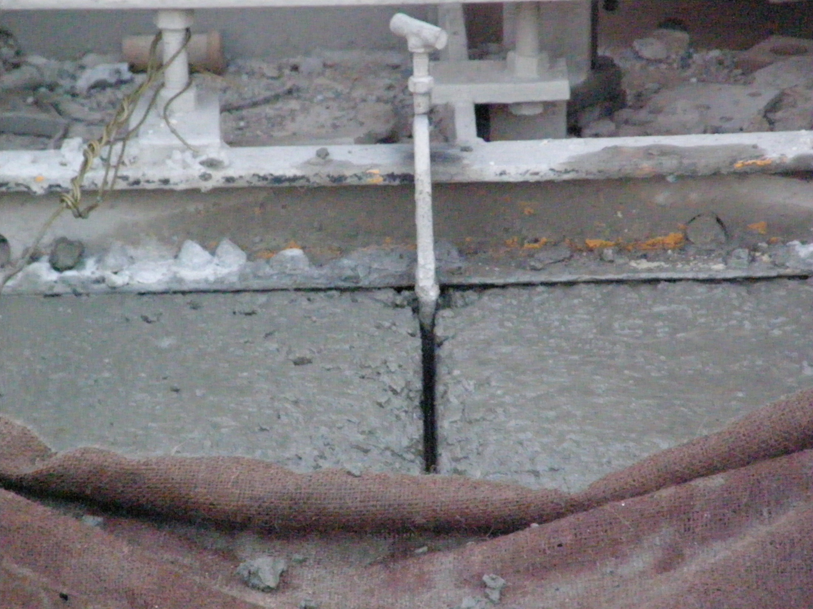
Utilized Longitudinal Joint Device Forming

Slide 42
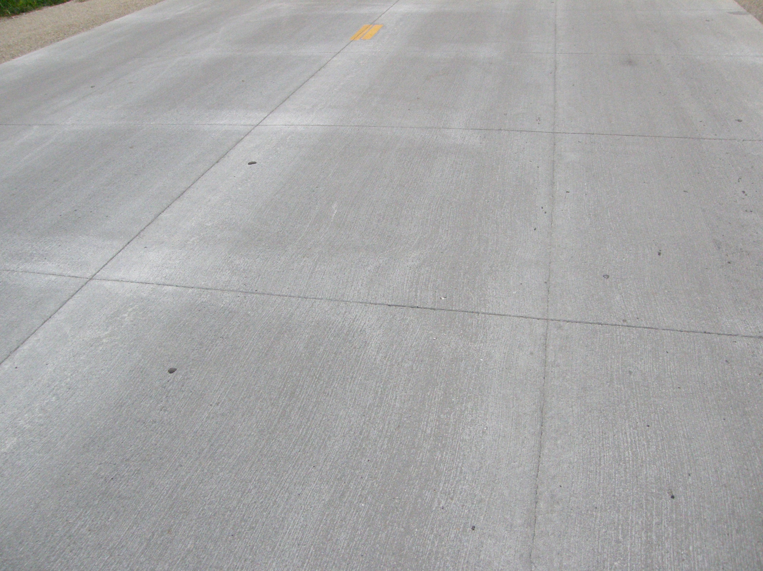
Joint Formation

Slide 43
February 2016 Survey
First visual distress survey
31,840 panels total (~ 10 centerline miles)
333 panels cracked, spalled or patched for 1.06% failure rate
2/3 of failures located in northernmost mile

Slide 45
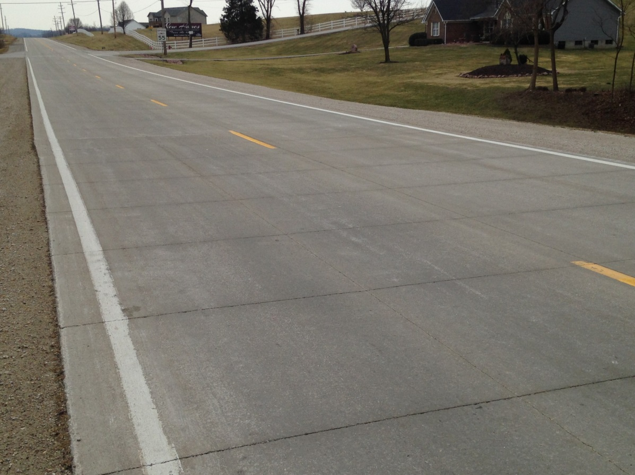
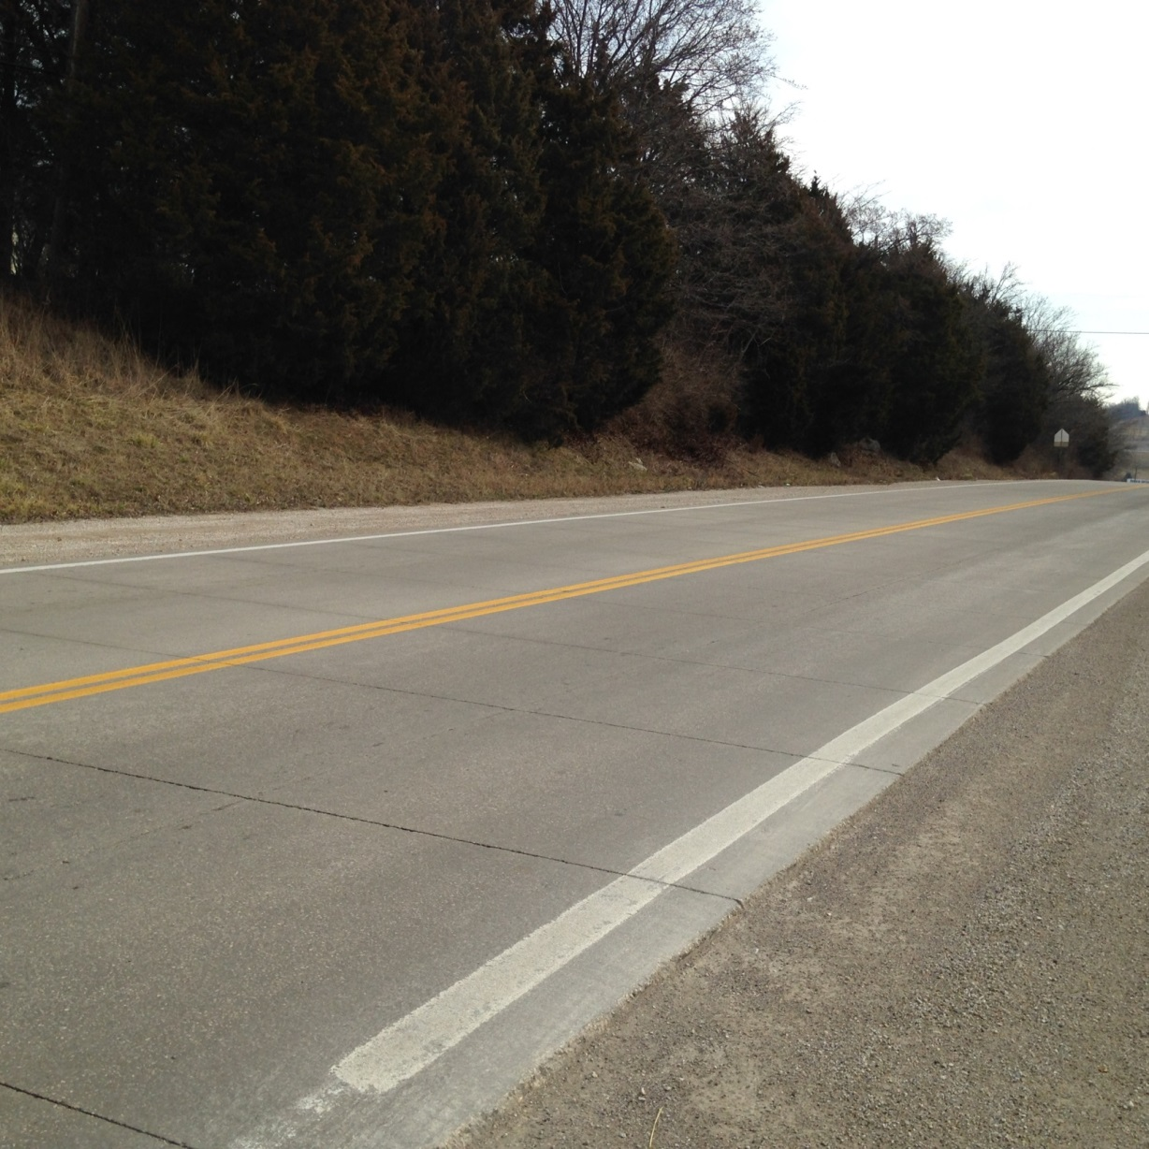
US 61 in Jefferson County
February 2016

Slide 46
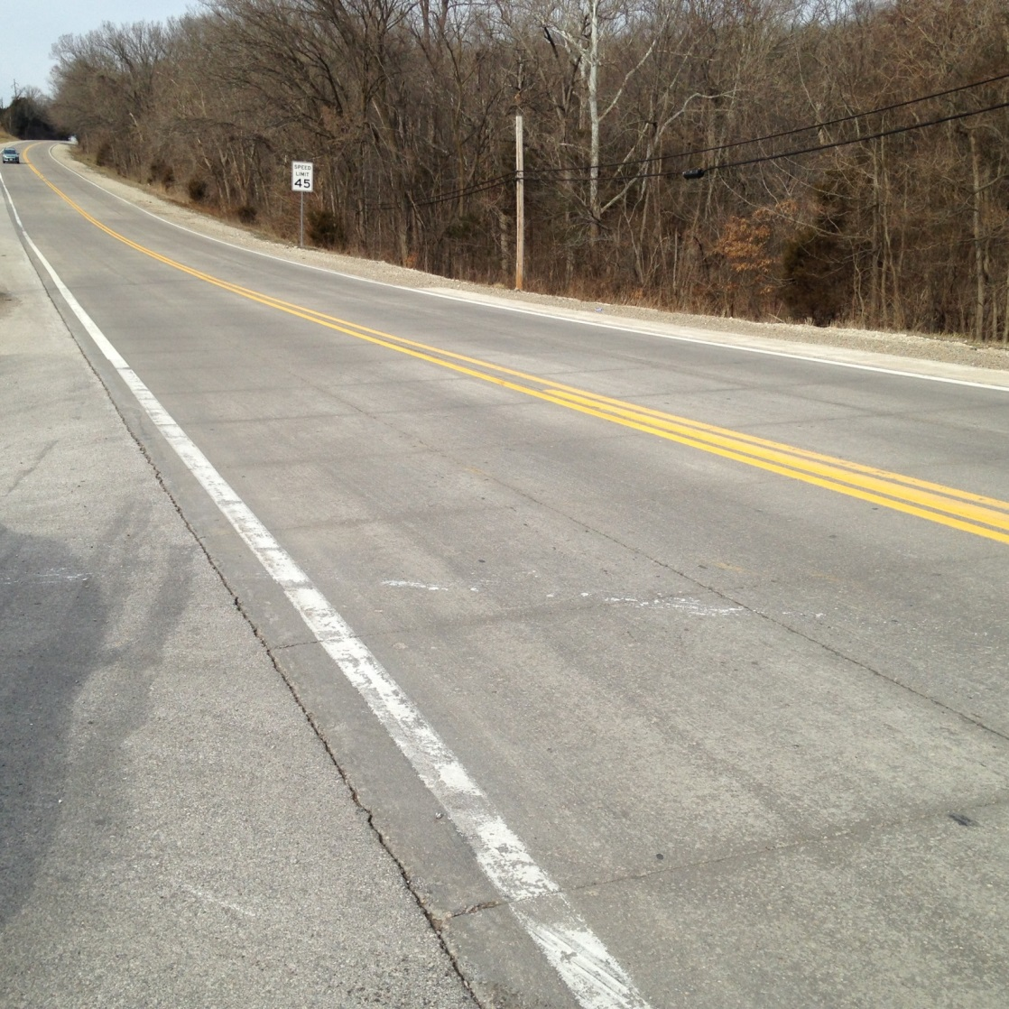
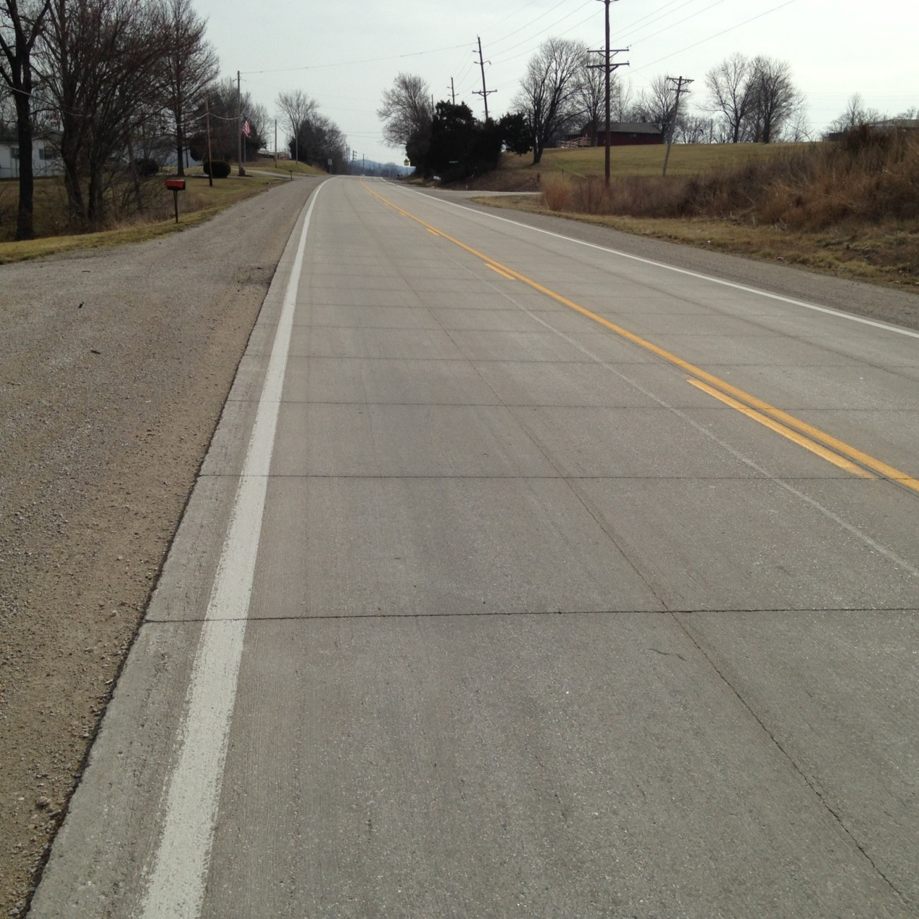
US 61 in Jefferson County
February 2016

Slide 47
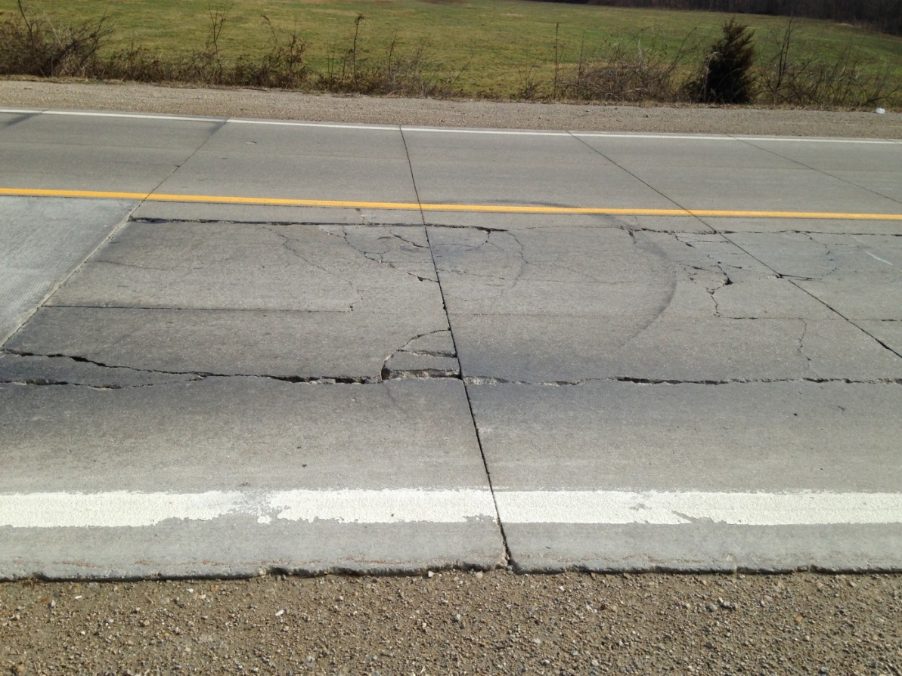
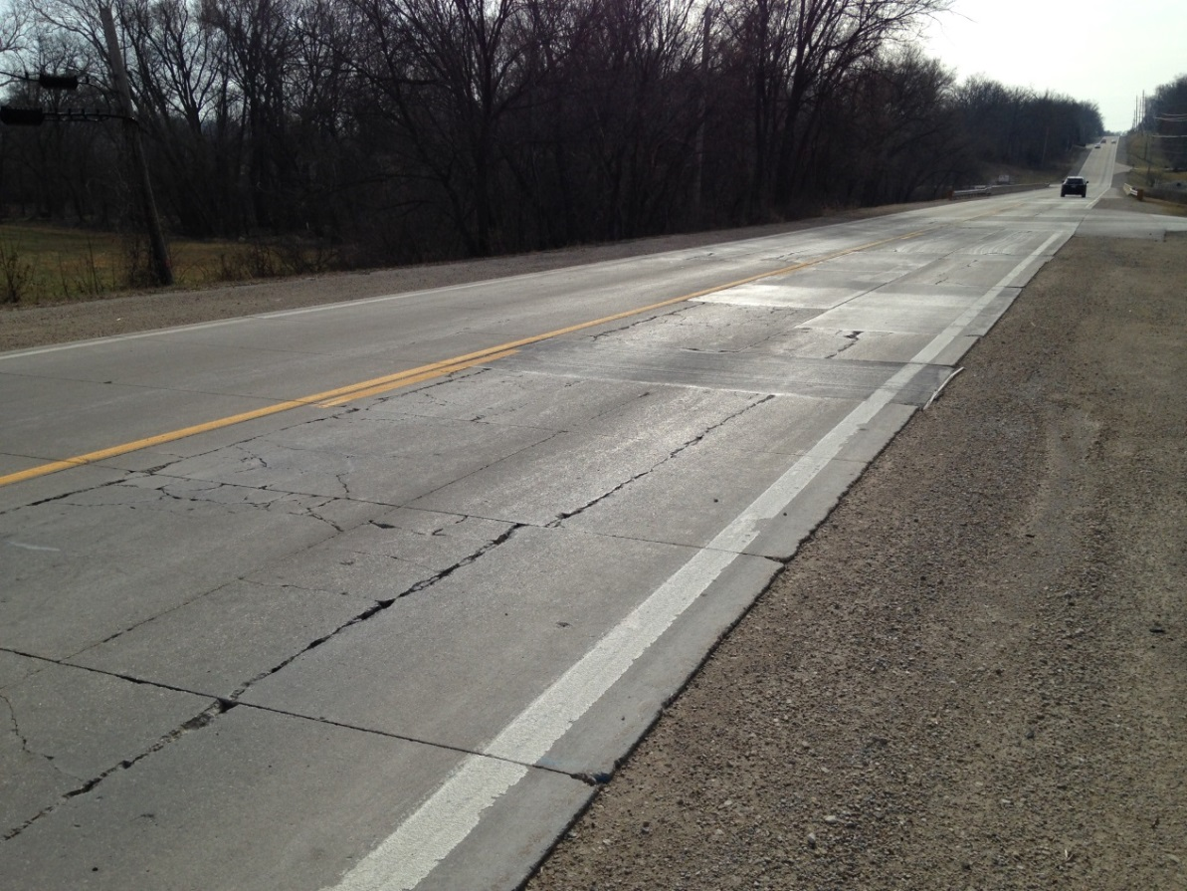
US 61 in Jefferson County
February 2016

Slide 48

What experience have you had?

Slide 49

Thank You!!
Brett.Trautman@modot.mo.gov
573-751-1036

