Slide 1

Longitudinal Joint Seal
Development & Implementation
NRRA Pavement Conference
Jim Trepanier
Aggregate, HMA & Metals Unit Chief
Illinois Dept. of Transportation

Slide 2
HMA Quiz
What is the leading HMA distress driving pavement rehabilitation in Illinois?
  Loss of Friction
  Wheel Path Rutting
  Raveling
  Premature Cracking
  Raveling & Cracking at the Centerline Joint

Slide 3
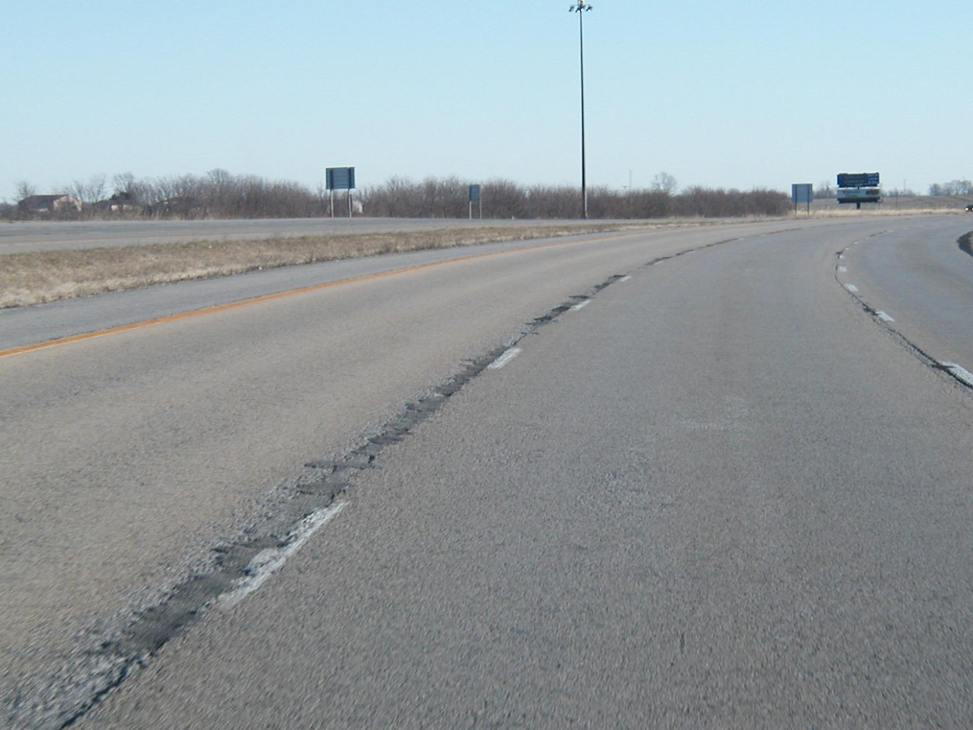
Deteriorated Joint

Slide 4
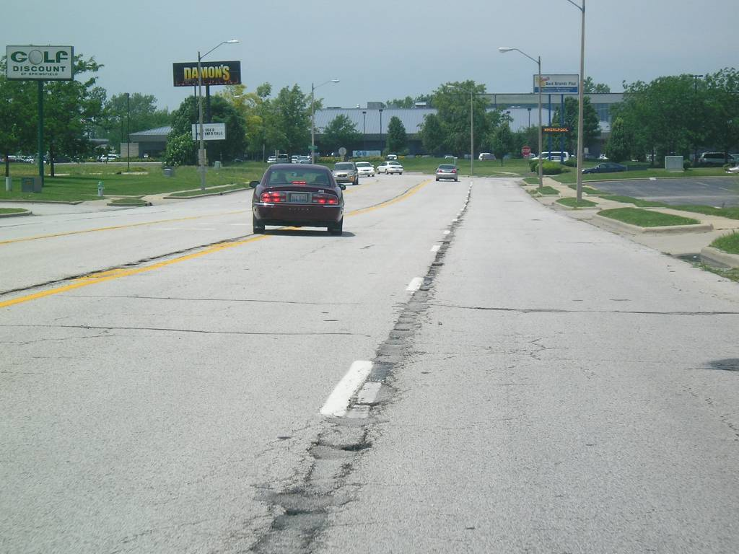

Slide 5
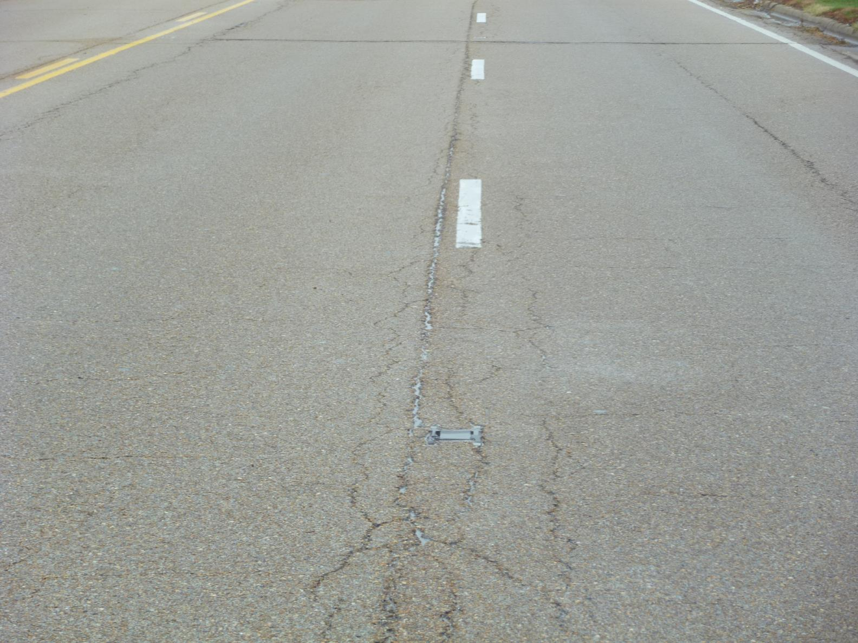

Slide 6
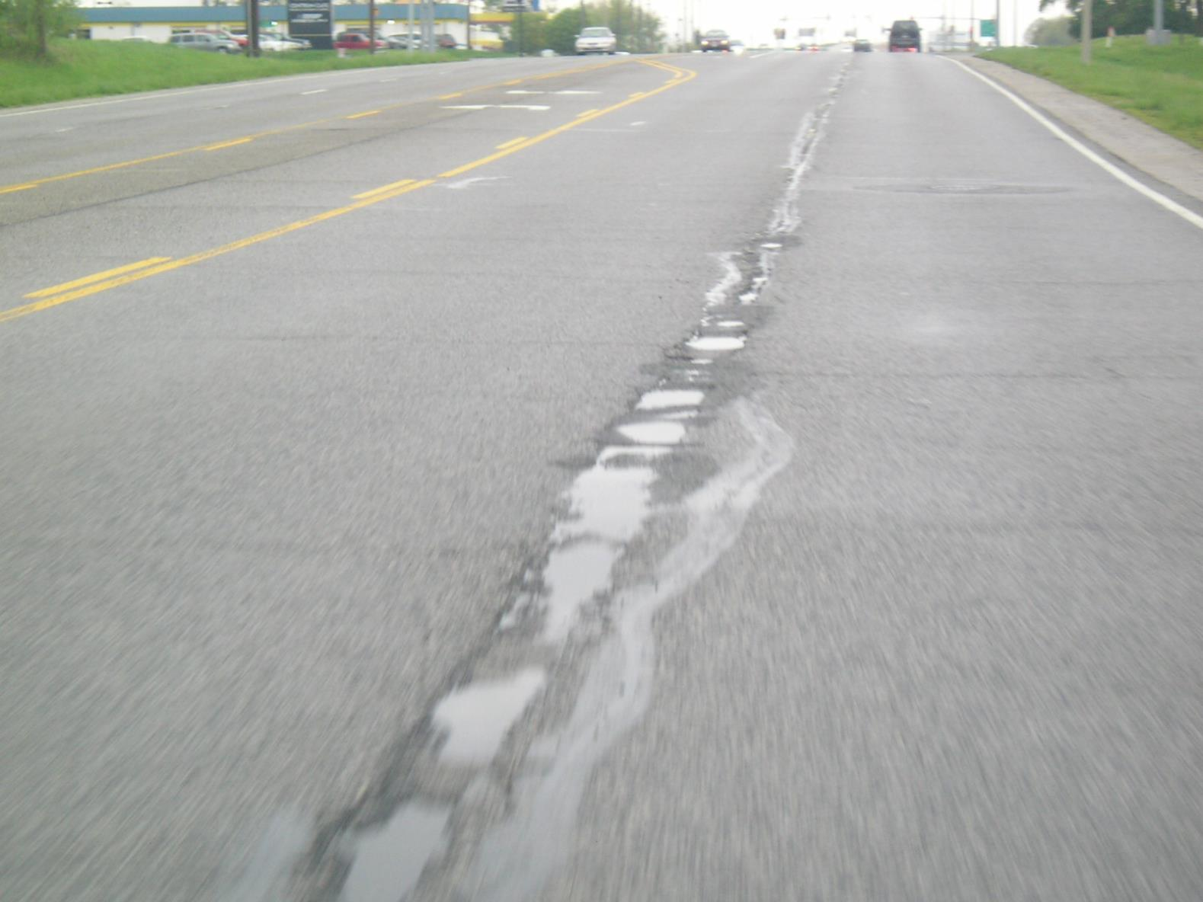
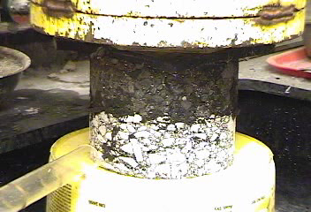

Slide 7
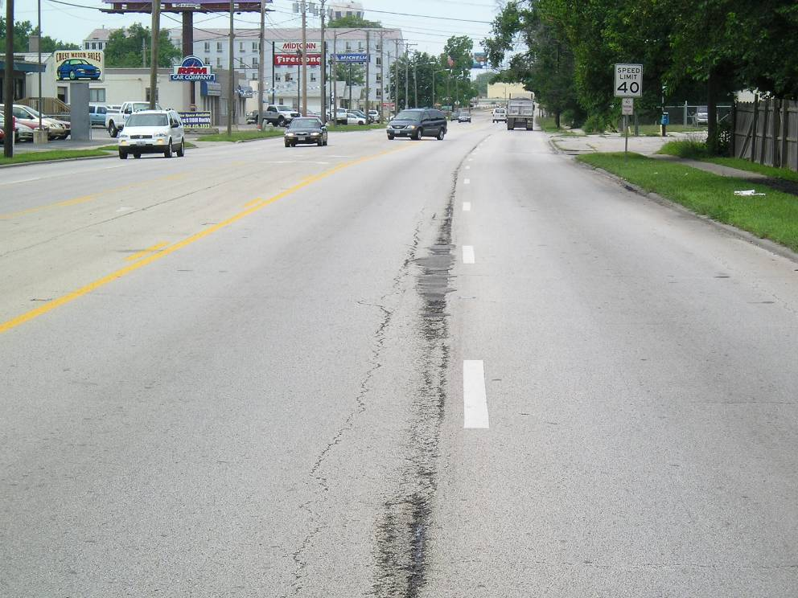

Slide 8
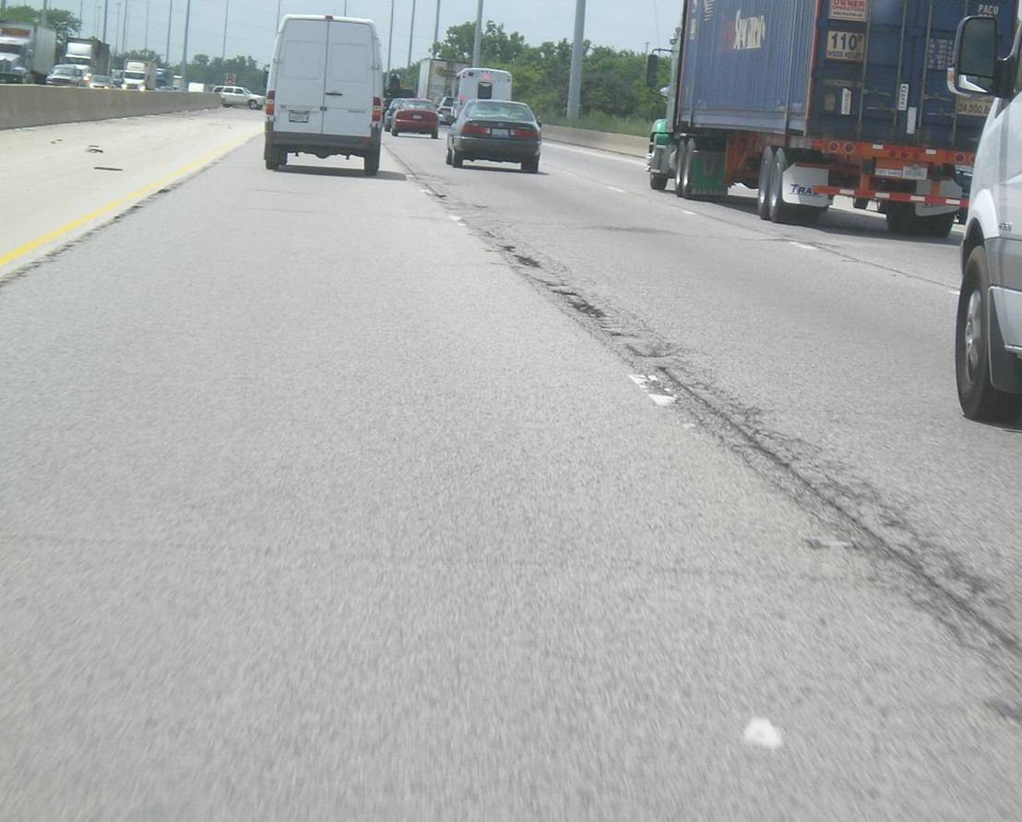

Slide 9
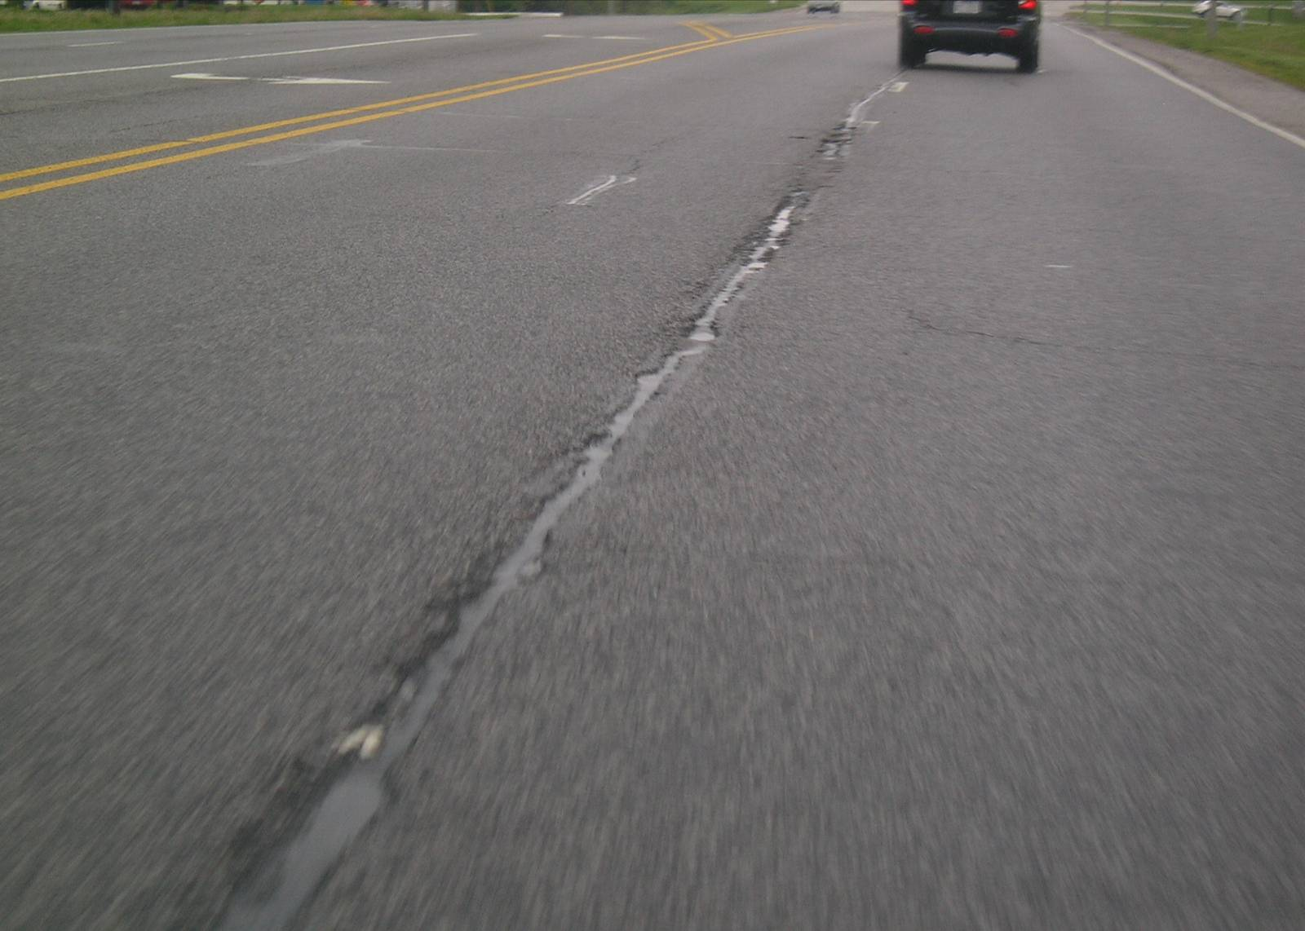

Slide 10
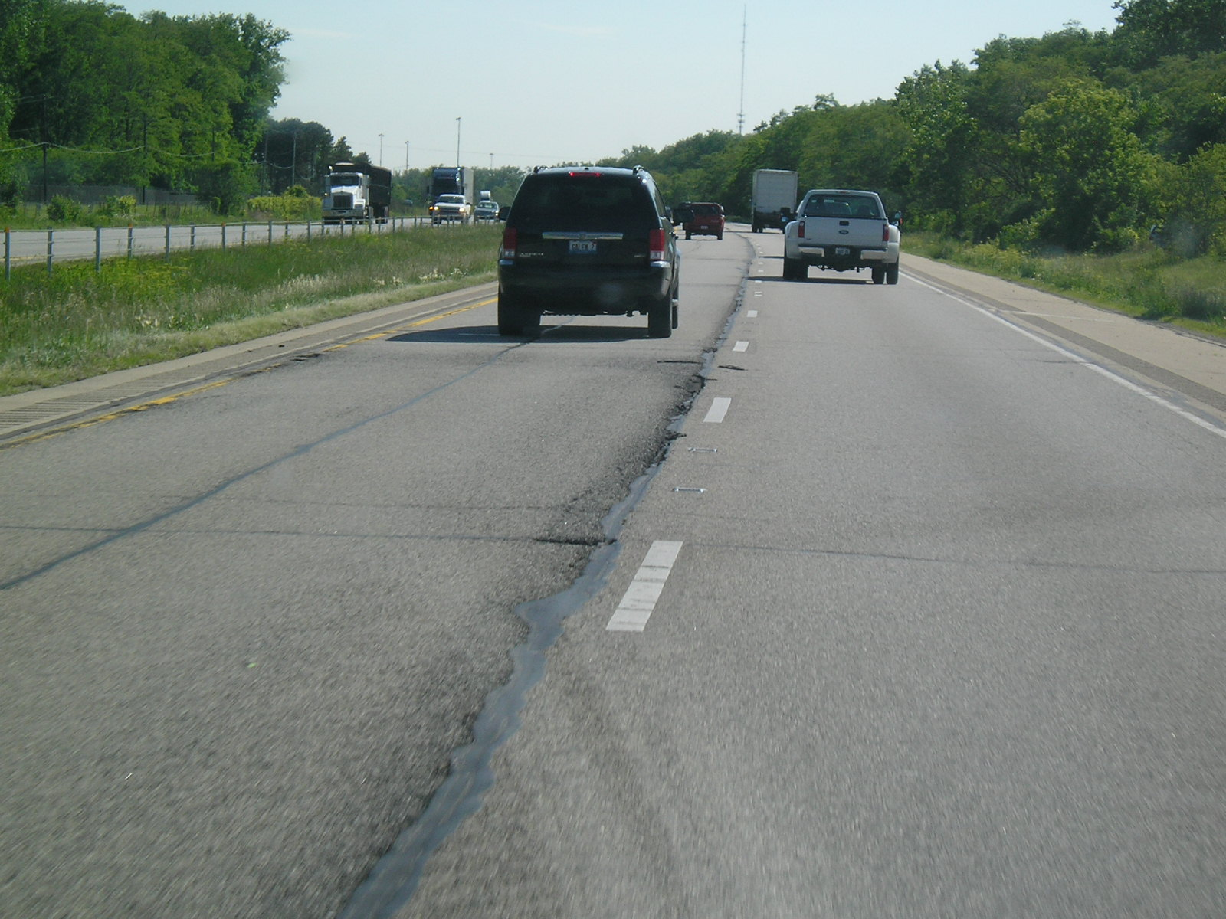

Slide 11
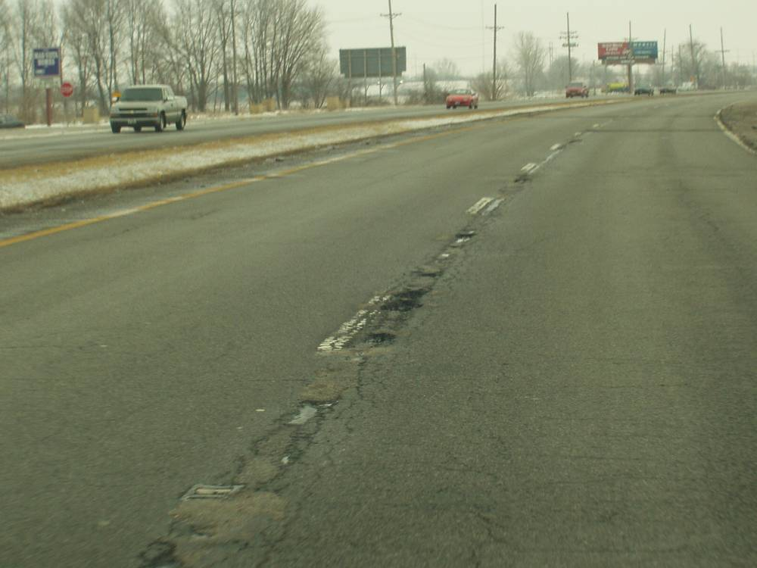

Slide 12
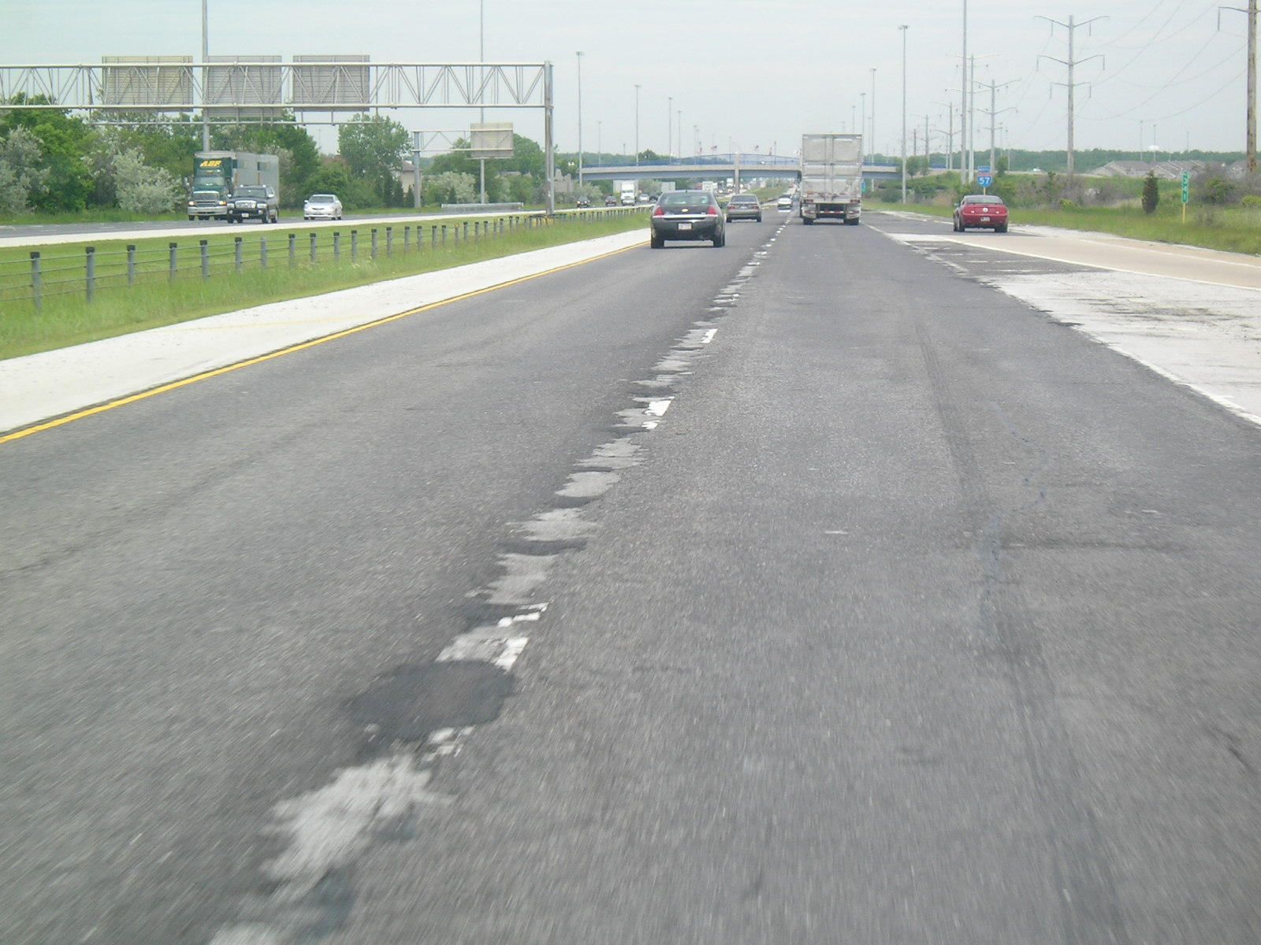

Slide 13
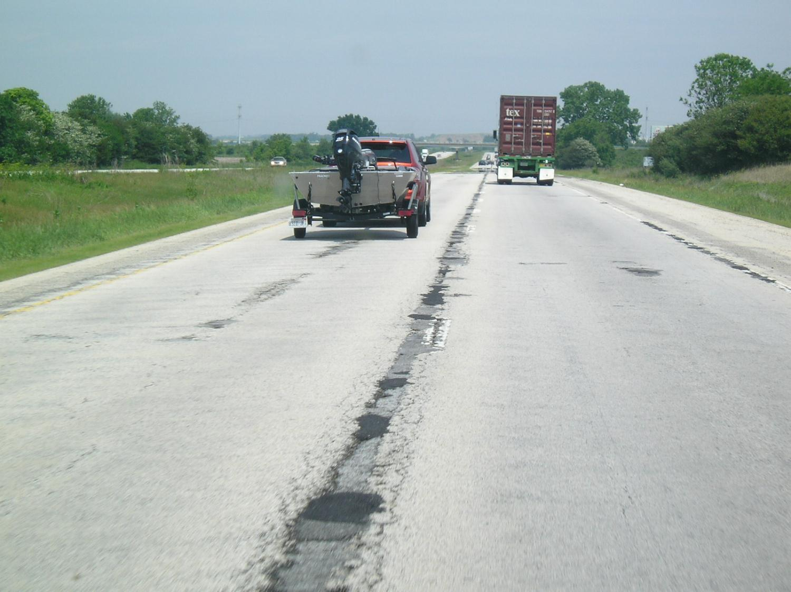

Slide 14
Answer
What is the leading HMA distress driving pavement rehabilitation?
  Loss of Friction
  Wheel Path Rutting
  Raveling
  Premature Cracking
  Raveling & Cracking at the Centerline Joint

Slide 15

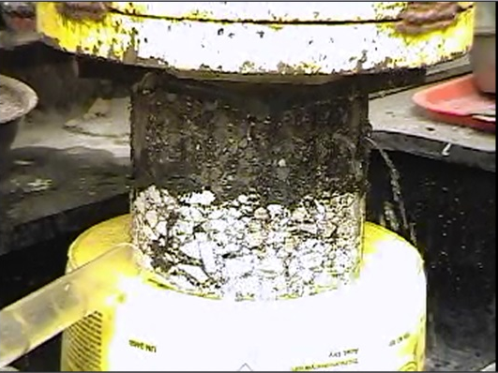
Why the Poor
Performance?

Slide 16
Effect of In-Place Voids on Life
Washington State DOT Study
93% 92% 91% 90% 89%
Compaction Level
Notes:
This Washington study is often referenced. It highlights the relationship between in-place pavement air voids and pavement service life.
With longitudinal joint densities typically at 90% or less it is easy to explain those opening photos of premature joint failures. At ninety percent compaction (10-percent air voids) we can expect joint performance to be: joint performance = mat performance – 1/5.
When joint density drops to 89% then joint performance can expect to be: joint performance = mat performance – 1/3. For a 15 year expected mat performance, giving up 1/5th means the joints fail 3 yrs earlier than mat (giving up 1/3rd means the joints fail 5 yrs earlier).

Slide 17
Effect of In-Place Voids on Life
Washington State DOT Study
93% 92% 91% 90% 89%
Compaction Level
Notes:
This Washington study is often referenced. It highlights the relationship between in-place pavement air voids and pavement service life.
With longitudinal joint densities typically at 90% or less it is easy to explain those opening photos of premature joint failures. At ninety percent compaction (10-percent air voids) we can expect joint performance to be: joint performance = mat performance – 1/5.
When joint density drops to 89% then joint performance can expect to be: joint performance = mat performance – 1/3. For a 15 year expected mat performance, giving up 1/5th means the joints fail 3 yrs earlier than mat (giving up 1/3rd means the joints fail 5 yrs earlier).

Slide 18
Deteriorated Joint
How many years?

Slide 19
How many years?

Slide 20
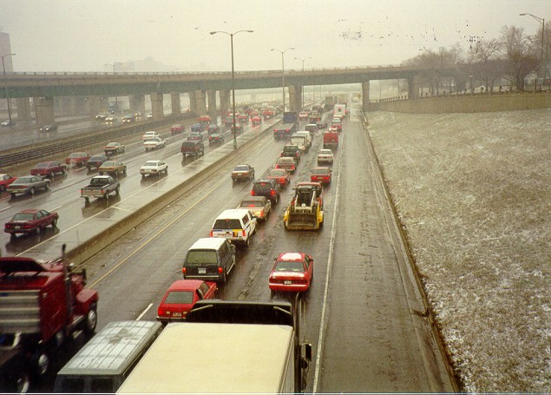
Maintenance - Disruptive and Dangerous

Slide 21
Efforts to Minimize Permeability along Longitudinal Joints
2001/2002 Longitudinal Joint Sealants
  IDOT worked w/ 2 companies to Develop a Longitudinal Joint Sealant (LJS)
  LJS is a Band of Asphalt Binder that Seals a lift of HMA from the Bottom Up.
  Here is How it Works:

Slide 22
Joint Sealant Concept
Band melts up into the joint thus:
  Increasing density
  Decreasing permeability
  Increasing joint life
Unconfined
Joint Sealant
18 inches

Slide 23
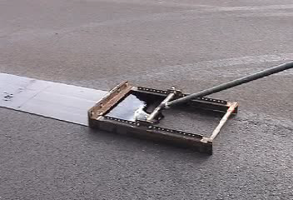
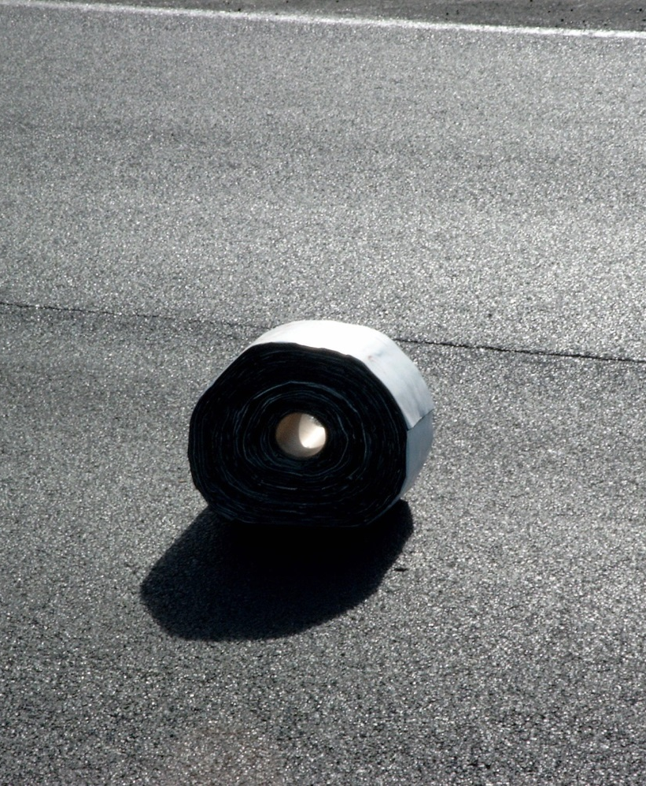
Asphalt Materials/Hendy Quickseam

Slide 24

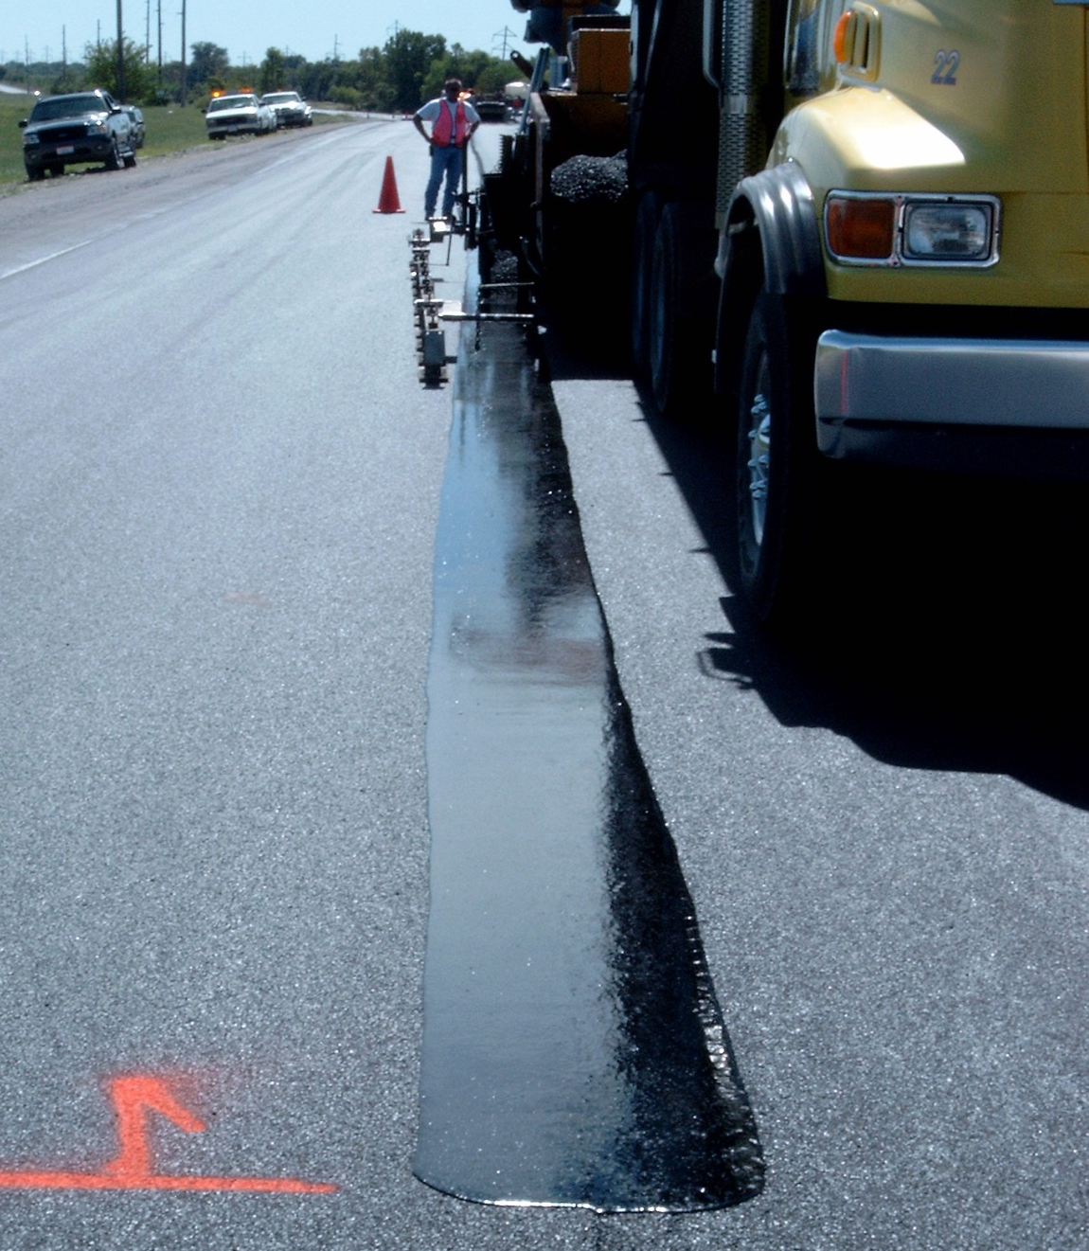
Longitudinal Joint Seal

Slide 25

Longitudinal Joint Seal 12 Yrs Later

Slide 26
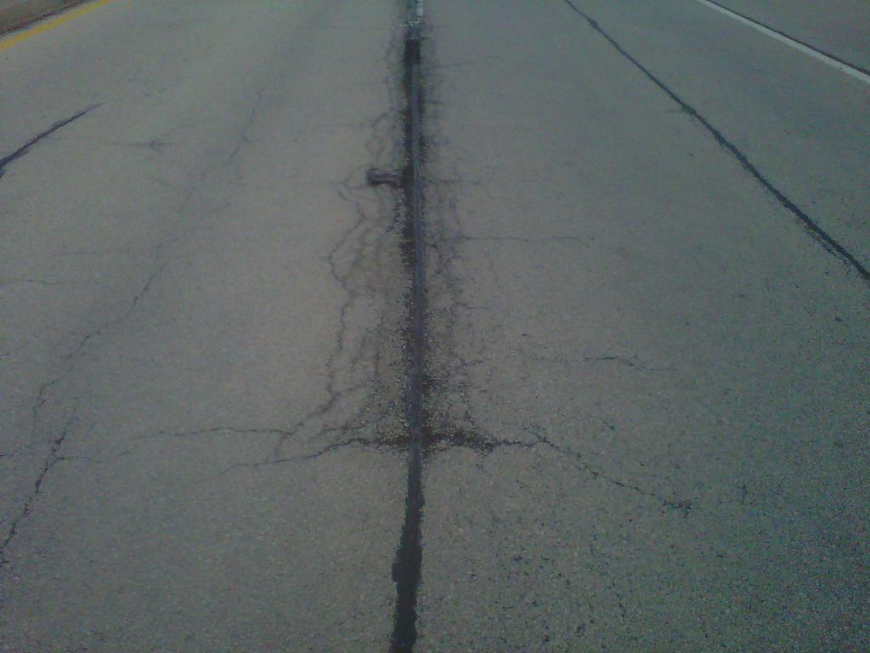
Longitudinal Joint Seal 12 Yrs Later
No LJS
LJS

Slide 27
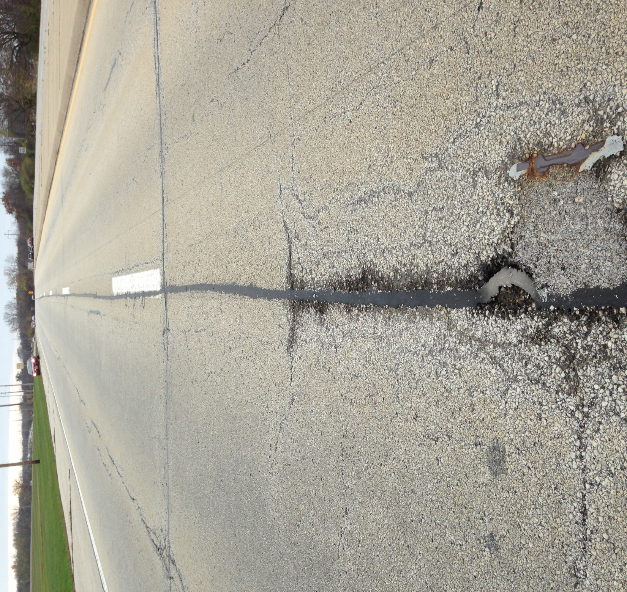
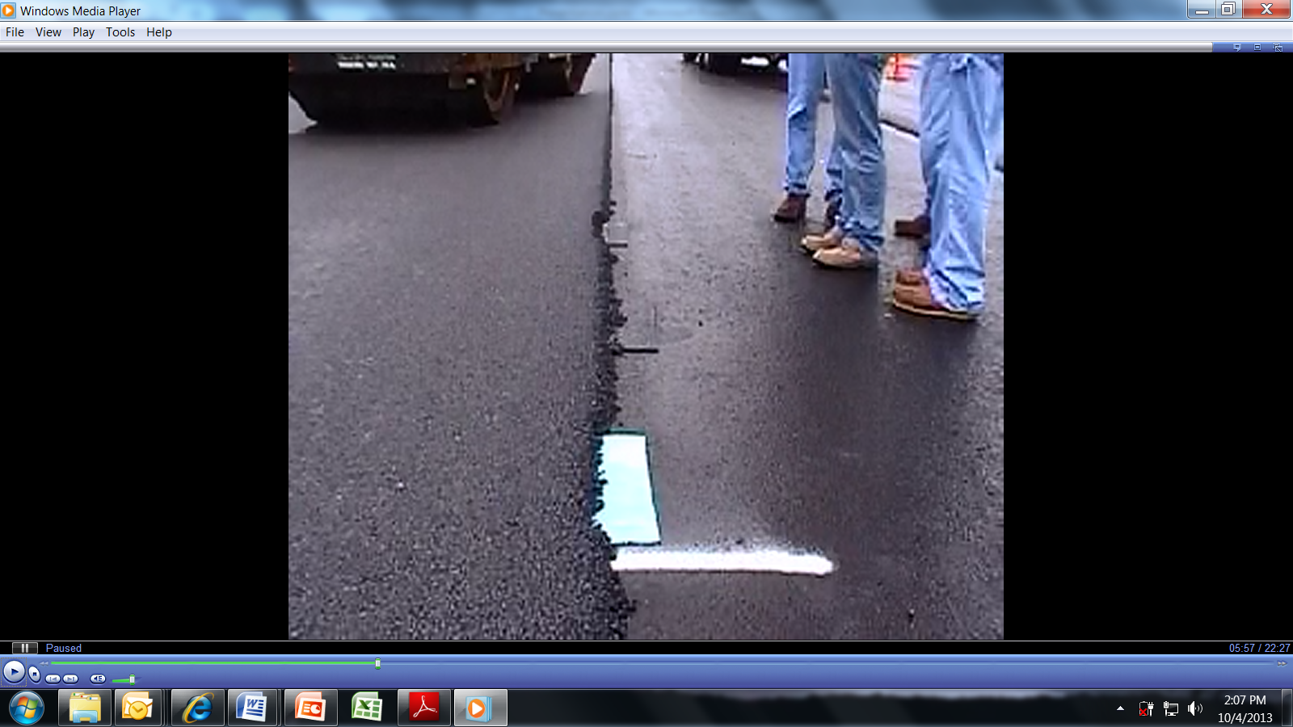
Shear Tears

Slide 28
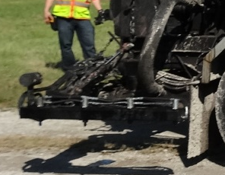

Heavy Duty Pressure Distributor for Applying LJS

Slide 29
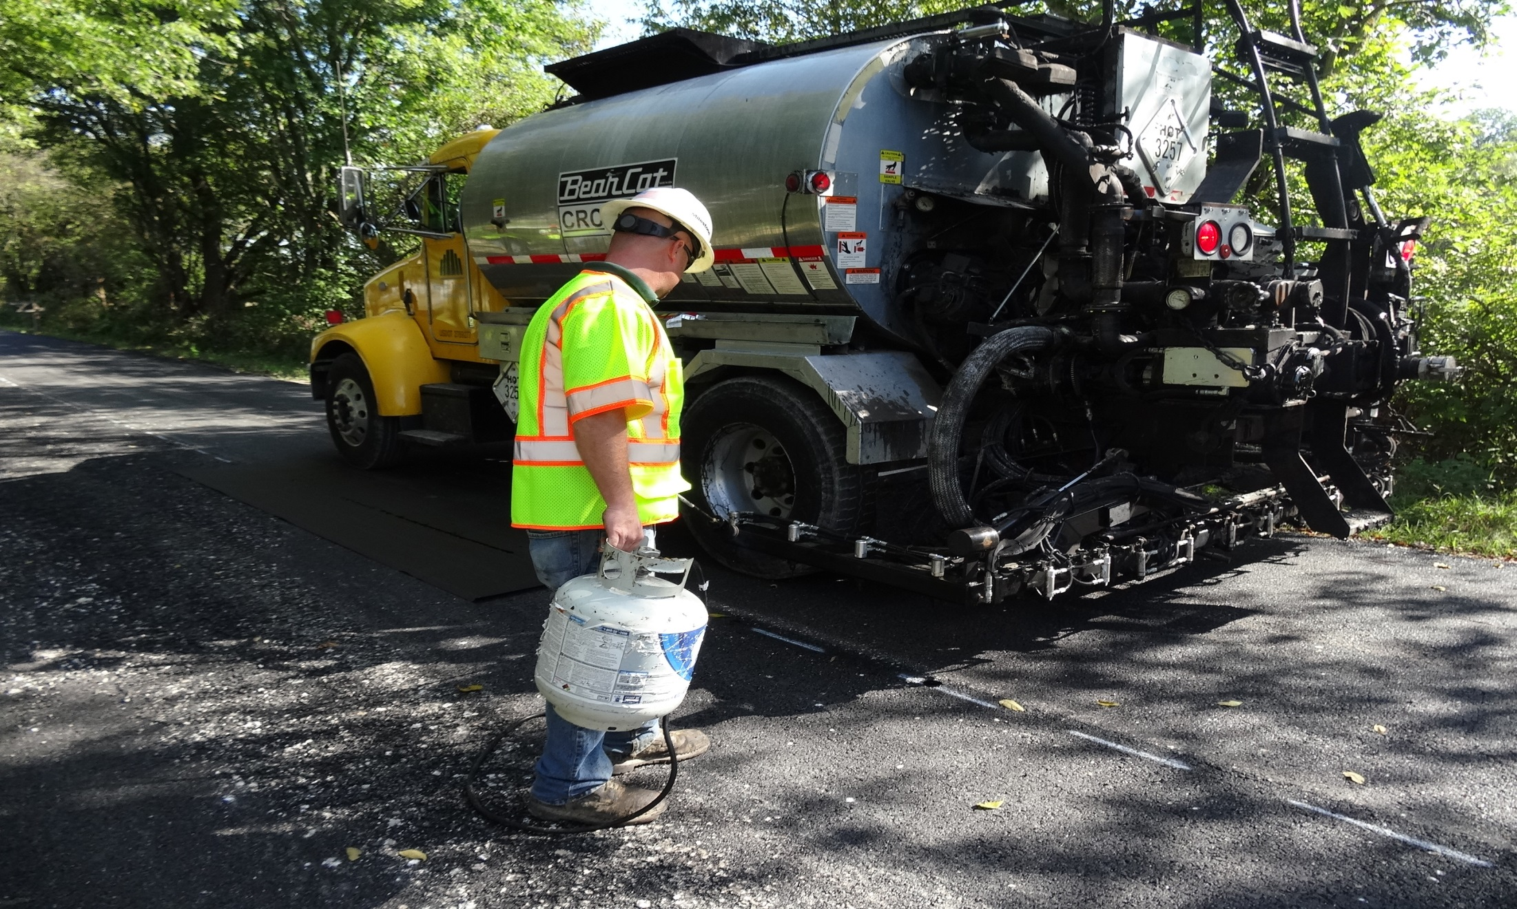
Heavy Duty Pressure Distributor for Applying LJS

Slide 30
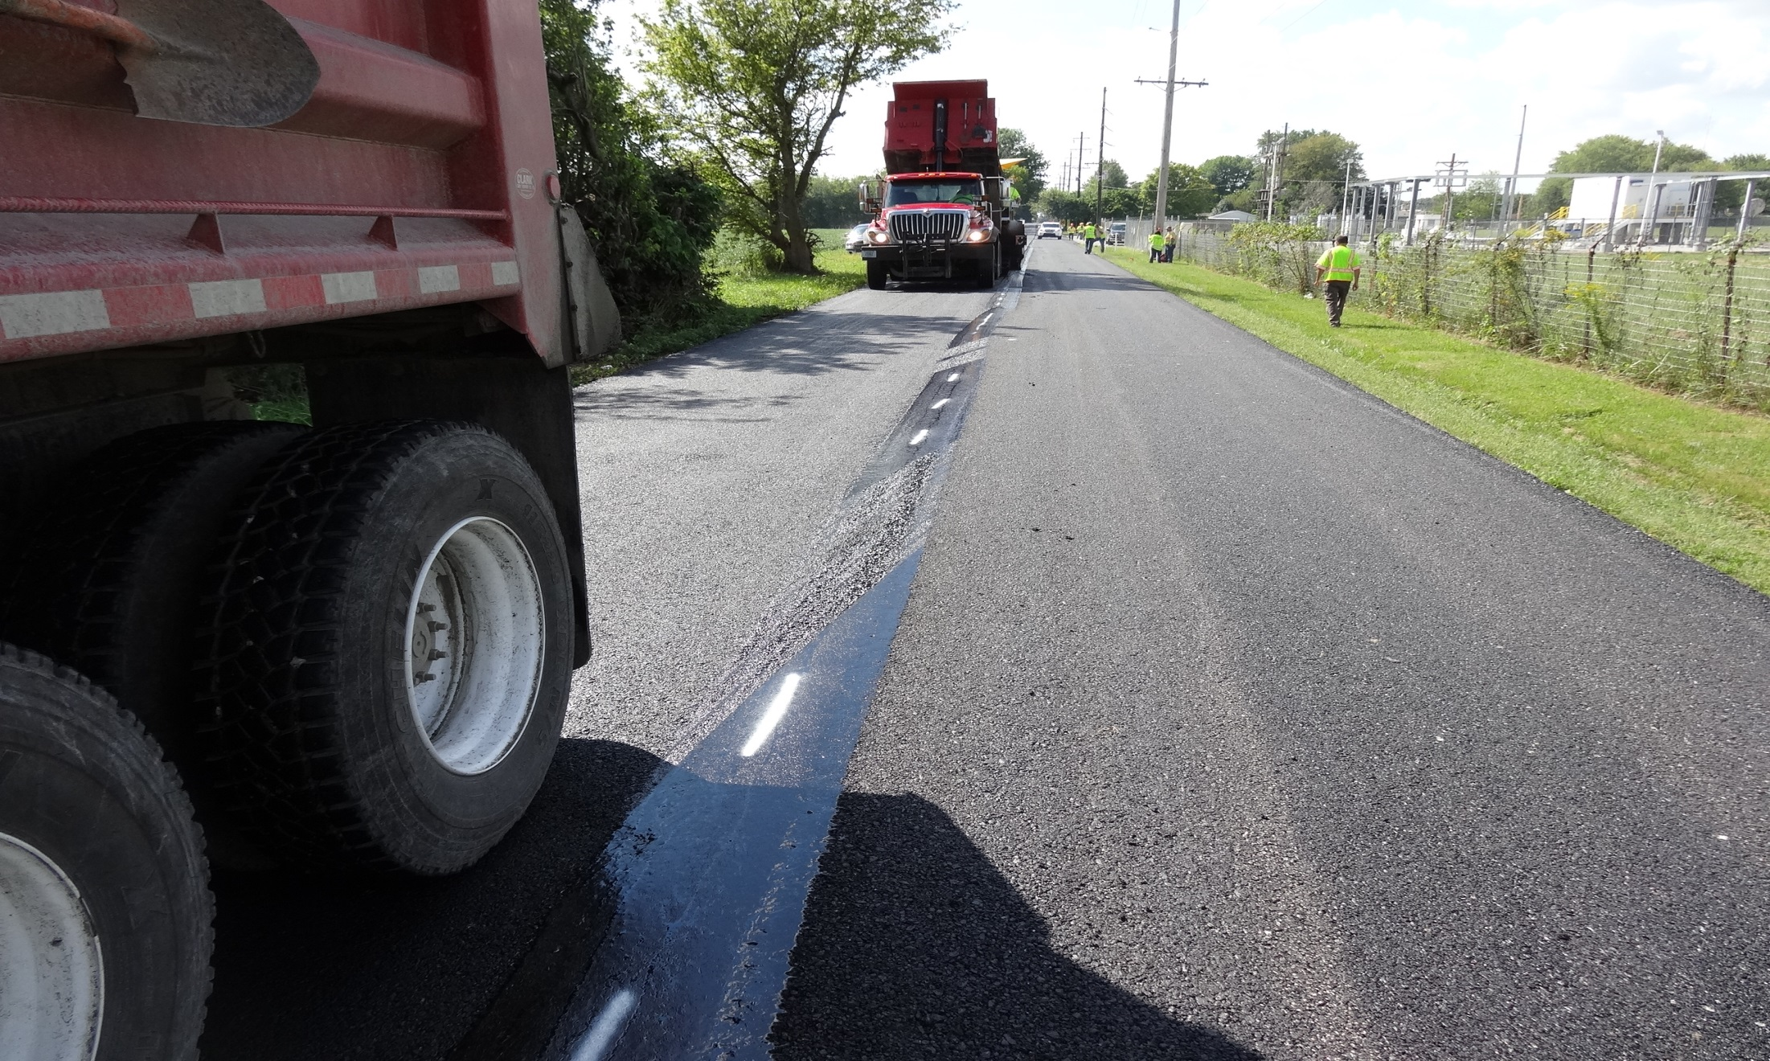
Five Minutes After Placement

Slide 31
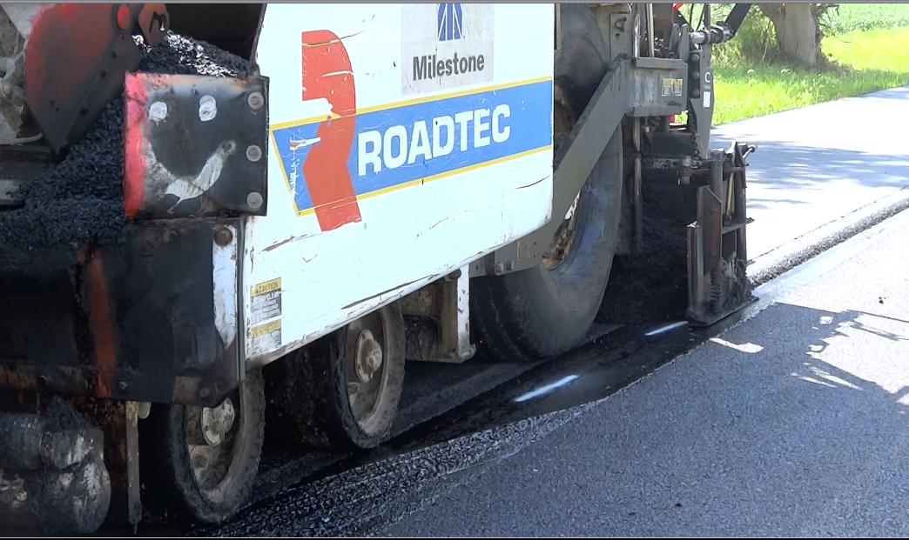
Paving over LJS

Slide 32
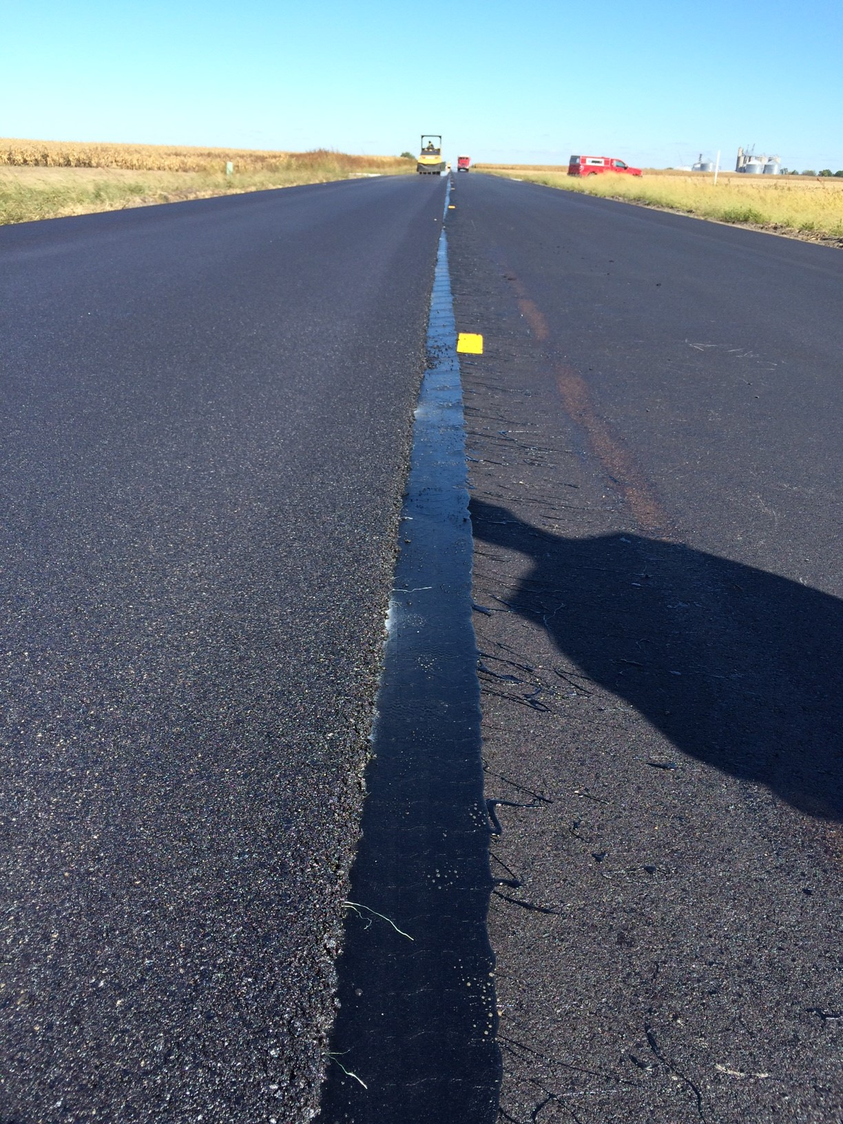

Slide 33
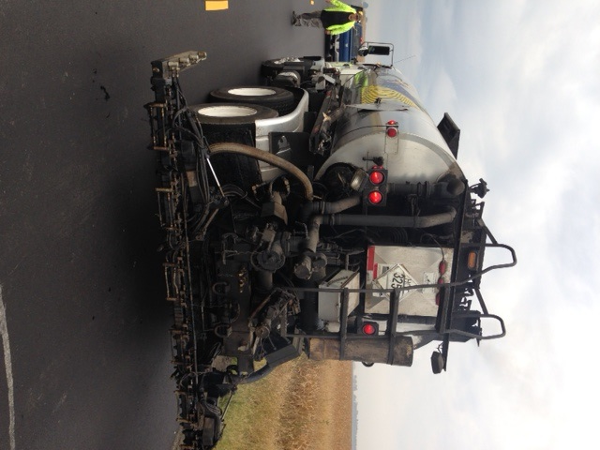
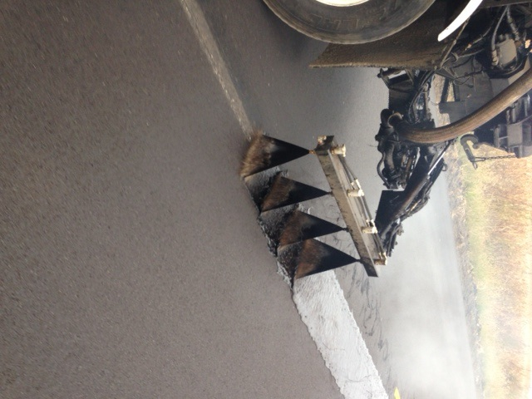
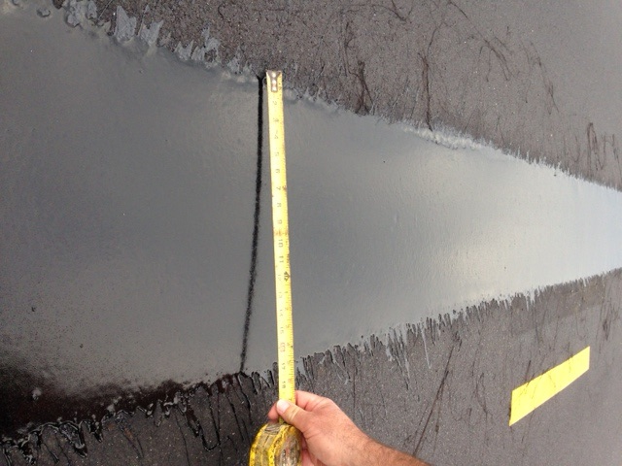
Licensed Subcontractor ≈ 11 Trucks

Slide 34
LJS Spec Features
No Density Measurements within 1 foot from Joint
  Cannot use Production G_{mm}
  G_{mm} substantially reduced due to dramatic increase in asphalt binder
LJS can be applied:
  Push Cart
  Drag Box
  Roll out Tape
  Heavy Duty Pressure Distributor

Slide 35
LJS Material Spec
Test | Test Requirement | Test Method
Dynamic shear @ 88°C (unaged), G*/sin δ, kPa | 1.00 min. | AASHTO T 315
Creep stiffness @ -18°C (unaged), Stiffness (S), MPa m-value | 300 max. 0.300 min. | AASHTO T 313
Ash, % | 1.0 - 4.0 | AASHTO T 111
Elastic Recovery, 100 mm elongation, cut immediately, 25°C, % | 65min. | ASTM D 6084 (Procedure A)
Separation of Polymer, Difference in °C of the softening point (ring and ball) | 3 max. | ITP Separation of Polymer from Asphalt Binder”

Slide 36
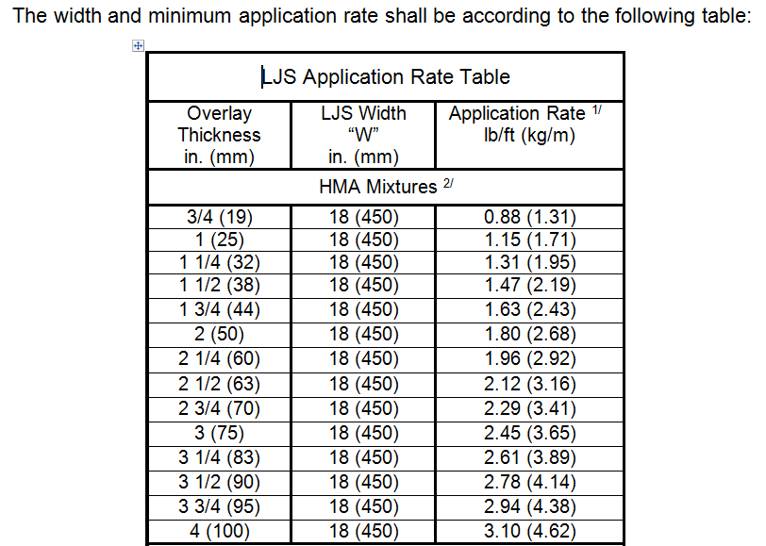
LJS Spec Application Rates

Slide 37
Longitudinal Joint Spec
Implementation Goals:
  2016 – 2 Projects per District
  2017 – 50% of Projects per District
  2018 – Full Implementation

Slide 38
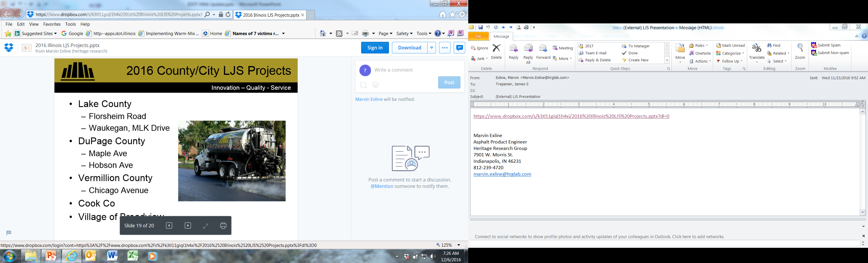
2016 - LJS Projects
Total of 20-plus projects statewide
Average awarded cost $2.17 / lineal ft
Observations:
  Some minimal sporadic flushed spots < 25 feet in 10 plus miles (not a hindrance & shows migration is occurring)
  Shear tear will occur if required tack not in place
  Pressure Distributor Operators getting better
  Mix will pull up over unbonded scabs

Slide 39
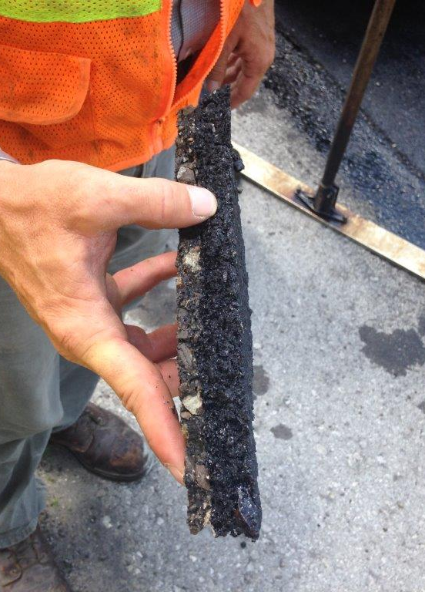
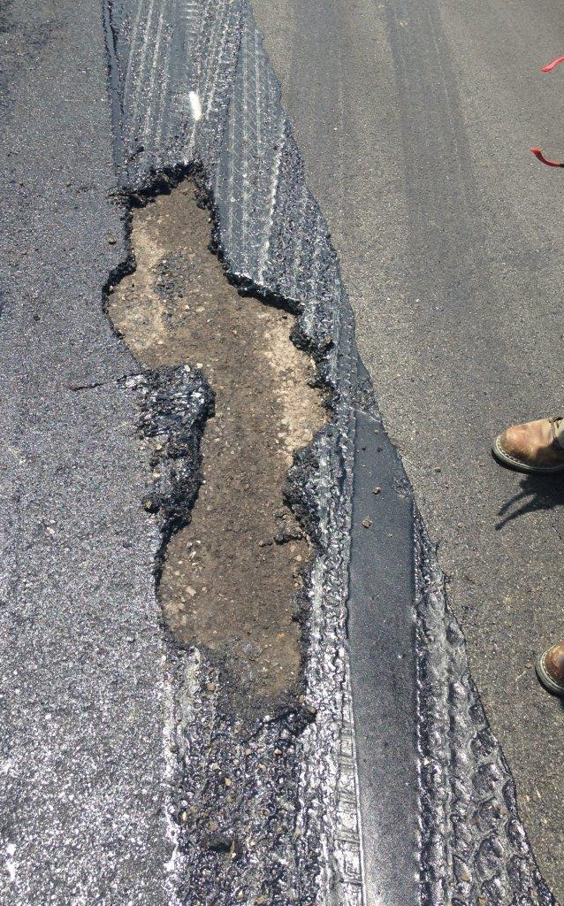

Slide 40
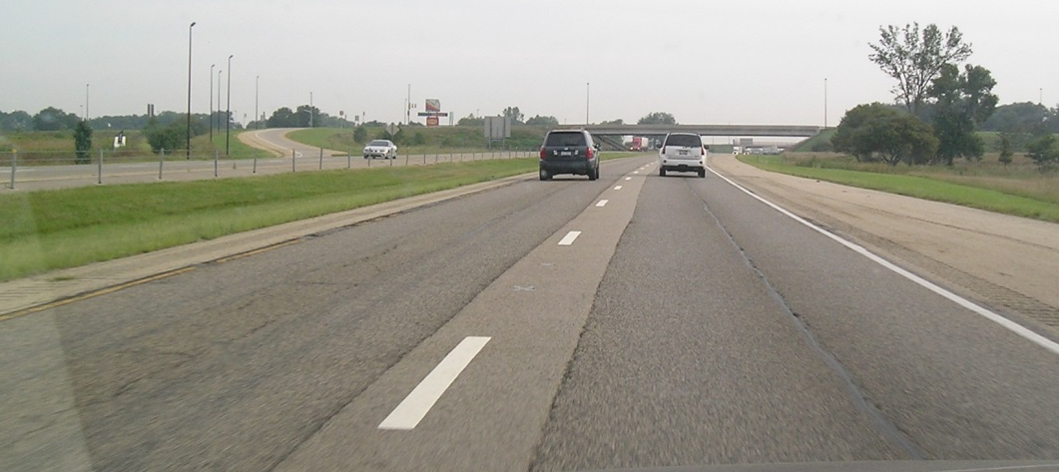
Cost Comparison
Inlay: $8.00 / lineal ft
  Includes: traffic control, mobilization, milling, priming, paving, pavement marking

Slide 41
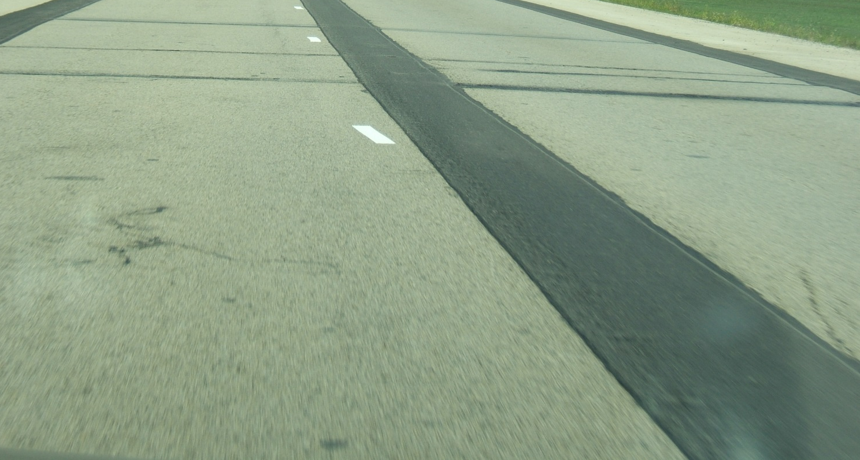
Cost Comparison
Microsurfacing: $4.81 / lineal ft
  Includes: crack seal, traffic control, pavement marking/removal

Slide 42
Cost Comparison
Route and Seal: $2.00 / lineal ft
  Includes: crack seal, traffic control

Slide 43
Cost Comparison
Longitudinal Joint Seal: $2.00 lineal ft

Slide 44
LJS - Life Cycle Cost Analysis
Two Lane Road
Cost per lineal foot

Slide 45
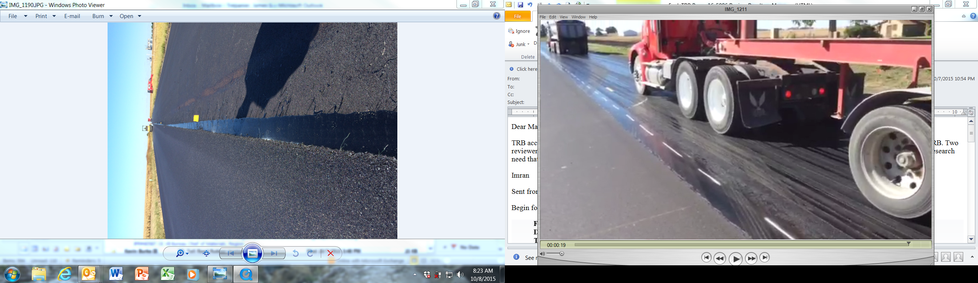
Also Works as a Tack Coat

Slide 46


Thank You

