Slide 1


How Can We Make a Greater Impact?
Julie M. Vandenbossche, Ph.D., P.E.
University of Pittsburgh
National Road Research Alliance 2017 Pavement Conference
May 24, 2017
Notes:
Primarily from the academic point of view but maybe a bit of a different perspective since I worked for a DOT. Also more of a concrete perspective but just as applicable to asphalt as well

Slide 2
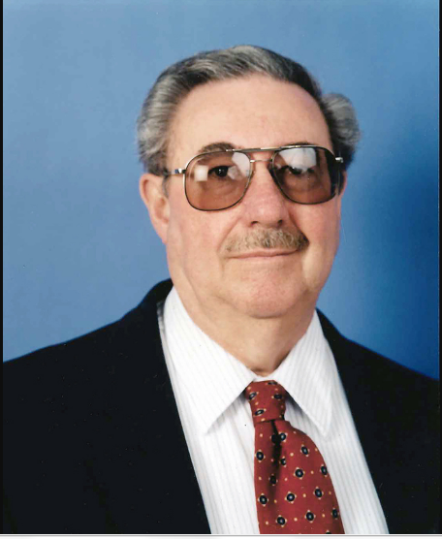
Gerald Rohrbach Distinguished Speaker
MnDOT - 35 + years
Director of Office of Materials and Road Research
Served on
  NCHRP committees
  AASHTO Subcommittee of Materials
  International scanning tours
Well known and respected throughout the state and around the country
Dedicated to the advancement of pavement technologies.

Slide 3
Gerald Rohrbach’s Impact
Gerry created a productive culture…..
Liked and respected by all
Everybody had an important role to contribute
Working together you can be a part of something bigger than yourself

Slide 4

Gerald Rohrbach’s Impact
Lab Activities
Staff Meetings
Design Roads
Basketball
Material testing
Softball
Develop Specs
Hockey
Perform research
Fishing
Collect performance data
Golf
Develop mixture designs
Brew offs
Research
Office of Mat.ls & Road Research
Fosters communication,
increases moral,
better understanding of what each person contributes.
Notes:
Optional, but well attended, “Staff” meeting – Held after works hours at an off-site location and free pizza was served. Not engineers meeting, researchers meeting, technicians meeting, administrative assistance meeting but STAFF meeting.
Fosters – communication, moral, better understanding of what each person does.
TRB was sending a letter and asked how they could direct it to me within the office of materials and road research. I told them to just put my name on it.

Slide 5
Gerald Rohrbach’s Impact
Research
Office of Mat.ls & Road Research
Design
Concrete Office
Asphalt
Office
Districts
Testing Lab
Pavement Management
Notes:
Gerry established a culture and it trickled down through Glenn Engstrom and Dave Rettner.
Interaction between offices so research was addressing problems
Also learning from other offices Duane Young/Doug Schwarz/Dave Janish/ were helpful in passing on their knowledge.

Slide 6
Gerald Rohrbach’s Impact
Contractors & Suppliers
Office of Mat.ls & Road Research
Industry
Academia
Notes:
Steve Crouch with Umn
Never called up Dave or Mark at Umn
Dan Frentress with Min Pave Assoc
Schafer, PCI, Kenny Hoffman and didn’t get questions answered while I was at the DOT
Neat time to work for the DOT -The culture created by Gerry made it possible for a greater impact to be made.
He has had an impact on me as I have tried to adopt this culture into my research group and how I conduct my research.

Slide 7





Career path
High School Graduation
4- 5 yrs Living off Parents
First Job
Retirement
Min. of about
90,000 hrs
on the job
Notes:
Wave good bye to our parents who already have the door shut and are working on changing the locks.

Slide 8
Career path
High School Graduation
4- 5 yrs Living off your Parents
First Job
Retirement
Min. of about
90,000 hrs
on the job
Notes:
We spend a significant portion of our life at work. it is nice to know that what we are dong at work is having impact of some kind

Slide 9


Defining Impact
Academic definition:
NUMBERS….
Number of publications
Numbers of students
Number of research dollars
Number of committees served on
Etc……
Impact?
Quantifying true impact is difficult but it is easily recognized when seen.
Notes:
Defining how somebody can be impactful but it is easy to see it when it happens.
Gene Skok ad Gerry Rohrback are good examples.

Slide 10
How can we make a greater impact?
Contractors & Suppliers
DOT
Industry
Academia
Notes:
If we go back to Gerry’s philosophy we will have a greater impact when we are all contributing.

Slide 11



Impact on workforce development
Future employees
  Attract good students (into CE and pavement area)
    Industry, Contractors, Suppliers, DOT:
    Funding undergraduate and graduate research
    Industry, Contractors, Suppliers, DOT:
    Internships, co-ops, scholarships
Engineering
Civil
Engineering
Pavements
Notes:
How many graduated from high school knowing they wanted to be a civil engineer?...of those, how many wanted to work in pavements?
Never heard of a student wanting to go into the pavement area…

Slide 12
Impact on workforce development
Future employees
  Courses on pavement design, rehab. and materials
    Industry, Contractors, Suppliers, DOT:
    Site visits (new construction and rehab projects, cement and asphalt plants, asphalt and PC concrete plants, etc.)
    Guest lecturers
    Provide project data
    Communicate information on current practices

Slide 13
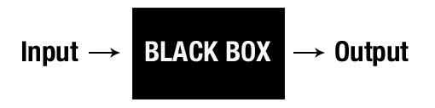

Impact on workforce development
Current employees
  Continued education:
    Learn new applications, tools and techniques.
    Avoid becoming a software operator
      Lack of understanding of appropriate application
      Inappropriate extrapolation
      Understanding sensitivity of inputs (save $$ and time)
Notes:
As soon as we graduate with our bs we seem to get this fear of backwards S’s and greek symbols but they are really cool things.

Slide 14
Impactful research
Implementable research
Addresses a need
Usable product developed
All parties see the benefit (buy-in)
Sounds easy enough…
Get all parties involved early in the process
Maintain their involvement throughout the process

Slide 15
Impactful research
Cleary define need and objectives
Develop approach
Execute research
Integrate results into practice
Interaction of all parties must be maintained throughout process

Slide 16
Impactful research
Typical Research Approach
Understand the mechanism
Identify/Generate data
Develop models
Insure validity of models
Integrate into practice

Slide 17
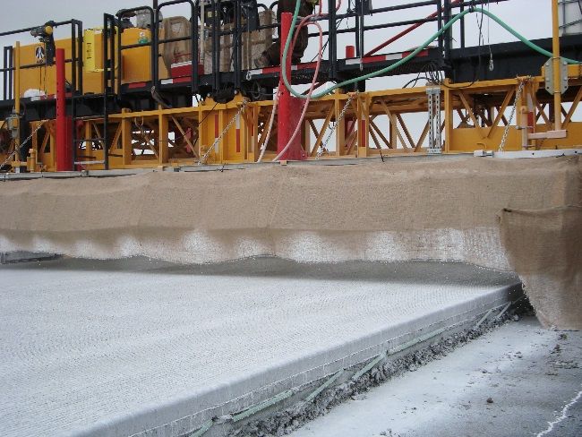
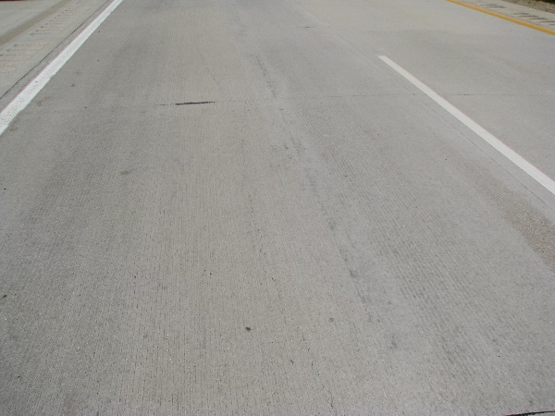
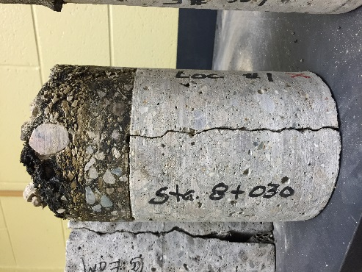
Increasing impact with team approach
Example-Unbonded overlay procedure
Understand the mechanism
(States, industry, suppliers & contractors)
Identify projects and facilitate site visits
Site visits of construction sites
Share successes & failures
Notes:
Understanding of sections in one state can help shed additional light on failures, successes in another state.

Slide 18
Increasing impact with team approach
Example-Unbonded overlay procedure
Identify/Generate data
(States, industry, suppliers & contractors)
PMS
Material test results (fabric products, construction data, etc.)
Data collection on old sections with limited data
  Sample and testing
  Distress info.
  Traffic data, etc
Fabric suppliers
  Information on project locations
  Fabric design and materials

Slide 19
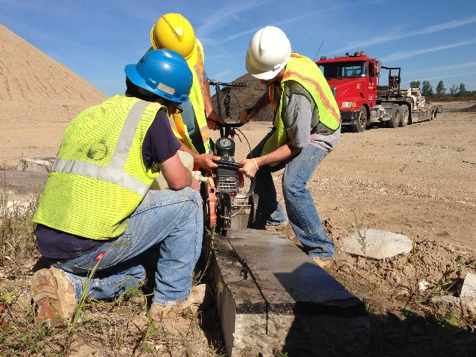
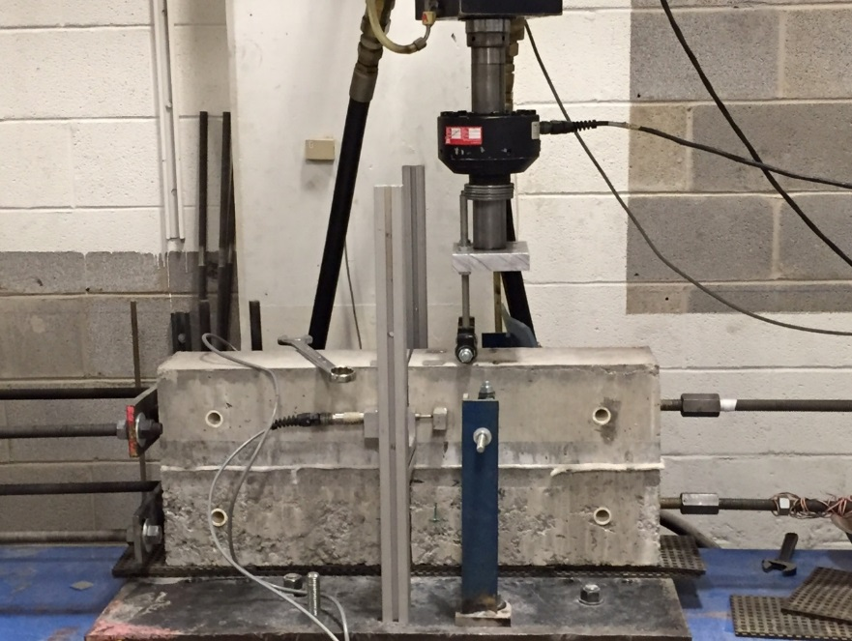
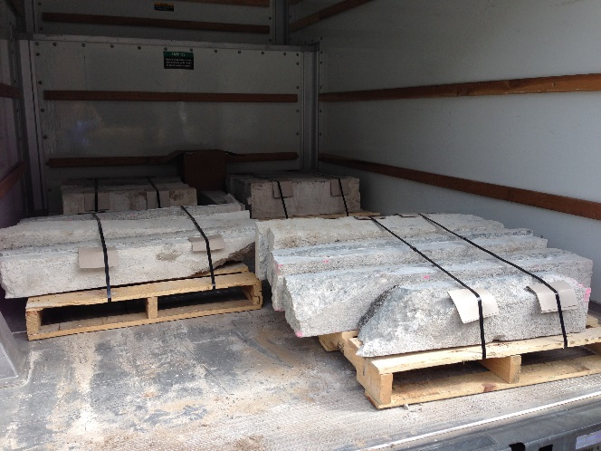
Increasing impact with team approach
Example-Unbonded overlay procedure
Identify/Generate data (cont.)
(States, industry, suppliers & contractors)
Harvest samples from the field for laboratory testing

Slide 20
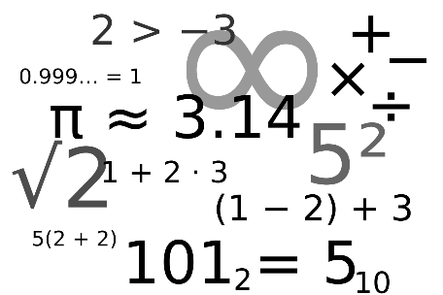
Increasing impact with team approach
Example-Unbonded overlay procedure
Develop models
Model
Data
Industry, states, suppliers & contractors
Form of function
Needed range of parameters
Intended use
Etc.

Slide 21
Increasing impact with team approach
Example-Unbonded overlay procedure
Validate models
Model
Validate
Industry, states, suppliers & contractors
Gut check
Trends match past performance observed
Etc.

Slide 22
Increasing impact with team approach
Example-Unbonded overlay procedure
Integrate into practice
(States, industry, suppliers & contractors)
Communicate:
  How to use the tool
  When is it appropriate to use
  Strengths and limitations
Industry can assist in dissemination to local city/county agencies and those of their counterparts across the country
Industry communicates findings to contractors and suppliers
Central office disseminates to districts

Slide 23
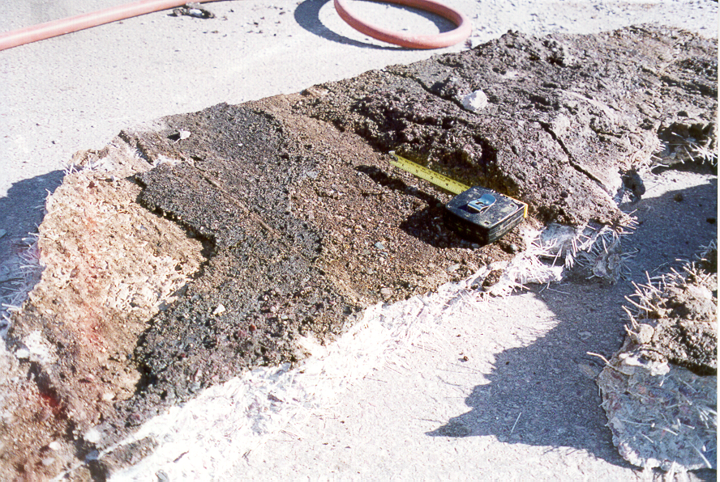
Increasing impact with team approach
Example-BCOA design procedure
Identify/Generate data (cont.)
(States, industry, suppliers & contractors)
Harvest samples from the field for laboratory testing
Debonding at interface
Delamination between lifts
U.S. 169, N. Mankato, MN,10/98
Effect of Interface debonding of performance of BCOA

Slide 24
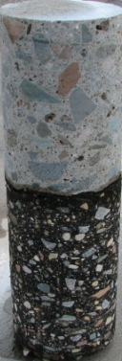
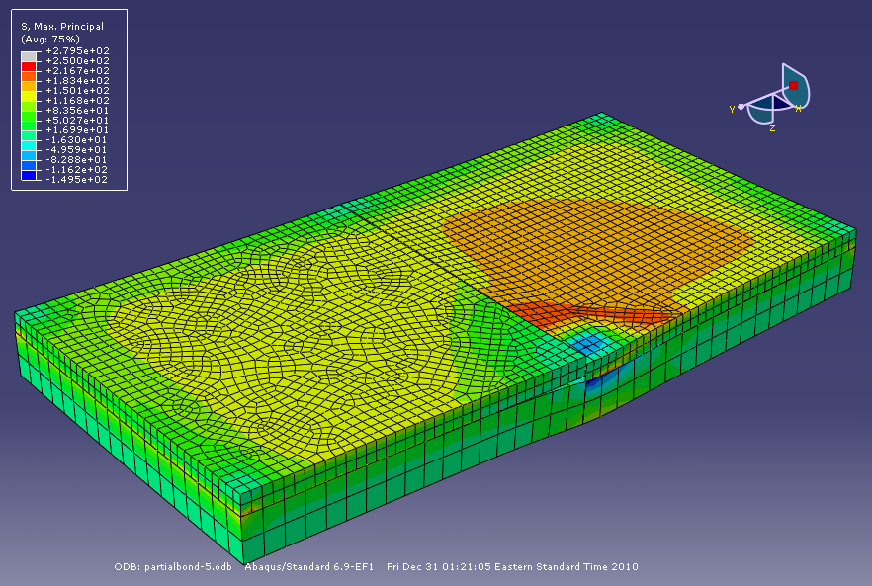
Increasing impact with team approach
Material characterization
Interface debonding model
Accelerated load testing
Finite element model

Slide 25
Increasing impact with team approach
Laboratory material testing
Interface fracture toughness
Mode I :Tensile failure
Mode II: Shear failure
Double notch test
Wedge splitting test

Slide 26
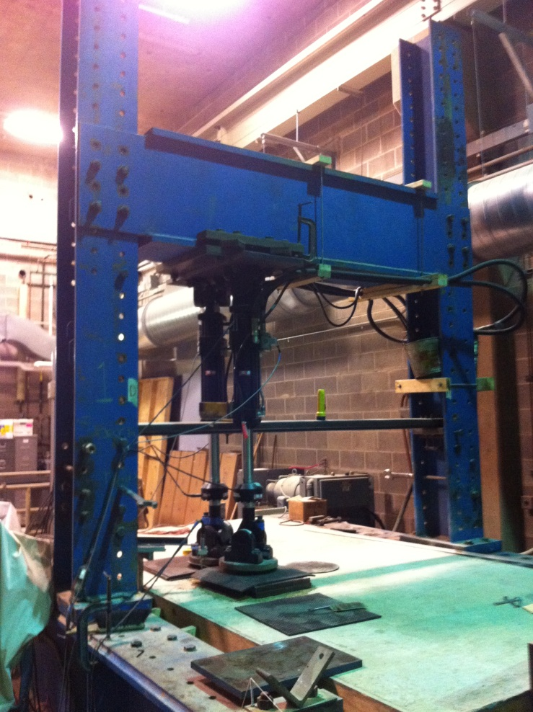
Increasing impact with team approach
Accelerated load testing
Fatigue of the interface due to:
Repetitive loading
Moisture
Temperature
Surface preparation
Debonding

Slide 27
GOAL:
Increasing impact with team approach
6 aged asphalt slabs:
2 unmilled
4 milled
Completed with the assistance :
PennDOT District 11
Swank Construction

Slide 28
Process:
Increasing impact with team approach
Project selection
Distress survey and Coring
Sawing
Milling
Slab Extraction
Debonding
Transporting and handling

Slide 29
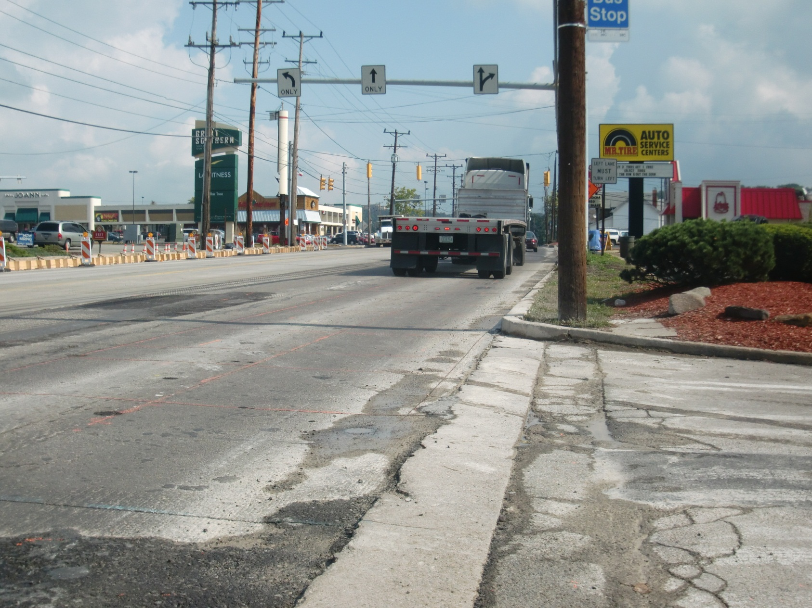
Increasing impact with team approach
Project selection
45 ft
10 ft

Slide 30
Increasing impact with team approach
Wearing course thickness? (milling depth)
Base course thickness? (post-mill slab depth)
Quality of the interface bond? (extract asphalt)
Distress survey and Coring
Total thickness? (slab bucket)
Preliminary Investigation
Core locations

Slide 31
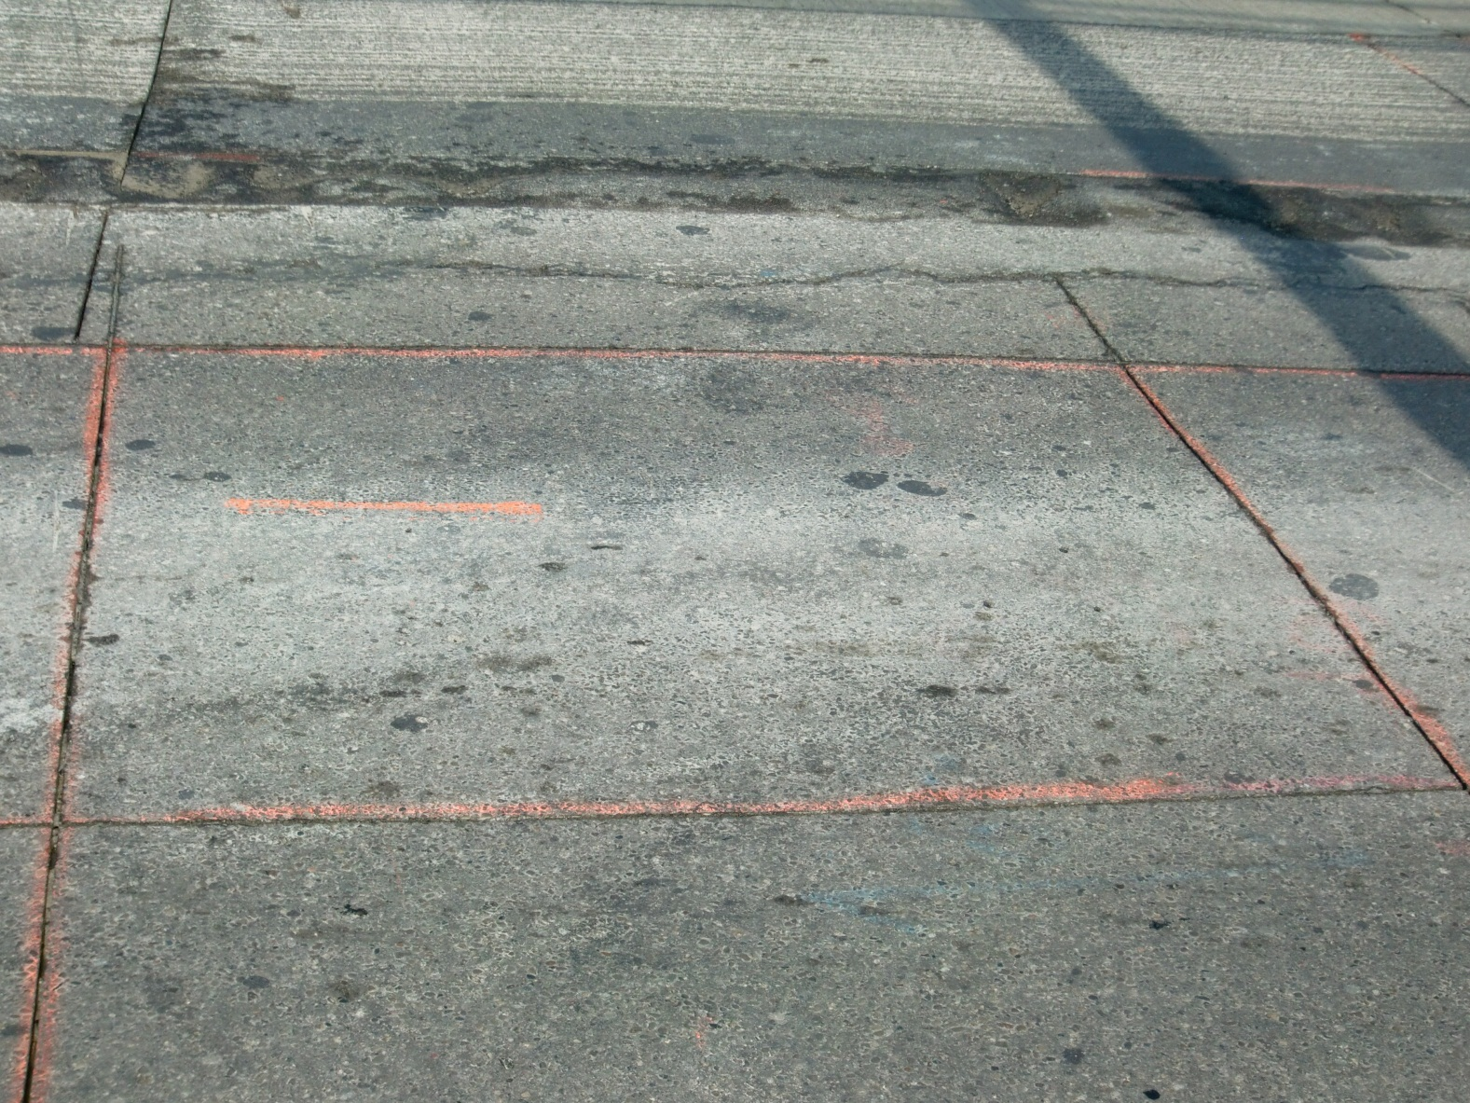
Increasing impact with team approach
Saw full depth (PCC & HMA)
Sawing
Saw Cut
4 ft 8 in
6 ft

Slide 32
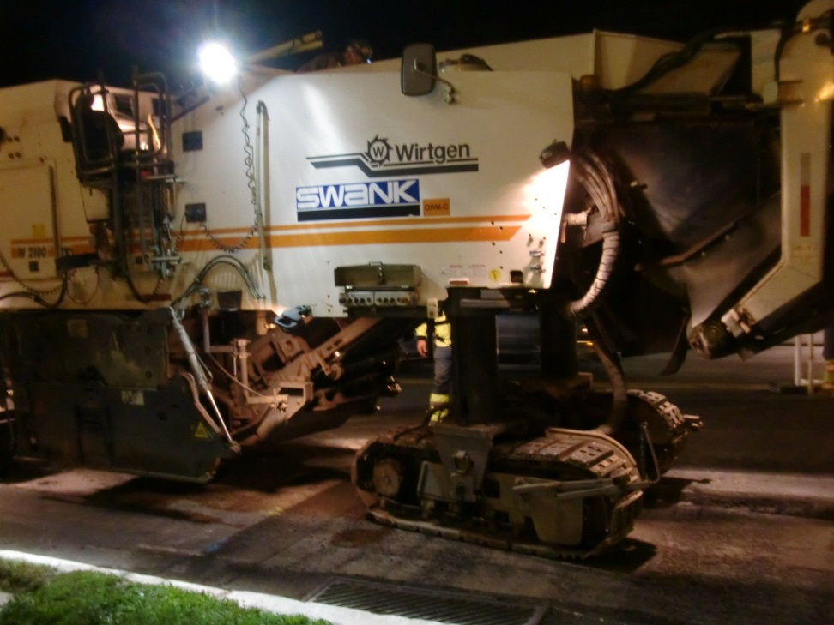
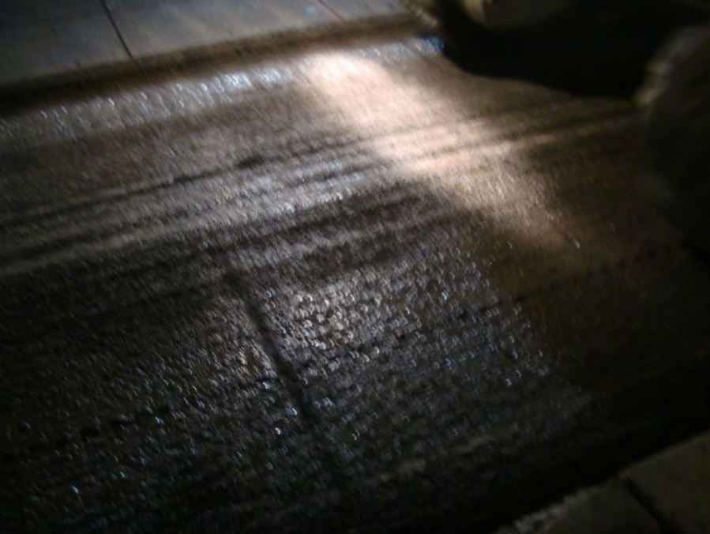
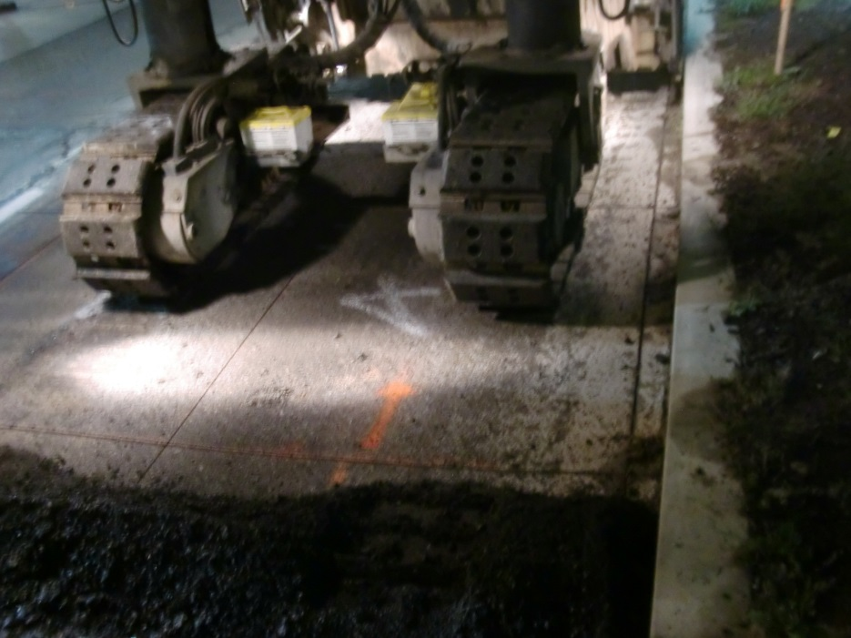
Increasing impact with team approach
Milled
Unmilled

Slide 33
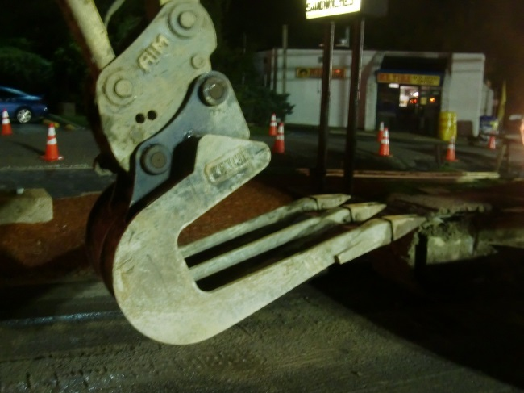
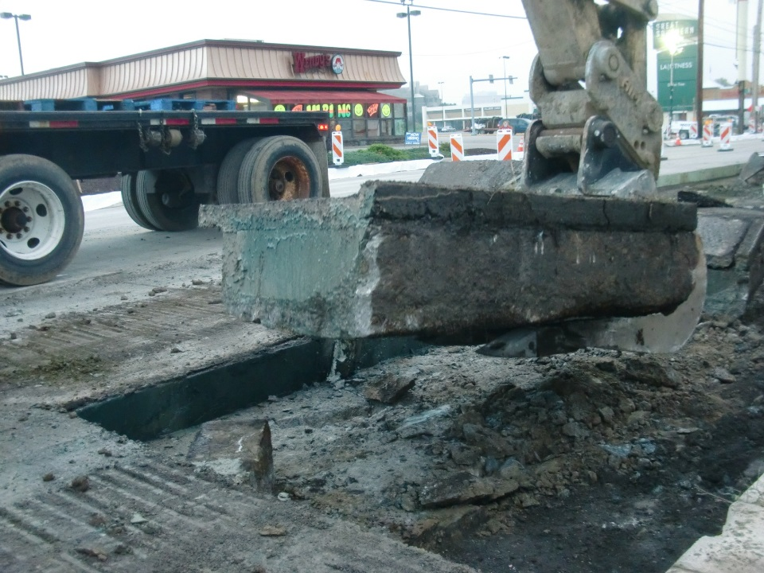
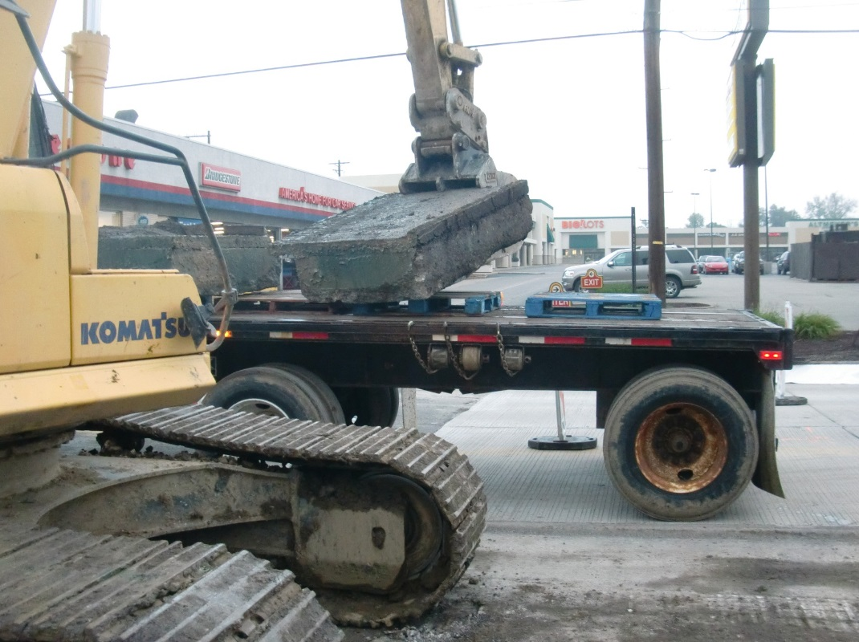
Increasing impact with team approach
Slab Extraction
2 ft
6 ft

Slide 34
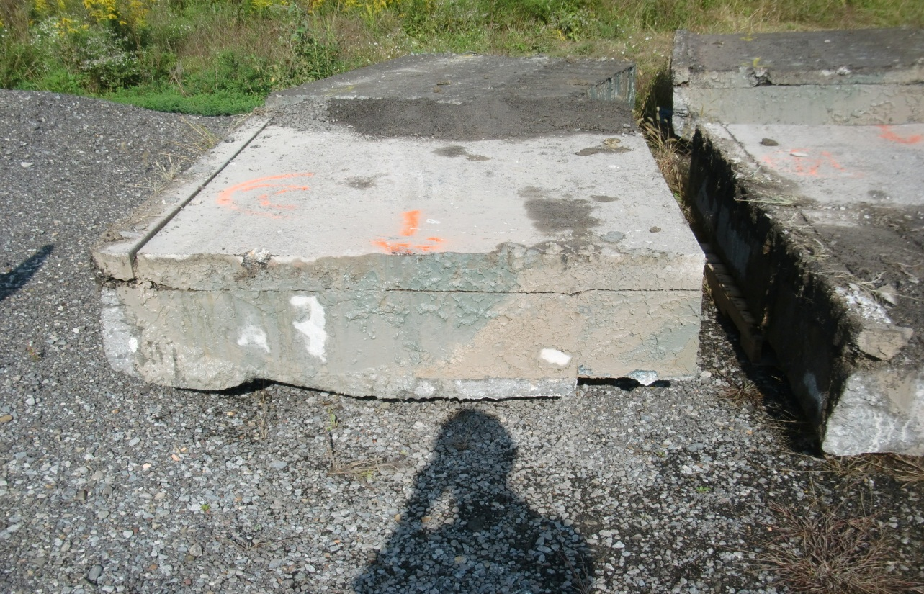
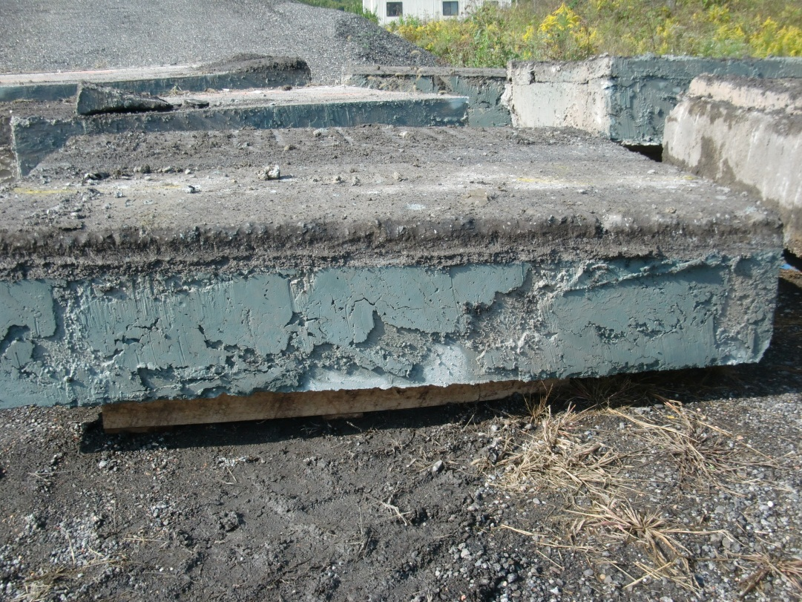
Increasing impact with team approach
Debonding
4 slabs debonded by traffic or the operation
Debonding
bonded

Slide 35
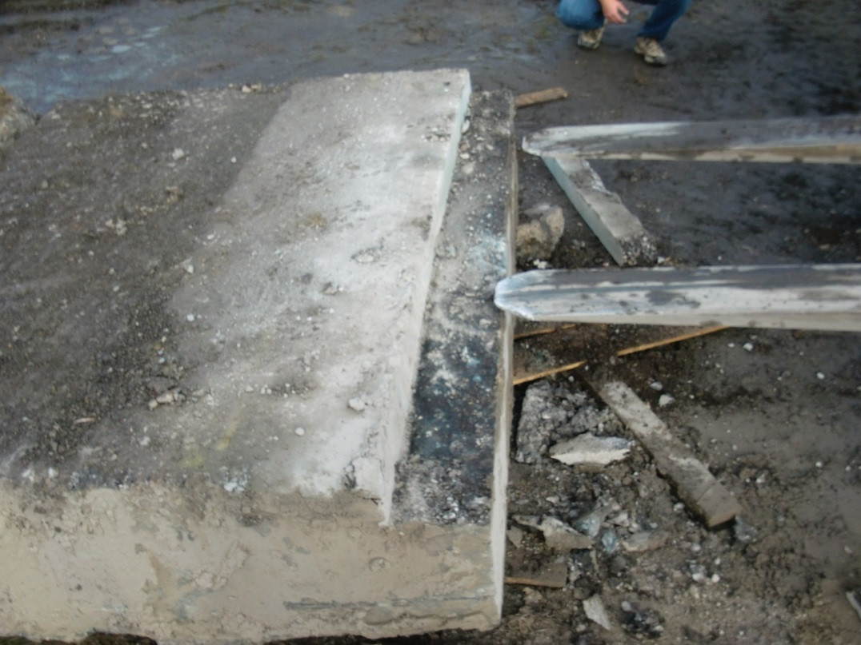
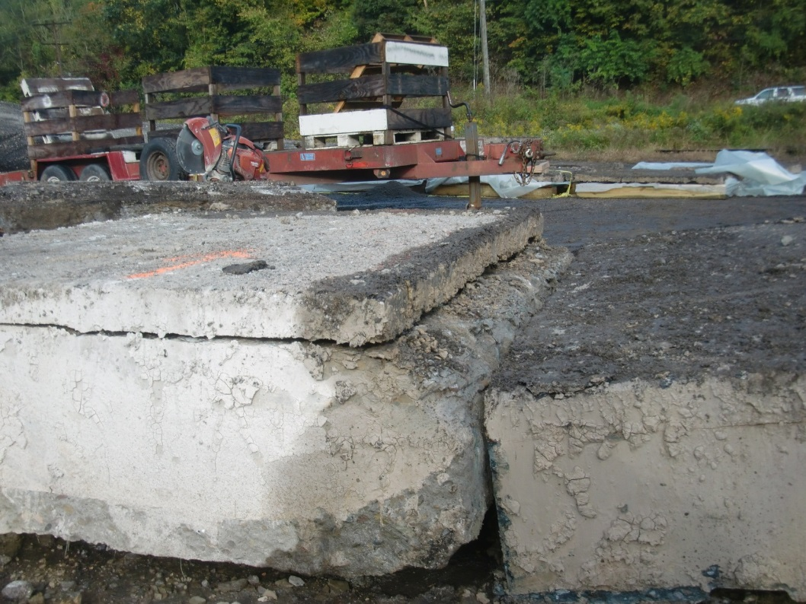
Increasing impact with team approach
Separating the asphalt

Slide 36
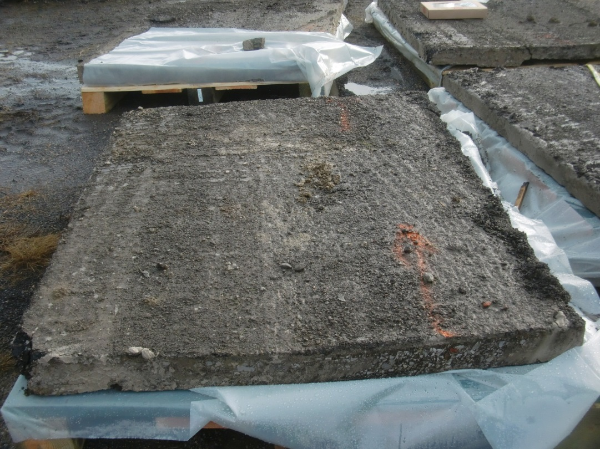
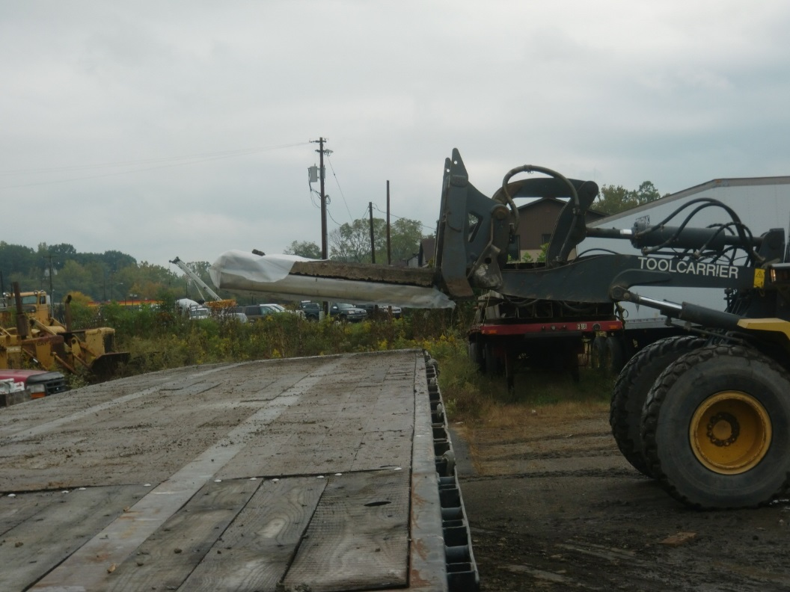
Increasing impact with team approach
Transporting and handling
9 slabs were recovered (6 intact and 3 cracked)
Nearly 1 ton each

Slide 37
Increasing impact with team approach
Example: BCOA Design Procedure
Integrate into practice
(States, industry, suppliers & contractors)
On-line procedure went live in 2013
Over 8,000 users representing 49 different countries
  (past 2 years)

Slide 38
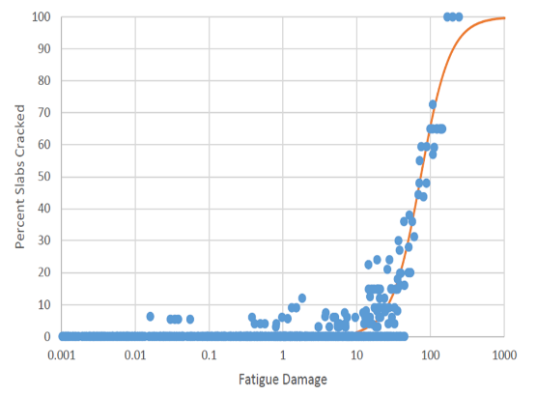
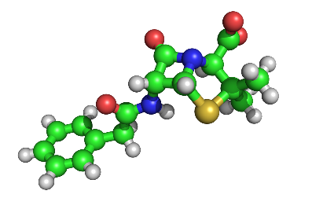
Impactful research
Applied research
Addresses an immediate need
Usable product developed
Leads to small incremental change
Fundamental research
Can be high risk -> high reward
Development of implementable product may take more time
Funding agencies must be committed long-term
Cross-pollinate with other disciplines
Notes:
Applied: Local implementation of Pavement ME
Fundamental: restructuring materials at a molecular level to optimize performance – bring good talent to the pavement area, opportunity for cross-pollinating with other disciplines

Slide 39

Impactful research
Funding projects
Small incremental steps in improvement
Lower but more immediate impact
Needed for improving everyday practice
Funding big ideas
Many projects interconnected to achieve an overarching goal
Requires greater vision and planning
Slower but potentially huge impact
Requires long-term commitment

Slide 40
Implementable Research
Roles industry can play
  Encourage DOT’s to adopt new technology
  Informational resource:
    Identify locations of relevant project sections
    Identify availability of data
    Identify people with info. on undocumented research/studies

Slide 41
Implementable Research
Roles industry can play
  Network with other state industry reps.
  Identify contractors/suppliers can could assist in the research effort
  Insure research results are implementable by contractors/suppliers
  Assist contractors/suppliers with implementation

Slide 42
Foster DOT-Academic Relationship
University benefits
  Communication with actual users
    Better understanding of the problems
    More implementable solutions
  Opportunity to conduct impactful research
DOT benefits
  Accessible expertise
  Conduit to info. from national/international activities
  Student interaction (future employees, colleagues, faculty…)

Slide 43
Impact of MnROAD
Majority of the national design procedures developed in the last 15-20 years used MnROAD data
I have used it on about 85% of my pavement-related research projects
Primary reasons
  Quality and reliability of the data collected
  Frequency of the data collected
  Diversity of the data collected (FWD, IRI, instrumentation, material testing, etc.)
  Experimental design (effects of influencing factors can be isolated)
  Data is easily accessibly and provided in an organized, user friendly format
Notes:
All national design procedure on the side of rigid pavements

Slide 44
Impact of MnROAD
My students who used MnROAD data in their research
Katherine Chymay
Thomas Adams
Nathan Bech
John DeSantis
Kevin Alland
Steven Sachs
Zichang Li
Alexander Vuotto
Manik Barman
Feng Mu
Somayeh Nassiri
Rania Asbahan
Juan Guiterrez
Jamie Cooper
Alexander Melo de Sousa
Aldo Ferreira Montenegro
Erica Reiser
Vernica Boyce
Scott Sachs
Joseph Santonie
Gregory Kuzy
John Butt
Jessica Carr
James Kearny
Gary Gehringer
Nicole Dufalla
Patrick Daley
Jay Masi
Evan Luab
Kyle Kaminski
Stephanie Zolnak
Evan Laub
Kellie Fischer
Sarah Hansel
Brian Phillups
William Eschenfelder
Melissa Fonatanese
Nicholas Burdette
Mathew Geary
Notes:
Chose UMn over U of IL and U of Washington to have the opportunity to work with MnROAD

Slide 45
Impact of MnROAD
Use of MnROAD data in the classroom
Investigate…..
  Factors that affect response/performance
  Variability in materials and construction
Better understand the need for test roads
Shows pavements are not boring/low tech (compete for good students)
Notes:
Chose UMn over U of IL and U of Washington to have the opportunity to work with MnROAD

Slide 46
Future Impact of MnROAD
Continue to keep the quality of the data high
Continue to collect data in frequent and systematic manner
Avoid sections that are too short to provide meaningful conclusions

Slide 47



Future Impact of MnROAD
Avoid the “throw it in and try it”
  Difficult to determine why it was/was not successful
  Under what other conditions would it/would it not work
Aquarium Fish
PERFECT
Dinner
NOT SO GOOD

Slide 48
Future impact of MnROAD
Experimental design:
  Limits variables that can be studied
  Results will be more conclusive and not just result in more questions
Adequate inference space
      Few data points
      “Holes” (under-representation)
      Bias (over-representation)
>Possibly supplement MnROAD sections with off-site sections (MN or in NRRA states)

Slide 49
Future impact of MnROAD
Collect as much data as feasible
    Initial investment in construction is large –avoid being penny wise and dollar foolish
    Information can be used to satisfy future needs

Slide 50

Future impact of MnROAD
Collect as much data as feasible (cont.)
    Research starts with a guess as to the solution. Sufficient info. needs to be available if initial approach is not correct
Idealized research path
Research
Problem
End Product
Actual research path
Research Problem
End Product

Slide 51
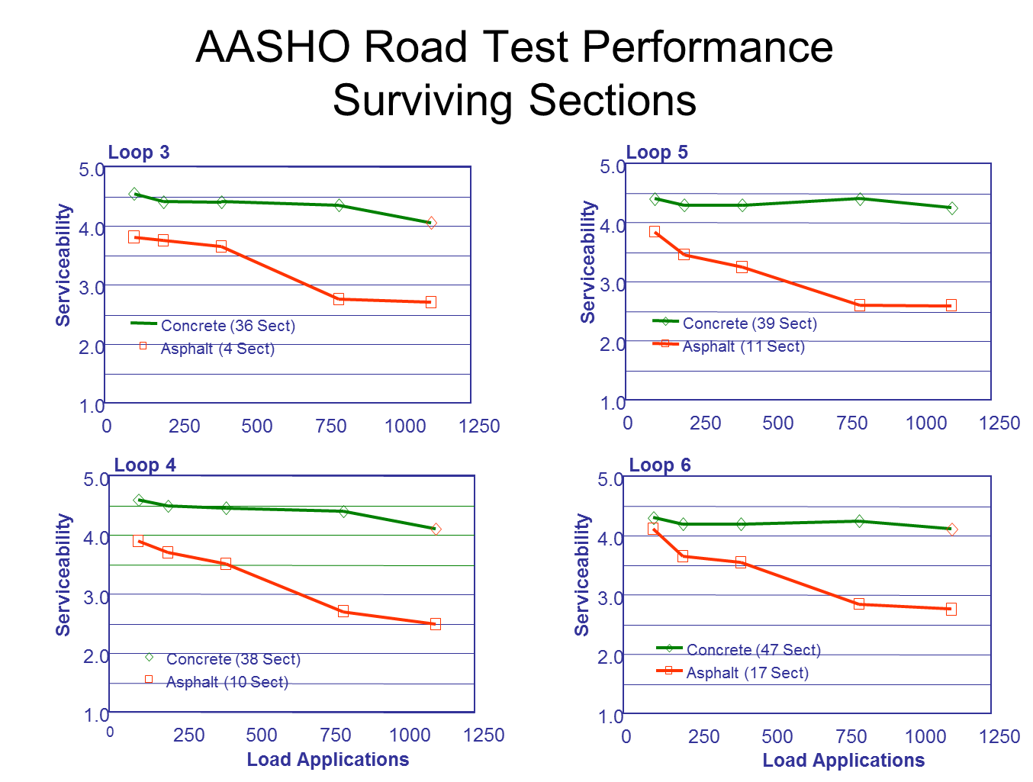
Future impact of MnROAD
Dont reconstruct too early

Slide 52

Future impact of MnROAD
Dont reconstruct too early

Slide 53
Future Impact of MnROAD
Get researchers involved early on (don’t initiate research projects AFTER the sections have been constructed)
  Confirm approach is feasible and/or appropriate
  Insure data needed will be collected
  Assist with experimental design

Slide 54
Future impact of MnROAD
Host faculty on sabbatical
  Gain familiarity with MnROAD (data availability, layout, people, instrumentation, etc.)
  Strengthen DOT-academia relationship (possible co-sponsorship)
  Information exchange
Hire post-docs (6 mth to 1-2 yrs)
  Establish relationships with next generation of faculty
  Provide a background on design/construction/rehab to insure future research is relevant/implementable

Slide 55
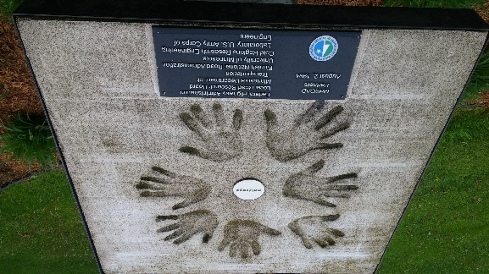
How can we make a greater impact?
Contractors & Suppliers
DOT
Industry
Academia
Notes:
Steve Crouch with Umn
Dan Frentress with Min Pave Assoc

Slide 56
How can we make a greater impact?
Everybody has an important role to contribute
Working together you can be a part of something bigger than yourself
Key
Recognizing how each can contribute
Good communication
Willingness to put in the energy and time
Patience
Notes:
Everybody had an important role in contributing to something bigger

Slide 57
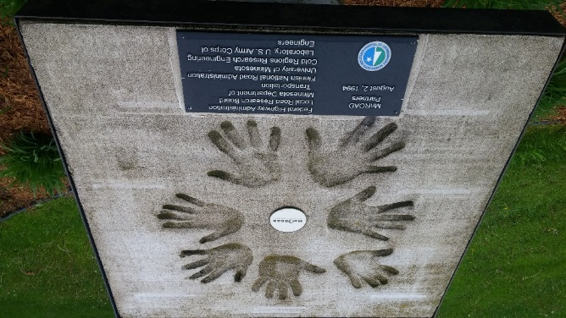
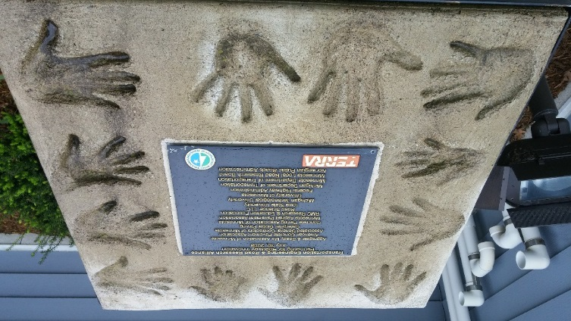
Thank You
Any Questions?

