Slide 1
Research, Engineering, and Education
Mike Anderson, Asphalt Institute
National Road Research Alliance Workshop
University of Minnesota, St Paul Campus
May 24, 2018

Slide 2

Research, Engineering, Education

Slide 3
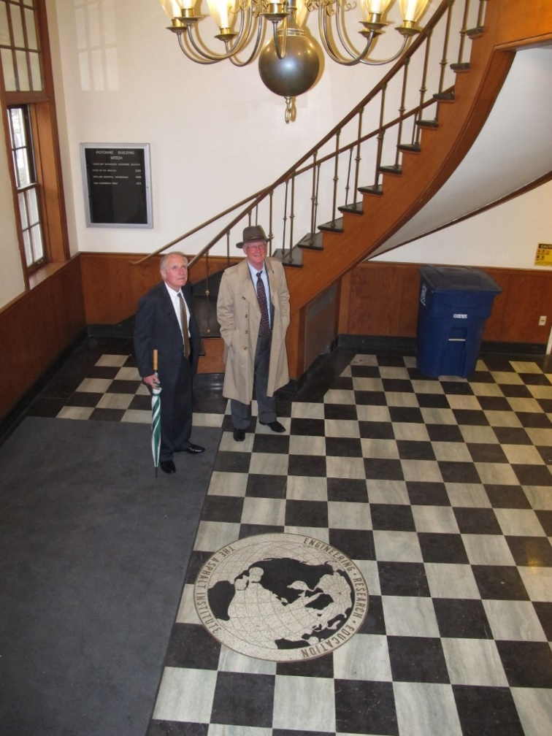

Asphalt Institute: College Park, MD (1955 – 1989)
University of Maryland, College Park
1955 - 1989
Notes:
Prof Chuck Schwartz; Professor and Chair
Department of Civil and Environmental Engineering
UMD
On recommendation of Prof Matt Witczak, worked at AI HQ here before joining UMD; now retired from Ariz. State Univ. Long time mentor of Chuck’s.

Slide 4

Asphalt Institute: Lexington, KY (1989 - )

Slide 5
Research
Strategic Highway Research Program (SHRP)
1988-1993

Slide 6
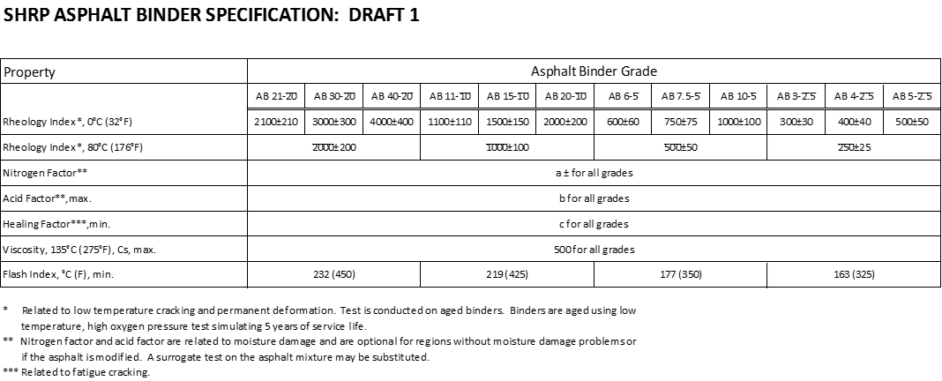
PG Asphalt Binder Specification: First Draft

Slide 7
Performance Grades

Slide 8
AASHTO T301 - Elastic Recovery
Same equipment as ductility test
  Only exception is use of modified molds
Used as a SHRP Plus test by some agencies
  Primary use is to verify presence of elastomeric modifier
  Elastomeric or rubber-like modifiers will cause the binder to recover when stretched and broken

Slide 9
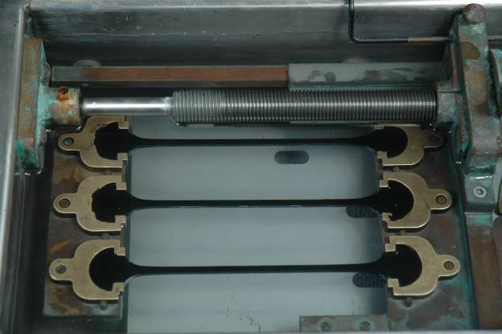
Specimens being pulled

Slide 10
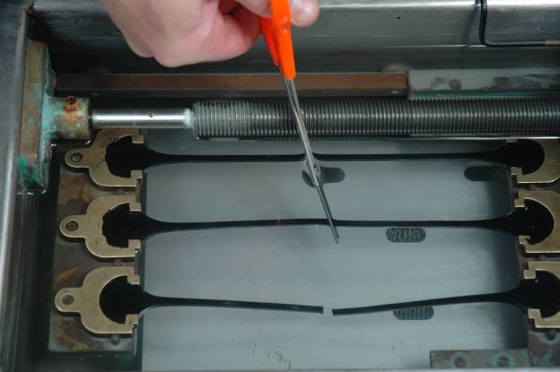
Specimens being cut with scissors

Slide 11
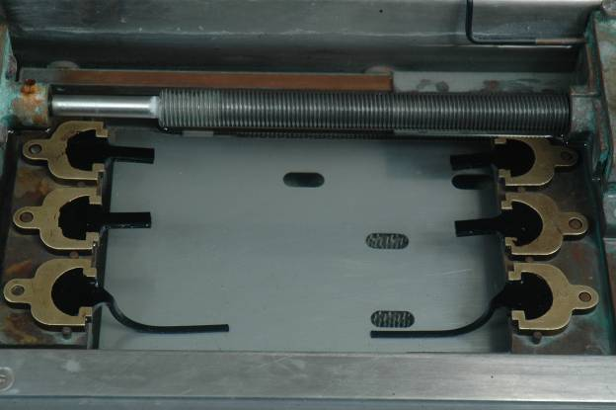
Specimens at end of recovery period
unmodified

Slide 12
Multiple Stress Creep Recovery Test
AASHTO T350, ASTM D7405
Performed on RTFO-aged Binder
Test Temperature
  Environmental Temperature
  Not Grade-Bumped
10 cycles per stress level
  1-second loading at specified shear stress
    0.1 kPa
    3.2 kPa
  9-second rest period

Slide 13
Multiple Stress Creep Recovery Test
Calculate Recovery for each Cycle, Stress
  Difference between strain at end of recovery period and peak strain after creep loading
Calculate Non-recoverable Creep Compliance (J_{nr})
  Non-recoverable shear strain divided by applied shear stress
    “J” = “compliance”
    “nr” = “non-recoverable”

Slide 14
MSCR Strain Response

Slide 15
MSCR Strain Response

Slide 16
Validate Polymer Modification
Recovery = 29.37*J_{nr}^{-0.26}

Slide 17
Binder Grade Selection
Selecting the Appropriate Binder Grade for the Project
  Air Temperatures
    Converted to pavement temperatures
  Reliability
  Effect of Loading

Slide 18
Binder Grade Selection
Developed from Air Temperatures
Superpave Weather Database
  6500 stations in U.S. and Canada
Annual air temperatures
  hottest seven-day temp (avg and std dev)
  coldest temp (avg and std dev)
Calculated pavement temps used in PG selection
> 20 years
SHRP
A-648A

Slide 19
Reliability
Percent Probability of Not Exceeding Design Temp
> using Normal Distribution
frequency of
observed temps
(Total area under
curve = 100 %)
Reliability is area under curve
to the left of T_{des}
T_{avg}
T_{des}

Slide 20
Observed Air Temperatures
Cleveland, OH
50 % reliability
average summer
very hot summer
98 % reliability
> this data - standard
deviation of 2°C
32
36
7-Day Maximum Air Temperatures

Slide 21
Convert to Pavement Temperature
Calculated by LTPPBind software
High Temperature
  20 mm below surface of mixture
    Region of greatest combination of shear stress and temperature
Low Temperature
  at surface of mixture
Pavement Temp = f(Air Temp, Depth, Latitude)

Slide 22
PG Binder Grades
Cleveland, OH
PG 58-28 (98% minimum reliability)
PG 52-16 (50 % minimum reliability)
-40
-30
-20
-10
0
10
20
30
40
50
60
70
PG grades - six degree increments

Slide 23
Effect of Loading Rate on Binder Selection
Dilemma
  specified DSR loading rate is 10 rad/sec
  what about longer loading times ?
Use binder with more stiffness at higher temps
  Slow
    increase one high temp grade
  Stationary
    increase two high temp grades
  no effect on low temp grade
90 kph

Slide 24
Effect of Traffic Amount on Binder Selection
10 - 30 Million ESAL
  one high temp grade
More than 30 Million ESAL
  two high temp grades
> Equivalent Single Axle Loads

Slide 25
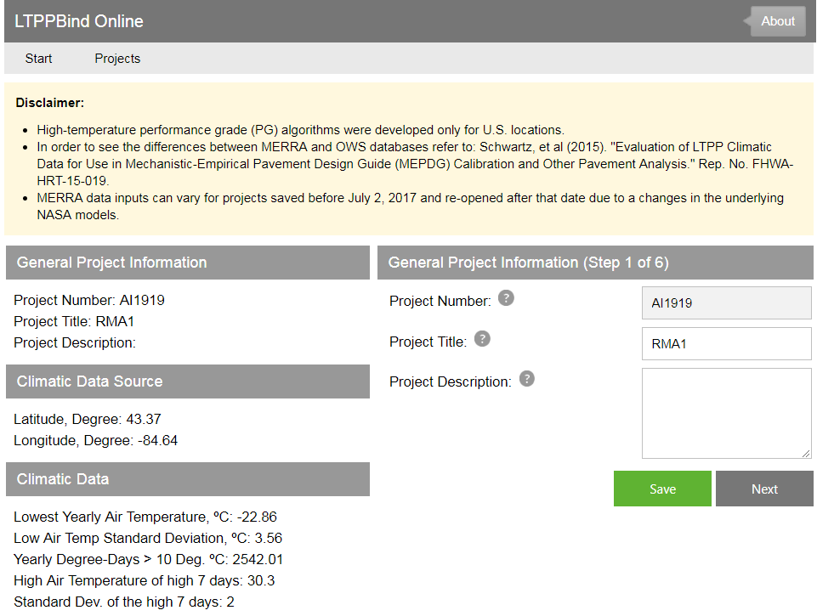
LTPPBind Online

Slide 26

National Snapshot of State Binder Specifications

Slide 27
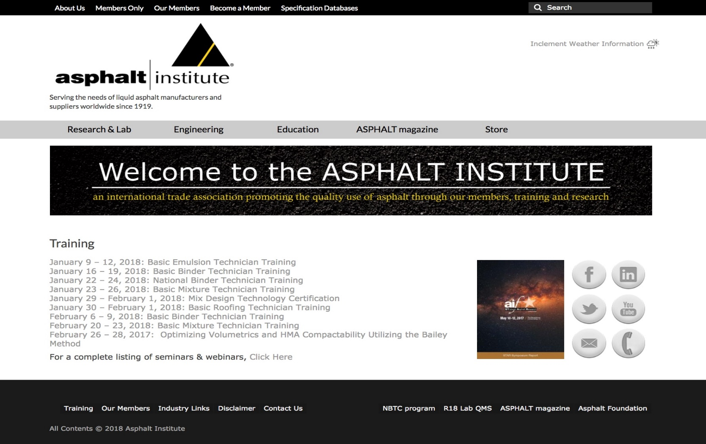
AI Spec Databases

Slide 28
Grade/Specs in Table Format
M 320 Grade Names
M 332 Spec

Slide 29
Plus Any Associated Notes

Slide 30
23 “MSCR” States; 21 Use M332 Nomenclature, 2 Stayed with M320 Nomenclature
WASHINGTON
NEW HAMPSHIRE
MONTANA
NORTH DAKOTA
VERMONT
MAINE
MASSACHUSETTS
OREGON
MINNESOTA
IDAHO
SOUTH DAKOTA
WISCONSIN
NEW YORK
WYOMING
MICHIGAN
RHODE ISLAND
NEBRASKA
IOWA
PENNSYLVANIA
CONNECTICUT
NEVADA
OHIO
NEW JERSEY
UTAH
ILLINOIS
INDIANA
WEST
VIRGINIA
DELAWARE
CALIFORNIA
COLORADO
KANSAS
VIRGINIA
MARYLAND
MISSOURI
KENTUCKY
WASHINGTON D.C.
NORTH
CAROLINA
ARIZONA
NEW MEXICO
OKLAHOMA
ARKANSAS
TENNESSEE
SOUTH
CAROLINA
ALABAMA
GEORGIA
Use M332 Nomenclature
TEXAS
MISSISSIPPI
Stayed With M320 Nomenclature. Reasons cited were over potential confusion, changing plans/specs, etc.
LOUISIANA
ALASKA
FLORIDA
MOLOKAI
KAUAI
OAHU
HAWAII

Slide 31
25 States Using MSCR % Recovery to Ensure Minimum Elastic Behavior
WASHINGTON
NEW HAMPSHIRE
MONTANA
NORTH DAKOTA
VERMONT
MAINE
MASSACHUSETTS
OREGON
MINNESOTA
IDAHO
SOUTH DAKOTA
WISCONSIN
NEW YORK
WYOMING
MICHIGAN
RHODE ISLAND
NEBRASKA
IOWA
PENNSYLVANIA
CONNECTICUT
NEVADA
OHIO
NEW JERSEY
UTAH
ILLINOIS
INDIANA
WEST
VIRGINIA
DELAWARE
CALIFORNIA
COLORADO
KANSAS
VIRGINIA
MARYLAND
MISSOURI
KENTUCKY
WASHINGTON D.C.
NORTH
CAROLINA
ARIZONA
NEW MEXICO
OKLAHOMA
ARKANSAS
TENNESSEE
SOUTH
CAROLINA
ALABAMA
GEORGIA
Full Implementation
Full Implementation – Modified Only
TEXAS
MISSISSIPPI
LOUISIANA
Planned Full Implementation in Next 12 mos.
ALASKA
FLORIDA
Implementation by substitution (M332 or M320)
MOLOKAI
KAUAI
OAHU
Partial Implementation - % Rec Only as PG+ test
HAWAII

Slide 32
Binder Exclusions
(PPA, REOB, Air Blown Asphalt, Other)
Others
- Motor Oil (5 states).
Any modifier other than SBR or SBS unless preapproved.
Fuel oils, other solvents.
Extenders, fillers, adhesion promoters, reinforcing agents.
Railcar for PG 64-28NV and 76-22NV
WASHINGTON
NEW HAMPSHIRE
MONTANA
NORTH DAKOTA
VERMONT
MAINE
MASSACHUSETTS
OREGON
MINNESOTA
IDAHO
SOUTH DAKOTA
WISCONSIN
NEW YORK
WYOMING
MICHIGAN
RHODE ISLAND
NEBRASKA
IOWA
PENNSYLVANIA
CONNECTICUT
NEVADA
OHIO
NEW JERSEY
UTAH
ILLINOIS
INDIANA
WEST
VIRGINIA
DELAWARE
CALIFORNIA
COLORADO
KANSAS
VIRGINIA
MARYLAND
MISSOURI
KENTUCKY
WASHINGTON D.C.
NORTH
CAROLINA
ARIZONA
NEW MEXICO
OKLAHOMA
ARKANSAS
TENNESSEE
SOUTH
CAROLINA
ALABAMA
GEORGIA
TEXAS
MISSISSIPPI
LOUISIANA
Exclusion
ALASKA
FLORIDA
None
MOLOKAI
KAUAI
OAHU
HAWAII

Slide 33
REOB/VTAE
WASHINGTON
NEW HAMPSHIRE
MONTANA
NORTH DAKOTA
VERMONT
MAINE
MASSACHUSETTS
OREGON
MINNESOTA
IDAHO
SOUTH DAKOTA
WISCONSIN
NEW YORK
WYOMING
MICHIGAN
RHODE ISLAND
NEBRASKA
IOWA
PENNSYLVANIA
CONNECTICUT
NEVADA
OHIO
NEW JERSEY
UTAH
ILLINOIS
INDIANA
WEST
VIRGINIA
DELAWARE
CALIFORNIA
COLORADO
KANSAS
VIRGINIA
MARYLAND
MISSOURI
KENTUCKY
WASHINGTON D.C.
NORTH
CAROLINA
ARIZONA
NEW MEXICO
OKLAHOMA
ARKANSAS
TENNESSEE
SOUTH
CAROLINA
ALABAMA
GEORGIA
TEXAS
MISSISSIPPI
Ban
LOUISIANA
Limit on use
ALASKA
FLORIDA
None
MOLOKAI
KAUAI
OAHU
HAWAII

Slide 34
Use of Performance Tests in Mix Design

Slide 35
Laboratory Performance Testing of Asphalt Mixtures
Introduction
  Why use performance testing?
    to estimate the performance of asphalt mixtures prior to use on a road
    to estimate the performance of asphalt mixtures as produced and placed
    to provide forensic analysis of a distressed asphalt mixture
    to evaluate new materials and design tools to improve the performance of asphalt pavements

Slide 36
Laboratory Performance Testing of Asphalt Mixtures
Why use performance testing?
  Mix design concept
    Proper mix design should provide a reasonable level of assurance that the mixture will perform.
      Based on correlations with performance; not a direct measure
      Can’t account effectively for new materials

Slide 37
Pavement Distress
Principal asphalt pavement distresses
  Permanent deformation (rutting)
  Cracking
    Load-associated (fatigue)
      Classical bottom-up
      Top-down
    Non load-associated (environmental)
      Thermal single-event
      Thermal fatigue
  Durability
  Moisture Sensitivity

Slide 38
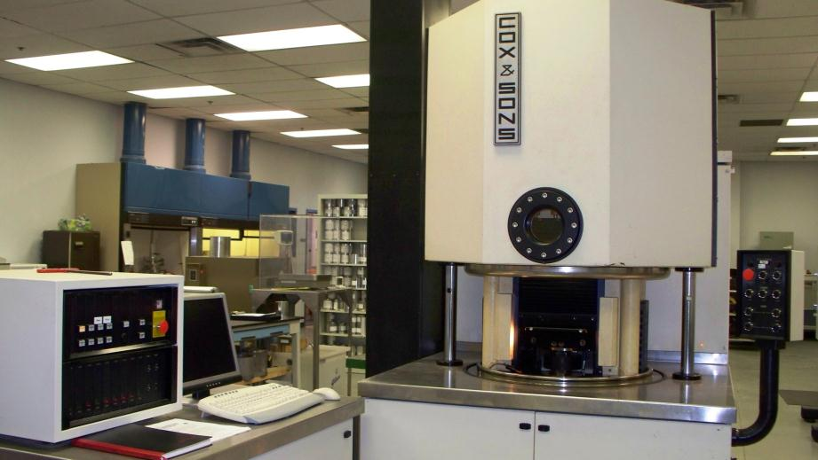
Superpave Shear Tester (Cox & Sons)

Slide 39
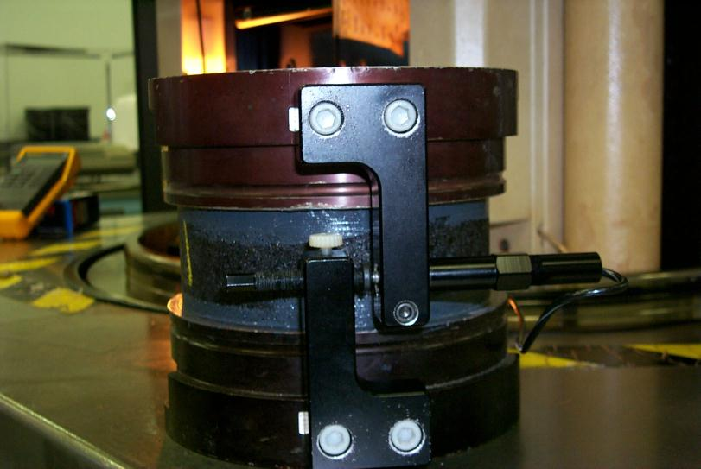
SST Test Specimen (Shear LVDT)

Slide 40
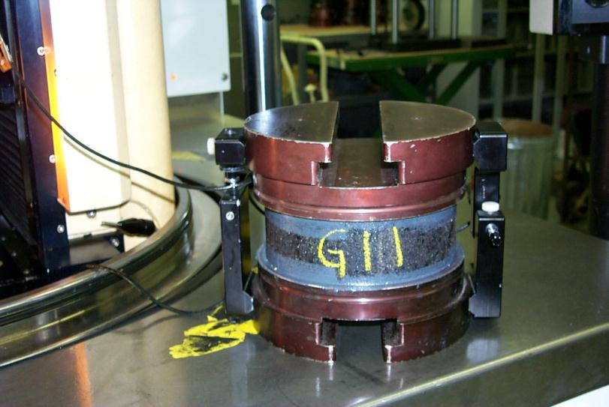
SST Test Specimen (Front View)

Slide 41
Superpave Mix Design
When SHRP ended in March 1993, the following guidelines were suggested as the break points for whether additional analysis should be considered:
Mix Design (Lower traffic) ≤ 1E06 ESALs
Mix Design + Intermediate Mix Analysis (Intermediate traffic) ≤ 1E07 ESALs
Mix Design + Complete Mix Analysis (High traffic) > 1E07 ESALs
Initial starting points for potential Superpave mix designers.
Many agencies have designed and built pavements at higher traffic levels based on Superpave mix design alone.
The setting of these traffic levels and the utilization of Superpave mix analysis is a policy decision of each agency.

Slide 42
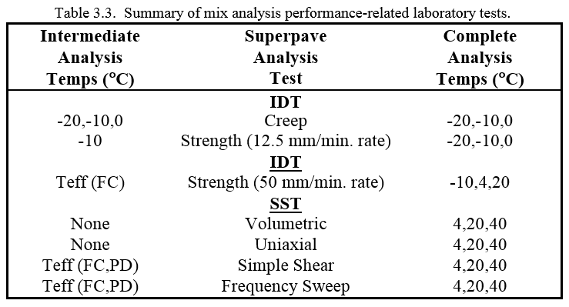
Superpave Mix Design and Analysis

Slide 43
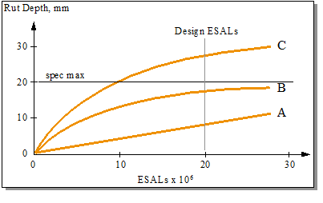
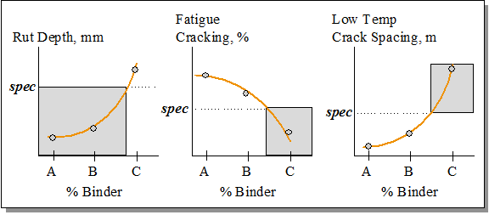
Superpave Mix Analysis

Slide 44
Use in Mix Design
Recommended Tests and Conditions
  NCHRP Report 673
    It should not be necessary for conventional asphalt mixtures, including those made with most modified asphalt binders, to conduct performance tests to address all forms of distress – permanent deformation (rutting), fatigue (load-associated) cracking, and thermal (non load-associated) cracking.

Slide 45
Use in Mix Design
Recommended Tests and Conditions
  NCHRP Report 673
    Of the three main distresses, permanent deformation is the most affected by compositional factors such as aggregate angularity, asphalt binder grade (stiffness), and asphalt binder content. These factors could work in combination, in a manner difficult to estimate, to result in poorer-than-anticipated performance. For this reason, one or more tests to assess the laboratory permanent deformation performance of an asphalt mixture should be considered.

Slide 46
Use in Mix Design
Recommended Tests and Conditions
  NCHRP Report 673
    Laboratory testing to assess the permanent deformation performance of an asphalt mixture should be conducted when the expected in-service traffic over the life of the asphalt mixture is at least 3,000,000 ESALs.

Slide 47
Use in Mix Design
Recommended Tests and Conditions
  NCHRP Report 673
    Substantial research has shown that the laboratory fatigue cracking performance of asphalt mixtures is most strongly affected by the volume of effective asphalt binder in the mixture.
      Controlling the percentage of voids in the mineral aggregate (VMA) and percentage of air voids in the mix, controls the volume of effective asphalt binder.
      Thus, as long as the recommended volumetric mix design criteria are met for VMA and Air Voids, the expectation for conventional asphalt mixtures will be that they will have adequate laboratory fatigue cracking performance.

Slide 48
Use in Mix Design
Recommended Tests and Conditions
  NCHRP Report 673
    Research also has shown that thermal cracking performance of asphalt mixtures is most strongly affected by the asphalt binder properties.
      As long as the asphalt binder that is used in the mixture has the appropriate low temperature properties for the expected use, the expectation for conventional asphalt mixtures will be that they will have adequate laboratory thermal cracking performance.

Slide 49
Superpave Mix Analysis
SST
  Volumetric or hydrostatic strain test
  Uniaxial strain test
  Simple shear test at constant height
  Frequency sweep test at constant height
  Repeated shear test at constant stress ratio
IDT
  Intermediate temperature indirect tensile strength test
  Low temperature indirect tensile creep test
  Low temperature indirect tensile strength test
The test measurements are entered into the Superpave software which then performs all of the necessary calculations to predict pavement performance.
In addition, the engineer is asked to supply a few other input values to describe the circumstances of the particular pavement where the mix is being placed.

Slide 50
What is Balanced Mix Design?
      Definition
        “Asphalt mix design using performance tests on appropriately conditioned specimens that address multiple modes of distress taking into consideration mix aging, traffic, climate and location within the pavement structure.”
      Condensed Definition
        “Use the right mix for the job!”

Slide 51
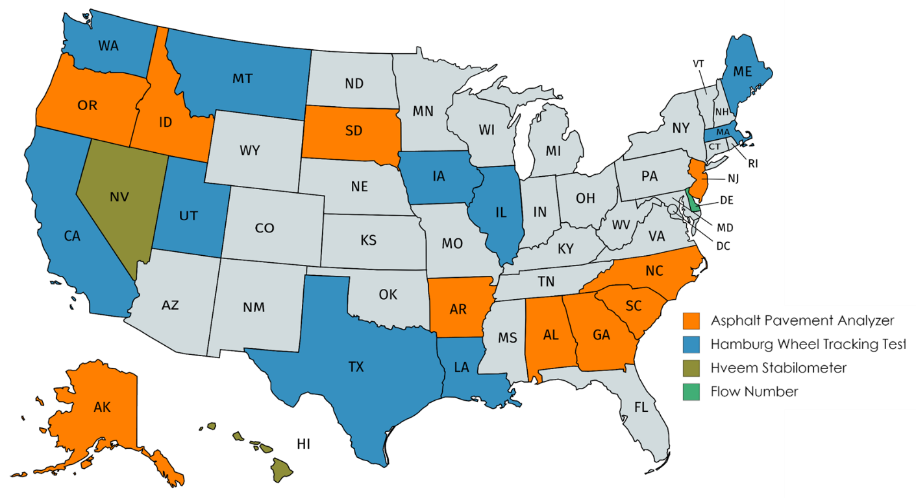
Current Use of Rutting Tests
Slide courtesy of Randy West, NCAT

Slide 52
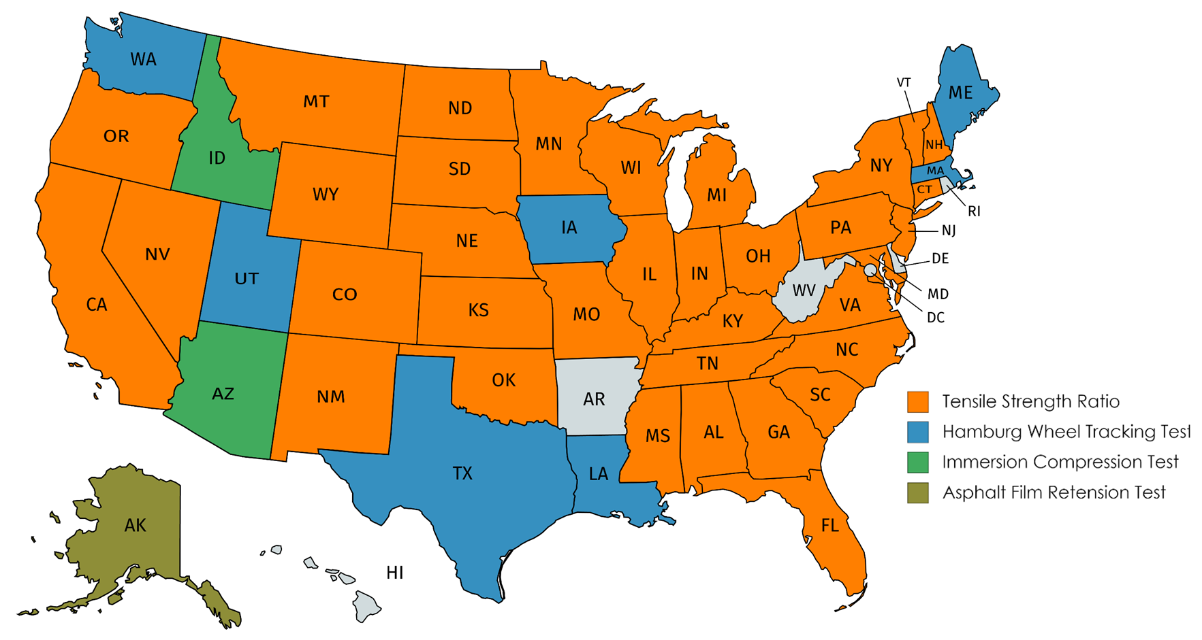
Current Use of Moisture Damage Tests
Slide courtesy of Randy West, NCAT

Slide 53
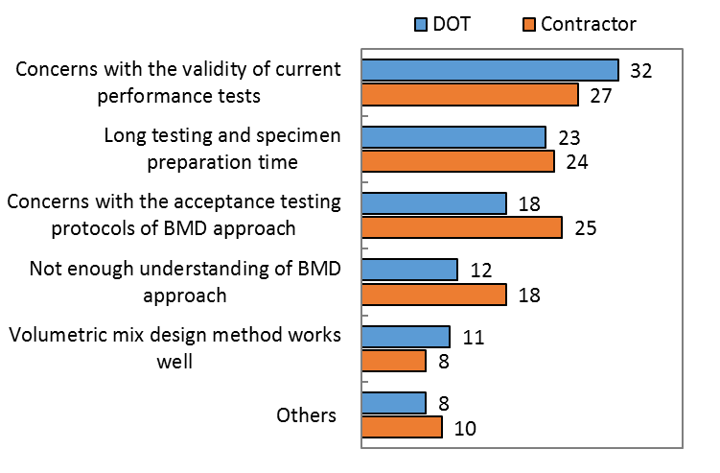
NCHRP 20-07/Task 406
What are your concerns regarding the implementation of BMD?
DOT
Contractor
Slide courtesy of Randy West, NCAT

Slide 54
Engineering
Enhanced Density

Slide 55
Enhanced Durability of Asphalt Pavements through Increased In-Place Pavement Density
AK
WA
VT
MT
ME
ND
OR
MN
NH
ID
SD
WI
NY
MA
MI
RI
WY
NE
IA
PA
CT
NJ
DE
MD
DC
NV
IL
IN
OH
UT
CO
WV
CA
KS
VA
MO
KY
HI
TN
NC
AZ
OK
SC
NM
AR
MS
AL
GA
TX
LA
Key:
FL
Workshop Only (15)
Demonstration projects (10)
PR
Notes:
10 states selected for field demonstration projects and workshops.
15 states selected for workshops only.

Slide 56
Evolution of Traffic
Stress
Interstate highways - 1956
AASHO Road Test - 1958-62
  still widely used for pavement design
  legal truck load - 73,280 lbs.
Legal load limit to 80,000 lbs. - 1982
  10% load increase
  40-50% greater stress to pavement
Radial tires, higher contact pressure
FAST Act raising load limit to 120,000 lbs. (in select locations)

Slide 57
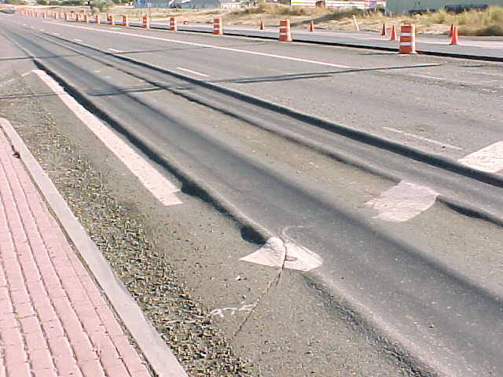
Led to Rutting in 1980s
Courtesy of pavementinteractive.org

Slide 59
Which led to…Superpave
Fixed the rutting problem
Gyratory compaction lowered binder contents
Add in higher and higher recycled materials?

Slide 60
Effect of In-Place Voids on Life
Washington State DOT Study
93% 92% 91% 90% 89%
Compaction Level
Notes:
This Washington study is often referenced. It highlights the relationship between in-place pavement air voids and pavement service life.
With longitudinal joint densities typically at 90% or less it is easy to explain those opening photos of premature joint failures. At ninety percent compaction (10-percent air voids) we can expect joint performance to be: joint performance = mat performance – 1/5.
When joint density drops to 89% then joint performance can expect to be: joint performance = mat performance – 1/3. For a 15 year expected mat performance, giving up 1/5th means the joints fail 3 yrs earlier than mat (giving up 1/3rd means the joints fail 5 yrs earlier).

Slide 61
In-Place Voids vs Fatigue Life
UK-AI Study
1.5% increase in density leads to 10% increase in fatigue life.

Slide 62
FHWA Performance Based Mix Design
 | Fatigue Cracking | Rutting
Design Air Voids For every 1% increase | 40% increase | 22% decrease
Design VMA For every 1% increase | 73% decrease | 32% increase
Compaction Density For every 1% lower in-place Air Voids | 19% decrease | 10% decrease
Courtesy of Nelson Gibson
Increasing Density Improved Both!

Slide 63
NCAT Report 16-02 (2016)
“A 1% decrease in air voids was estimated to improve the fatigue performance of asphalt pavements between 8.2 and 43.8%, to improve the rutting resistance by 7.3 to 66.3%, and to extend the service life by conservatively 10%.”

Slide 64
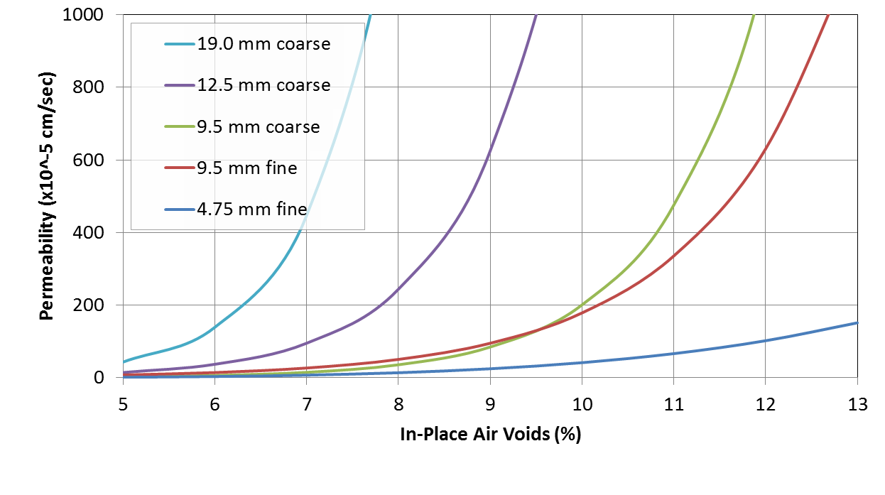
NCAT Permeability Study
125x10⁻⁵ cm/sec
Finer NMAS mixes generally less permeable at equivalent air void levels!
From NCAT Report 03-02

Slide 65
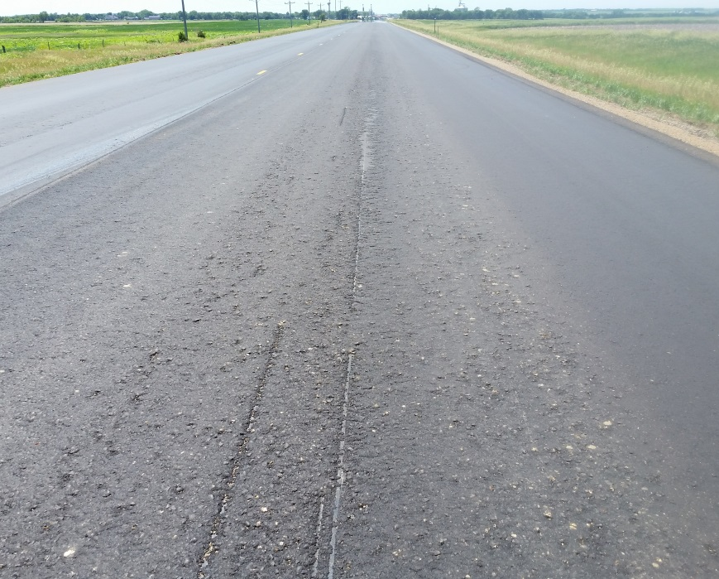
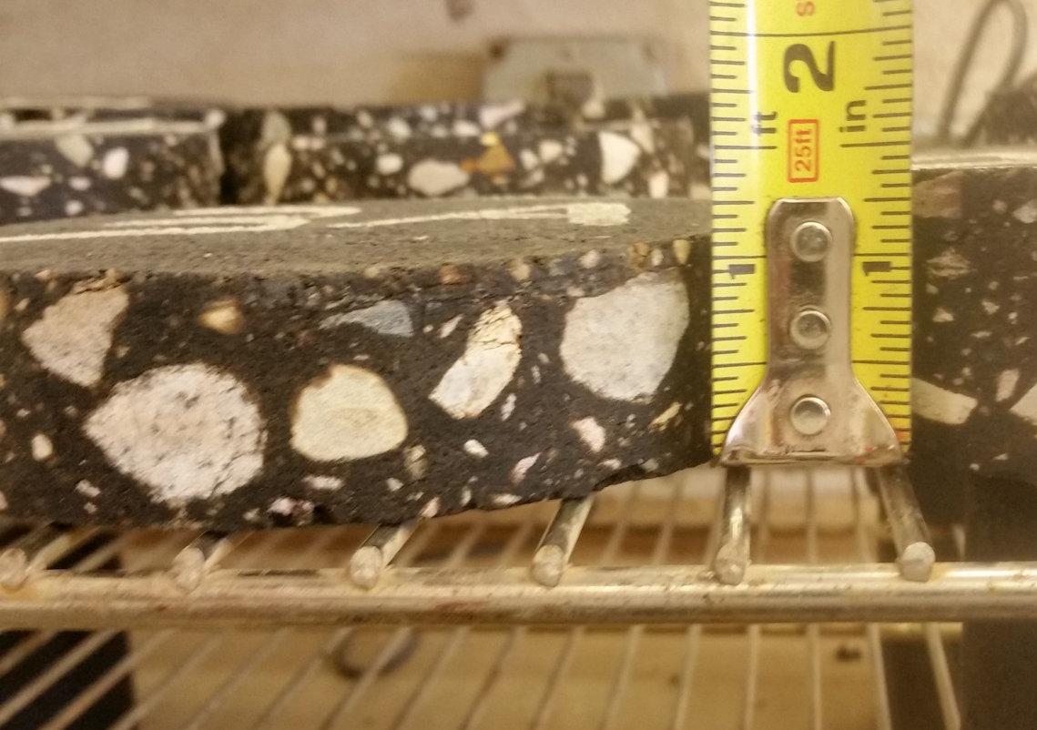
Reduce Permeability
Design to a minimum lift thickness
  ≥ 3X NMAS on fine graded mixtures
  ≥ 4X NMAS on coarse graded mixtures
Do not neglect future pavement preservation

Slide 66

Balance the Mix Design
Smooth Quiet Ride
Skid Resistance
Strength/
Stability
Rut Resistance
Shoving
Flushing Resistant
Durability
Crack Resistance
Raveling
Permeability
DON’T ATTACK ONE HALF AT THE EXPENSE OF THE OTHER HALF!!
Notes:
Mix design is a balance between strength and durability. We can design and mix that will be highly rut resistant, but it will not be durable. Or we can design a very durable mix that will be prone to rutting. The key is to balance the various constituents so as to best produce a mix that will resist rutting and yet last for years. On top of it all, we want a smooth quite ride.

Slide 67
State X: Statewide Results 2013-17
Courtesy of Tim Aschenbrener

Slide 68
State D: Statewide Results from 2016
Courtesy of Tim Aschenbrener

Slide 69
Successful Tack Coat
The Ultimate Goal:
Uniform, complete, and adequate coverage

Slide 70
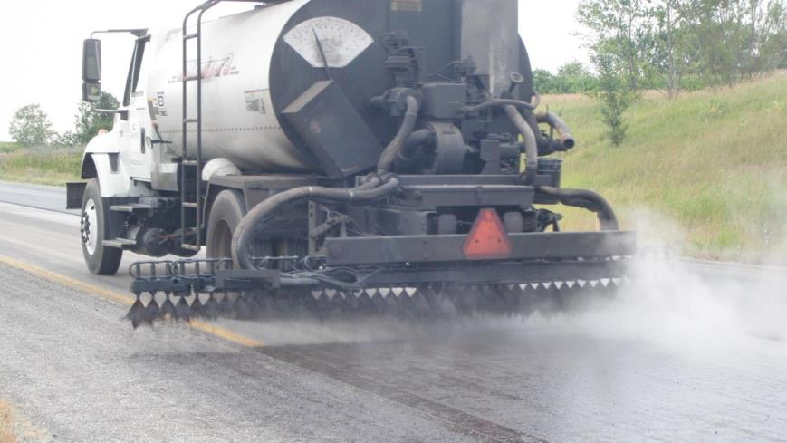
Proper Tack Coat Application
Specify and monitor adequate tack coat application
  Allow the use of alternate materials
    Low Tracking tack
    Modified materials
    Paving grade binders
  A well compacted pavement section will not perform if it is not properly bonded!!

Slide 71
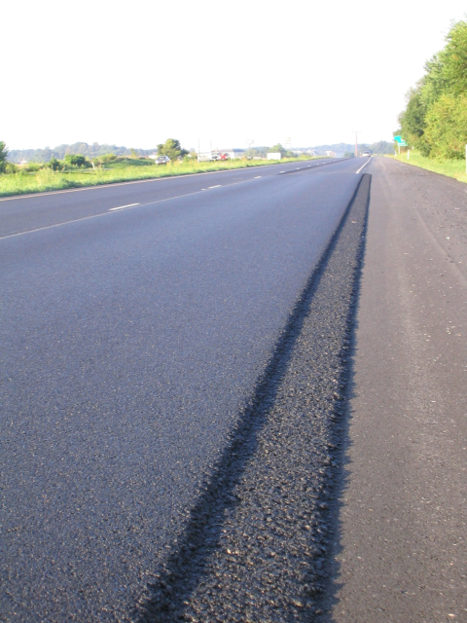
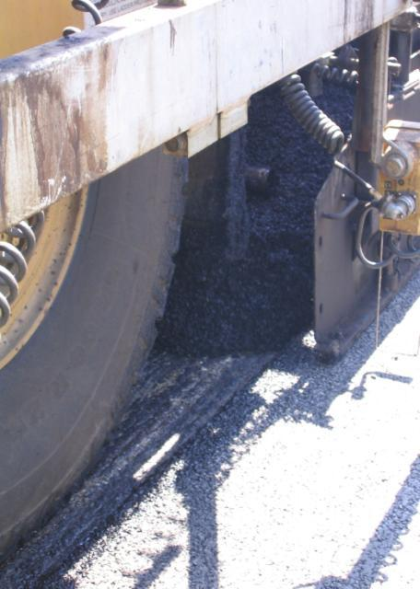
Successful Longitudinal Joints
Notched Wedge
Butt
Notes:
Looking at longitudinal joints, the research would seem to favor the use of the notched wedge, but the interviewed paving experts were pretty evenly divided. Each joint has its advantages and disadvantages. The notched wedge offers the opportunity for higher tonnage (not required to pull second lane up) and for safety (FHWA requires closing up any lift 2 inches or greater before opening for traffic). Thin overlays do not provide sufficient depth to use the notched wedge. One Sheldon Hayes winner suggested that their company felt they achieved a smoother pavement with the butt joint (An important consideration if there is a ride incentive specification). Considering previous research and the interviews it appears using “best practices” to constructing the joint outweighs the type of joint.
Personal opinion: If I was a contractor with a minimum density specification I would build the notched wedge to reduce the possibility of a void between lanes. In another 3 slides from here, it is stated in speaker notes that two states (PA and MA) have recently found higher densities with the notch-wedge vs the butt joint. If I was a contractor with a smoothness spec and no joint density spec, I would probably build a butt joint.

Slide 72
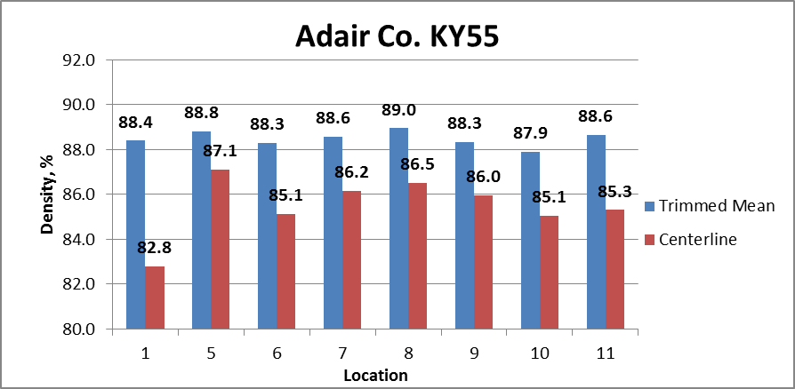
Kentucky Density Study – 2012

Slide 73
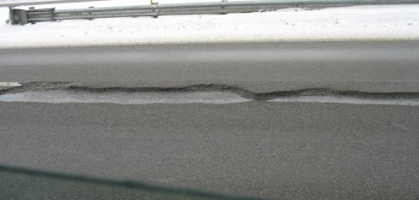
Improve Longitudinal Joints
Permeable Longitudinal Joints will:
Cause safety concerns
Necessitate premature maintenance
Contribute to delamination
Severely impact the life cycle performance
Joint density no less than 2% mat density requirement

Slide 74
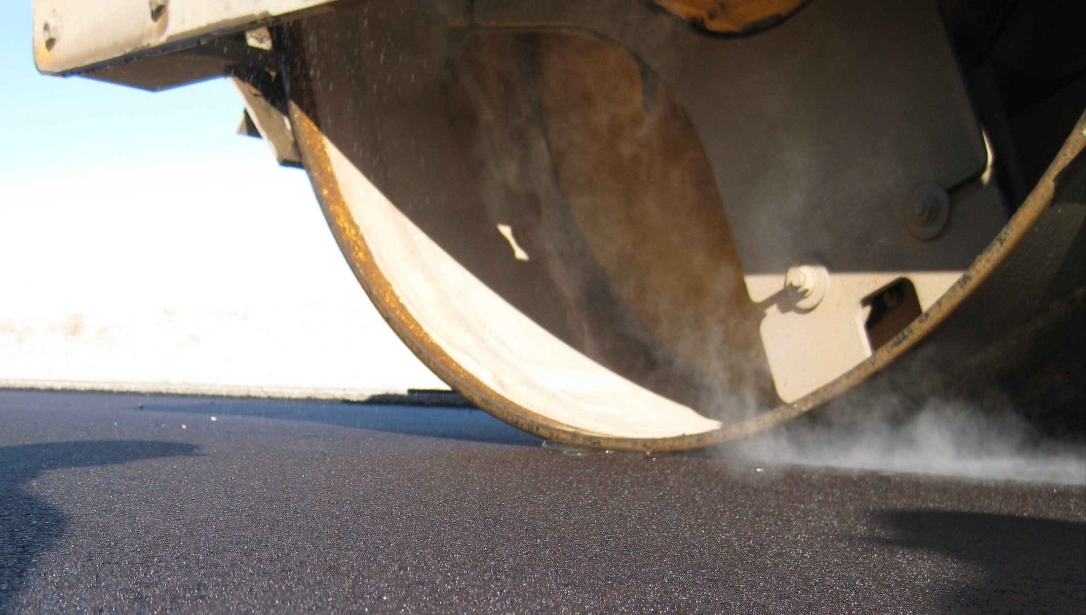
Premise:
Compaction is essential for long-term pavement performance
There are many compaction enhancements currently in use
Compaction goals can be improved
74
Notes:
So, how can asphalt pavement durability be improved. Compaction, has been long recognized as the essential element to long life pavement performance. Many improvements have been made over the years to aid in compacting asphalt pavement to a required density. Introduction of vibratory rollers made a huge impact on compaction efforts, rubber tire rollers can play an important role, and of course proper mix design is critical. Additionally, in recent years we have seen various compaction aids being implemented.
And so, compaction goals as set forth in state specifications should have increased.

Slide 75
Maximizing Our R.O.I.
Infrastructure loads continue to rise
Budget availability continues to fall
Increased pavement life can be economically achieved
Research conservatively shows that a 10% increase in pavement life can be achieved by increasing compaction by 1%.
What would a 3% increase in compaction
do for our industry?

Slide 76
Specify Increased Compaction
Shoot for 94% TMD
  Regularly achieved on airfields throughout the country.
Use Percent Within Limit specifications
  A 92% LSL demands 93 – 94% compaction target
  Use a one sided test – LSL only
  Consider high side outlier testing
Assure Density is achieved on the road
  Consider Cores for acceptance
  Require adequate gauge calibration
  Regularly determine G_{mm} on plant produced mix
Pay for increased compaction – 5% Bonus

Slide 77
Use Best Construction Practices
Promote Innovation
  Encourage / require Intelligent Compaction
  Use WMA – compaction aid
  SHRP2 – IR
  Consider alternative rollers
    Pneumatic
    Vibratory Pneumatic
    Oscillatory
    ?

Slide 78


Bottom Line
Increased compaction = Increased Performance
Better “Return on Investment” for the taxpayers
More Successful Pavements = More Tonnage for the HMA Industry !!!
Thank you for your time!!!

Slide 79
Engineering
Pavement Preservation

Slide 80
Concept
Non-Cracking
Durability Parameter
Critical Range
Cracking
Year

Slide 81
1981 CA Durability Study
16
Valley
12
LA Basin
Santa Maria
Absolute Viscosity Ratio, (Aged/Original)
8
4
0
0
20
40
60
Aging Time, Months
Kemp, et.al.
Sacramento (62.9C), 7-9% Air Voids, Non-Absorptive Aggregate

Slide 82
Witczak and Mirza: Global Aging Model (1995)
Stiffness
Depth

Slide 83
DC(T) Results: TH-56

Slide 84
TH56 Findings
Sealing improves resistance to aging (cracking)
Sooner is better when sealing
  Waiting for 3 or more years to seal after construction produced same results as unsealed pavement
  Sealing after 1 or 2 years showed improvement in resistance to aging (cracking)

Slide 85
Emulsion Task Force (ETF)
AASHTO TSP² ETF Sampling and Testing Program Coordinator
  2017 Testing Program
    evaluate candidate test procedures for chip seal performance-related specifications.
    The principal goals of the program are to:
      Determine appropriate procedures to be used for high and low temperature rheological properties;
      Determine the need for long-term aging; and
      Evaluate procedures intended to ensure the quality of polymer modification without excluding good performers.
  SPG and EPG Specifications

Slide 86
Education
“Sharpening the Saw”

Slide 87
Does Experience, Training, and Certification Matter?
Key Question
  Believe it to be true, but…
  How do you quantify?

Slide 88
Factors Affecting Variability
Each point represents a mean of half of the 64 total experiments
Two geometries provide different result
Pavel Kriz, ExxonMobil

Slide 89
T315 DSR, Original, RTFO, PAV
Karl Zipf, Delaware DOT

Slide 90

AI Laboratory Training Programs
BBT/NBTC
  Basic Binder Technician (BBT) training; and
  National Binder Technician Certification (NBTC)
  NBTC
    Partnership with NETTCP since 2008
    MS-25, 3rd Edition, 2nd Printing
    Over 350 certifications/re-certifications awarded in 57 classes in 15 different states/provinces/countries
      Canada, Qatar

Slide 91

National Binder Technician Certification (NBTC) Program
AI Certification Vision
To provide a consistent nationwide means of ensuring that asphalt binder technicians are knowledgeable and fully qualified to produce valid specification compliance and quality assurance data.
Notes:
Another key initiative is the National Binder Technician Certification Program. The vision was based on input from Members.
91

Slide 92
NBTC Course
1.5 days of lecture
  Intended as review, not training
Covers all 13 chapters in MS-25
  Basic Information
    Basic concepts, sampling and handling, thermometry, specification and grading
    Chapters 1-6 (Part I)
  Miscellaneous Tests
    Rotational Viscosity, Flash Point, Specific Gravity, Plus Tests
  Aging
    RTFO, PAV
  BBR, DSR, DTT

Slide 93
Laboratory Proficiency Exam
Two tests to be demonstrated
  DSR
  BBR
Why only two?
  Time
  Reasoning that a technician that can handle the most complicated procedures (DSR and BBR) can handle the rest
Rare that experienced technicians fail

Slide 94
Written Exam
Open book/note, multiple-choice exam
2 hours
60 questions
  Four sections
    Part 1 – General (24 questions)
    Part 2 – Miscellaneous Tests and Aging (16 questions)
    Part 3 – DSR
    Part 4 – BBR
Must score 80% or better (48 correct)
Must also score 70% or better on each Part

Slide 95
NBTC Program (2008-16)

Slide 96
NBTC Program (2008-16)

Slide 97
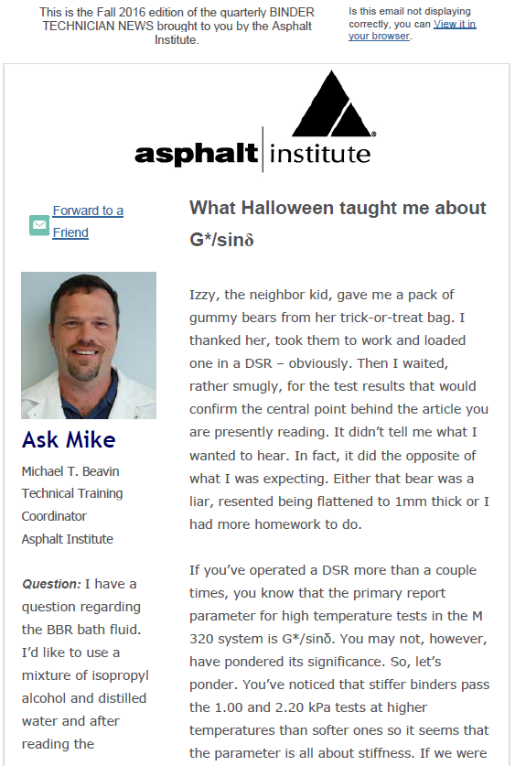
Binder Technician News
Started in 2012
  Means of providing some (hopefully) light reading for asphalt binder technicians
Key Components
  Feature Article
  Tech Tip
  Ask Mike
  Technician Spotlight
Mail Chimp Distribution

Slide 98
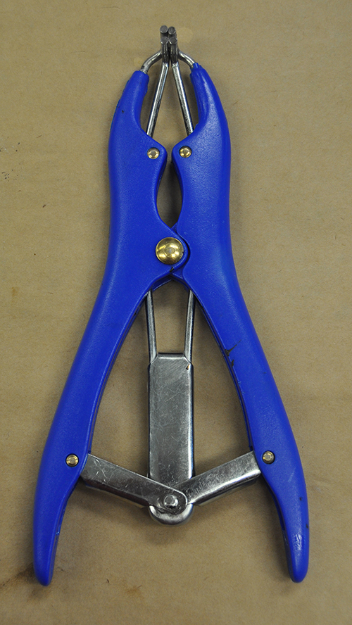
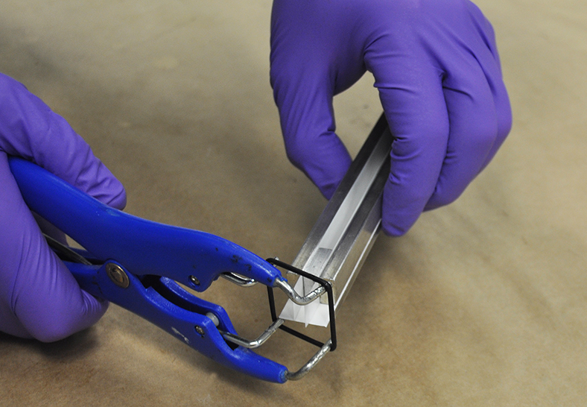
Tech Tip: BBR Accessory

Slide 99
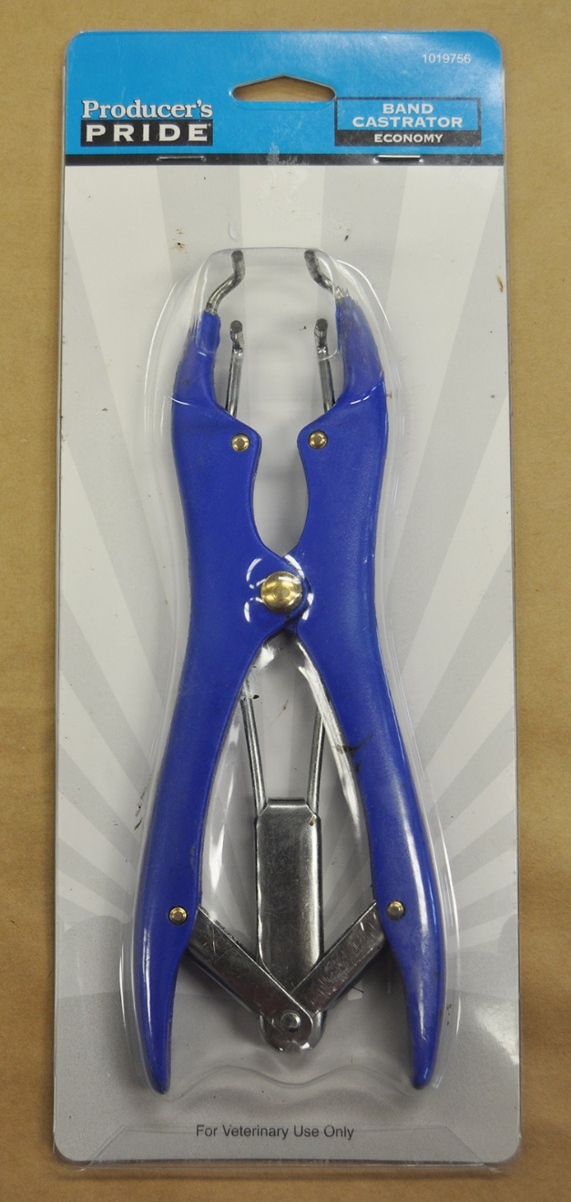
Asphalt Meets Animal Husbandry
For Veterinary Use Only

Slide 100
Asphalt Emulsion Training
Basic Emulsion Technician Training
  Courses (AI HQ – Lexington, KY)
    November 6-9, 2017
    January 9-12, 2018
    February 27-March 2, 2018
    April 24-27, 2018
    November 6-9, 2018
  $1,195
  6 students maximum per course

Slide 101
Asphalt Emulsion Technician Certification
National Emulsion Technician Certification (NETC)
  Modelled after NBTC Program
  Classroom review (1 day)
  Written exam (2 hours allotted)
  Lab Proficiency exam
    Considering tests to demonstrate
      Distillation, Saybolt-Furol Viscosity?
    NBTC concept is to use tests with focus on sample preparation and detailed testing steps
      If you can perform the best, you can perform the rest
  5-year certification cycle

Slide 102
Education
Technology Transfer through Professional Associations

Slide 103
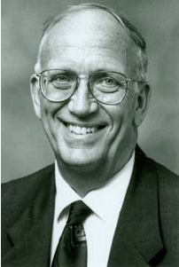
AAPT
Dr. Eugene L. Skok, Jr.
  BS, MS, and PhD from Univ. of Minnesota
  Some Career Highlights…
    Worked at AASHO Road Test in Ottawa, IL
    Researcher for the Asphalt Institute
    Research Fellow at the University of Minnesota
    Instructor at St. Paul Technical College
    Director of Research for Braun Intertec
    PI in North Central Region Coordination Office for the FHWA LTPP Division
    Implemented research findings for Minnesota LRRB from 1975-1987
    Secretary-Treasurer of AAPT from 1969-2013
  Elected to Asphalt Institute Roll of Honor in 1995
    Fewer than 100 individuals so honored

Slide 104
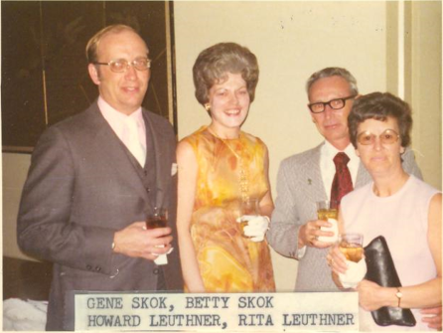
Gene and Betty Skok – AAPT Through the Years

Slide 105
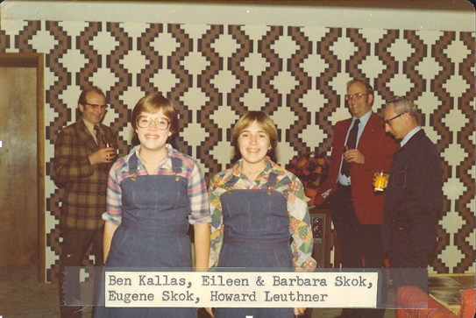
Gene and Betty Skok – AAPT Through the Years

Slide 106
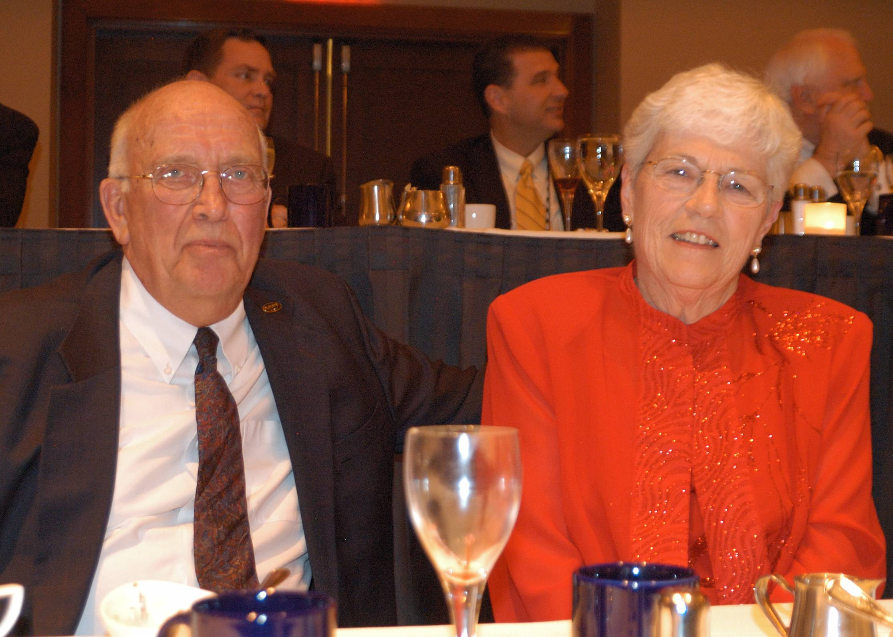
Gene and Betty Skok – AAPT Through the Years

Slide 107

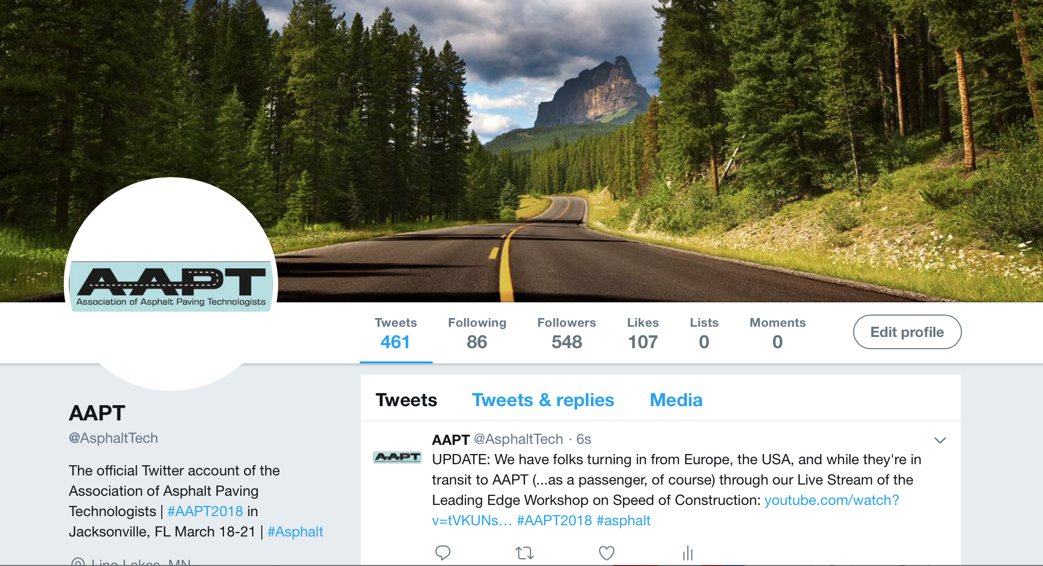
AAPT New Initiatives: Social Media
Twitter (@AsphaltTech) – 548 followers
Facebook (Facebook.com/AsphaltTech) – 686 page followers
LinkedIn – 2,884 members

Slide 108
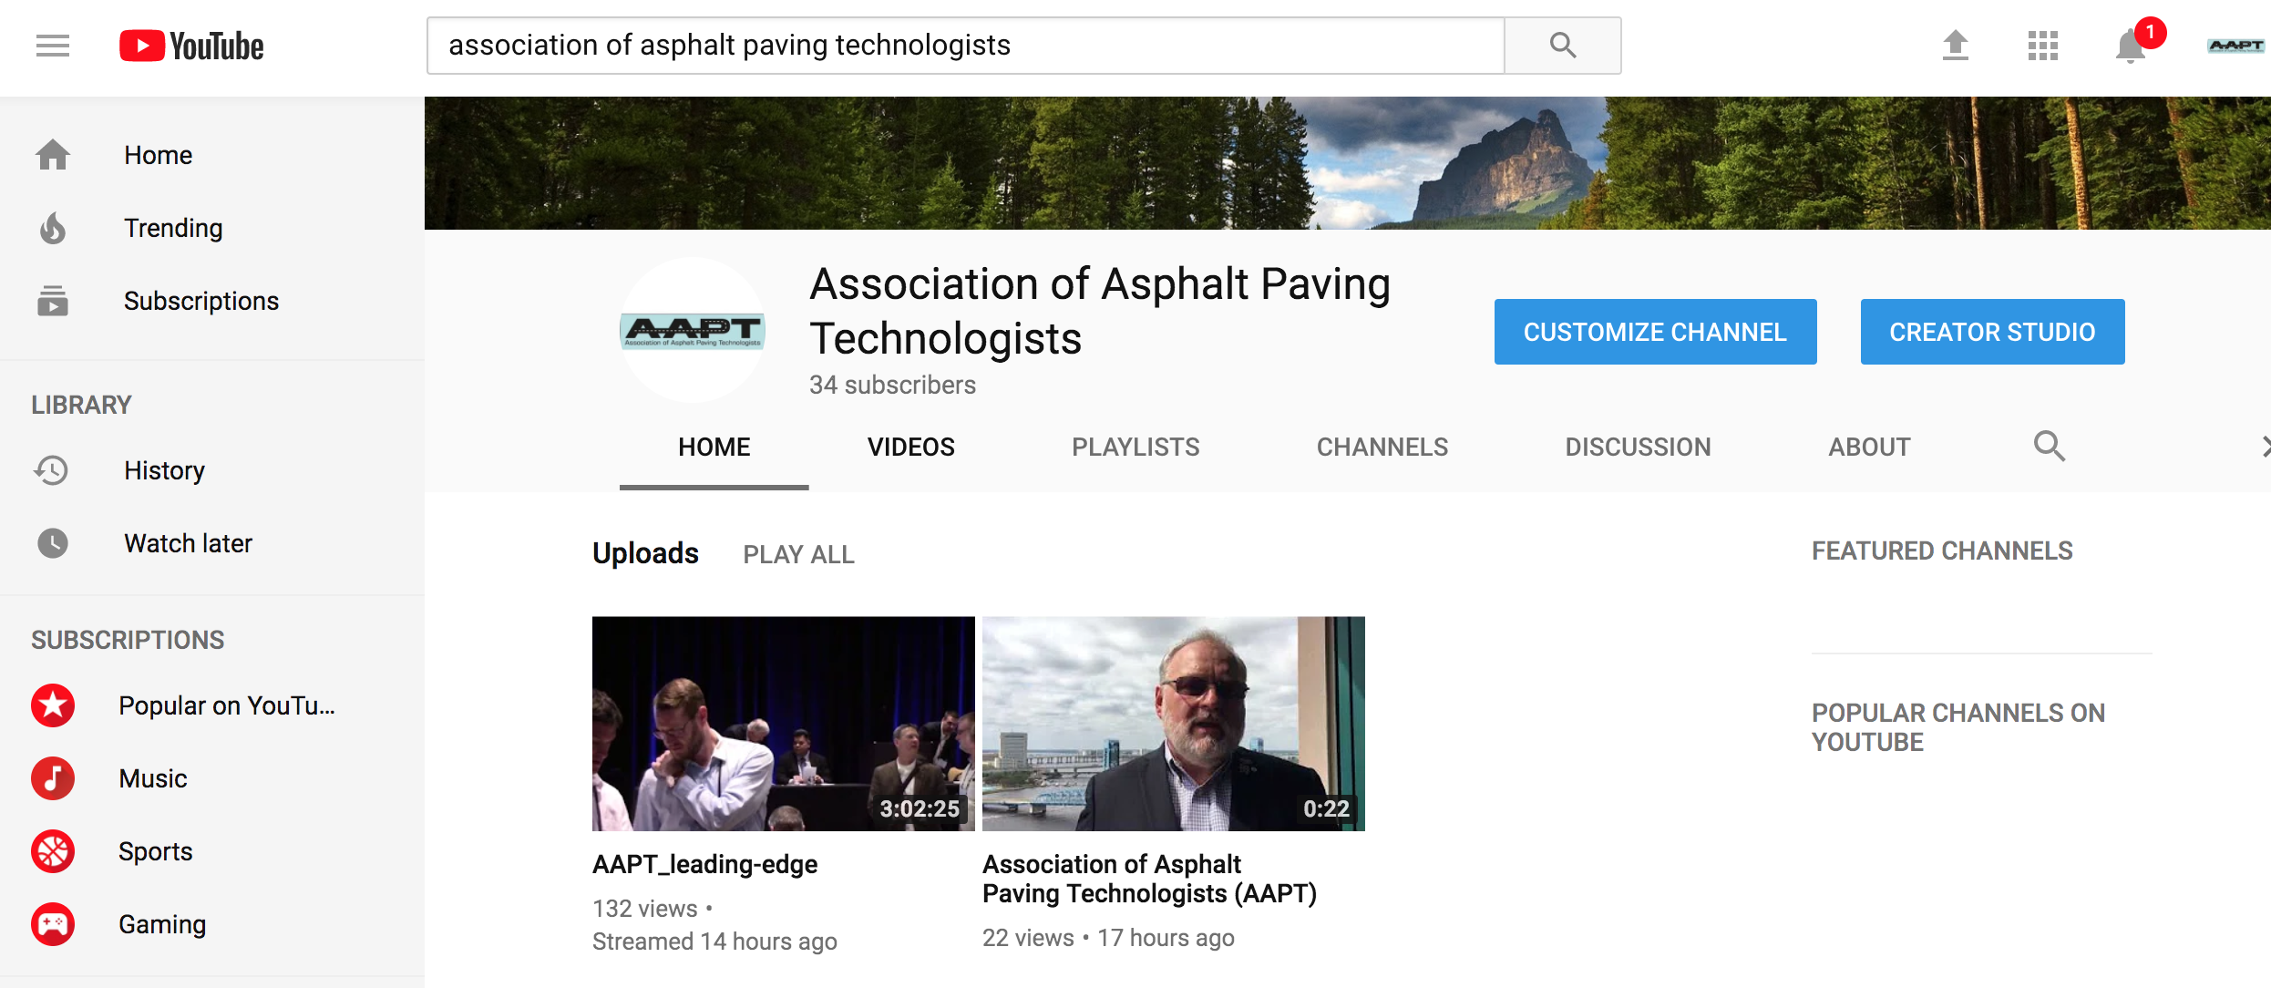
AAPT New Initiatives: Webcasting
During the 2018 Annual Meeting, the Leading Edge Workshop and Symposium were broadcast live via YouTube
  Folks tuned in across the country and even internationally
  Go to YouTube.com and search “Association of Asphalt Paving Technologists”

Slide 109
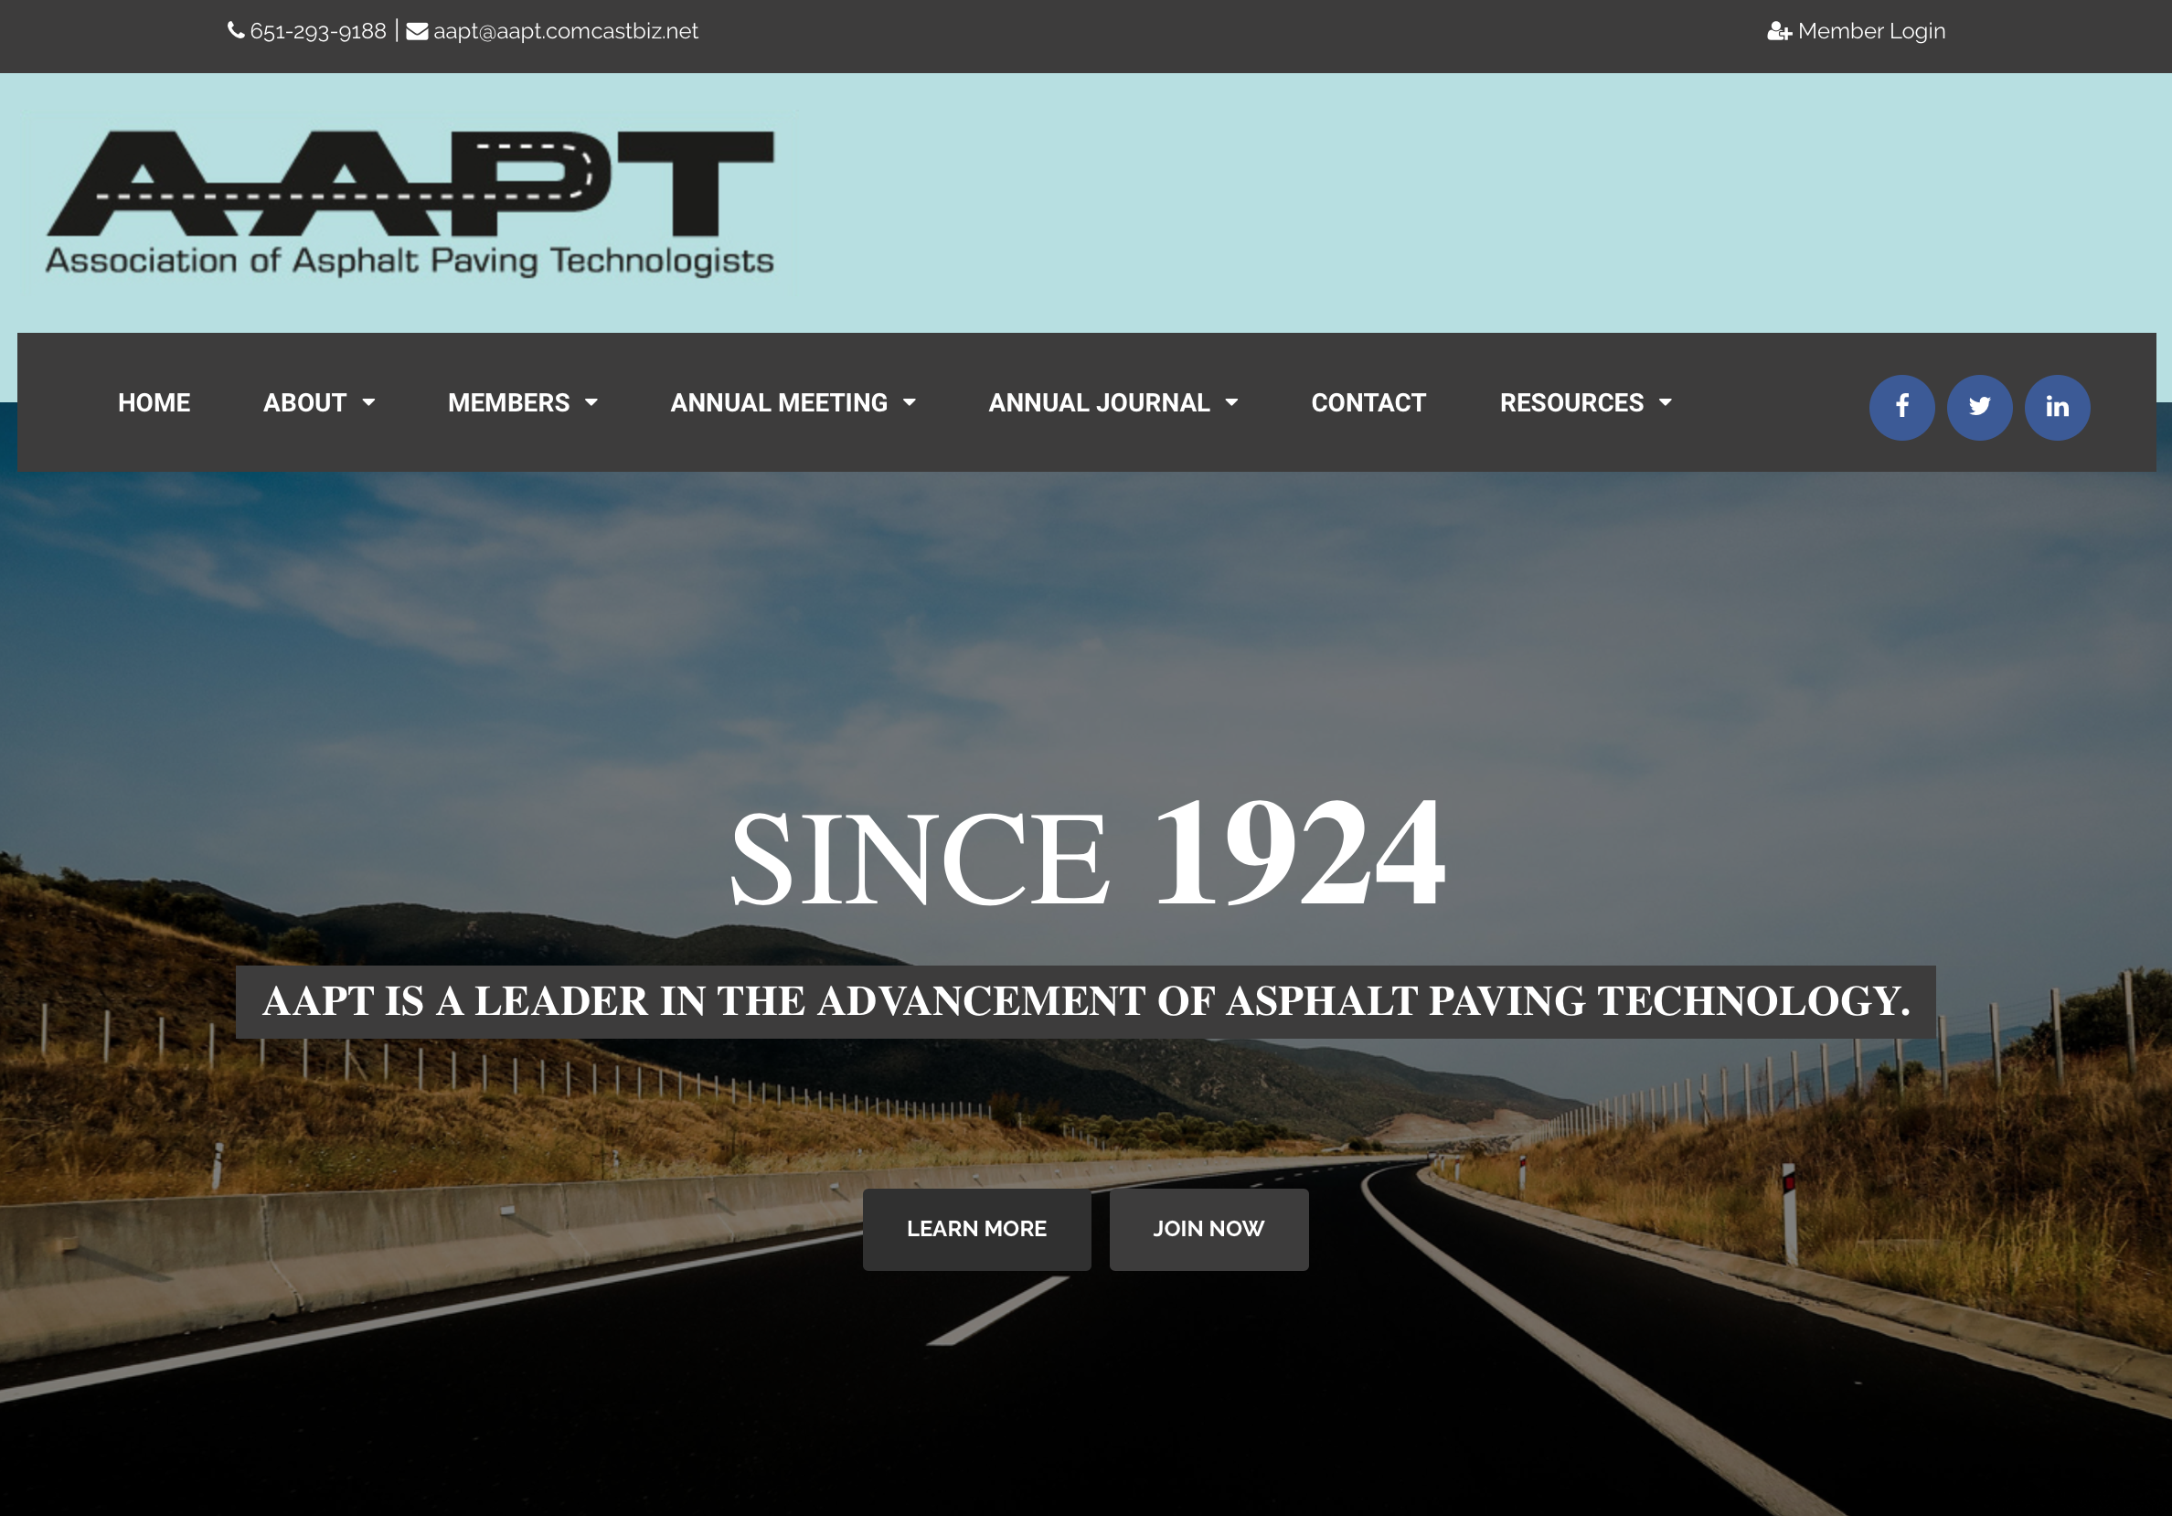
AAPT New Initiatives: Website

Slide 110

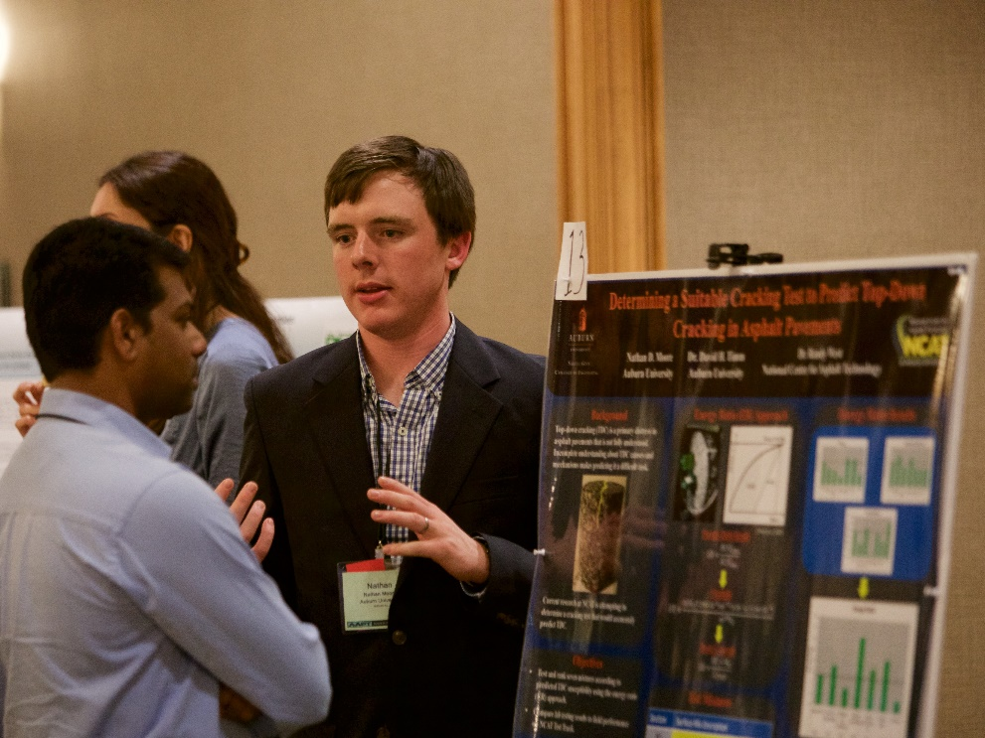

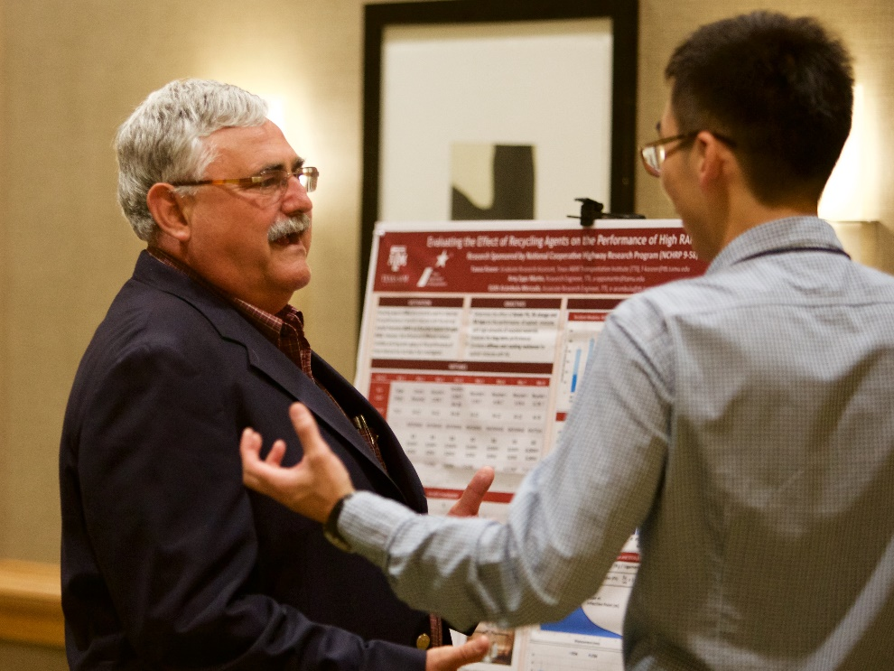
AAPT New Initiatives: Student Posters

Slide 111




Become an AAPT Member!
Access to information and emerging technologies
Technical community comprised of individuals from all parts of the asphalt industry
Debate on important technical issues
North American-based organization with significant international membership and focus
No organizational biases
Support the next generation of asphalt technologists through a robust student scholarship program
www.asphalttechnology.org
Notes:
Visit our website and check us out on Facebook, LinkedIn, and Twitter

Slide 112

Thanks!

