Slide 1


2018 Pavement Workshop
May 23-24, 2018
Evaluation of the Benefits From Structural Fibers in Thin Concrete Pavements
Manik Barman
Assistant Professor, UMD
+ 46 Associate Members

Slide 2


Research Team
Manik Barman, Assistant Professor (PI)
Bryce Hansen, Former Graduate Student
Jared, Munch, Graduate Student
Uma Arepalli, Post Doctoral Associate
Manik Barman

Slide 3
Thanks to TAP Members and other Experts
Tim Anderson, MnDOT Kaye Bieniek, Minnesota LRRB Tom Burnham, MnDOT (TL) John Donahue, Missouri DOT Christine Dulian, MnDOT Debra Fick, MnDOT Bernard Izevbekhai, MnDOT | James Krstulovich, Illinois DOT Clifford, McDonald Maria Masten, MnDOT Luke Pinkerton, Helix Steel Dulce Rufino, California DOT Julie Vandenbossche, University of Pittsburgh Matthew Zeller, CPAM

Slide 4
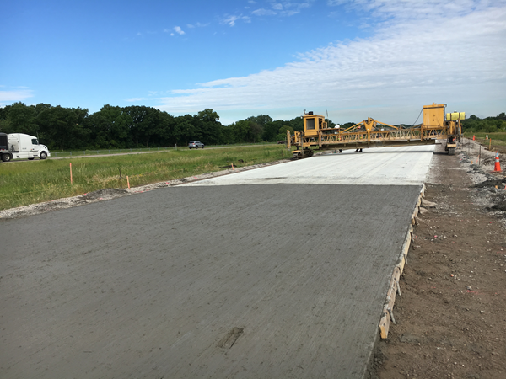
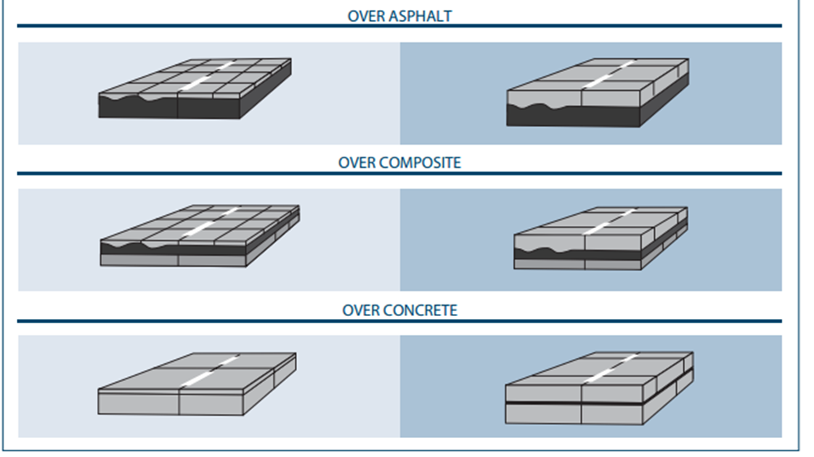
Thin Concrete Pavement/ Overlay
Thin conc. Pavement
Thin conc. Overlays
Over asphalt
Over agg. base
Over composite
Over concrete
Thickness: 3 to 6 inches
(bonded/unbonded)

Slide 5
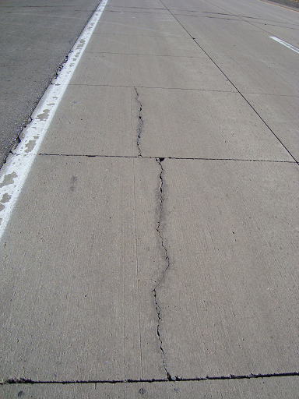

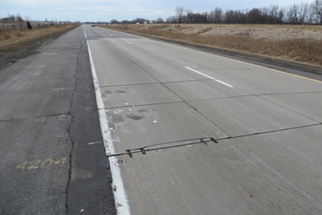
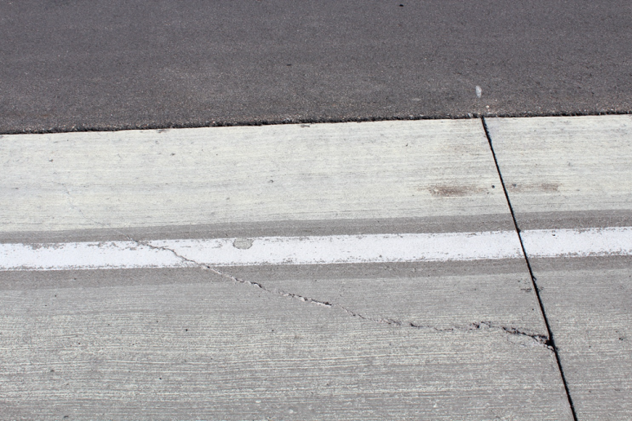
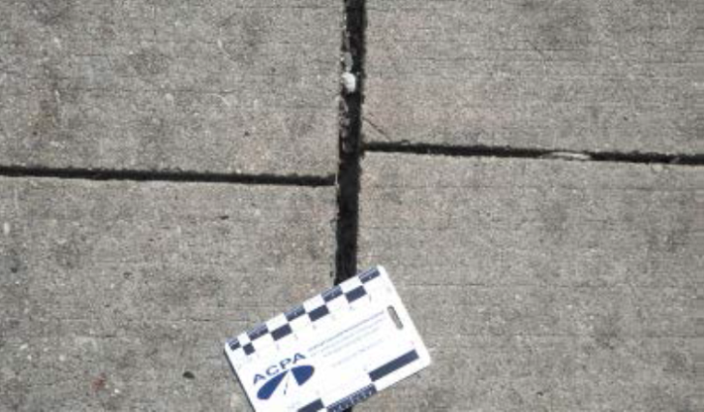
Thin Concrete Pavement Distresses
Joint faulting
Cracks
Slab migration
Notes:
Introduction of thin concrete overlays. Importance of bonding and load transfer.

Slide 6
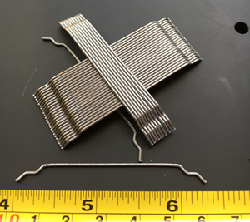
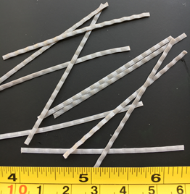
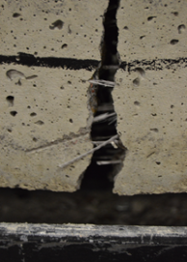
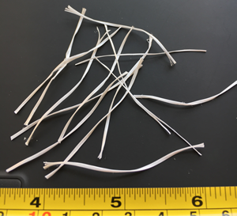
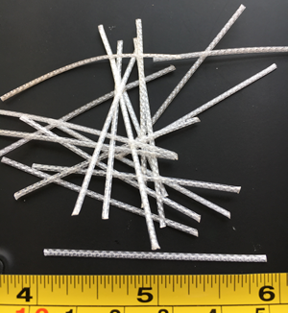
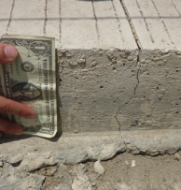
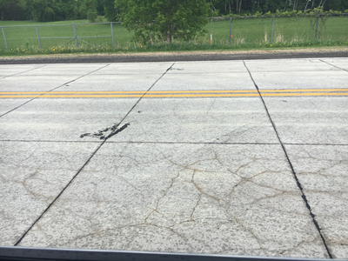
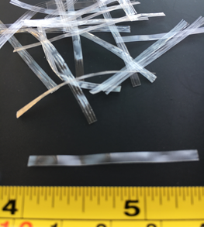
Use of Fibers
Verities of Fibers; Many States
Observed benefits:
1. Reduce cracking/ hold cracks tight
2. Increase load transfer efficiency
- reduce faulting
3. Reduce slab migration
4. Reduce slab thickness
5. Increase slab size (?)
Notes:
Introduction of thin concrete overlays. Importance of bonding and load transfer.

Slide 7
Commonly used Structural Fibers
State | Number of Projects | Projects using Steel fibers |  | Projects using Synthetic fibers |  | Synthetic Fiber Dosage Distribution (%)
 |  | % | Dosage lb/yd³ | % | Dosage lb/yd³ | 3 lb/yd³ | Other lb/yd³
Georgia | 6 | 0 | N/A | 100 | 3 | 100 | 0
Illinois | 19 | 6 | 80 | 94 | 3, 4, 7.5 | 11 | 89
Kansas | 8 | 0 | N/A | 100 | 3 | 88 | 12
Minnesota | 11 | 0 | N/A | 100 | 3, 6.5, 25 | 36 | 64
South Carolina | 3 | 0 | N/A | 100 | 3 | 100 | 0
Virginia | 3 | 28 | 50, 75 | 72 | 3, 20, 25, 0.9 | 17 | 83
Total | 50 | 6 | N/A | 94 | -- | 51 | 49

Slide 8
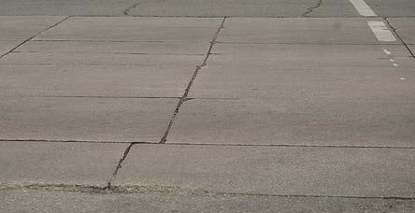
Examples of Performance Benefits
Illinois
With FRC (King & Roesler, 2014).
Fibers helped to reduce slab
migration
Pavement performing well over the
design life, with heavy truck traffic
With PCC (King & Roesler, 2014).

Slide 9
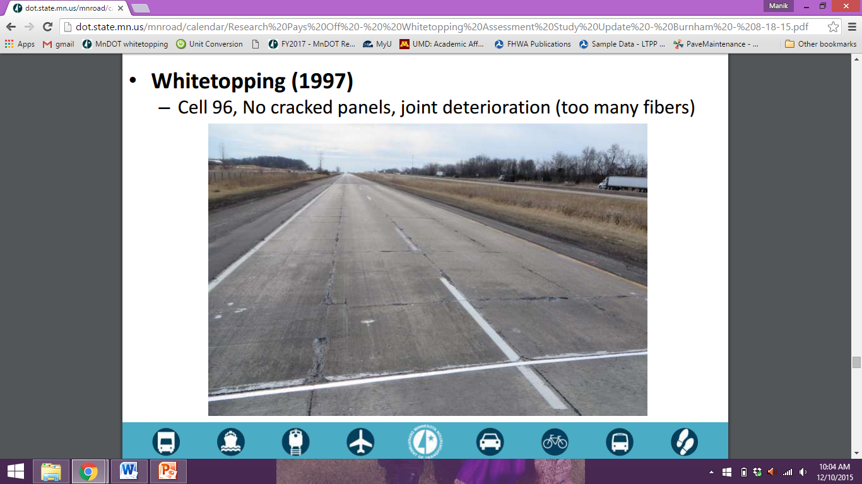
Examples of Performance Benefits
Minnesota
Still performing after 20 years of interstate traffic
Burnham, 2015
Notes:
Generally, LTE will be low at low temperature because of a wider crack width. We can observe this kind of trend in Cells 94 and 95. We do not see this trend in Cell 95, which had structural fiber. It appeared that structural fiber helped in transferring load in low temperature. So, we can say structural fiber contributed in Cell 95. It may be noted that as much as 25 lb/cy fiber was added in the concrete.

Slide 10
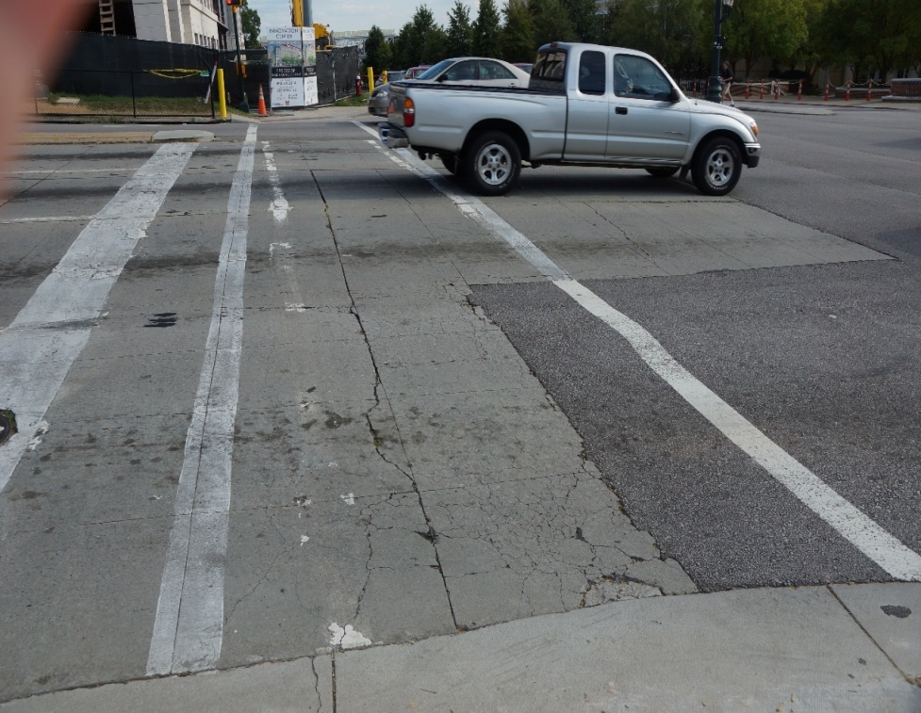
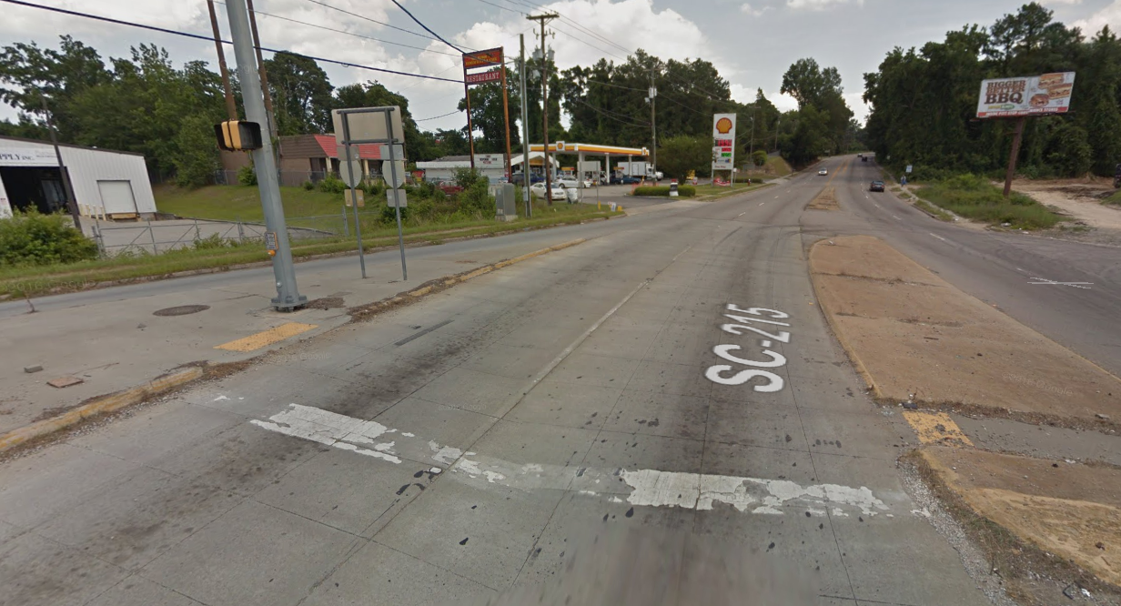
Examples of Performance Benefits
South Carolina
Fibers holding shattered slab
pieces

Slide 11
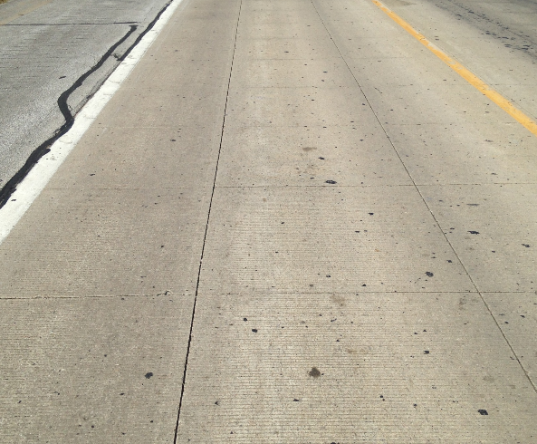
Examples of Performance Benefits
Missouri
Fibers did not reduce panel cracking but did reduce crack widths and joint degradation. No faulting was observed on this project and may be related to the use of fibers.
-- John Donahue
September, 2015

Slide 12
General Performance Summary
State | Performance summary
Illinois | Reduced slab migration, joint separation, faulting and increased ride quality
Kansas | Less faulting, spalling and panel cracks
Minnesota | Increased LTE in old cells; no strong conclusions on 2014 cells, NRRA sections?
Missouri | Restricted faulting, reduced crack width and joint degradation
South Carolina | Increased service life
Virginia | Fibers exhibited good resiliency in minimizing cracking and crack width

Slide 13
Now The Big Question is:
      How do we select fibers and dosages?
      How do we quantify fibers’ benefits and appropriately incorporate in the structural design?
      Use -
      Laboratory test results
      Use field performance and distress data
      Use test results on instrumented test sections, e.g. MnROAD
      Numerical Modeling

Slide 14
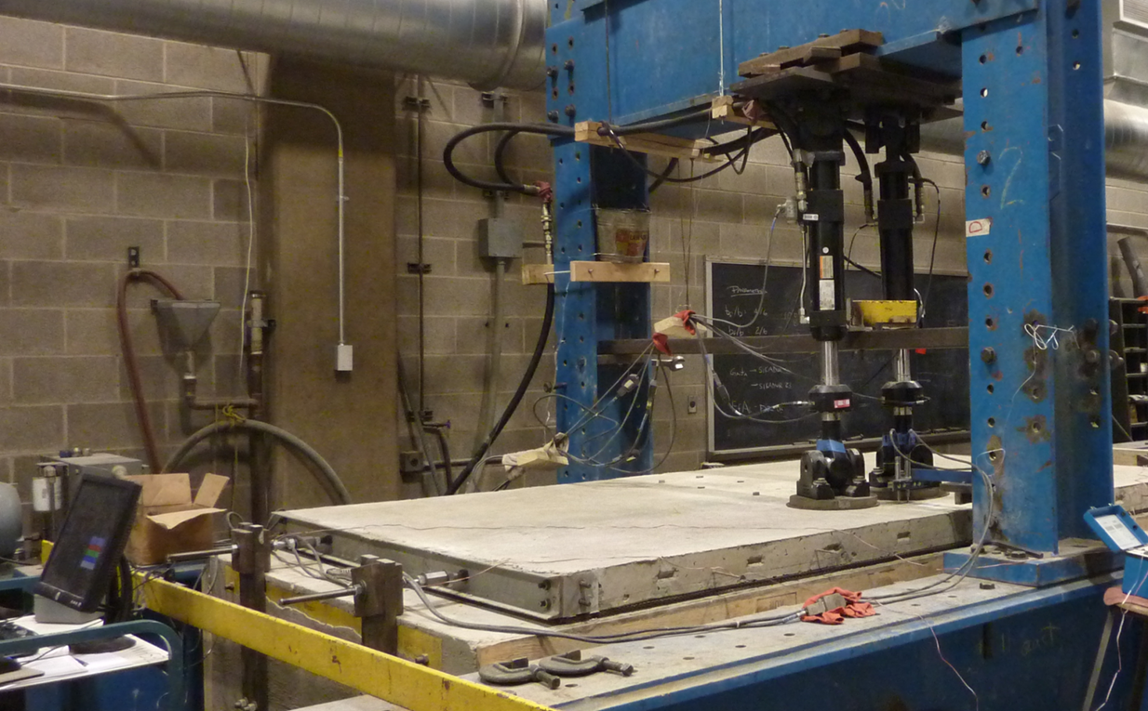
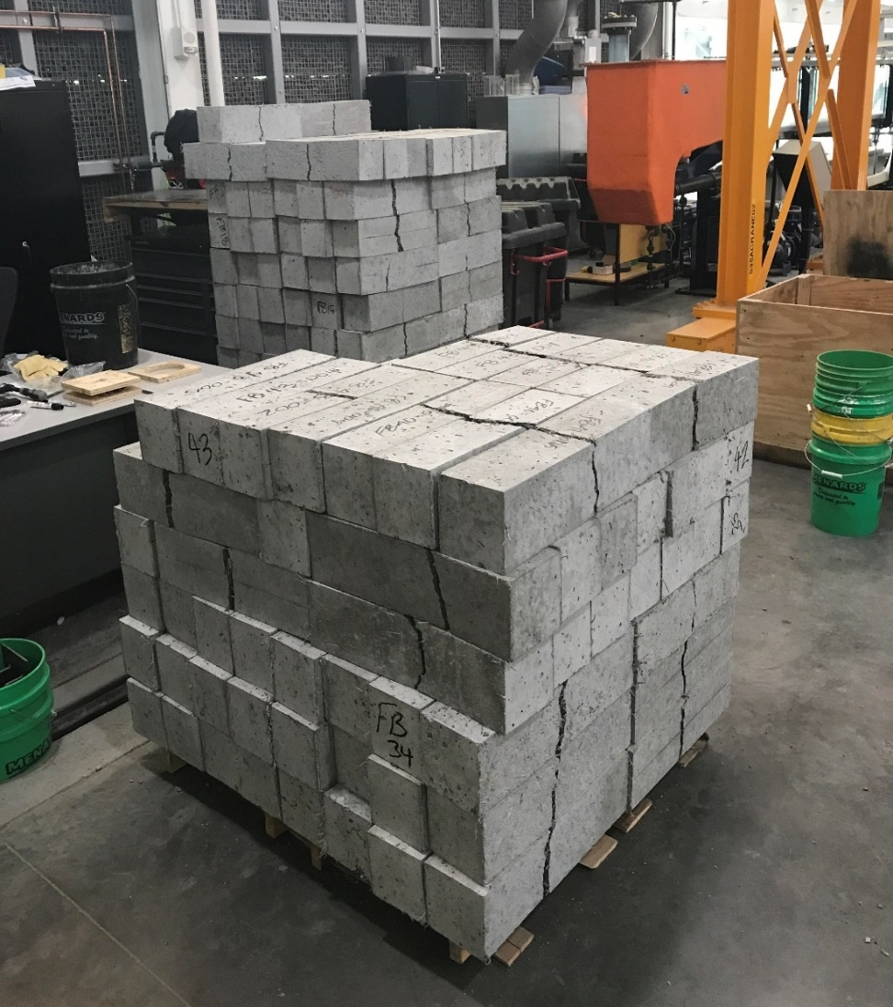
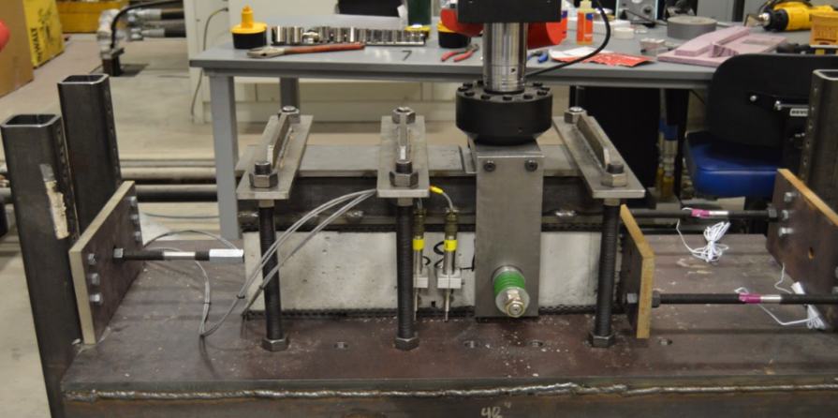
Laboratory Study

Slide 15
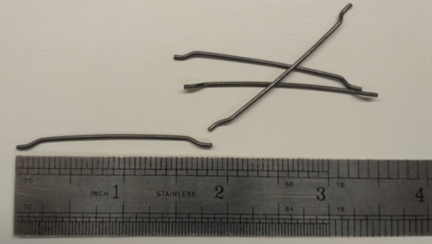
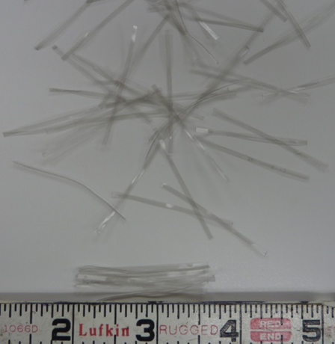
FRC: Fresh Conc. Properties
Steel
Synthetic
Typical volume fraction: 0.25% to 1.5%
Slump: 1 to 4 in. lower compared to PCC
Fiber balling: When aspect ratio >100
V_{f} > 1%
Typical volume fraction: 0.25% to 1.5%
Slump: Usually drops
Fiber balling: When aspect ratio >100
V_{f} > 1%

Slide 16
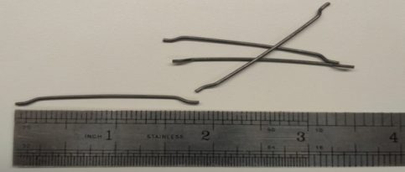
Steel FRC: Hardened Conc. Properties
Comp. strength: 0% to 25% increase
Flexural strength: 0 to 50%
Direct tensile strength: 40% more compared to PCC
After Mahadik & Kamane, 2014

Slide 17
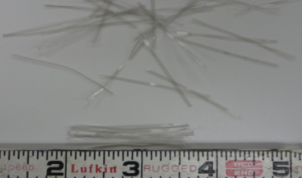
Syn. FRC: Hardened Conc. Properties
Comp strength: Little improvement; ductile failure of cylinders
Flexural strength: No improvement
Toughness/ Residual strength: Significant improvement
Load transfer efficiency (LTE): Significant improvement
Most Popular

Slide 18
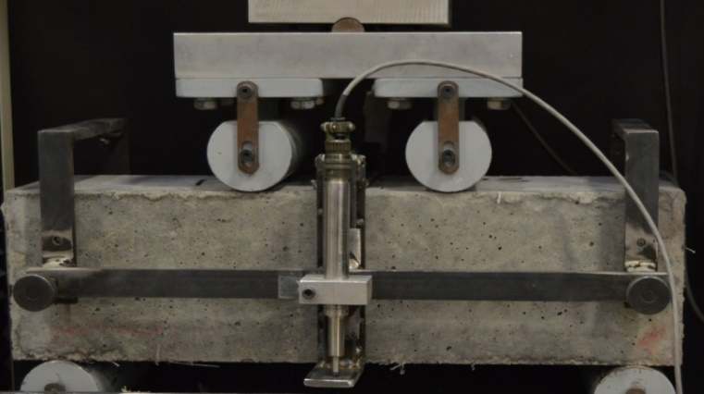
Post Crack Performance
a
b
RSR= b/a*100

Slide 19
Post Crack Performance

Slide 20
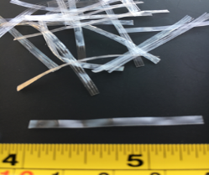
Post Crack Performance
~ 50% more

Slide 21
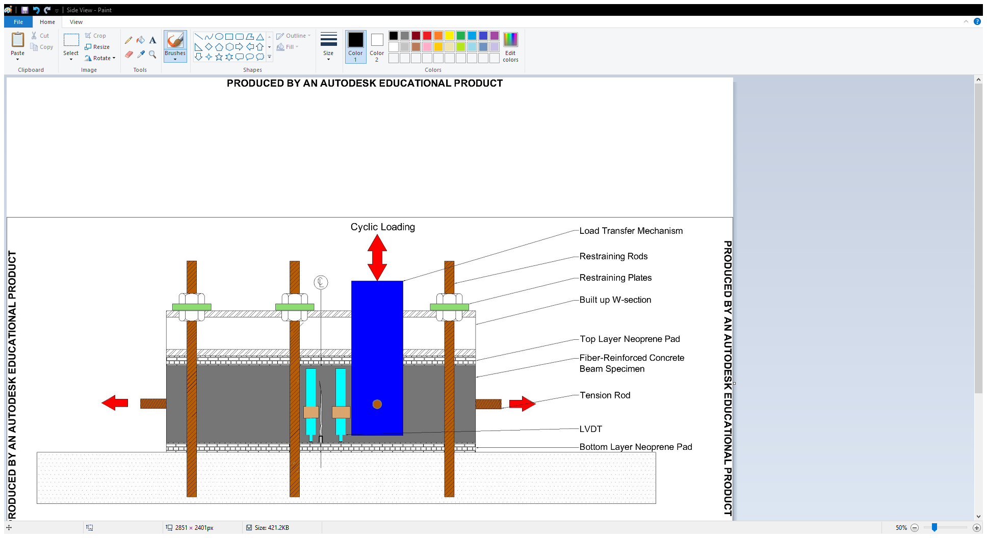
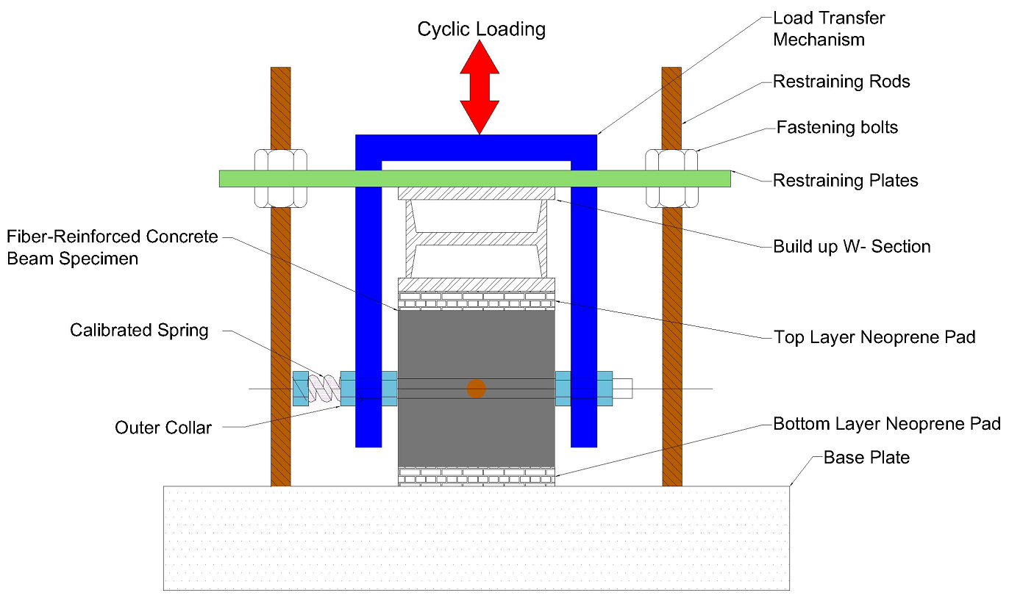

Joint Performance/ LTE

Slide 22

Joint Performance/ LTE

Slide 23
Joint Performance/ LTE
Deflections
CW = 16 mils
CW = 47 mils
CW = 126 mils
Plain concrete

Slide 24
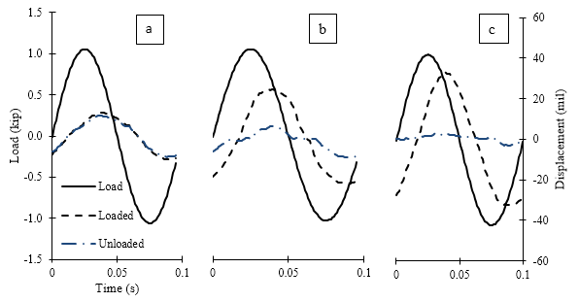
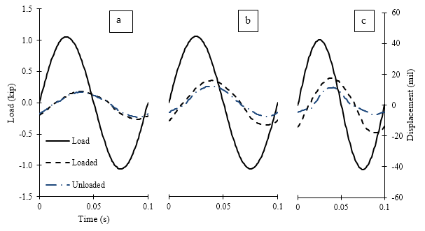
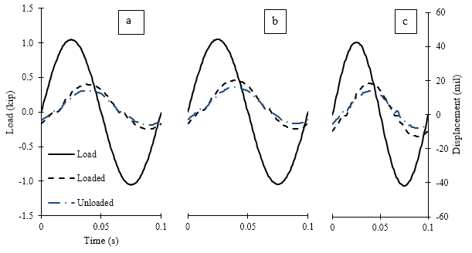
Joint Performance/ LTE
No Fibers
0.25% V_{f}
0.50% V_{f}

Slide 25

Joint Performance/ LTE: Beam vs Slab
R² > 0.8
Barman and Vandenbossche, 2014

Slide 26
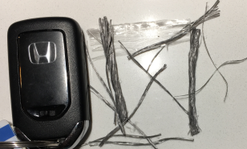
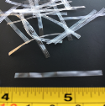
Joint Performance/ LTE vs Crack Width
S.T.11 fiber was used MnROAD NRRA sections

Slide 27
Joint Performance/ LTE vs Crack Width

Slide 28
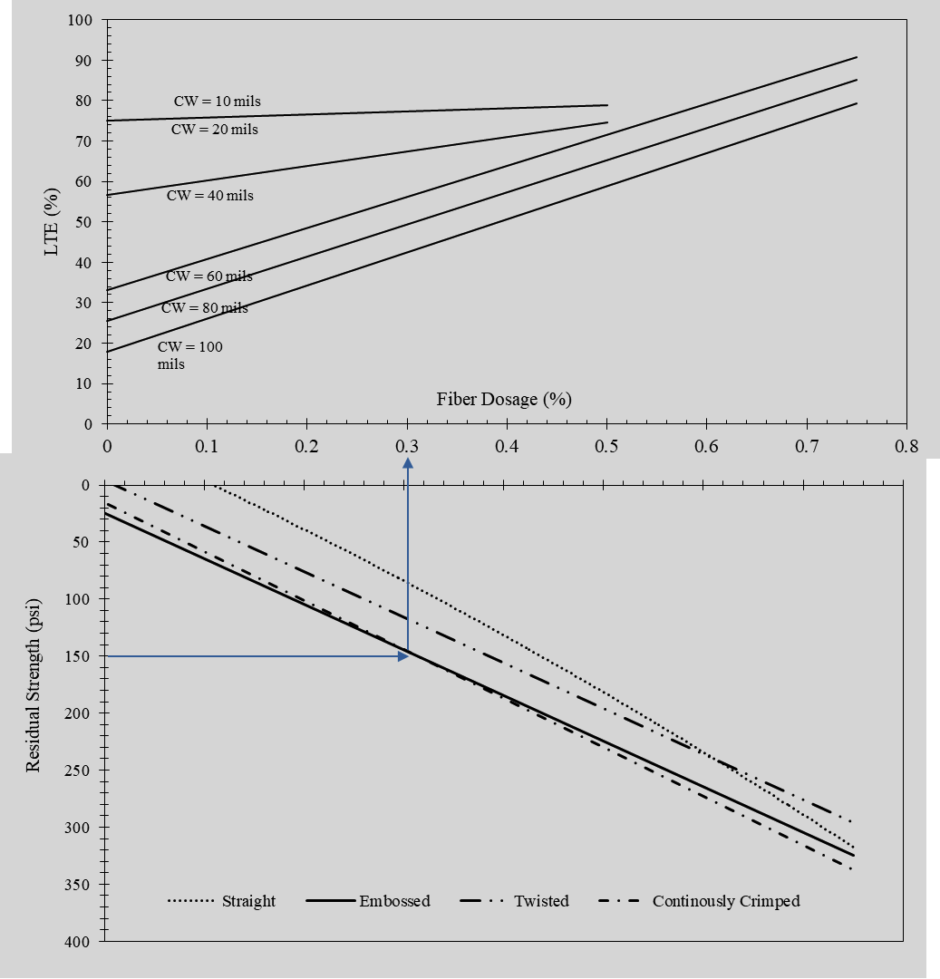
Nomograph for Quantifying FRC Benefits
Notes:
Fiber dosages: standard - corresponding to 20% residual strength ratio (ASTM C1609); enhanced - corresponding to 30% residual strength ratio (ASTM C1609); high – corresponding to 0.75 fibers volume fraction.

Slide 29
Fiber Relaxation: A concern (?)
No Fibers
0.25% Vf
0.50% Vf
Notes:
Fiber dosages: standard - corresponding to 20% residual strength ratio (ASTM C1609); enhanced - corresponding to 30% residual strength ratio (ASTM C1609); high – corresponding to 0.75 fibers volume fraction.

Slide 30
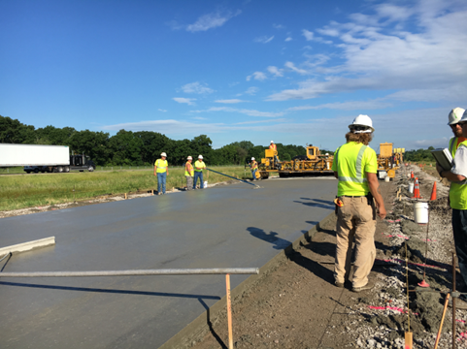
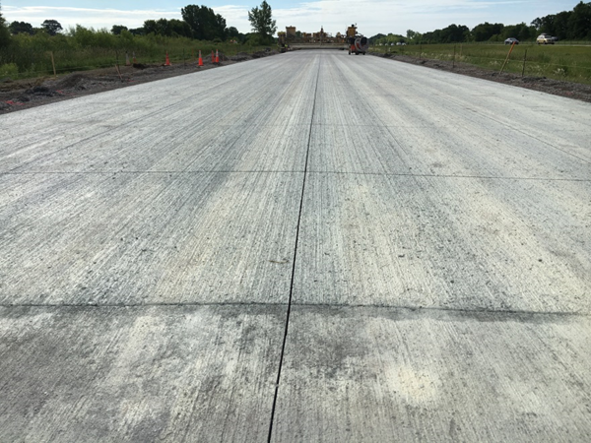
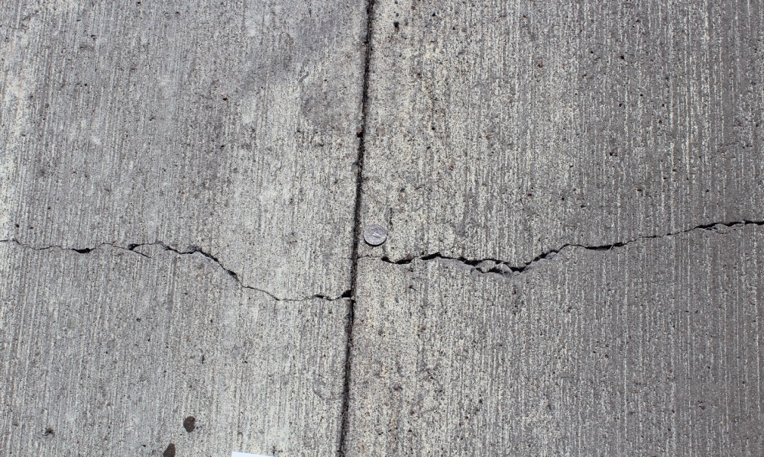
Field Study
Notes:
Fiber dosages: standard - corresponding to 20% residual strength ratio (ASTM C1609); enhanced - corresponding to 30% residual strength ratio (ASTM C1609); high – corresponding to 0.75 fibers volume fraction.

Slide 31
NRRA-MnROAD FRC Test Sections
Cell number | Length (ft) | Pavement/ overlay Type | Underlying layer (constr. year) | Type of concrete/ fiber dosage* | Panel size W ft x L ft | Panel thickness (inch)
506 | 144 | Thin pavement on grade | 11 in. class 5Q aggregate base (2017) | Plain concrete | 6 x 6 | 5; 6*
606* | 138 |  |  | FRC/ standard
706 |  |  |  | FRC/ enhanced
806 |  |  |  | FRC/ high
139 | 270 | Ultra-thin Pavement on grade | 6 in. class 5 aggregate base (2017) | FRC/ enhanced | 6 x 6 | 3
239 | 273 | Thin Pavement on grade |  |  | 6 x 6 | 4
705 | 144 | Thin unbonded overlay | Concrete (1993) | FRC/ standard | Driving: 14 x 12 Passing: 13 x 12 | 5
805 | 124 |  |  |  | Driving: 6 x 12 and 8 x 12 Passing: 6 x 12 and 7 x 12 | 5
Notes:
Fiber dosages: standard - corresponding to 20% residual strength ratio (ASTM C1609); enhanced - corresponding to 30% residual strength ratio (ASTM C1609); high – corresponding to 0.75 fibers volume fraction.

Slide 32
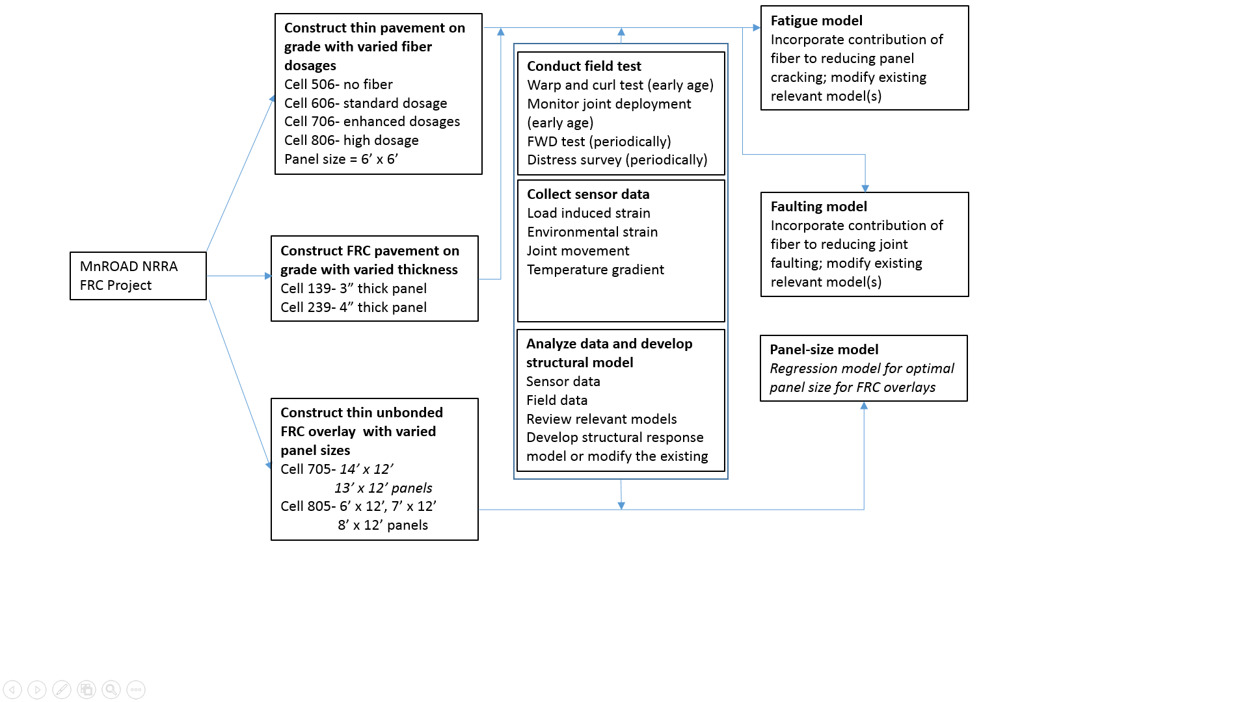
Research Methodology and Objectives

Slide 33
Tasks
Tasks | Schedule
Task 1: Literature review | 2017 Nov to 2018 February: COMPLETED, Report available at NRRA webpage
Task 2: Annual cell performance report | 2018 Aug to 2018 October: Year 1 2019 Aug to 2019 October: Year 2 2020 Aug to 2020 October: Year 3
Task 3: Contribution of fibers in reducing panel fatigue cracking | 2019 Jan to 2019 Dec
Task 4: Contribution of fibers in mitigating joint faulting | 2019 May to 2020 April
Task 5: Optimal panel size for FRC overlays | 2019 Aug to 2020 July
Task 6 and 7: Final report | April 2020 to 2020 October

Slide 34
MnROAD NRRA Section: FWD Data Analysis

Slide 35
MnROAD NRRA Section: FWD Data Analysis
59

Slide 36
MnROAD NRRA Section: FWD Data Analysis

Slide 37
MnROAD Old FWD Data
Cell 95 had Polyolefin fibers
Crack width increase

Slide 38
MnROAD Old Crack Width Data
Notes:
Fiber dosages: standard - corresponding to 20% residual strength ratio (ASTM C1609); enhanced - corresponding to 30% residual strength ratio (ASTM C1609); high – corresponding to 0.75 fibers volume fraction.

Slide 39
Concluding Remarks
Structural fibers are contributing; we have evidence
Most commonly used fibers are structural synthetic fibers
Stiffer fibers with crimped, embossed and twisted geometry performs better than the low stiffness
straight fibers, in terms of post crack performance
Fibers can improve 20% load transfer efficiency
We need to look at the fiber relaxation characteristics
These benefits shall be considered in the performance models that would be required for structural
design
Notes:
Fiber dosages: standard - corresponding to 20% residual strength ratio (ASTM C1609); enhanced - corresponding to 30% residual strength ratio (ASTM C1609); high – corresponding to 0.75 fibers volume fraction.

Slide 40
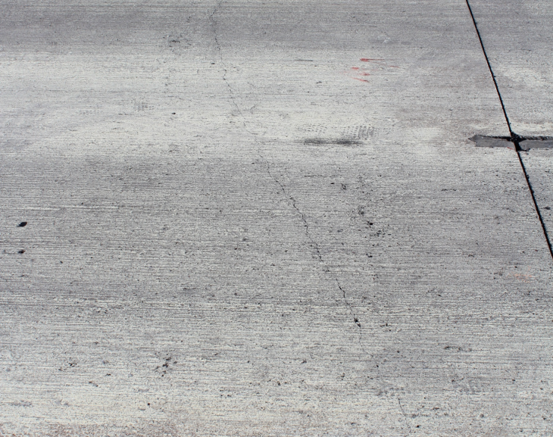
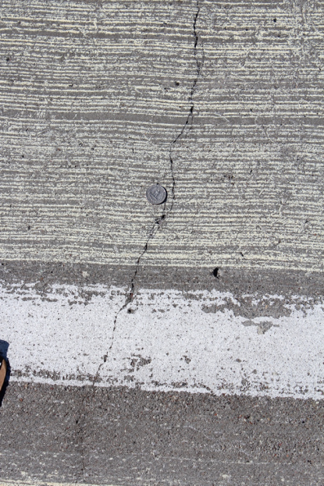
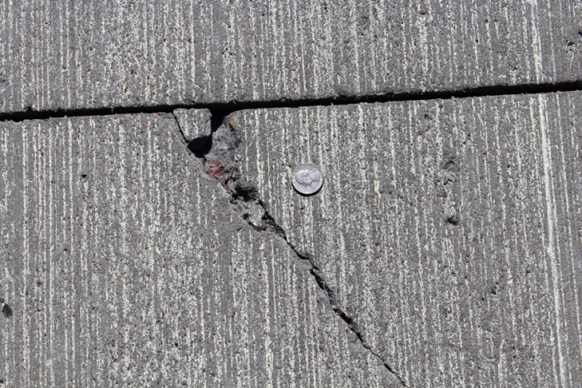
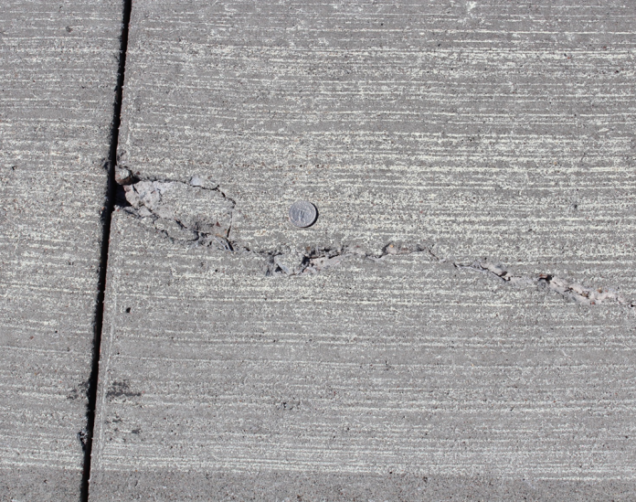
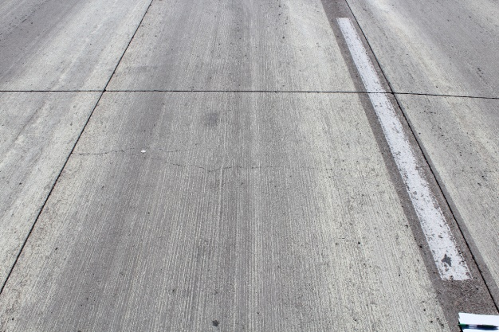
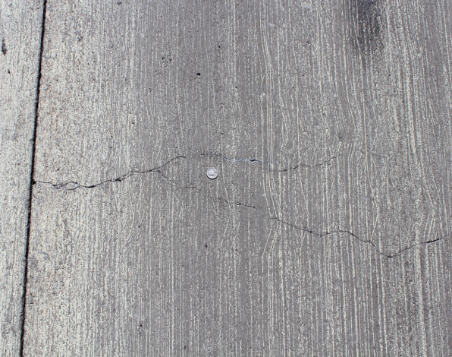
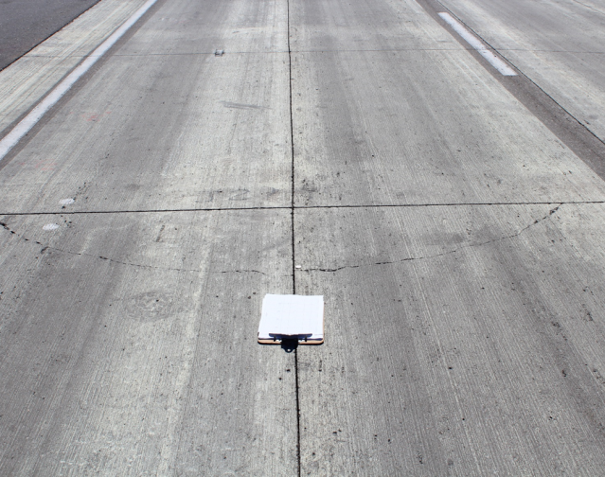
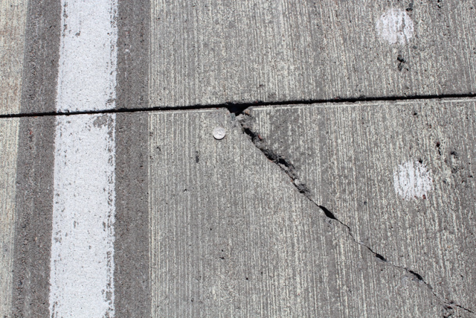
Questions?
Cell 705
mbarman@d.umn.edu
Cell 805

Slide 41


















































Thank You

