Slide 1


Concrete Pavement Repair Product Evaluations at MnROAD
Tom Burnham, P.E. | Senior Road Research Engineer, Minnesota Department of Transportation
NRRA Pavement Workshop 2018
5/23/2018

Slide 2
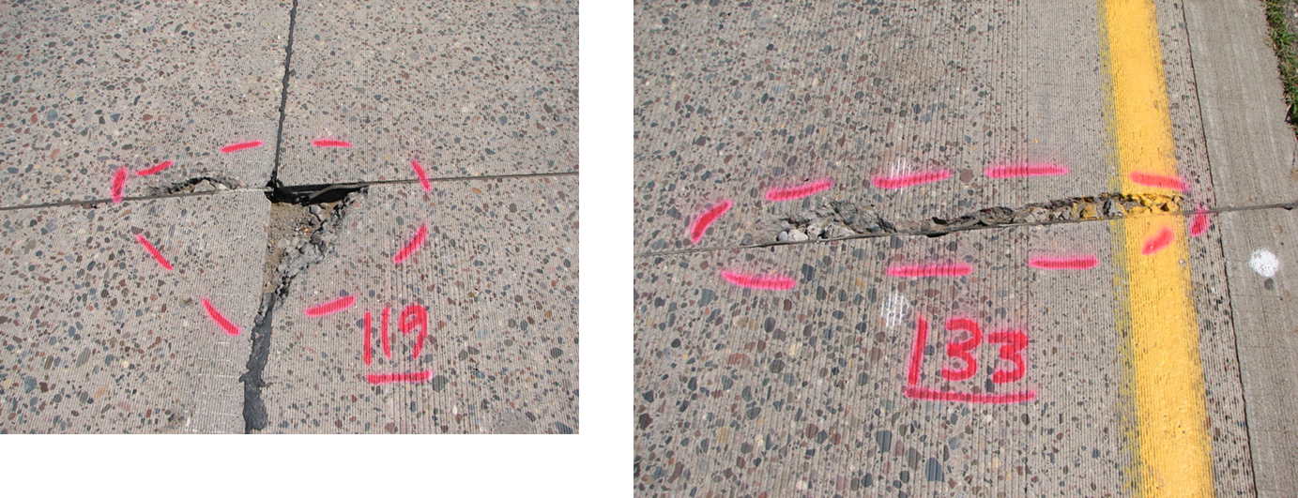
Typical Condition Before Patching
Original MnROAD concrete pavement cells constructed in 1992
1990 era MnDOT mixes not as durable as today (18 years to 1st repairs)

Slide 3
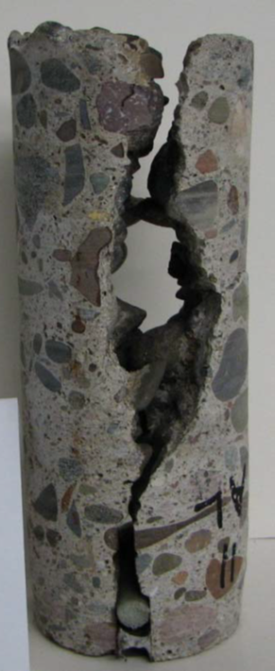
Not As Suitable for Partial-Depth Repairs
Due to surface condition (top 3” is sound) likely to ignore until it’s too late
Options for repair
Short term fix: Fill with sand to one-half depth
(to support mortar)
Long term fix: Change to full-depth repair

Slide 4
Partial-Depth Joint Repairs at MnROAD
Installed in 2011
93 concrete joints repaired
22 different materials (includes asphalt)
Many donated products (some installed by supplier)
Distress and soundness surveys conducted 4 times over 3 years
MnDOT Report 2016-16:
“Performance of Various Partial-Depth Repair
Materials at the MnROAD Facility”
Authors: Tom Burnham, Eddie Johnson, Ben Worel
http://www.dot.state.mn.us/research/TS/2016/201616.pdf

Slide 5
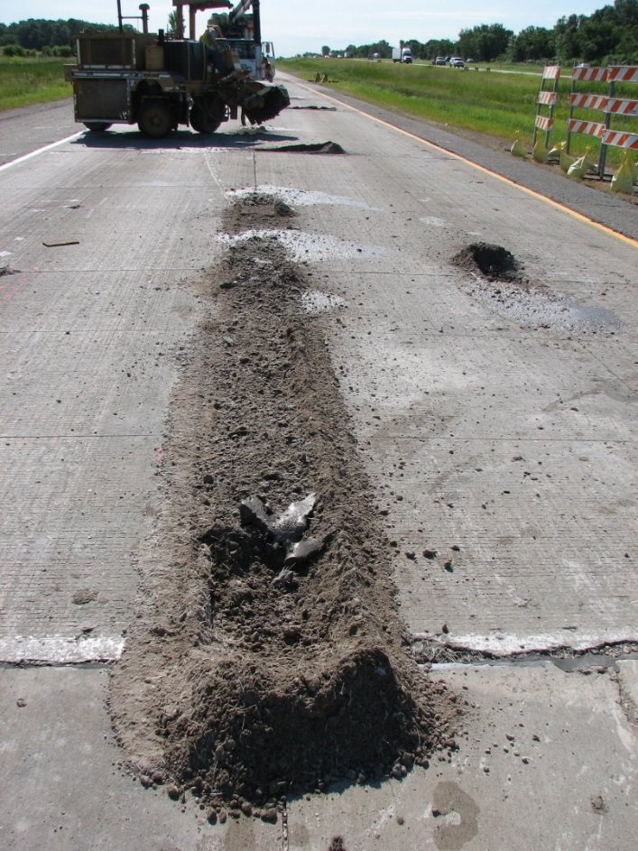
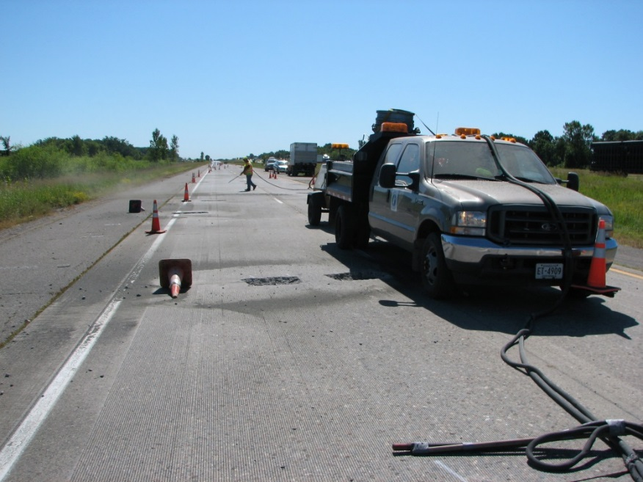
Repair Area Preparation
Rotary-Head Milling
Sand Blast & Cleaning

Slide 6
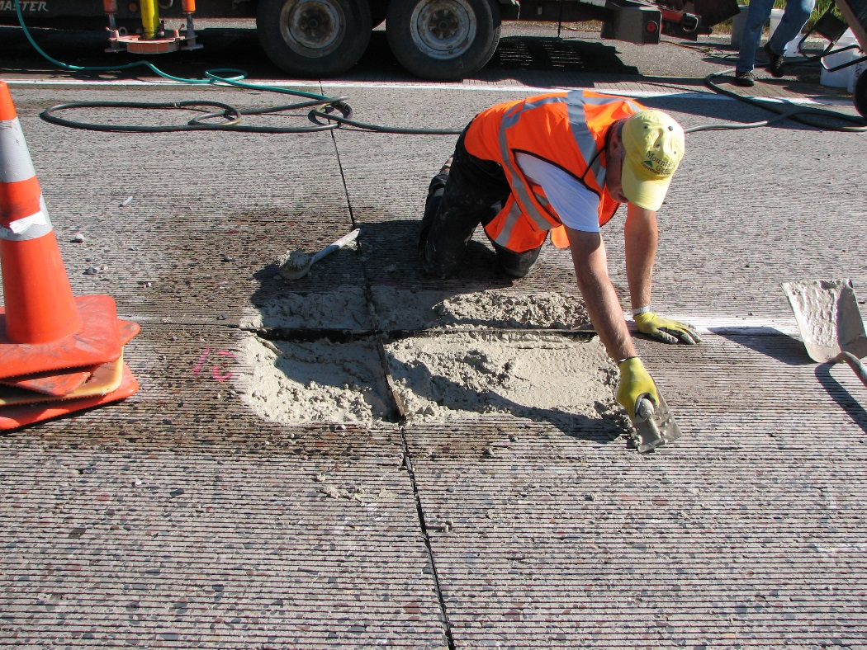
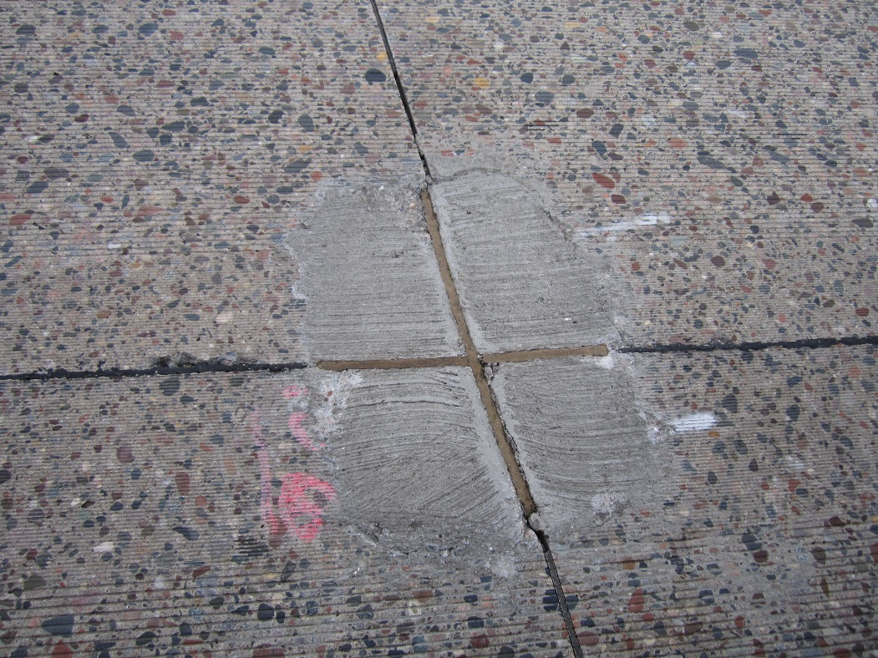
Typical MnDOT Installation
- Pre-wet and prime surface with mortar (for cementitious materials)
- Important to reestablish joint/crack

Slide 7
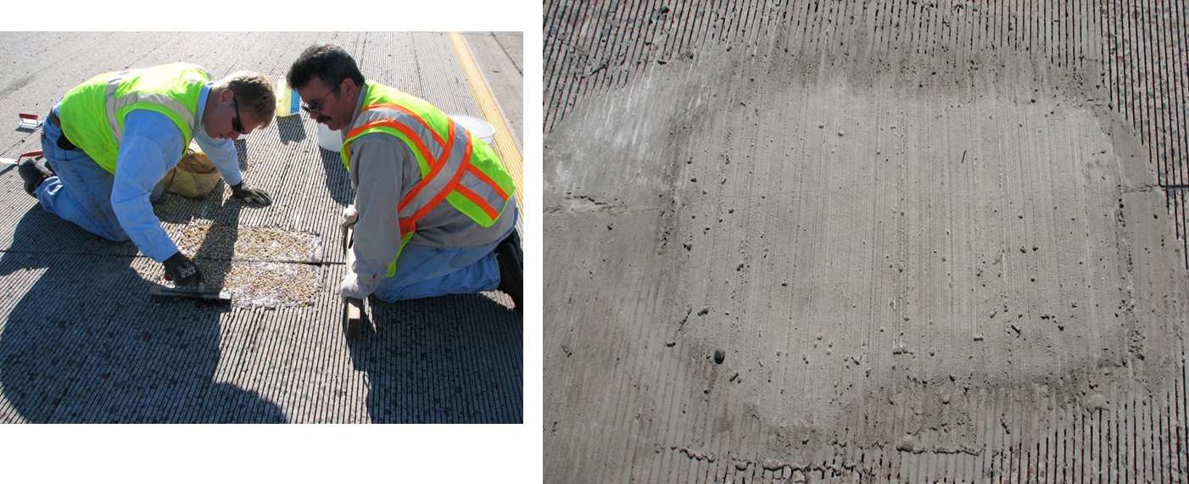
Installation by Suppliers
Some did not reestablish joint/crack

Slide 8
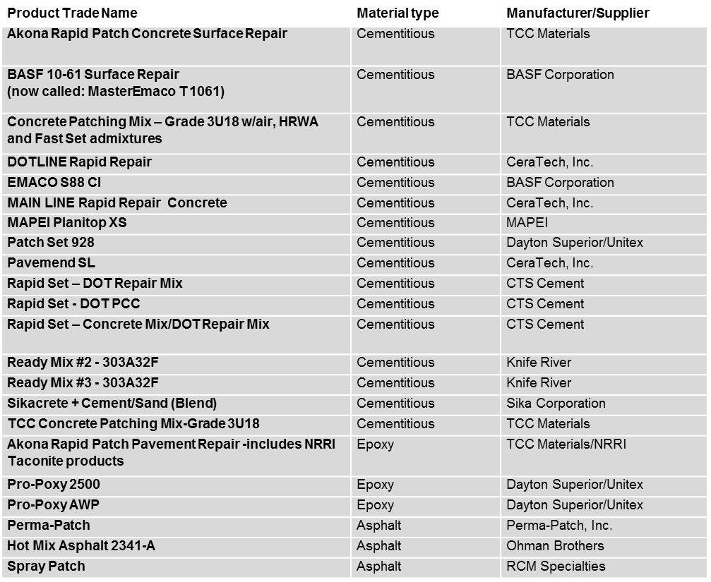
PCC Repair materials installed at MnROAD in 2011

Slide 9
Performance Parameters
Location
  Frequently Loaded: Wheel paths, corners near shoulders
  Infrequently loaded: Between wheel paths, centerline
Traffic volume
  Driving lane = 80%
  Passing lane = 20%
Condition
Cracking: subjective rating scale 0-5, based on visual survey
  0 = failed, replaced by other material
  5 = no distress (condition similar to new)
Bonding
  Subjective range: None to full
  Determined with ballpeen hammer sounding

Slide 10
Conditions Surveys
Patch Material | Joint Number | Patch location | Condition rating |  |  |  |  | Bonding condition Oct 2014
 |  |  | Feb 2012 | Oct 2012 | Apr 2013 | Sep 2013 | Oct 2014
BASF 10-61 Surface Repair | 112 | Centerline | 4 | 4 | 3 | --- | 2 | Full
Blow Patch - RCM | 94 | Centerline | 5 | 5 | 4 | --- | 4 | Full
Blow Patch - RCM | 95 | Drive Ln | 4 | 4 | 3 | --- | 0 | Full
Blow Patch - RCM | 95 | Drive Ln | 5 | 4 | 4 | --- | 3 | Full
Blow Patch - RCM | 95 | Pass Ln | 5 | 5 | 3 | --- | 3 | Full
DOTLINE Rapid Repair | 119 | Drive Ln | 5 | 5 | 5 | --- | 2 | Full
EMACO S88 C1 | 114 | Centerline | 5 | 4 | 4 | --- | 3 | Full
Mainline 4 hour PCC | 109 | Pass Ln | 2 | 2 | 1 | --- | 1 | None
MAPEI Plaintop XS | 111 | Pass Ln | 4 | 3 | 3 | --- | 2 | Full
Rapid Set - Green/Orange | 127 | Centerline/Pass Ln | 4 | 4 | 3 | --- | 3 | Full
Rapid Set - Green/Orange | 128 | Centerline/ Drive Ln | 3 | 2 | 2 | --- | 1 | Full
Rapid Set - Green/Orange | 129 | Centerline | 3 | 3 | 3 | --- | 2 | Full
Rapid Set - Green/Orange | 129 | Pass Lane | 4 | 4 | 4 | --- | 4 | Full
Rapid Set - Orange | 125 | Centerline | 4 | 4 | 2 | --- | 1 | Full
Rapid Set - Orange | 126 | Centerline | 4 | 4 | 3 | --- | 3 | Full
Ready Mix 2 - 303A32F | 101 | Centerline | 4 | 4 | 4 | --- | 2 | Partial - NW corner
Ready Mix 2 - 303A32F | 101 | Pass Lane | 5 | 5 | 4 | --- | 2 | Partial - West side
Ready Mix 2 - 303A32F | 102 | Drive Ln | 5 | 4 | 3 | --- | 1 | Full - with patch
Ready Mix 2 - 303A32F | 104 | Drive Ln | 5 | 4 | 3 | --- | 2 | Partial along W side of transv jt
Ready Mix 2 - 303A32F | 104 | Centerline | 5 | 5 | 5 | --- | 4 | Full
Sikacrete + Cement/Sand (Blend) | 117 | Centerline | 4 | 4 | 4 | --- | 3 | Full

Slide 11
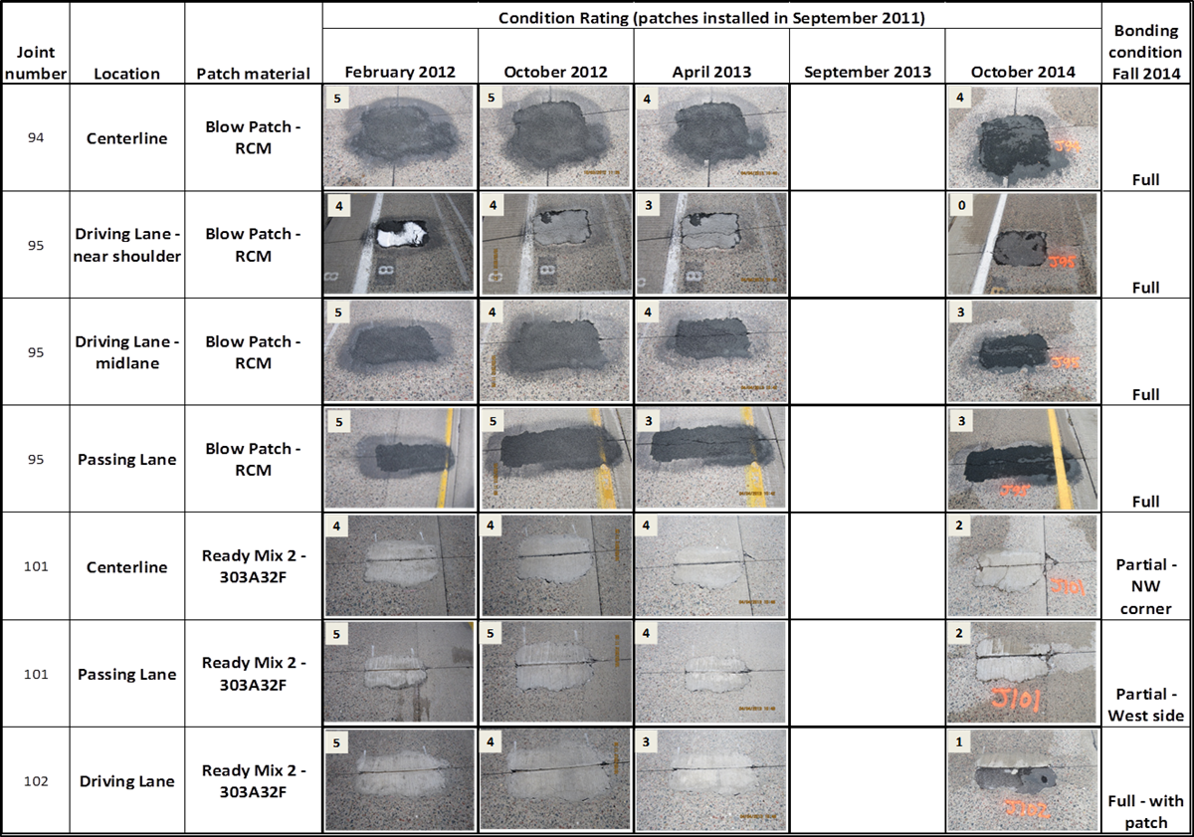
Patch Performance

Slide 12
Good Performance
Ready mix (not practical for rapid repairs)
Pavemend (only 1 repair on centerline)
Propoxy 2500
Rapid Set DOT
TCC 3U18
Hot Mix

Slide 13
Evaluation Summary
55 of the 93 (59%) patches remained in good serviceable condition as of October 2014 (3 years of service)
The location of the patch did not seem to affect the performance significantly
  61% of centerline and 67% of the loaded area patches were in good condition
Certain materials were installed by a supplier, with some not following standard installation procedure followed by MnROAD and MnDOT installers
  May have had negative effects on the condition rating, particularly when isolation/expansion joints were not reestablished
Each material type had good and poor performers

Slide 14
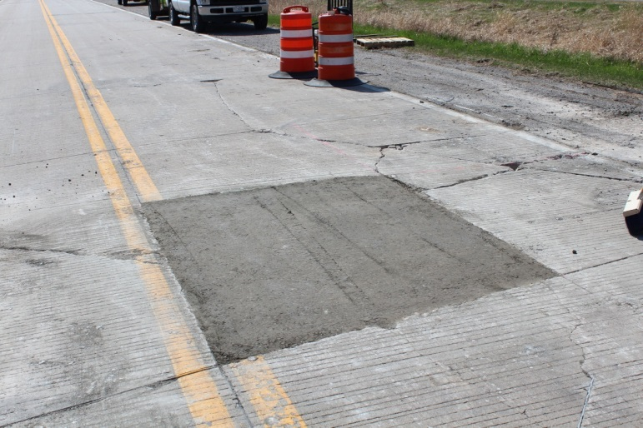
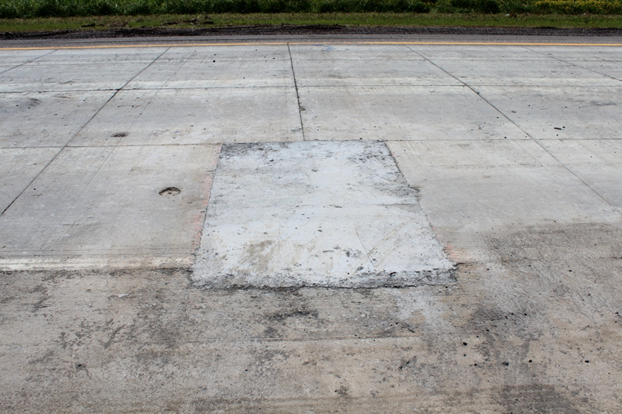
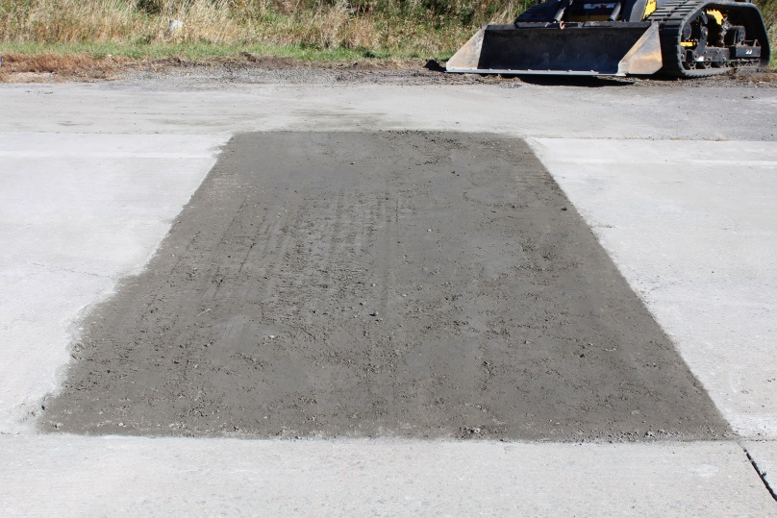
Full-Depth Repairs with RCC (2015)
Cell 38 – 6” JPCP
Cell 162 – 4” BCOA
Applied 80k MnROAD truck loading within 18 hours (no visible cracking)
Cell 505 – 5” UBOL

Slide 15
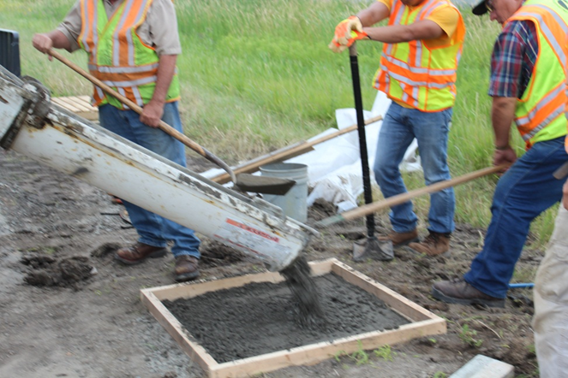
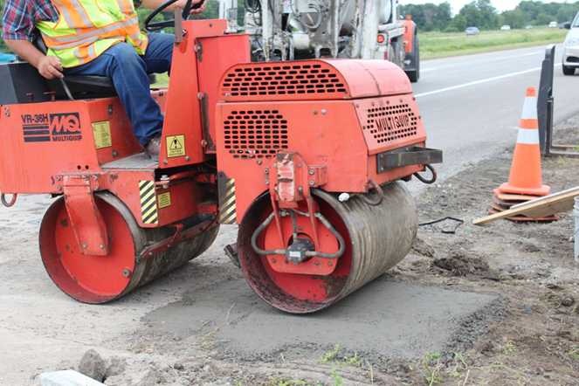
Installation of Full-Depth Repairs with RCC
Trial slab to determine surcharge before compaction

Slide 16
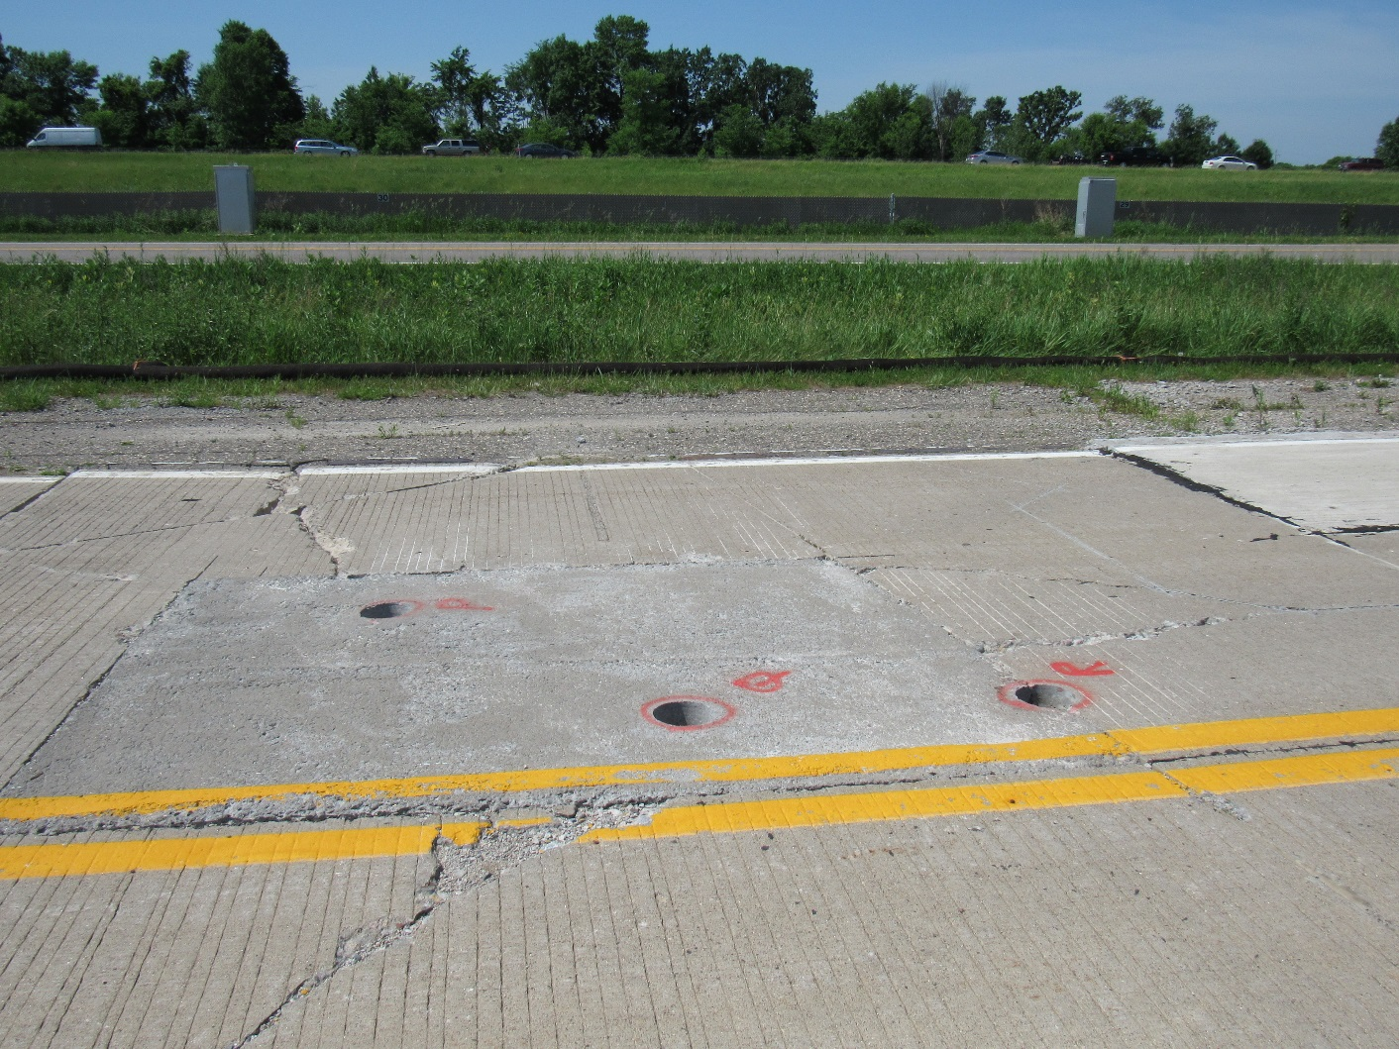
Performance of Full-Depth Repairs with RCC
After 2 years of LVR loading

Slide 17
Partial-Depth PCC Repairs on WB I-94 (MnROAD Bypass)
Installed in 2017
162 locations repaired
17 different materials (includes asphalt)
Donated products (some installed by supplier)
Distress and soundness surveys will be conducted periodically
Details on locations and mixes can be found in Chapter 9 of:
“Report on 2017 MnROAD Construction Activities” (Available Summer 2018)

Slide 18
PCC Repair Materials on WB I-94 Bypass
Product Trade Name | Material type | Manufacturer/Supplier
Rapid Set – DOT Repair Mix | Cementitious | CTS
RepCon 928 | Cementitious | SpecChem
FastRac 246 | Cementitious | Western Material and Design
3U18 Modified | Cementitious | TCC Materials
Ecofix | Cementitious | USG
Rapid Set DOT Repair Mix w/Helix 5-25-Standard BA (zinc coated) fibers | Cementitious | CTS/Helix
Rapid Set DOT Repair Mix w/Helix 5-25-SS BA (stainless steel) fibers | Cementitious | CTS/Helix
ProSpec Concrete Patching Mix | Cementitious | TCC Materials
CE 700 HPC | Epoxy | Western Material and Design
PaveSaver Polymeric Concrete Patch | Epoxy | D.S. Brown
FastPatch | Epoxy | Willamette Valley Company
Rapid Surface Repair Easy Mix | Epoxy | Five Star
Rapid Surface Repair Epoxy Fix | Epoxy | Five Star
HP Concrete Cold Patch | Petroleum-based | Crafco
Techcrete-TBR | Hot Mastic | Crafco
Aqua Patch | Asphalt | Aqua Patch Road Materials
Hot Mix Asphalt 2341-A | Asphalt | Ohman Brothers

Slide 19
Installation Pattern

Slide 20
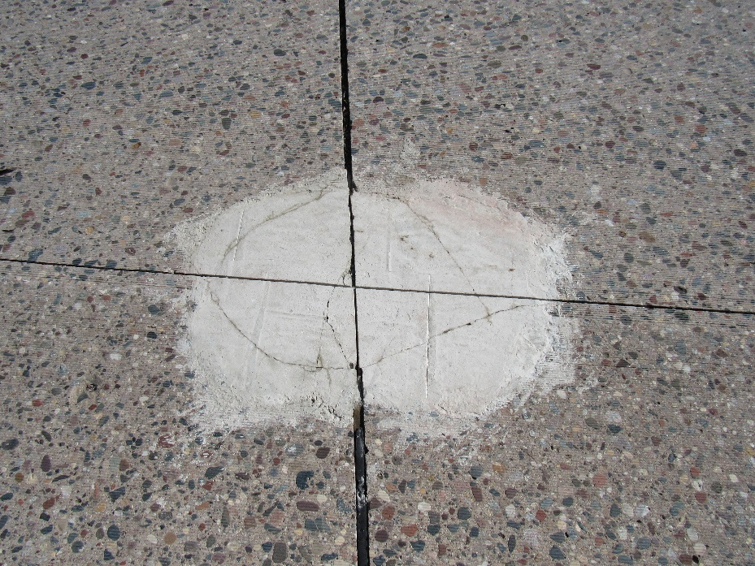
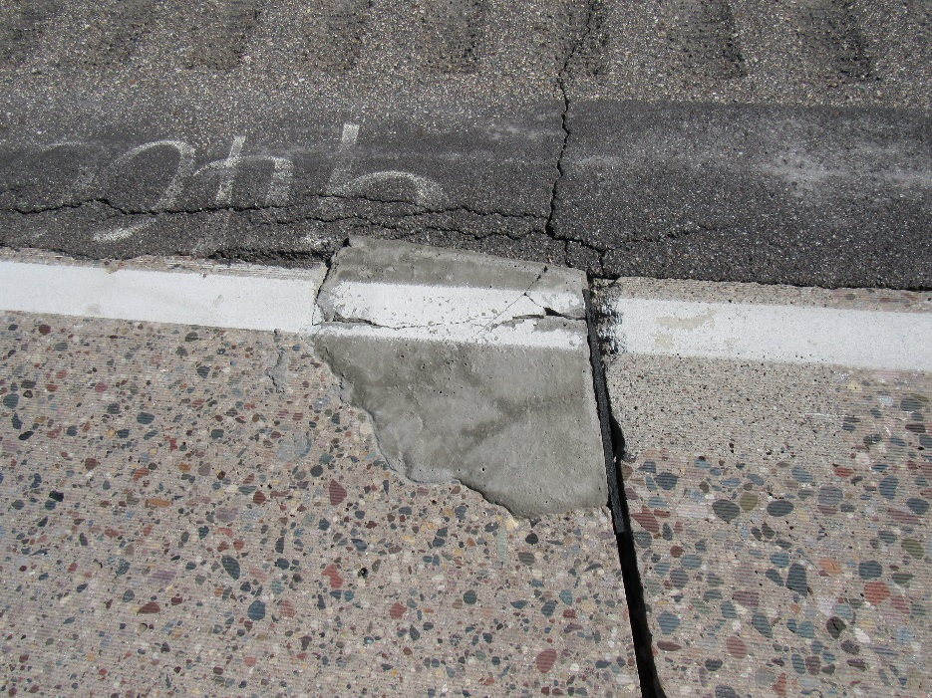
Condition - May 2018
Some cracking reported immediately after installation

Slide 21
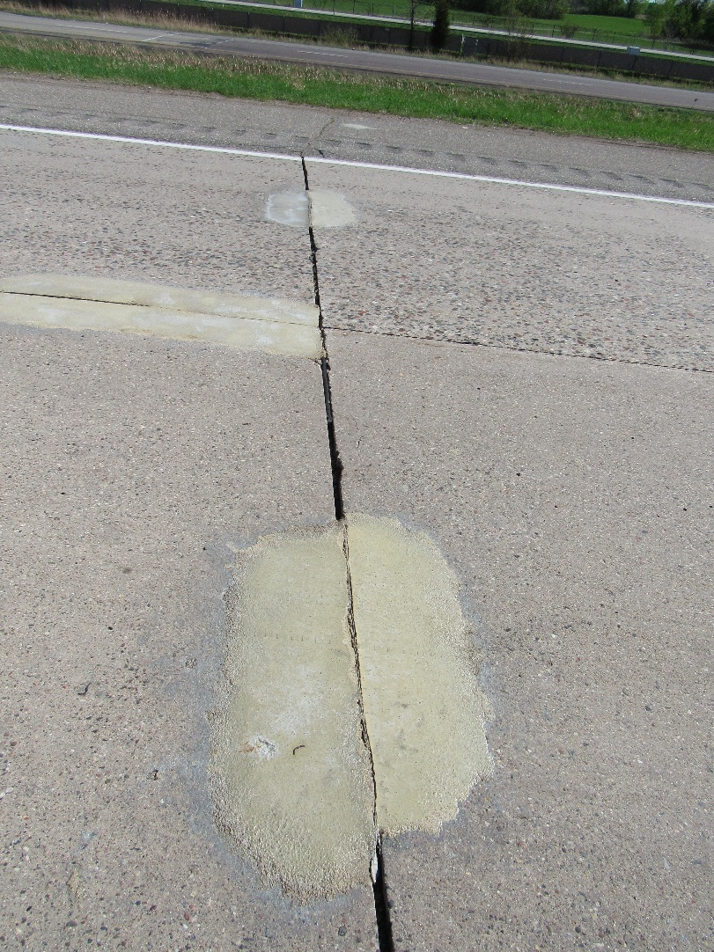
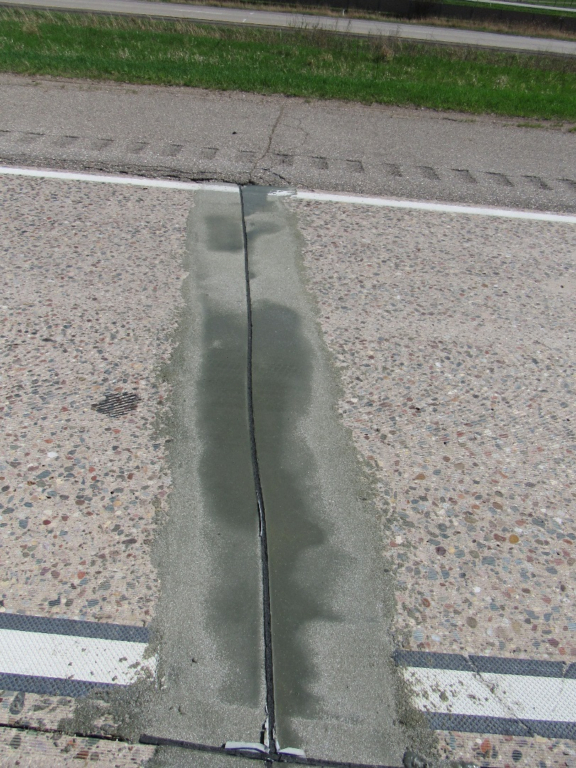
Condition - May 2018

Slide 22
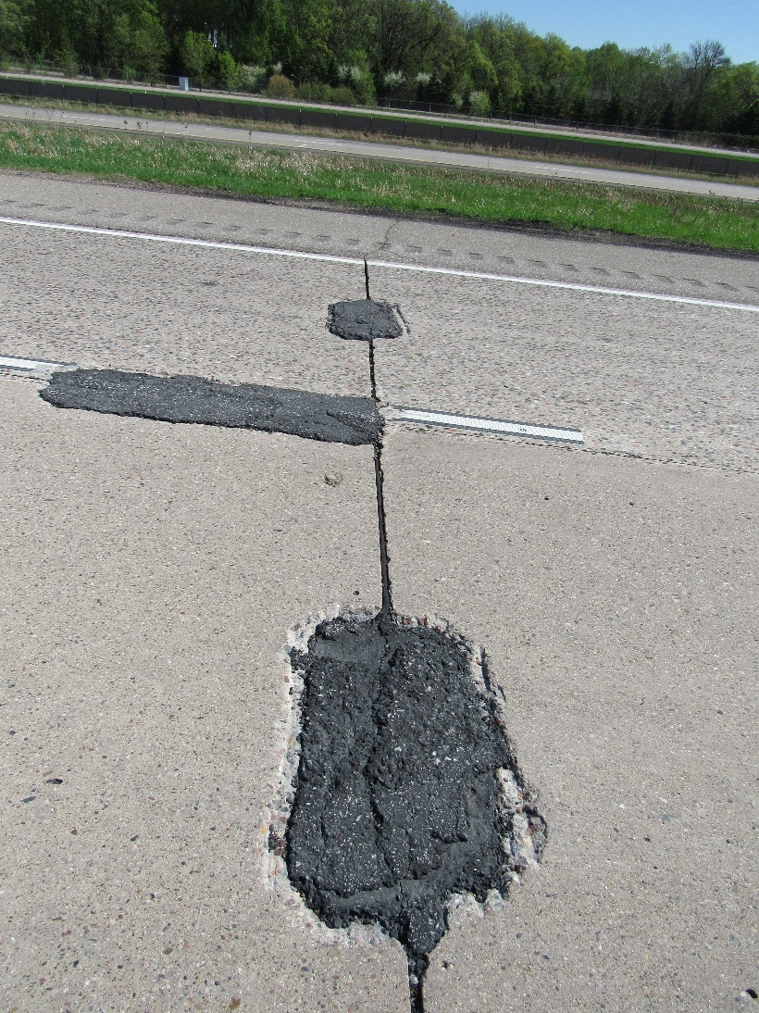
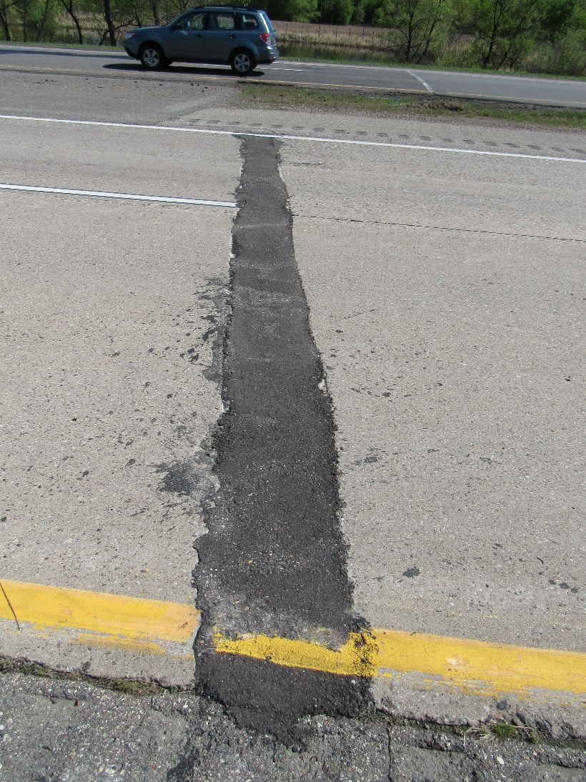
Condition - May 2018

Slide 23
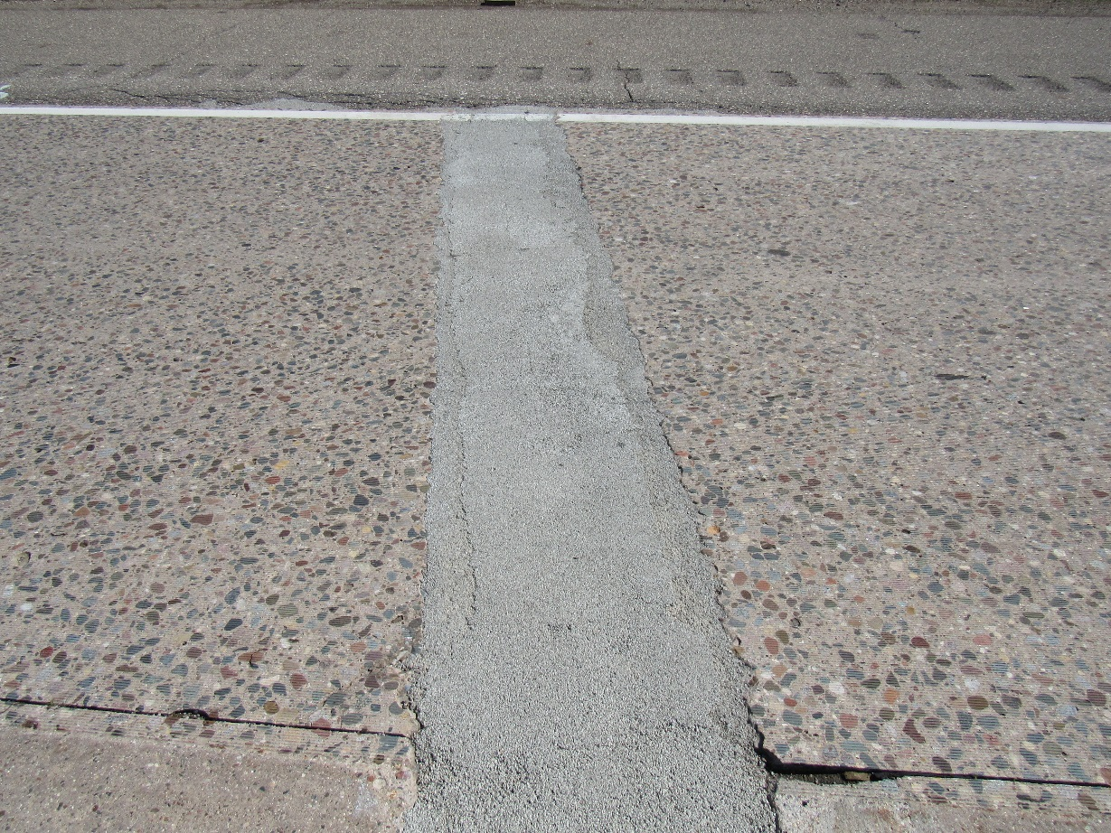
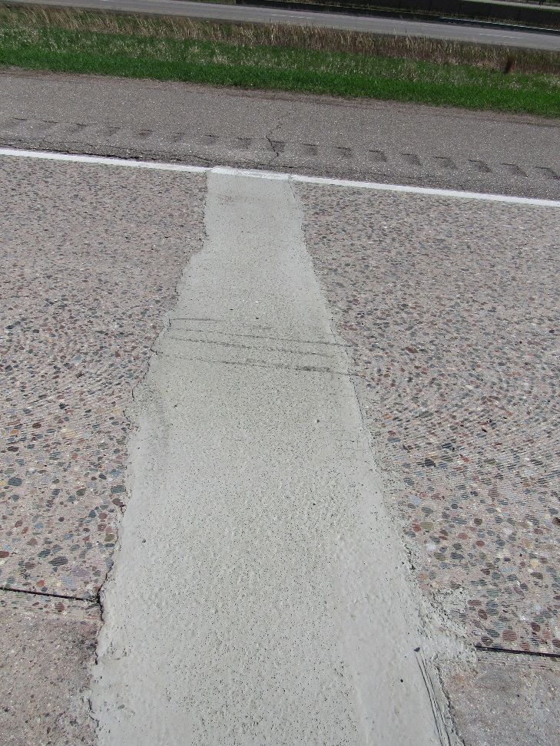
Condition - May 2018

Slide 24
Potential Issues?
Some products require special installation equipment/techniques
  Suitable for DOT maintenance forces/budgets?
Recyclability during future removal
  Will it “contaminate” recycled product?
  Will it “gum-up” milling/reclaiming machines?

Slide 25
2018 Repairs at MnROAD
Partial and full-depth joint repairs
  3U18
  3U58
  Special HE (3-4 hour opening strength)
Two full panel replacements
  RCC (including dowel bars)
  Internal Cure Mix
Early loading by empty tandem dump truck based on maturity
  ≈ 100 psi flexural first pass

Slide 26
Acknowledgments
All product suppliers and installers

Slide 27
Discussion
Discussion on topic

