Slide 1


2018 Pavement Workshop
May 23-24, 2018
The Future of Asphalt Binder Specifications
Andy Cascione
Asphalt Technical Representative
Flint Hills Resources
+ 46 Associate Members

Slide 2

One Hundred Years Ago in 1918
World War I officially ends with the Treaty of Versailles
US Congress approves time zones
The average middle class family makes $1,500 per year
The Boston Red Sox win the World Series and trade Babe Ruth to the Yankees
The US Bureau of Public Roads develops penetration grades for asphalt

Slide 3
Evolution of Binder Specifications
Penetration Grading
Viscosity Grading
Performance Grading
MSCR Testing
?
The Future
1918
1963
1993
2010
60/70
85/100
AC-10
AC-20
PG 58-28
PG 64-22
PG 58H-28
PG 58V-28
Notes:
In the last 100 years we come a long way with binder testing. Starting in 1918 the US adopted a penetration grading system, then in 1963 we transitioned to viscosity grading. Starting in 1993 we used performance grading, with the most recent update being MSCR grades in 2010. So what will the future bring? Based our history, our specs will likely continue to evolve.

Slide 4
MSCR Test Development
Grading System Based on Climate and Traffic
Applies a larger stress to an asphalt sample in the DSR
Measures Jnr to characterize rutting resistance at the design traffic level
Measures % Recovery to ensure proper polymer networking and overall elastic behavior at the pavement temperature
PG 58H - 28
Performance Grade
Minimum pavement design temperature
Average 7-day max pavement design temp
Traffic
Level
Notes:
For those of you who aren’t familiar with MSCR grading, it’s a system that’s based on climate and traffic. When you conduct the MSCR test, you can add an additional grading element to the performance grade. After the high temperature PG, a letter is added that corresponds to the traffic level the asphalt can resist flow at that test temperature. The benefit of the MSCR test is that a larger stress is applied to the asphalt sample in the DSR. That improves the characterization of polymer modified asphalt. Two parameters are measured in the test, the Jnr and the %Recovery. The Jnr has a better correlation with field rutting performance than G*/Sind, while the %Recovery ensures proper polymer networking.

Slide 5
Past “Temperature Bumps”
58°C
(136°F)
64°C
(147°F)
70°C
(158°F)
PG 58-28
PG 64-28
PG 70-28
1 “Bump”
2 “Bumps”
  Standard traffic
  Slow or heavy traffic
  Stationary or
  high volume traffic

Slide 6
MSCR “Traffic Bumps”
58°C
58°C
58°C
58°C
PG 58S-28
PG 58H-28
PG 58V-28
PG 58E-28
1 “Bump”
2 “Bumps”
3 “Bumps”
  Standard traffic
  Heavy traffic
  Very heavy traffic
  Extreme
  traffic

Slide 7
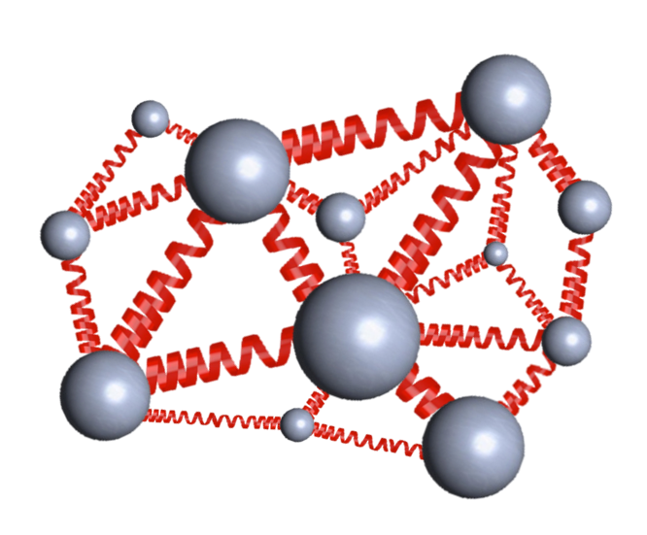
AASHTO M332 (Modified by CSBG)
E
V
H
S

Slide 8
Production Samples 2013 -2017
Asphalt Grade | High PG |  | % Recovery
 | Average | Lowest | Lowest
PG 58-34 | 61.8 | 58.9 | 11.8
PG 58H-34 | 63.3 | 59.9 | 38.1
PG 64-34 | 66.6 | 64.4 | 43.4
PG 58V-34 | 67.3 | 64.0 | 60.2
PG 64-28 | 67.2 | 65.2 | 19.8
PG 58H-28 | 67.6 | 65.3 | 35.8
Red values plot below AASHTO Recovery Curve

Slide 9
Polymer Modified Asphalt
In a Fluorescence Microscope
Unreacted
Partially Reacted
Fully Reacted
200 μm
% R = 21.0
Jnr = 0.68 Pa⁻¹
%R = 46.4
Jnr = 0.39 Pa⁻¹
%R = 58.3
Jnr = 0.31 Pa⁻¹
The % Recovery improves as the polymer develops a crosslinked network in the asphalt
Notes:
At FHR we captured images of a polymer modified asphalt with a fluorescence microscope at different stages in the production process. At each stage, we tested the sample in the MSCR test at 58°C.
This allows us to see what the MSCR test result is telling us. The first image shows individual particles of polymer floating separately within the asphalt. The neat asphalt is black under the microscope, and the polymer is green. At this stage, the polymer is fully melted and mixed in the asphalt, but it’s not correctly reacted. The MSCR result of 21% recovery tells us that even with a substantial amount of polymer, there is very little elastic response in the asphalt, and it only classifies as a standard S grade. Even though the Jnr is very low, there’s still little elastic response. Polymer modified asphalt in this condition will also be unstable and prone to separation during production.
The middle image shows what happens to the sample as the polymer is reacted within the asphalt. The polymer chains begin to crosslink and form a tightly linked and stable network. The MSCR percent recovery test shows us that the formation of this network improves the elastic properties (and performance) of the asphalt binder. The Jnr didn’t change that much, but the % Recovery increased to 46%.
With this value, you know that when a stress causes a deformation in the asphalt, the asphalt will begin to rebound as a result of its elastic properties. This leads to a reduction in rutting and fatigue related distresses in pavements.
The bottom images shows what a fully reacted polymer modified asphalt looks like. The polymer chains are now completely crosslinked. By further improving the polymer network, the % Recovery increased to 58% which qualifies it as a V grade binder.
The images show that polymer modified asphalt cement is an engineered product. Simply mixing in polymer with asphalt will not necessarily improve asphalt properties and pavement performance. The system must be designed by properly reacting the polymer in the asphalt using the correct temperature, timing, and production process. And the MSCR test % Recovery value allows you to know when a supplier properly reacts and produces a polymer modified asphalt.

Slide 10
Beyond MSCR: Current Research
NCHRP 9-59 – Development of asphalt binder fatigue parameter
  G* X Sin(δ) needs improvement
  Replacement needs to relate binder fatigue to mixture fatigue
NCHRP 9-60 – Impact of asphalt formulation and manufacture
  Address poor quality asphalts that lead to low pavement durability & premature block cracking
NCHRP 9-61 – Improve laboratory aging methods
  Optimize RTFO and PAV procedures to simulate longer field aging times
Fatigue & Cracking Tests Under Evaluation
DeltaTc
SENB
ExBBR
R-value
Phase Angle
Glover-Rowe
LAS
Crossover Temp.
Crossover Freq.
DENT
ABCD
BBR
DSR
Other

Slide 11
Asphalt Binder Fatigue Testing
G*x Sinδ is highly variable (d2s% = 40.2)
Test variability is greater than production variability
  G* is the culprit, not phase angle (δ)
Current parameter can actually make asphalt binders more susceptible to fatigue damage
Glover-Rowe parameter demonstrates δ needs to be higher at intermediate temperatures, not lower, for stress relaxation and microcrack healing
G* x Sin(δ)

Slide 12
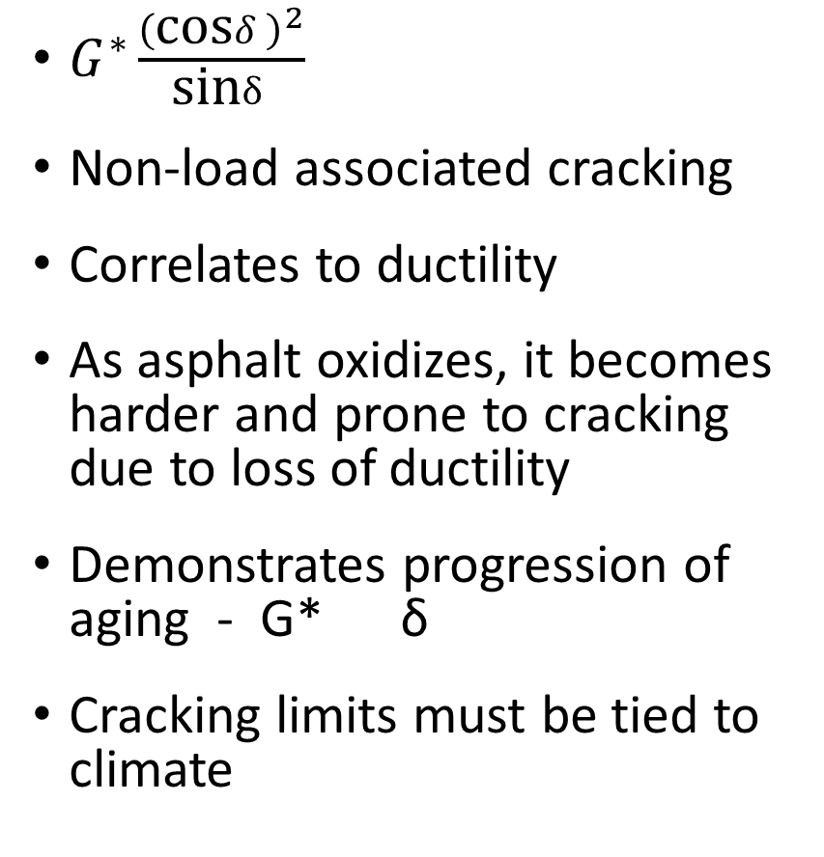
Glover – Rowe (G-R) Parameter
$G^{∗}\frac{{\left(\text{cos}δ\right)}^{2}}{\text{sin}δ}$
Non-load associated cracking
Correlates to ductility
As asphalt oxidizes, it becomes harder and prone to cracking due to loss of ductility
Demonstrates progression of aging - G* δ
Cracking limits must be tied to climate

Slide 13
Delta Tc (ΔT_{c}) – Age Related Cracking
ΔT_{c} = Stiffness Low PG – m-value Low PG
As asphalt ages, it becomes more m-controlled and loses it’s ability to relax stresses - ΔT_{c}
Asphalts < -5 could be prone to cracking
Some asphalts have a low ΔT_{c}
  Waxes, REOB, paraffinic crudes
  Leads to physical hardening, cracking
Testing time and variability?
BBR Results for Gulf-Southeast Asphalt
-10.0
-20.0
Temperature, °C
Tc (Stiffness)
-30.0
Tc,(m-value)
-40.0
0
20
40
60
80
PAV Aging Time, Hrs
From AAPT 2011; M. Anderson, et al

Slide 14


















































Thank You

