Slide 1

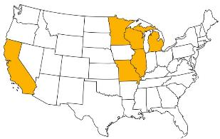
2018 Pavement Workshop
May 23-24, 2018
Determining Pavement Design Criteria for Recycled Aggregate Base and Large Stone Subbase
TPF-5(341)
Bora Cetin
Assistant Professor
Iowa State University
+ 46 Associate Members

Slide 2
RESEARCH TEAM
Iowa State University
Principal Investigator – Bora Cetin
  Assistant Professor – Department of Civil, Construction & Environmental Engineering
Co-Principal Investigator – Ashley Buss
  Assistant Professor – Department of Civil, Construction & Environmental Engineering
Co-Principal Investigator – Halil Ceylan
  Professor – Department of Civil, Construction & Environmental Engineering
Co-Principal Investigator – Junxing Zheng
  Assistant Professor – Department of Civil, Construction & Environmental Engineering
Research Personnel – Haluk Sinan Coban
  PhD Student – Department of Civil, Construction & Environmental Engineering
  University of Wisconsin-Madison
Co-Principal Investigator – William Likos
  Professor – Department of Civil and Environmental Engineering
Co-Principal Investigator – Tuncer B. Edil
  Professor Emeritus – Department of Civil and Environmental Engineering

Slide 3
OUTLINE
Problem Statement
Background
Objectives
Research Plan & Current Progress
Research Progress
Products and Deliverables

Slide 4



PROBLEM STATEMENT

Slide 5
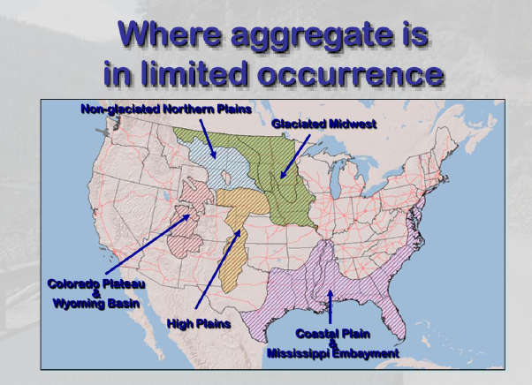
PROBLEM STATEMENT

Slide 6
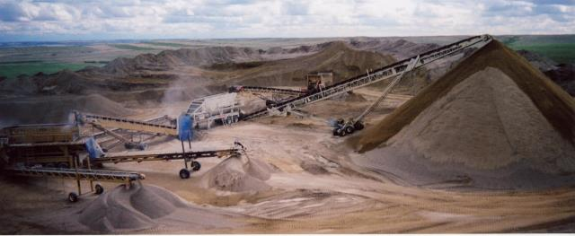
PROBLEM STATEMENT
2 billion tons/year aggregate produced (FWHA 2004)
200 million tons/year of RCA and 90 million tons/year of RAP generated (FHWA 2011)
(http://www.gratechcompanyltd.com/aggregate.htm)

Slide 7
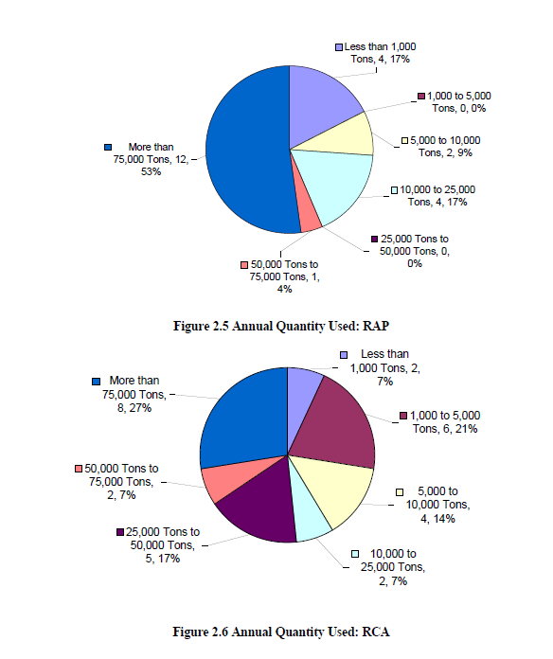
PROBLEM STATEMENT
Annual Quantity Used
RAP
RCA
(Edil et al. 2012)

Slide 8



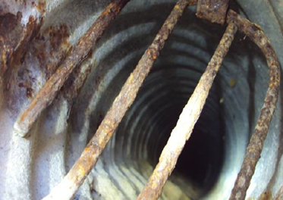
PROBLEM STATEMENT
Recycled Aggregates and Large Stone Subbase
Guideline?
Environmental Impact?
Performance?
Fit?

Slide 9
OBJECTIVES
1st Goal – Determine the field and laboratory performance
FWD, LWD, DCP, Intelligent compaction (IC) data
2nd Goal – Develop a method to estimate the stiffness and permeability
Percent crushing of recycled aggregates and LSSB
Sphericity, angularity, and surface texture of aggregates
3rd Goal – Prepare a pavement design and construction specification
Performance
Cost benefits
Unsaturated characteristics, index properties
Gravel, sand, fines content, gravel-to-sand ratio, D₁₀, D₃₀, D₅₀, D₆₀
Life cycle cost

Slide 10
RESEARCH PLAN
Task 1 – Literature Review and Recommendations
Task 2 – Tech Transfer “State of Practice”
Task 3 – Construction Monitoring and Reporting
Task 4 – Laboratory Testing
Task 5 – Performance Monitoring, Reporting and Climatic Effects
Task 6 – Instrumentation
Task 7 – Pavement Design Criteria
Task 8 & 9 – Draft/Final Report

Slide 11
Task 1 – Literature Review and Recommendations
Pavement Systems and Base/Subbase Course Applications
  Pavement Systems
  Recycled Materials in Base Course Applications
  Large-Size Aggregates in Subbase Course Applications
  Motivation and Purpose of This Research
  Engineering Properties of RAP, RCA and LSSB Materials
  Gradation Characteristics
  Compaction Characteristics
  Hydraulic Properties
  Strength Properties
  Shear Strength Properties
  Stiffness Properties
  Permanent Deformation Properties
  Creep Properties
  Freeze-Thaw and Wet-Dry Durability
  Environmental Properties of RAP and RCA
  Properties of RAP
    pH Characteristics
    Heavy Metal Leaching Characteristics
    Poly-Aromatic Hydrocarbons (PAHs) Leaching Characteristics
  Properties of RCA
    pH Characteristics
    Heavy Metal Leaching Characteristics
  Geosynthetic Applications
  Functions of Geosynthetics
  Effects of Using Geosynthetics
  Design Methods
  Selected Practices of State DOTs
  Recommendations
  References
Design Methods
AASHTO 1993
MEPDG Design
Selected Practices of State DOTs
MnDOT
CalTrans
MDOT
MoDOT
IDOT
WisDOT

Slide 12
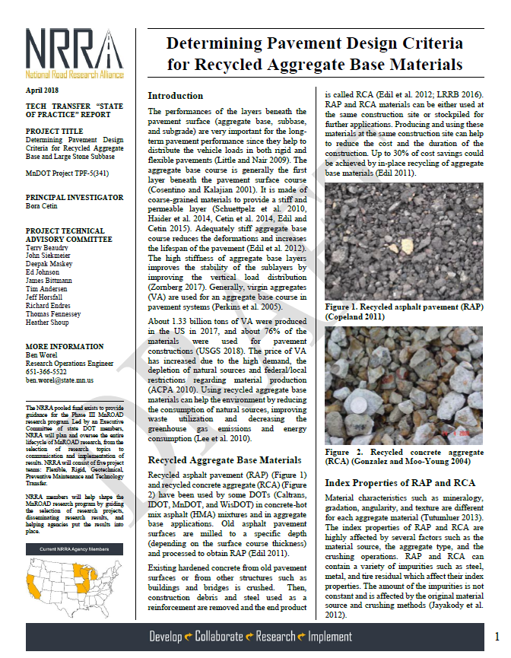

Task 2 – Tech Transfer Drafts
Determining Pavement Design Criteria for Recycled Aggregate Materials
Determining Pavement Design Criteria for Large Stone Subbase Materials

Slide 13
Task 3 – Construction Monitoring and Reporting

Slide 14
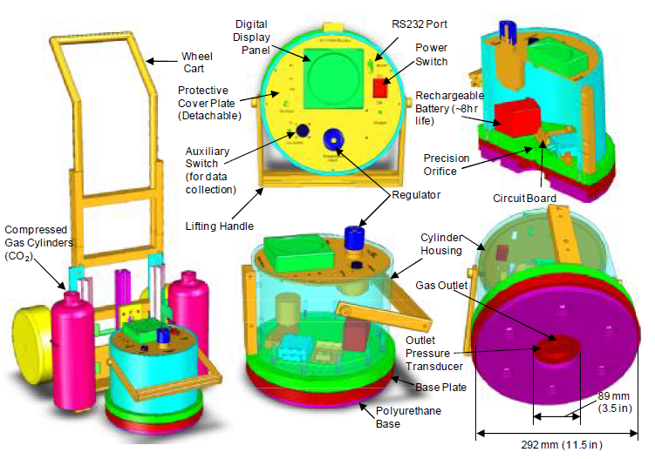
PERMEAMETER DATA ANALYSIS
Concept (White et al. 2010)
Variability of in-situ permeability – up to 400%
Gas permeameter test (GPT)
Rapid (< 30 sec) and portable (16 kg)
    Self-contained pressurized gas system
    Self-sealing base plate

Slide 15
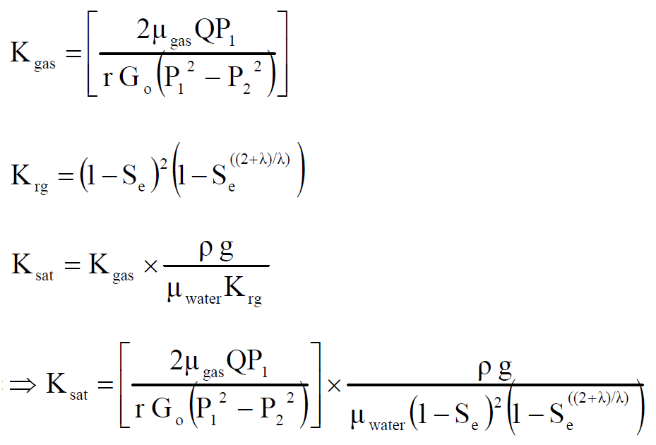
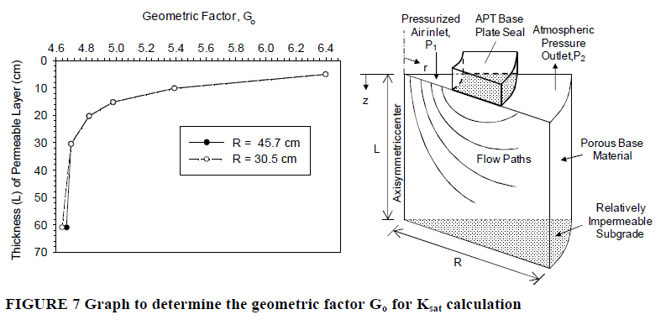
PERMEAMETER DATA ANALYSIS
Concept (White et al. 2010)
where;
K_{sat} = saturated hydraulic conductivity (cm/s)
K_{gas} = gas permeability
K_{rg} = relative permeability to gas
μ_{gas} = kinematic viscosity of the gas (PaS)
Q = volumetric flow rate (cm³/s)
P₁ = absolute gas pressure on the soil surface;
[P₁ (Pa) = P_{o(g)} (mm of H₂O) x 250 + 101325]
P_{o(g)} = gauge pressure at the orifice outlet (mm of H₂O)
P₂ = atmospheric pressure (Pa)
r = radius at the outlet (4.45 cm)
G_{o}= Geometric factor (dimensionless factor see Figure 7)
S_{e} = effective water saturation [S_{e} = (S – S_{r})/(1-S_{r})]
λ = Brooks-Corey pore size distribution index
S_{r} = residual water saturation
S = water saturation
ρ = density of water (g/sm³)
g = acceleration due to gravity (cm/s²)
μ_{water} = absolute viscosity of water (gm/cm-s)

Slide 16
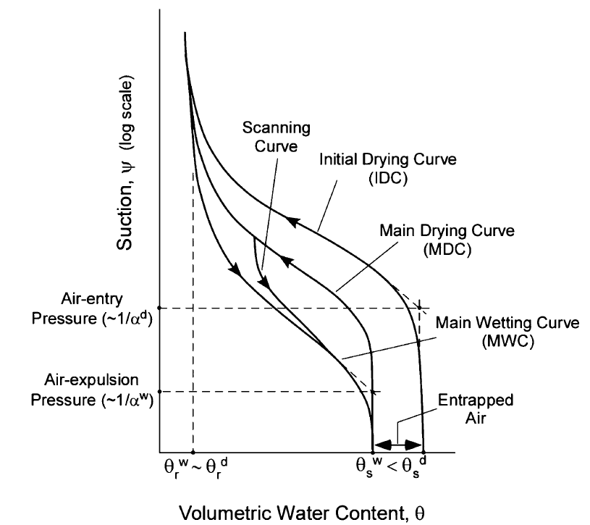
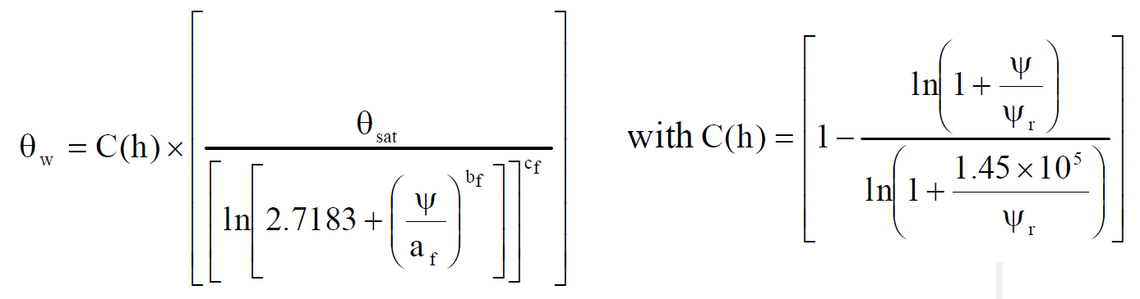
PERMEAMETER DATA ANALYSIS
Concept (White et al. 2010)
    S ➔ from in-situ dry unit weight and moisture content
    S_{r} and λ ➔ from soil water characteristic curves (SWCC)
    SWCC ➔ need to know gradation
(Likos et al. 2013)
af, bf, cf, and ψr ➔ SWCC curve fitting parameters correlated with material gradation properties
SWCC parameters are derived, then Sr and λ values are calculated using the Brooks and Corey (35) approach.

Slide 17
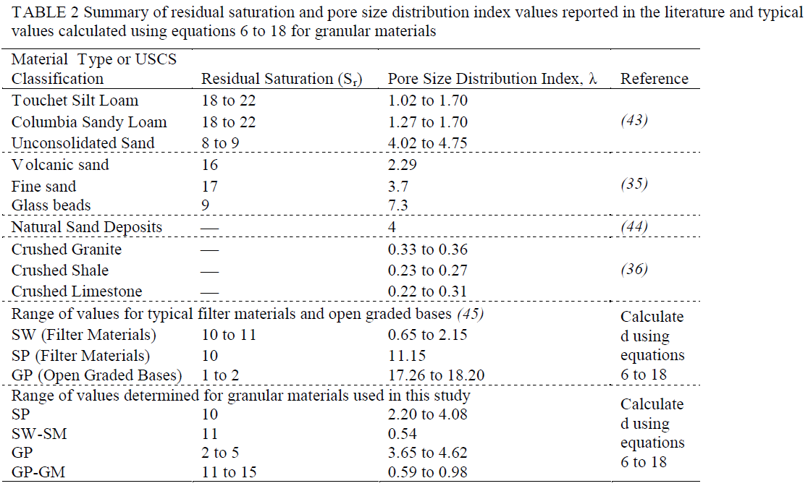
PERMEAMETER DATA ANALYSIS
Concept (White et al. 2010)
Typical S_{r} and λ values (alternative)

Slide 18
PERMEAMETER DATA ANALYSIS
Data Analysis

Slide 19
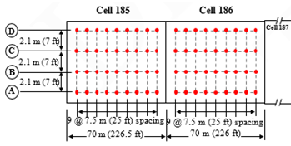
PERMEAMETER DATA ANALYSIS
Data Analysis
Inside
Outside
Notes:
After analyzing the test data, it was determined that some of the saturated hydraulic conductivity values were negative. The ISU team has gotten in contact with Dr. White regarding the unexpected negative values. It was told by Dr. White that the reason might have been some possible error during the testing or the malfunction of the gas permeameter test equipment. As a result, it was determined by the ISU team that negative values would be ignored.

Slide 20
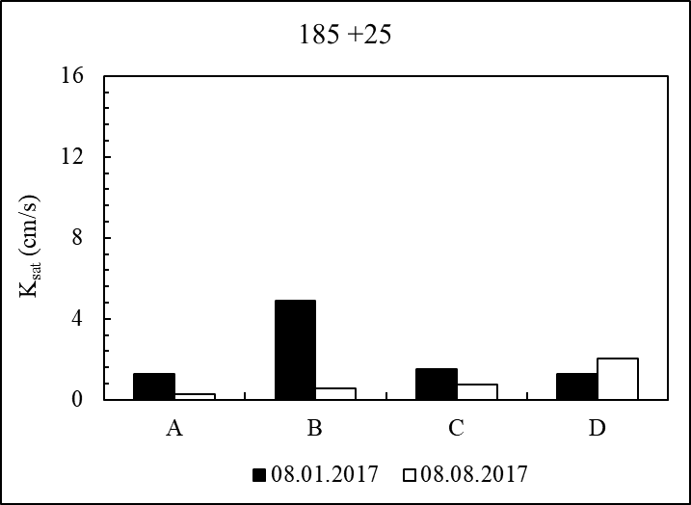
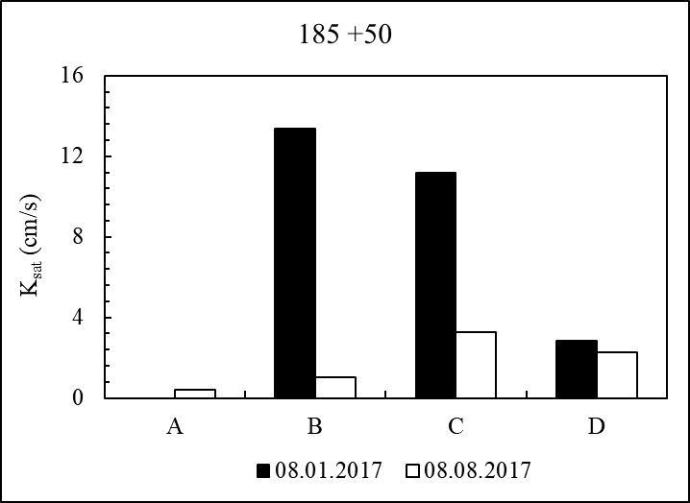
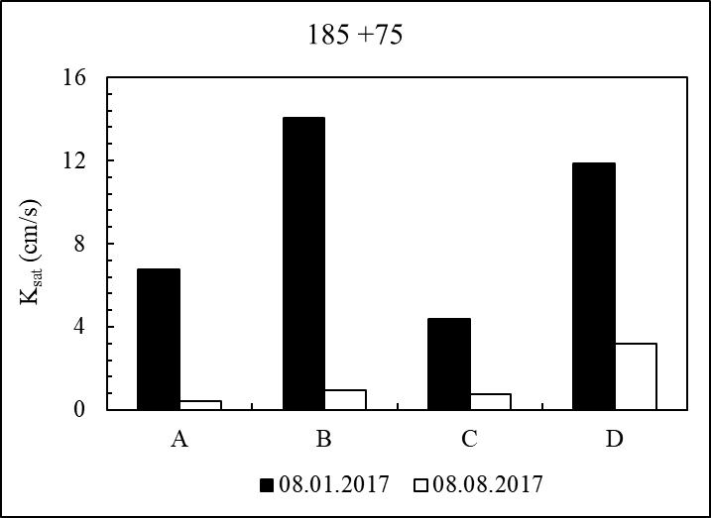
PERMEAMETER DATA ANALYSIS
Effect of Compaction
Inside
Outside

Slide 21
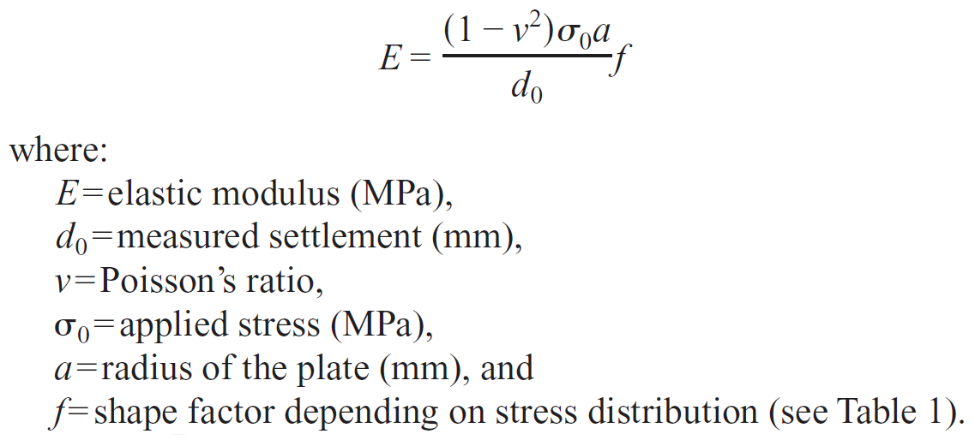
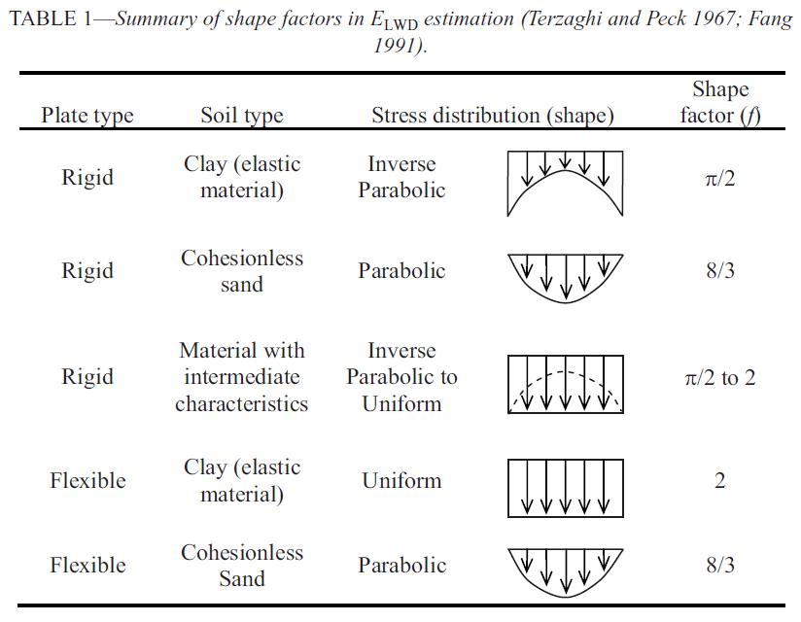
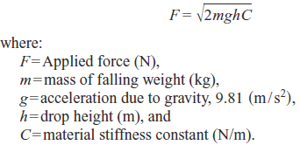
LWD DATA ANALYSIS
Concept (Vennapusa and White 2009)

Slide 22
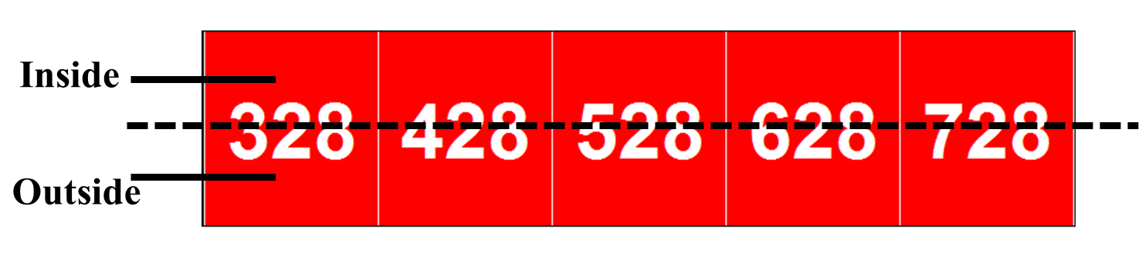
LWD DATA ANALYSIS
Data Analysis

Slide 23
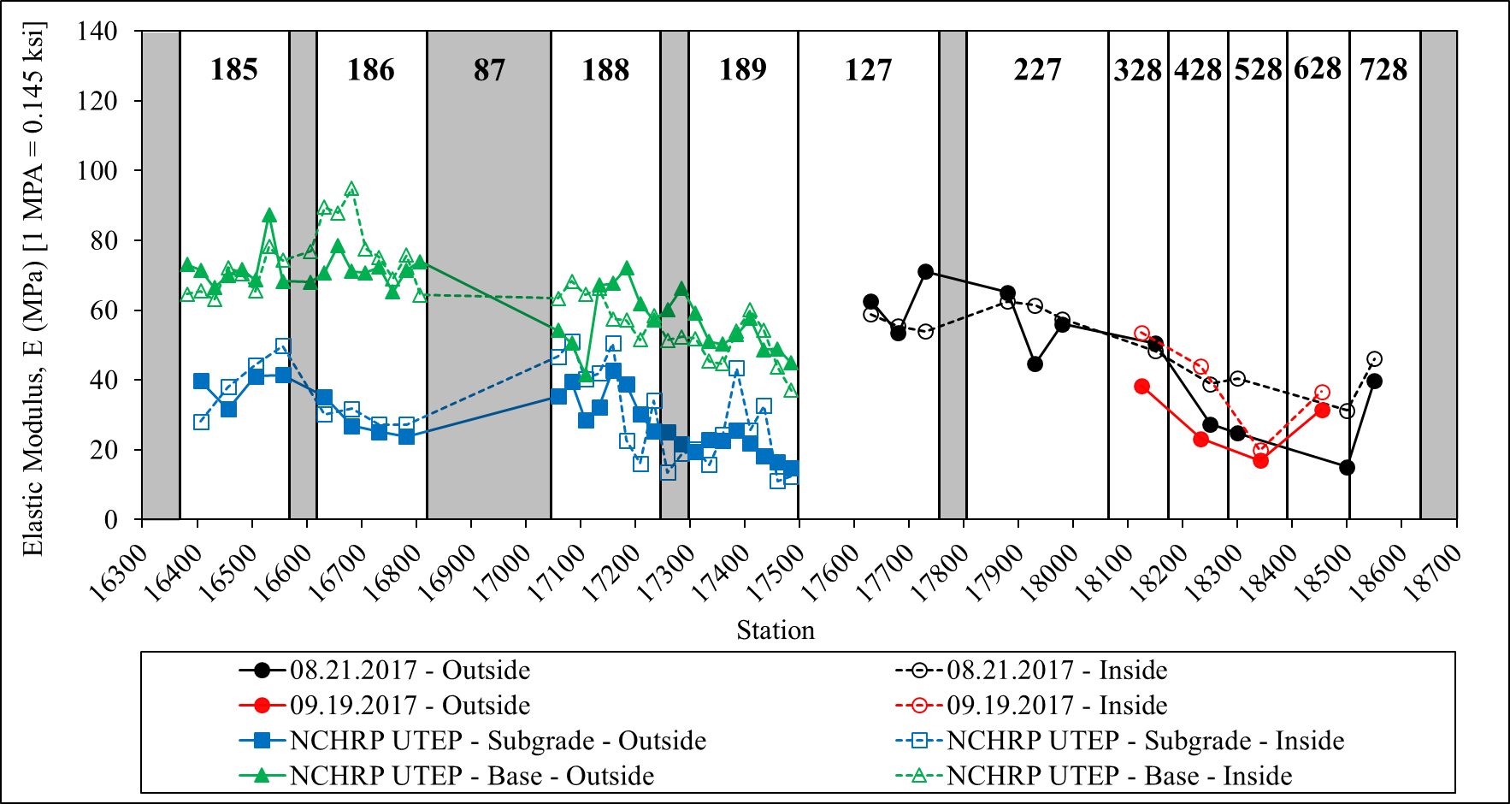
LWD DATA ANALYSIS
08.21.2017
09.19.2017
NCHRP UTEP

Slide 24
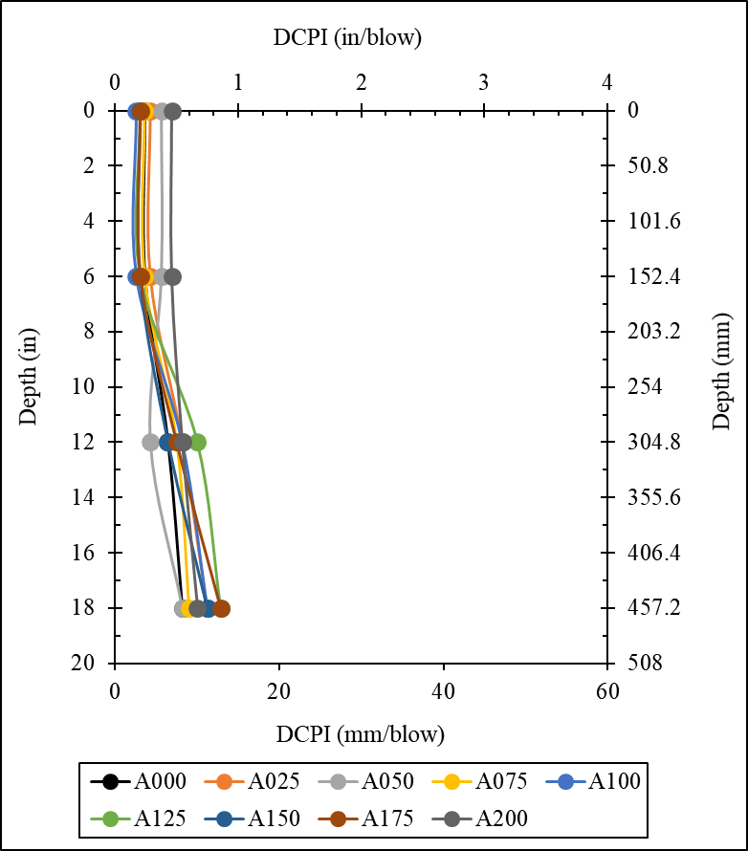
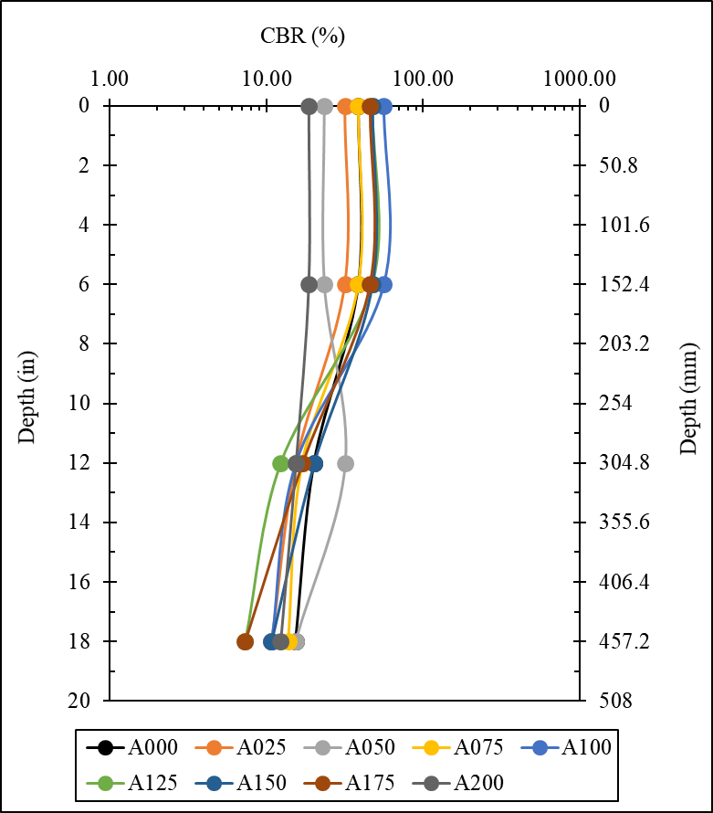
DCP DATA ANALYSIS
188 – Subgrade A – 01.24.2018 (NCHRP UTEP)

Slide 25
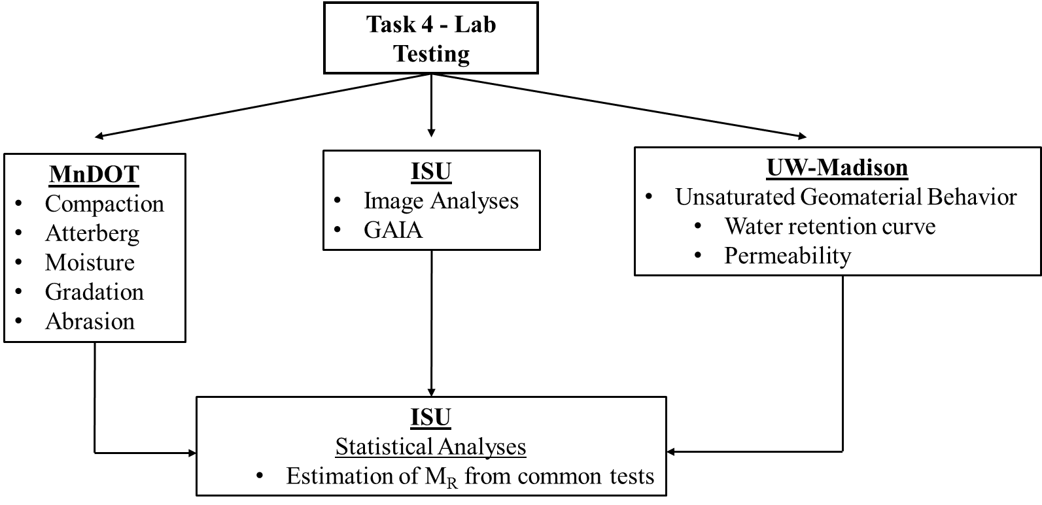
Task 4 – Laboratory Testing

Slide 26
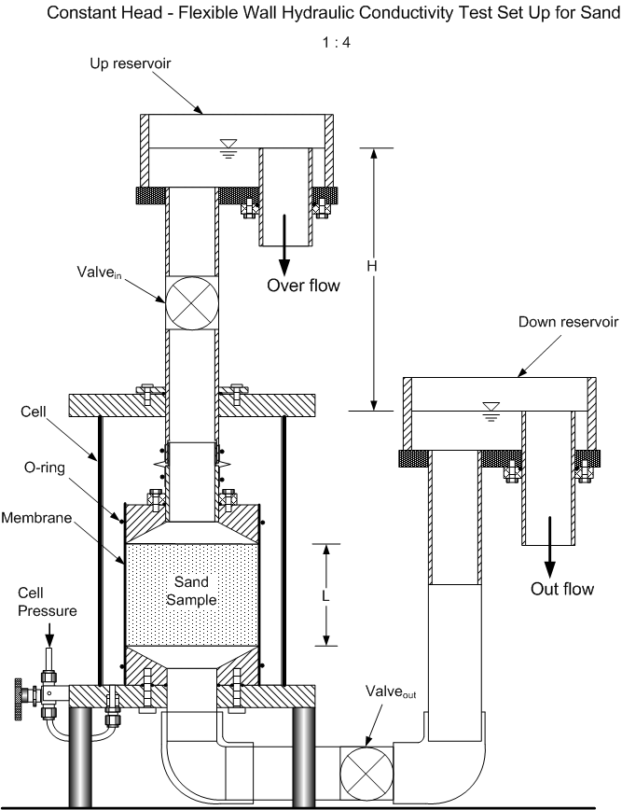
UW-Madison Flexible-Wall Permeameter for Coarse-Textured Soils
Photographic Portrayal by Xiaodong Wang &
Craig H. Benson

Slide 27
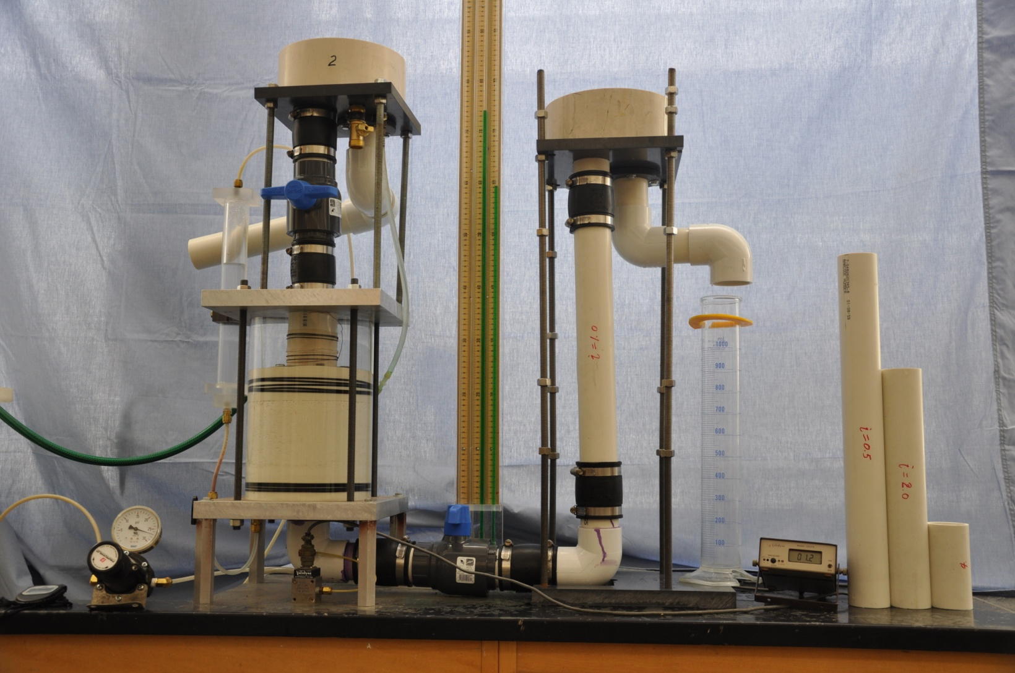
Permeameter with Constant Head Reservoirs for Headwater & Tailwater

Slide 28


K_{SAT} TEST RESULTS TO DATE

Slide 29
SWCC TEST RESULTS TO DATE

Slide 30
SWCC TEST RESULTS TO DATE

Slide 31
Task 5 & 6 – Performance Monitoring, Reporting, and Climatic Effects
The following data will be collected and analyzed:
    FWD, frost heave-thaw settlement, IRI, rutting, surface survey.
    Temperature, moisture, matric suction, strain data.
      Determine freeze-thaw cycle numbers and its impact on pavement performance
      Determine impact of frost heave and thaw settlements on pavement performance
      Predict frost/thaw depth

Slide 32
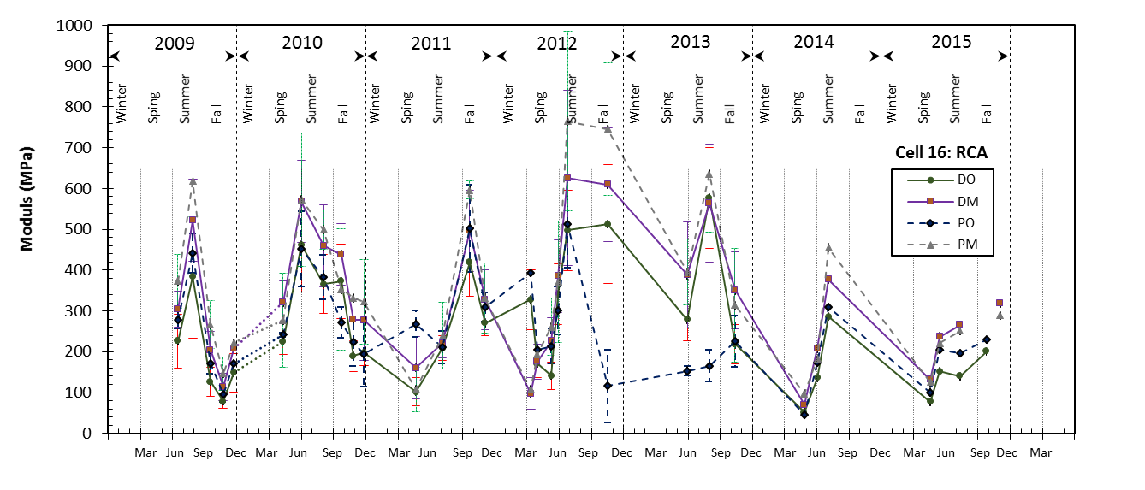
Task 5 & 6 – Performance Monitoring, Reporting, and Climatic Effects
FWD elastic modulus of RCA base layer during 7 years (Data collected from MnDOT 2008 project).

Slide 33
Task 5 & 6 – Performance Monitoring, Reporting, and Climatic Effects
a) Cumulative number of F-T cycles since 2008 in RCA base layer and b) field elastic modulus of RCA, RCA-VA blend, RAP, and Class 5 aggregate field test sections with F-T cycles (Edil et al. 2017).

Slide 34
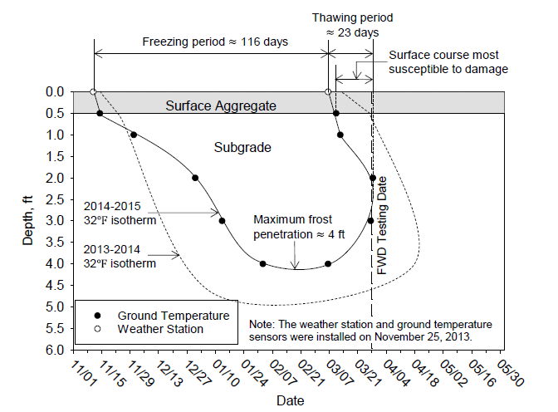
Task 5 & 6 – Performance Monitoring, Reporting, and Climatic Effects
(Li et al. 2016)

Slide 35
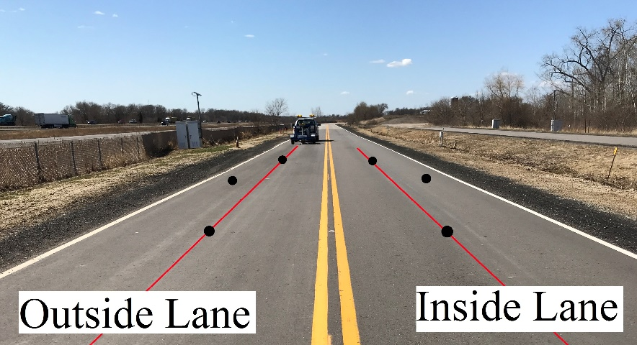
FIELD TESTING

Slide 36
Task 7 – Determine Pavement Design Criteria
Prepare a report that:
    Summarizes the findings from the laboratory and field tests
    Provides detailed review on pavement design inputs in terms of benefits and costs
    Analyzes the cost effectiveness of using recycled materials and LSSB
    Shows correlations between the index properties and stiffness/permeability of geomaterials tested
    Provides the results of sustainability assessment analyses

Slide 37


Task 8 & 9 – Draft/Final Report

Slide 38
SCHEDULE
TASKS | MONTHS
 | 1 | 2 | 3 | 4 | 5 | 6 | 7 | 8 | 9 | 10 | 11 | 12 | 13 | 14 | 15 | 16 | 17 | 18 | 19 | 20 | 21 | 22 | 23 | 24 | 25 | 26 | 27 | 28 | 29 | 30 | 31 | 32 | 33
Task 1
Task 2
Task 3
Task 4
Task 5
Task 6
Task 7
Task 8
Task 9

Slide 39
PRODUCTS & DELIVERABLES
Quarterly progress reports as required
Draft final report
Final report
Technology transfer brief
A copy of the executive final presentation

Slide 40


















































Thank You

Slide 41
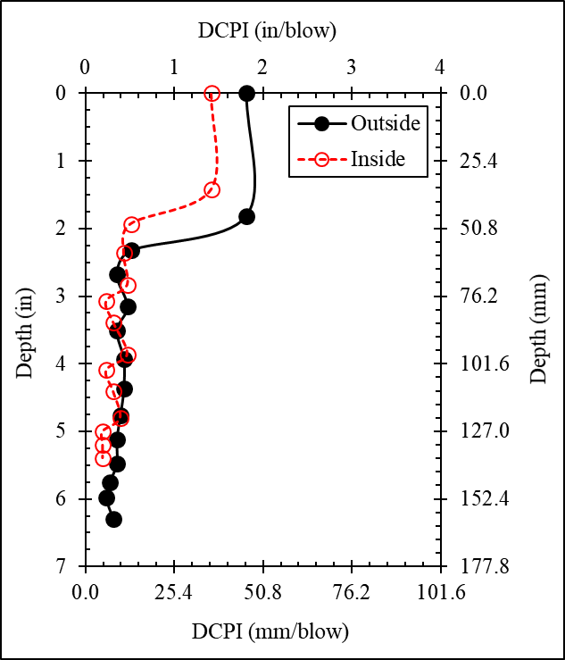
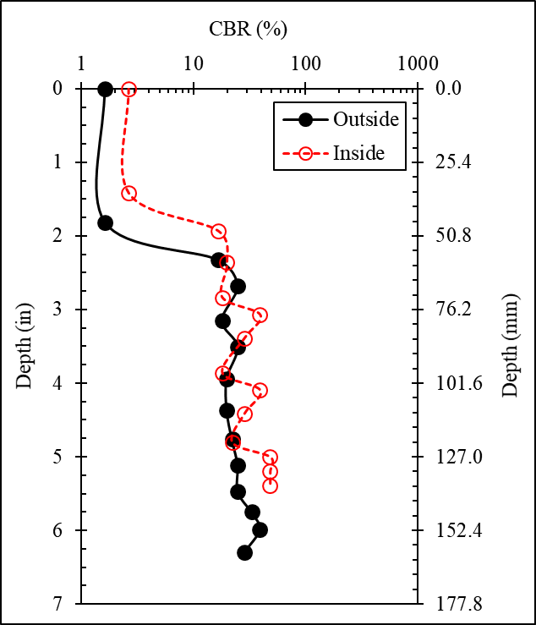
DCP DATA ANALYSIS
328 - 09.18.2017

Slide 42
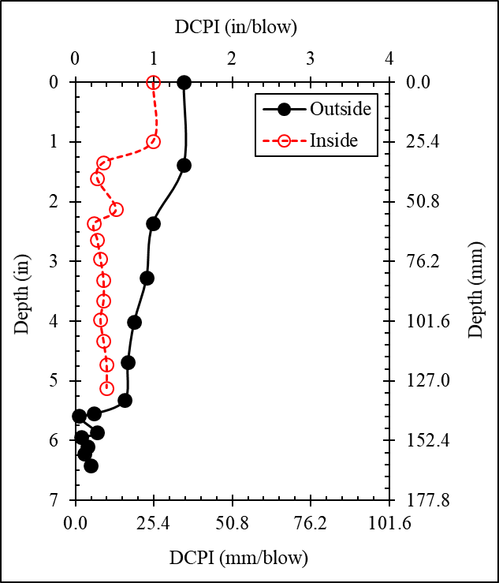
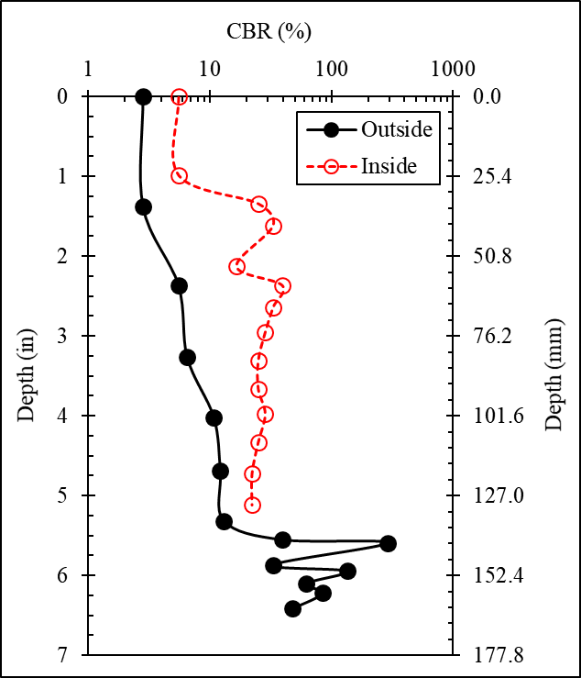
DCP DATA ANALYSIS
428 - 09.18.2017

Slide 43
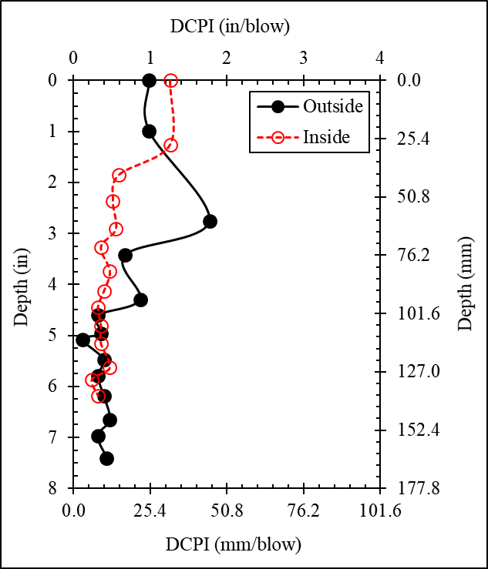
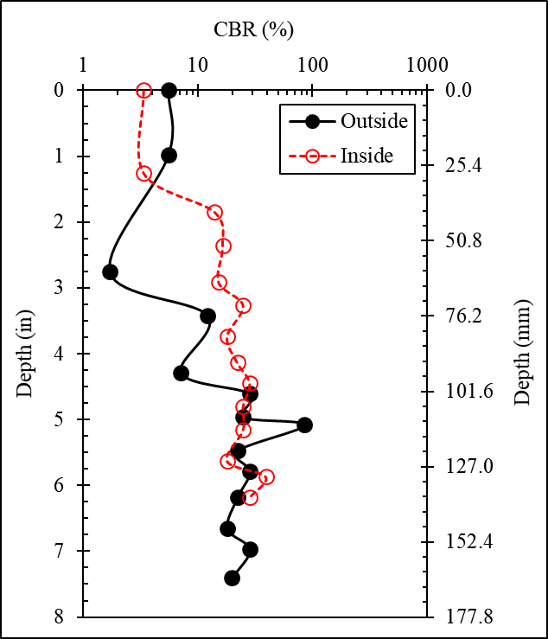
DCP DATA ANALYSIS
528 - 09.18.2017

Slide 44
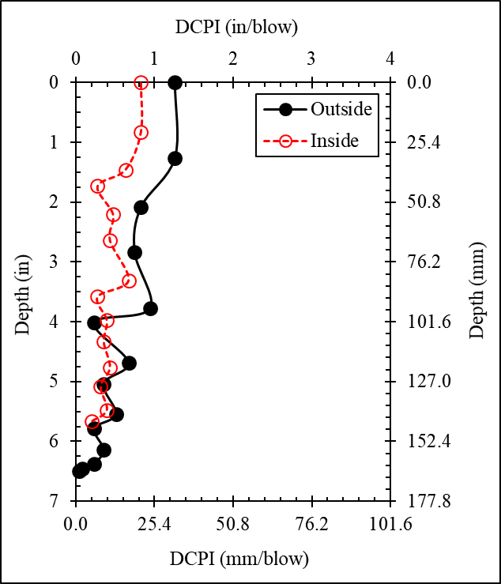
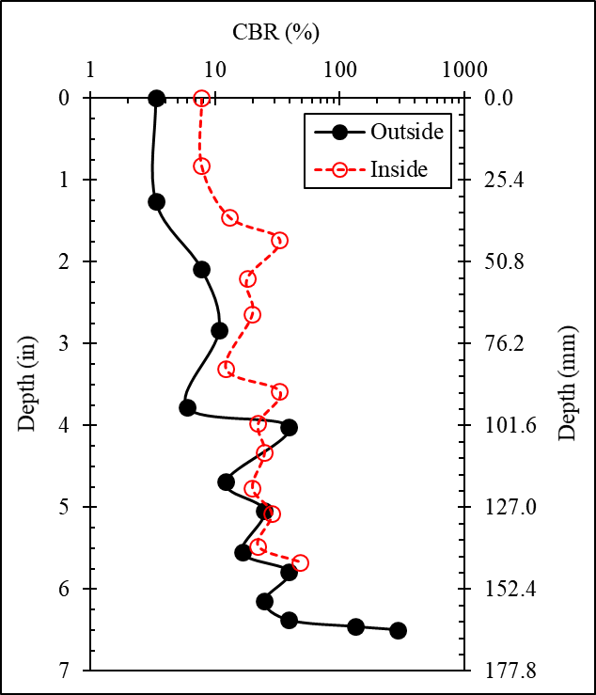
DCP DATA ANALYSIS
628 - 09.18.2017

Slide 45
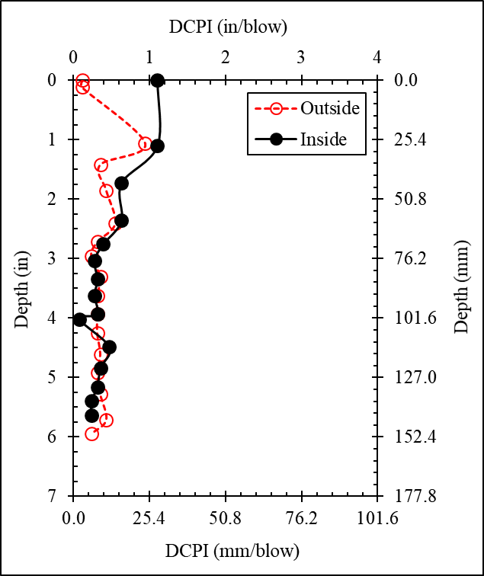
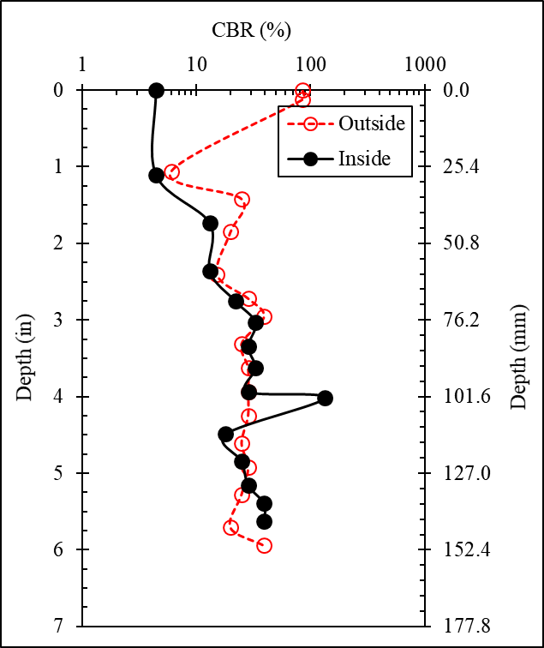
DCP DATA ANALYSIS
528 – 08.21.2017 (Example)

