Slide 1


2018 Pavement Workshop
May 23-24, 2018
Research Project Flexible Team LT1: Developing Best Practices for Rehabilitation of Concrete with Hot Mix Asphalt Overlays Related to Density and Reflective Cracking
Eshan V. Dave
Jo Sias Daniel and Katie Haslett
University of New Hampshire
+ 46 Associate Members

Slide 2
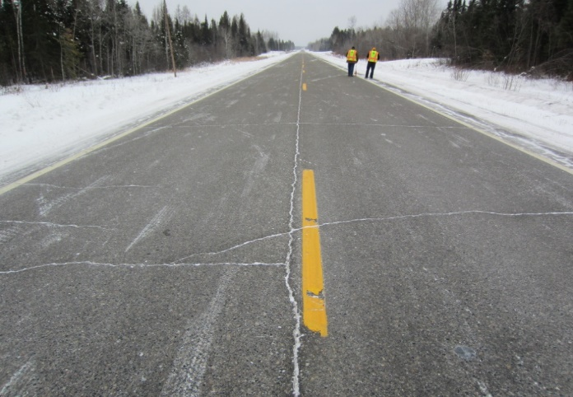
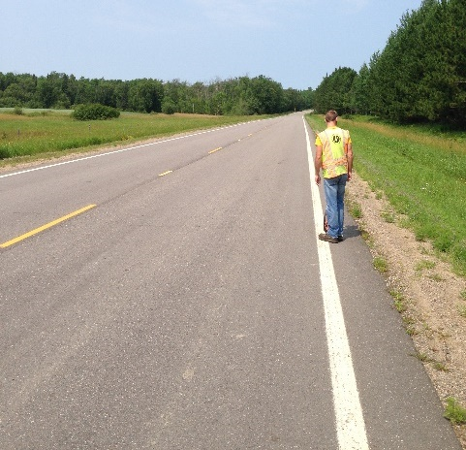
Outline
Introduction and Project Overview
  Goals and Objectives
  MnROAD Sections
  Project Tasks
Research Approach
  Lab Tests
  Performance Models
Early Performance Results
Summary

Slide 3
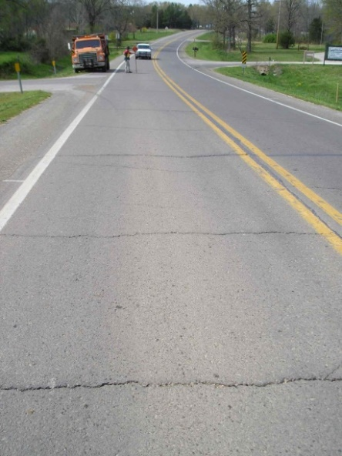
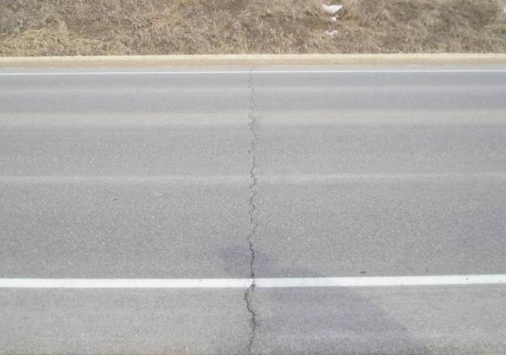
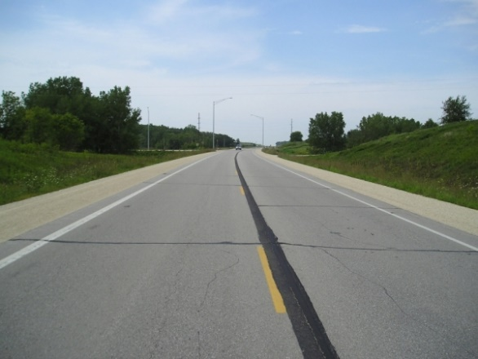
Reflective Cracking in Asphalt Overlays
Appearance of a cracking pattern in the surface of an overlay that reflects the cracking/joint pattern in the underlying pavement
Allows water to infiltrate into underlying pavement structure, leading to further deterioration
One of the predominant failure modes in rehabilitated pavements

Slide 4
Reflective Cracking Performance in Minnesota
26 Pavement Sections from Minnesota:
  Thin and Thick Overlays on milled pavement
  Full depth reclamation
Thin (mill and) overlay sections show an average cracking rate of 16%/yr. where as FDR and overlay sections average at 4%/yr.

Slide 5
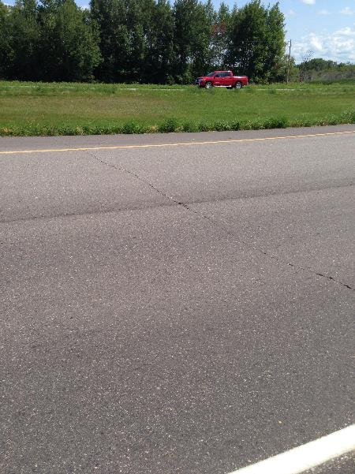
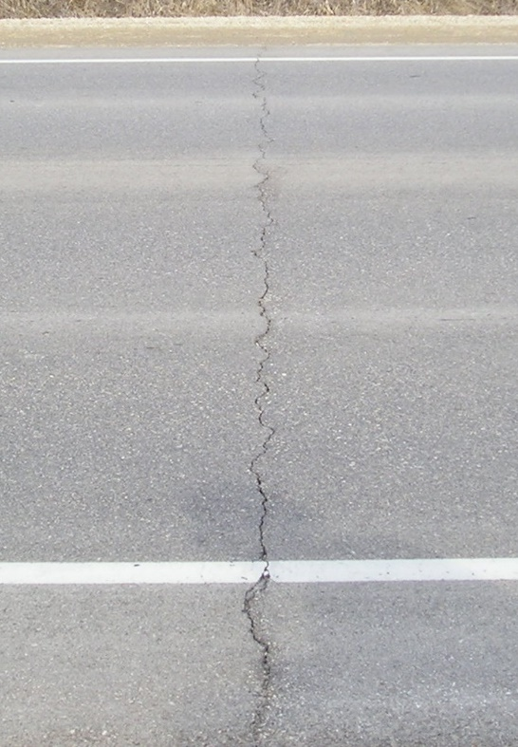
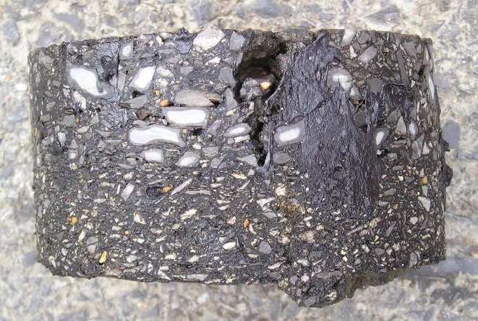
Project Overview
This research aims to develop a simple decision tree tool for selecting suitable asphalt mixtures and overlay designs to prolong overlay lives by lowering reflective cracking and improving in-situ density.

Slide 6
Project Objectives
Slow reflective (and thermal and fatigue) cracking
Improve pavement life cycle costs
Suitability of lab tests for reflective cracking performance
Evaluate constructability considerations, including time needed to perform testing
Assess density evolution of mixes (current vs. Superpave 5 and retrogressed AV approaches)
Develop LCCA (Cost vs. benefit) decision tree for treatment of rigid pavement and selection of overlays

Slide 7
Pavement Sections and Materials
12 cross sections with varying surface course and interlayer properties
  Surface course
    Thickness, gradation, density
  Interlayer
    Polymer modified, tack coat application and type
Control Section (983)
9.5" PCC 27X12 PANELS 1.25" DOWELS
5" CLASS 5 BASE AGGREGATE
CLAY SUBGRADE

Slide 8
Cell 987
Cell 988
Cell 989
1.5" HMA (9.5 mm)
2.5" HMA (19 mm)
9.5" PCC 27X12 PANELS 1.25" DOWELS
1.75" HMA (12.5 mm, 4% AV)
2.25" HMA (19 mm)
9.5" PCC 27X12 PANELS 1.25" DOWELS
1.75" HMA (12.5 mm, 5% AV)
2.25" HMA (19 mm)
9.5" PCC 27X12 PANELS 1.25" DOWELS
Cell 990
Cell 991
Cell 992
1.75" HMA (12.5 mm, 3% AV)
2.25" HMA (19 mm)
9.5" PCC 27X12 PANELS 1.25" DOWELS
1.75" HMA (9.5 mm, AASHTO M323 #8)
2.25" HMA (19 mm)
9.5" PCC 27X12 PANELS 1.25" DOWELS
1.5" HMA (9.5 mm)
1" HMA (High Polymer Asphalt)
9.5" PCC 27X12 PANELS 1.25" DOWELS
Cell 993
Cell 984
Cell 985
1.5" HMA (9.5 mm)
1" HMA (PSAB/PASSRC)
9.5" PCC 27X12 PANELS 1.25" DOWELS
1.5" HMA (9.5 mm) Conventional Paver (0.08-0.10 gal/sy)
9.5" PCC 27X12 PANELS 1.25" DOWELS
1.5" HMA (12.5 mm) Conventional Paver (0.05-0.06 gal/sy)
9.5" PCC 27X12 PANELS 1.25" DOWELS
Cell 986
Cell 994
Cell 995
1.75" HMA (12.5 mm) Spray Paver (0.10 gal/sy)
9.5" PCC 27X12 PANELS 1.25" DOWELS
1.5" HMA (9.5 mm) Conventional Paver (0.08 – 0.10 gal/sy)
9.5" PCC 27X12 PANELS 1.25" DOWELS
0.75" UTBWC 0.20 gal/sy (Polymer mod. Membrane)
9.5" PCC 27X12 PANELS 1.25" DOWELS

Slide 9
NRRA LT1 Research Tasks (1/2)
Task 1: Literature Review (ongoing)
Task 2: Gathering Past Performance Data and Laboratory Testing (ongoing)
  Field performance data, MnROAD and NRRA state agencies
  Survey for agencies (coming soon)
  Lab performance testing
Task 3: Mechanistic Analysis of HMA Overlays
  Performance simulations using PavementME (NCHRP 1-41) and FE Reflective Cracking Model
Task 4: Asphalt Density Evolution Over Time
  Density changes with time/traffic and relationship to performance

Slide 10
NRRA LT1 Research Tasks (2/2)
Task 5: Life and Performance Curves for Asphalt Overlays
  Comparisons between mix properties, lab tests and field performance
  Cost effectiveness comparison (user and agency) of overlay structure options using LCCA
Task 6: Establish State of the Practice for PCC Condition
  Guidelines to assess existing PCC pavement conditions
Task 7: Establish State of the Practice for HMA Mixtures and their Effects on Reflective Cracking
  Simple decision tree based tool for selection of asphalt mixture and overlay design
Task 8: Reporting

Slide 11
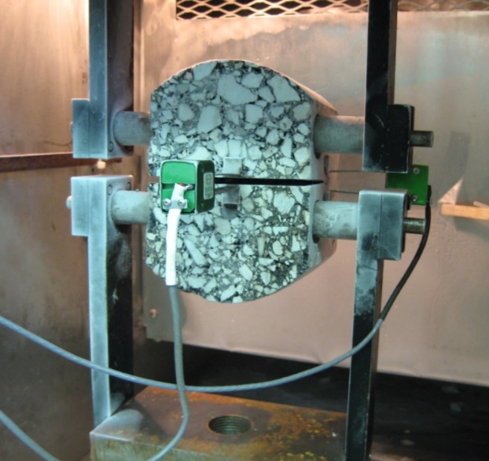
Outline
Introduction and Project Overview
  Goals and Objectives
  MnROAD Sections
  Project Tasks
Research Approach
  Lab Tests
  Performance Models
Early Performance Results
Summary

Slide 12
Mix Tests
I-FIT (SCB) – IDOT
Texas Overlay Tester (OT) – IDOT
Disk-shaped Compact Tension (DCT) – MnDOT
AASHTO T-283 TSR - MODOT
Hamburg Wheel Tracking Test – WisDOT
MiST - MTU
Indirect tensile Strength and Creep (IDT) – MnDOT
Dynamic Modulus Test (E*) – MnDOT and UNH
Ideal-CT – (TTI/TAMU)
MN Semi-Circular Bend – UMN
Direct Tension Cyclic Fatigue (S-VECD) – UNH
Compact Tension (CT) - UNH

Slide 13
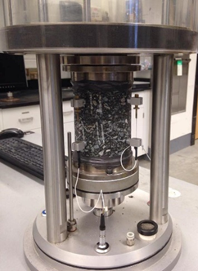
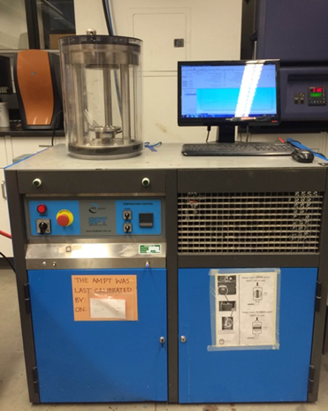
Testing: S-VECD Fatigue (AASHTO TP 107)
Direct tension cyclic fatigue
Test temperatures ((PGHT-PGLT)/2)-3°C
Number of specimens: Typically 4 (1 at each strain level)
Outcome: Damage Characteristic Curve (DCC) and Energy dissipation for fatigue damage
Outcomes are utilized in pavement structural analysis model (FHWA Flexpave, part of PEMD initiative)

Slide 14
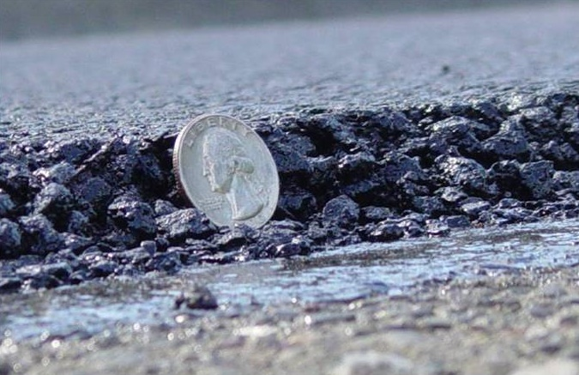
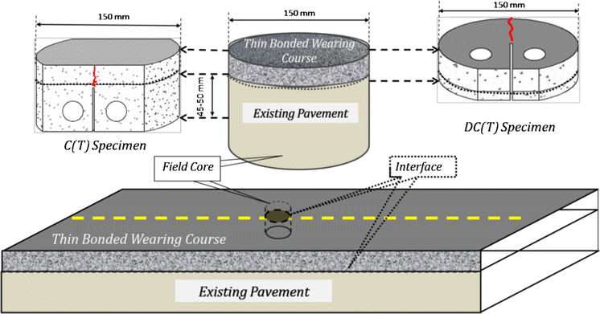
Testing: Compact Tension (CT)
Test procedure tailored to
measure fracture resistance
of UTBWC
Crack propagation in
reflective crack direction

Slide 15
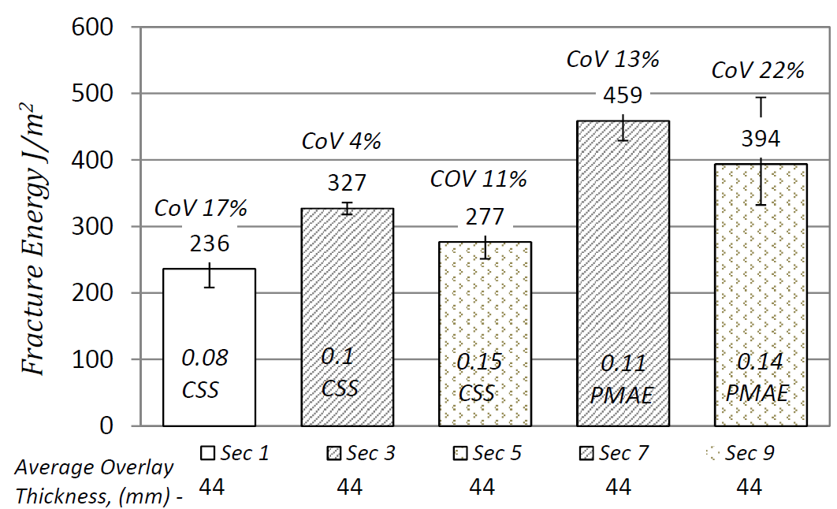
CT Fracture Test:
Effects of Tack Type, Rate and Construction Method
Missouri Route-T
1
2
3
4
5

Slide 16
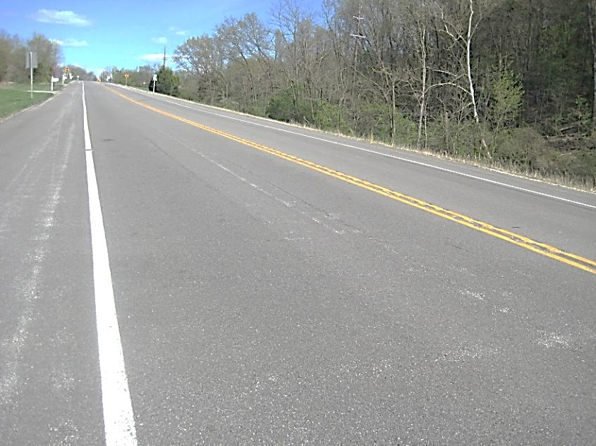
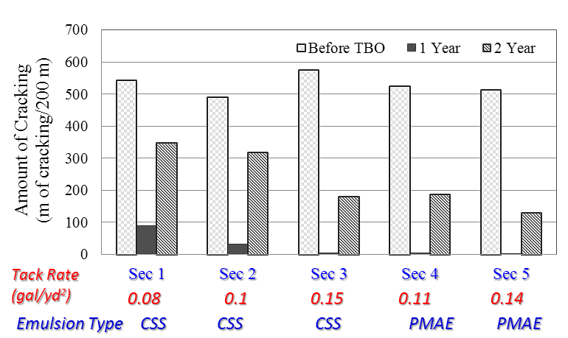
Field Performance
Missouri Route-T

Slide 17
Overlay Life and Performance
Curve Development
Combination of field performance, lab performance test results, performance modeling and life cycle cost analysis
Field Performance: 12 MnROAD sections
Performance Models:
  More than 12 sections
    AASHTOWare PavementME
    Finite Element Reflective Cracking Model (In-house)
Life Cycle Cost Analysis:
  FHWA RealCost
  Pavement Roughness-based User Cost Calculations

Slide 18
Life Cycle Cost Analysis (LCCA)
An economic analysis
  Compares design or rehabilitation alternatives
  Considers all significant costs
  Evaluates the alternatives over scientifically correct analysis periods
Importance of LCCA
  All costs can be taken into account
    Agency costs (data will be collected from NRRA member states)
    User costs
    Salvage value
  Alternative strategies can be compared
    On an equivalent basis

Slide 19
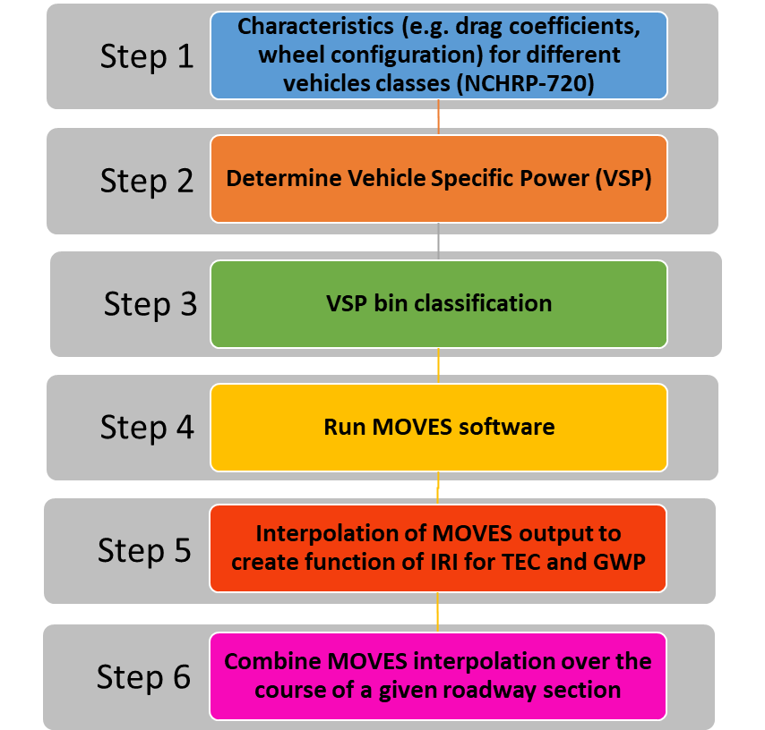
UNH Study on Maintenance Alternatives Selection: Vehicle Fuel Efficiency vs. IRI
Linking of EPA MOVES (Mobile Vehicle Emissions Simulator) and pavement roughness to estimate fuel consumption
RTTD: Real Time Traffic Data

Slide 20
UNH Study on Maintenance
Alternatives Selection
I-494 Case-study
IRI curves generated for 6 scenarios
  Baseline: No maintenance until terminal condition
  Mill & Overlay
  Crack Sealant (CS)
  Microsurfacing (MS)
  Cold-In-Place (CIR) Recycling
Steady flow versus Real-time traffic data (RTTD)
Simulation conditions:
  Initial IRI = 63 in/mi; Terminal IRI = 172 in/mi; Minimum of 3 cycles

Slide 21

Maintenance Alternatives Life Cycle
Cost Comparison
Total Net Present Value (NPV)
Cross Section | Maintenance Alternative
 | Baseline | Crack Sealant | MS (IRI =140) | MS (IRI =160) | CIR | Thin Overlay
ARGG -1 | $231,618,958 | $219,152,098 | $187,105,111 | $190,671,362 | $158,051,156 | $156,954,499
ARGG -2 | $230,873,072 | $219,152,047 | $186,925,693 | $190,632,806 | $157,966,037 | $156,950,403
T - 1 | $231,618,958 | $223,500,437 | $187,105,111 | $190,634,818 | $158,039,813 | $156,950,403
THS - 1 | $266,628,116 | $251,815,947 | $218,765,220 | $198,617,699 | $159,240,577
SHM - 1 | $298,528,698 | $277,218,842 | $253,118,168 | $214,731,747 | $160,287,057
Average percent difference from 2 inch mill & overlay alternative
CIR = 0.7 %
MS at IRI 160 in/mi = 19.4 %
MS at IRI 140 in/mi = 17.5 %
CS = 33.7 %
Baseline = 38.3 %
Most Economical
Least Economical

Slide 22
Life Cycle Costs (Agency and User)
56% difference in operations cost (users)
68% difference in construction/maintenance cost (agency)

Slide 23
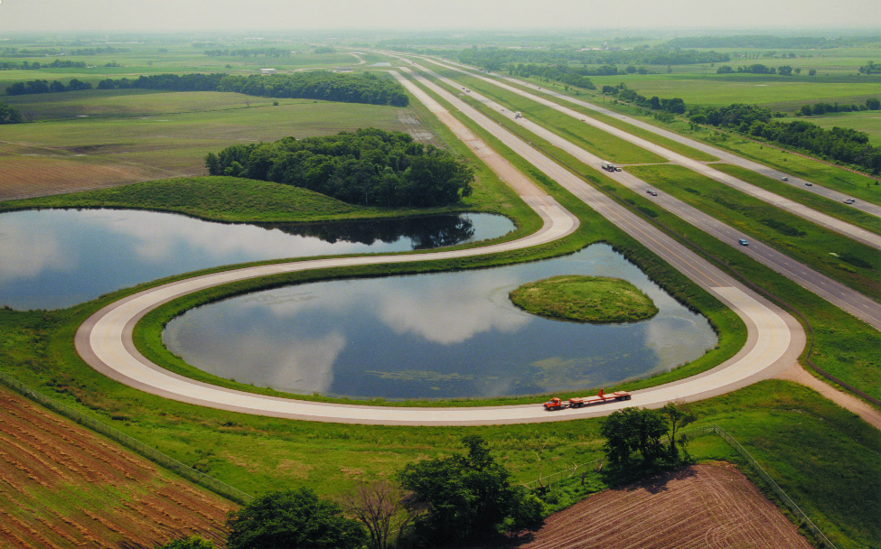
Outline
Introduction and Project Overview
  Goals and Objectives
  MnROAD Sections
  Project Tasks
Research Approach
  Lab Tests
  Performance Models
Early Performance Results
Summary

Slide 24
Early Results: DCT Fracture Energy and Cracking Amounts (1 of 3)
Acknowledgements: D. Ghosh and D. Van Deusen (MnROAD/MnDOT)

Slide 25
Early Results: DCT Fracture Energy and Cracking Amounts (2 of 3)
Acknowledgements: D. Ghosh and D. Van Deusen (MnROAD/MnDOT)

Slide 26
Early Results: DCT Fracture Energy and Cracking Amounts (3 of 3)
Acknowledgements: D. Ghosh and D. Van Deusen (MnROAD/MnDOT)

Slide 27
Summary
Project is underway, simultaneous focus on reflective cracking and density/volumetrics
Majority of test data is now available
Field performance data after one winter is also now available
Researchers are starting to make comparisons between field performance and lab tests
Agency surveys are being prepared to obtain cost data, current practice review and past performance data

Slide 28



Thank you for your attention!
Contact:
  Email: eshan.dave@unh.edu
  Phone: 603-862-5268

Slide 29


















































Thank You!

Slide 30
Appendix

Slide 31
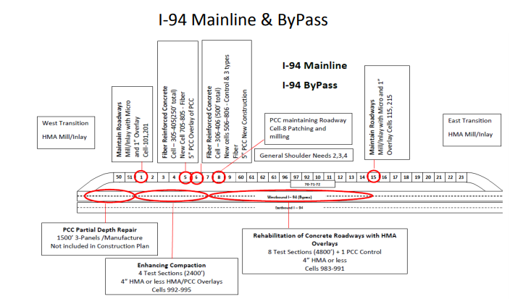
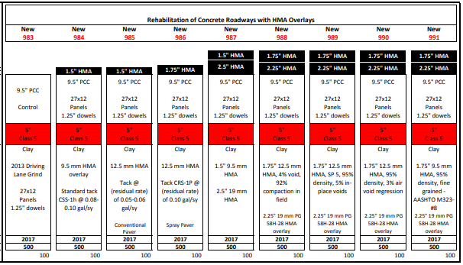
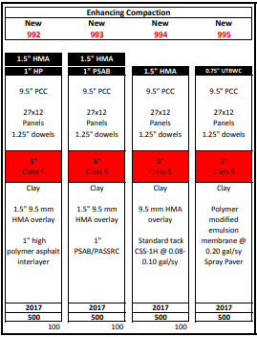
Cross Sections

Slide 32
Material Information
CELL | DESC | TRAFF LEVEL | AGG SIZE | BINDER | DES VOIDS | COMMENT
992 | HMA over concrete | 4 | 4.75 | 58E-34 | 3 | Lift 1 (interlayer)
991 |  |  |  | 58H-28 | 4 | Lift 2
984, 994 | HMA over concrete | 4 | 9.5 | 58H-28 | 4 | Lift 1
987 |  |  |  |  |  | Lift 2
992 |  |  |  |  |  | Lift 2 (over interlayer)
993 |  |  |  |  |  | Lift 2 (over PASSRC)
985, 986 | HMA over concrete | 4 | 12.5 | 58H-28 | 4 | Lift 1
988, 989, 990 |  |  |  |  |  | Lift 2
987-991 | HMA over concrete | 4 | 19 | 58H-28 | 4 | Lift 1

Slide 33
Timeline – Year 1
Tasks |  | Month
 | Month of Contract: | 1 | 2 | 3 | 4 | 5 | 6 | 7 | 8 | 9 | 10 | 11 | 12
 | Calender Month: | F | M | A | M | J | J | A | S | O | N | D | J
Task- 1 | Literature Review
Task- 2 | Data Collection and Lab Testing
Task- 3 | Mechanisitic Analysis of HMA overlay
Task- 4 | Asphalt Density Evolution Over Time
Task- 5 | Life and Performance Curves
Task- 6 | State of Practice or PCC Conditions
Task- 7 | State of Practice for HMA Mixtures and effects on Reflective Cracking
Task- 8 | Reporting
8.1 | Quarterly Staus Reports
8.2 | Technical Committee Meetings
8.3 | Progress Reports
8.4 | Final Report and Recommendations

Slide 34
Timeline – Year 2
Tasks |  | Month
 | Month of Contract: | 13 | 14 | 15 | 16 | 17 | 18 | 19 | 20 | 21 | 22 | 23 | 24
 | Calender Month: | F | M | A | M | J | J | A | S | O | N | D | J
Task- 1 | Literature Review
Task- 2 | Data Collection and Lab Testing
Task- 3 | Mechanisitic Analysis of HMA overlay
Task- 4 | Asphalt Density Evolution Over Time
Task- 5 | Life and Performance Curves
Task- 6 | State of Practice or PCC Conditions
Task- 7 | State of Practice for HMA Mixtures and effects on Reflective Cracking
Task- 8 | Reporting
8.1 | Quarterly Staus Reports
8.2 | Technical Committee Meetings
8.3 | Progress Reports
8.4 | Final Report and Recommendations

Slide 35
Timeline – Year 3
Tasks |  | Month
 | Month of Contract: | 25 | 26 | 27 | 28 | 29 | 30 | 31 | 32 | 33 | 34 | 35 | 36
 | Calender Month: | F | M | A | M | J | J | A | S | O | N | D | J
Task- 1 | Literature Review
Task- 2 | Data Collection and Lab Testing
Task- 3 | Mechanisitic Analysis of HMA overlay
Task- 4 | Asphalt Density Evolution Over Time
Task- 5 | Life and Performance Curves
Task- 6 | State of Practice or PCC Conditions
Task- 7 | State of Practice for HMA Mixtures and effects on Reflective Cracking
Task- 8 | Reporting
8.1 | Quarterly Staus Reports
8.2 | Technical Committee Meetings
8.3 | Progress Reports
8.4 | Final Report and Recommendations

