Slide 1


2018 Pavement Workshop
May 23-24, 2018
10 Years Later – The First Unbonded Concrete Overlay with a Geotextile Interlayer
John P. Donahue
Construction and Materials Liaison Engineer
MoDOT
+ 46 Associate Members

Slide 2
Route D in Jackson County
2-lane 8-inch JPC pavement constructed in 1986
30-foot joint spacing w/ 1-inch dowels
3.13 miles long (Route 150 to Route 58)
9300 AADT w/ 5 % trucks (currently ~ 9900 ADT w/ 7% trucks)
Badly D-cracked - estimated 25% of area required full depth repair prior to conventional HMA overlay

Slide 3
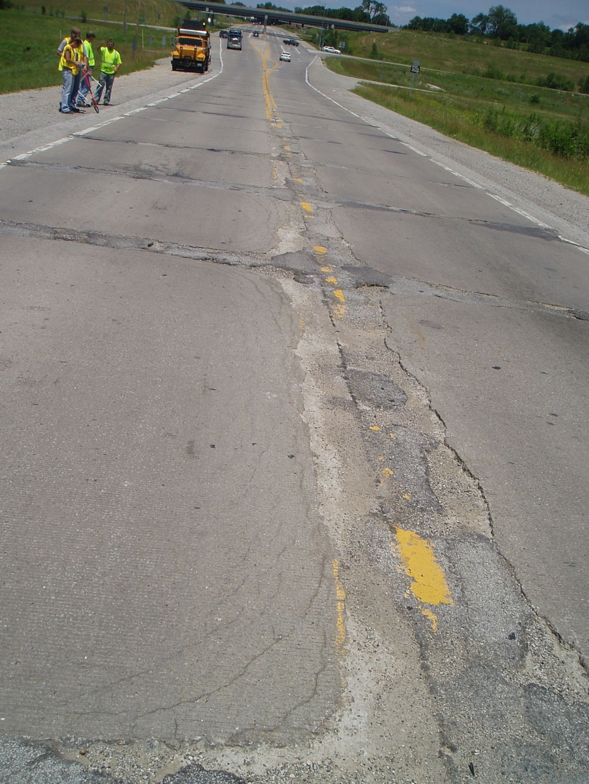
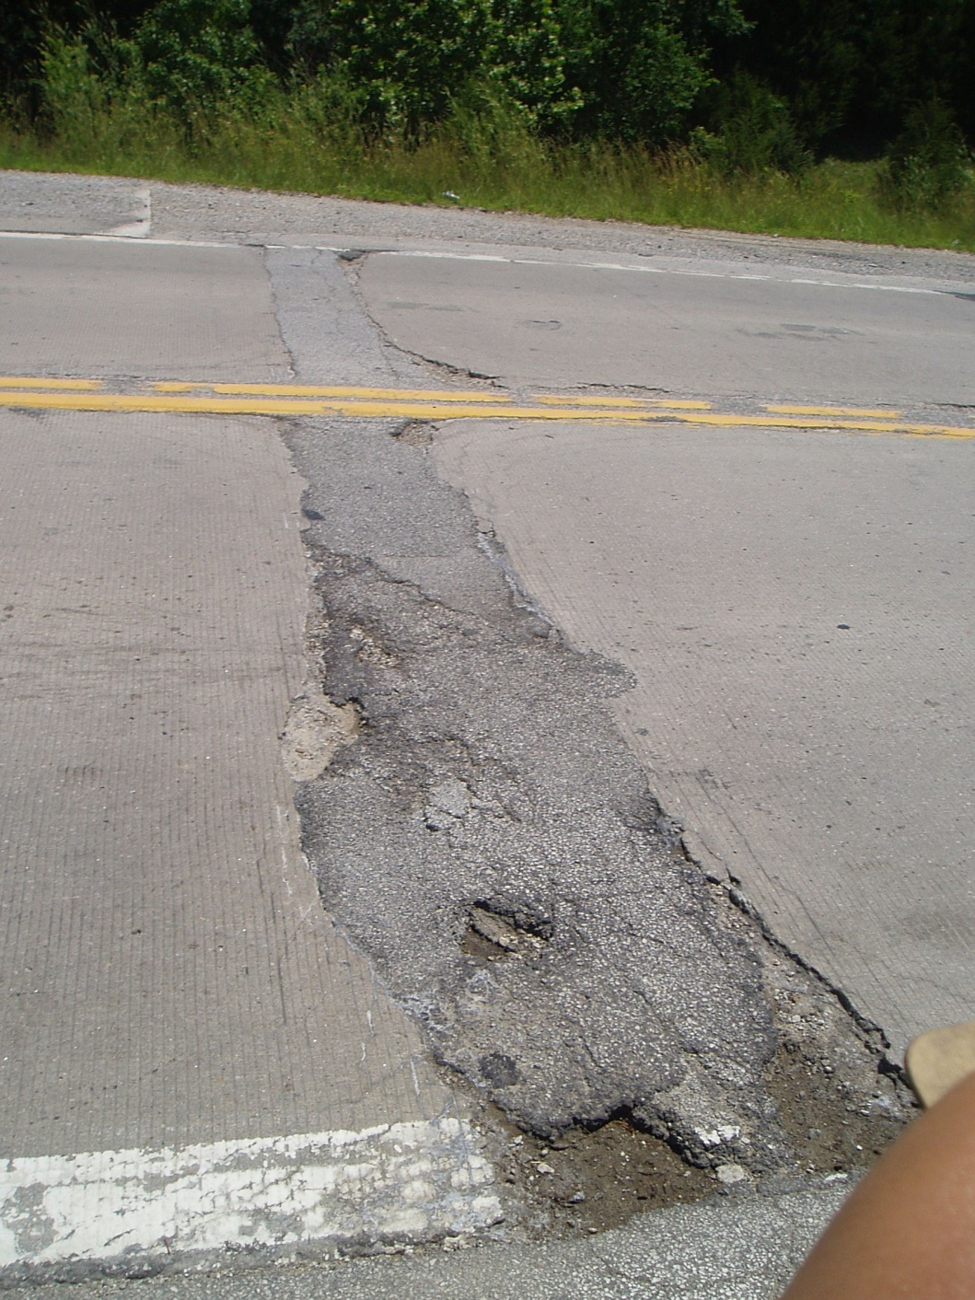

Slide 4
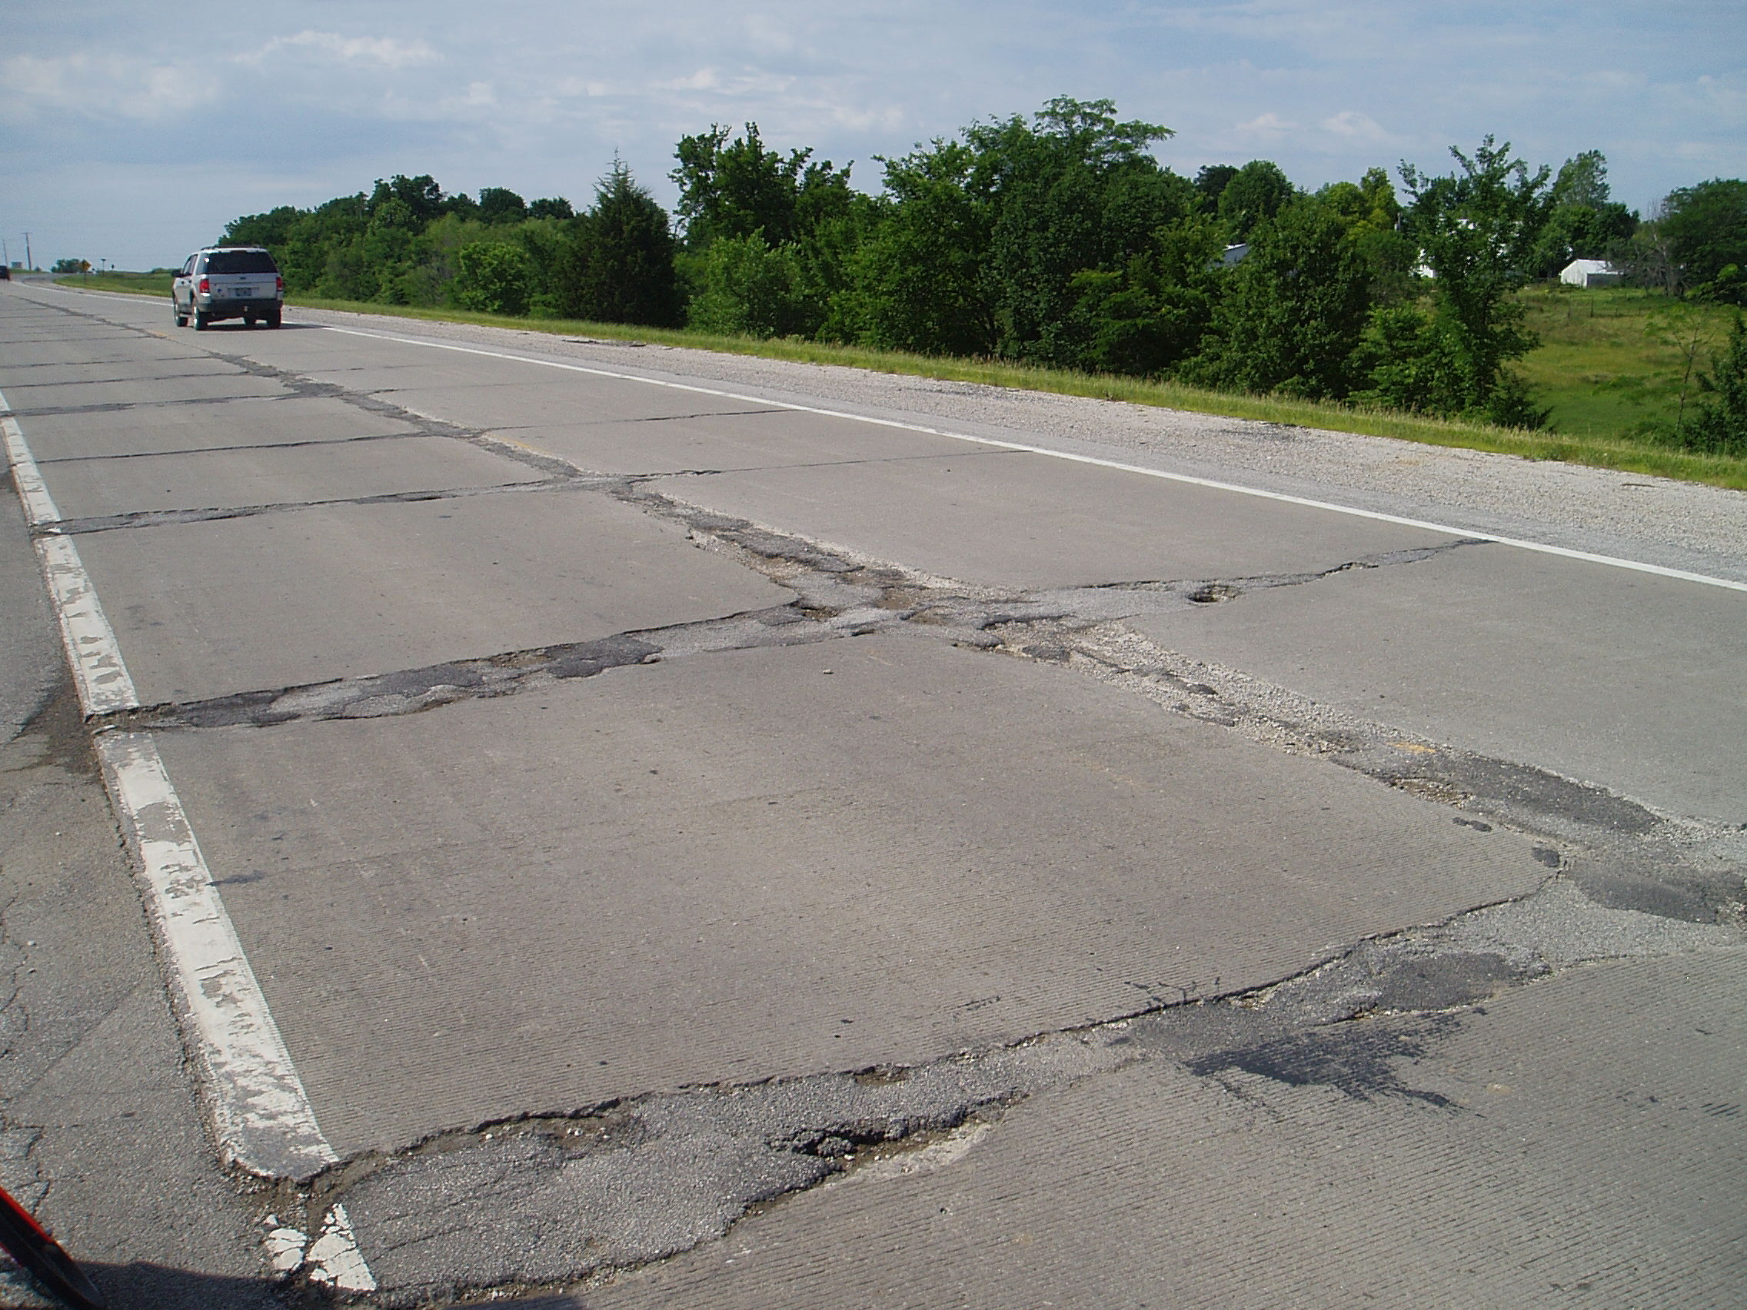

Slide 5
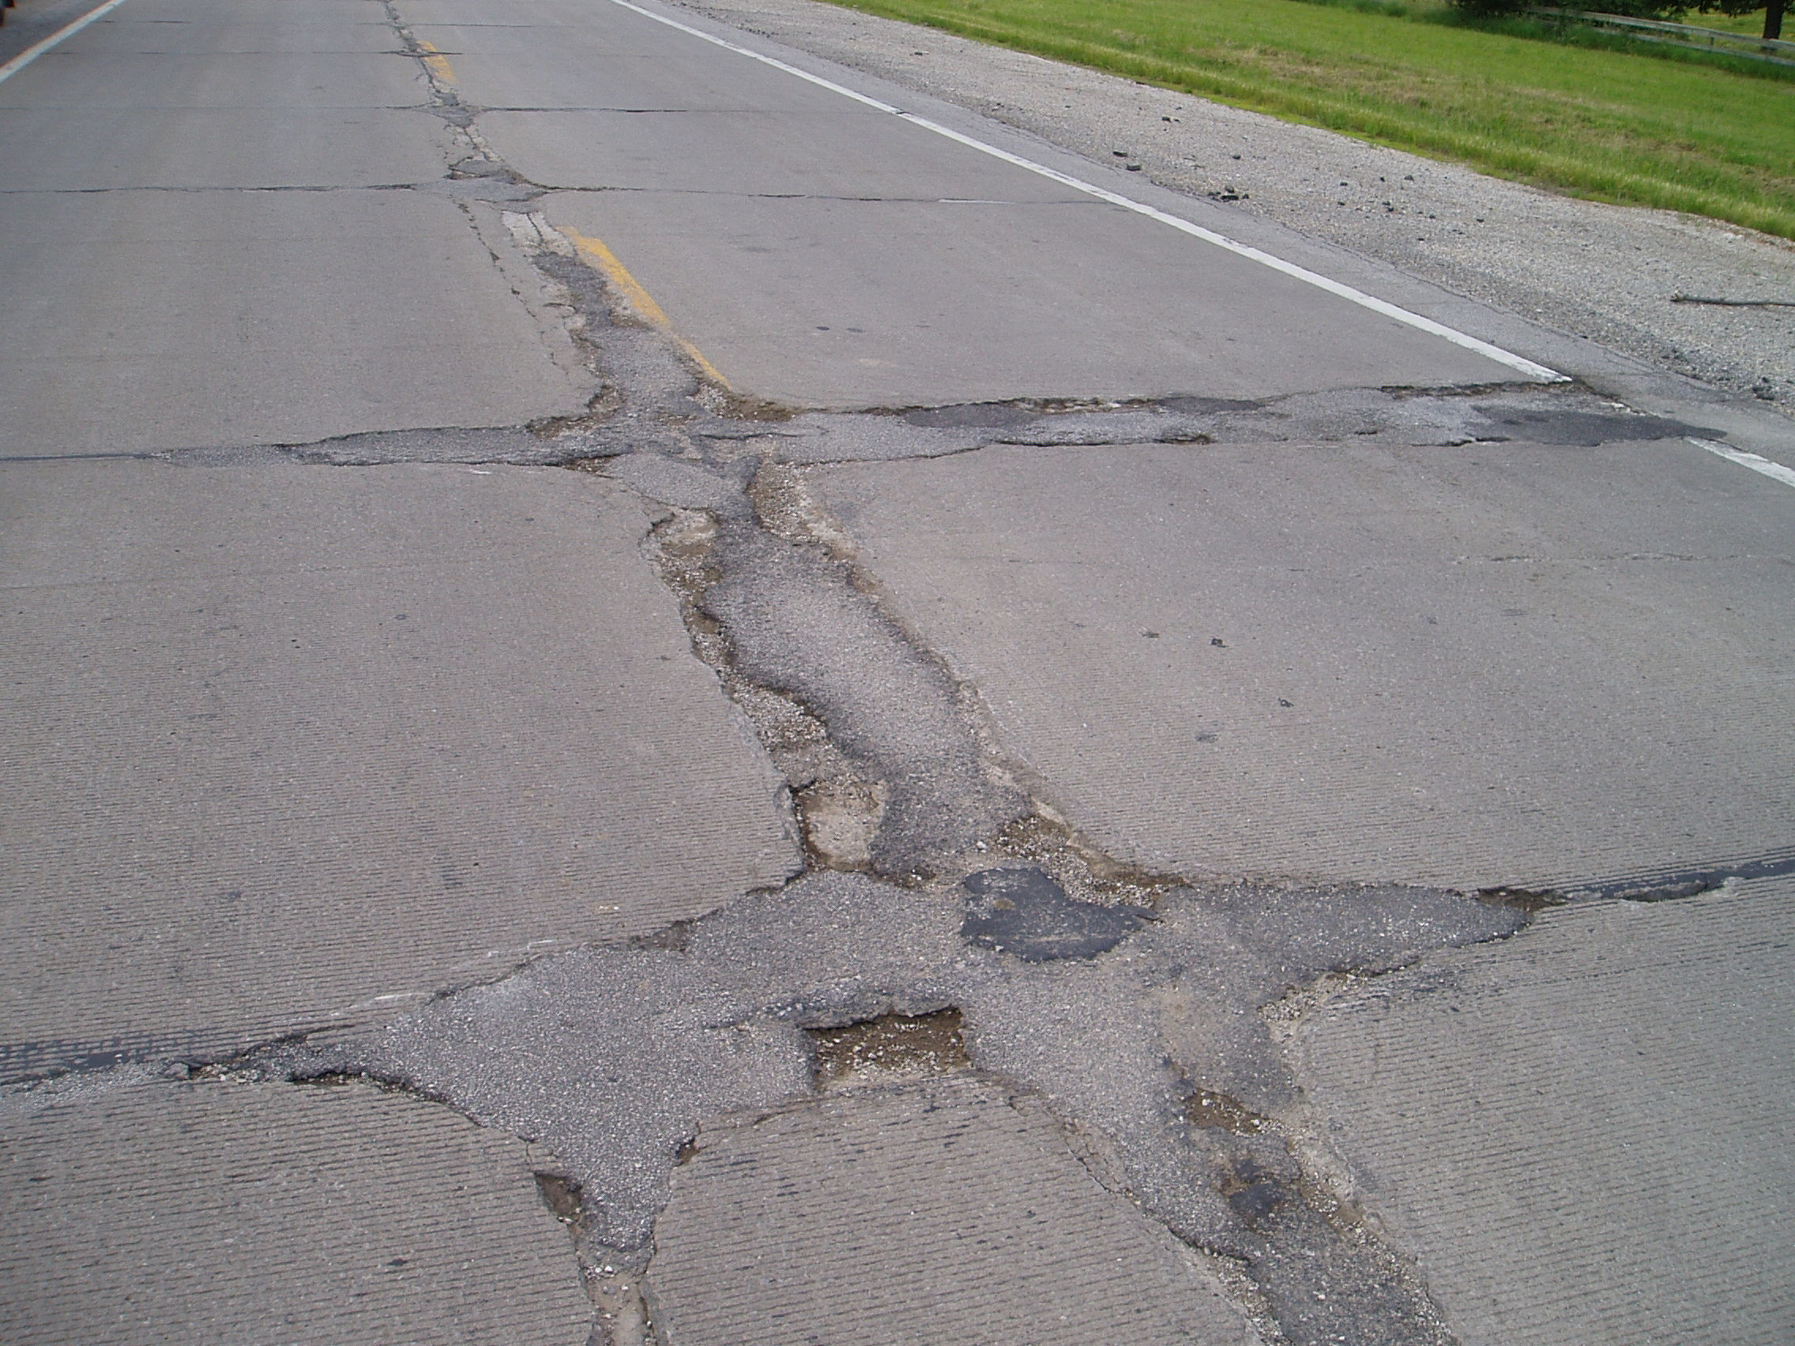

Slide 6
Route D Optional Designs
Mainline options
  5-inch unbonded PCC overlay (selected)
  1 ¾-inch SP125C PG70-22 on 4-inch SP190C PG70-22
Shoulder options same as mainline
  Contractor opted for asphalt design on shoulder

Slide 7
Route D UBOL Design
6-foot square panels (‘Big block’)
No steel
No fibers
Geotextile interlayer

Slide 8
Purpose of the Interlayer
Separation
  To prevent bonding between concrete layers which keep cracks and joints from reflecting upward.
Drainage
  To channel water that infiltrates away from the interlayer and to the edge. Ideally, the fabric should terminate at the edge in a drainage layer or be daylighted.
Bedding
  To reduce bearing stresses and the effects of dynamic traffic loads.

Slide 9
Fabric Specs
Property | Requirement (95% PWL)
Fabric Type | Non-woven Geotextile Uniform color
Mass per unit area | ≥ 450 g/m² (13.3 oz/sq.yd) ≤ 550 g/m² (16.2 oz/sq.yd)
Thickness under load (pressure) | 2 kN/m² (0.29 psi): ≥ 3.0 mm (0.12 in.) 20 kN/m² (2.9 psi): ≥ 2.5 mm (0.10 in.) 200 kN/m² (29 psi): ≥ 1.0 mm (0.04 in.)
Tensile strength | ≥ 10 kN/m (685 lb/ft)
Maximum elongation | ≤ 130% (≤ 60% recommended as best practice)
Water permeability in normal direction under load (pressure) | ≥ 1×10⁻⁴ m/s (3.3×10⁻⁴ ft/s) [under pressure of 20 kN/m² (2.9 psi)]
Water permeability in the plane direction of the fabric (transmittivity) under load (pressure) | ≥ 5×10⁻⁴ m/s (1.6×10⁻³ ft/s) [under pressure of 20 kN/m² (2.9 psi)] ≥ 2×10⁻⁴ m/s (6.6×10⁻⁴ ft/s) [under pressure of 200 kN/m² (29 psi)]
Weather resistance | Resistance ≥ 60% (per EN 12224)
Alkali resistance | ≥ 96% Polypropylene/Polyethylene

Slide 10
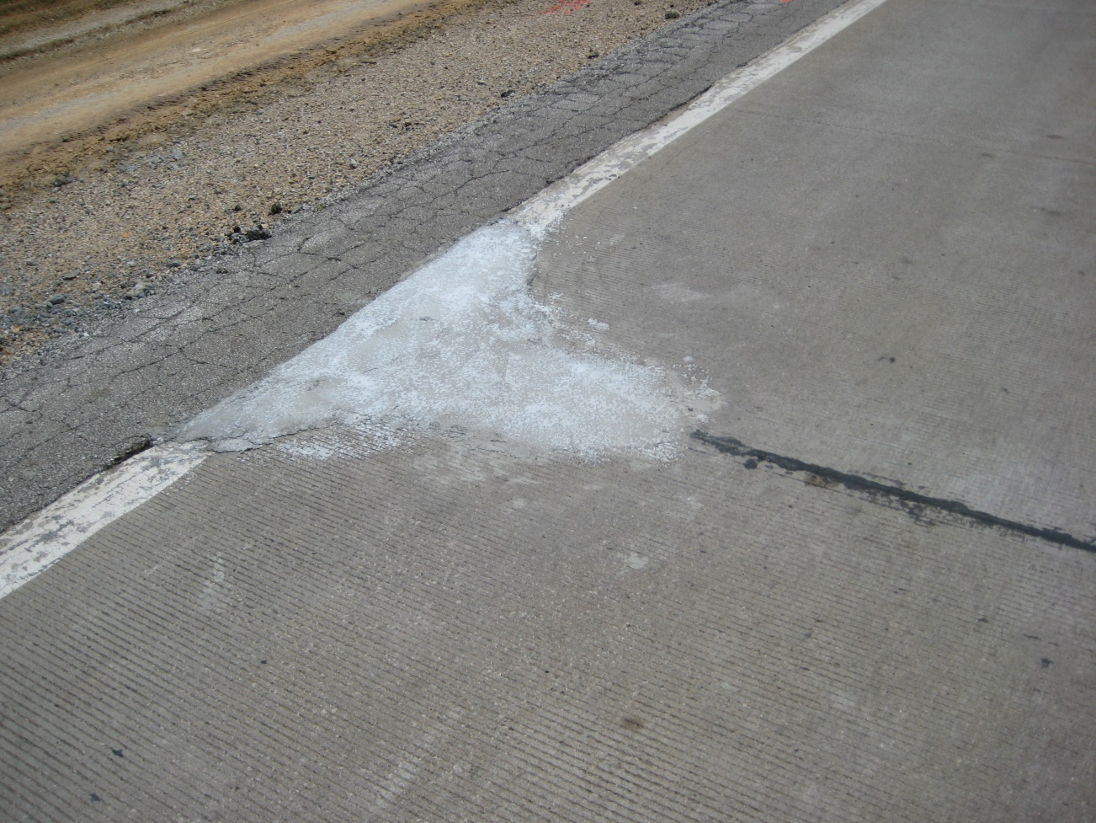
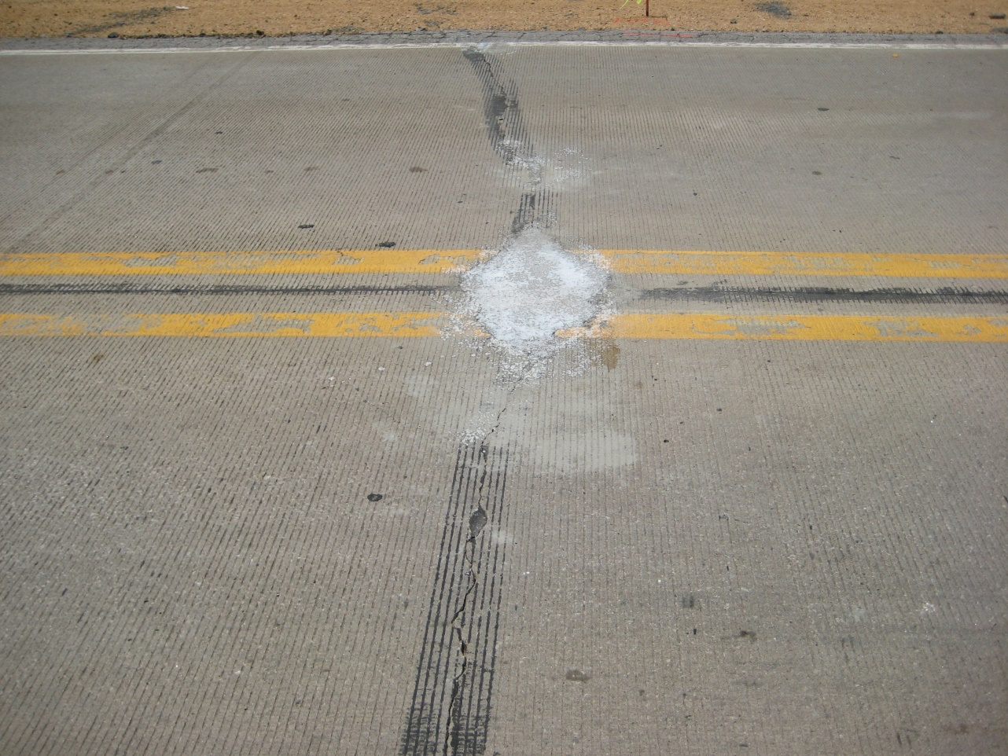
Pre-overlay Repairs

Slide 11
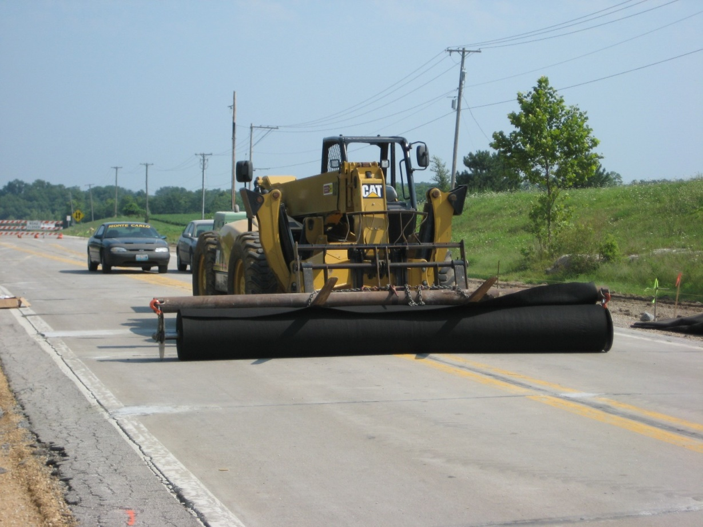
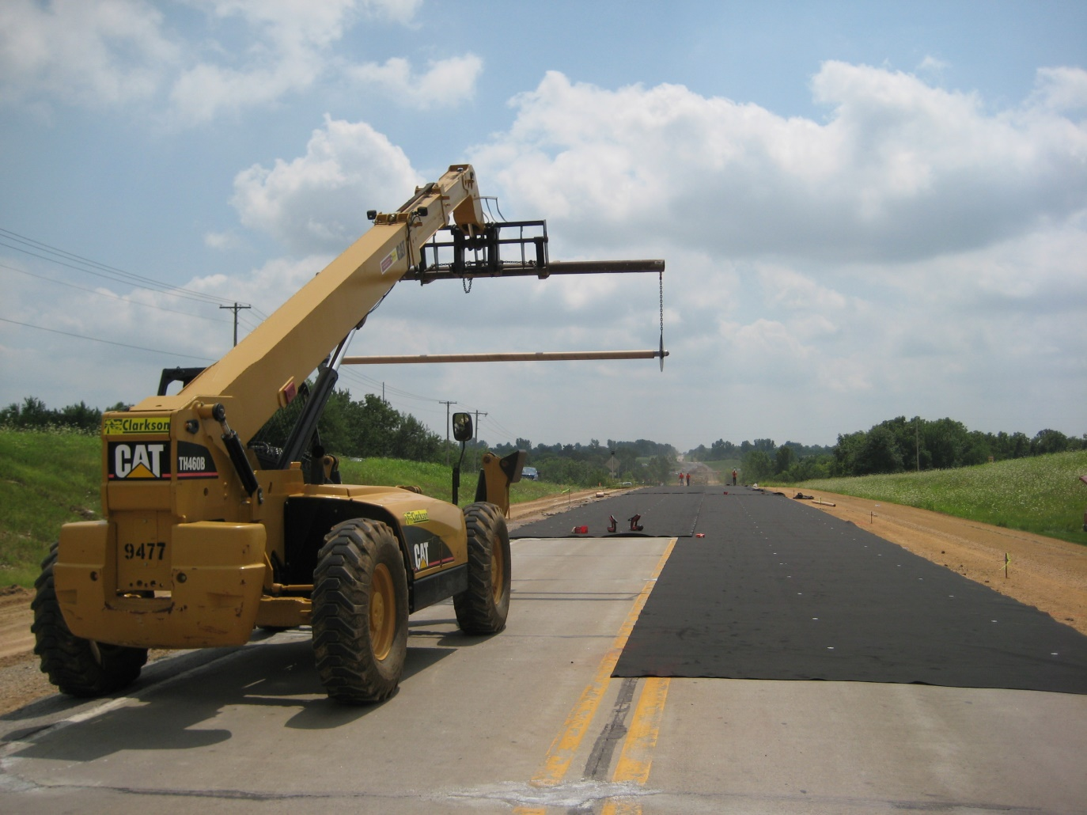
Placing Fabric
Swept surface prior to placement
Avoided wrinkles
Overlapped by 8”
Avoided 3 layers

Slide 12
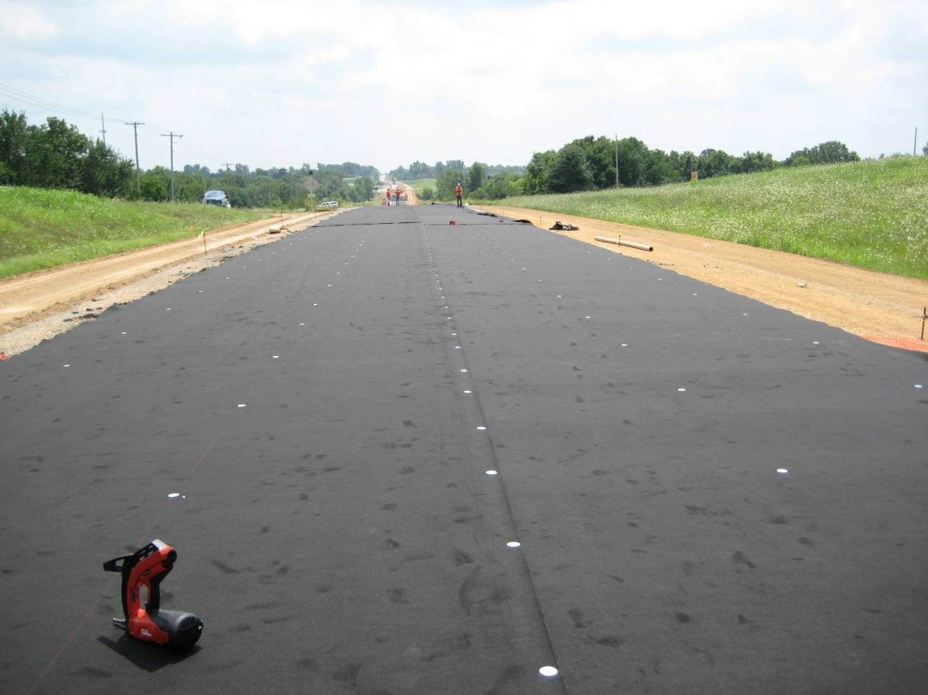
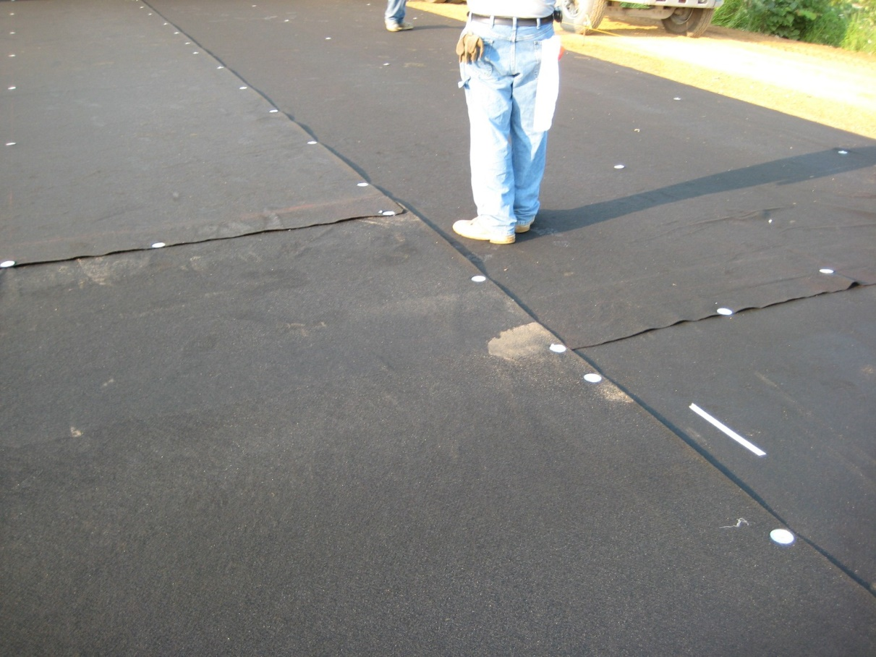
Securing Fabric
Fastened with nails and ~ 2” galvanized washers at minimum 6-foot spacing
Avoided excessive trafficking on fabric

Slide 13
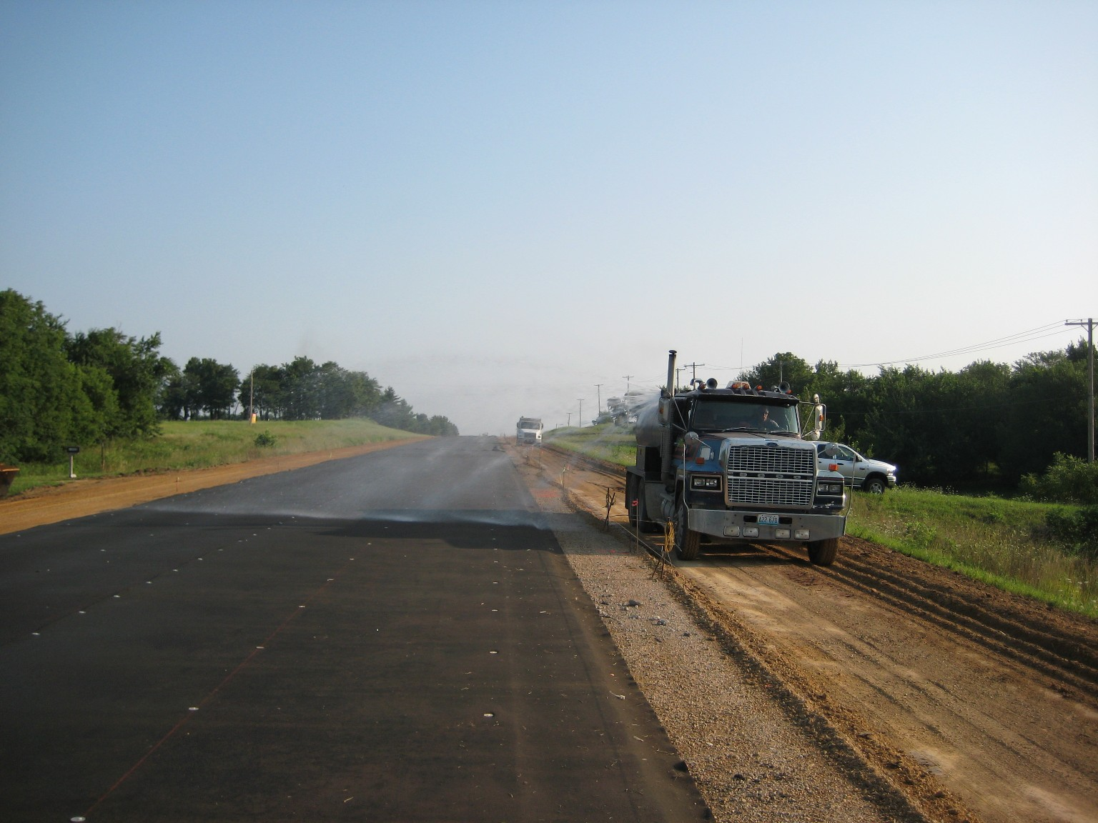
Fabric dampened, but not saturated, prior to concrete placement

Slide 14
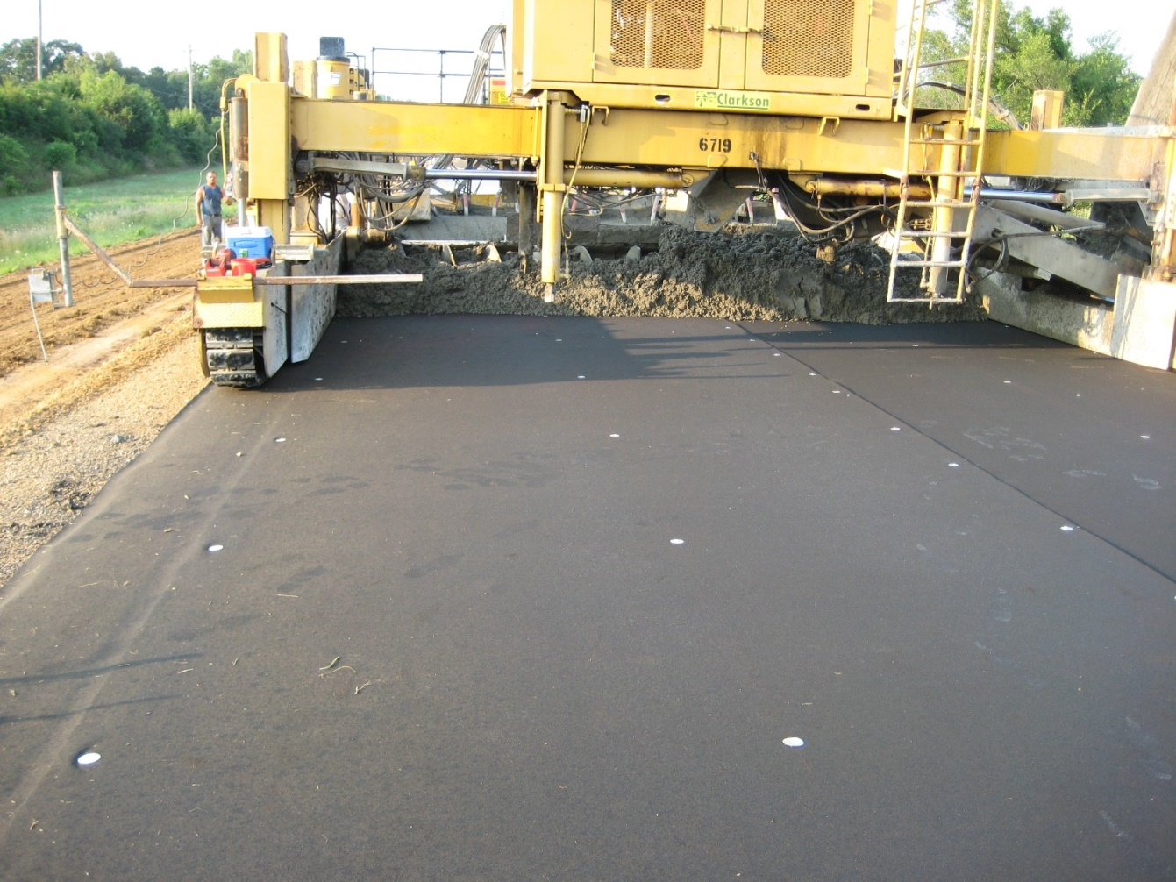
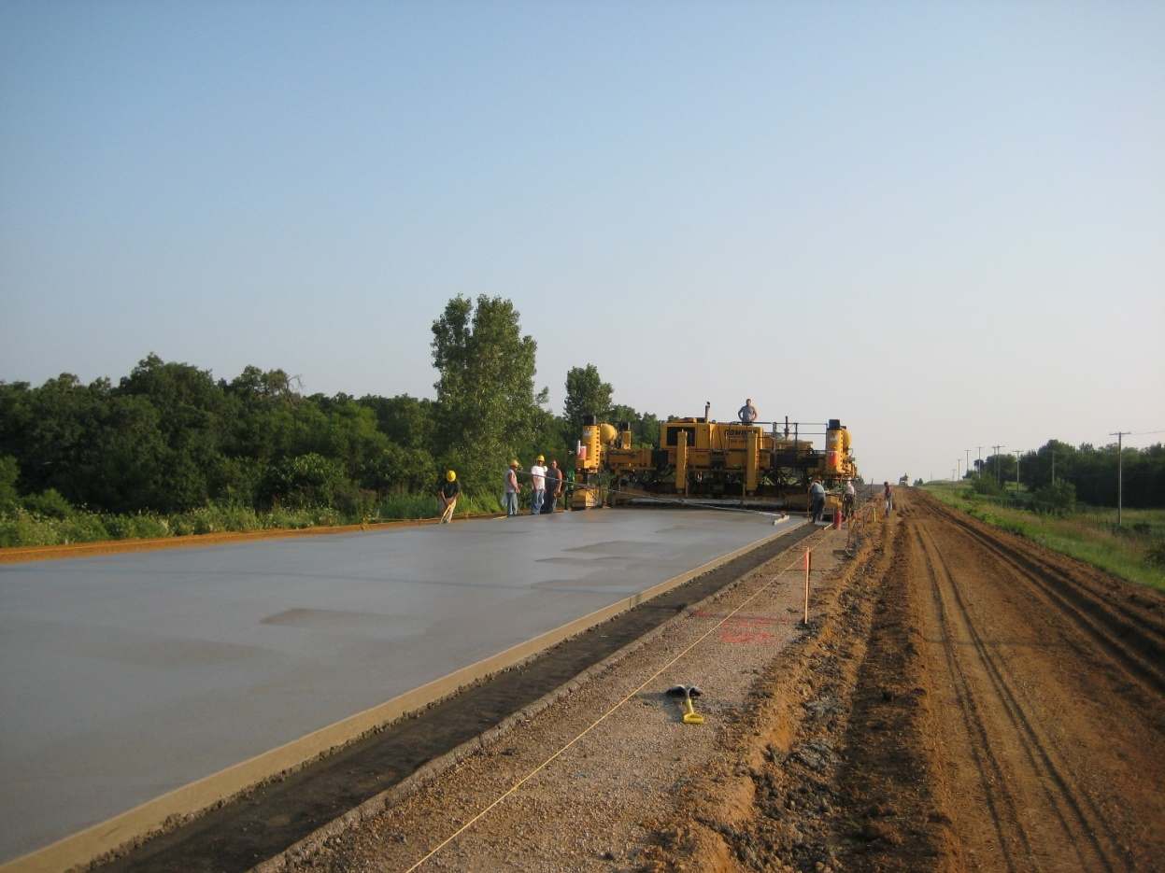
Placing Overlay

Slide 15
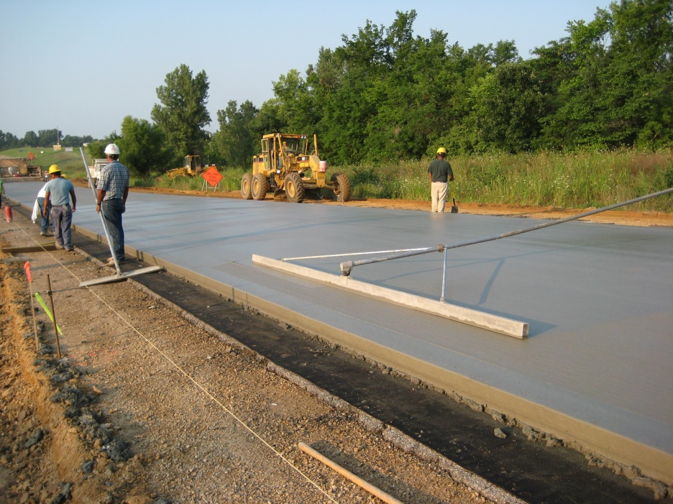
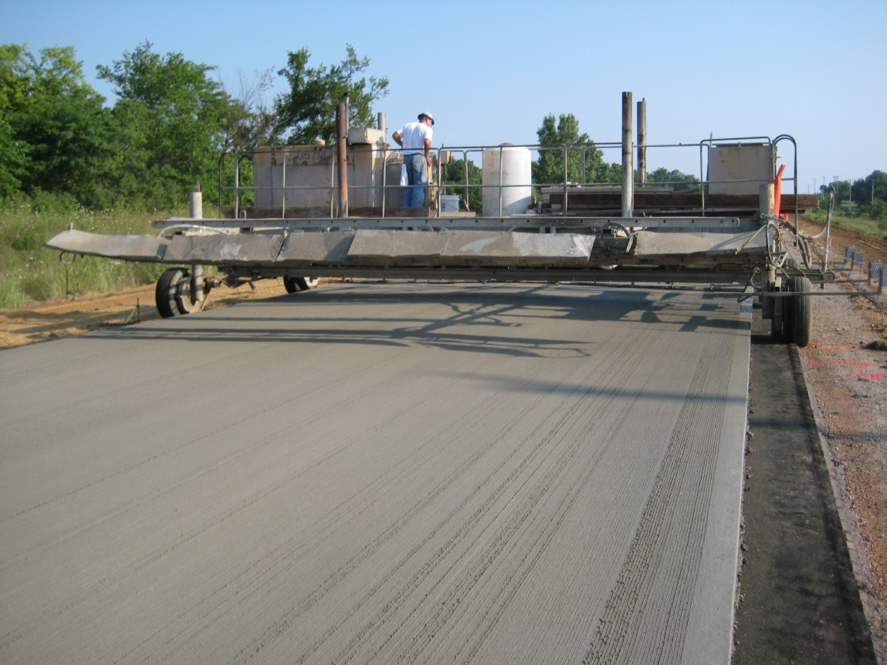
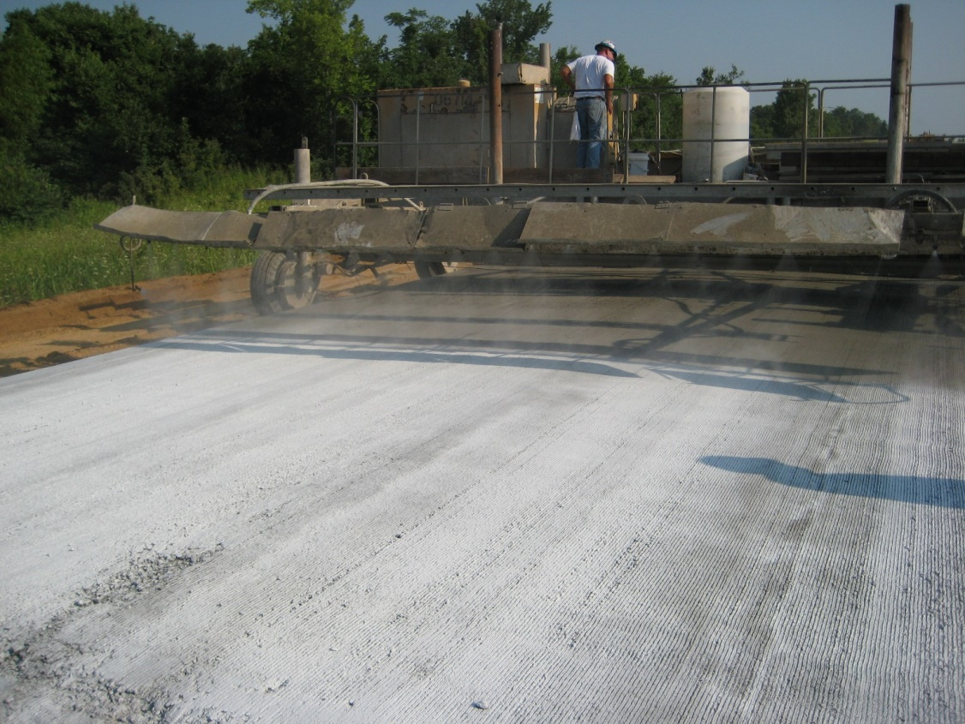
Finishing Surface

Slide 16
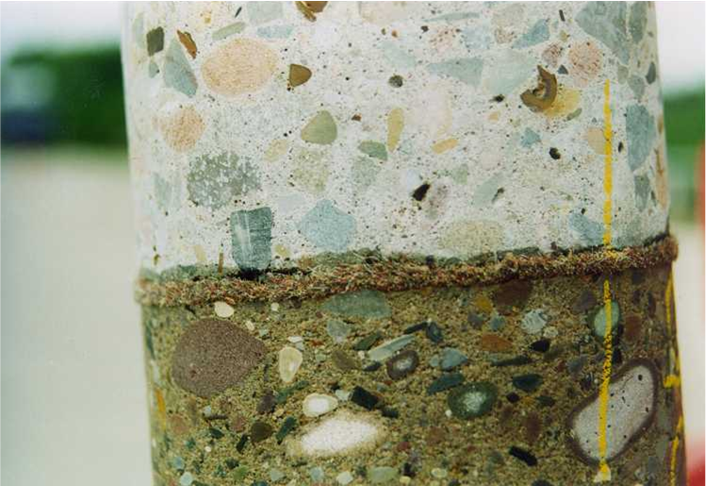

Slide 17
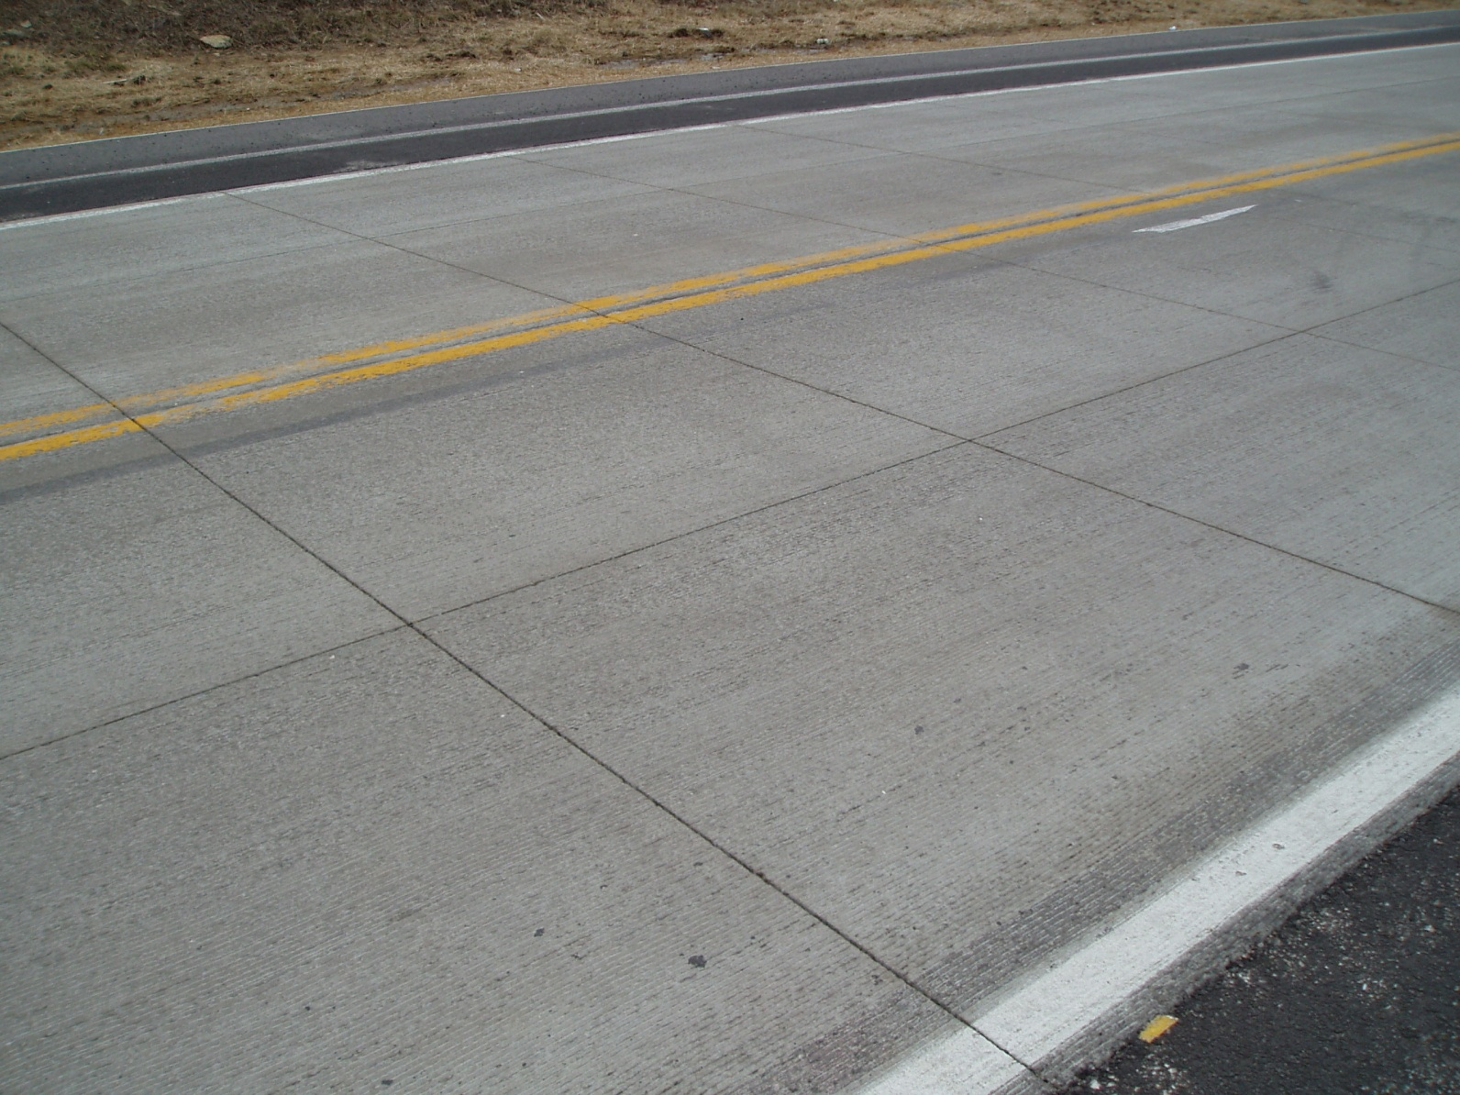

Slide 18
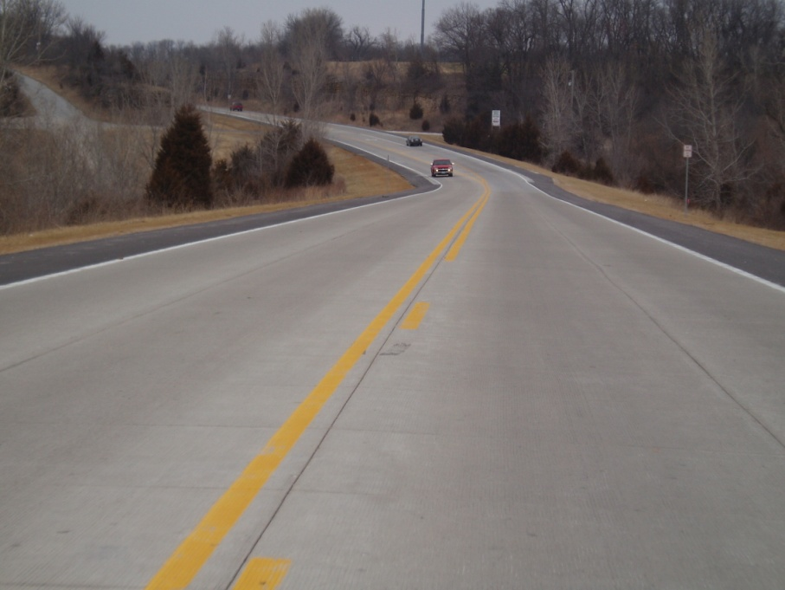

Slide 19
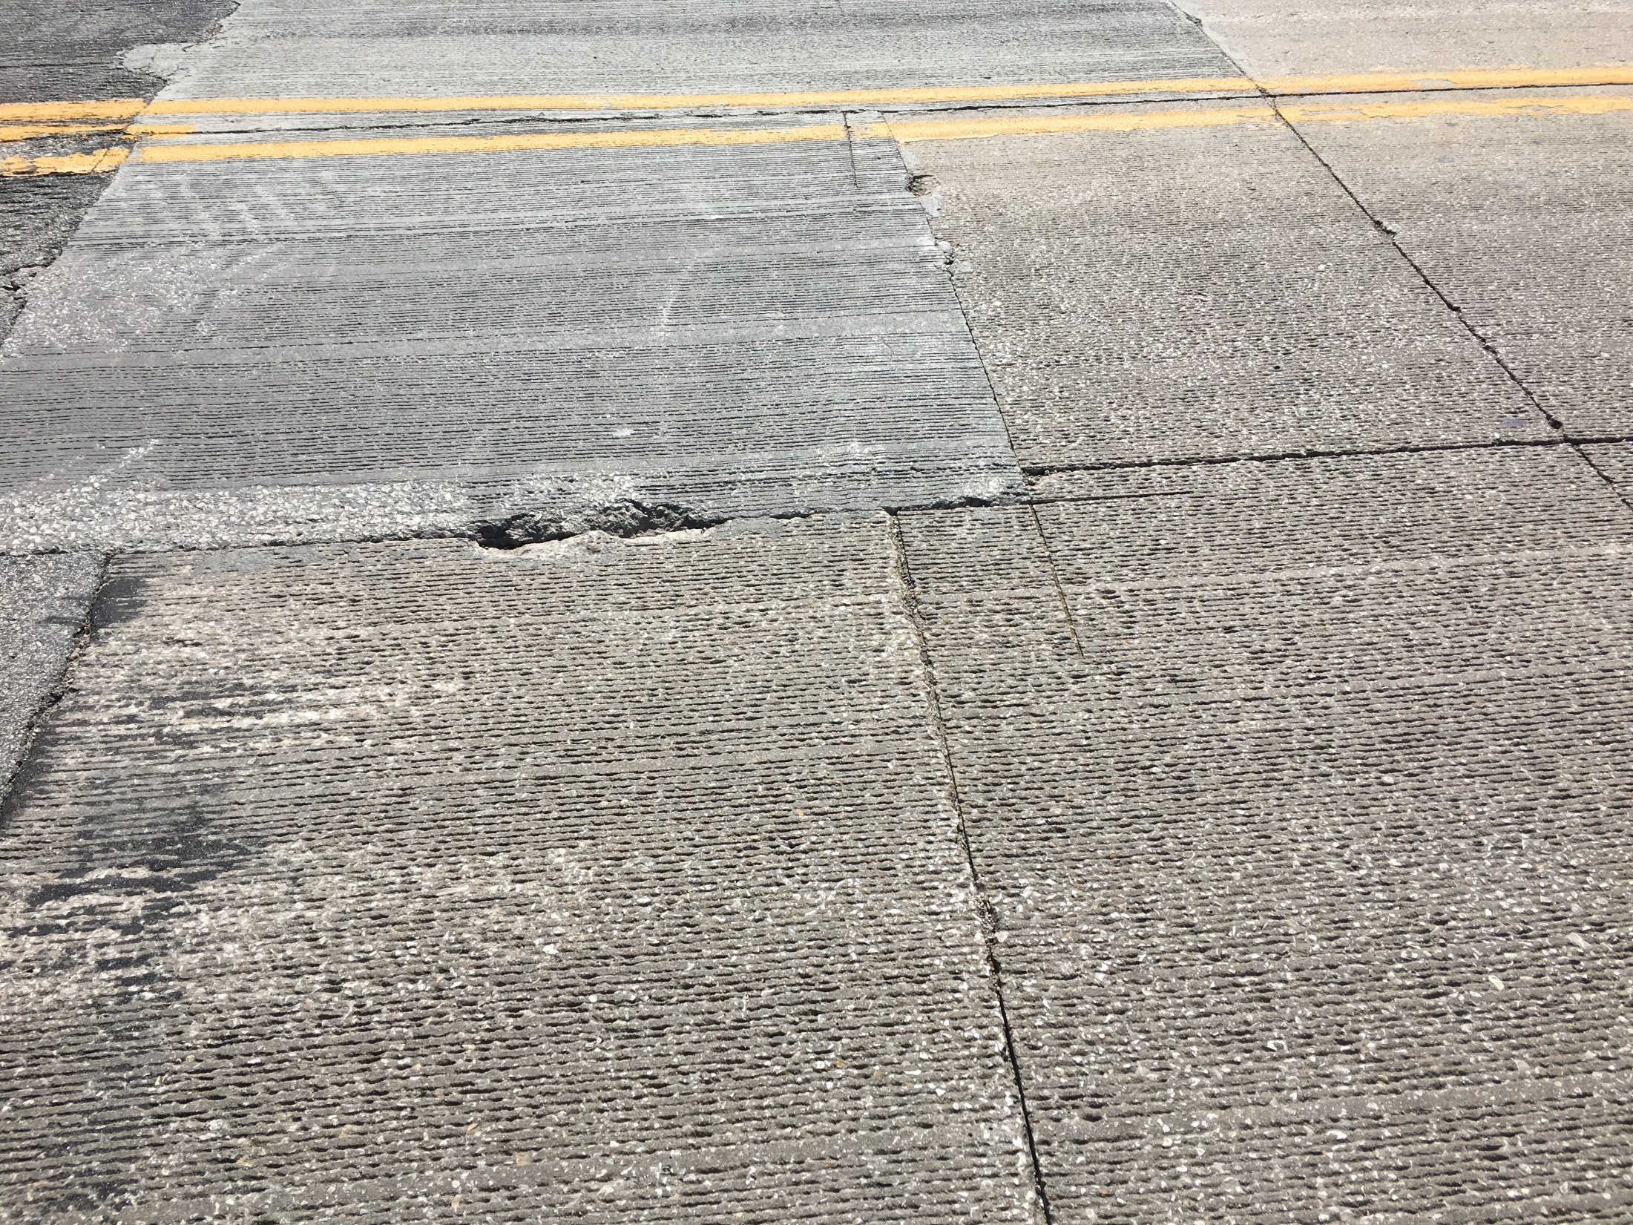
Northern Transition

Slide 20
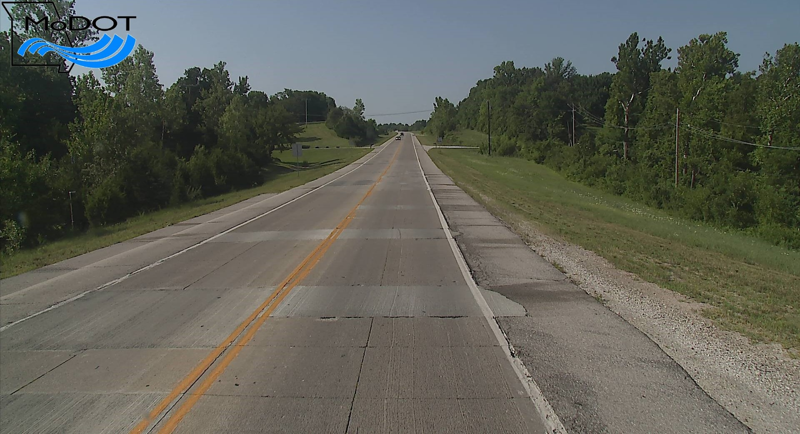
North End

Slide 21
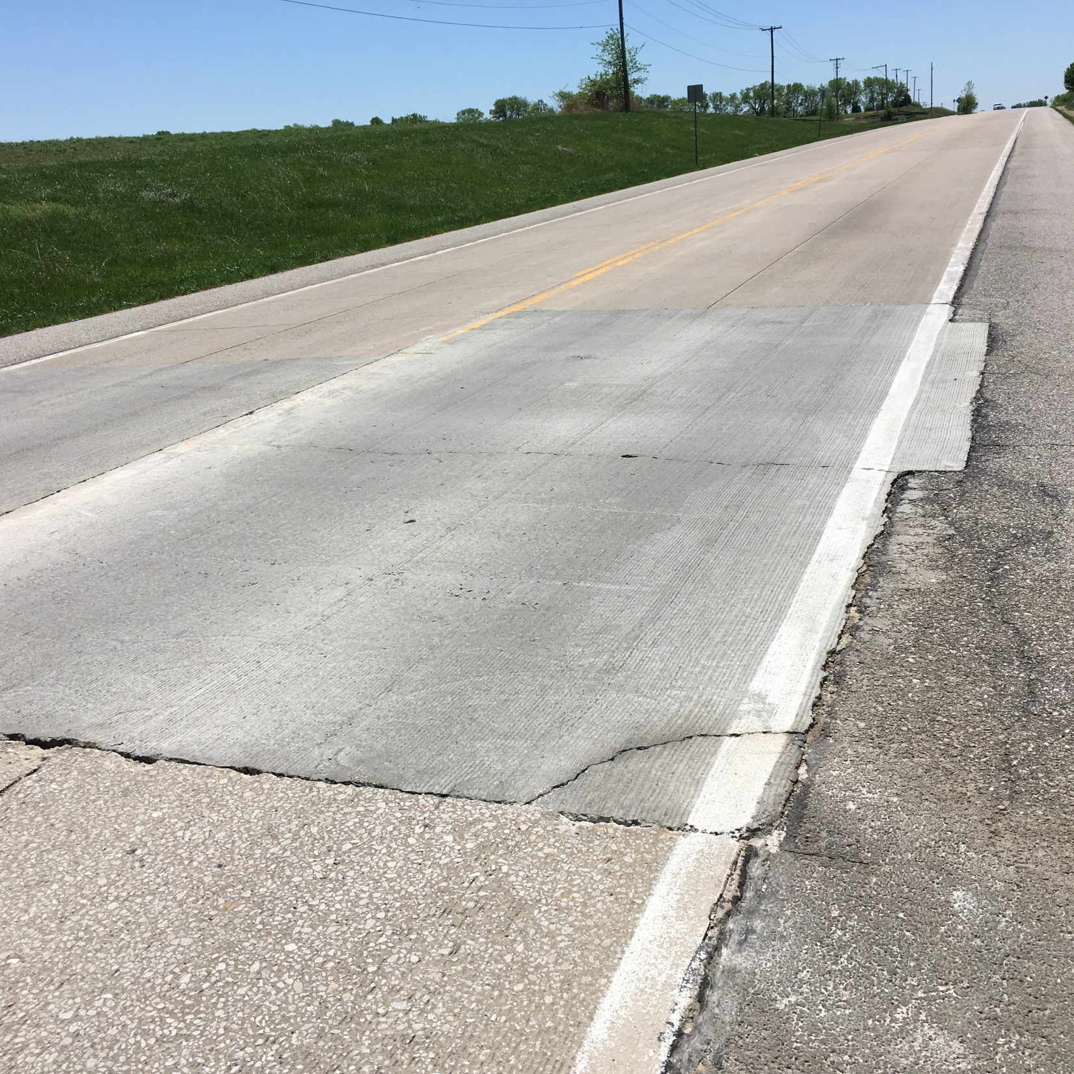
Patch in Cut Area

Slide 22
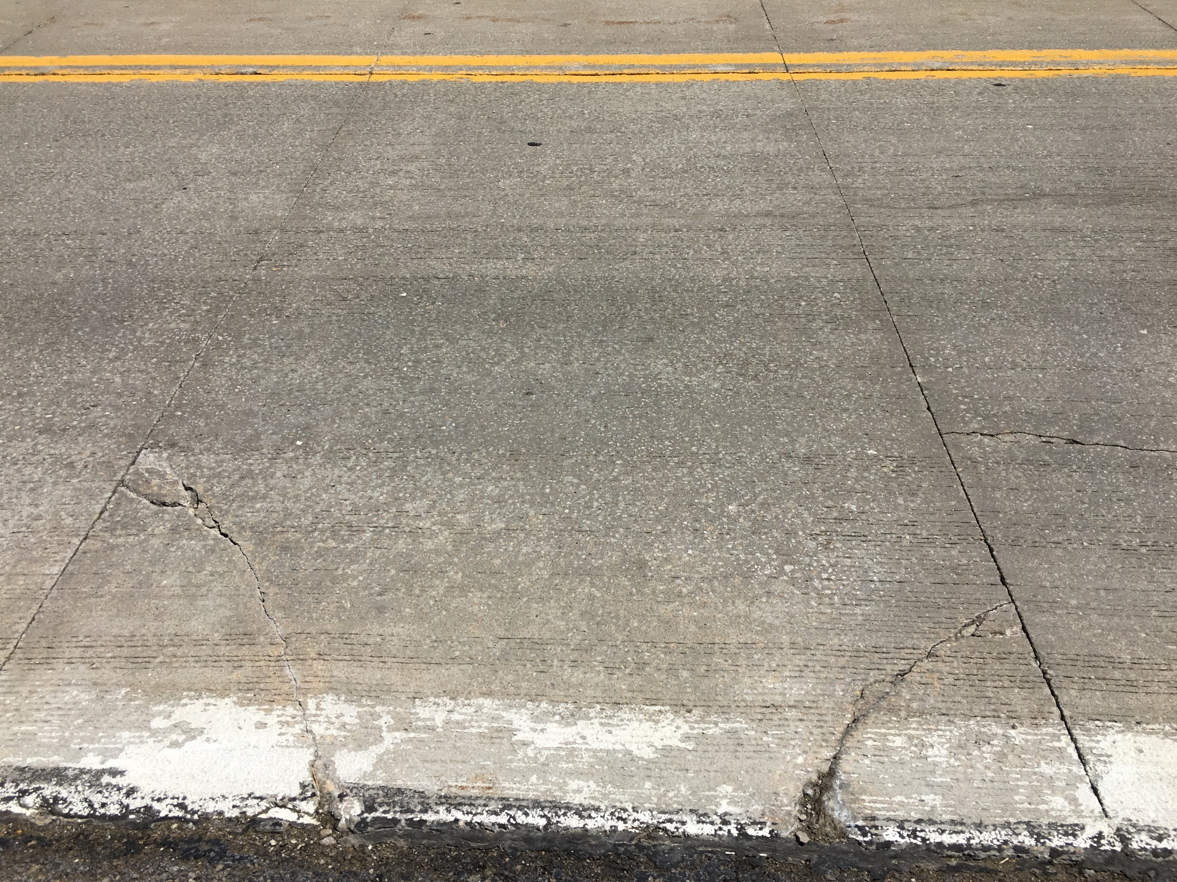
Corner Cracking

Slide 23
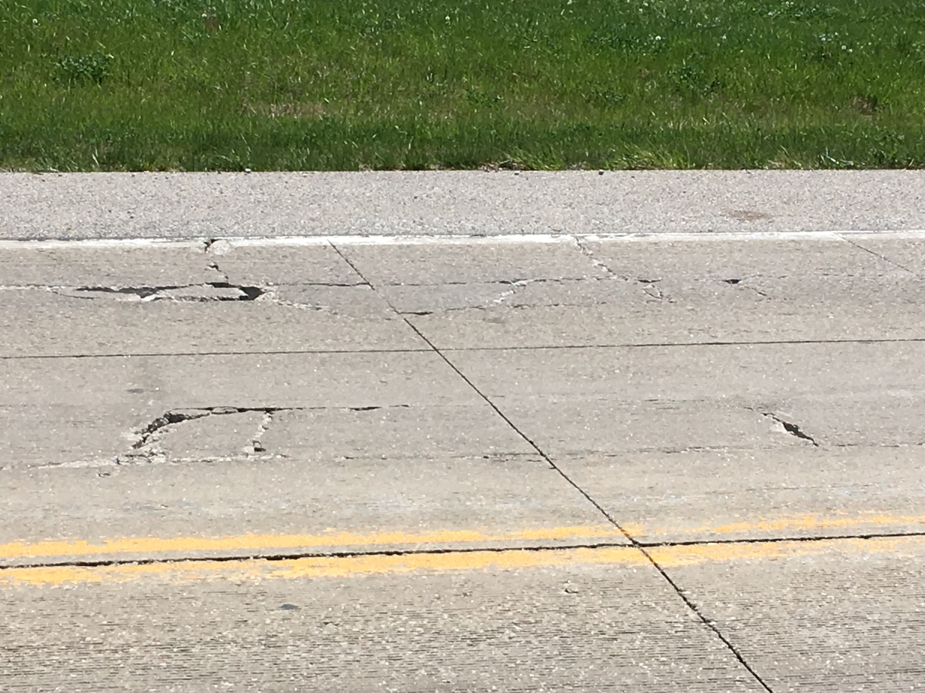
Shattered Panels

Slide 24
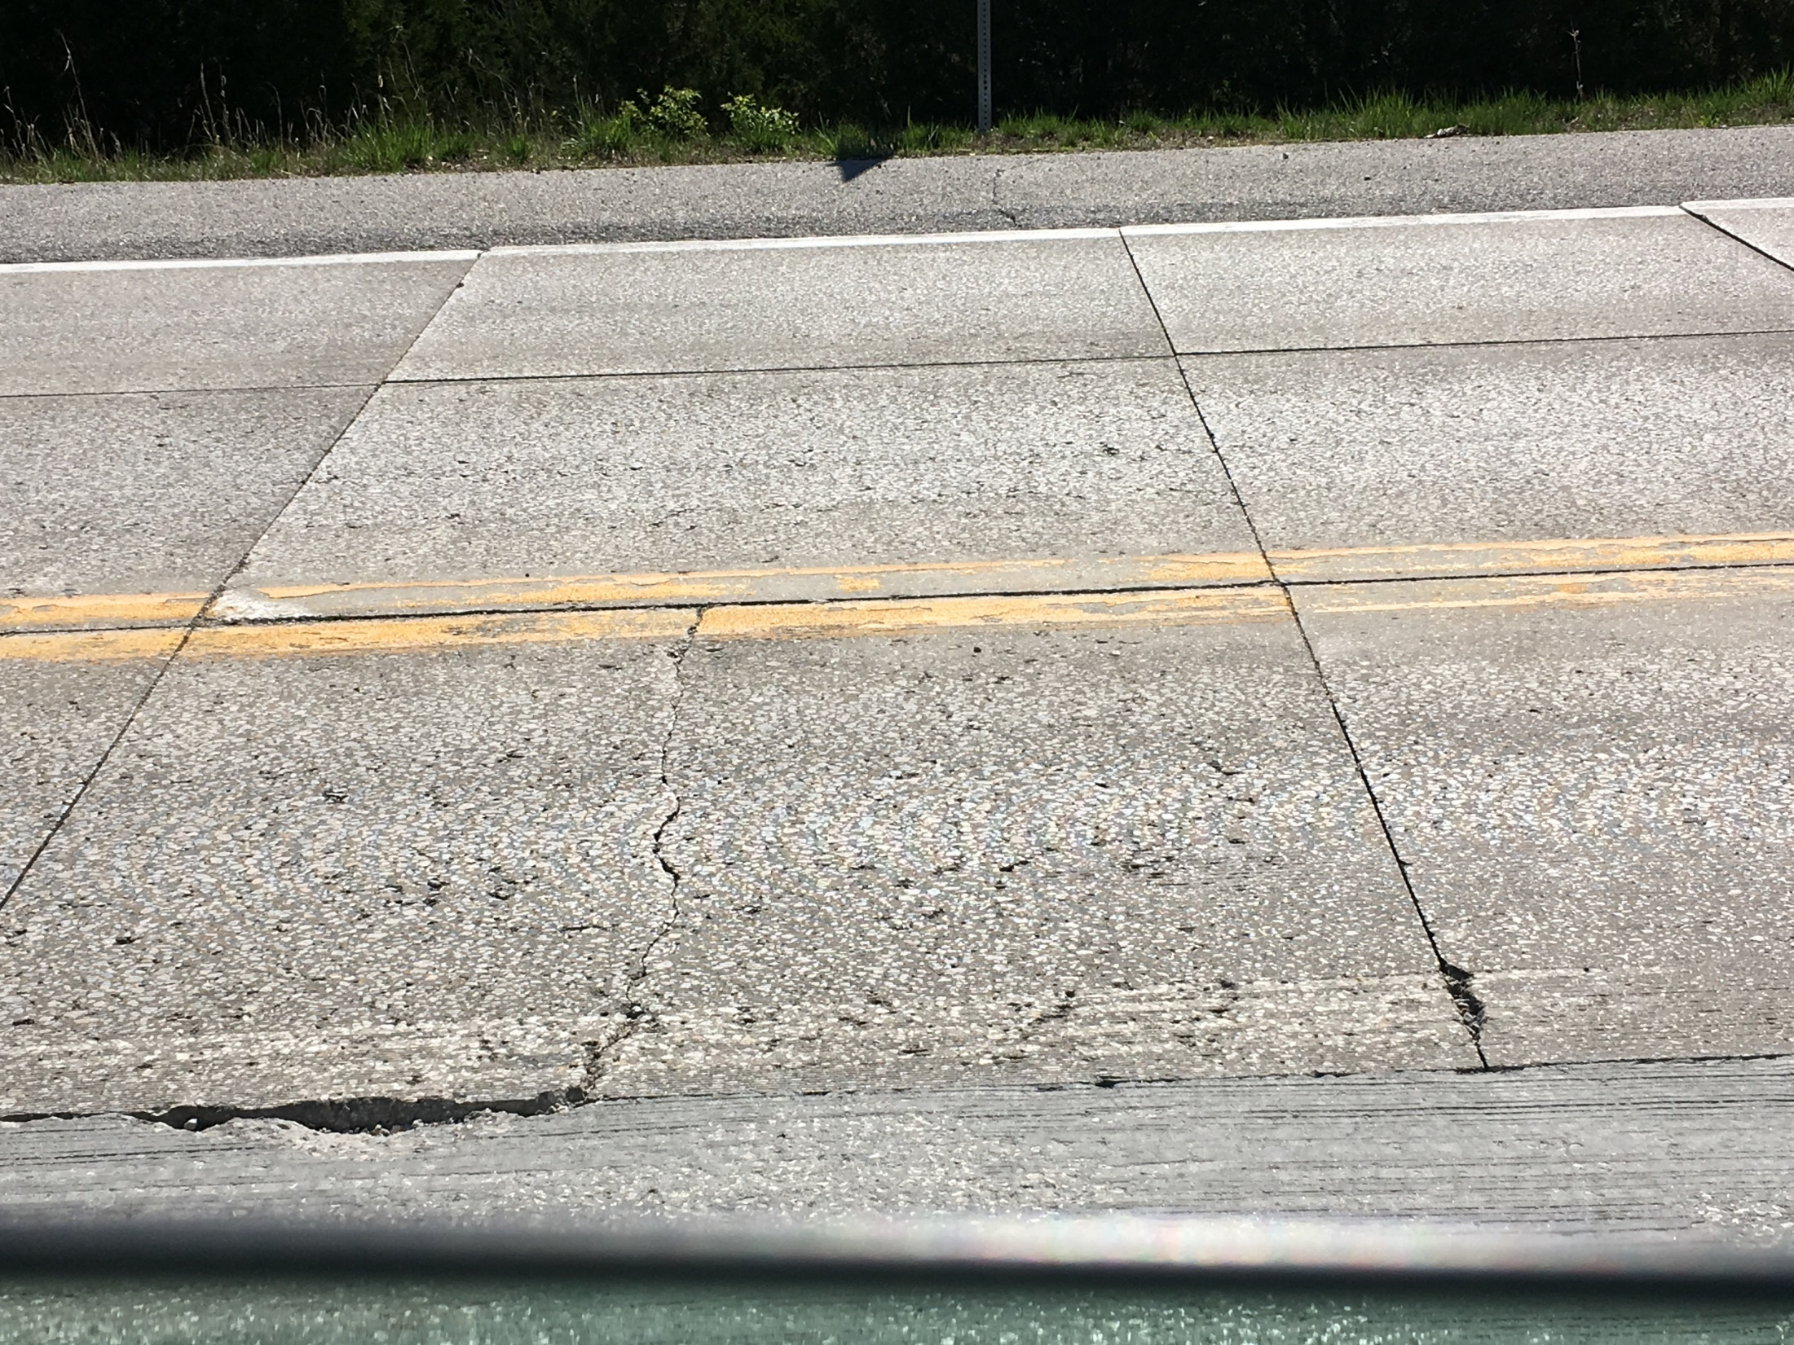
Mid-Panel Crack

Slide 25
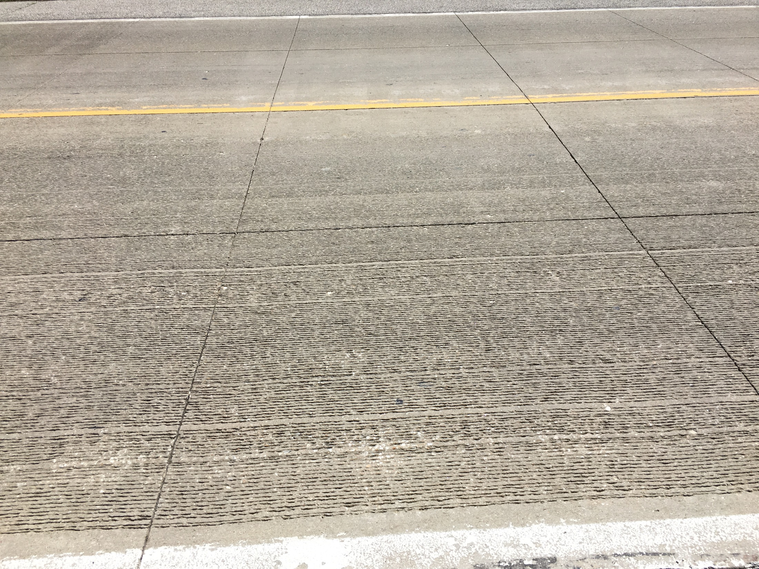

Slide 26
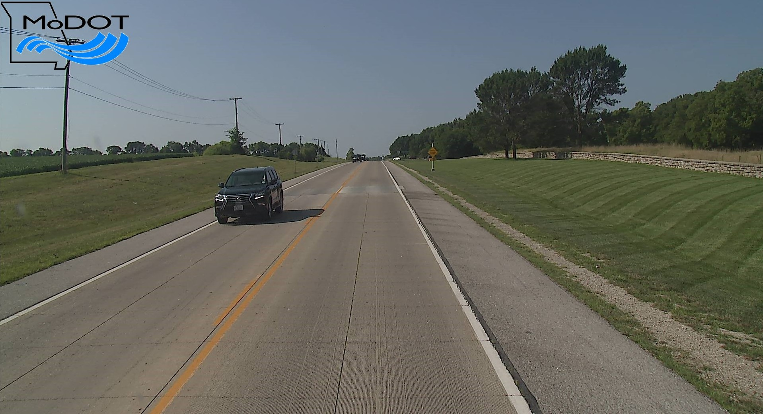

Slide 27
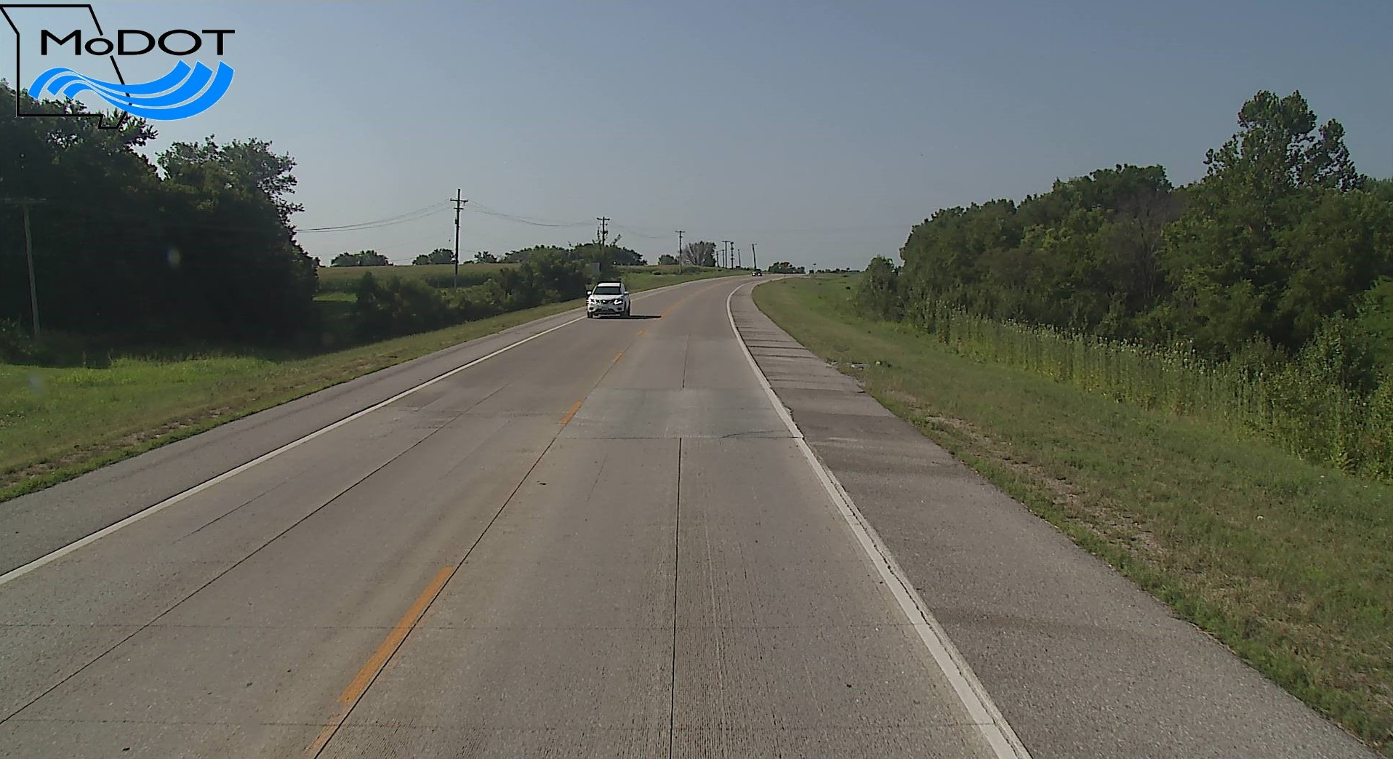
Patch in Pumping Area

Slide 28
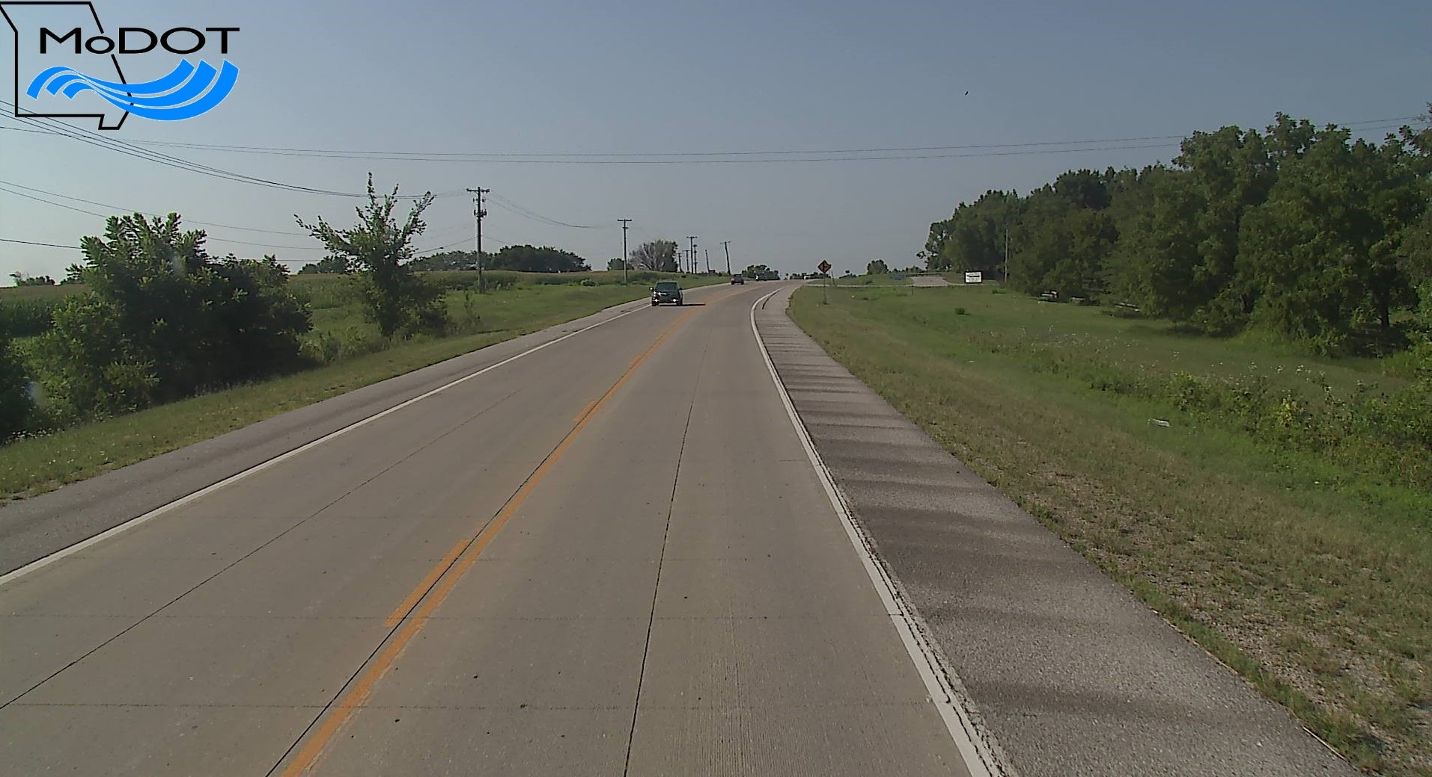
Pumping Area

Slide 29
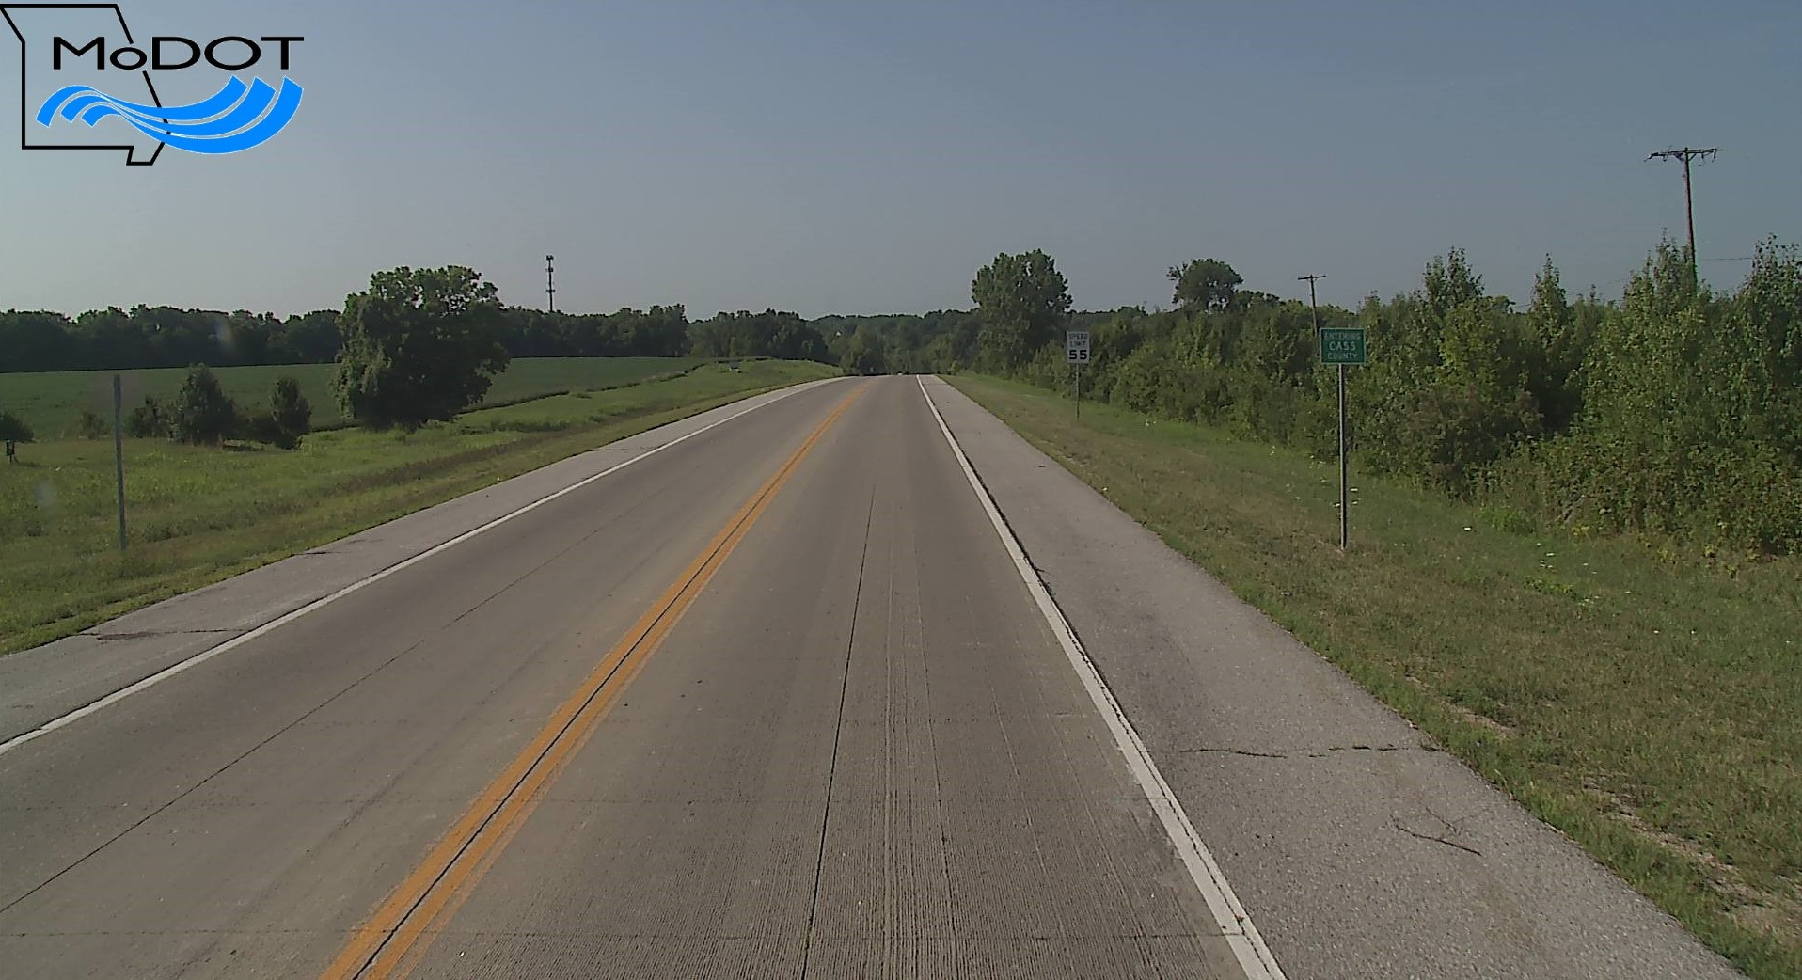

Slide 30
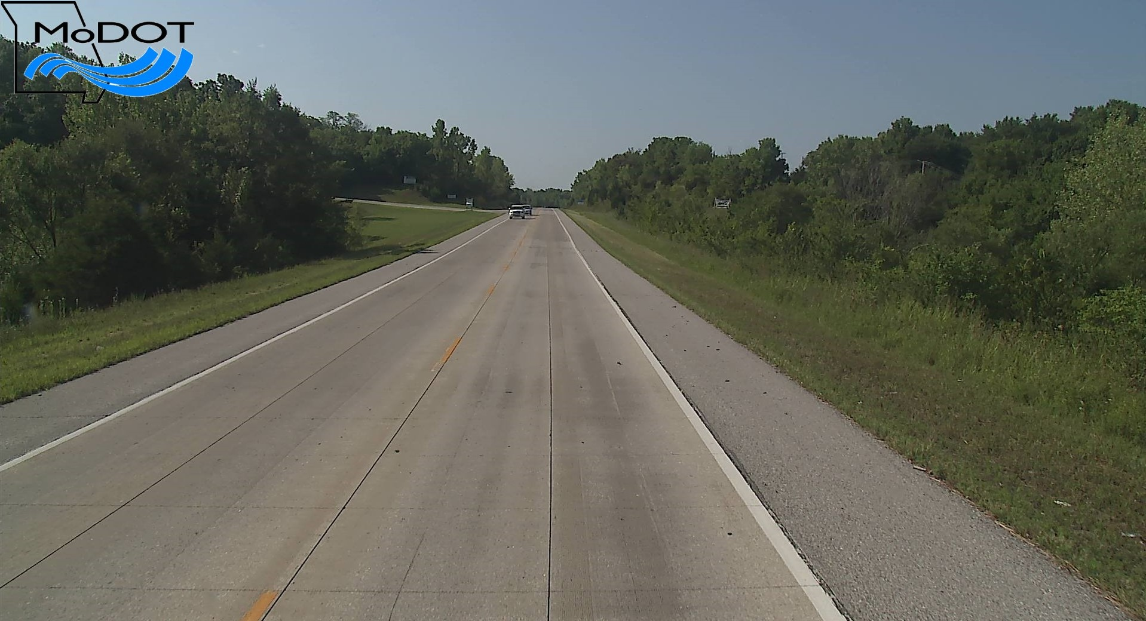

Slide 31
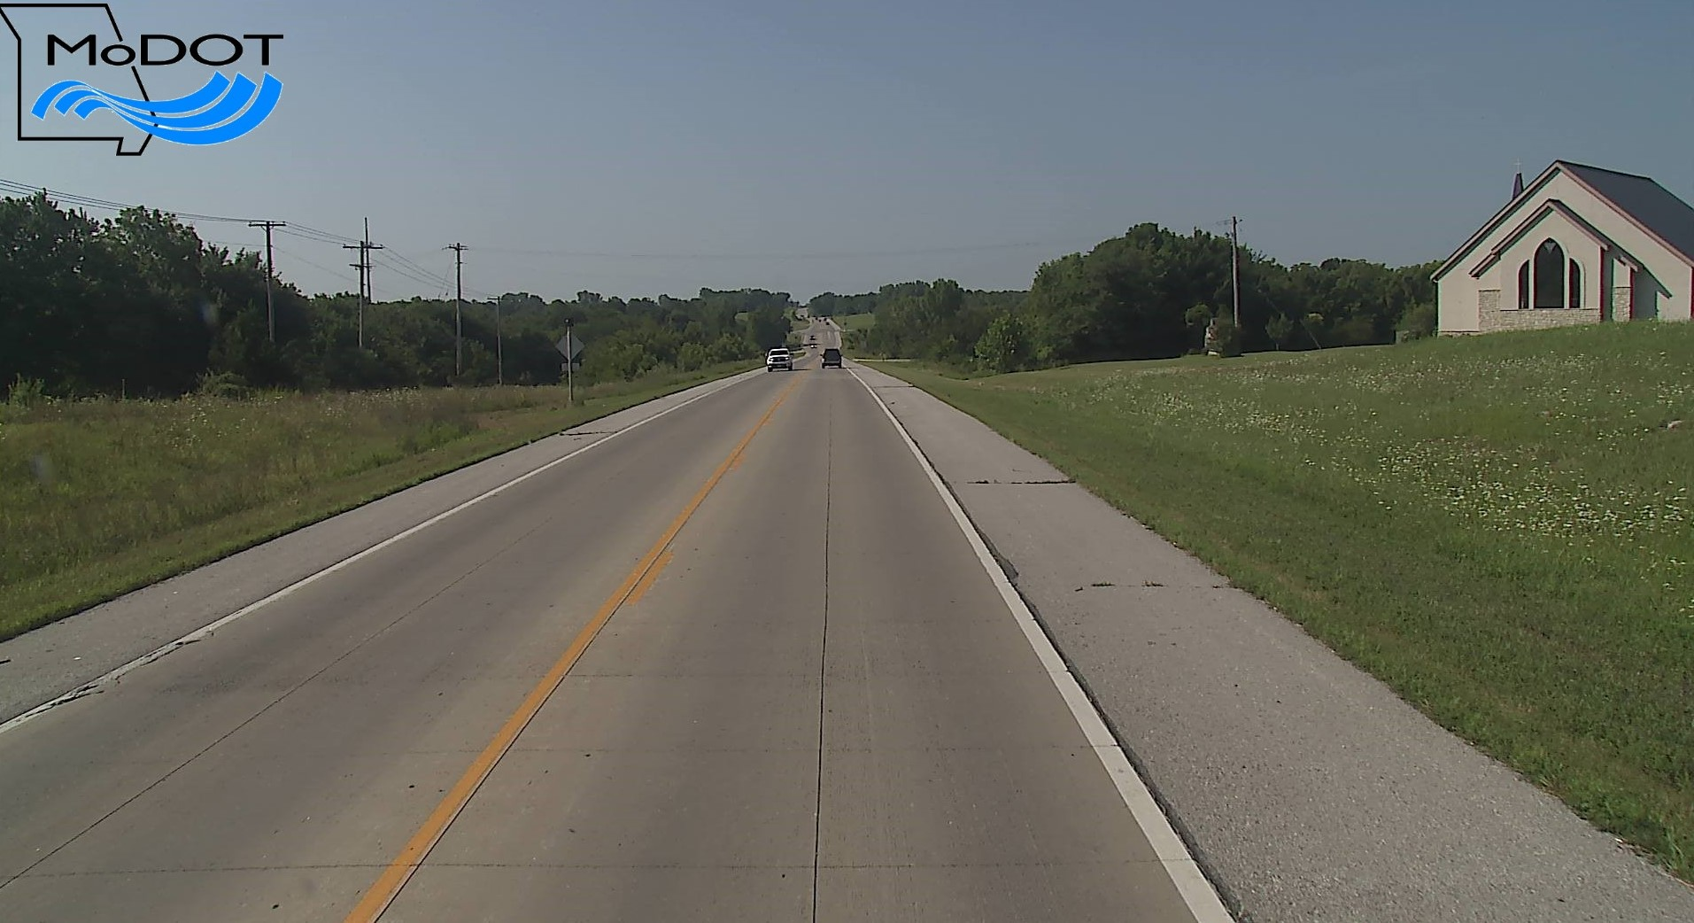

Slide 32
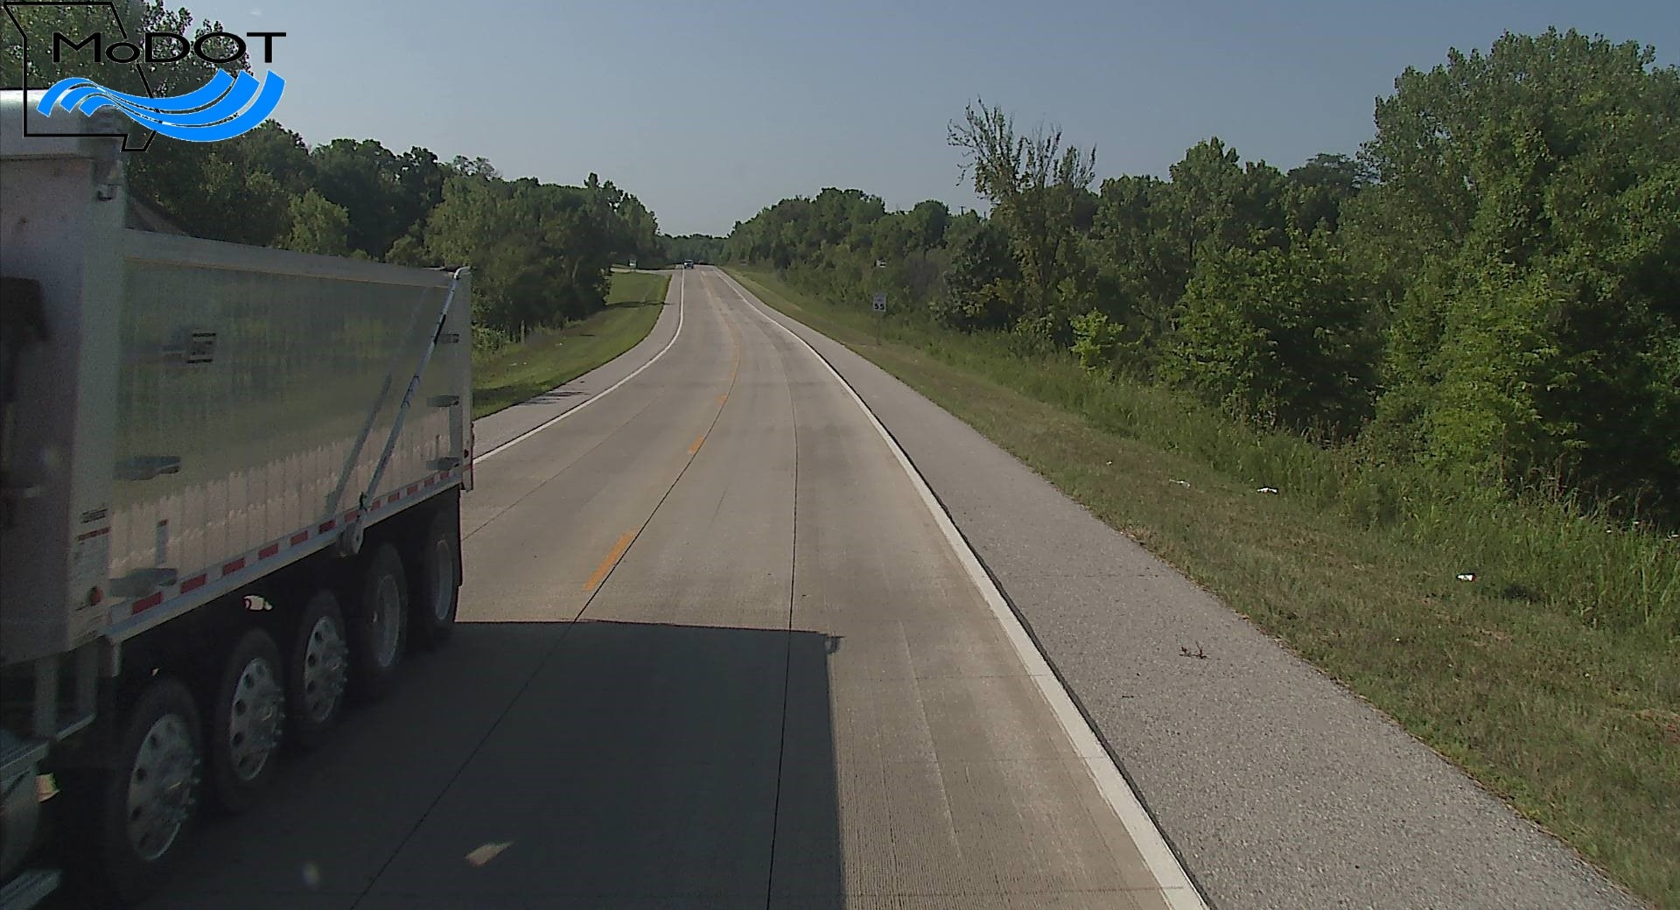

Slide 33
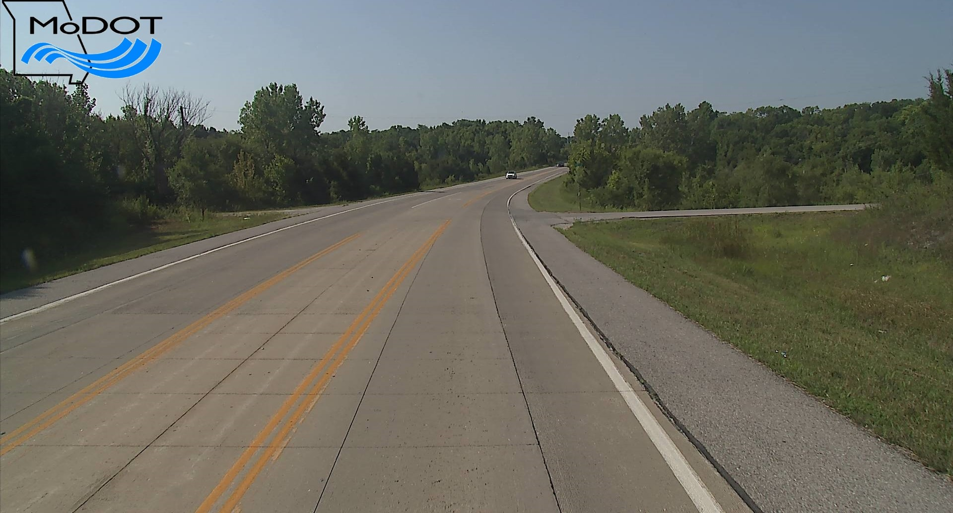

Slide 34
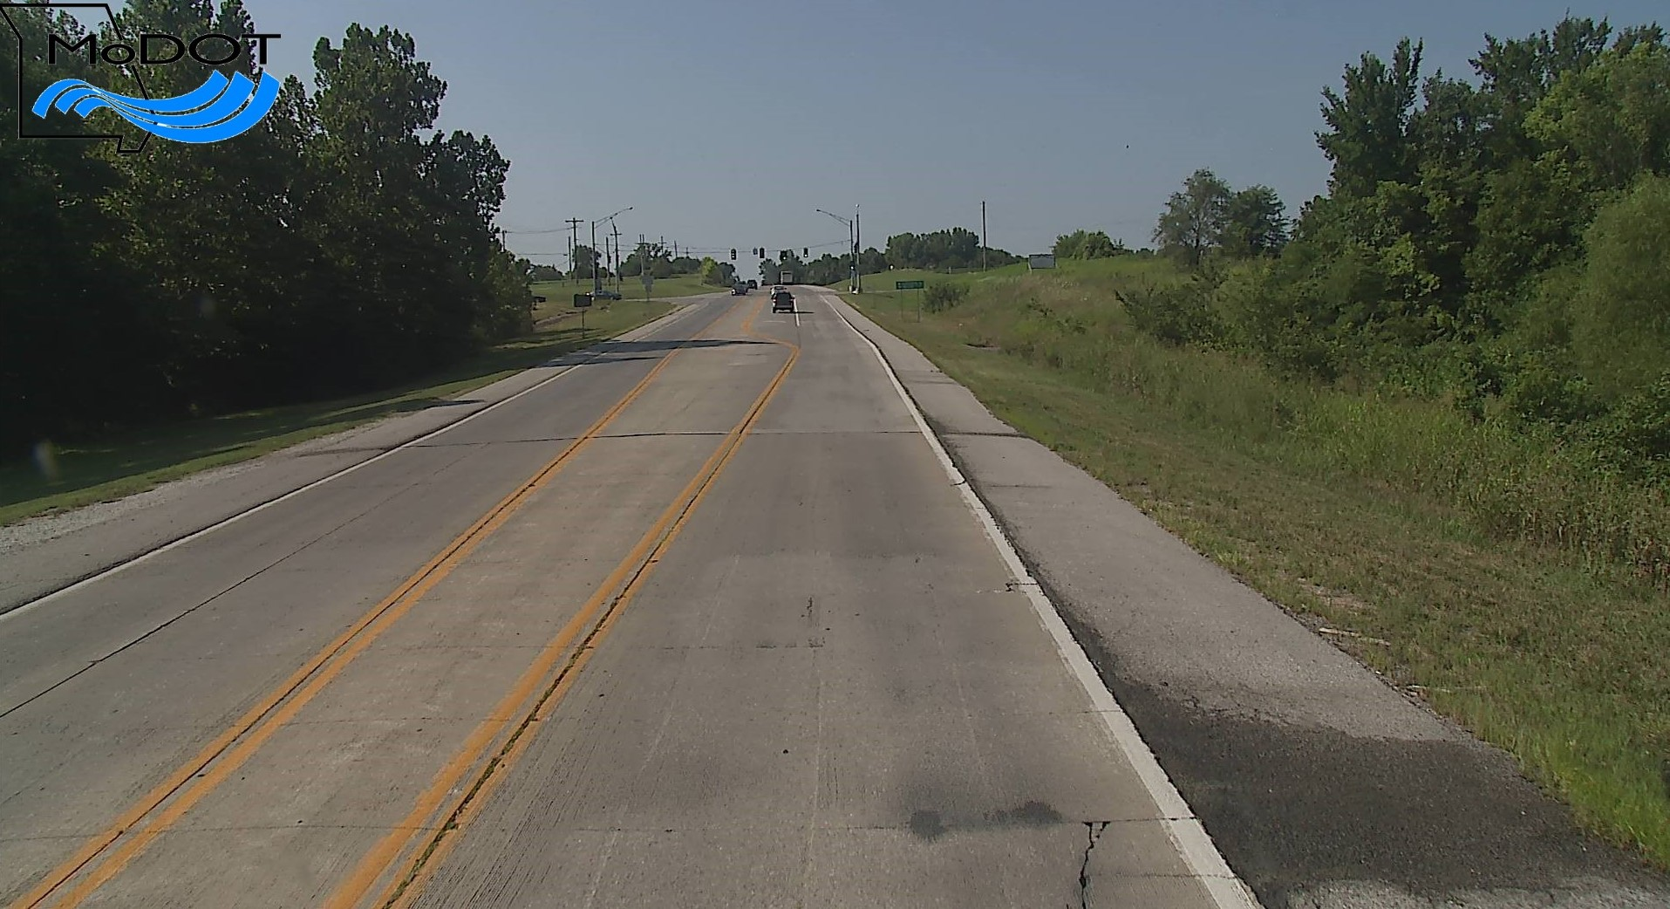
South End Transition

Slide 35
May 2018 Survey Results
Thorough visual distress survey
9828 panels total (2.79 centerline miles)
192 panels cracked or spalled for 1.95% failure rate
Half of failures located within first 600 feet near northern transition (@ Rte 150)
Average IRI ~ 88 (in/mi)

Slide 36
Findings
Overall, very good performance at 10 years
Transition areas are prone to higher rates of failure
Some failures linked to poor drainage, particularly in depressed cut areas
No distresses linked directly to geotextile interlayer

Slide 37


















































Thank You
Questions?

