Slide 1



Fracture Energy Performance Testing of 2017 NRRA Mixtures
Debaroti Ghosh, PhD
Dave Van Deusen, PE
Minnesota Department of Transportation
NRRA Pavement Workshop 2018
5/23/2018

Slide 2
Overview of Several Studies _ NRRA 2017 Construction
    Concrete rehab w/HMA overlays and HMA compaction over concrete
    Geotechnical sections – recycled aggregate base and large-stone subbase
    Cold Central Plant Recycling
    Maintaining poor pavements (Thinlay)
Mix Type used for various lift thickness (6 types) | Traffic Level | Agg Size, mm | Binder Type | Design Air voids, %
SP WE A 4 40 E; SP WE B 4 40 E; SP WE C 4 40 E; SP WE B 4 50 E; SP WE B 4 30 E; SP WE D 4 30 I | 3; 4 | 4.75; 9.5; 12.5; 19.0 | PG 58H-28; PG 58E-34 | 2.0-5.0
Mix Type for Both Lift | Traffic level | Agg size, mm | Binder Type | Design Air voids, %
SP WE B 3 40 C | 3 | 12.5 | PG 58H-34 | 4.0
Mix Type for Single Lift | Traffic Level | Agg Size, mm | Binder Type | Design Air voids, %
SP WE B 3 40 C | 3 | 12.5 | 58H-34 | 4.0
Mix Type for Single Lift | Traffic Level | Agg size, mm | Binder Type | Design Air voids, %
SP WE D 4 40 E | 4 | 4.75 | 58H-28 | 4.0

Slide 3
MAP
B Overlay study, Cells 984-987
B
C Compaction study, Cells 988-991

Slide 4

NRRA Construction Report

Slide 5
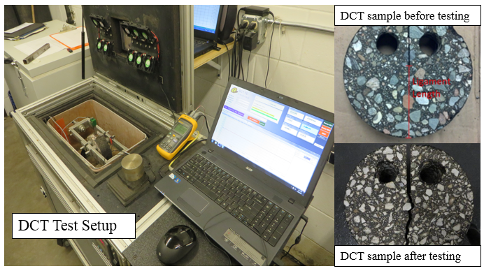
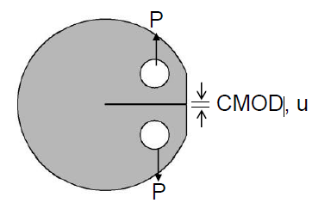
Objectives
  Present overall results of DCT testing
  Preliminary cracking performance of HMA overlays of concrete
  Disk Shaped Compact Tension Test
Mixture Type: 8; Replicate: 12; Test Temperature: -21.4°C
W_{f}

Slide 6
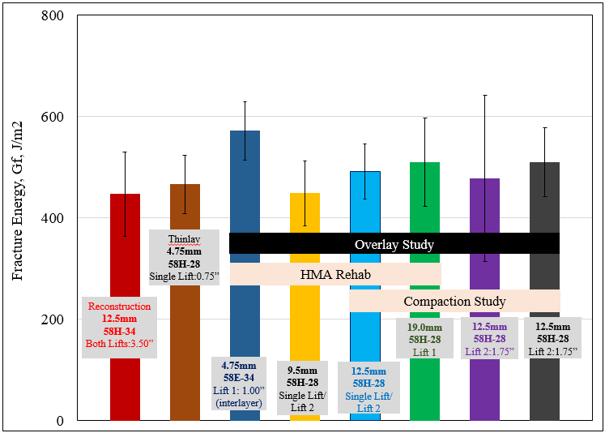
Overview of Fracture Energy for Different Experiments

Slide 7
HMA over Concrete _ Concrete Rehab

Slide 8
HMA over Concrete _ Compaction Study

Slide 9
HMA over Concrete_ Concrete Rehab

Slide 10
Correlation between Lift Thickness and Length of Cracking based on Preliminary Performance
Cell No. | Experiment Type | Lift Thickness, inch | Total Length of Reflective Cracking, ft
984 | Concrete rehab w/HMA overlays | 1.5 | 173
985 |  | 1.5 | 178
986 |  | 1.75 | 146
987 |  | 4 | 64
988 | HMA compaction over concrete | 3.5 | 62
989 |  | 3.5 | 12
990 |  | 3.5 | 0
991 |  | 3.5 | 36
992 | Concrete rehab w/HMA overlays | 2.5 | 85
993 |  | 2.5 | 50
994 |  | 1.5 | 300

Slide 11
Preliminary Statistical Analysis of Mixture Fracture Energy
Student T-test was performed for p-value to determine significantly different mix compared to the control mix SPWEB440E.
Mix | Aggregate size, mm | PG | Average Fracture Energy, G_{f}, J/m² | Maximum G_{f} | Minimum G_{f} | Range | Standard Deviation | p-value, (95% CI)
SP WE B 4 40 E | 12.5 | 58H-28 | 491 | 564 | 406 | 159 | 54 | Control
SP WE A 4 40 E | 9.5 | 58H-28 | 449 | 635 | 380 | 256 | 64 | 0.05
SP WE B 3 40 C | 12.5 | 58H-34 | 447 | 599 | 350 | 249 | 83 | 0.07
SP WE B 4 30 E | 12.5 | 58H-28 | 510 | 628 | 417 | 211 | 68 | 0.23
SP WE B 4 50 E | 12.5 | 58H-28 | 477 | 582 | 384 | 198 | 164 | 0.29
SP WE C 4 40 E | 19.5 | 58H-28 | 510 | 729 | 438 | 291 | 87 | 0.26
SP WE D 4 30 I | 4.75 | 58E-34 BLEND2 | 572 | 643 | 454 | 189 | 58 | 0.00
SP WE D 4 40 E | 4.75 | 58H-28 | 466 | 556 | 383 | 173 | 58 | 0.14

Slide 12
Distribution of replicate-sets identified as significantly different based on p-value

Slide 13
Effects of Various Mixture Properties on
Fracture Energy
Pearson Correlation Coefficient was calculated to observe the effects of various mixture properties individually on Fracture Energy.

Slide 14
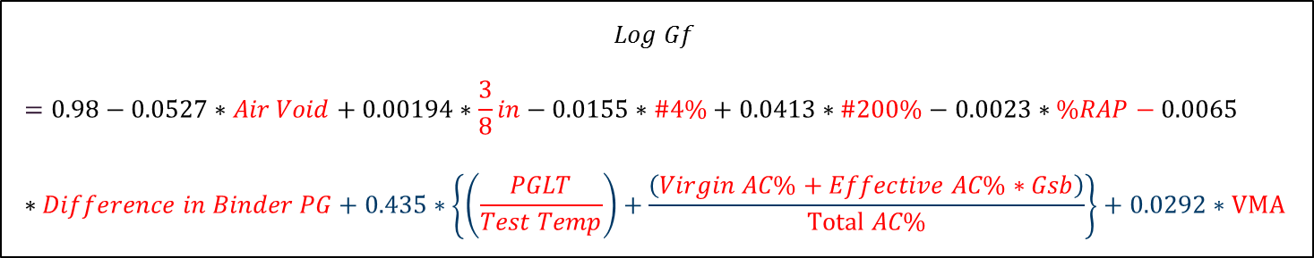
Fracture Energy Prediction Model (in progress)
$$Log Gf$$
$$=0.98−0.0527∗Air Void+0.00194∗\frac{3}{8}in−0.0155∗\#4\%+0.0413∗\#200\%−0.0023∗\%RAP−0.0065∗Difference in Binder PG+0.435∗\left\{\left(\frac{PGLT}{Test Temp}\right)+\frac{\left(Virgin AC\%+Effective AC\%∗Gsb\right)}{Total AC\%}\right\}+0.0292∗VMA$$
MnDOT DCT Master database has around 1500 replicates test results,
157 different mixes,
More than 12 different projects.
Model Based on 861 data points from master database

Slide 15
Prediction of NRRA 2017 Mixture Fracture Energy Using Prediction Model

Slide 16
Thank you

