Slide 1
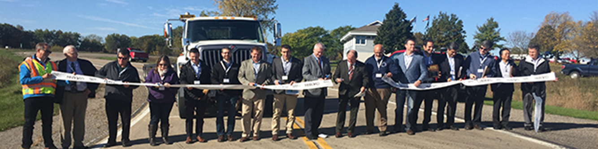
NRRA Future Goals and Direction
May 24, 2018

Slide 2



















































Slide 3

Goals
Membership
  Agencies $
  Associates $
Two Year Extension
Request for Proposals
  Leverage/Maximize Resources
We Must Implement
  Tech Transfer
Welcoming Organization

Slide 4
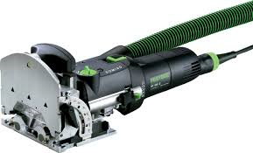
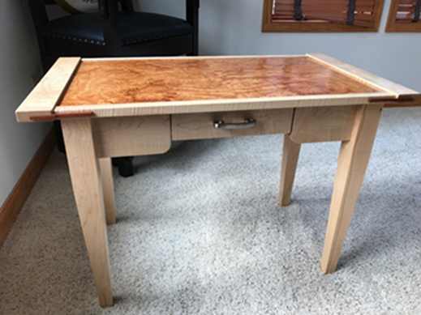

New Tools!!!
Why do we hold new methods to a higher standard?

Slide 5


