Slide 1
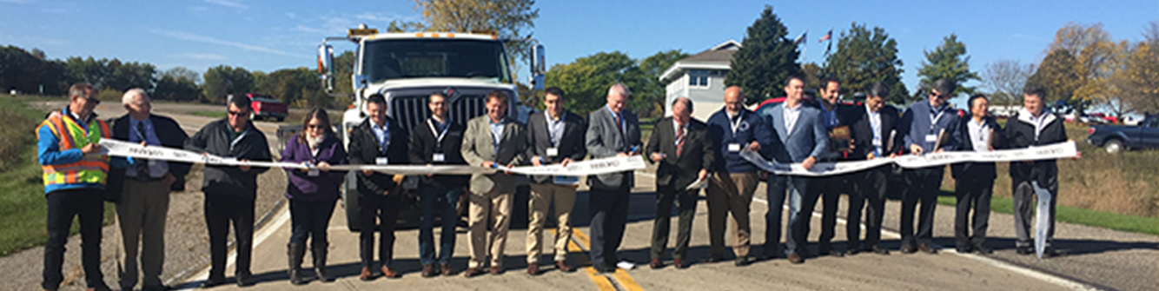
NRRA Workshop
May 23, 2018

Slide 2
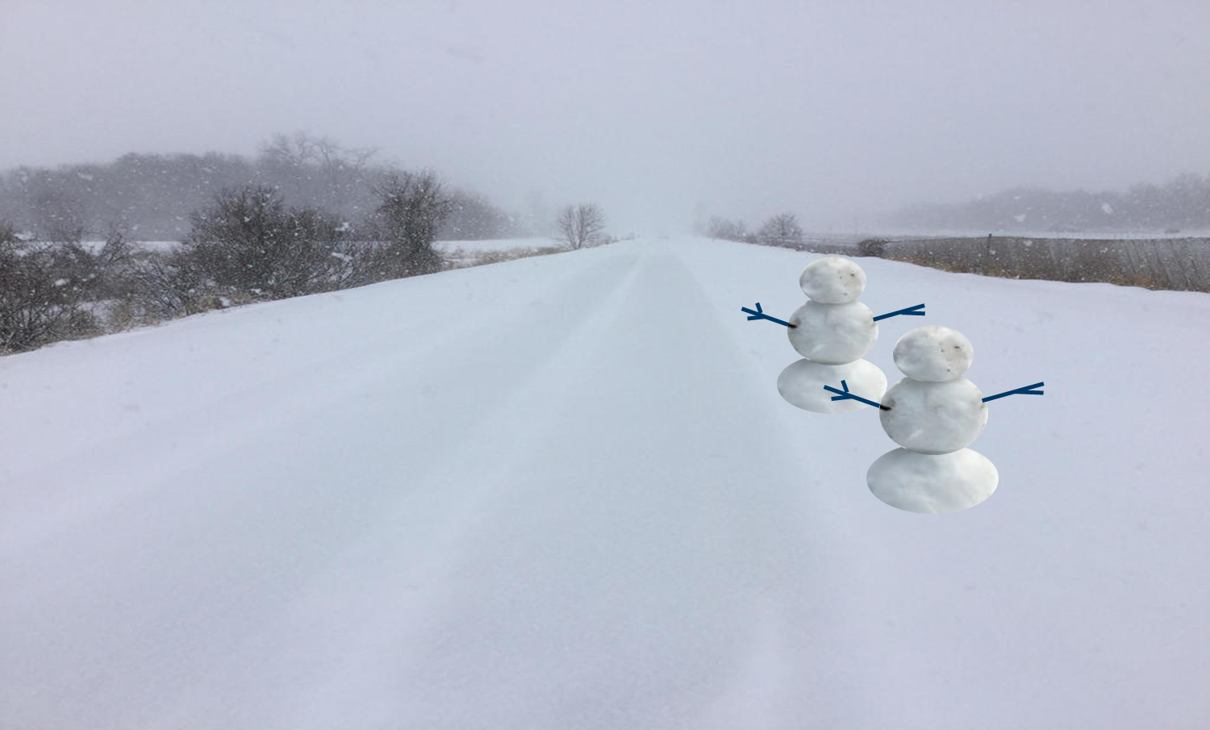
N DoubleR A
Start Date
  February 22, 2016
Growth
Accomplishments
Current Opportunities
How are we doing?
Future
Feedback

Slide 3

Growth
48 members
New Team

Slide 4





































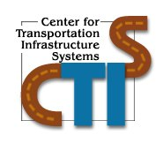













Slide 5
Intelligent Construction Technologies
The focus of this team is the application and advancement of current and emerging nondestructive testing (NDT) and intelligent construction technology (ICT) to highway pavement.
The NDT technologies include, ground penetrating radar, acoustics and ultrasonics, infrared imaging and LIDAR and other laser-based systems
The intelligent construction technologies include, intelligent compaction, paver-mounted thermal, high precision surveys/LiDAR/drones and 3D design/modeling and automated machine guidance

Slide 6
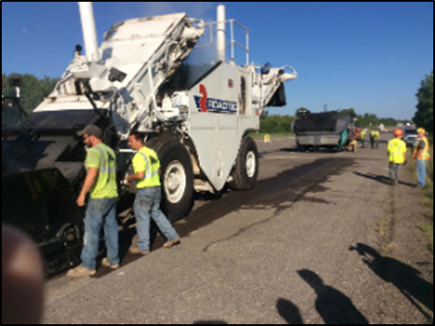
Accomplishments
MnROAD experimental design
MnROAD construction
  140 page summary report
Research projects underway
  Short Term – 7 projects
  Long Term – 8 projects
Specification sharing

Slide 7
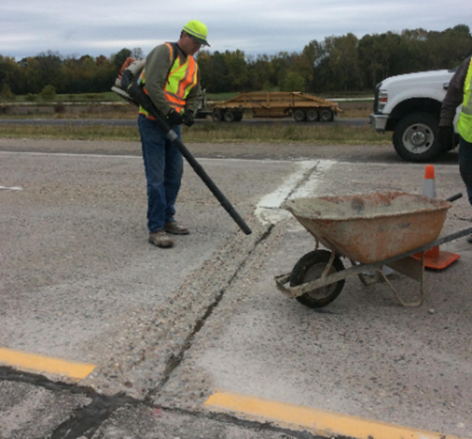
Current Opportunities
NRRA
  Technical Committees
  Research Pays Off
  NRRA Workshop
  Newsletter
  Website
  Long and short term research
  Technology transfer

Slide 8
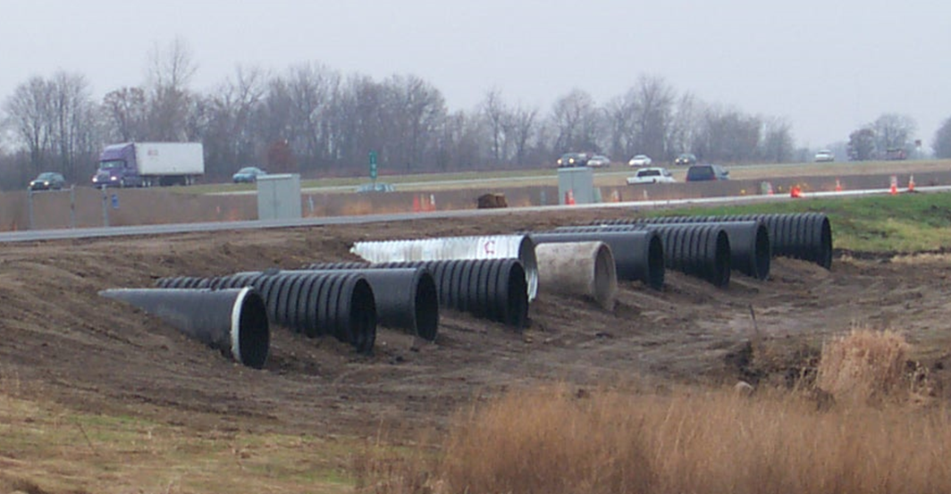
How are we doing?
Seven Keys to Building a Robust Research Program - NCHRP Synthesis 280
  Found it on Trust
  Market Boldly
  Root it in Economics
  Make Deals Unabashedly
  Insist on Accountability
  Embrace policy Research
  Empower the Staff

Slide 9
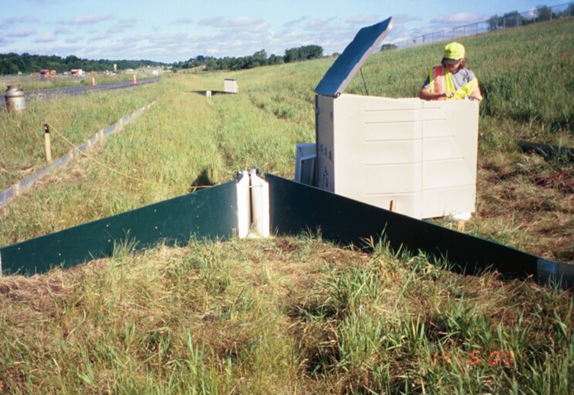
Found it on Trust
Most important of the 7 keys
Takes time
Feeling of confidence
Connectedness
Assurance of shared goals
Being on the same team

Slide 10
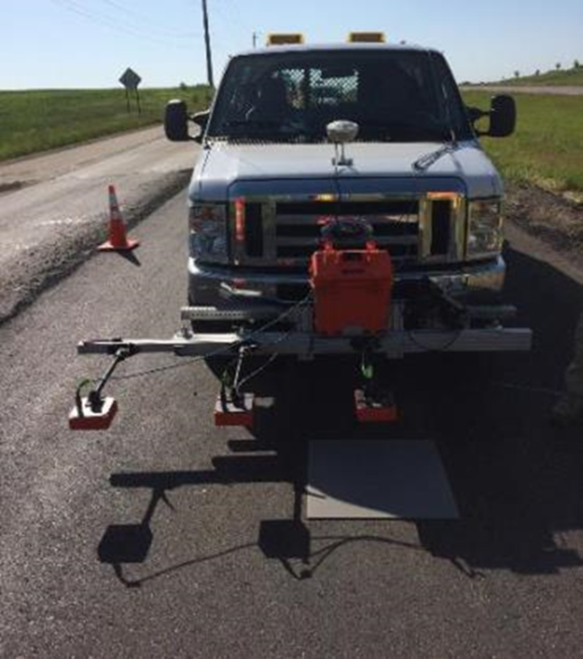
Market Boldly
Does not come naturally to many researchers
Needed at every stage of the process
  Anticipating research needs
  Justifying the time and budget required
  Persuading others to test the product
  Arguing for deployment
  Advertising successful products
  Selling the overall need for research

Slide 11
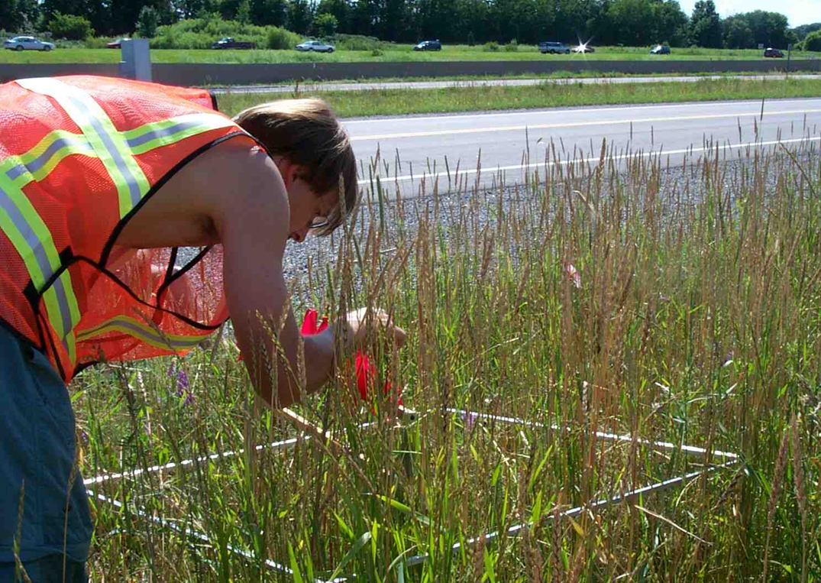
Root it in Economics
Economic justification for all activities
Technical interest is secondary
Optimum use of taxpayer resources
Implementation of results

Slide 12
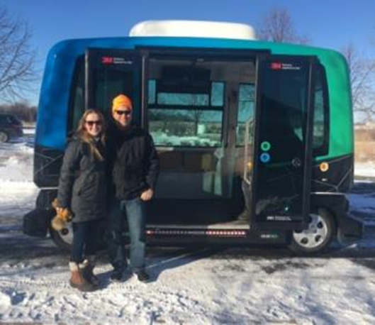
Make Deals Unabashedly
Cultivation of alliances of all types
Promote partnerships
Joint ventures
Joint research among members will enhance the credibility of the outcome

Slide 13
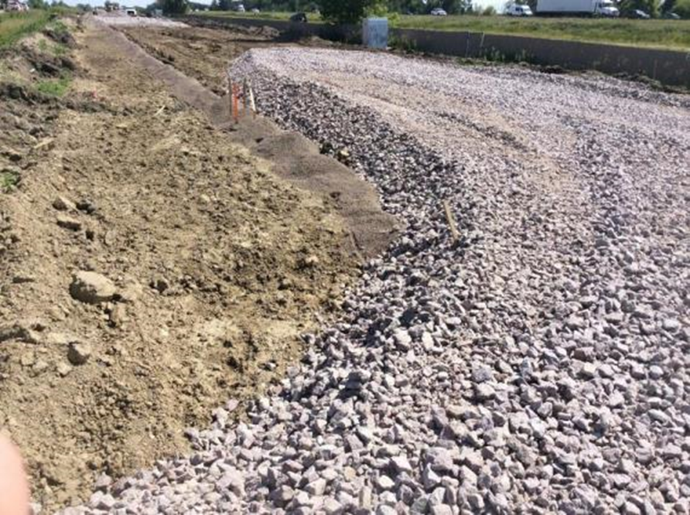
Insist on Accountability
Accountable for the use of resources and the output
There is a close connection with research and long-term profitability
Agreement with organizational goals and research agenda
Communicate strategy to stakeholders

Slide 14
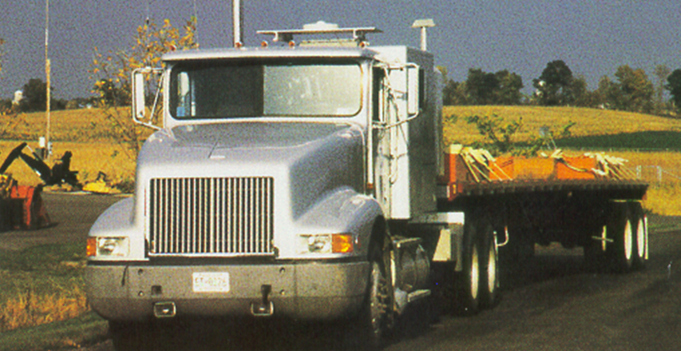
Embrace policy Research
Policy issues are at the center of top management’s concerns
Provides a channel to top management
Potential for large positive change

Slide 15
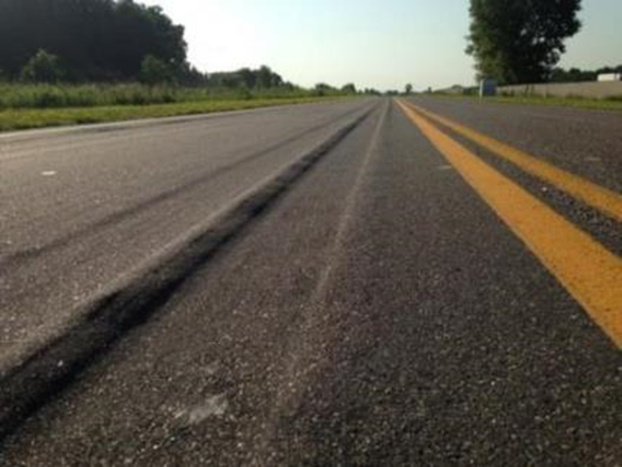
Empower the Staff
Creates a positive work environment
Fosters the flow of novel ideas
Enhances work across organizational lines
Maximizes the skill levels of the group

Slide 16
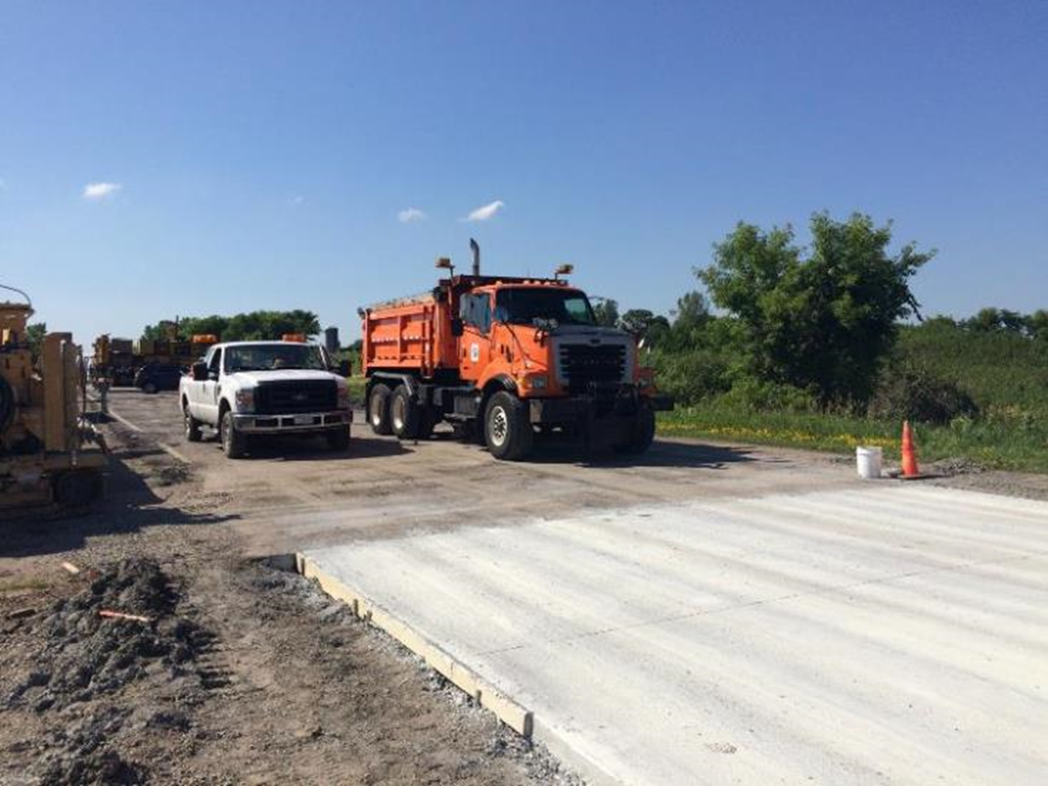
Future
Technical Transfer
  provide assistance documenting unique activities happening in your organization
  Research pays-off series
Extension of Pooled Fund to 5 years

Slide 17
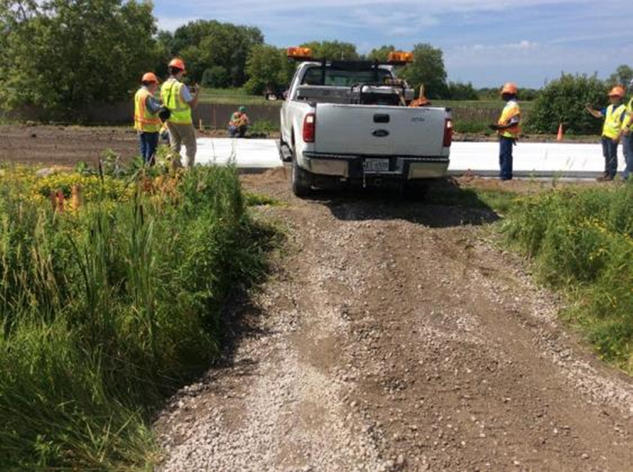
Future
Call for innovation/RFP
  Each Team will develop problem statements
    Test section construction
    Test section maintenance
    Product testing
    Pilot projects
    Etc.
  Proposals by NRRA members

Slide 18
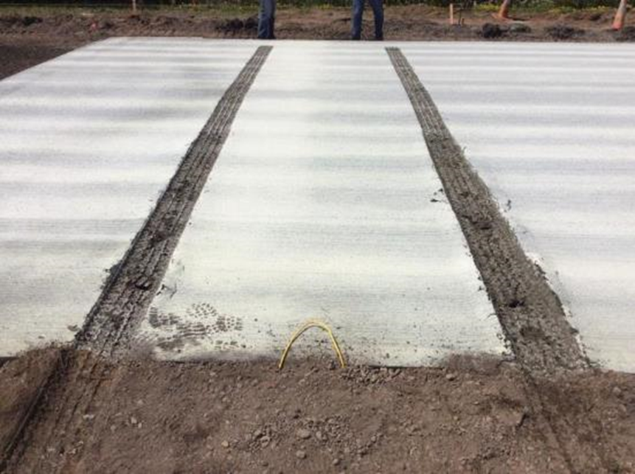
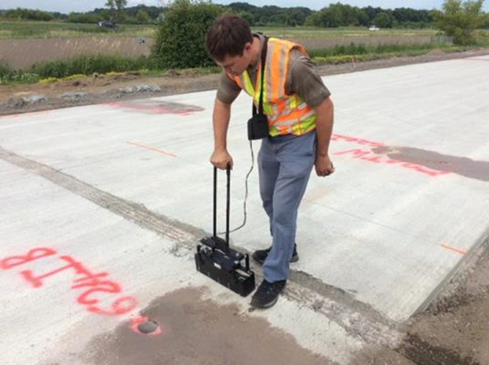
Feedback
Survey to get your ideas
How can we improve the N DoubleR A?
  Workshop
  Outreach
  Products
  Member involvement
  Implementation

Slide 19


Slide 20

Thanks!

