Slide 1


2018 Pavement Workshop
May 23, 2018
Geotechnical Team
Terry Beaudry
John Siekmeier
Dave Van Deusen
+ 46 Associate Members

Slide 2
Geotechnical Team - Agencies
Robert Arndorfer, Wisconsin Department of Transportation
Terry Beaudry (Chair), Minnesota Department of Transportation
Ken Darby, Caltrans – California Department of Transportation
Richard Endres, Michigan Department of Transportation
Tom Fennessey, Missouri Department of Transportation
Jeff Horsfall, Wisconsin Department of Transportation
Deepak Maskey, Caltrans – California Department of Transportation
Kevin McLain, Missouri Department of Transportation
Heather Shoup, Illinois Department of Transportation
John Siekmeier, Minnesota Department of Transportation
Notes:
Put the faces with the names.

Slide 3
Geotechnical Team - Associates
Aaron Budge, Minnesota State University Mankato
Dick Larson, First State Tire Recycling
Soheil Nazarian, Univ. of El Paso, Center for Transportation Infrastructure Systems
Matt Oman, Braun Intertec
Mike Rief, WSB & Associates, Inc
David Saftner, University of Minnesota Duluth
Dan Schellhammer, Midstate Reclamation
David White, Ingios Geotechnics, Inc.
Notes:
Industry is Involved – should always be involved
Hang out with smart people
Learn new things
White down questions on a post it, get answers.

Slide 4
Geotechnical Team – Friends and Support
Tim Anderson, Minnesota Department of Transportation
Bora Cetin, Iowa State University
Tuncer Edil, University of Wisconsin--Madison
Eddie Johnson, Minnesota Department of Transportation
Kevin Kliethermes, FHWA
Renae Kuehl, SRF Consulting
Bill Likos, University of Wisconsin--Madison
Dave Van Deusen, Minnesota Department of Transportation
Ben Worel, Minnesota Department of Transportation

Slide 5
Update on 2017 NRRA
Geotechnical Construction
General overview of project objectives and designs
  Large-sized Subbase
  Recycled Base
Construction
Field testing rodeo

Slide 6
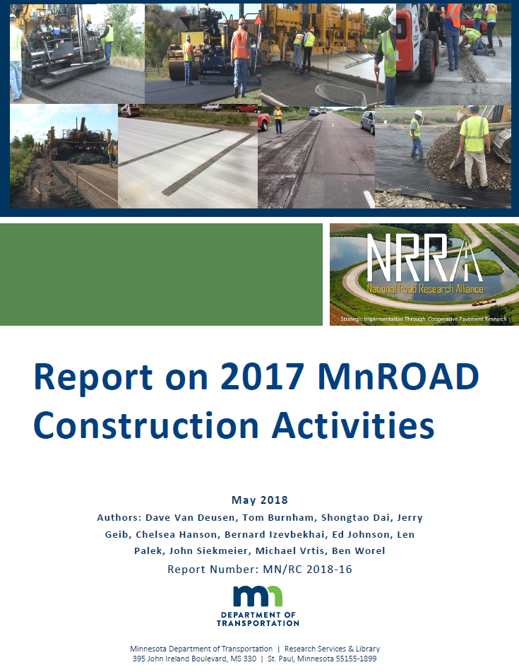
NRRA Construction Report

Slide 7
MAP
B Overlay study, Cells 984-987
B
C Compaction study, Cells 988-991

Slide 8
Large-sized Subbase (X27 and X28)
Objectives
  Test soft-soil condition stabilization technique used by Wisconsin, Illinois
  Two sections: 9-inch and 18-inch
  Same aggregate base and bituminous pavement section above
  Create condition with moisture, scarification, and minimum compaction
  Penetration Index req ➔ 2.5-3.5 inches per blow over top 1-foot
Construction
  9-inch section failed within one week

Slide 9
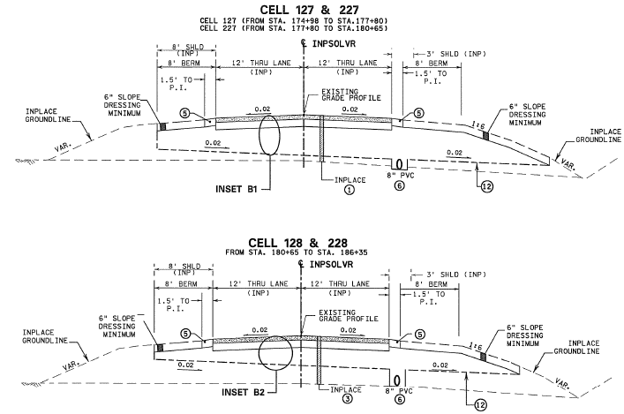

Slide 10
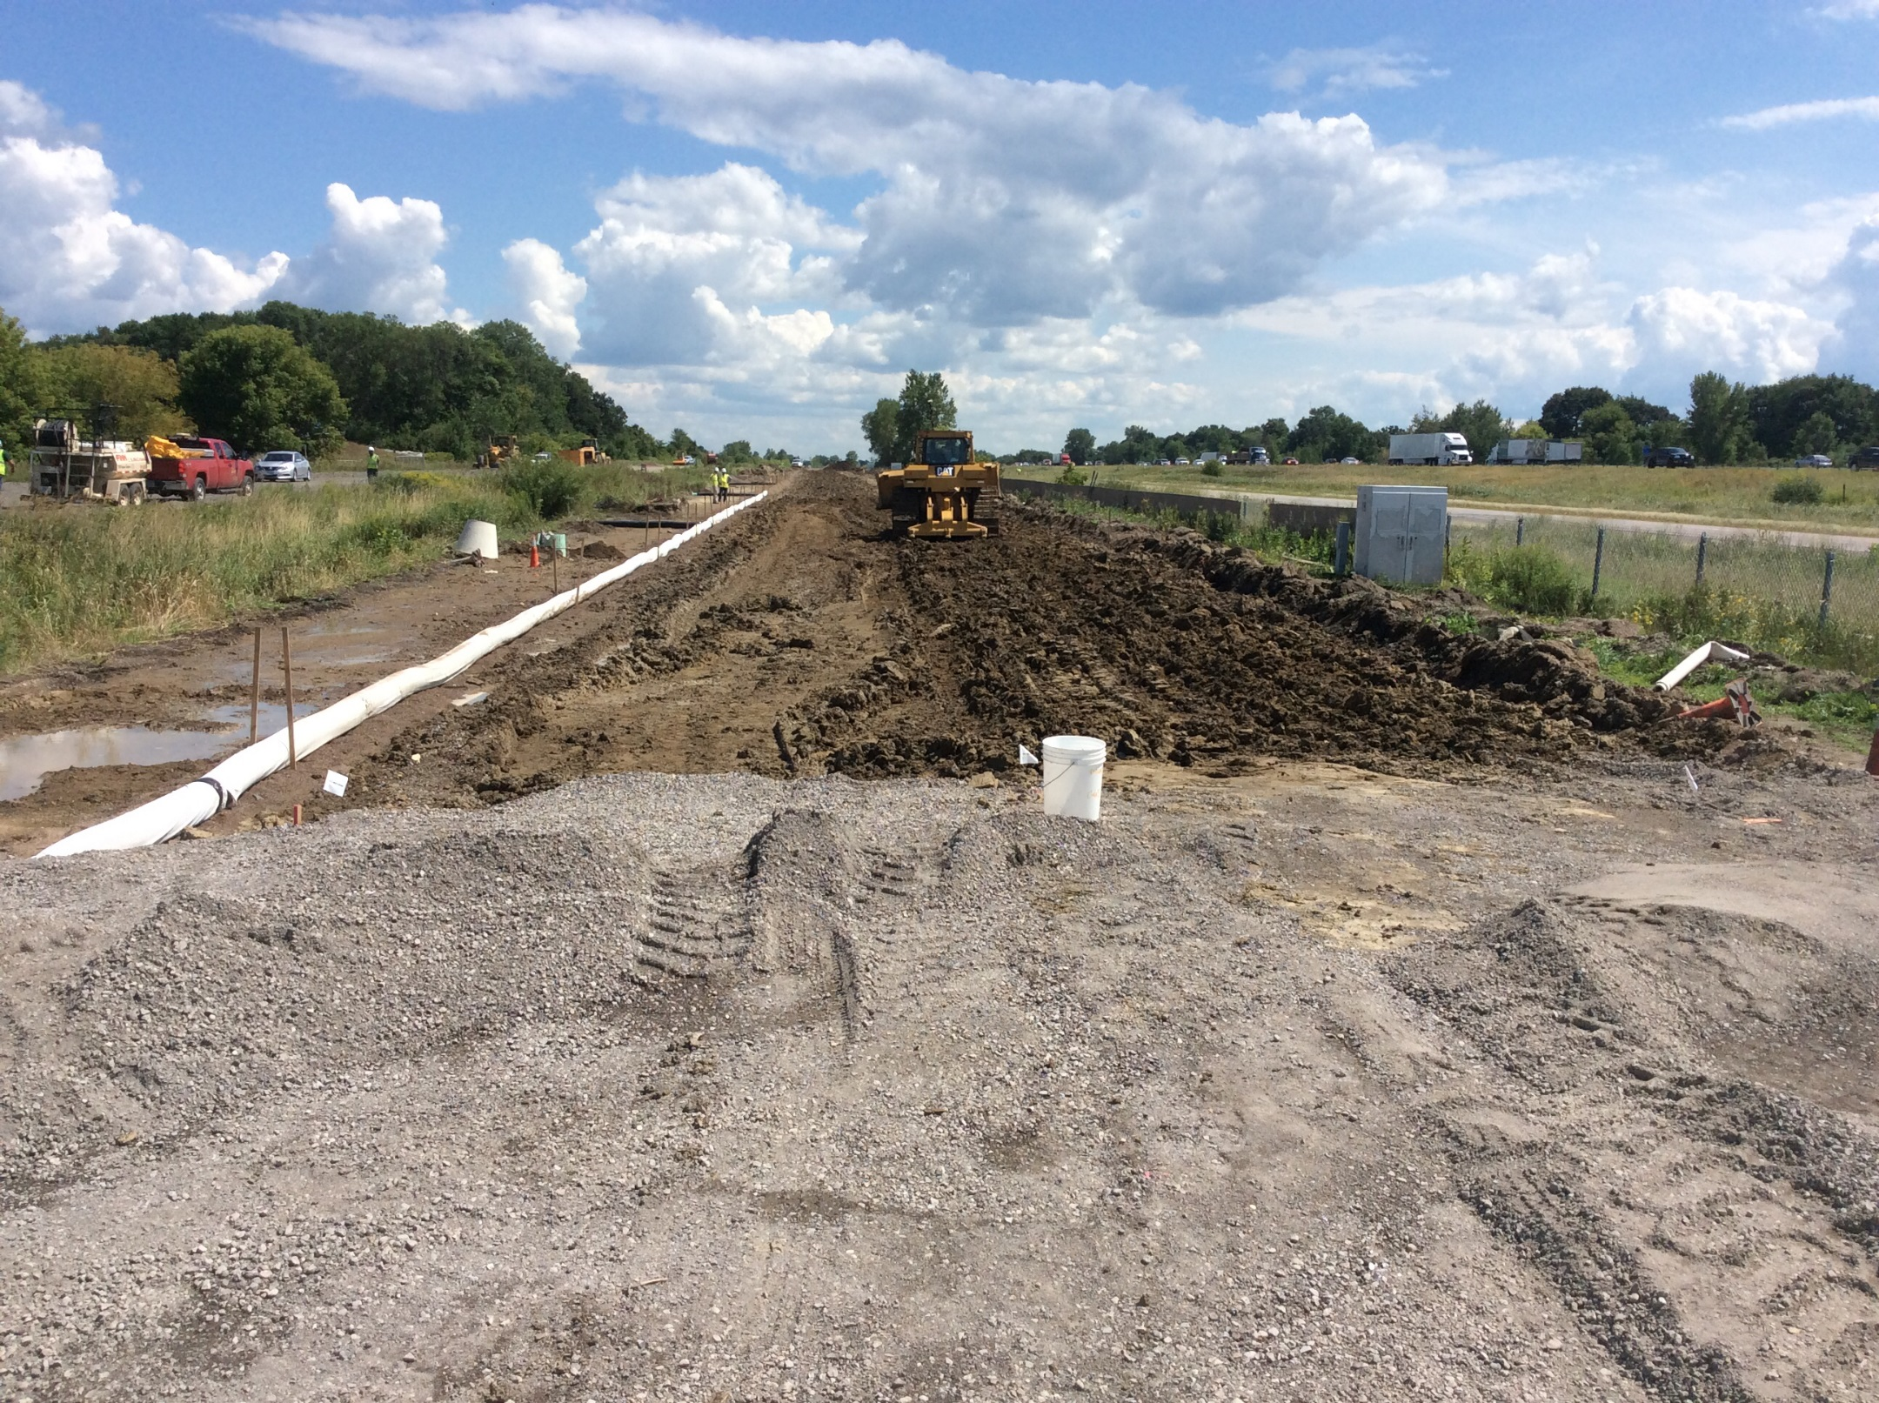

Slide 11
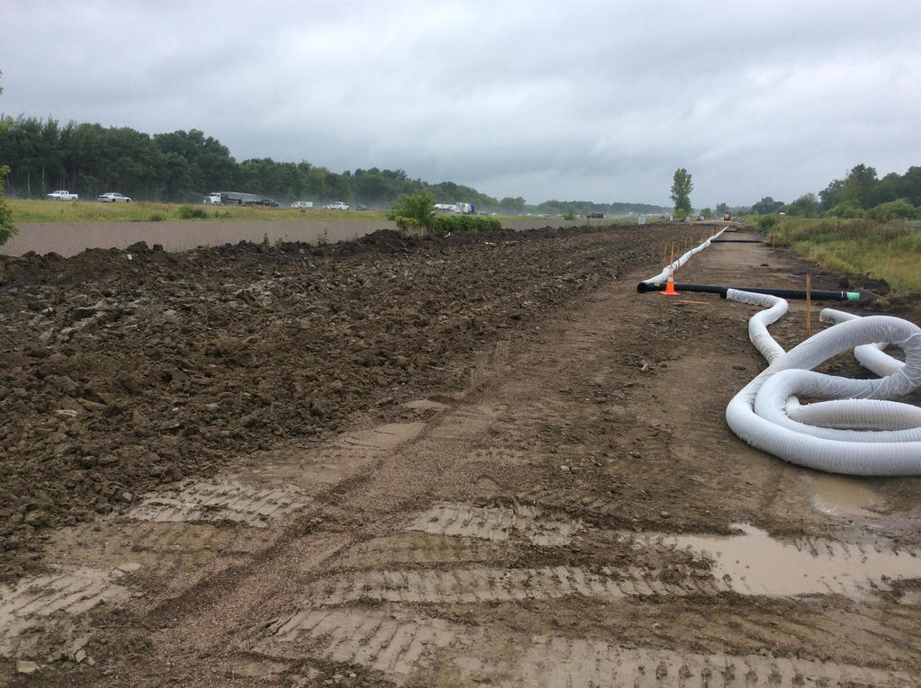

Slide 12
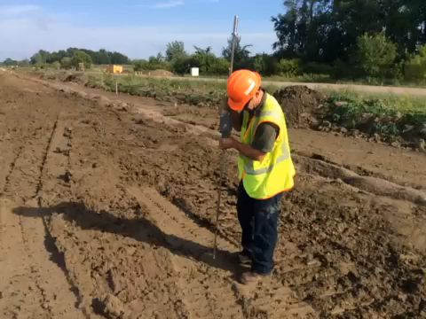

Slide 13
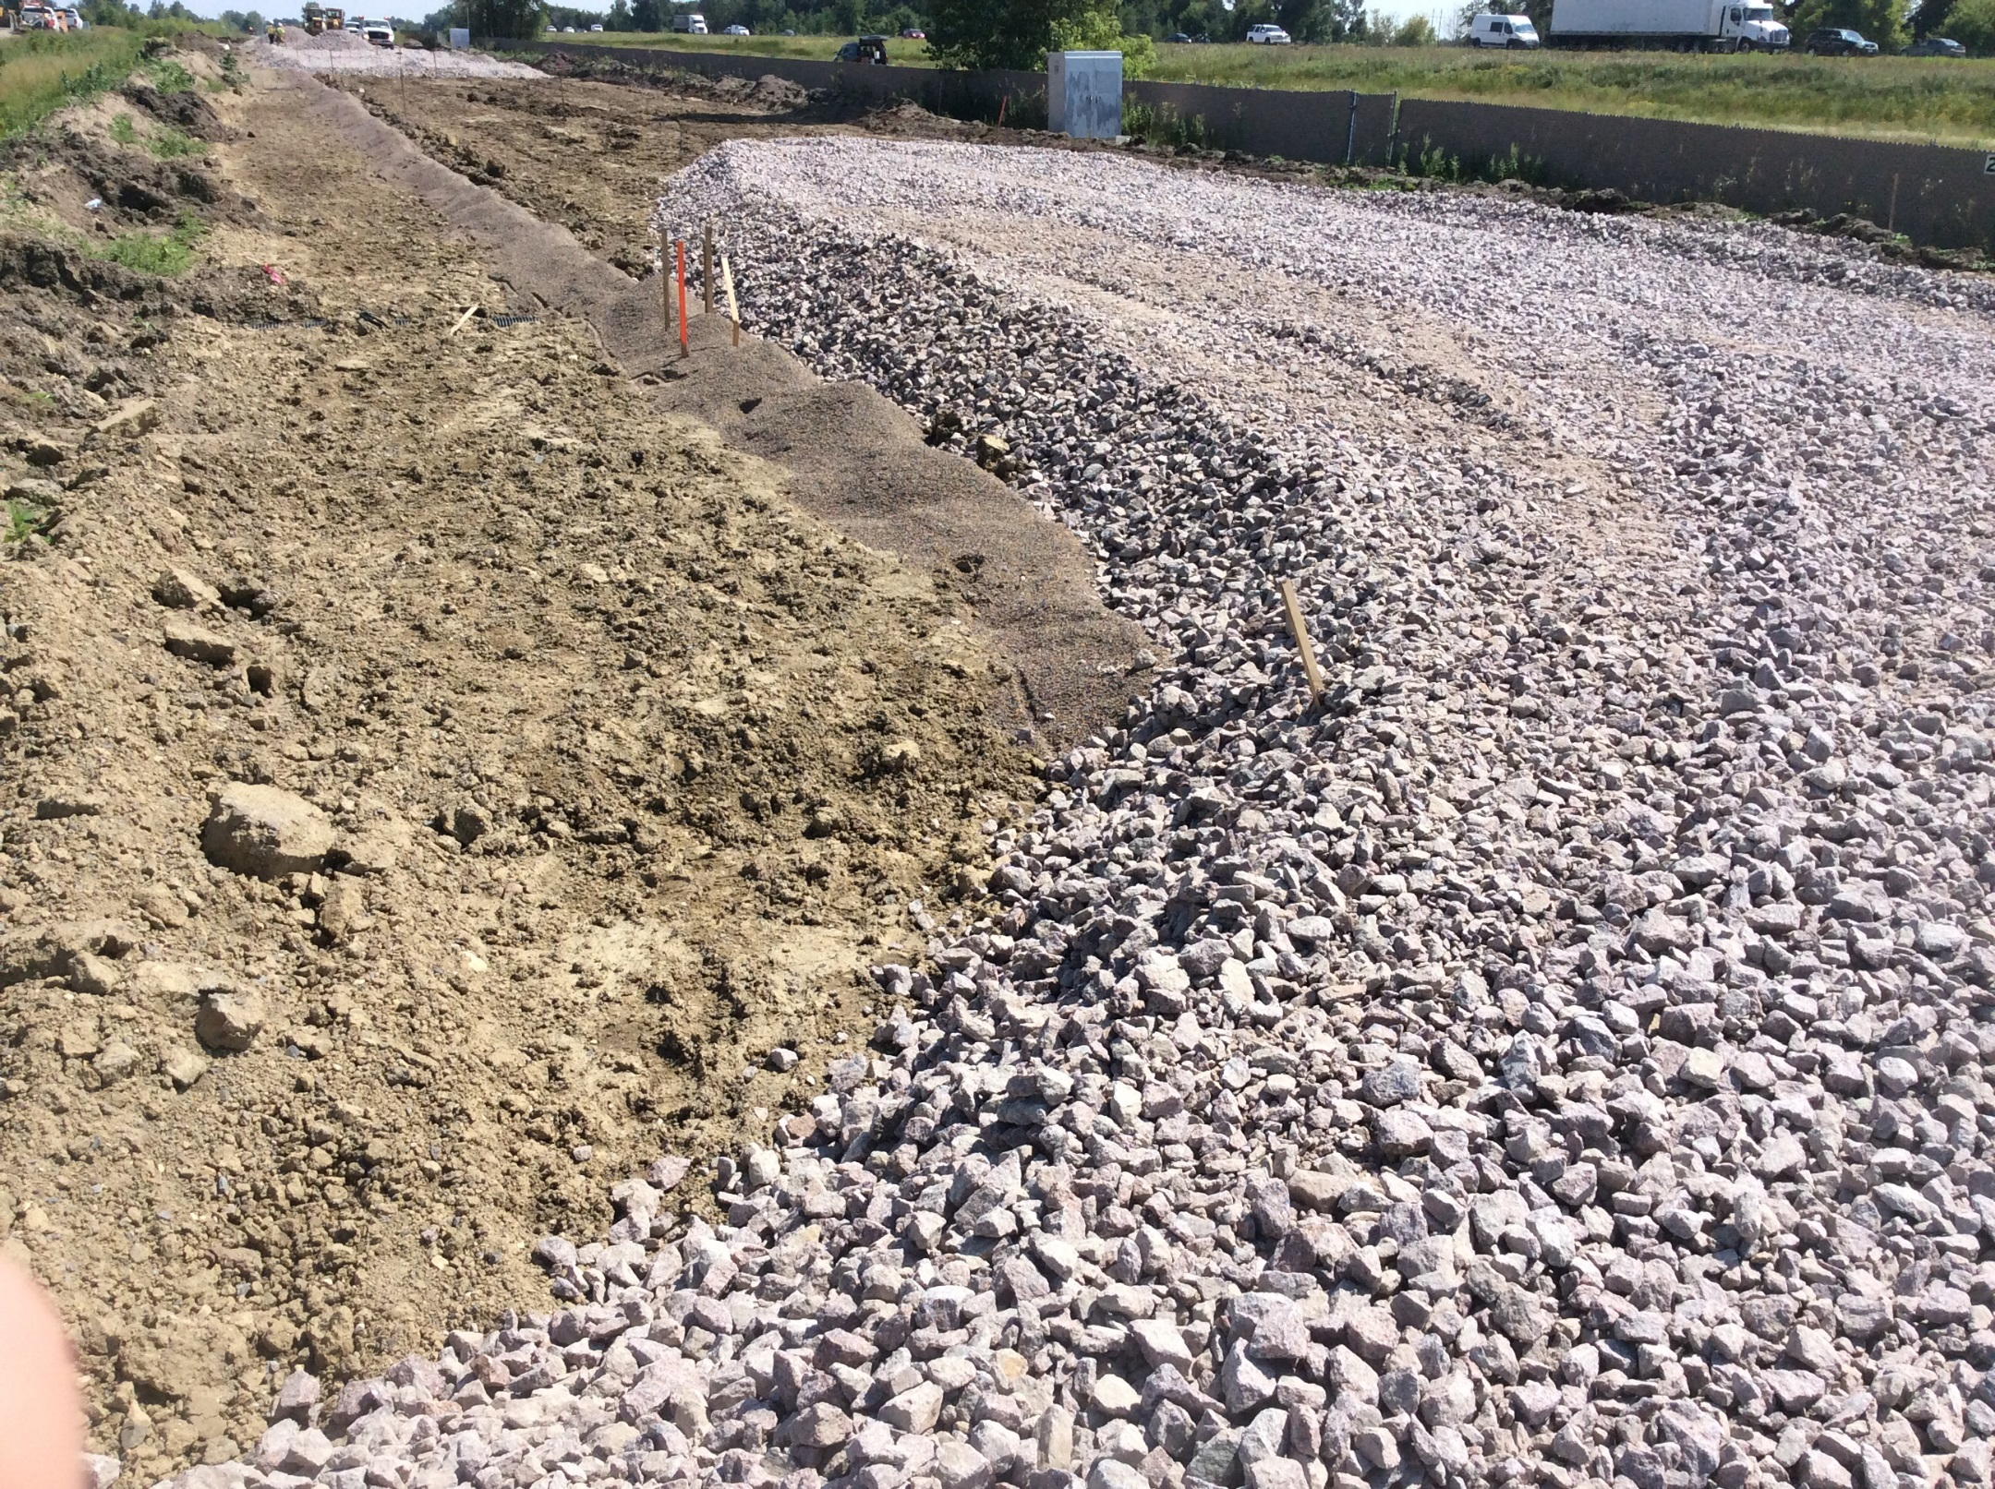

Slide 14
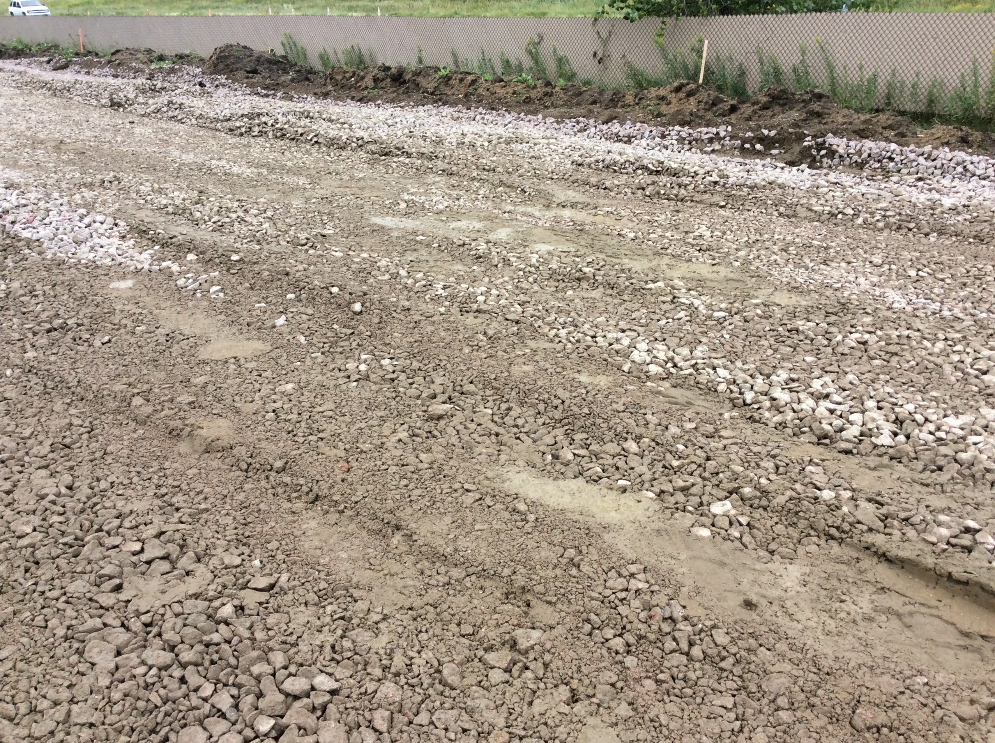

Slide 15
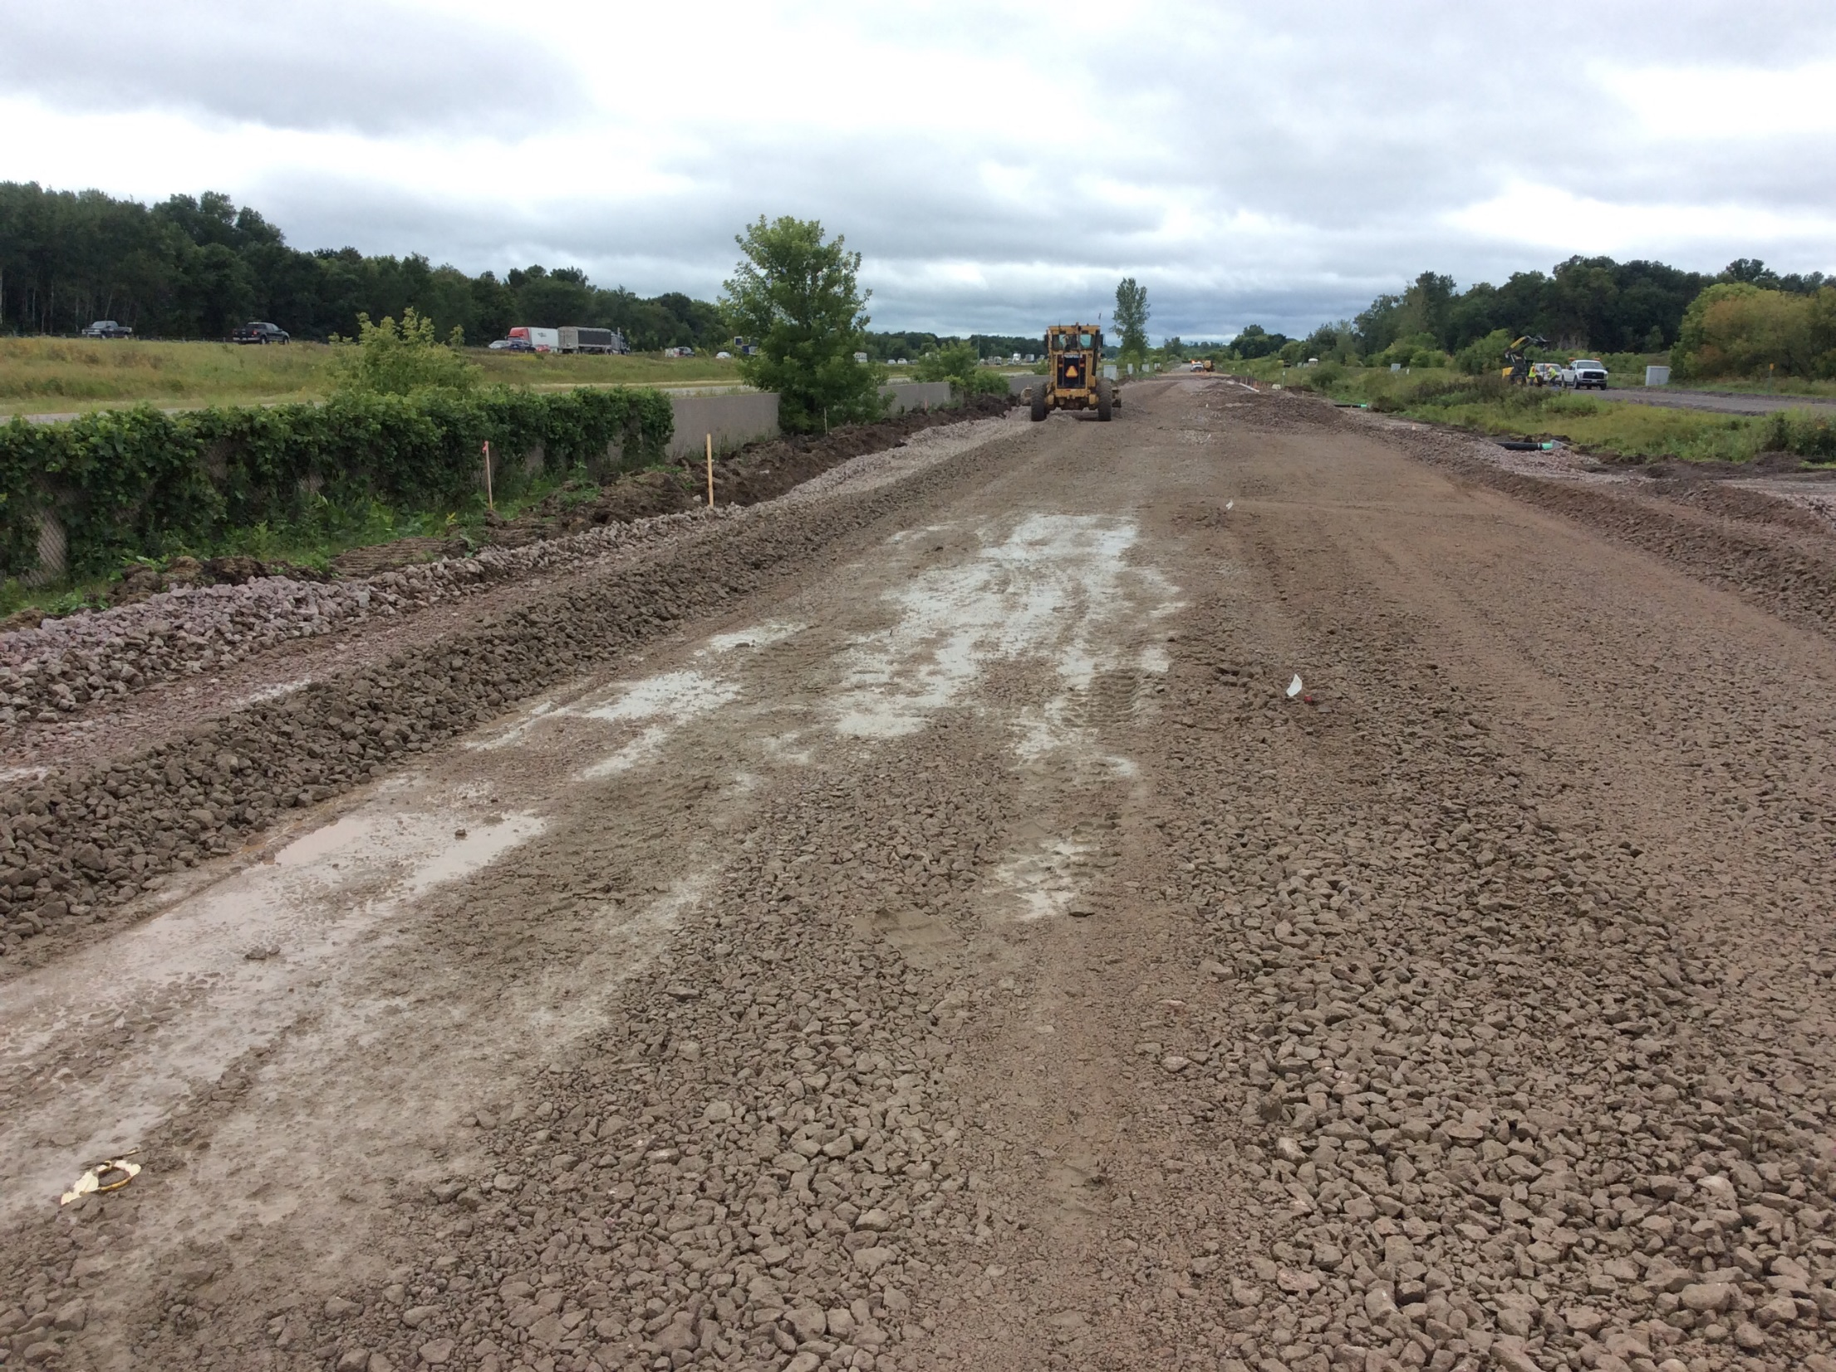

Slide 16
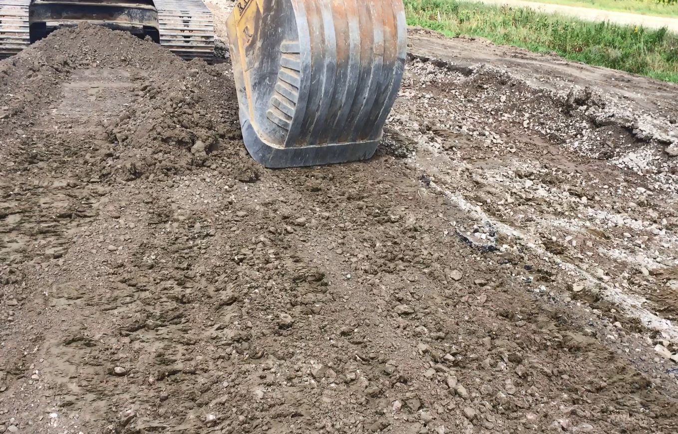

Slide 17
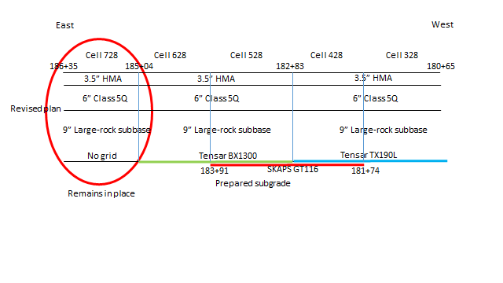
Redesigned sections

Slide 18
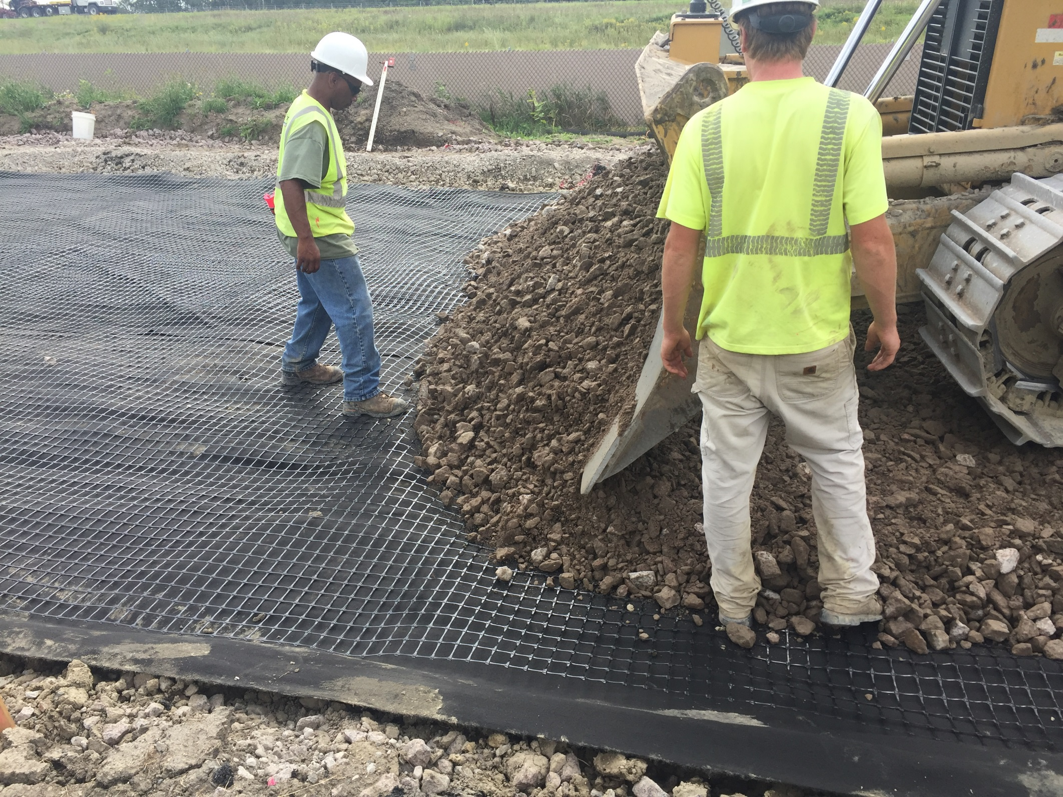

Slide 19
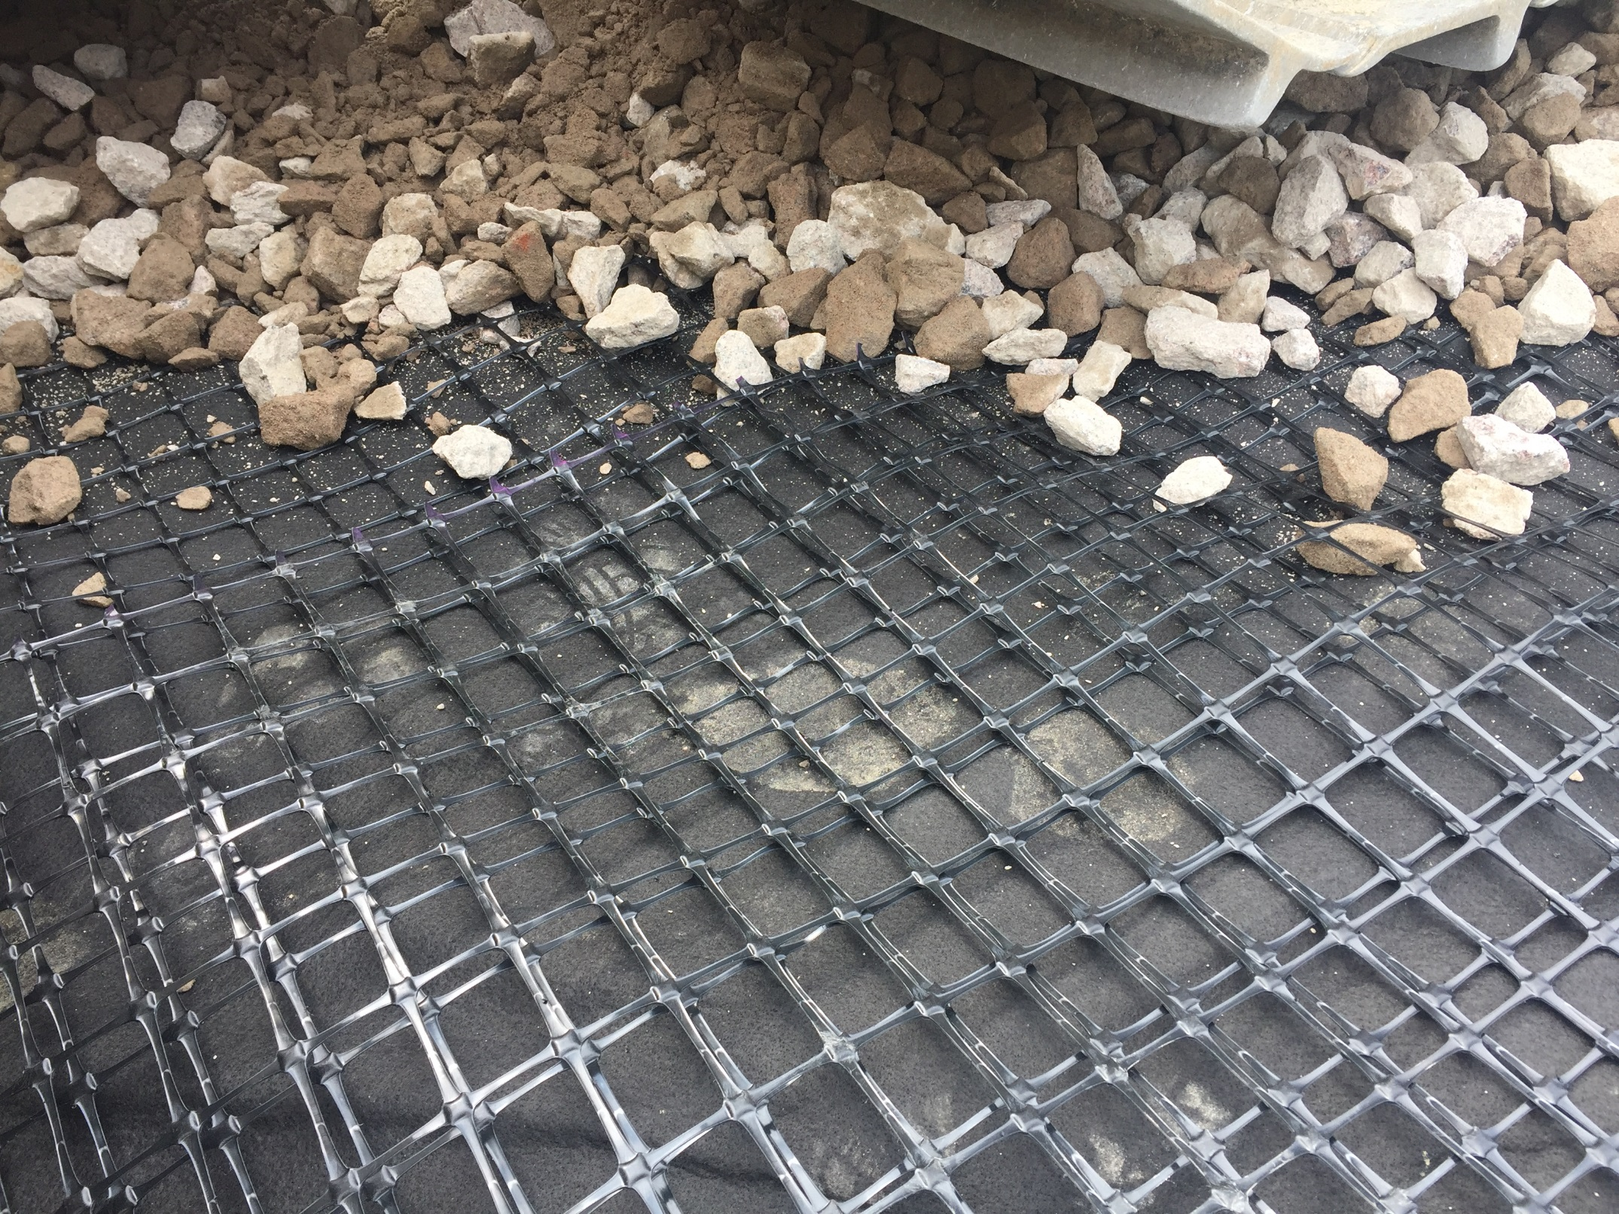

Slide 20
Recycled Aggregate Base Sections (185, 186, 188, 189)
Objectives
  Measure and analyze field and laboratory performance of test sections built with recycled aggregate base
  Develop method to estimate the stiffness and permeability of recycled aggregate base
  Provide mechanistic pavement design input values and recommend construction specifications for roadways built with recycled aggregate base

Slide 21
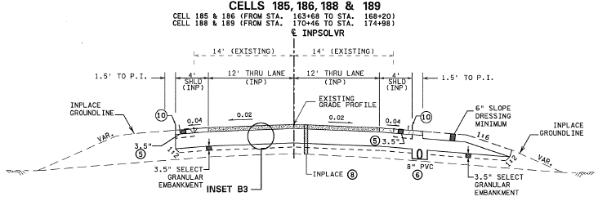
CELL | AGG BASE
185 | Class 5Q (RCC, coarse)
186 | Class 5 (RCC)
188 | Class 6 (limestone)
189 | Class 6 (RCC/RAP)

Slide 22
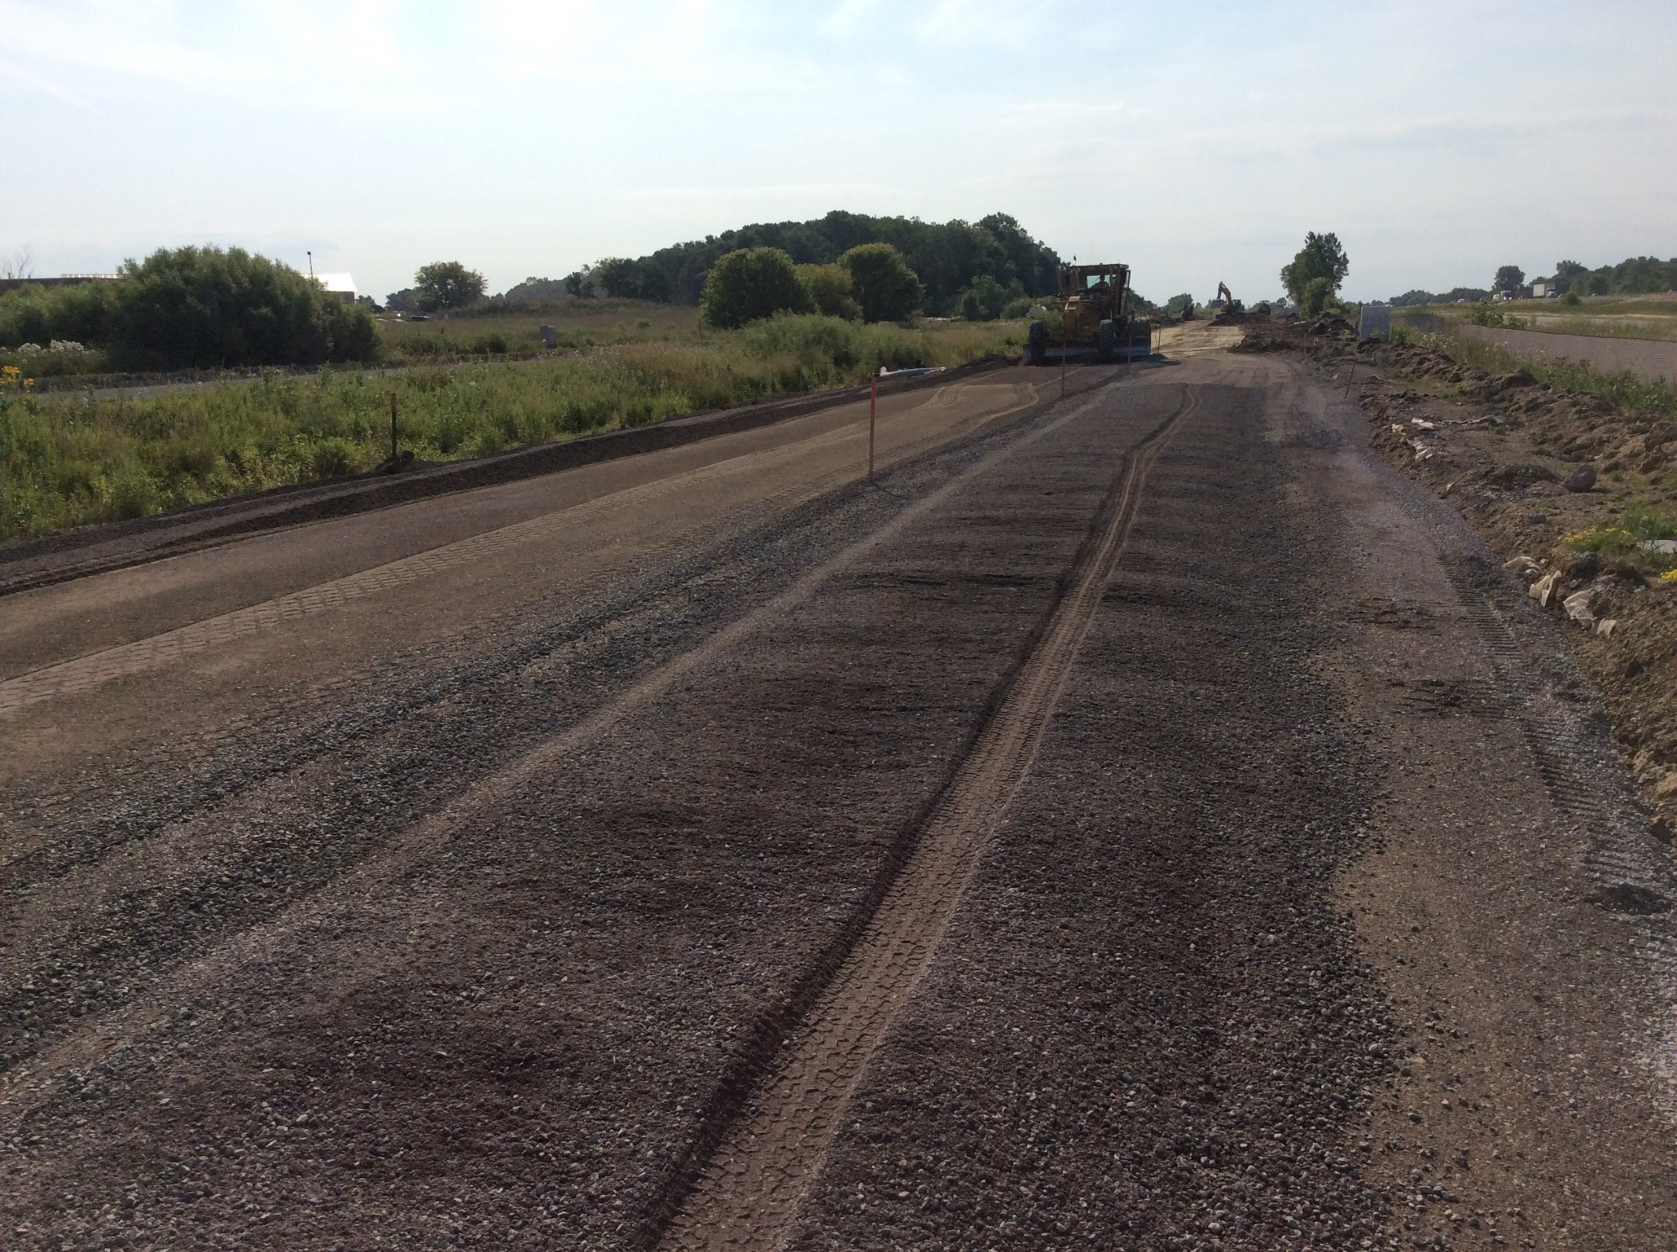
Cell 189

Slide 23
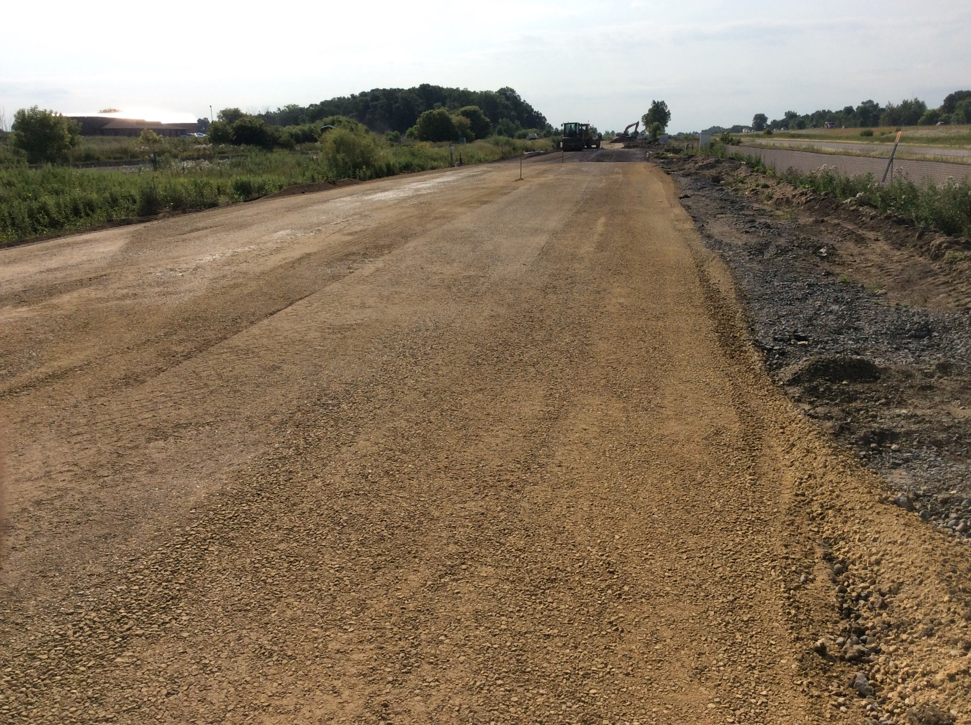
Cell 188

Slide 24
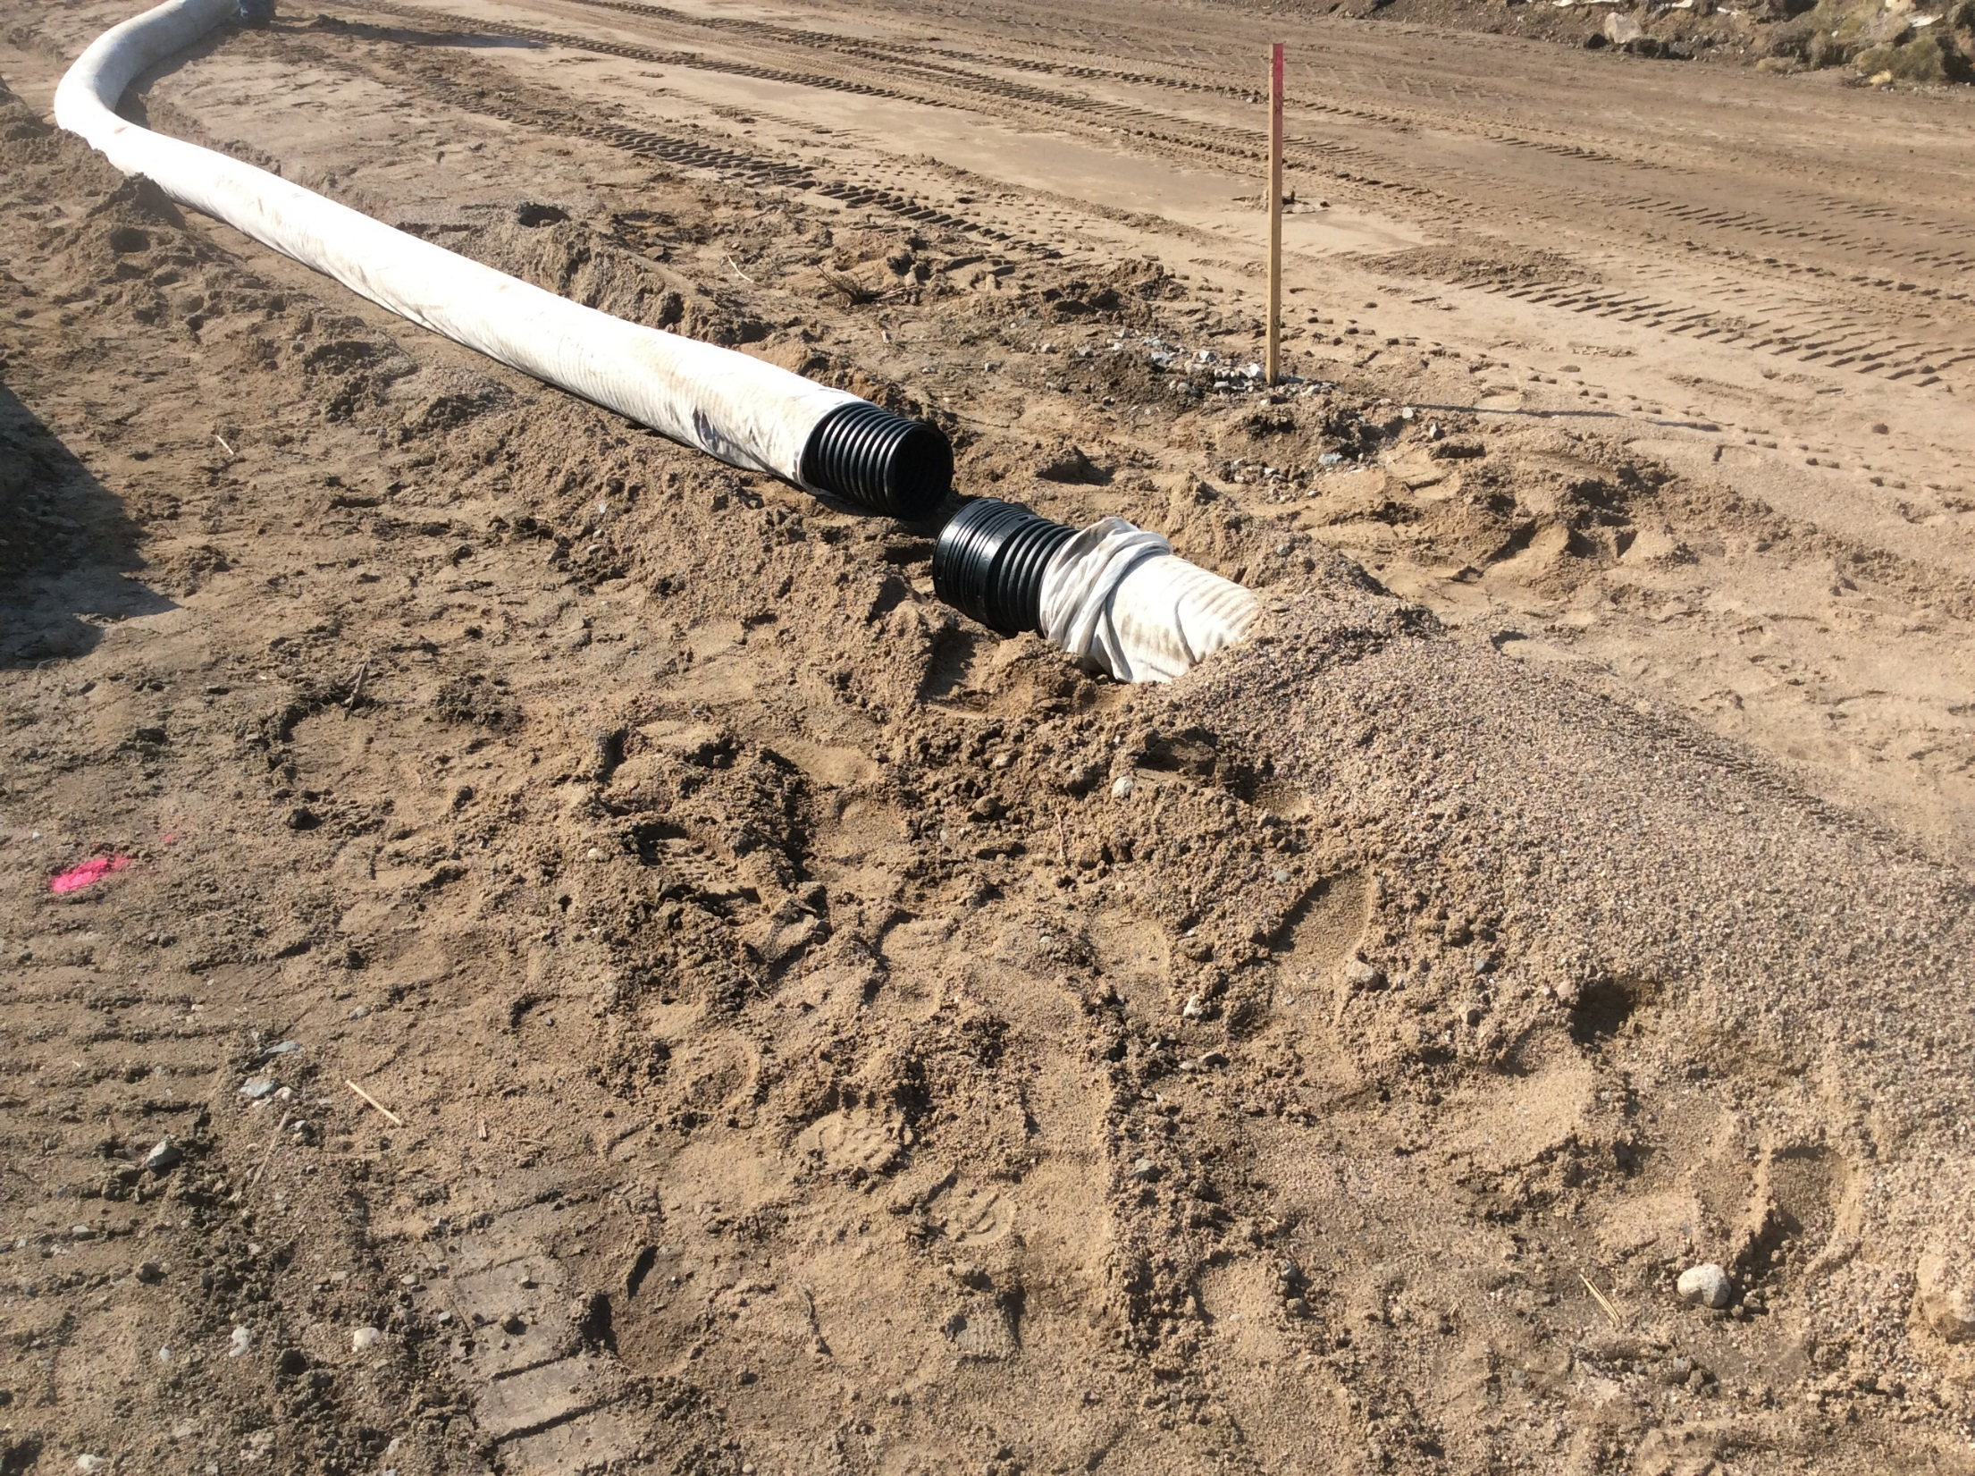
Cell 185

Slide 25
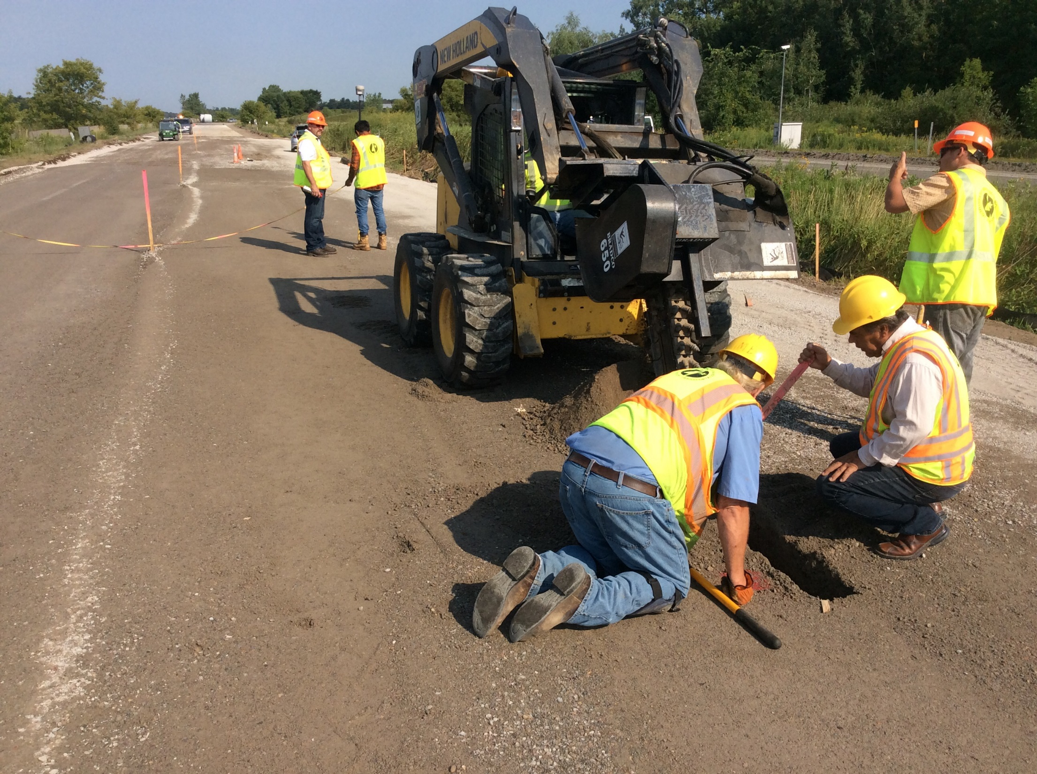
Cell 186

Slide 26
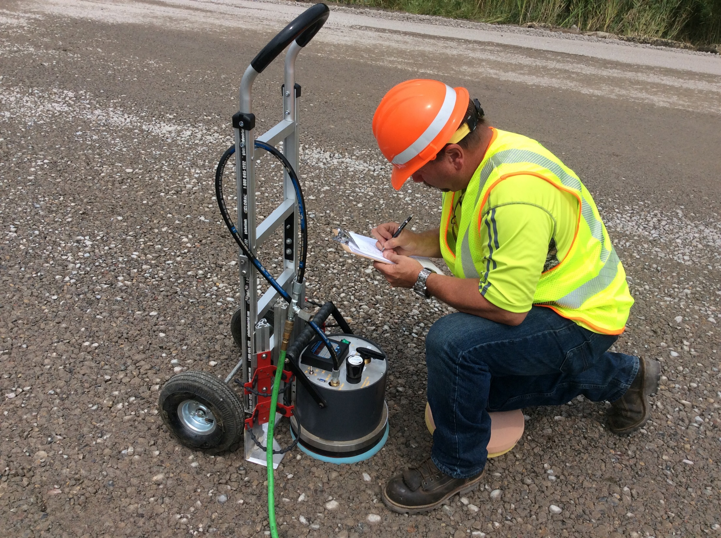
Cell 185

Slide 27
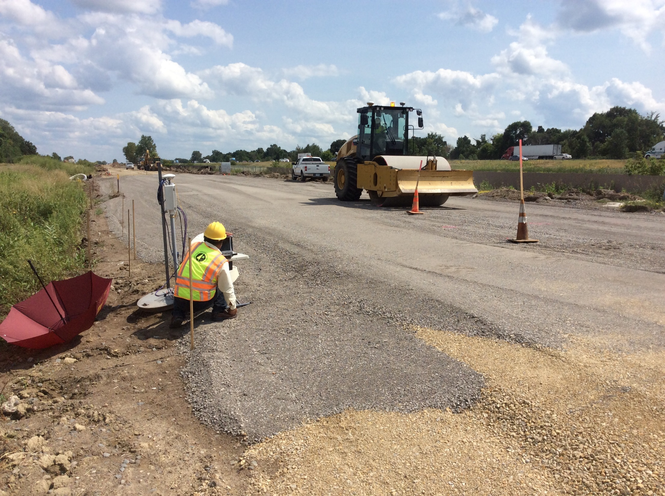
Cell 189

Slide 28
Acknowledgments
NRRA pooled-fund Sponsors and Associates
MnDOT Golden Valley NW Resident Office
District 3 – Maintenance, Surveys, Materials
CS McCrossan
Tensar

Slide 29


















































Thank You

