Slide 1


2018 Pavement Workshop
May 23-24, 2018
Designing Base & Subbase to Resist Environmental Effects
Steven Henrichs
MnDOT Assistant Pavement Design Engineer
+ 46 Associate Members

Slide 2
Introduction
Need: MnDOT has pavement design procedures to carry traffic but not for environmental effects.
Objective: A design tool to calculate the depth pavement layers to resist the environment.
Applies only to HMA.
Technical Liaison – myself
Principle Investigator – Matt Oman (& Neil Lund), Braun Intertec

Slide 3
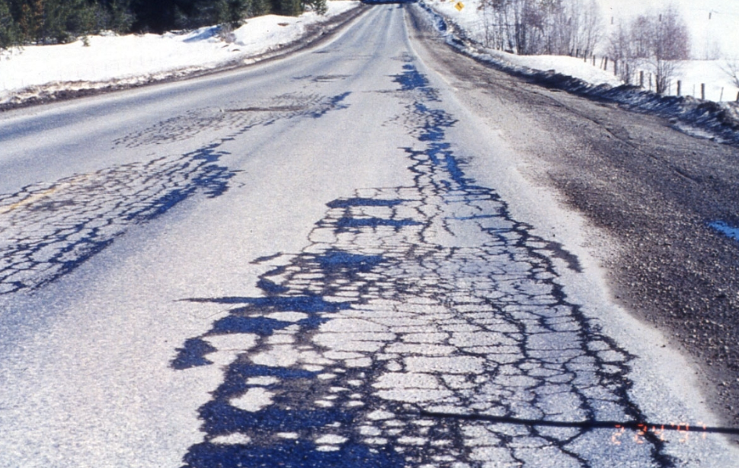
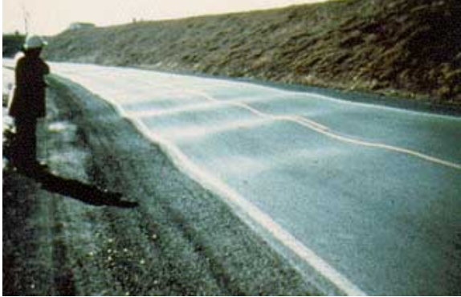
What Environmental Effects?
Thaw Weakening
Frost Heaving

Slide 4
Frost Heaving
Freezing Air Temperatures
Ice Lenses
Frost Susceptible Soil
Frozen Layer
Ice Lenses
Mixture of Water (in the soil pore structure) and Ice.
Capillary Rise
Deepest Advance of Freezing Temperatures
Remains Unfrozen
Water Source

Slide 5
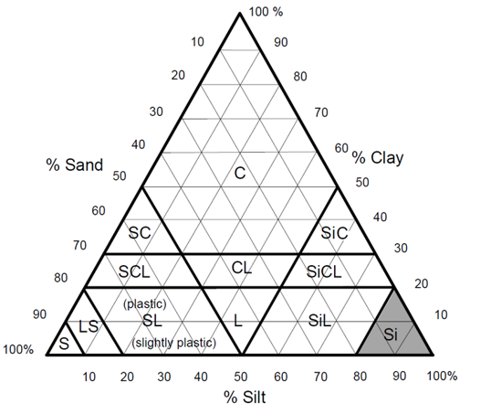
Frost Susceptible soil
Soils that allow capillary rise of water
Sands: Low capillarity and high permeability= low frost susceptibility
Clays: High capillarity but low permeability = low frost susceptibility
Silts: Moderate capillarity and moderate permeability = High Frost susceptibility

Slide 6
MnDOT Practices
Remove water source with good roadway drainage – surface and subsurface
Make any heave uniform by
Making soils uniform
Matching materials and using transitions
Replace frost-susceptible soil with frost resistant materials

Slide 7
MnDOT “frost-free material” requirement
(Bituminous Pavement)
Pavement
Aggregate Base
-*30” for 20-year ESALS ≤ 7 million
- 36” for 20-year ESALS > 7 million
*Approximately ½ of frost depth
Granular Subbase

Slide 8
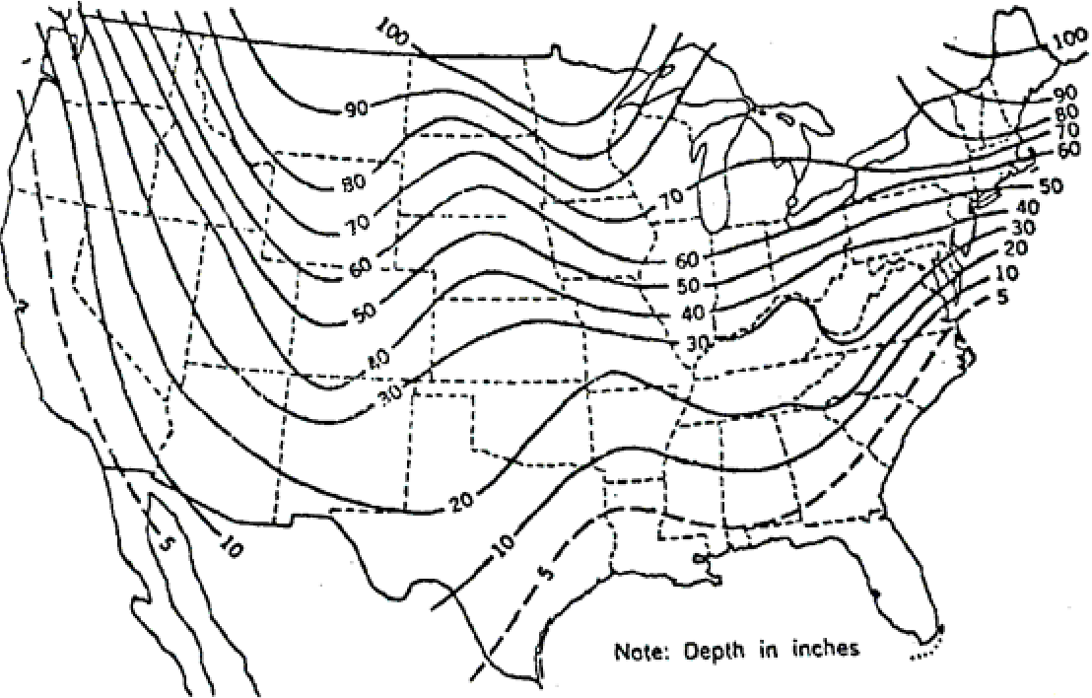
We can do better
Frost depth isn’t the same across the state.

Slide 9
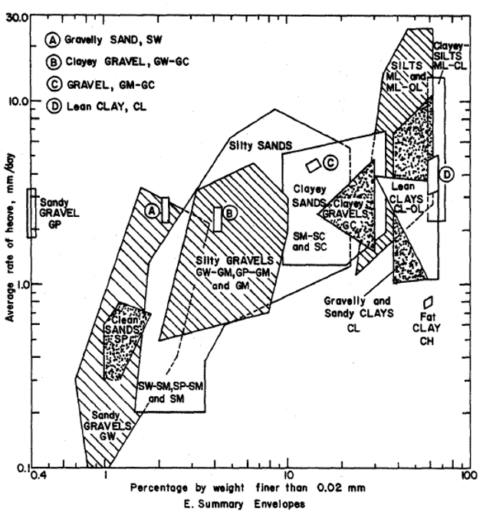
The frost susceptibility of soils aren't the same.

Slide 10
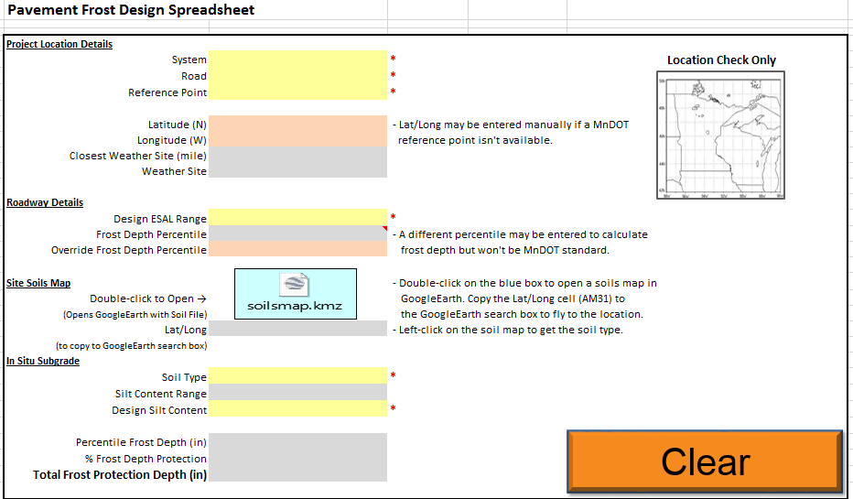
Pavement Frost Design Spreadsheet(s)

Slide 11
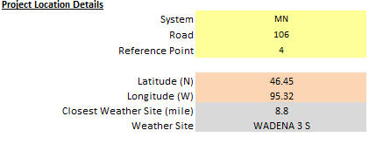
Location

Slide 12
NOAA Freezing index data
State and Station Name | Station Number | Elev. (feet) | Mean Annual Temp. (⁰ F) | 1.1 Year (10%) | 1.2 Year (20%) | 2 Year (50%) | 2.5 Year (60%) | 3.3 Year (70%) | 5 Year (80%) | 10 Year (90%) | 20 Year (95%) | 25 Year (96%) | 50 Year (98%) | 100 Year (99%) | Lat. (Deg. - Min.)
ADA | 210018 | 906 | 41.1 | 1737 | 2004 | 2487 | 2622 | 2762 | 2919 | 3126 | 3286 | 3331 | 3458 | 3567 | N4718
ALBERT LEA | 210075 | 1220 | 44.8 | 926 | 1162 | 1637 | 1780 | 1934 | 2111 | 2352 | 2546 | 2602 | 2760 | 2899 | N4339
ALEXANDRIA FAA AIRPORT// | 210112 | 1421 | 40.9 | 1774 | 2000 | 2398 | 2507 | 2619 | 2744 | 2906 | 3031 | 3066 | 3163 | 3247 | N4552
ARGYLE 4 E | 210252 | 870 | 37.5 | 2275 | 2578 | 3115 | 3263 | 3415 | 3584 | 3805 | 3975 | 4023 | 4156 | 4271 | N4820
ARTICHOKE LAKE | 210287 | 1075 | 43.2 | 1362 | 1602 | 2047 | 2174 | 2307 | 2456 | 2654 | 2809 | 2853 | 2976 | 3083 | N4522
AUSTIN 3 S | 210355 | 1215 | 44.5 | 1122 | 1320 | 1687 | 1792 | 1901 | 2024 | 2187 | 2315 | 2351 | 2453 | 2541 | N4337
BABBITT 2 SE | 210390 | 1615 | 38.6 | 2010 | 2208 | 2544 | 2634 | 2726 | 2827 | 2956 | 3055 | 3082 | 3159 | 3224 | N4741

Slide 13
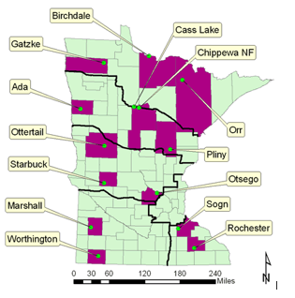

Frost Depth Equation
Frost Depth: General Prediction Model
Pegah Rajaei, Gilbert Y. Baladi

Slide 14
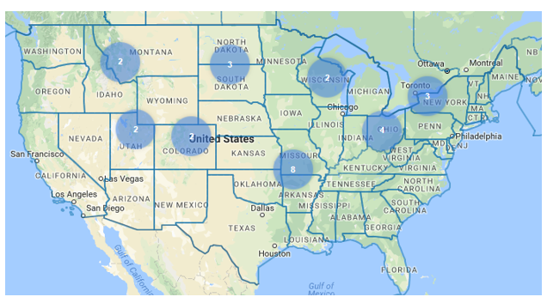
LTPP Database - SPS-8 Sites
LTPP – Long Term Pavement Performance
SPS-8 – Environmental Effects
<10,000 annual ESALs

Slide 15
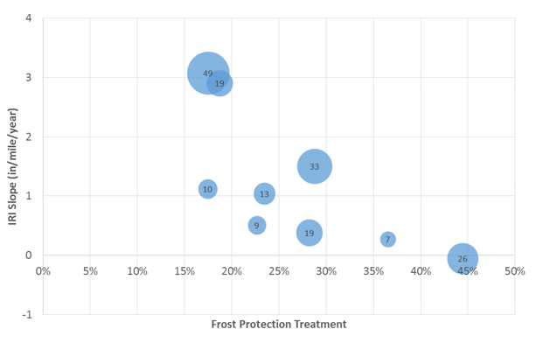

IRI Slope vs Frost Protection Treatment

Slide 16
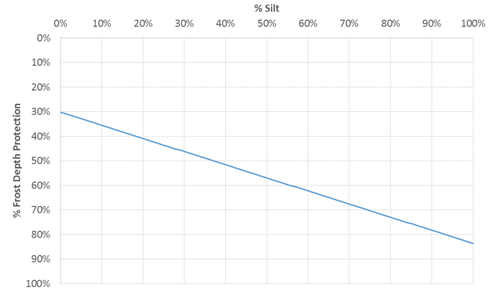
Frost Protection Depth vs Silt %

Slide 17
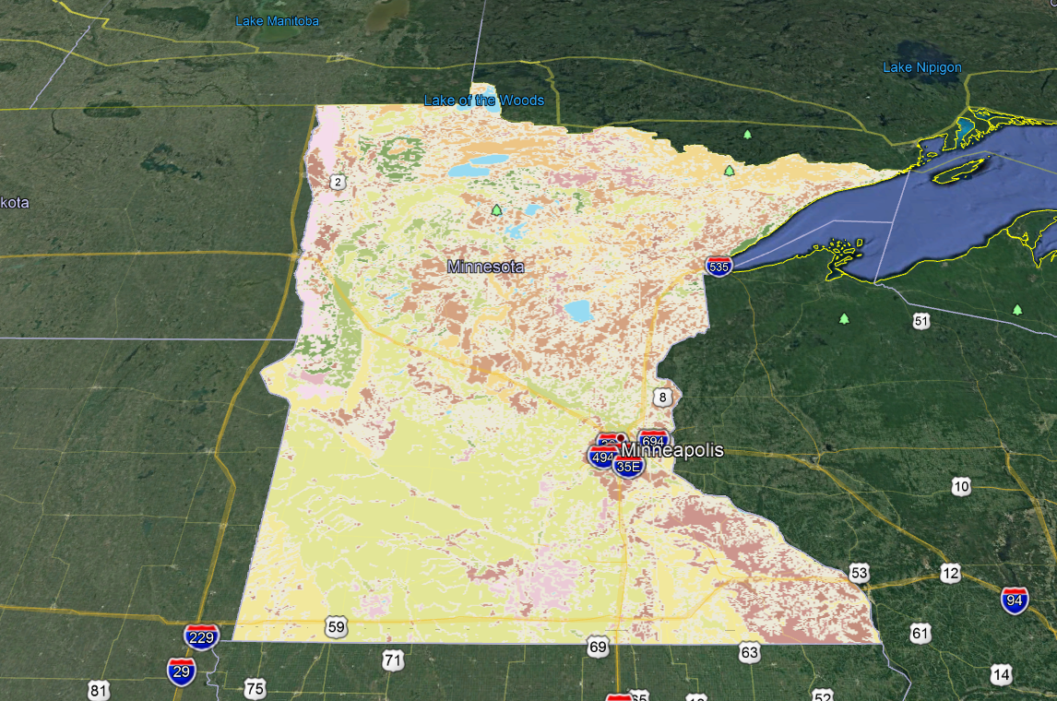
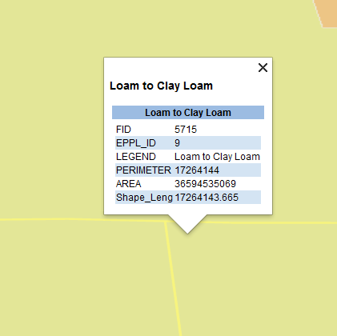
Soil map

Slide 18
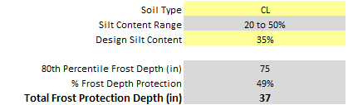
% Frost Depth Protection

Slide 19
What’s Next
We’re evaluating it
- Do the calculations appear correct?
Does it need any adjustments?
Can projects be designed with the results?
Can we make it a standard?

Slide 20


















































Thank You

