Slide 1


2018 Pavement Workshop
May 23-24, 2018
Reliability Evaluation Of MnDOT’s Concrete Rehabilitation Sections
Bernard Igbafen Izevbekhai P.E., Ph.D.
Research Operations Engineer MnDOT
+ 46 Associate Members

Slide 2
Pavement Planning Predictions & Prognostications
Purposes and Objectives are Deterministic
Solution Matrix is Stochastic
Expected Results are Probabilistic
      Reliability Analysis ≈ Reliable Approach !!

Slide 3
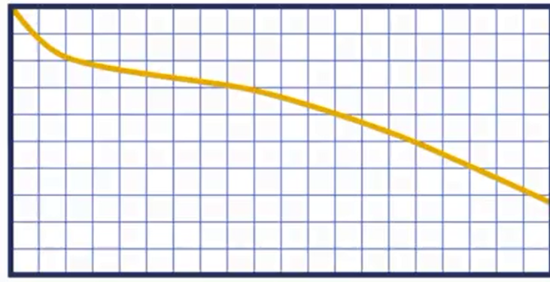
Reliability is a Probabilistic Approach
Reliability
Hazard
Time
Time

Slide 4
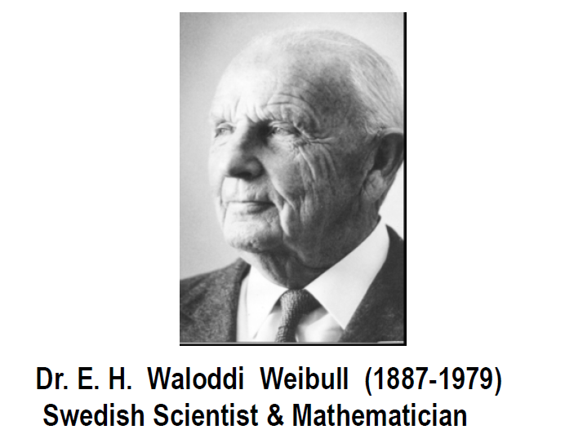
Used Weibull Method For Reliability Analysis
Assumes no Distribution Type but Discovers What it is
Provides the Three Parameters and More
Applicable to all Fields of Human Endeavor
Needs more Usage in Infrastructure
Notes:
Assumes no Distribution Type but Discovers What it is

Slide 5
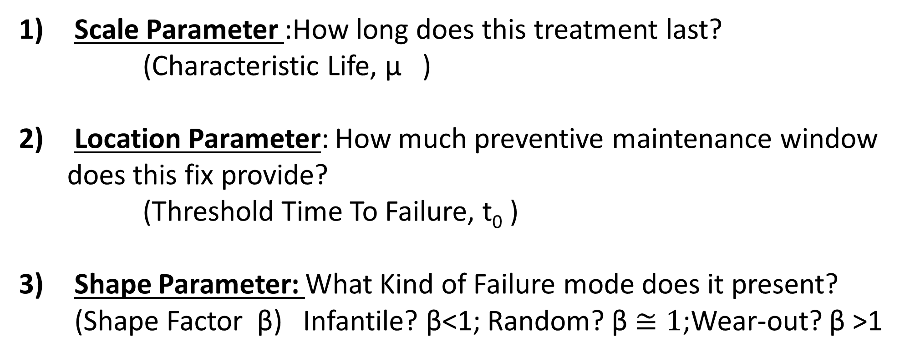
THREE VITAL RELIABILITY PARAMETERS
Scale Parameter :How long does this treatment last?
(Characteristic Life, μ )
Location Parameter: How much preventive maintenance window
does this fix provide?
(Threshold Time To Failure, t₀ )
Shape Parameter: What Kind of Failure mode does it present? (Shape Factor β) Infantile? β<1; Random? β $≅1$;Wear-out? β >1
Notes:
1) How Long does thuis pavement Last

Slide 6
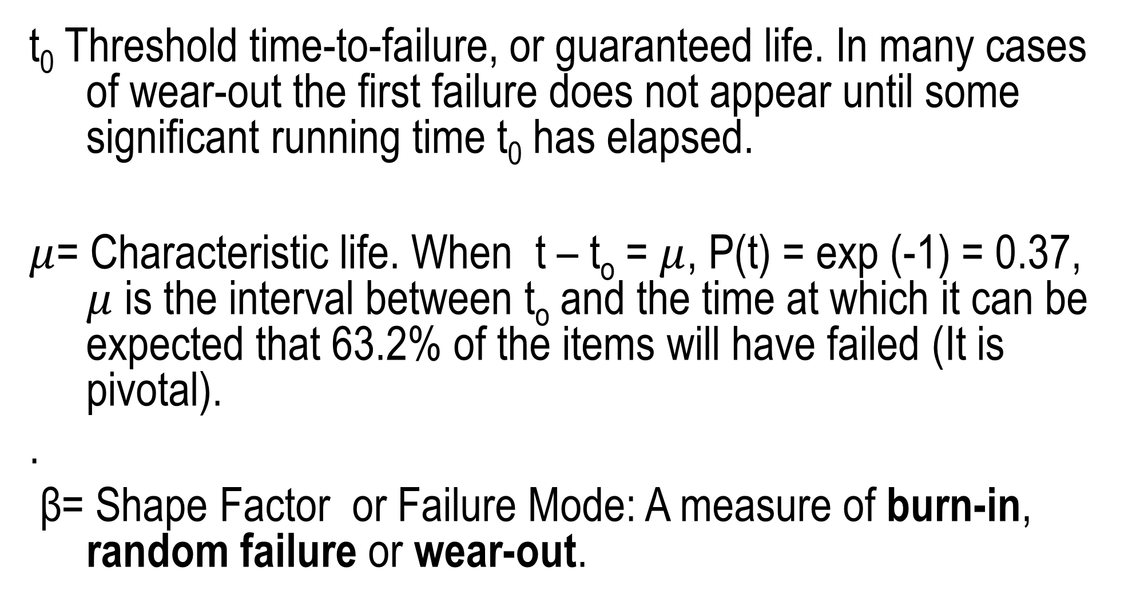
IMPORTANT WEIBULL CHARACTERISTICS
t₀ Threshold time-to-failure, or guaranteed life. In many cases of wear-out the first failure does not appear until some significant running time t₀ has elapsed.
$μ$= Characteristic life. When t – t_{o} = $μ$, P(t) = exp (-1) = 0.37, $μ$ is the interval between t_{o} and the time at which it can be expected that 63.2% of the items will have failed (It is pivotal).
.
β= Shape Factor or Failure Mode: A measure of burn-in, random failure or wear-out.

Slide 7
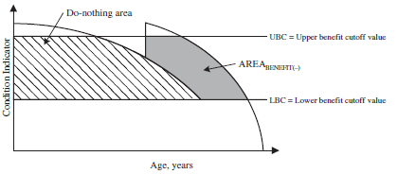
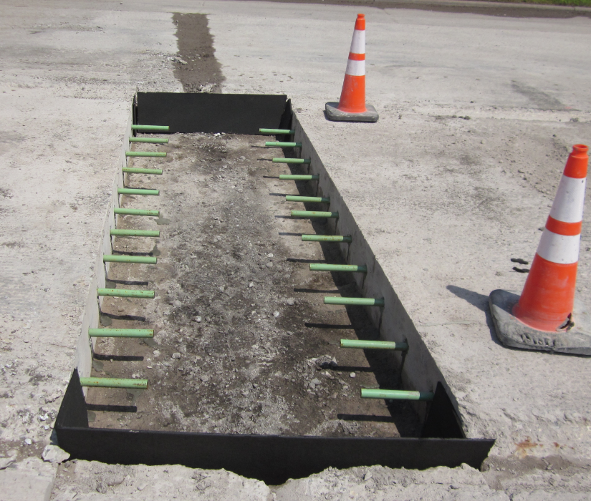
WHY CONCRETE REHABILITATION
Preventive/Preservative
Rehabilitation
Benefit Area
Replace
Reconstruct
Area Normalized By Cost of Fix is the Actual Benefit Indicator

Slide 8
RIGHT TREATMENT RIGHT PURPOSE RIGHT TIME
Notes:
RIGHT TREATMENT RIGHT PURPOSE RIGHT TIME

Slide 9
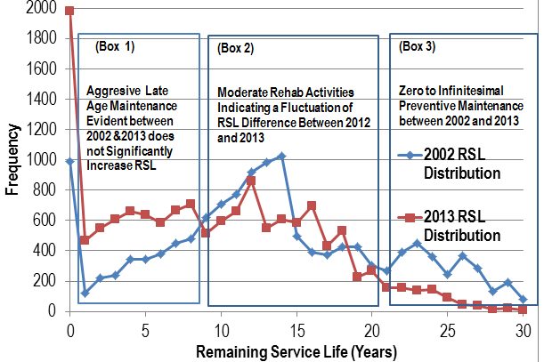
A STRONG CASE FOR REHAB
Notes:
A STRONG CASE FOR REHAB

Slide 10
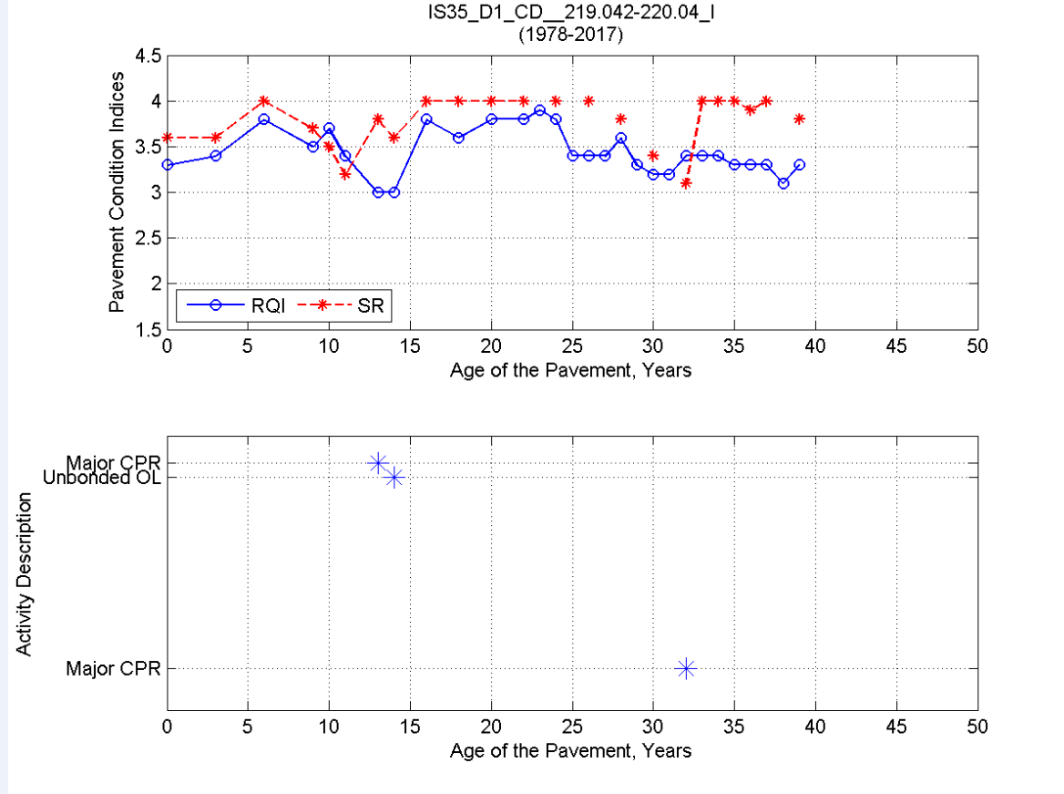

Slide 11
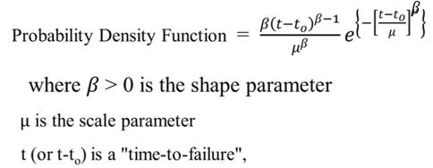

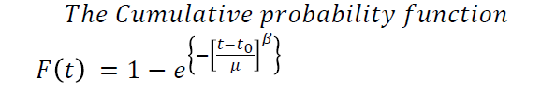
WEIBULL PROCESS MINIMIZES RIGOR
Weibull Distribution
Normal Distribution
Good News

Slide 12

Finding the Weibull Parameters
$$\text{From} \text{Linear} \text{Plot} \text{obtain} \text{Shape} \text{factor}$$
$${Ln (Ln \left(1−F(t)\right)}^{−1}=βln \left(t−t_{0}\right) +β\ln{μ}$$
$β$= slope of best line (identifying t0) = Shape factor
$μ$ = $e^{ \left(−\frac{Intercept}{β}\right) }$

Slide 13
INTERSTATE MAJOR REHABILITATION

Slide 14
Weibull Results for Major CPR WITH GRIND
INT from LnLn((1-Ft)⁻¹) Vs Ln t-to | -8.433
Failure Mode (Beta) = | 2.904
Mu=e ^{(ABS(INT))/Beta)} = | 18.25

Slide 15
Reliability Without Presumption

Slide 16
Reliability Without Presupposition

Slide 17
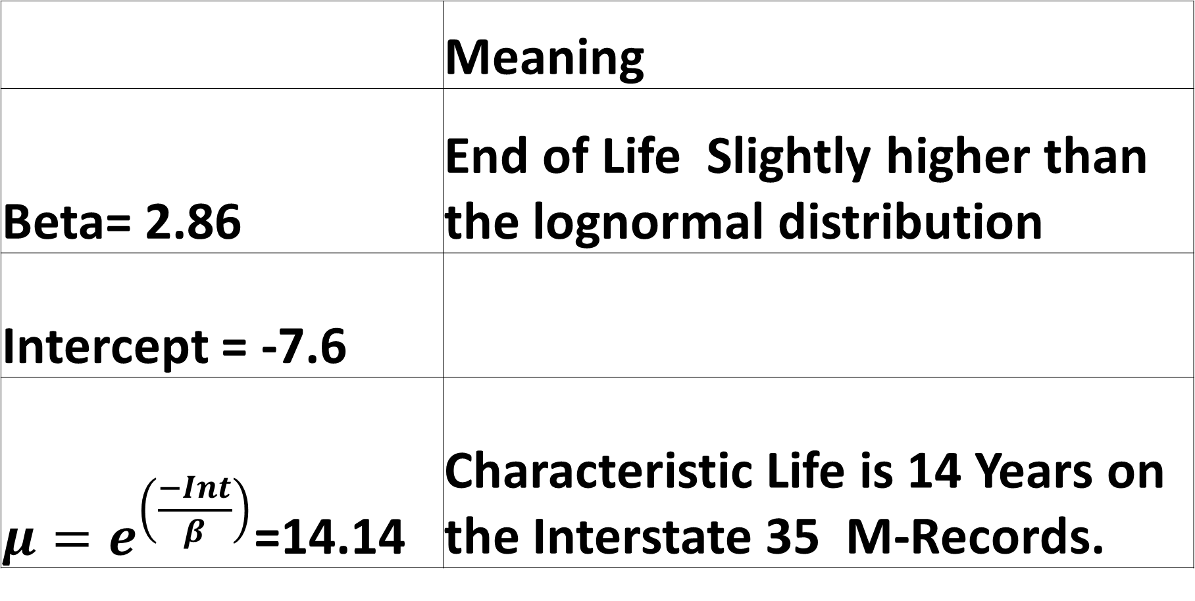
SNAPSHOT: SUMMARY RESULTS IS 35 IS 94
 | Meaning
Beta= 2.86 | End of Life Slightly higher than the lognormal distribution
Intercept = -7.6
${μ=e}^{\left(\frac{−Int}{β}\right)}$=14.14 | Characteristic Life is 14 Years on the Interstate 35 M-Records.

Slide 18
Shape Function For Concrete Rehab

Slide 19

Rehab Hazard Function

Slide 20
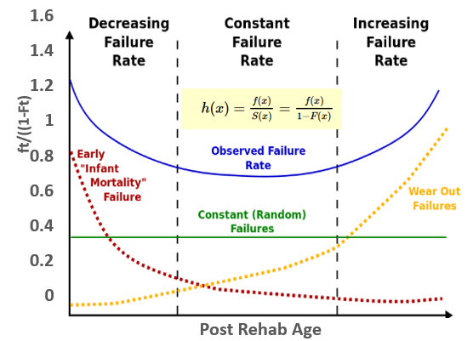
Hazard Function for Major Concrete Rehabilitation

Slide 21
Concrete Rehab US Highways Hazard Function
INT= | 3.6366
Beta = | 1.32
Mu= | 15.7

Slide 22
US HIGHWAY WEIBULL VARIABLES
INT= 3.6366
Beta = 1.32
Mu= 15.7

Slide 23
RQI AT REHAB US HIGHWAYS BEFORE Vs AFTER

Slide 24
Influence of Time to Rehab on RSL

Slide 25

Threshold Time to Failure Can be Challenging
Data seems to emanate from t_{o} which makes it stochastic.,
Ft vs time
Convex portion of curve
Where t_{o} is the location parameter, t₁ is the lower
extreme abscissa t₂ is upper extreme abscissa t_{m} is
the abscissa corresponding to the mid point of
the convex portion

Slide 26
US Highways Rehab M. Record Performance
Location Parameter t₀ = 2.5 Years
INT= | 3.64
Beta (Shape Parameter)= | 1.32 (Random)
Mu (Scale Parameter)= | 15.7 Years

Slide 27
Location Parameter for US Highway Rehab
t₁=12; t_{m}=18; t₂ =28 Therefore t₀=3

Slide 28
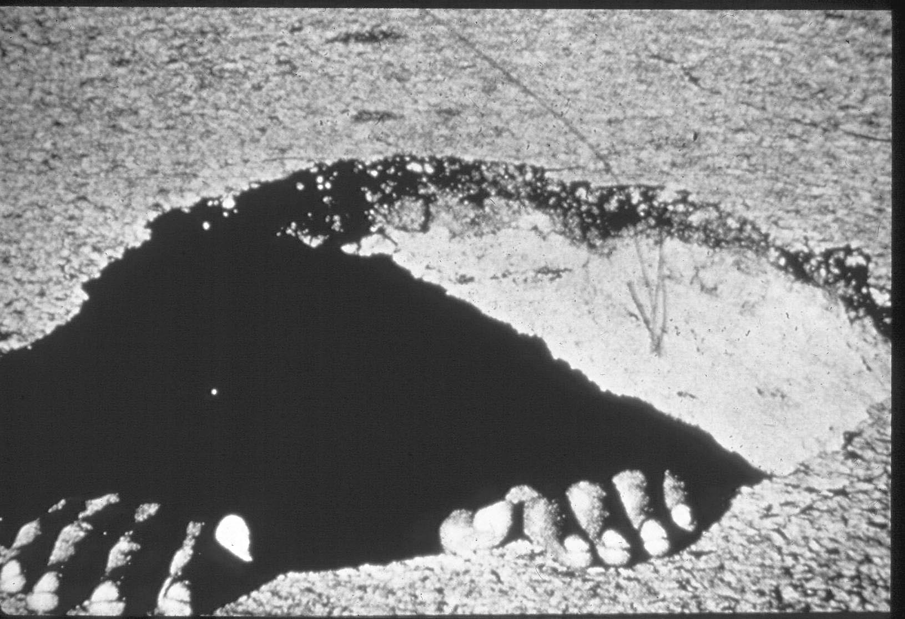
Bandaids are not Cost Effective
Perform CPR:
Regrades are Very Expensive
Notes:
1) Pavement Distress

Slide 29
Acknowledgements
Glenn Engstrom
Jeff Brunner
Curt Turgeon
Dave Janisch
Debaroti Ghosh
Brandon Ong
MnDOT District Materials Engineers

Slide 30


















































Thank You

