Slide 1


2018 Pavement Workshop
May 23-24, 2018
Partial Depth Joint Repairs
Justin Lashley
Concrete Engineer
Braun Intertec
+ 46 Associate Members

Slide 2
Project Task
Task 1 – Summary of Patch Installation
  Patch preparation
  Mixing procedures
  Placing procedures
  Curing Techniques
Task 2 – Manufacturer Survey and Literature Review

Slide 3
Project Task
Task 3-5 – Yearly Review
  How are the materials performing
  3 years
Task 6 – Final Report

Slide 4
Installation – Typical Cell

Slide 5
Installation
16 Products
Varied mixing procedures
  Revovling drum
  Paddle
  Drill
  Screw

Slide 6
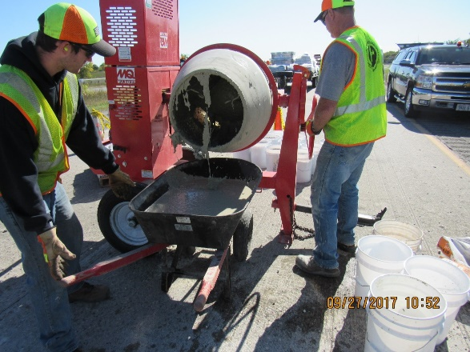
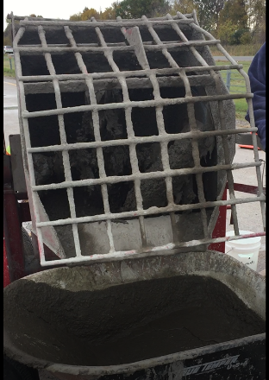
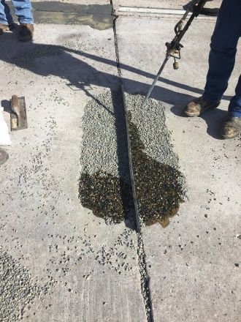
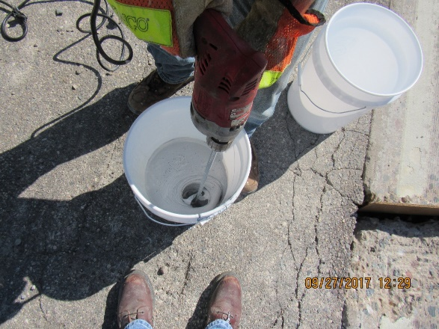
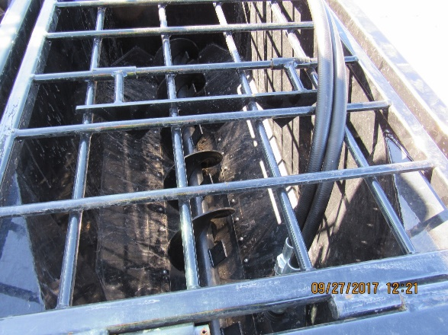
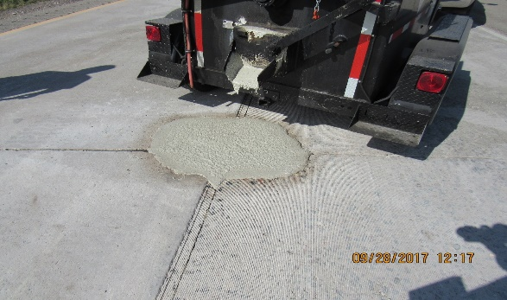
Installation
16 Products
Varied mixing procedures
  Revolving drum
  Paddle
  Injection
  Drill
  Screw
  Compaction
  Heated trailer

Slide 7
Installation
Placing and finishing procedures were similar
Curing procedures varied
  Epoxy vs cementitious

Slide 8
First Winter
One material would be considered a failure
Several patches have delaminated
  Bond still seems intact
  Potentially caused by existing concrete (undermining)
Broadcast aggregate is mostly gone

Slide 9
Pulling it all Together
Can the repair be done quickly and how long can it be expected to last?
What needs to be done to prepare the patch?
What is the equipment needed for placing the material?
  Can it be done with what maintenance currently has
  Does training need to take place

Slide 10
Questions?
Justin Lashley
  jlashley@braunintertec.com

Slide 11


















































Thank You

