Slide 1
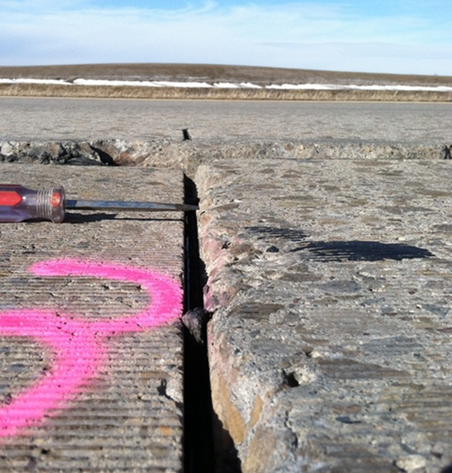
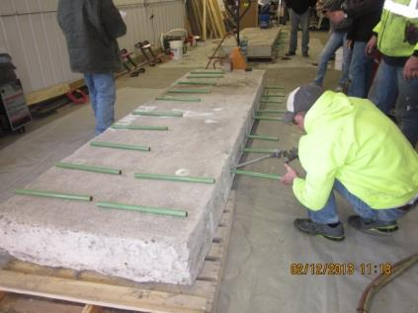
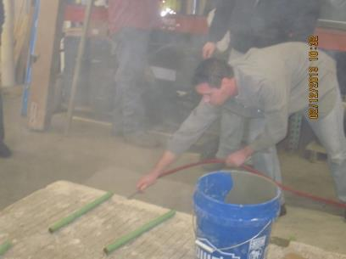
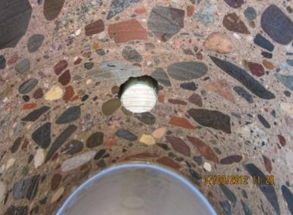
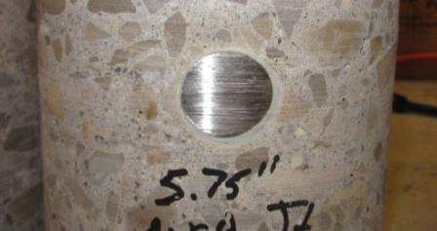
Findings From Study on Dowel Bar Anchorage in Full-depth Concrete Repairs
Maria Masten, P.E
MnDOT Concrete Engineer
NRRA Rigid Workshop
May 23, 2018

Slide 2
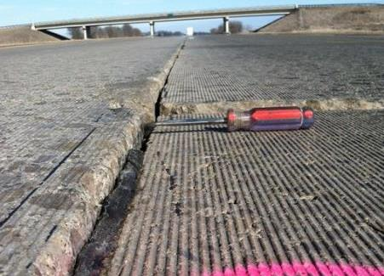
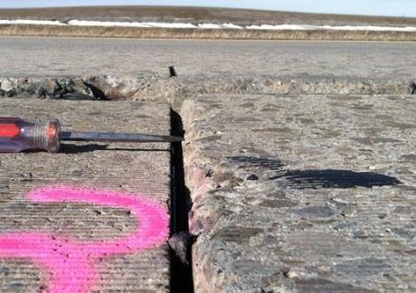
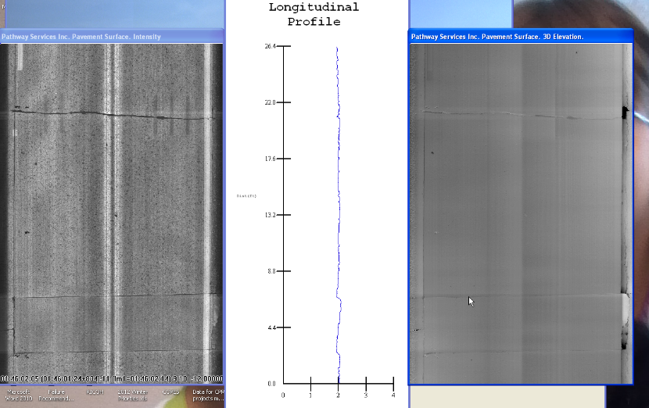

Slide 3
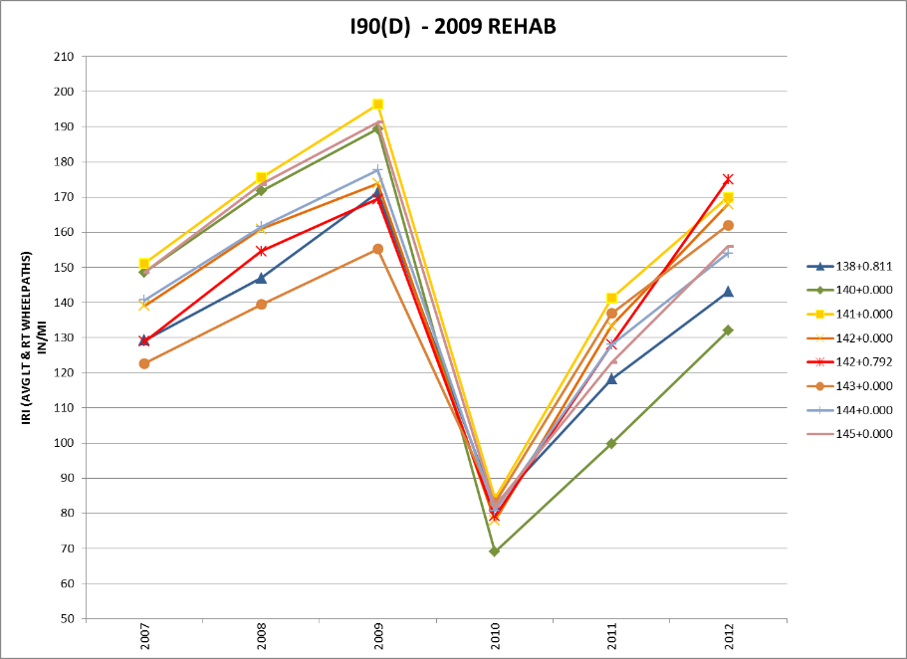
SP 2280-126 I-94 Alden
6 dowel bars
25.4% Trucks
7,668 AADT

Slide 4
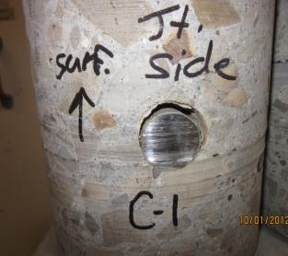
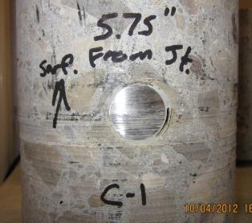
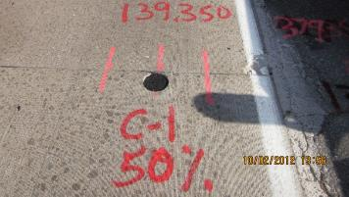
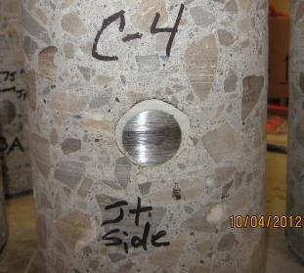
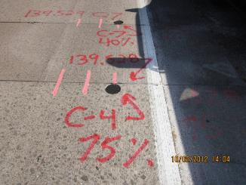
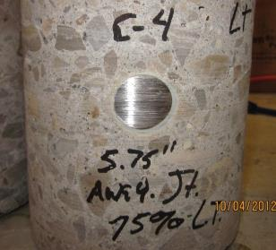
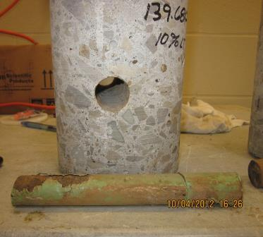
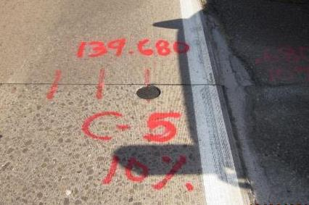

Slide 5
Results of Investigation
During investigations of I-90 and 5 other projects, found a lack of epoxy adhesive / grout around the dowels from all of the Contractors
“I watched them install dowels on many projects and thought they were good.”
Change standard back from 8 dowel bars to 11 dowel bars due to problems we have encountered with workmanship
Time to discuss with Concrete Industry and educate Inspection Personnel

Slide 6
Agency-Industry Meeting
December of 2012
Focused on premature failure of full depth repair project
“It has been working for 30 years – what’s changed?”
Workmanship and Best Practices were the end result
  How good can we really do? Let’s go to MnROAD and find out….

Slide 7
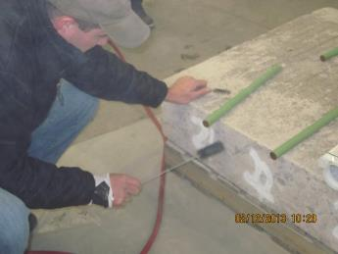
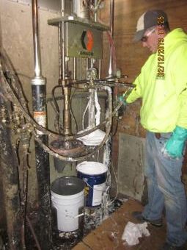
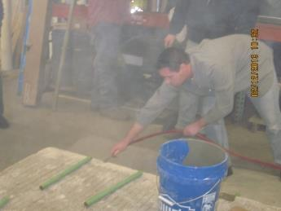
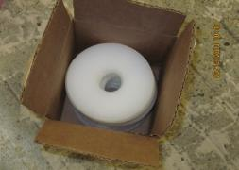
FDR Investigation
MnROAD – Phase I – 2/12/2013
What did we try?
  Grout
    Grout box method
    Dip and stick
    1 hour old grout
    Grout capsules
  Epoxy
    Dip and stick*
    double dip*
    Fill and twist*
    Polygrip epoxy
  *Had problems with epoxy due to cold temperatures
  Additional brushing
  Compressed air
  Grout rings

Slide 8
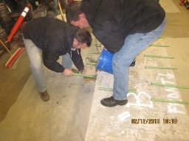
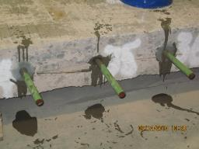
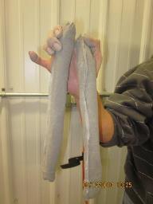
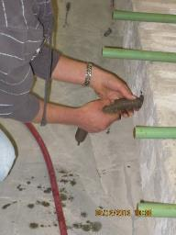
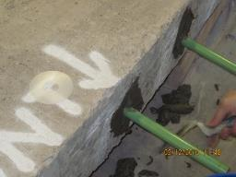
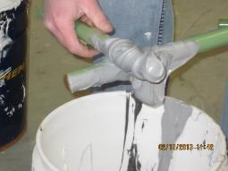
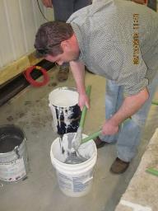
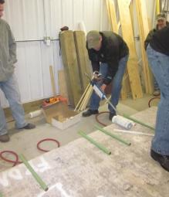
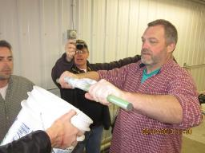
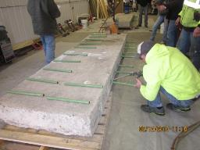
MnROAD – checking workmanship

Slide 9
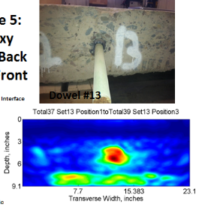
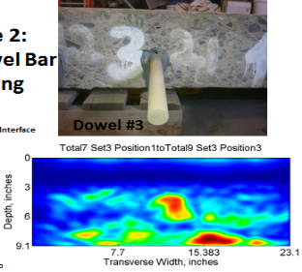
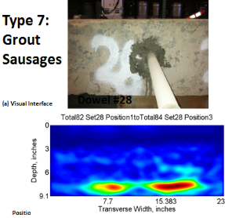
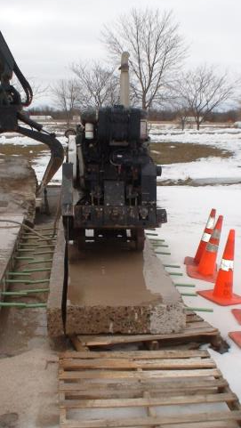
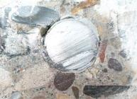

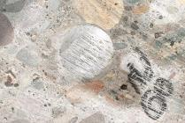
MnROAD Results – Phase I
U of M tested with MIRA to see if provide information non-destructively

Slide 10
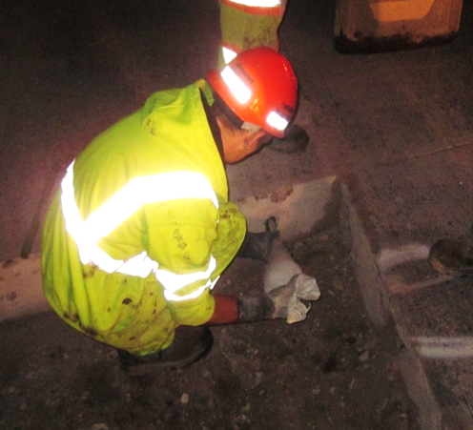
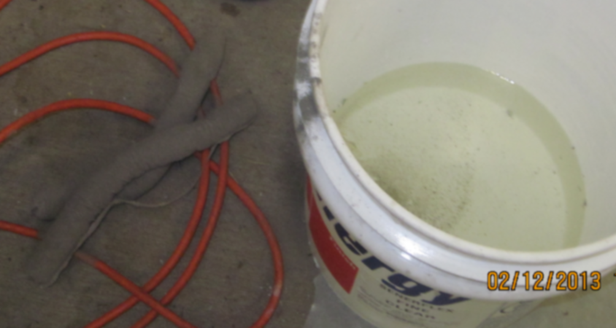
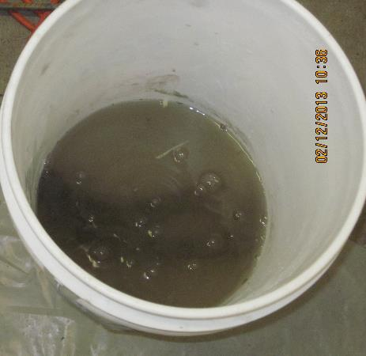
MnROAD FDR Field Installation – Phase 2 – 8/15-16/2013
1” and 1.25” diameter dowel bars
All lanes diamond ground
No grout, modified grout bag, grout capsule, epoxy (2 types)
Controlled location
FWD testing seasonally
Coring
Monitoring over time

Slide 11
MnROAD Traffic (I-94 Bypass)
9” JRCP/6” Class-6 Base / Clay (1973)
Estimated 140,000 Rigid ESAL/Year
28,500 AADT – 13% Trucks
Since Test Section Installations (8/16/13-12/31/16)
 | Days on By-pass | Rigid CESALS | AADT | %WB Traffic | %Trucks in DL
9/1/2013 | 29 | 164,133 | 6576 | 23.8 | 81.7
2014 | 66 | 348,656 | 4871 | 18.1 | 79.2
2015 | 58 | 316,824 | 4585 | 15.9 | 78.9
2016 | 166 | 869,463 | 12574 | 45.4 | 81.9
Totals | 319 | 1,699,076

Slide 12
Measuring Dowel Bar Effectiveness with FWD Testing
Typical “Action” thresholds range from 50 to 70 percent Load Transfer Efficiency (LTE) considering LTE only
Larson and Smith (2005) suggest that “The maximum differential deflection criteria of 5 mils may help evaluate dowel looseness or the possibility of delaminations in the concrete at the dowel bar level.”
Source: Guide to Dowel Load Transfer Systems for Jointed Concrete Roadway Pavements (Sept 2011)

Slide 13
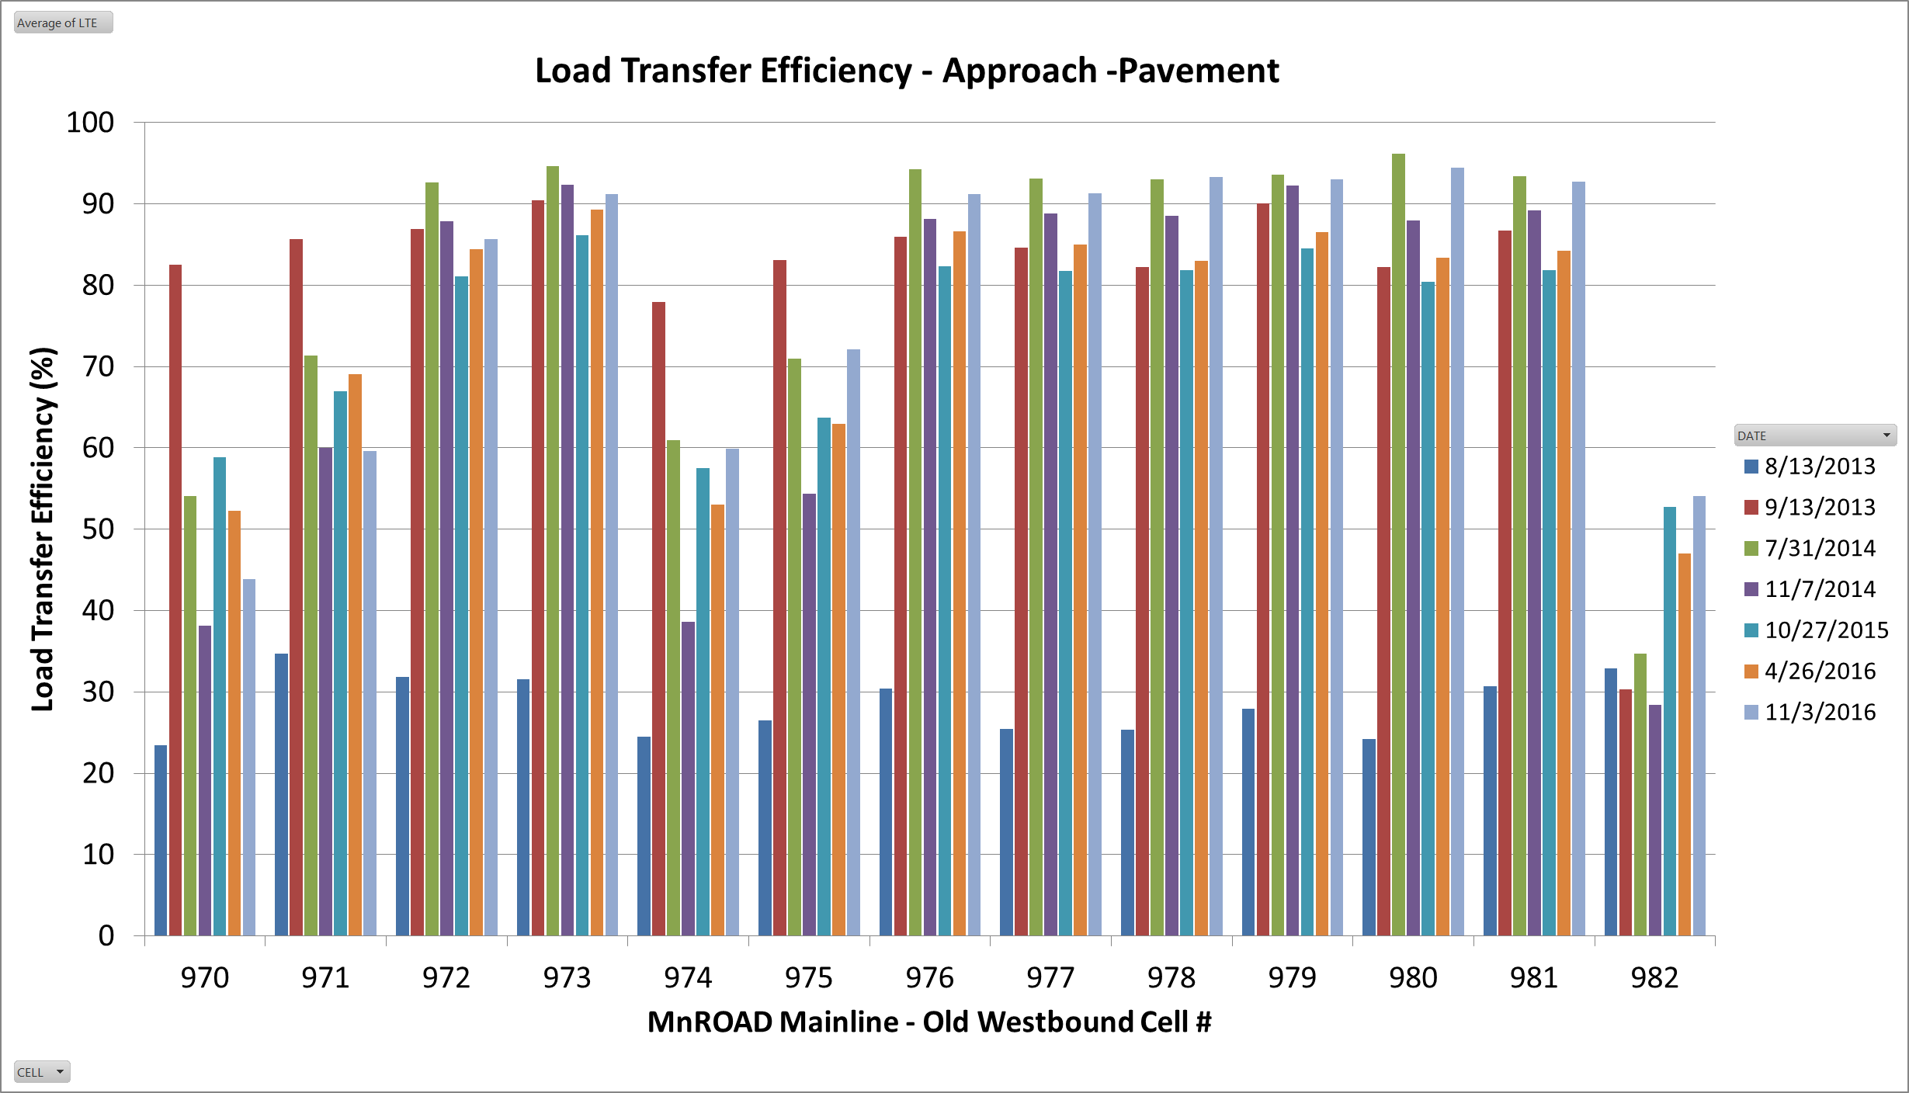
NG1 NG1.25 GB1 GB1.25 GD1 GD1.25 GC1 GC1.25 EP1 EP1.25 ER1 ER1.25 C

Slide 14
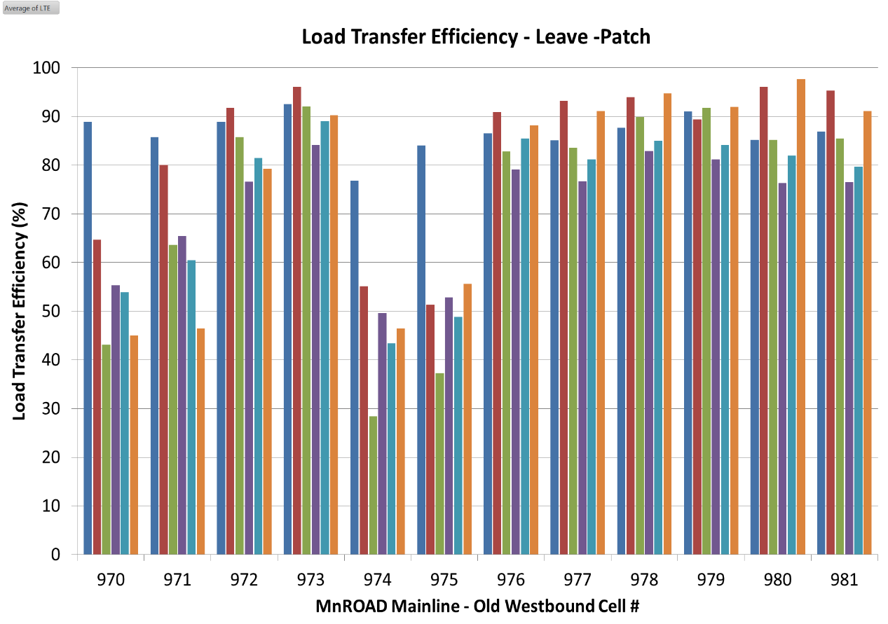

NG1 NG1.25 GB1 GB1.25 GD1 GD1.25 GC1 GC1.25 EP1 EP1.25 ER1 ER1.25

Slide 15
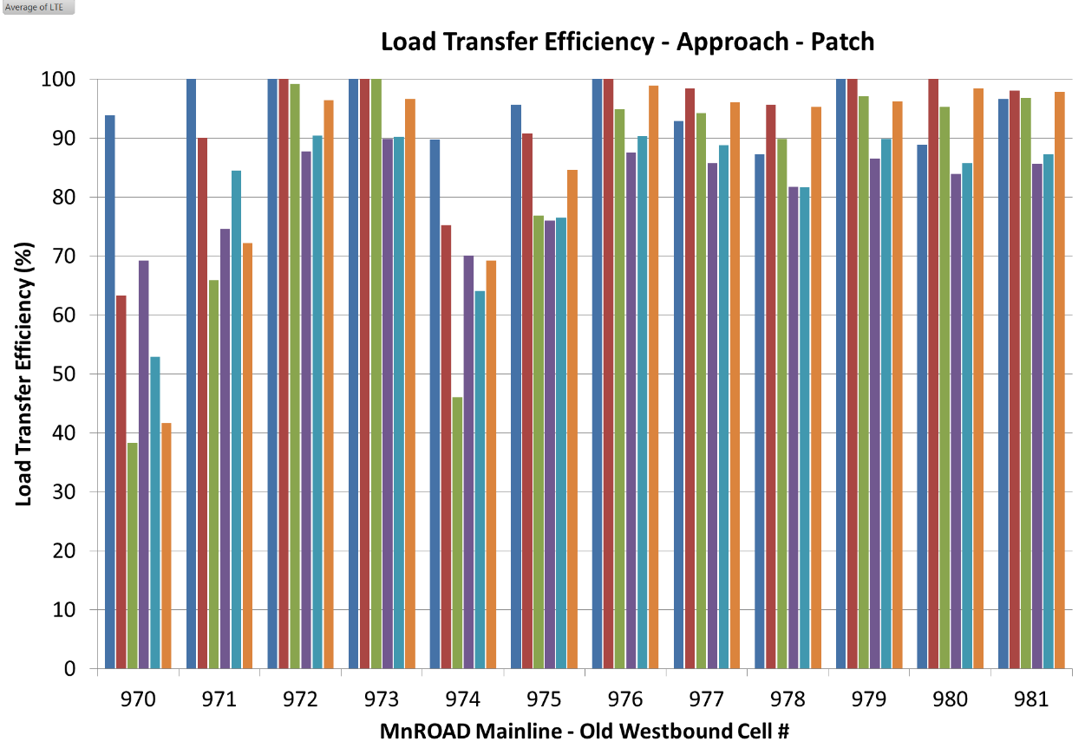
NG1 NG1.25 GB1 GB1.25 GD1 GD1.25 GC1 GC1.25 EP1 EP1.25 ER1 ER1.25

Slide 16
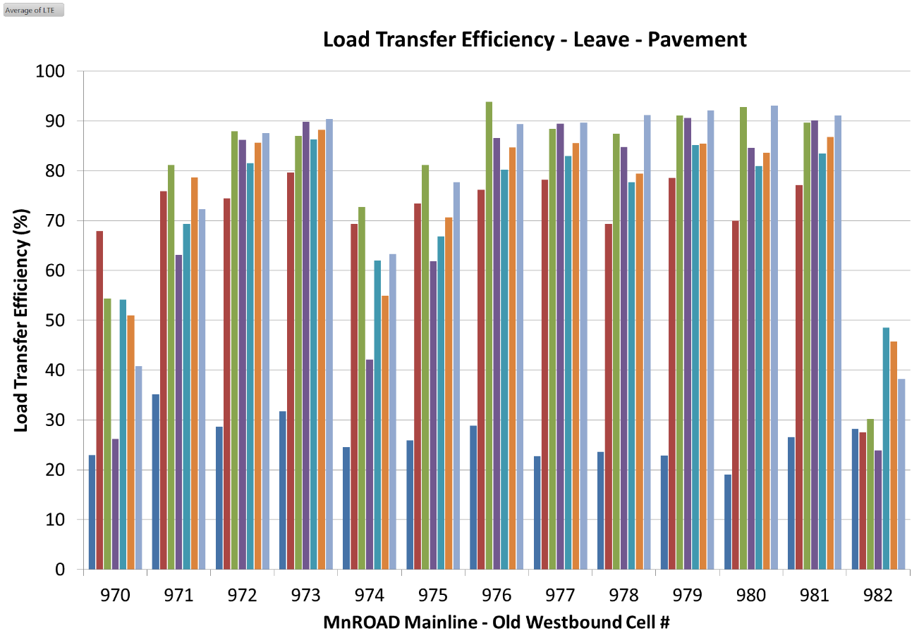
NG1 NG1.25 GB1 GB1.25 GD1 GD1.25 GC1 GC1.25 EP1 EP1.25 ER1 ER1.25 C

Slide 17
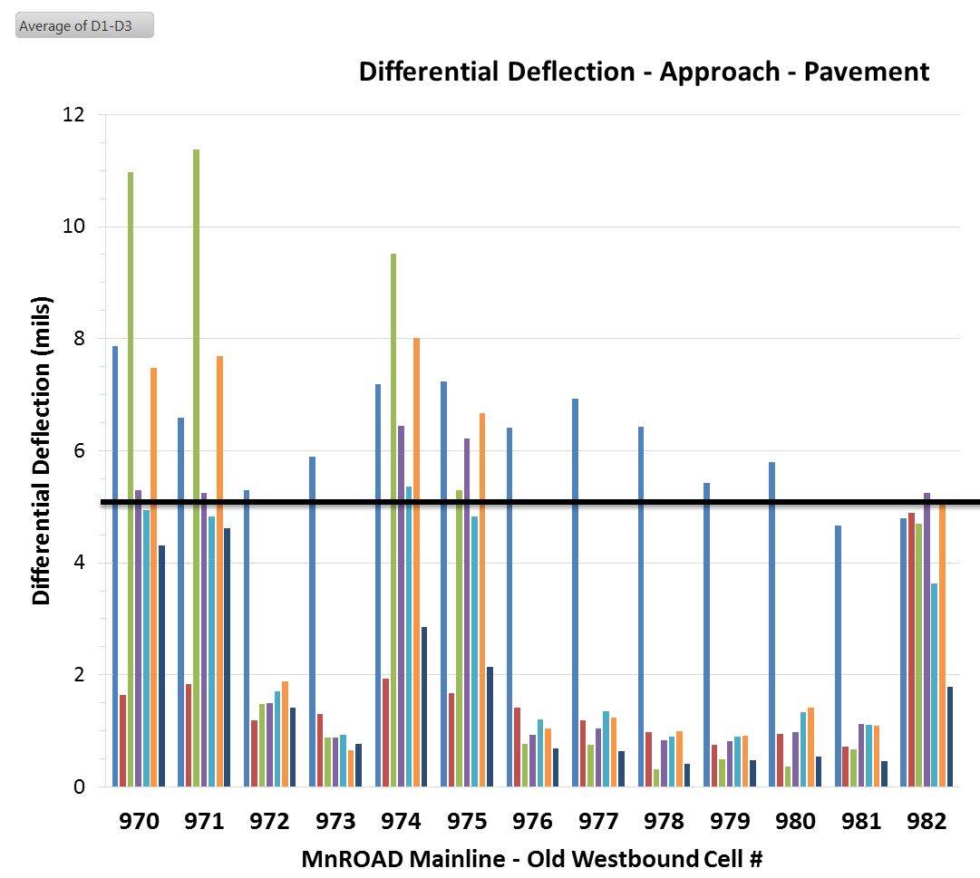

Dowel bar looseness
NG1 NG1.25 GB1 GB1.25 GD1 GD1.25 GC1 GC1.25 EP1 EP1.25 ER1 ER1.25 C

Slide 18
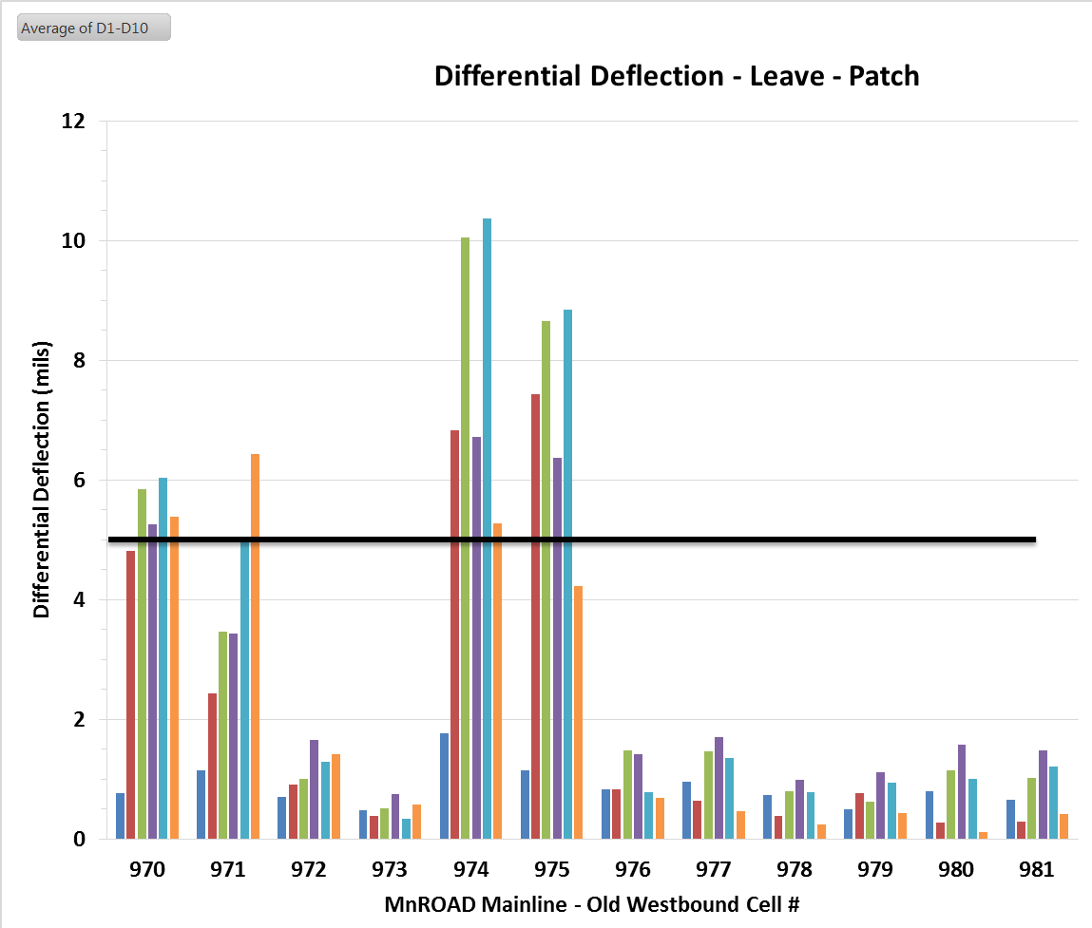

Dowel bar looseness
NG1 NG1.25 GB1 GB1.25 GD1 GD1.25 GC1 GC1.25 EP1 EP1.25 ER1 ER1.25

Slide 19
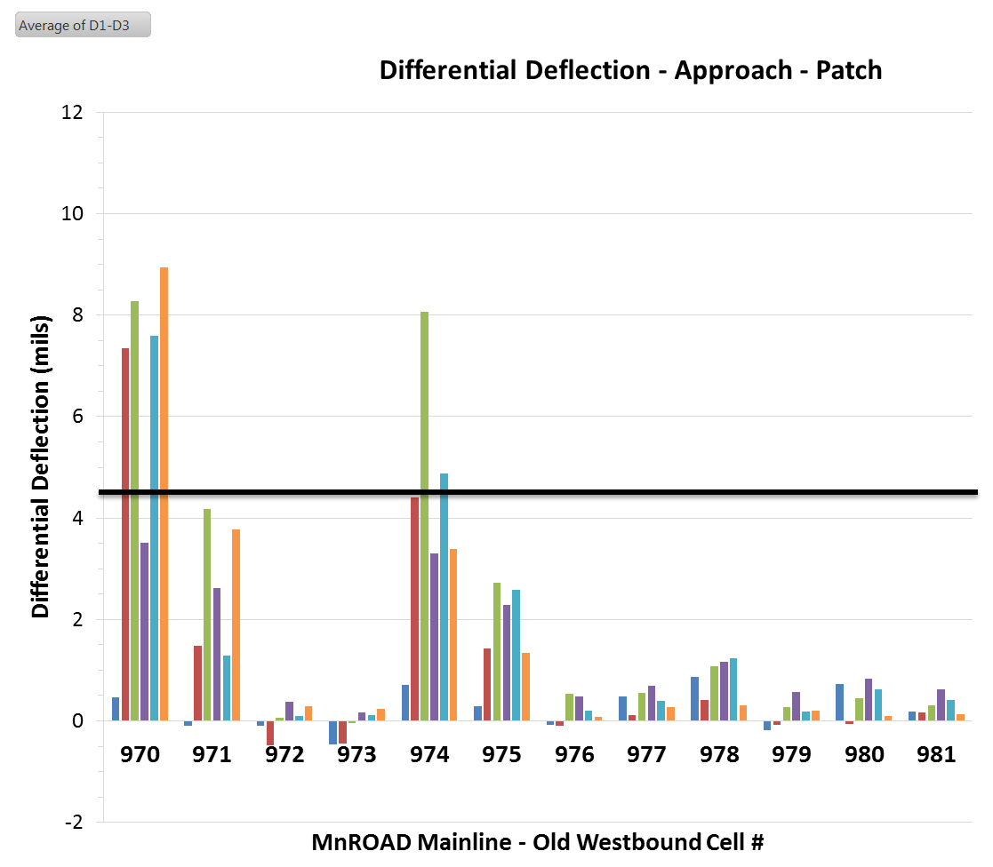
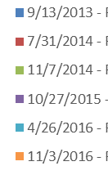
Dowel bar looseness
NG1 NG1.25 GB1 GB1.25 GD1 GD1.25 GC1 GC1.25 EP1 EP1.25 ER1 ER1.25

Slide 20
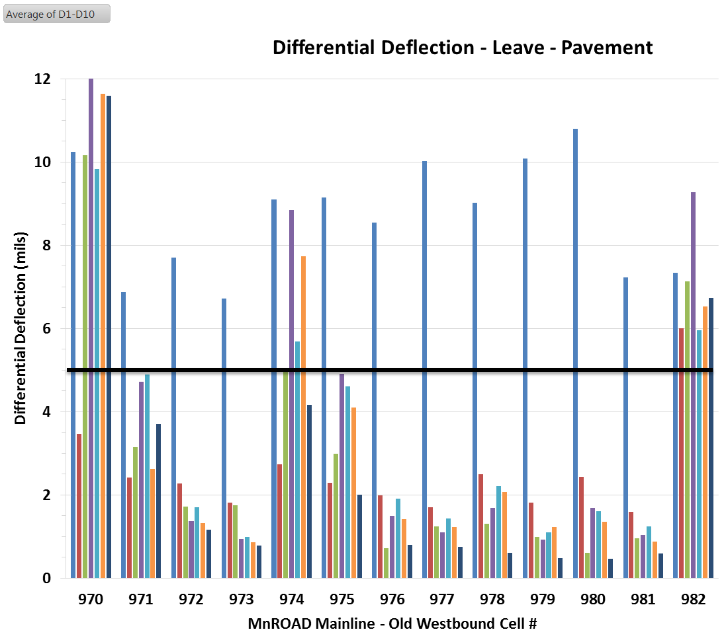

Dowel bar looseness
NG1 NG1.25 GB1 GB1.25 GD1 GD1.25 GC1 GC1.25 EP1 EP1.25 ER1 ER1.25 C

Slide 21
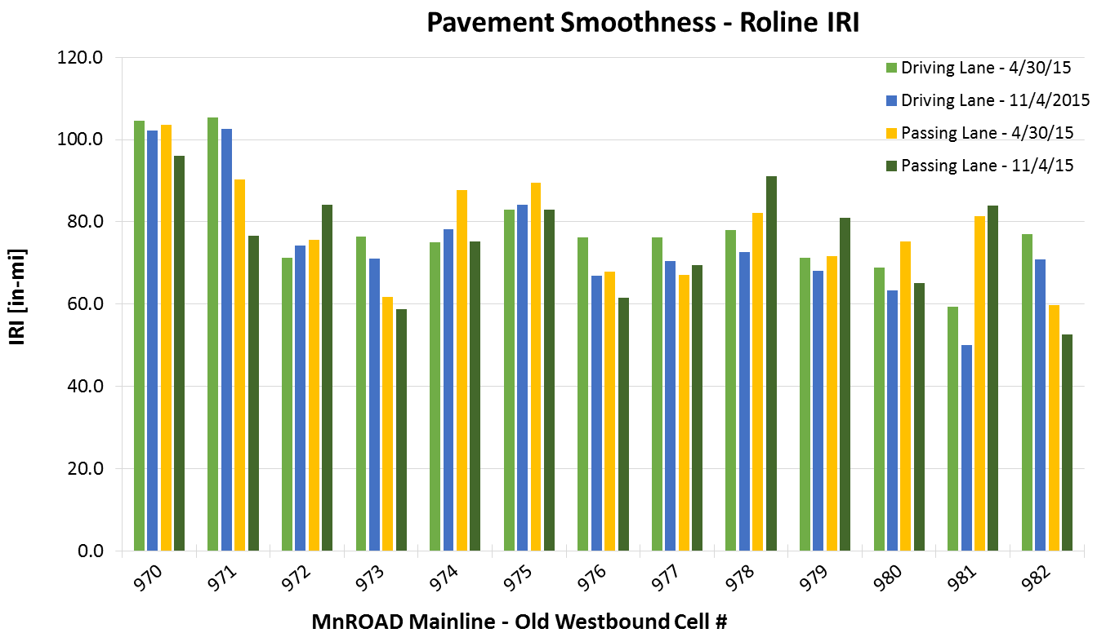
NG1 NG1.25 GB1 GB1.25 GD1 GD1.25 GC1 GC1.25 EP1 EP1.25 ER1 ER1.25 C

Slide 22

Acknowledgements
Gordy Bruhn, Concrete Rehab Specialist, MnDOT Concrete Unit
Matt Zeller, Concrete Paving Association of Minnesota
MnROAD and Research
Construction Materials
CPR, Inc.
Diamond Surfaces, Inc.
Interstate Improvement
PCI Roads
Simplex Construction Supplies

Slide 23
Thank you
Questions?
Maria Masten
maria.masten@state.mn.us
651-366-5572

