Slide 1


2018 Pavement Workshop
May 23-24, 2018
Utilization of MnROAD as part of NCHRP 24-45: Evaluating Mechanical Properties of Earth Material During Intelligent Compaction
How lucky we are to have access to MnROAD and have NRRA as partner
Soheil Nazarian, PhD, PE, D.GE
Professor, The University of Texas at El Paso
+ 46 Associate Members

Slide 2
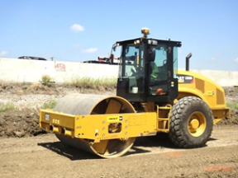
Goal of Project
Thank you Caterpillar
“to develop procedure(s) that measure
mechanical properties
of earth materials to
facilitate adoption
of IC technologies for field
acceptance”
E (modulus)?
k (stiffness)?
Straightforward specification
Solid to minimize dispute

Slide 3
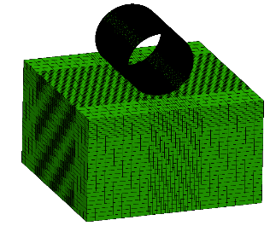
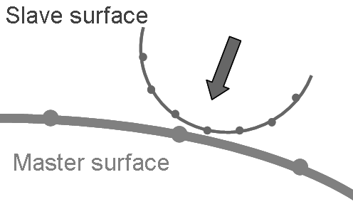
Calibration of Forward Model
Simulation of Roller Measurements
Select Roller Parameters
Select Material Type for Layers
Estimate Layer Properties

Slide 4
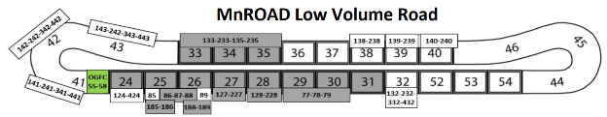
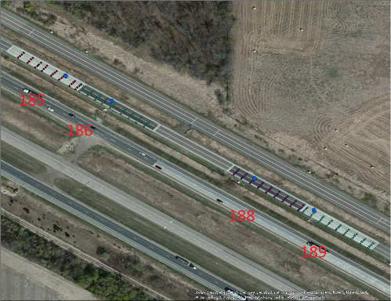
Test Strip at MnROAD Low Volume Road
MnROAD Low Volume Road
North Side
Geophones and
Pressure Cells Locations
South Side
185
186
Cell 185
Cell 186
Cell 188
Cell 189
D
Cell 187
C
2.1 m (7 ft)
2.1 m (7 ft)
188
B
A
2.1 m (7 ft)
189
9 @ 7.5 m (25 ft) spacing
9 @ 7.5 m (25 ft) spacing
9 @ 7.5 m (25 ft) spacing
9 @ 7.5 m (25 ft) spacing
70 m (226.5 ft)
70 m (226 ft)
70 m (226 ft)
70 m (225.5 ft)
Spot test (LWD, DCP)

Slide 5
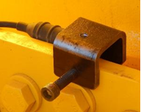
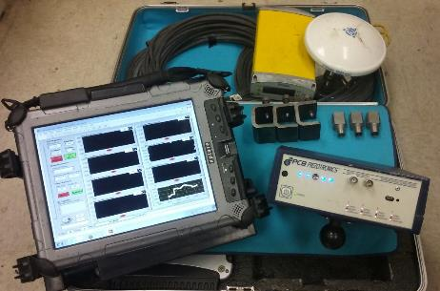
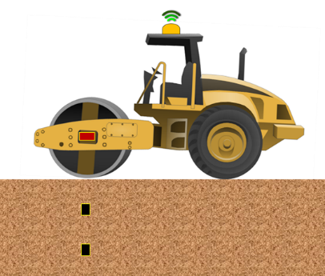
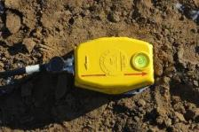
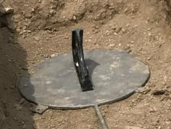
Components of UTEP Developed Data Acquisition System (DAQ)
3D Geophone
Accelerometer
Data Acquisition Box and Laptop
Accelerometer
GPS
Pressure Cell
3D Geophone
Pressure Cell

Slide 6
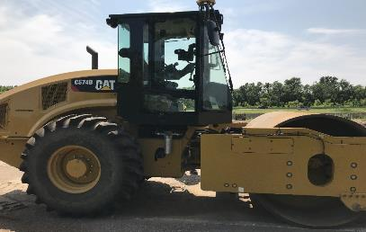
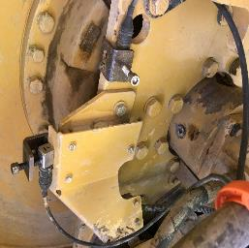
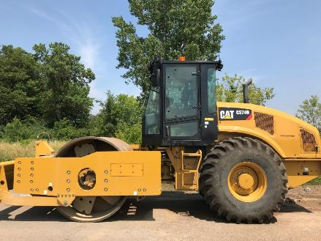
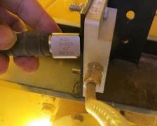
Instrumentation of IC Roller for Mapping
RTK GPS
Mounted
Accelerometers
Smooth Drum IC Rollers
Accelerometers and Connections to DAQ
Mounting Accelerometers

Slide 7
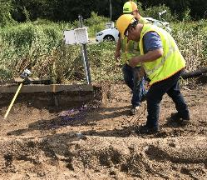
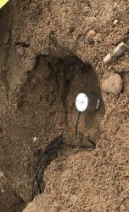
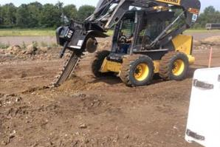
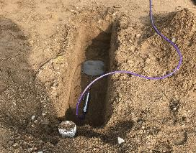
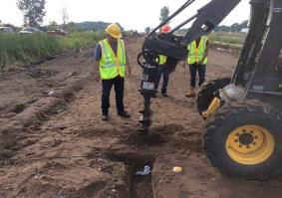
Installation of Ground Sensors
Embedding
3D Geophones
300 mm
(12 in.)
150 mm
(6 in.)
300 mm (12 in.)
Coarse RCA
300 mm (12 in.)
Fine RCA
300 mm (12 in.)
Limestone Aggregate Base Class 6
300 mm (12 in.)
Recycled Aggregate Base Class 6
90 mm (3.5 in.)
Select Granular Borrow
90 mm (3.5 in.)
Select Granular Borrow
90 mm (3.5 in.)
Select Granular Borrow
90 mm (3.5 in.)
Select Granular Borrow
Embedding
Pressure Plate
150 mm
(6 in.)
Subgrade
Sand
Subgrade
Clay
Subgrade
Clay
300 mm
(12 in.)
Subgrade
Sand
600 mm
(24 in.)
Geophone
Pressure Cell
*Not to scale
Cell 185
Cell 186
Cell 188
Cell 189

Slide 8
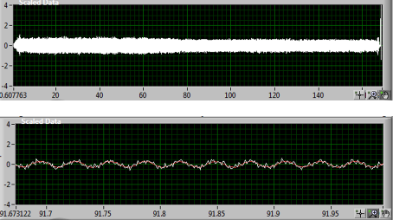
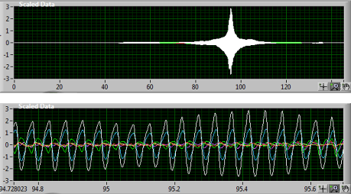
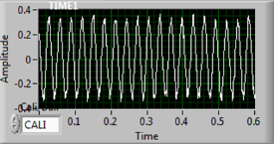
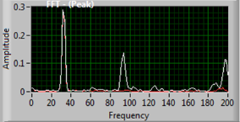
Vibration Data Collection Process
Time-record of acceleration data
from mounted accelerometer
Time-record of velocity data
from embedded geophone
Closer view of time-record of acceleration
Closer view of time-record of velocity
Fast Fourier Transform
Time domain
Frequency domain

Slide 9
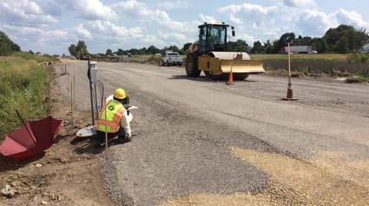
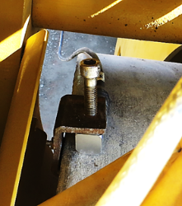
Vibration Response of Mounted Accelerometer
Amplitude
28 Hz Vibration Frequency (Standard) – Low Amplitude

Slide 10
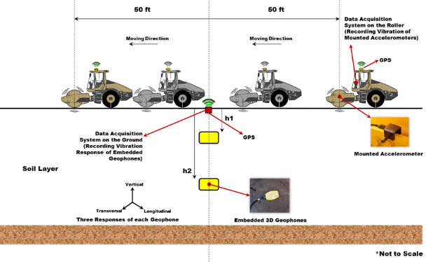
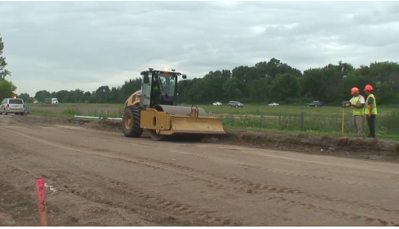
Vertical Response of Embedded Sensors
Moving Direction

Slide 11
Calibration of Forward Model
Simulation of Roller Measurements
Select Roller Parameters
Select Material Type for Layers
Estimate Layer Properties

Slide 12
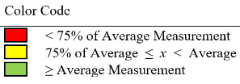

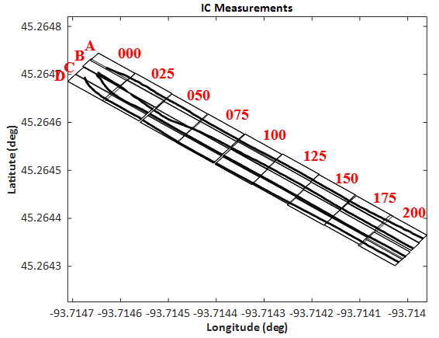
IC Mapping
Coefficient of Variation of
CMV
CMV
Frequency
(Hz)
Speed
(mph)
Color Code of Coefficient of Variation of CMVs
> 35%
25% < COV < 35%
< 25%
Cell 188 – Subgrade, Clay

Slide 13
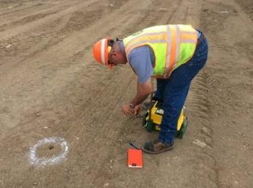
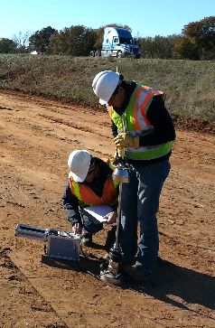
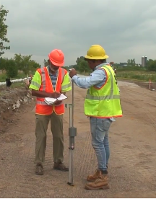
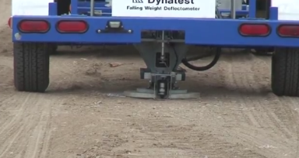
Performing Spot Tests
Nuclear Density Gauge (NDG)
Light Weight Deflectometer
(LWD)
Dynamic Cone Penetrometer
(DCP)
Falling Weight Deflectometer
(FWD)

Slide 14
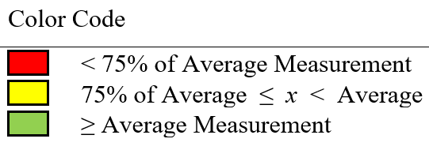
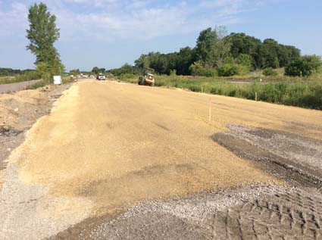
Spot Test Moduli
LWD
Modulus (ksi)
FWD
Modulus (ksi)
Stiffness from Roller
CMV
B
A
D
C
Cell 188 – Subgrade, Clay

Slide 15






Thank you!!
Can you help us with a site for Phase III?
nazarian@utep.edu or (915) 747-6911

Slide 16















































Thank You

