Slide 1


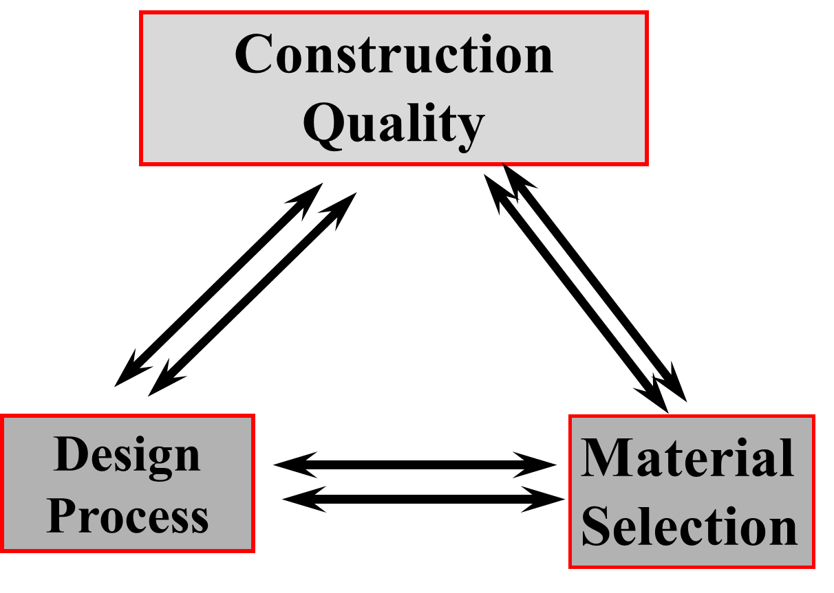
2018 Pavement Workshop
May 23-24, 2018
Quantifying Moisture in Granular Materials for Mechanistic Pavement Design
Soheil Nazarian, PhD, PE, DGE
Professor of Civil Engineering, UTEP
+ 46 Associate Members

Slide 2
Behavior of Soils (from Unsaturated Soil Principles)
Degree of Saturation, % | 120
 | 115
 | 110
 | 105
 | 100
 | 95
 | 90
 | 85
 | 80
 | 75
 | 70
 | 65
 | 60
 | 55
 | 50
 | 45
 | 40
 | 35
 | 30
 | 25
 | 20
 | 15
 | 10
 | 5
 | 0
 |  | Moisture Content, %
 |  | 5% | 7% | 9% | 11% | 13% | 15% | 17% | 19% | 21% | 23% | 25%
Dry Density, pcf | 90 | 15% | 22% | 28% | 34% | 40% | 46% | 53% | 59% | 65% | 71% | 77%
 | 95 | 17% | 24% | 31% | 38% | 45% | 52% | 59% | 66% | 72% | 79% | 86%
 | 99 | 19% | 27% | 35% | 43% | 50% | 58% | 66% | 74% | 81% | 89% | 97%
 | 104 | 22% | 31% | 39% | 48% | 57% | 66% | 74% | 83% | 92% | 101% | 109%
 | 109 | 25% | 35% | 45% | 55% | 65% | 75% | 85% | 95% | 105% | 115% | 125%
 | 115 | 29% | 40% | 52% | 64% | 75% | 87% | 98% | 110% | 121% | 133% | 145%
 | 121 | 34% | 48% | 61% | 75% | 88% | 102% | 116% | 129% | 143% | 156% | 170%
 | 127 | 41% | 57% | 74% | 90% | 106% | 123% | 139% | 155% | 172% | 188% | 204%
 | 133 | 51% | 71% | 91% | 111% | 131% | 152% | 172% | 192% | 212% | 233% | 253%
 | 140 | 65% | 91% | 118% | 144% | 170% | 196% | 222% | 248% | 274% | 300% | 327%
 | 147 | 90% | 127% | 163% | 199% | 235% | 271% | 308% | 344% | 380% | 416% | 452%
 | 154 | 143% | 200% | 257% | 314% | 371% | 428% | 486% | 543% | 600% | 657% | 714%
S_{r} = ω G_{s} ρ_{d}/( G_{s} ρ_{w} – ρ_{d})
G_{s} = specific gravity
ρ_{d} = dry mass density
ρ_{w} = mass density of water

Slide 3
Estimating Design Modulus
Determine nonlinear parameters k₁ through k₃ for each material
Conducting laboratory resilient modulus tests before structural design
Utilizing results from a catalog of most common soils that have been tested
Estimating modulus based on calibrated models that are functions of index parameters
Using presumptive design values based on experience
Best Option Worst Option
θ = bulk stress
τ_{oct} = octahedral shear stress
P_{a} = atmospheric pressure
k_{1,2,3} = regression constants

Slide 4
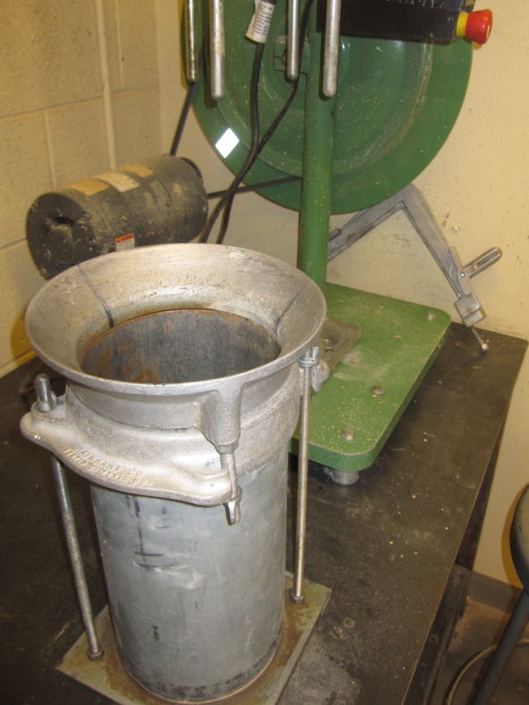
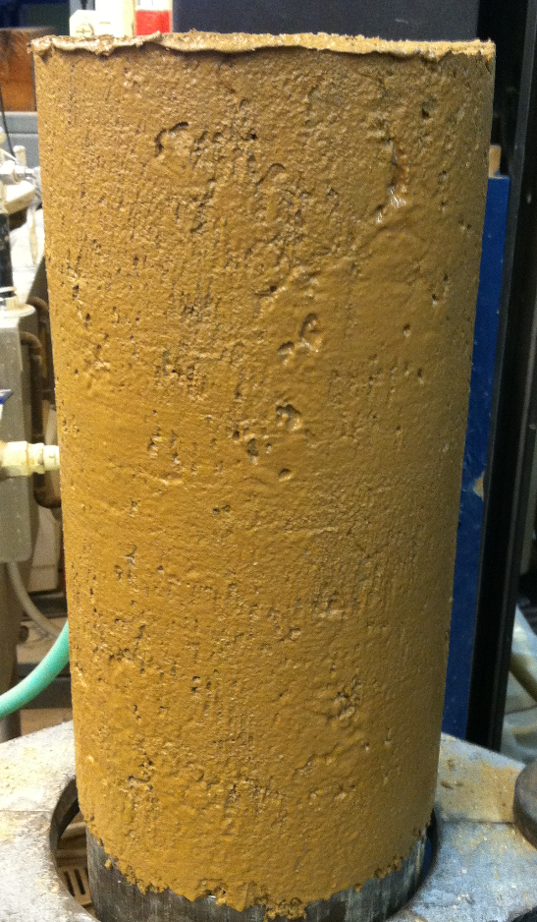
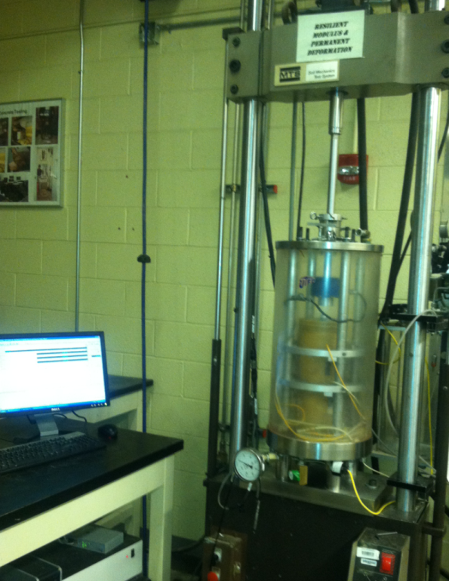
Laboratory Tests

Slide 5
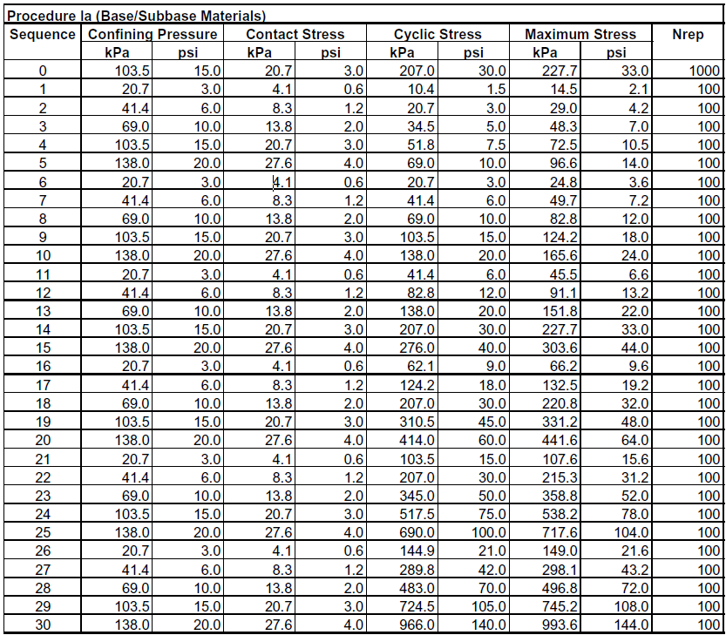
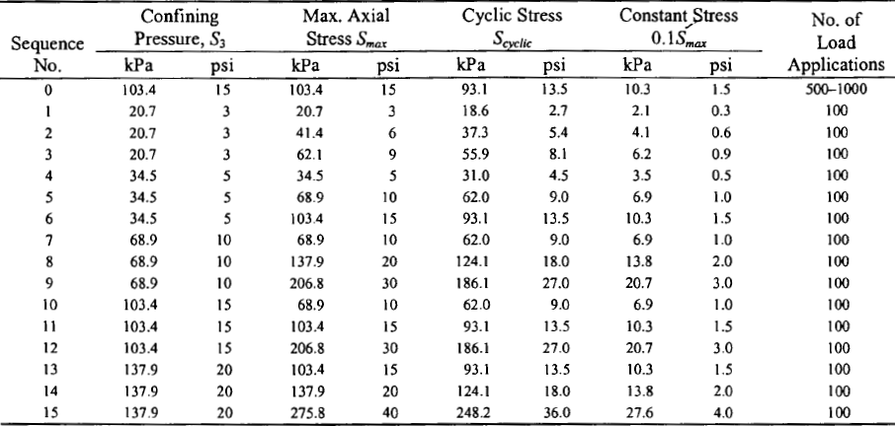
Loading Sequence (Base)
NCHRP 1-28A
AASHTO T-307

Slide 6
Resilient Modulus (Base)
There is a need once and for all to standardize MR Test

Slide 7
Factors Impacting Modulus
State of Stress
Moisture Content (Suction, Degree of Saturation)
  at compaction
  at testing
Density
Gradation and Plasticity

Slide 8




Calibrated Models for Estimating Modulus
Model Type | Developed by | Gradation and Plasticity Parameters Included
 | Malla and Joshi (2008) | Percent passing 3” sieve Percent passing 1” Percent Passing 1.5 “ sieve Percent passing #40 sieve Percent passing #10 sieve Percent fine sand Percent passing #200 sieve CU=Uniformity coefficient CC= Coefficient of curvature
 | Santha (1994) | S40=Percent passing sieve No.40 Percent of clay Percent of silt Percent of swell Percent shrinkage Liquid limit and plastic limit
 | Glover and Fernando (1995) | Liquid limit and plastic limit Specific gravity of soil binder Percent passing number 40 Dialectic constant
 | Mohammad (1999) | Liquid limit and plastic limit
 | Amber (2002) | Percentage passing sieve #3/8 Percentage passing #4 Percentage passing #40 Liquid limit and plastic limit
State of Stress
Index Properties

Slide 9


Major Moisture Models Considered
MEPDG (well publicized)
Zapata (Modification of MEPDG to be soil dependent)
$$log\left(\frac{M_{R}}{M_{Ropt}}\right)={\left(α+β×e^{−wPI}\right)}^{−1}+\frac{\left(δ+γ×{wPI}^{0.5}\right)−{\left(α+β×e^{−wPI}\right)}^{−1}}{1+e^{\left(ln\left(\frac{−\left(δ+γ×{wPI}^{0.5}\right)}{{\left(α+β×e^{−wPI}\right)}^{−1}}\right)+{\left(ρ+ω×e^{−wPI}\right)}^{0.5}×\left(\frac{S−S_{opt}}{100}\right)\right)}}$$
3. Siekmeier (Incorporates SWCC)
$M_{R}=k_{1}P_{a}{\left(\frac{σ_{eb}+f_{s}θ_{w}}{P_{a}}\right)}^{k_{2}}{\left(\frac{τ_{oct}}{P_{a}}+1\right)}^{k_{3}}$
$$log\left(\frac{M_{R}}{M_{Ropt}}\right)=a+\frac{b−a}{1+e^{\left(ln\frac{−b}{a}+k_{m}×\left(S−S_{opt}\right)\right)}}$$

Slide 10
Verification of Moisture Model from Lab Results
Zapata
MEPDG

Slide 11
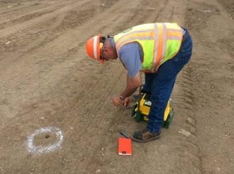
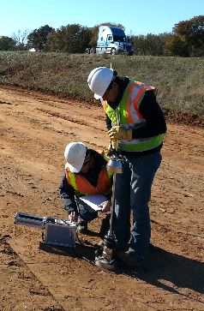
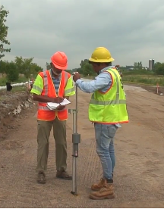
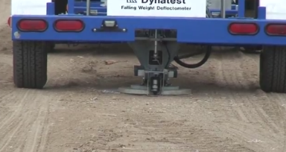
Field Tests
Nuclear Density Gauge (NDG)
Light Weight Deflectometer
(LWD)
Dynamic Cone Penetrometer
(DCP)
Falling Weight Deflectometer
(FWD)

Slide 12
Recommended Moisture Models
Based on Lab Tests
Based on Small Scale Tests

Slide 13
Impact of Moisture Content at Time of Testing relative to Moisture Content at time of Compaction: Prepared at OMC
Constant Density Specimens prepared at MDD

Slide 14
Impact of Moisture Content at Time of Testing relative to Moisture Content at time of Compaction: Prepared at OMC and 1.2 OMC
Constant Density Specimens prepared at MDD

Slide 15
Impact of Moisture Content at Time of Testing relative to Moisture Content at time of Compaction: Prepared at OMC, 1.2OMC and -1.2 OMC
Constant Density Specimens prepared at MDD

Slide 16
Impact of Moisture Content at Time of Testing relative to Moisture Content at time of Compaction: Recommended Model: MEPDG with a = -0.1119, b = 0.7887 and k_{m} = 12.372

Slide 17
Impact of Moisture Content at Time of Testing relative to Moisture Content at time of Compaction

Slide 18

Thank you

Slide 20
Conclusions and Observations
Impact of moisture content of base and subgrade should be considered in terms of change in
  Degree of Saturation (more fundamentally correct)
  Moisture content (better understood in Pavement Geotechnics)
Pavements should be designed by considering
  Laboratory Test Results (for major projects)
  Quality of construction (for major as well as minor projects)

Slide 21




Thank you!!
nazarian@utep.edu or (915) 747-6911

Slide 22


















































Thank You

