Slide 1


2018 Pavement Workshop
May 23-24, 2018
Flexible Research Team Update
Barry Paye – Flexible Team Chair
Chief Materials & Pavements Engineer (WisDOT)
+ 46 Associate Members

Slide 2


Slide 3
Agency Members
Imad Basheer - Caltrans
Ryan Culton - IDOT
Paul Denkler - MoDOT
Shongtao Dai - MnDOT
James Foldesi - St. Louis Co. MN
Kee Foo - Caltrans
John Garrity - MnDOT
Steve Hefel - WisDOT
Kevin Kennedy - MDOT
Dan Kopacz - WisDOT
Dan Oesch - MoDOT
Barry Paye (Chair) - WisDOT
Jim Trepanier - IDOT
Charles Wienrank – IDOT
Ryan Bassen - MnDOT
Tim Clyne – MnDOT
Gerry Geib – MnDOT
Renae Kuehl - SRF
Dave Van Deusen – MnDOT
Ben Worel – MnDOT

Slide 4
Associate Members
Jay Bianchini – Collaborative Agg.
Brandon Brever- MAPA
Gina Buccelato - 3M Transportation
Mike Byrnes - Mathy Const. Co.
Andy Cascione - Flint Hills
Jo Sias Daniel – U of New Hampshire
Stacy Glidden – Payne & Dolan
Kris Hansen - 3M Transportation
David Jones – UC Pavement Research Center
Lev Khazanovich - U of Pittsburgh
Mihai Marasteanu - U of Minnesota
Ken Maser - Infrasense
Dave Rettner - AET
Dan Staebell - APA
Brandon Strand - APA
Randy West - NCAT
Jason Wielinski – ARRA
Chris Winiecki – Payne & Dolan
Zhanping You - Michigan Tech

Slide 5
Short Term Research
Goals of Short Term Research
The Team
Topics where many states are doing work.
Share the current state of the practice and innovations via tech transfer
Short reports to summarize prepared by SRF.
Randy West (NCAT)
Eshan Dave (UNH)
Jim Trepanier (IL)
Ed Johnson (MN)
Tim Clyne (MN)
Brandon Brever(MAPA)
John Garrity (MN)
Zhanping You (MTU)
Curt Turgeon (MN)
Notes:
From the Preventive Maintenance , home page, click on links to all the project web pages.

Slide 6
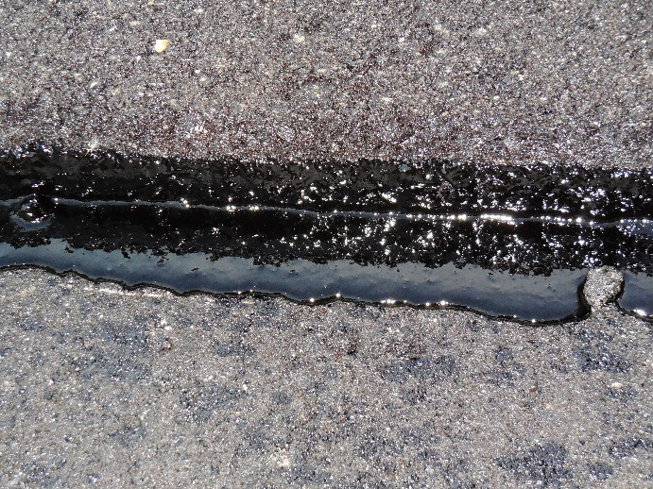
Short Term Research
Longitudinal Construction Joints
Project Summary: The construction of longitudinal joints in an asphalt pavement is typically the most difficult to achieve high density due to viscosity of pavements at high temperatures. Thus, deterioration of longitudinal joints is one of the major distresses facing agencies. The goal of this Tech Transfer would be to compile research and specifications from the NRRA states and others into a synthesis for publication.
Notes:
From the Preventive Maintenance , home page, click on links to all the project web pages.

Slide 7
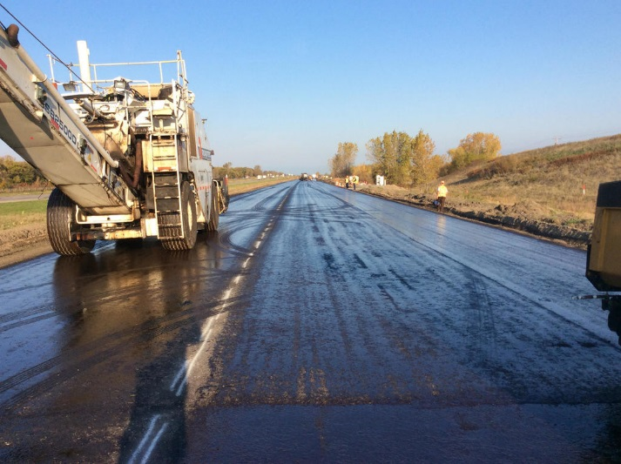
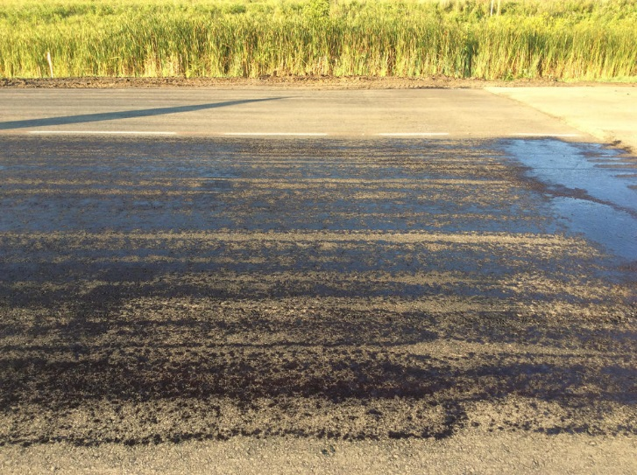
Short Term Research
Effective Use of Tack Coats
Project Summary: The purpose of this tech transfer project is to compile a synthesis of best practices being used by NRRA members in the area of tack coats and to identify any gaps in the research.
Notes:
From the Preventive Maintenance , home page, click on links to all the project web pages.

Slide 8
2016 MnROAD Construction
HMA Performance Testing Experiment
LTC Cracking
MnROAD Test Sections

Slide 9
2016 MnROAD Mix Designs
HMA Performance Test Experiment
MIX DESCRIPTION | RAP | RAS | CELL | BINDER | Aggregate Size | POLY | CRACK POTENTIAL
High Temp Mix | ~30 | 5 | 16 | PG 64S-22 | 12.5mm | No | High
High Temp Mix | <20 | 3 | 17 | PG 64S-22 | 12.5mm | No | High
High Temp Mix | <20 | 0 | 18 | PG 64S-22 | 12.5mm | No | Med/High
High Temp Mix + regressed voids (3.0) | <20 | 0 | 19 | PG 64S-22 | 12.5mm | No | Med/High
Soft Binder Mix | >30 | 0 | 20 | PG 52S-34 | 12.5mm | No | Med
Typical Low-Temp Mix | <20 | 0 | 21 | PG 58H-34 | 12.5mm | Yes | Low
Typical Low-Temp Mix + limestone | <20 | 0 | 22 | PG 58H-34 | 12.5mm | Yes | Low/Med
HiMA Mix | <15 | 0 | 23 | PG 64E-34 | 12.5mm | Yes | Low
9

Slide 10
Long Term Research
HMA Overlay of Concrete and Methods of Enhancing Compaction
  Current state of practice for asphalt overlay design is policy oriented
  There is need for establishing state of practice in design of overlays
  Objective of the proposed study is to develop a simple decision tree based tool:
    Selecting suitable asphalt mixtures & overlay designs
    To prolong overlay lives by lowering reflective cracking & improving density.
  Constructing, instrumenting and monitoring 12 test sections
  Laboratory performance tests on asphalt mixtures from the test sections
  Incorporate field performance data, performance modelling, and life cycle cost analysis to develop best practices for rehabilitation of PCC with asphalt overlays.

Slide 11
HMA Overlay and Rehab of Concrete and Methods of Enhancing Compaction
Selected Researcher
University of New Hampshire
  Eshan Dave
  Final Report – January 2021
Shongtao Dai (MnDOT)
Charles Wienrank (IL)
Kevin Kennedy (MI)
Barry Paye (WI)
Daniel Oesch (MO)
Randy West (NCAT)
Zhanping You (MTU)
Andy Cascione (Flint Hills)
Tom Burnham (MnDOT)
Ed Johnson (MnDOT)
Chris Dulian (MnDOT)
James Bittmann (MnDOT)
Brandon Brever (MAPA)
Tim Andersen (MnDOT)
Cody Brand (MnDOT)
John Garrity (MnDOT)
Jerry Geib (MnDOT)
Technical Advisory Committee

Slide 13
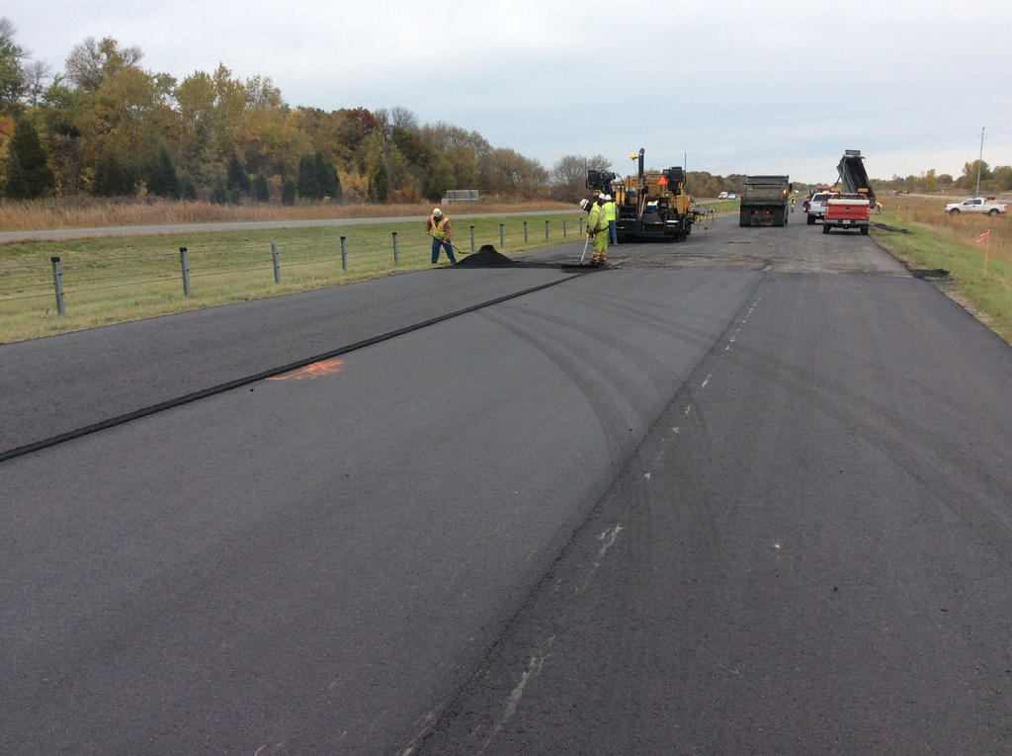
HMA Overlay and Rehab of Concrete and Methods of Enhancing Compaction
DESCRIPTION | CELL | DEPTH (inch) | MIX DESCRIPTION (NMAS, mm) | BINDER | DESIGN VOIDS
Control Section | 983 | - | - | - | -
HMA over PCC (1 lift) | 984 | 1.50 | Superpave (9.5) | 58H-28 | 4.0
 | 985 | 1.50 | Superpave (12.5) | 58H-28 | 4.0
 | 986 | 1.75 | Superpave (12.5) | 58H-28 | 4.0
HMA over PCC (2 lifts) | 987 | 1.50 | Superpave (9.5) | 58H-28 | 4.0
 |  | 2.50 | Superpave (19.0) | 58H-28 | 4.0
HMA over PCC (2 lift) | 988 | 1.75 | Superpave (12.5) | 58H-28 | 4.0
 |  | 2.25 | Superpave (19.0) | 58H-28 | 4.0
 | 989 | 1.75 | Superpave 95/5 (12.5) | 58H-28 | 5.0
 |  | 2.25 | Superpave (19.0) | 58H-28 | 4.0
 | 990 | 1.75 | Regressed voids design (12.5) | 58H-28 | 3.0
 |  | 2.25 | Superpave (19.0) | 58H-28 | 4.0
 | 991 | 1.75 | Superpave (9.5) | 58H-28 | 4.0
 |  | 2.25 | Superpave (19.0) | 58H-28 | 4.0
HMA over PCC w/interlayer | 992 | 1.50 | Superpave (9.5) | 58H-28 | 4.0
 |  | 1.00 | Crack inhibiting interlayer (4.75) | 58E-34 | 2.0-3.0
HMA over PCC w/PASSRC | 993 | 1.50 | Superpave (9.5) | 58H-28 | 4.0
 |  | 1.00 | Permeable interlayer mix | 64S-22 | -
HMA over PCC (1 lift) | 994 | 1.50 | Superpave (9.5) | 58H-28 | 4.0
 | 995 | 0.75 | Ultra-Thin Bonded Wearing Course with PCC/Soil Stabilization | 58V-34 | -
  12 Test Sections + 1 Control
  7 unique Mixes
  3/4” - 1.5” - 4” Overlays
  1 Undersealing PCC

Slide 14
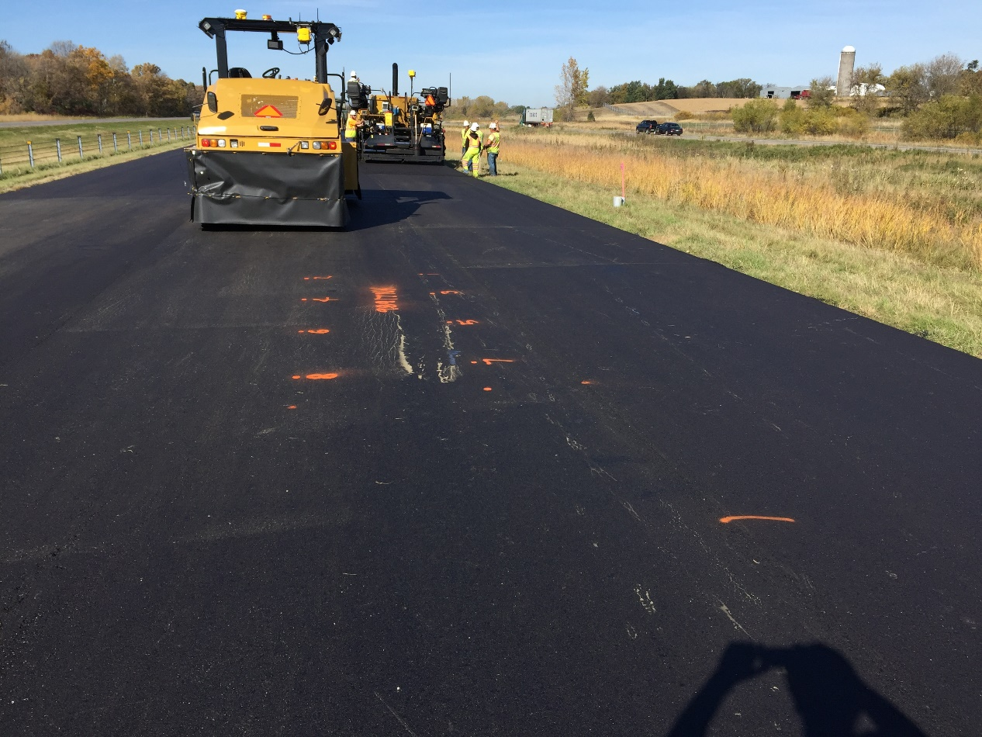
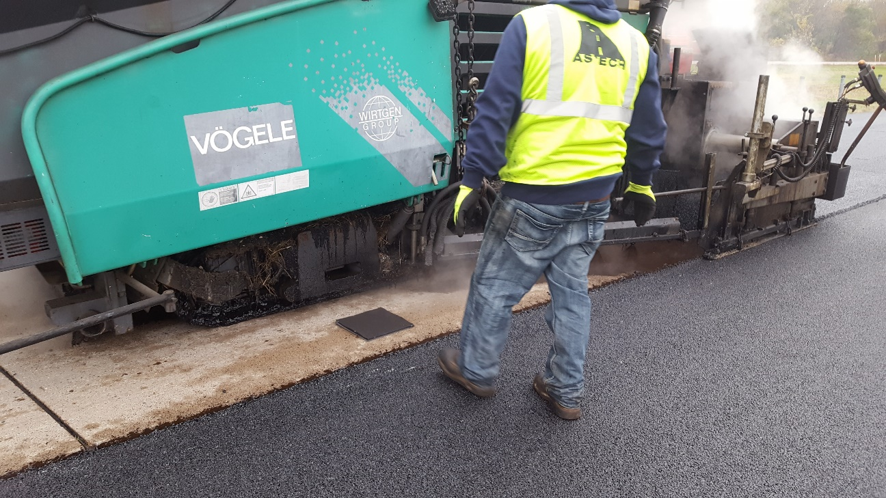
Overlay Cells
Cell 995 – Tacking Paver
Cells 989/990 – Superpave 5/Regressed

Slide 15
HMA Overlay and Rehab of Concrete and Methods of Enhancing Compaction
Research Efforts
Performance Testing (Workshop #3 Today)
Data collection
  Joint Openings
  Thermocouples
  FWD
  IRI
  Loading
  Distress Evaluation
Hamburg Wheel
IFIT
MIST
TSR
DCT
MN SCB
SVEDC
Ideal CT

Slide 16
  Long Term Research
Cold Central Plant Recycling (CCPR)
  Similar to Cold In-place Recycling (CIR), except uses of existing RAP stockpiles to make base layer
  Goals
    Documentation of the MnROAD experience with CCPR.
    Analysis of the performance of CCPR pavements and materials.
    Discussion of the cost-effectiveness of CCPR (including mix designs).
    Details on the CCPR construction state-of-the-practice.
    Discussion of agency concerns in developing a CCPR specification.

Slide 17
HMA Overlay and Rehab of Concrete and Methods of Enhancing Compaction
Selected Researcher
Technical Advisory Committee
American Engineering & Testing (AET)
  Dave Rettner
  Final Report – August 2020
Dave Van Deusen (MnDOT)
Randy West (NCAT)
Andy Cascione (Flint Hills)
Curt Turgeon (MnDOT)
Ed Johnson (MnDOT)
Zhanping You (MTU)
Barry Paye (WI)
Terry Beaudry (MnDOT)

Slide 18
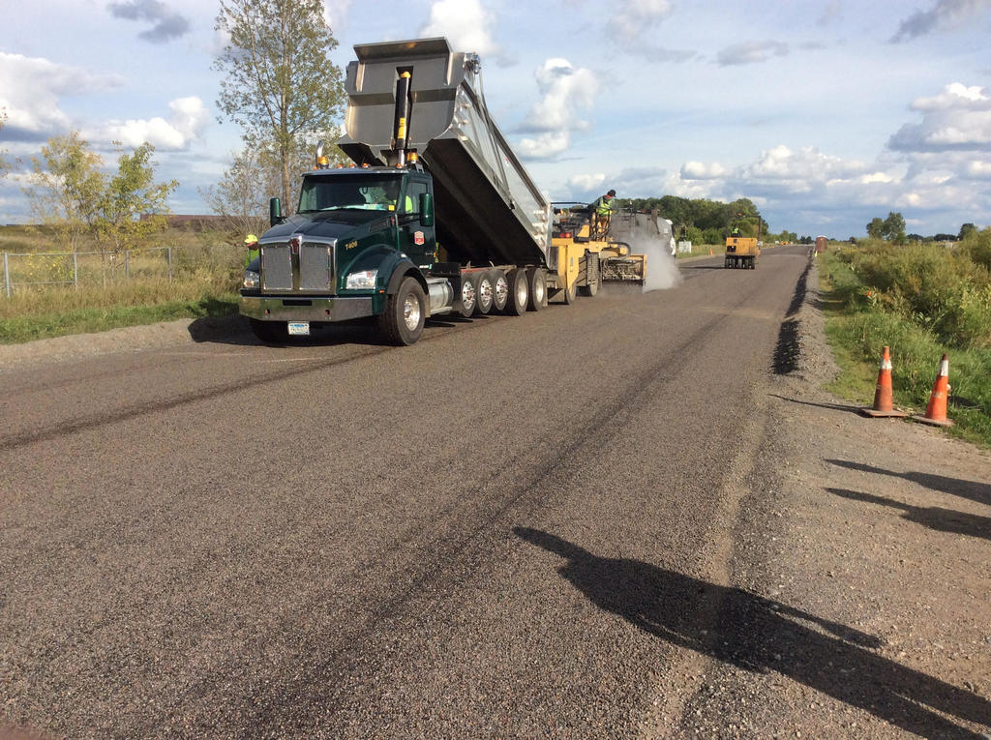
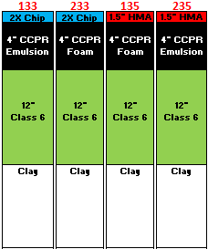
Cold Central Plant Recycling
  4 Test Sections
    Foam vs Emulsion
    2X Chip vs 1.5” HMA Overlay
  How can states be green in recycling but not impact long term performance?

Slide 19
Cold Central Plant Recycling
Field Data being collected:
  Strain Gauges
    Longitudinal
    Transverse
  FWD
  IRI
  Loading
  Distress Evaluation

Slide 20
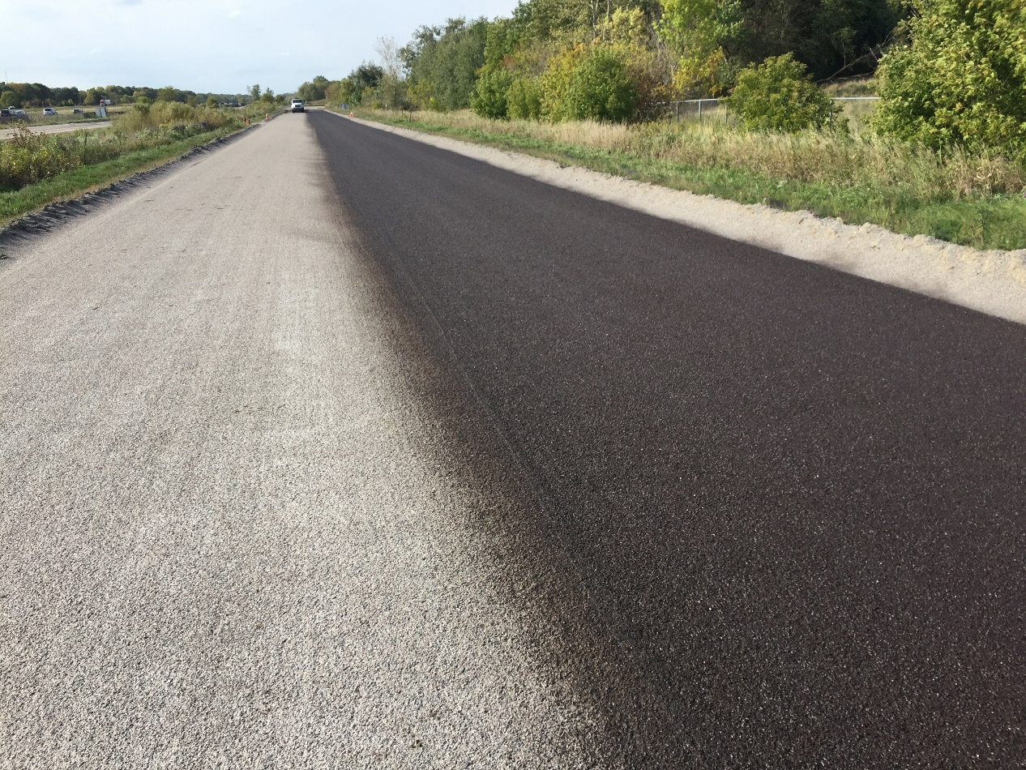
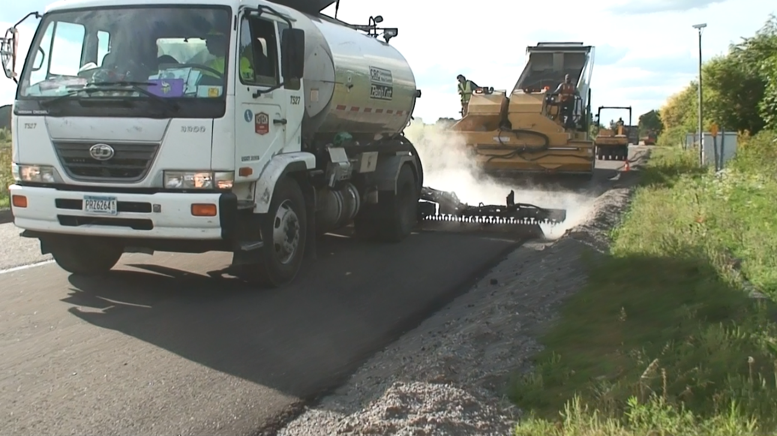
Cold Central Plant Recycling
Cell 133 Chip Application
Cell 233 Fog Seal

Slide 21
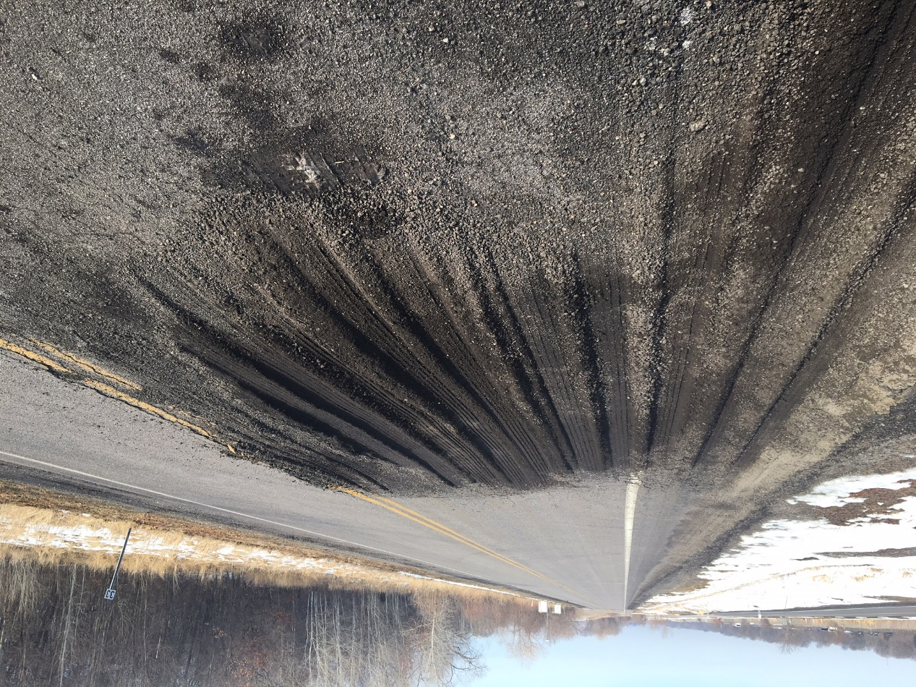
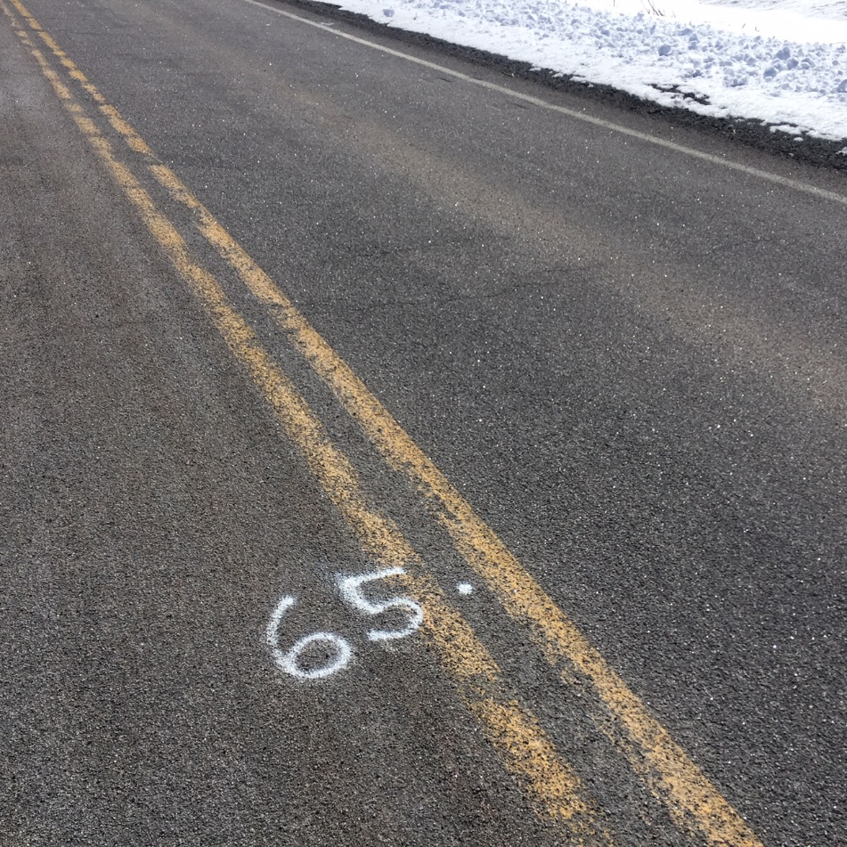
Cold Central Plant Recycling - Update
Spring Breakup – Double chip (233)
Cracking – Double chip (133)

Slide 22
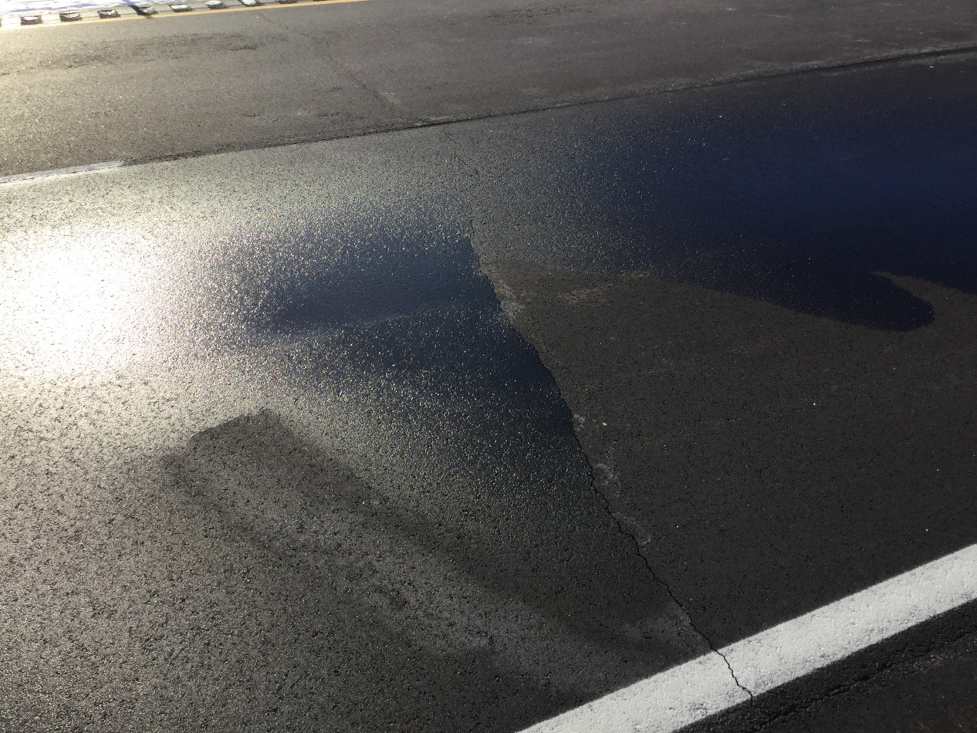
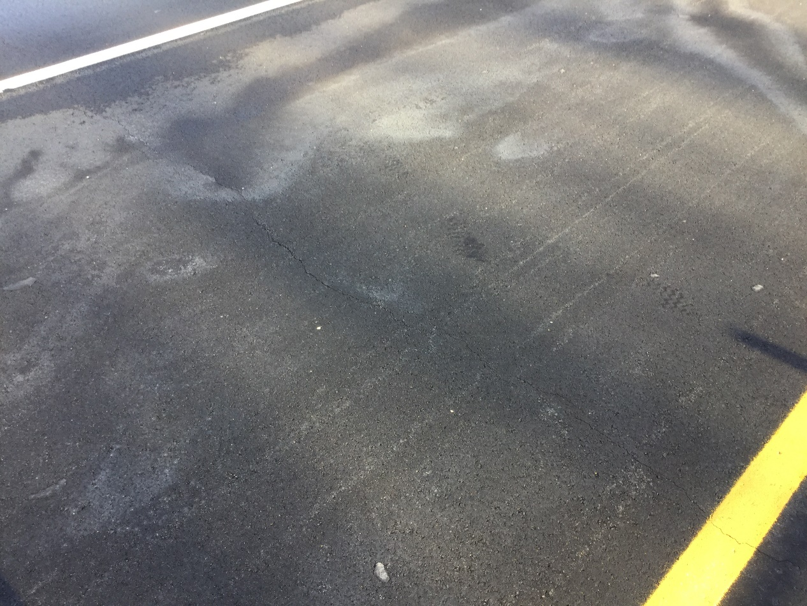
HMA Overlay & Enhanced Compaction - Update
Cell 984 – 9.5mm Overlay
Cell 992 – Interlayer with overlay

Slide 23


















































Thank You

