Slide 1

NRRA Hamburg Wheel Results
Barry Paye
Chief Materials & Pavement Engineer
NRRA Paving Workshop
May 23, 2018

Slide 2
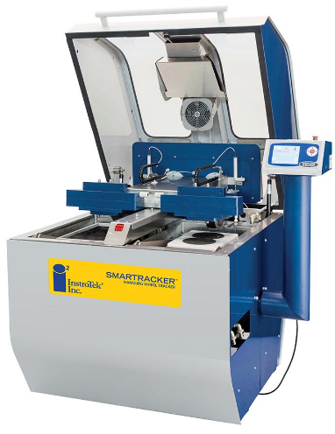
TESTING
InstroTek SmarTracker™ Hamburg Wheel
AASHTO T-324
  Modification: Tested at 45°C
All 58H-28 except
  58H-34 ON 12.5 TRAFFIC LEVEL 3
  58V-34 ON INTERLAYER

Slide 3
RESULTS
Mix ID | Cell Location | HWT Results Average of middle 7 data points |  |  | SIP Average | TRAFF LEVEL | AGG SIZE | BINDER | DES VOIDS
(SPWExxxxx) |  | (mm @ # passes)
A440E | 984, 987, 991-994 | 6.19 | @ | 20000 | 18995 | 4 | 9.5 | 58H-28 | 4
B340C | CCPR & LV | 12.5 | @ | 14405 | 12060 | 3 | 12.5 | 58H-34 | 4
B430E | 990 (Reg AV) | 6.75 | @ | 20000 | 18995 | 4 | 12.5 | 58H-28 | 3
B440E | 985, 986, 988 | 12.5 | @ | 19720 | 13962 | 4 | 12.5 | 58H-28 | 4
B450E | 989 (Sup 5) | 9.83 | @ | 20000 | 16797 | 4 | 12.5 | 58H-28 | 5
C440E | 987-991 | 6.34 | @ | 20000 | 18988 | 4 | 19 | 58H-28 | 4
D430I | 992 (Interlay) | 11.25 | @ | 20000 | 15171 | 4 | 4.75 | 58E-34 | 2.0-3.0
D440E | 201, 215 (PP) | 12.5 | @ | 9916 | 7319 | 4 | 4.75 | 58H-28 | 4

Slide 4
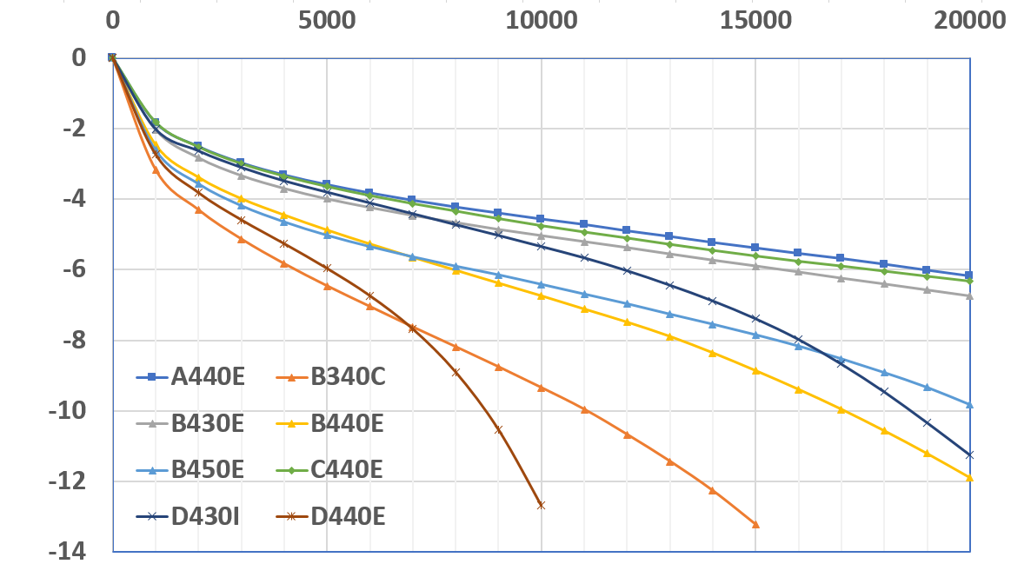
NUMBER OF PASSES
RUT DEPTH

Slide 5
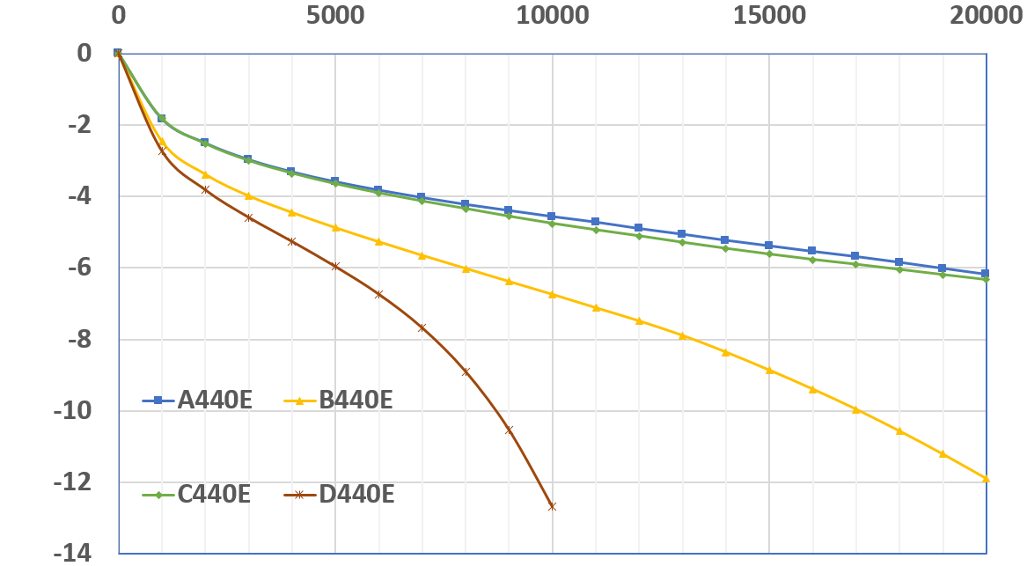
VARY GRADATION
19.0
9.5
12.5
4.75

Slide 6
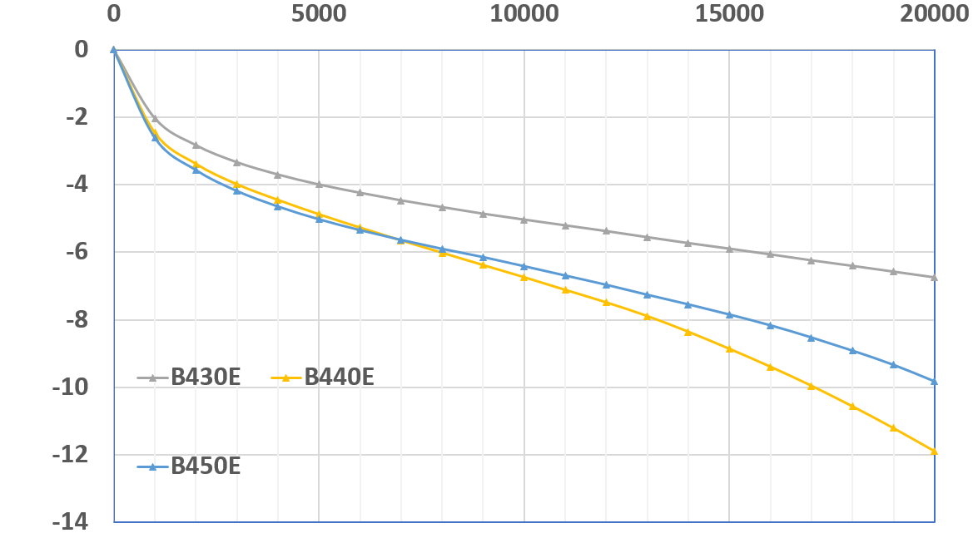
VARY DESIGN AIR VOID 12.5mm MIXES
3.0 REGR
SP 5.0
4.0

Slide 7
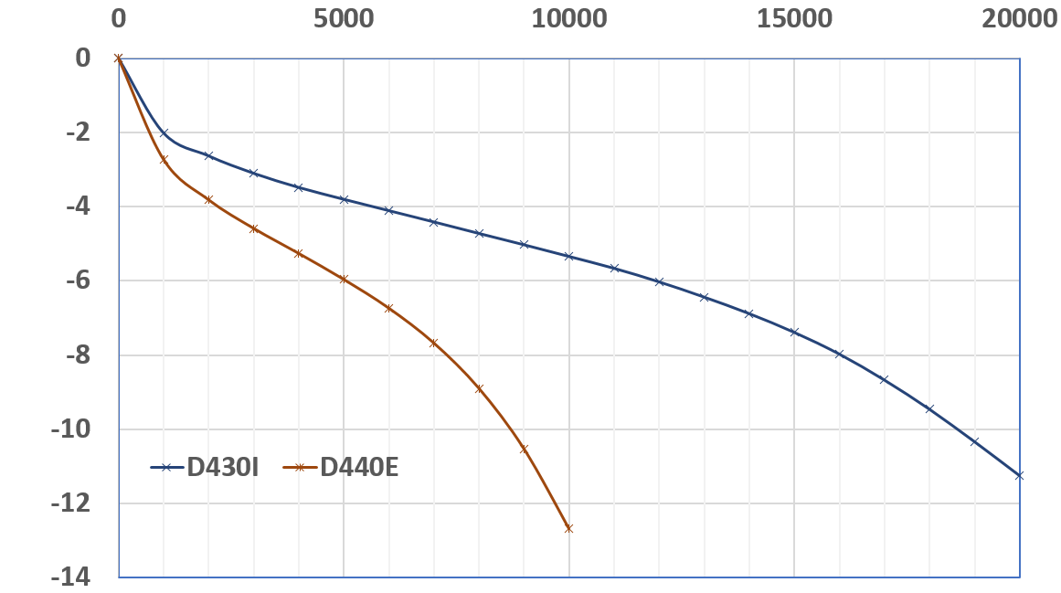
4.75mm MIXES
V BINDER INTERLAYER
H BINDER

