Slide 1


2018 Pavement Workshop
May 23-24, 2018
I-FIT and Illinois’ Experience
Brian Pfeifer
Engineer of Materials
+ 46 Associate Members

Slide 2
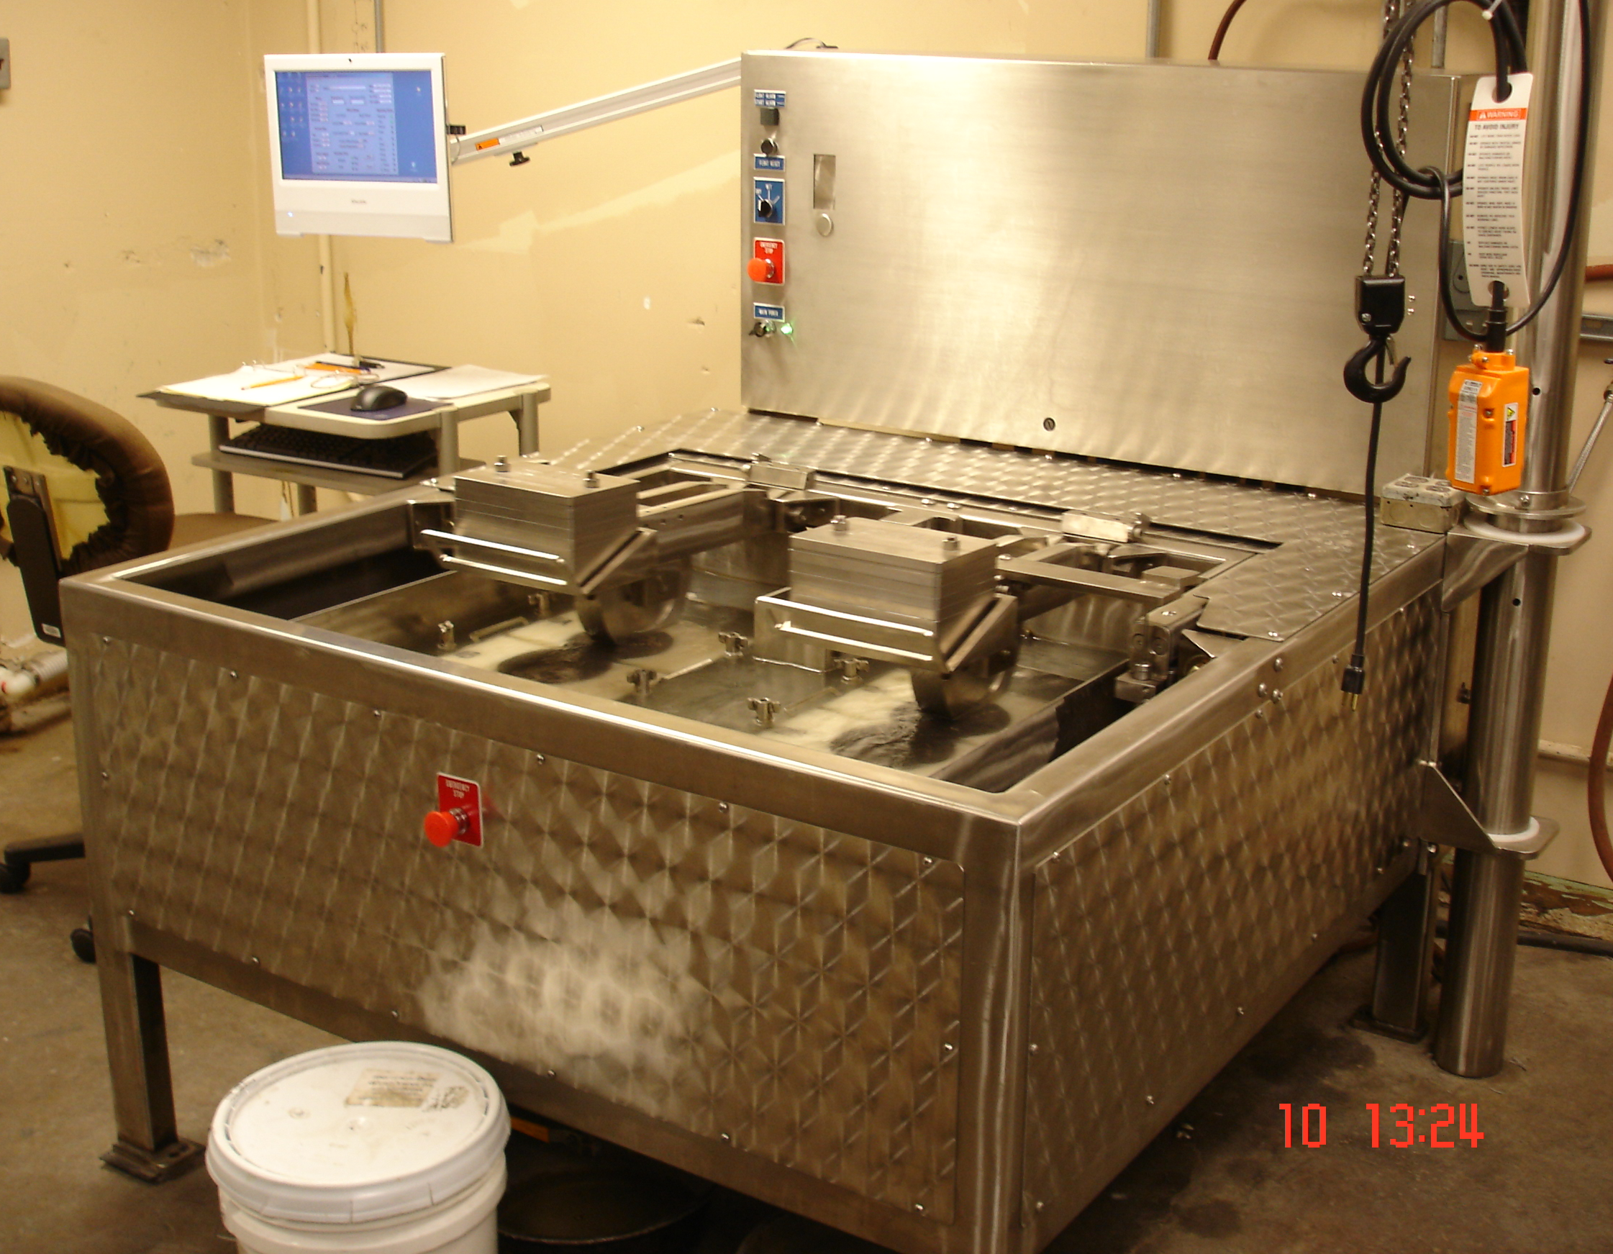
Hamburg Wheel Tracking Test
2011 Trip to TXDOT
50° C, 12.5 mm
Mix Design and Production Testing
PG High Temp | Passes
58 and lower | 5,000
64 | 7,500
70 | 15,000
76 and higher | 20,000

Slide 3
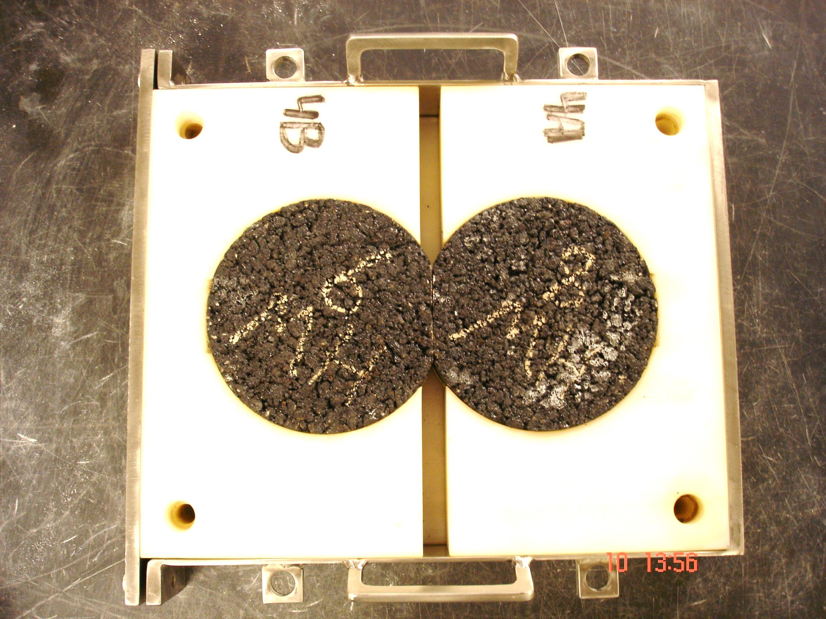
HWTT Implementation
All Mixes and Projects in 2013
Annual Uniformity Study
  Six rounds since 2012
  Currently 27 machines
Lessons Learned
  Greater proportion of manufactured sand
  Relaxed criteria (58 & 64 were 10,000 passes)

Slide 4
Recycled Materials
Reclaimed Asphalt Shingles (RAS) Introduced
Exploring Higher Asphalt Binder Replacement (ABR) Levels
Improved Rutting Resistance
Cracking Resistance – Investigation in 2012

Slide 5
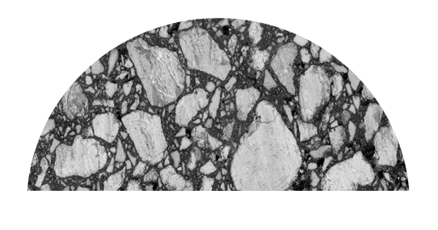
Illinois Center for Transportation
“Testing Protocols to Ensure Performance of High Asphalt Binder Replacement Mixes…”
Professor Imad Al-Qadi, PI
Cracking Resistance
Simple, Inexpensive

Slide 6
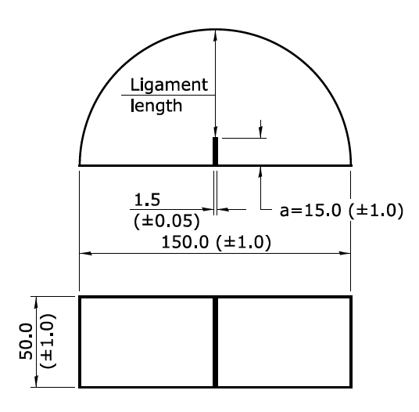



Illinois Flexibility Index Test
ITP 405/AASHTO TP 124
Conditioning
  25°C ± 0.5°C for 2.0 ± 0.5h
Load Line Displacement Loading Rate
  50mm/min
$$FI=\frac{G_{f}}{100\left|m\right|}$$
$$m$$
$$G_{f}=\frac{\int_{0}^{u_{f}}{P\left(u\right)du}}{b∙L}$$
(Units in mm)

Slide 7
Fracture Energy & Flexibility Index
N90 (30% ABR)
Fracture Energy = 1780 J/m²
Flexibility Index = 6.2
N90 (Control)
Fracture Energy = 1790 J/m²
Flexibility Index = 11.3

Slide 8
FHWA ALF Sections – I-FIT Testing
WMA/RAP/RAS Sections
23% Reduction in Cycles to Failure
Current Minimum Threshold =
8.0

Slide 9
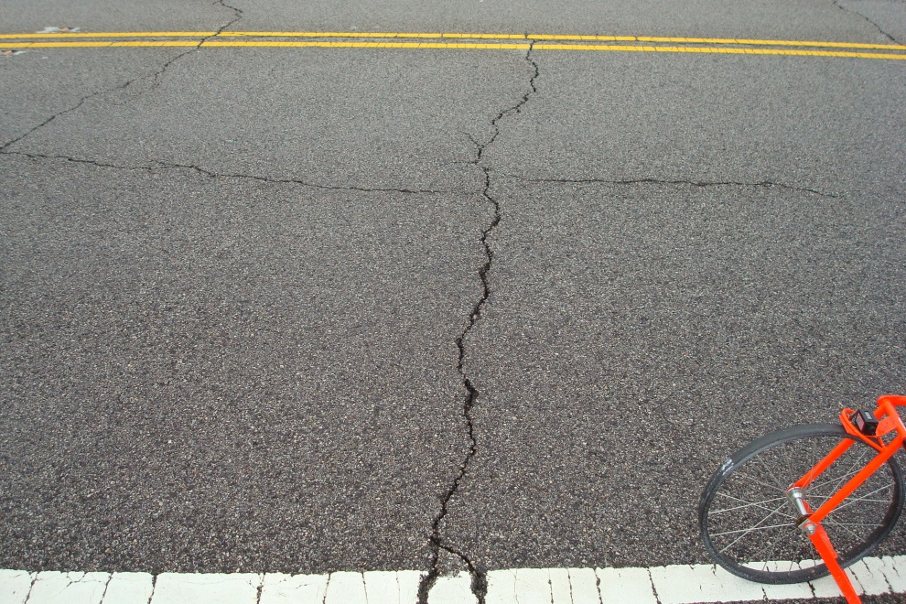
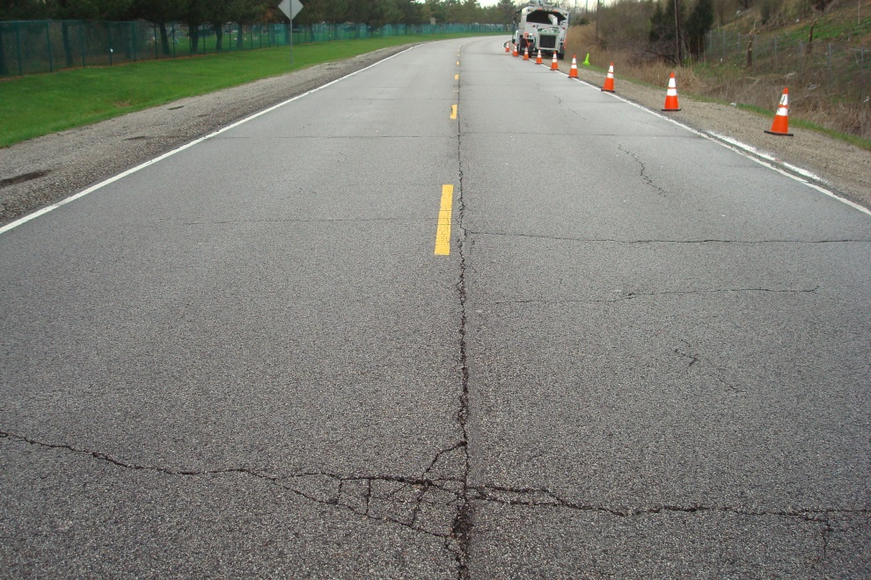
ICT Report: “Utilizing Lab Tests to Predict
Asphalt Concrete Overlay Performance”
Three High ABR Sections (Up to 60%) in 2013
Five Sections in 2014 & 2015 (15-48% ABR)
Detailed Crack Surveys Through 2017
FI = 0.9
56% ABR
4 yrs. old

Slide 10
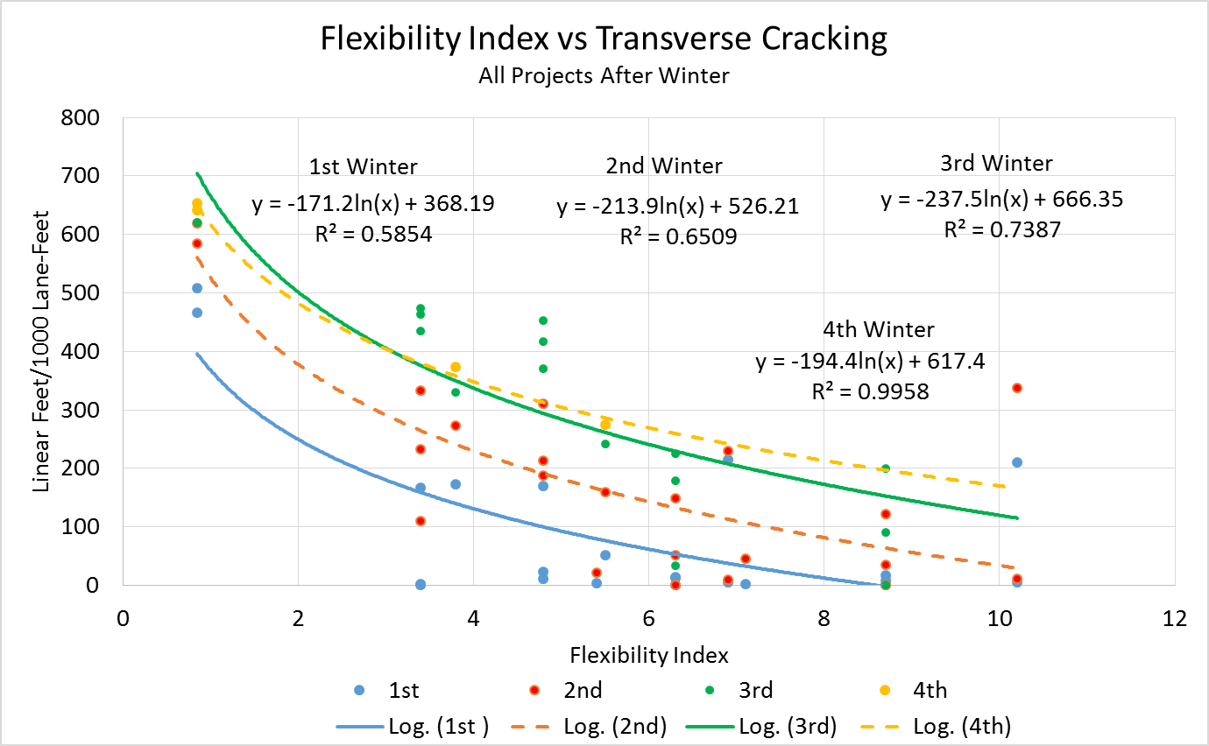
ICT Report: “Utilizing Lab Tests to Predict
Asphalt Concrete Overlay Performance”
Figure 8.1

Slide 11
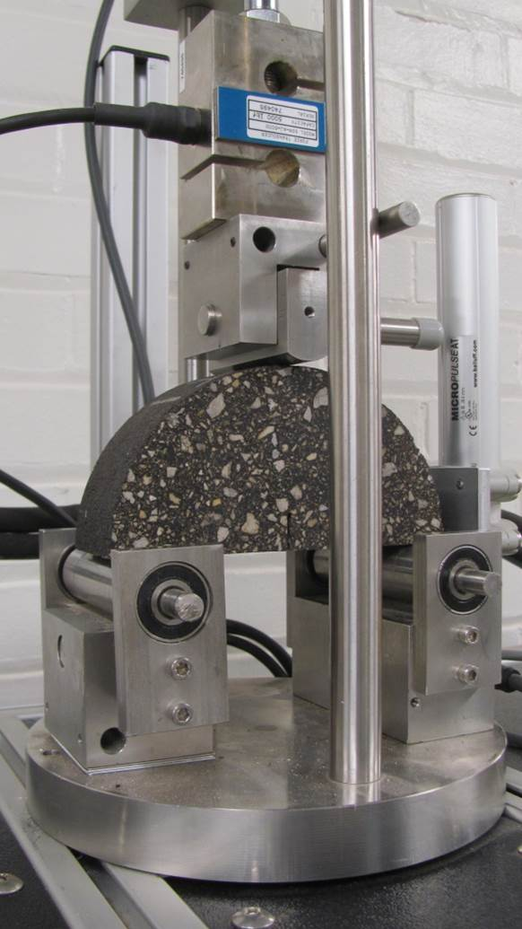
I-FIT Testing at IDOT
Central Lab and 9 District Labs
Mostly Plant-Produced Samples
Results from Over 600 Mixes

Slide 12
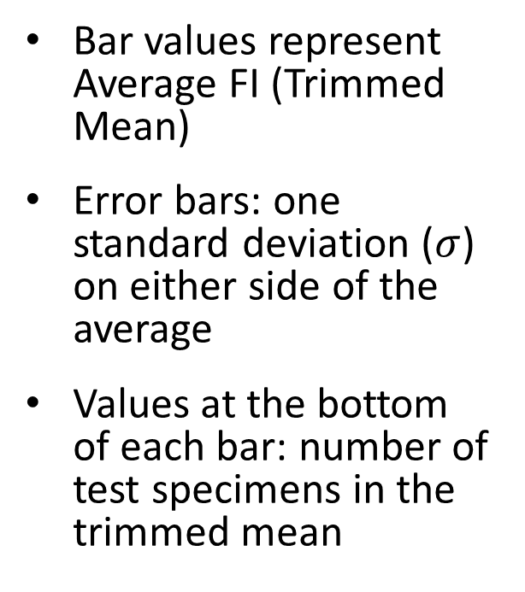
Plotting Methodology
Bar values represent Average FI (Trimmed Mean)
Error bars: one standard deviation ($σ$) on either side of the average
Values at the bottom of each bar: number of test specimens in the trimmed mean

Slide 13
Effect of LT Grade (Plant/Lab Specimens)

Slide 14
Effect of Virgin AC

Slide 15
Effect of ABR

Slide 16
Effect of SBS Polymer Modification

Slide 17
Findings
Lower AC low temperature grade increased FI
Increases in VMA and Virgin AC Content lead to increased FI
Increases in ABR lead to reductions in FI
Increased FI with SBS Polymers
FI Decays with Time

Slide 18
ICT Study on Machine Variability
Evaluated Effect of Machine Type and Fixture Configuration
  Servo-hydraulic and screw drive
  Spring and bearing rollers
Eight Mixtures (Six from MnROAD)
Device Configurations Found to Have No Significant Effect on FI Results

Slide 19
2017 I-FIT Uniformity Study
30 Machines: IDOT (10), WisDOT, InDOT, Private Labs (15), and ICT (3)
Round 1: Specimens Prepared and Cut at Central Lab
Round 2: Specimens Cut at Each Lab
Round 3: Loose Mix Sent to Labs

Slide 20
2017 I-FIT Uniformity Study
Average FI Values of 4.7, 4.5, and 5.9
Investigating Gyratory Height as Possible Cause of Higher Round 3 Average
Standard Deviation of Average FI Values:
  1.10, 0.80, and 1.65

Slide 21
2018 Uniformity Study Approach
Added MODOT, NCAT, and two IL labs
Round 1
  160mm gyratory
Round 2
  150mm gyratory
Round 3
  115mm gyratories

Slide 22
Round 1 Results
I-FIT Round Robin - 160mm Gyratory Height
Test Group | Number of Test Sets | Avg. G_{f}* (J/m²) | Avg G_{f} COV (%) | Avg. Slope (kN/mm) | Avg Slope COV (%) | Avg. FI | Individual Lab FI COV (%) | Population FI COV (%)
IDOT | 10 | 2522.1 | 8.1 | 1.0 | 17.8 | 25.3 | 15.7 | 19.9
Private | 17 | 2422.3 | 9.4 | 1.2 | 15.4 | 21.5 | 18.1 | 26.3
Other States and University | 7 | 2461.3 | 4.3 | 1.0 | 9.2 | 24.9 | 10.0 | 22.1
All Machines | 34 | 2459.7 | 8.0 | 1.1 | 14.8 | 23.3 | 15.7 | 24.5

Slide 23
Effect of Gyratory Height
I-FIT Round Robin - Round 1 – 160mm Gyratory
Test Group | Avg. FI | Individual Lab FI COV (%) | Population FI COV (%)
All Machines | 23.3 | 15.7 | 24.5
I-FIT Round Robin - Round 2 – 150mm Gyratory
Test Group | Avg. FI | Individual Lab FI COV (%) | Population FI COV (%)
All Machines | 22.0 | 14.7 | 26.9
I-FIT Round Robin - Round 3 – 115mm Gyratory
Test Group | Avg. FI | Individual Lab FI COV (%) | Population FI COV (%)
All Machines | 22.8 | 13.0 | 20.9

Slide 24
2018 I-FIT Uniformity Study
N50 D Surface Mix (Design PG 64-28)
Asphalt Grade | Total Asphalt Content | ABR | VMA | VFA | RAP
PG 64-28 | 6.1% | 9.8% | 15.9% | 74.8% | 10.0%

Slide 25
2018 Uniformity Study Findings
No Consistent Trends with Gyratory Height
Individual Lab COVs for FI < 16%

Slide 26
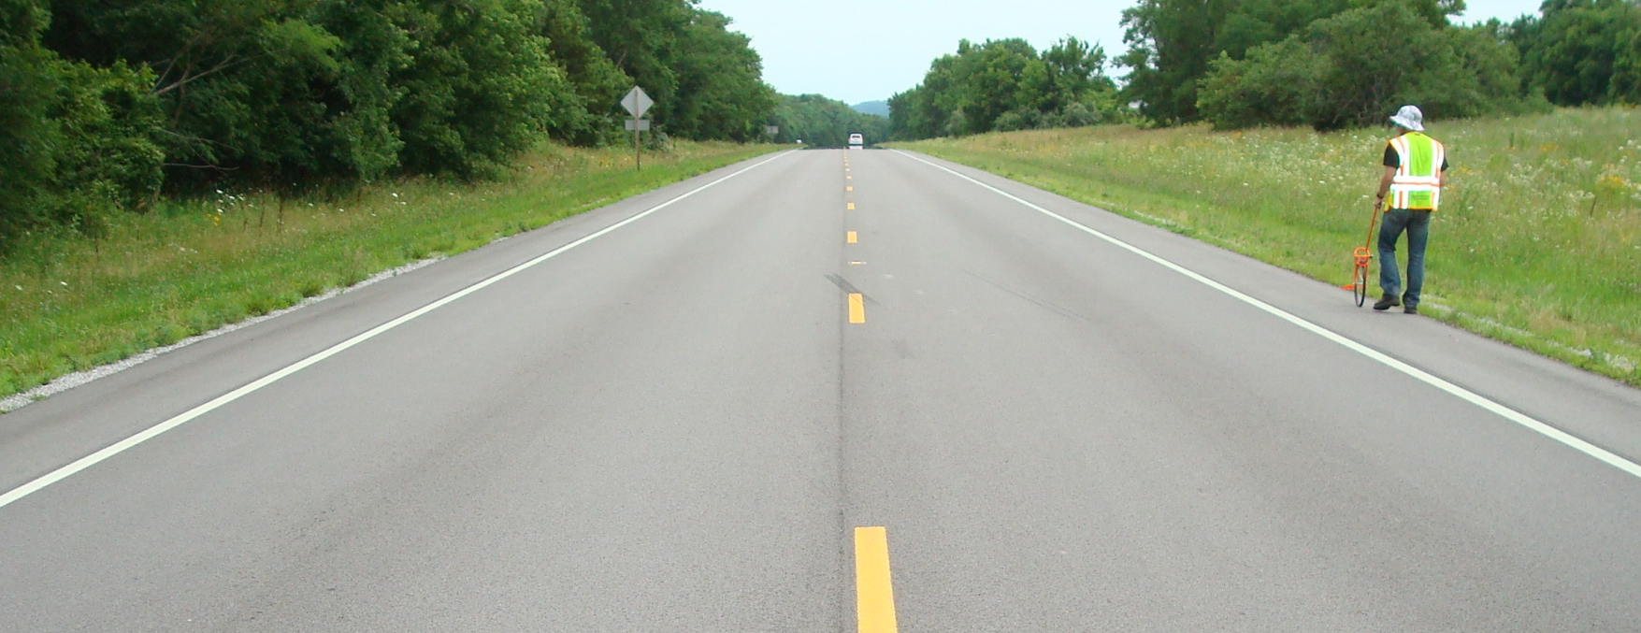
Pilot Projects in 2016
11 Projects Across All 9 Districts
Mix Design and Production Testing, HW & I-FIT
Coring and Distress Surveys (5+ Years)

Slide 27
2016 Pilot Projects – FI Results

Slide 28
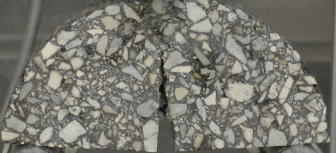
BMD (HW/I-FIT) Implementation
15 Projects Awarded in 2017
Additional Projects in 2018 (29 or more)
All Interstate Projects in 2019
All Projects in 2020

Slide 29
Task Force with Industry & FHWA
Mix Design Requirements/Expiration
Allow Higher Asphalt Binder Replacement
Production Testing, Running Average
Considering FI > 8.0 for SMA
  Williams Street SMA at 20 Years, FI=4.5 for surface and FI=12 and 18 for binder lifts

Slide 30
Long Term Aging
ICT Study Correlating LTA Protocol with Field Performance
Oven Aging of I-FIT Specimen at 95⁰ C
Threshold Expected Around FI=4.0
Evaluating Binder Additives and Modifiers

Slide 31
NCAT/MnROAD Cracking Study
NCAT, 7 Sections (2015), 10M ESALs
  Density, RAP/RAS, HiMA, AZ GTR
MnROAD, 8 Sections (2016)
  RAP/RAS, binder grades, HiMA
Six Cracking Tests, Including I-FIT

Slide 32
Acknowledgments
Illinois Department of Transportation
Matt Mueller (retired), Jim Trepanier, Tom Zehr,
Brian Hill, Joe Rechner
Illinois Center for Transportation
Imad Al-Qadi, Hasan Ozer, David Lippert

Slide 33


















































Thank You

