Slide 1


Introduction
Luke Pinkerton, PE
Helix Steel
Notes:
Slide 1 - Story
Intro –LP , background
Start with a drawing I came across that my daughter did with sidewalk chalk at her school playground
Chalk while not many people remember it in the classroom anymore is brittle and weak in tension like concrete
Concrete really not a good material because of this.
We bandaid it with rebar – placing it where there is need for tension resistance and ductility but is time consuming, dangerous to install
Worst, it does not evey carry load until the concrete its embedded in cracks which leads to water infiltration and corrosion and deteriortization – it really makes little sense to use it at all!
As a result we see stories like this one all the time - $10 million in repairs for roads, long closures, there was even a story last week about chunks of concrete hitting cars on 696 in Detroit

Slide 2
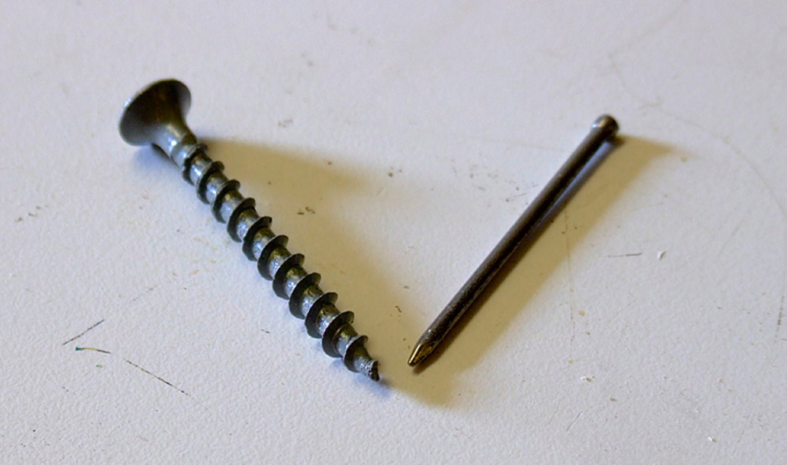
Notes:
Side 3. – Screw vs Nail
How is this possible? By making the concrete better. Instead of just giving up on it and letting it crack as we do with rebar, we turn it into a true composite material just like they use in aircraft
This was made possible by a simple concept, the screw vs the nail…. To make a composite you need very stiff reinforcement with very good bond to the concrete.
Everyone know a nail just does not hold as well as a screw.
The combination of a twisted shape and high tensile steel enabled this where other attempted had failed because concrete is so brittle, the fibers they tried either slipped or in the case of plastic stretched allowing cracks to form before adding any strength. At that point is too late

Slide 3
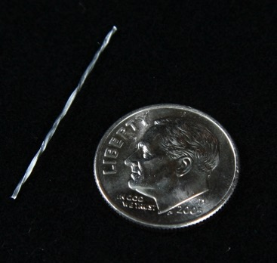
Helix 5-25
Steel wire tensile strength: 246 ksi (1700 MPa) minimum
Electroplated zinc coating: 3 g/m³
Length: 1.0 inch (25 mm)
Equivalent diameter: 0.020 inch (0.5 mm)
Rectangular Cross Sectional Shape
Twisted
>11,000 parts per pound
Notes:
Slide 5 - Untwist
Another key to the Helix twist is in the event of a crack in the concrete it changes the failure mechanism from slipping, like the nail, to untwisting.
This untwisting as you can see here provides stable tensile resistance even after the concrete cracks, just like rebar does as it stretches. (red curve)
This is a piece of Helix being pulled out of a block of concrete, you can see it literally untwisting as it does so.

Slide 4
Compressive strength improvement
Notes:
Slide 6 - Compression
Ironically we most commonly test the only property of concrete that is decent, compression.
Helix actually increases compressive strength and strain at failure and it makes compressive failures more ductile
Opens the door to thinner structures without need for compression rebar to assure ductility

Slide 5
Team
NRRA/MnDOT
CTS
Ben Worel
Jerry Geib
Jim Hansel
Matt Ross
Ken Vallens
Helix Steel would like to thank NRRA for quick opportunity for Research

Slide 6
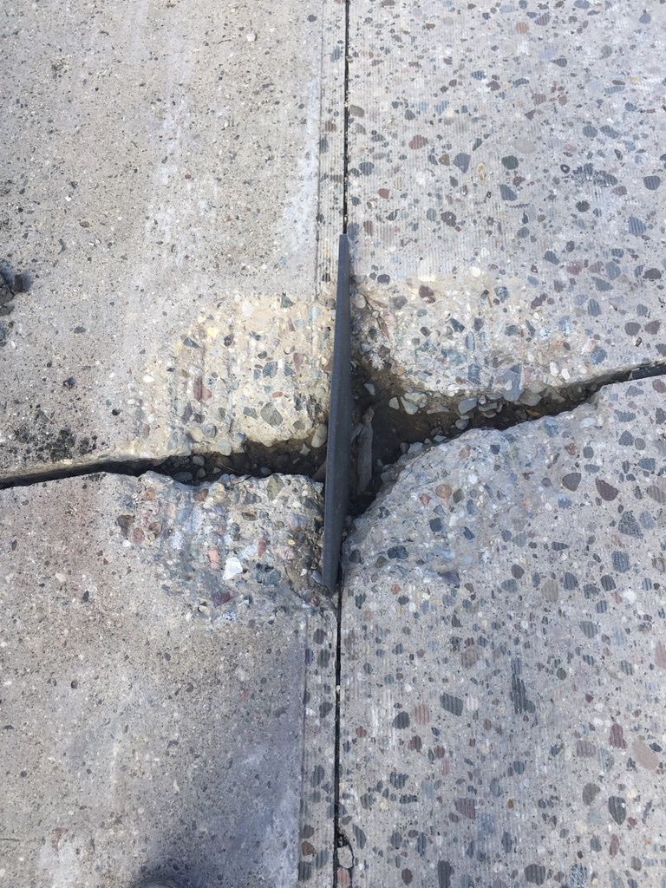
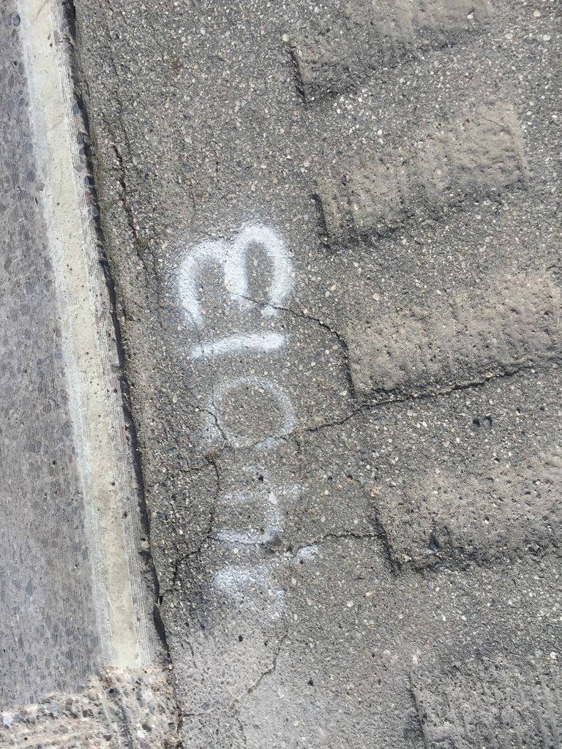

Slide 7
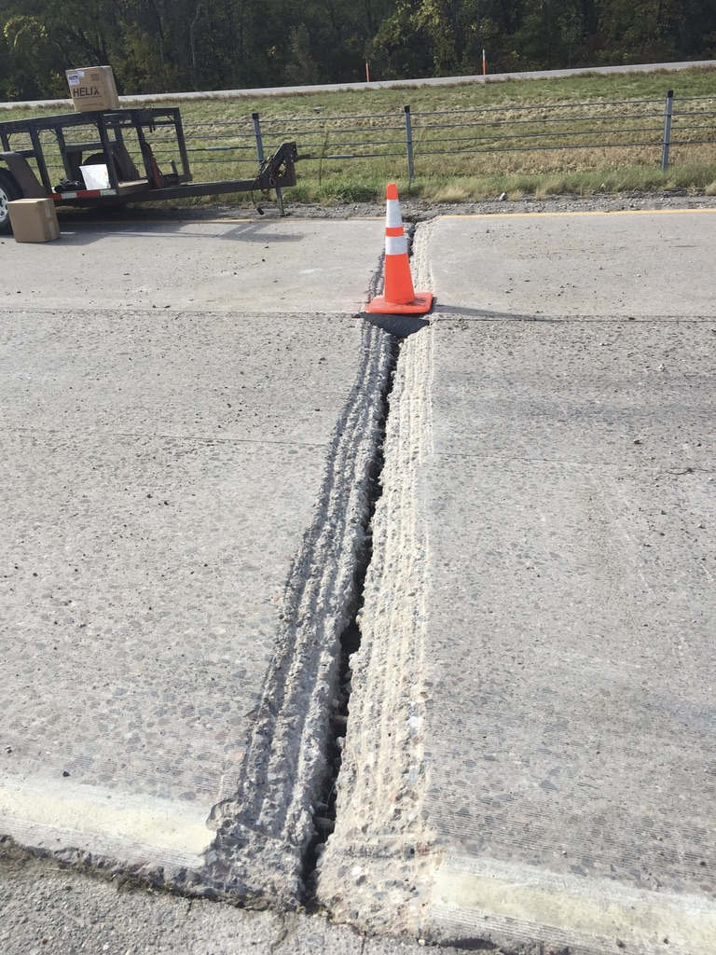
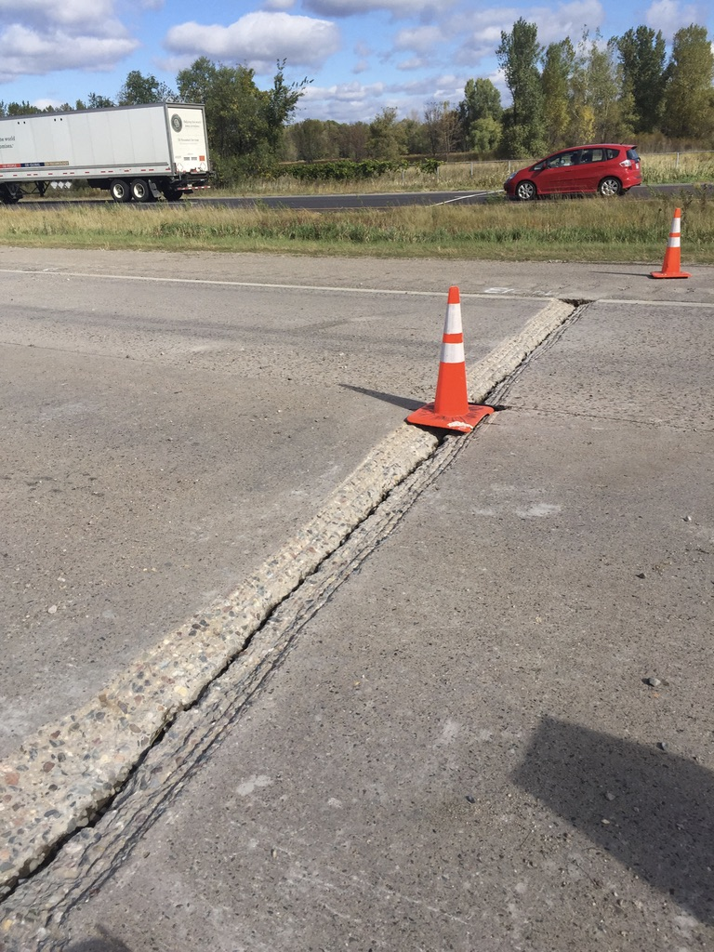

Slide 8
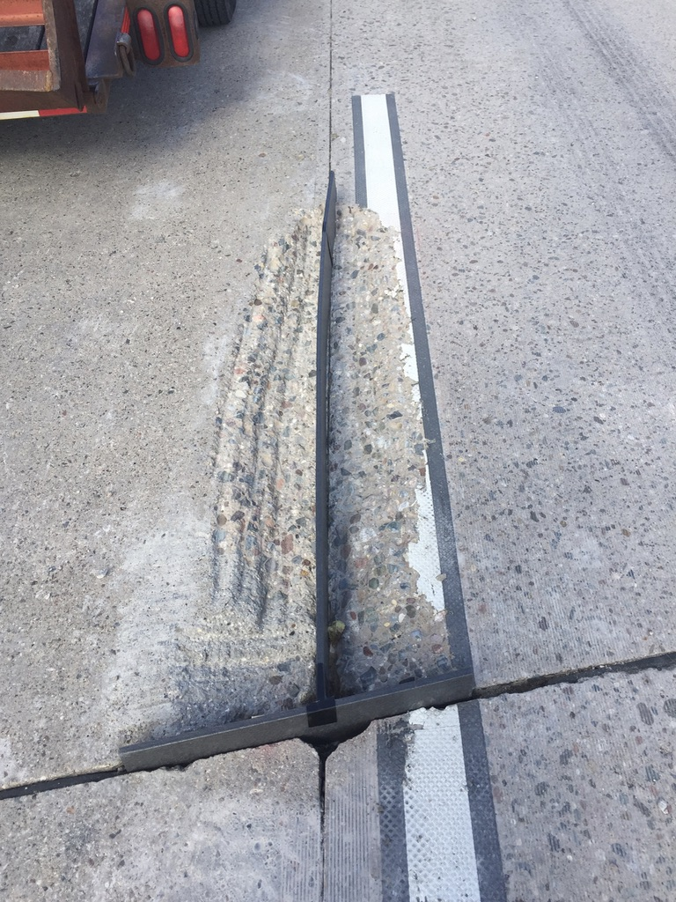
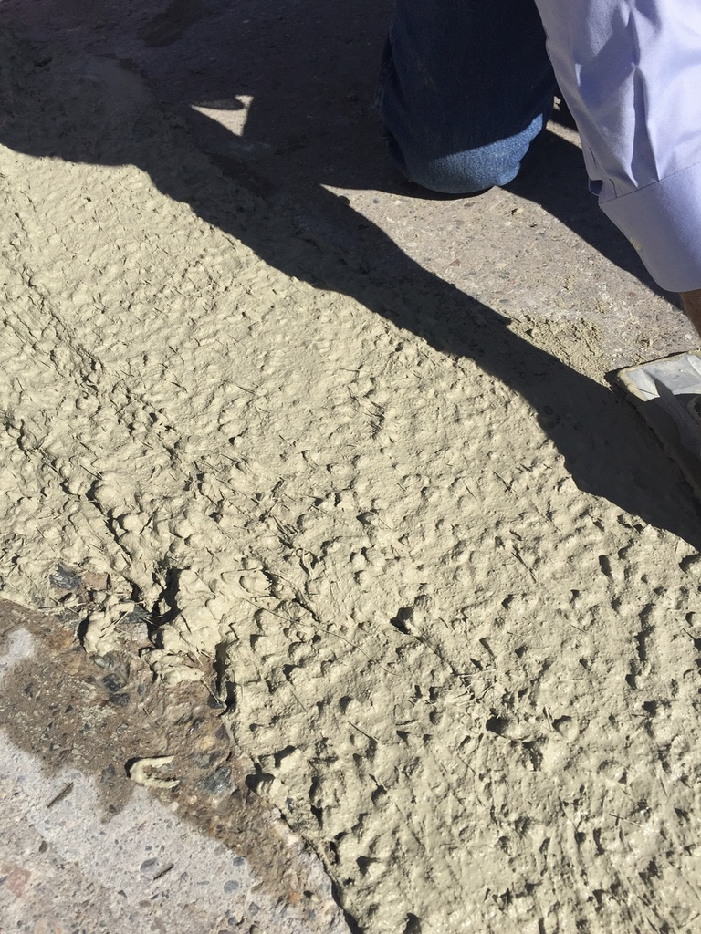

Slide 9
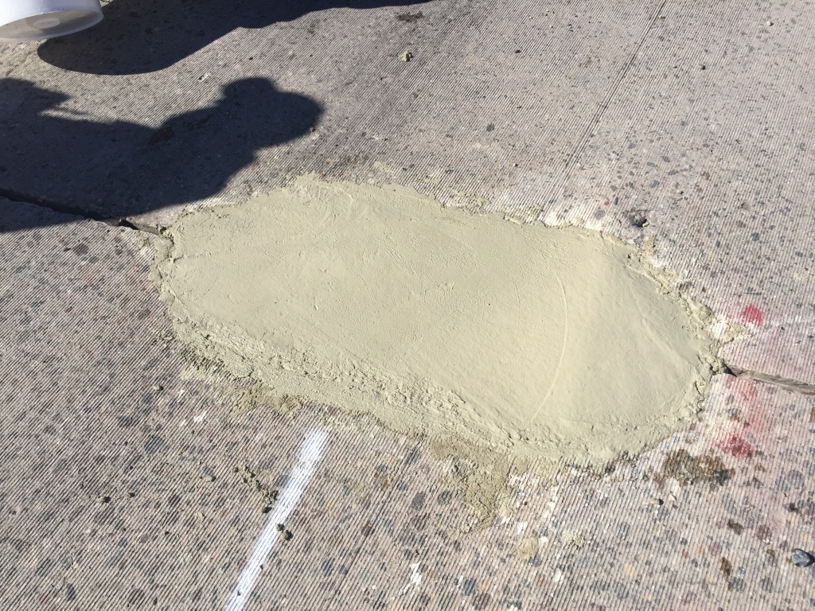

Slide 10
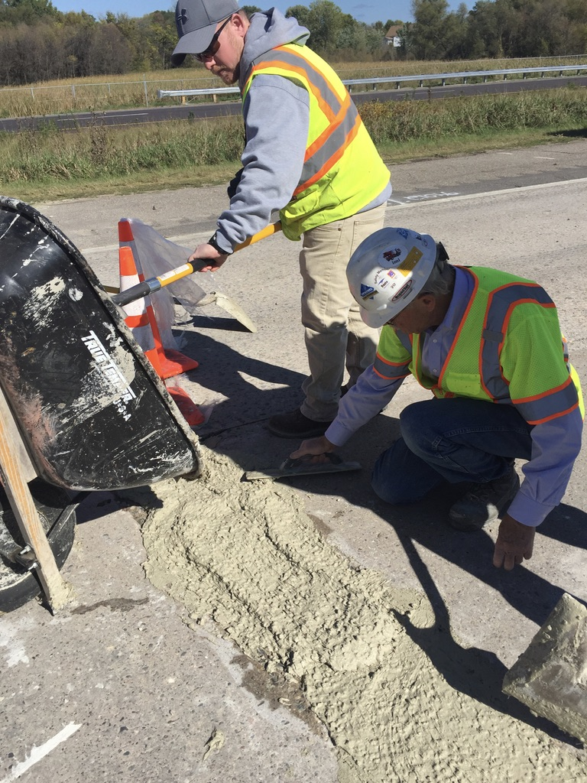


Slide 11
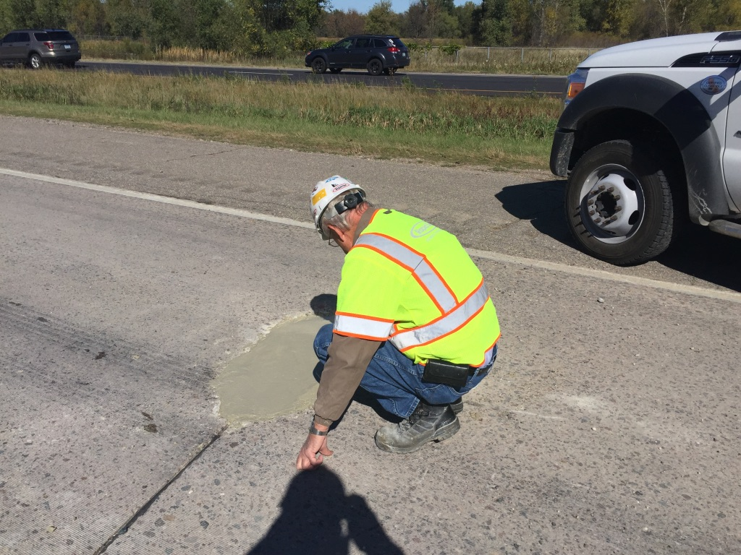

Slide 12
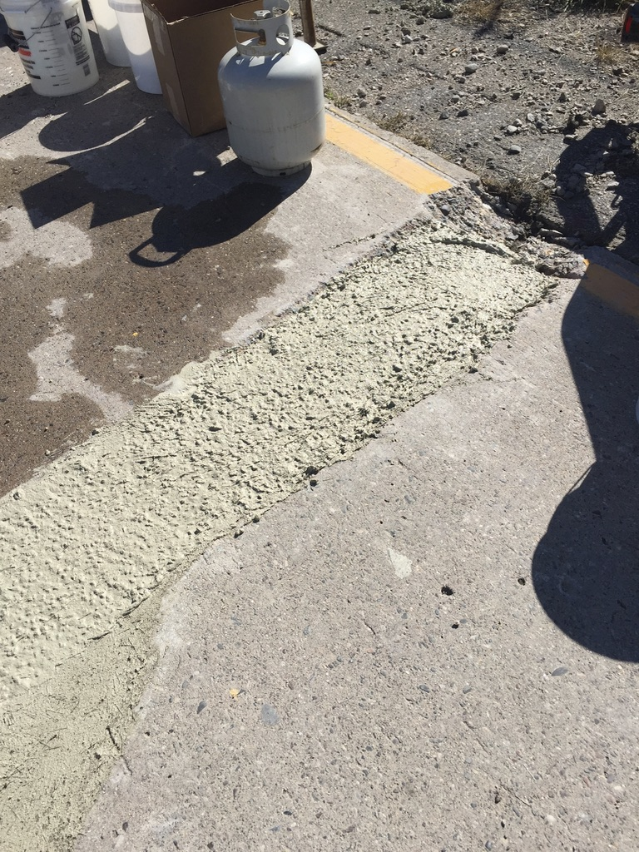
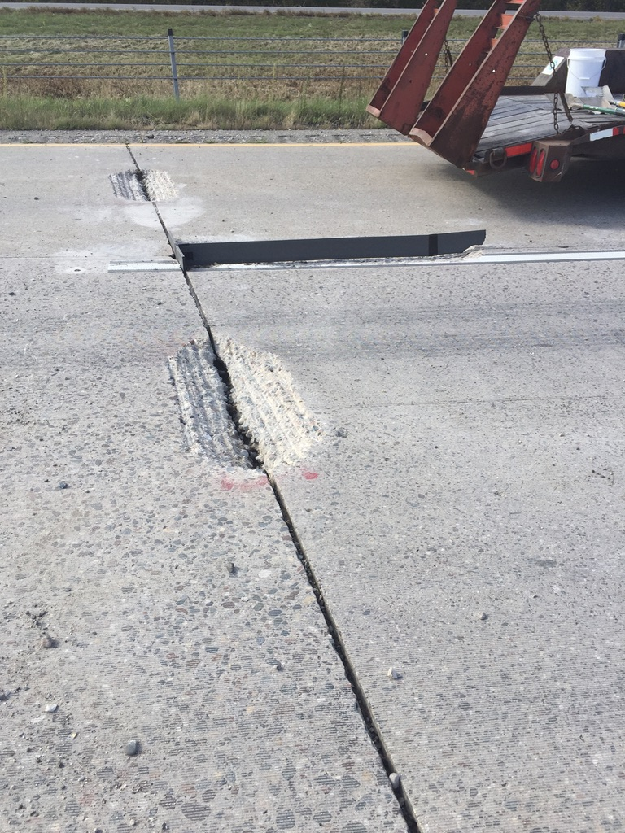

Slide 13
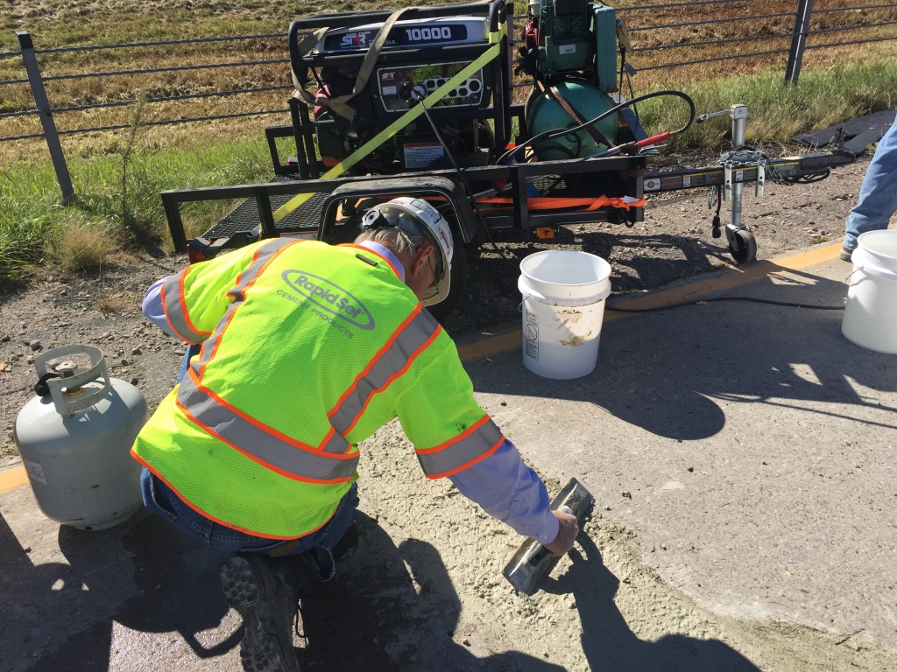

Slide 14
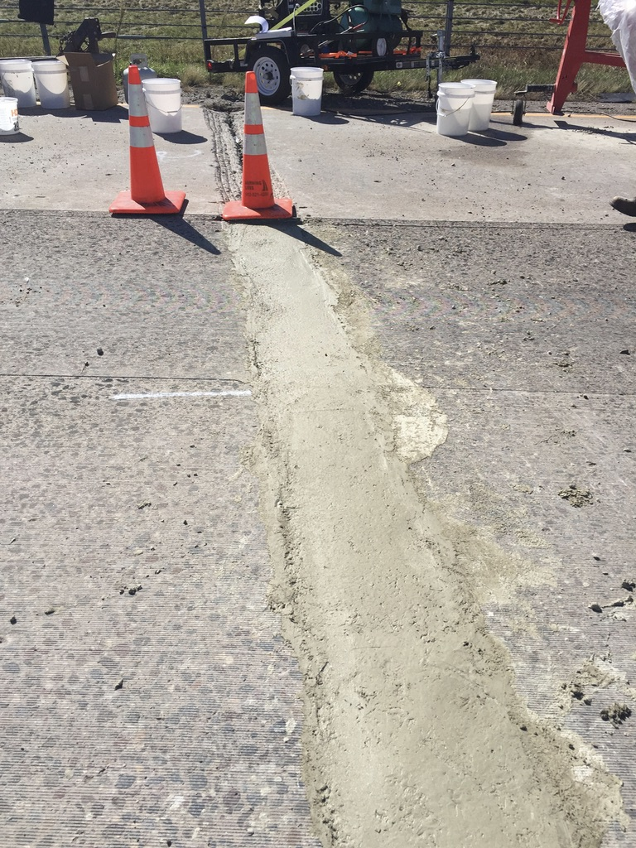

Slide 15
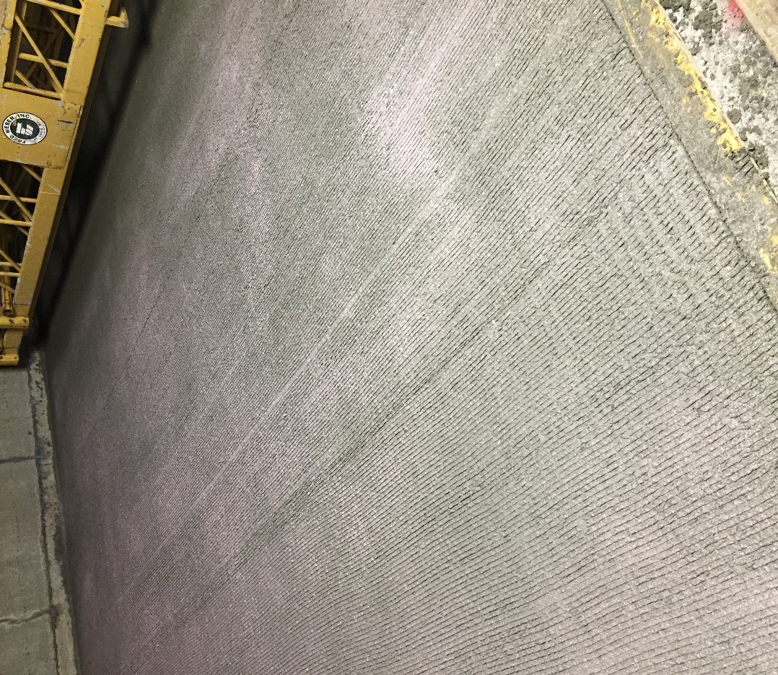
Applications
Bridge Decks
Pavements
Precast
Foundations
Walls
And Many More

Slide 16
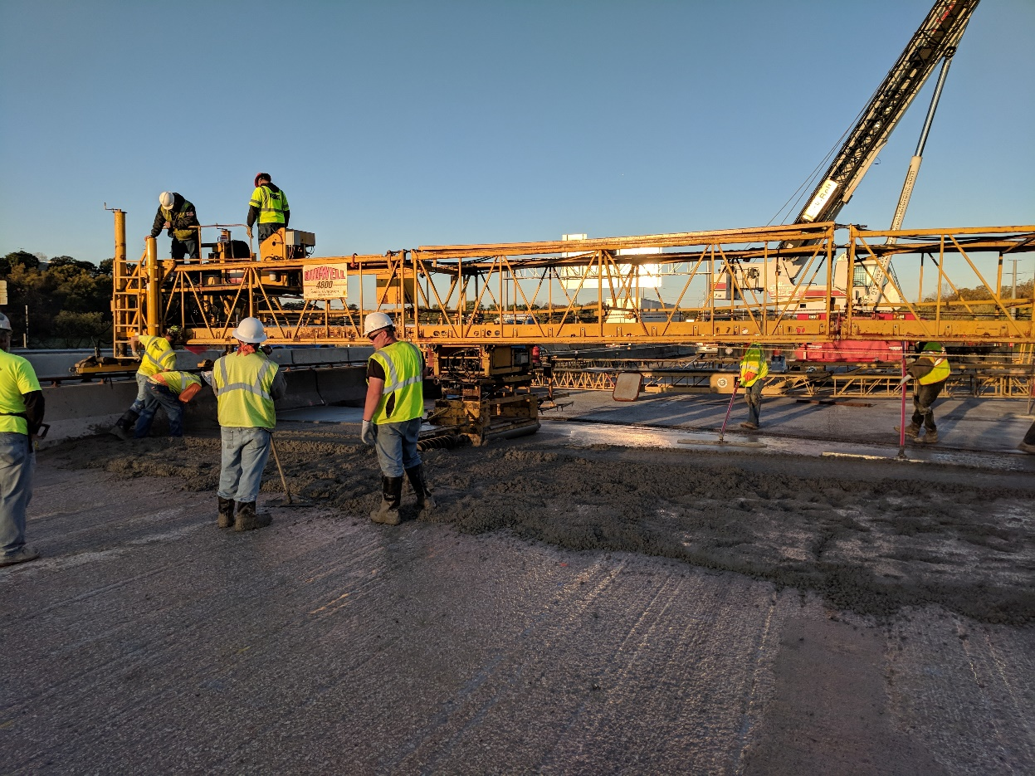
Advantages
Resiliency
Durability
Time/Labor Savings
Speed
Correct Placement
Safety

Slide 17
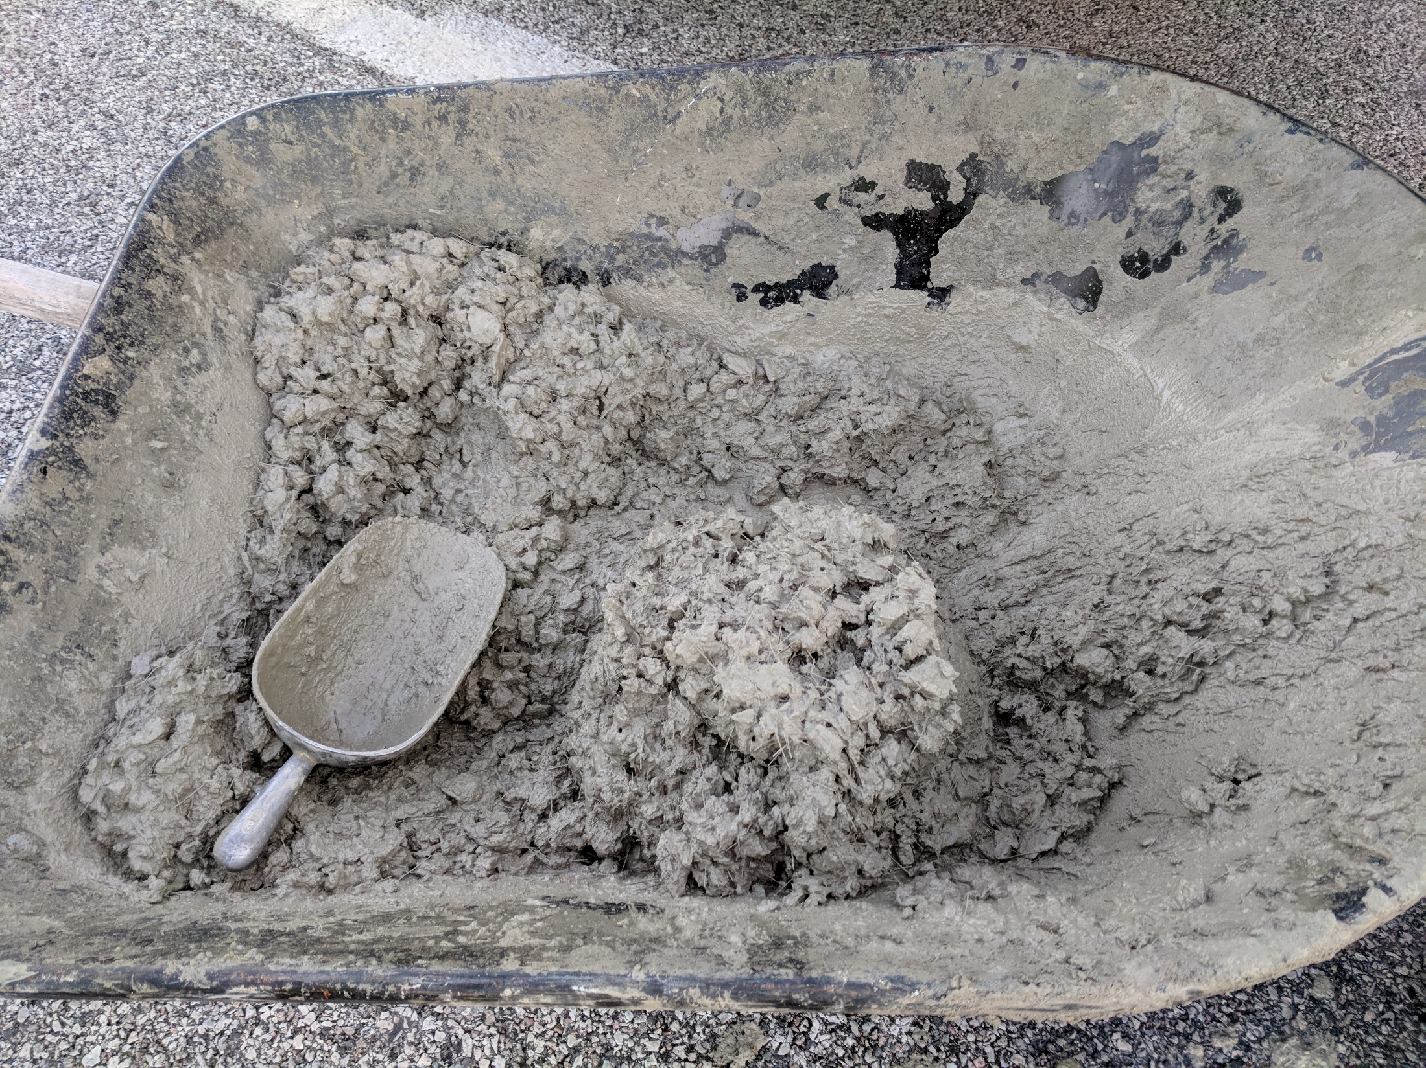

Slide 18
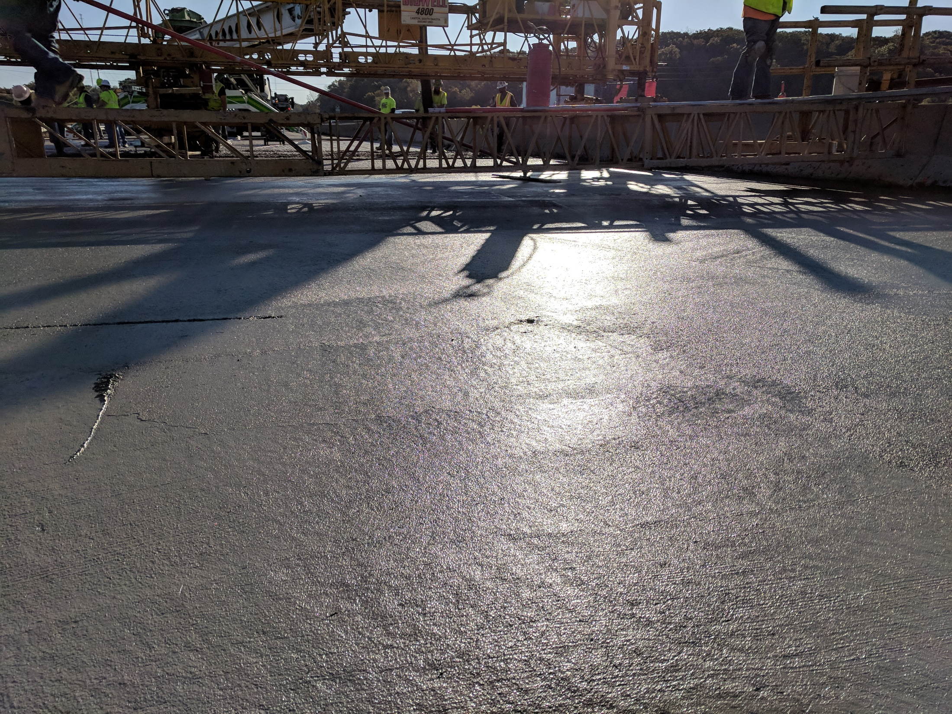

Slide 19
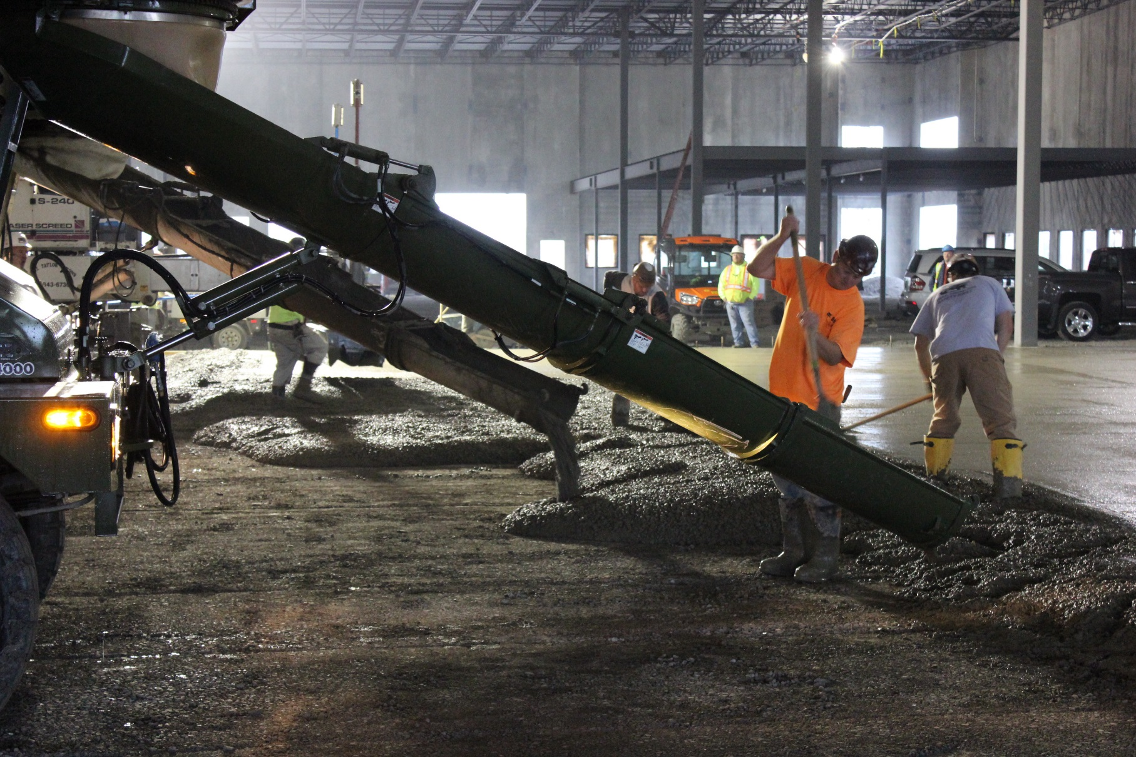
Speed of Construction
Notes:
Well we are back to the Helix project and it has come time to pour the Helix reinforced slab. The concrete trucks drive up to where the concrete needs to be placed and they direct discharge. The time and labor savings is very apparent as many more yards of concrete can be poured each day. Shown here there are two ready mix trucks discharging, and a laser screed is working behind the trucks without the need to worry about driving on mesh or rebar. The direct discharge method is not only faster but also less expensive and requires no boom pump. Less equipment means lower probability of mechanical failure, which can set projects back significantly.

Slide 20
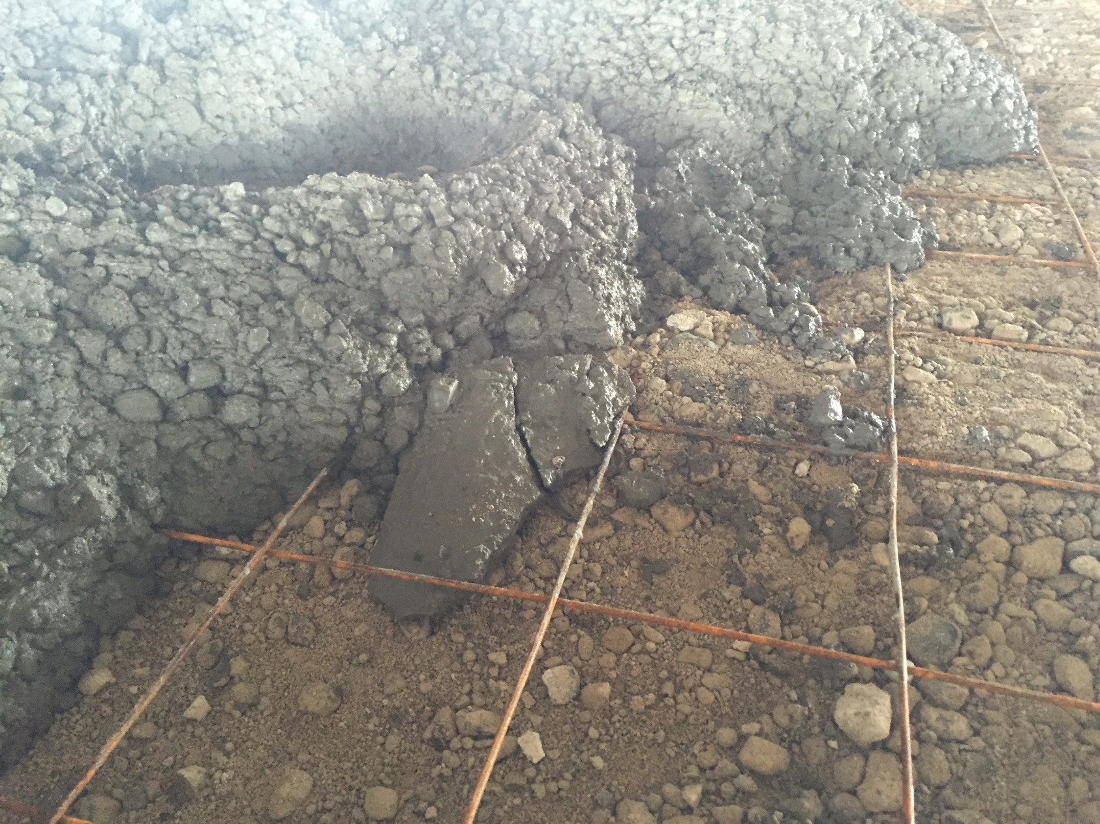
Constructability
Notes:
Compared with the first picture I showed of the double mat of rebar, many times slabs on grade only require a single layer of rebar or even light gauge welded wire mesh. In the case of using the single mat of rebar, the placing, tying and chairing is still quite labor intensive and the concrete must still be pumped.
In the case of using welded wire mesh, the contractor may opt to place the sheets of mesh directly on the subgrade. This allows them to direct discharge the concrete similar to the Helix reinforced slab. The problem with this option is that the mesh in not in the correct placement for crack control. Typically, an engineer will call for the mesh in the top third of the slab or with something like 2” top cover. As shown in the picture, the mesh is already corroded and is no where near the top of the slab. It is possible to chair wire mesh, but it usually ends of mangled by walking on it or driving over it. As an owner, this mesh on the ground is not something I would be interested in paying for. But as I know many may say, “its OK, they pull the mesh into the slab after the concrete is poured”

Slide 21
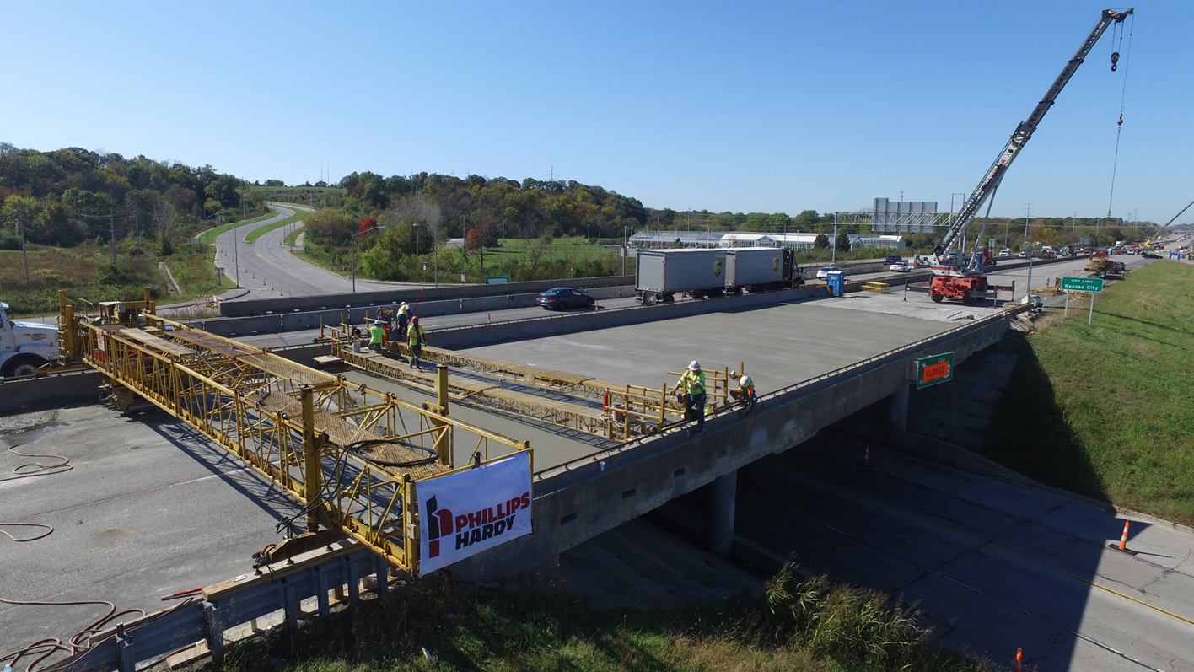
Bridge Deck Repair

Slide 22
New Bridge Deck, Utah

Slide 23
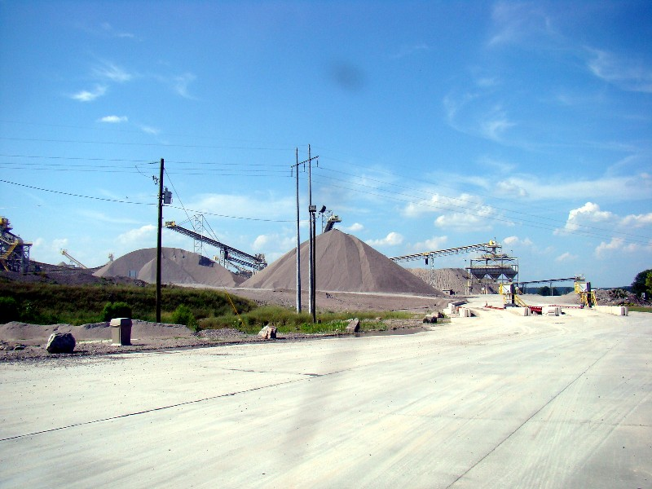
12” Plain Concrete to 6” Helix Reinforced @ 30 lb/yd³
Notes:
Here is a case study of a Helix pavement for an aggregate haul road. This project was for Martin Marietta in Columbia, SC. They original had specified a 12” thick plain concrete design. The previous 12” pavement lasted three years and was in shambles. The pavement in place currently is a 6” thick slab reinforced with 30 lb/yd3 of Helix 5-25. I am not trying to say this is a typical slab reduction, it is quite extreme. The reason it was feasible was because this application leverages all the strengths of using Helix. The increased MOR, along with durability and fatigue resistance are very important here. The plain concrete really failed from a fatigue standpoint rather than a strength perspective. Helix is able to carry more load repetitions and allows a higher fatigue limit. If the slab does undergo cracking, the Helix will hold the cracks tight with stable post crack behavior, which means very little water is allowed into the slab, thus preventing spalling and degradation of the slab. This pavement is 8 years old and is still in service.

Slide 24
Corbels, Texas DOT

