Slide 1


2018 Pavement Workshop
May 23-24, 2018
Cold Central Plant Recycling (CCPR)
David Rettner
President and Principal Engineer
American Engineering Testing, Inc.
+ 46 Associate Members

Slide 2
What is CCPR?
CIR methods with stockpiled RAP
Add binder as required
Pave as usual
Avoids possible concerns about in-place material
Using stockpiled material reduces variability
  Fractionating the RAP can produce a more consistent material
Additional costs of CCPR for hauling, storing, processing, etc
CCPR vs CIR
5/24/2018 | NRRA Workshop | 2

Slide 3
Project Objectives
Survey NRRA members about CCPR practice, costs, and needs
Laboratory testing and analysis of MnROAD CCPR
Summary of MnROAD CCPR field performance
Technical briefs summarizing:
  CCPR state of the practice
  CCPR costs
  CCPR characterization and testing
5/24/2018 | NRRA Workshop | 3

Slide 4


MnROAD field sections
Single-source, non-fractionated RAP
Constructed in Fall 2017
Compacted CCPR had final average thickness of 3.5”
Placed on 12” Class 6, clay/loam subgrade
CELL | SURFACE | SPEC | BINDER | LTC req.
133 | Double chip seal FA-3/FA-2.5 | Emulsion (58S-28) | CIR-EE (H) | -21.4°C
233 | Double chip seal FA-3/FA-2.5 | Foam (58S-28) | 58S-28 | -21.4°C
135 | 1.5” HMA SPWEB340C | Foam (XX-34) | 52-34 | -21.4°C
235 | 1.5” HMA SPWEB340C | Emulsion (XX-34) | CIR-TEC M | -21.4°C
5/24/2018 | NRRA Workshop | 4

Slide 5
Mix Designs
BINDER TYPE | Emulsion
MnROAD CELL | 133 | 135
SURFACING | DCS | 1.5" SP
PG | 58S-28 | XX-34
BINDER ADDED, % | 2.0
Voids @ Opt, % | 11.5 | 11.7
Max Dens @ Opt, pcf | 133.1 | 132.8
Marshall @ Opt, lbs | 1272 | 1365
Ret. Stability @ Opt, % | 72.1 | 71.0
Raveling, % | 1.60 | 1.70
Est Crit Crack Temp, °C | -35 | -36
IDT @ CC Temp, psi | 155 | 158
Developed at AET in Summer 2017
Exceeded low temp req of -21.4°C
Exceeded dry stability of 1250 lb
While no MnDOT requirement for raveling, foamed mixes did not meet target of 2.0%
5/24/2018 | NRRA Workshop | 5

Slide 6
Mix Designs
BINDER TYPE | Foamed
MnROAD CELL | 233 | 235
SURFACING | DCS | 1.5" SP
PG | 58S-28 | XX-34
BINDER ADDED, % | 1.5
Voids @ Opt, % | 12.2 | 10.8
Max Dens @ Opt, pcf | 131.8 | 133.8
Marshall @ Opt, lbs | 1311 | 1272
Ret. Stability @ Opt, % | 70.4 | 73.2
Raveling, % | 3.30 | 2.50
Est Crit Crack Temp, °C | -34 | -34
IDT @ CC Temp, psi | 128 | 132
Developed at AET in Summer 2017
Exceeded low temp req of -21.4°C
Exceeded dry stability of 1250 lb
While no MnDOT requirement for raveling, foamed mixes did not meet target of 2.0% of emsulsion mixes
5/24/2018 | NRRA Workshop | 6

Slide 7
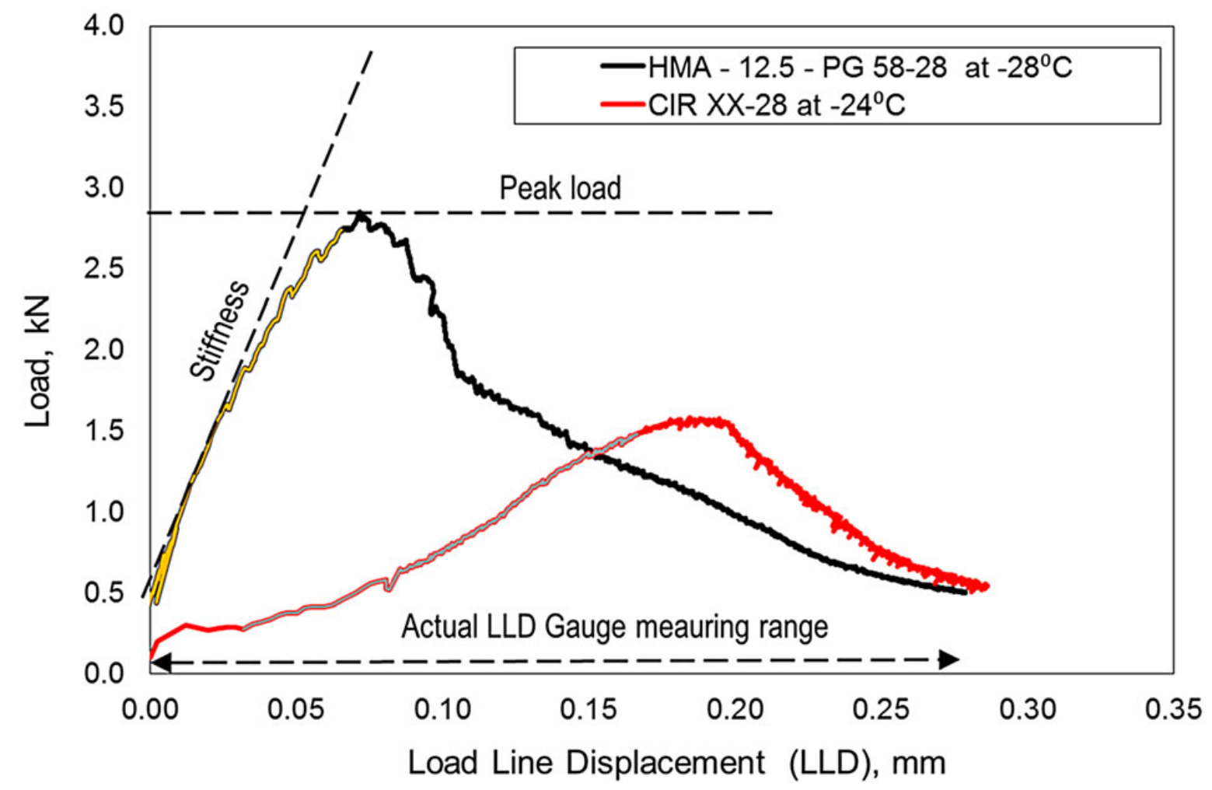
Challenges to lab tests
Building on past studies in CCPR materials
AET experience adapting SCB/IDT to test CIR samples
Obtaining viable samples
Actual LLD gauge measuring range
5/24/2018 | NRRA Workshop | 7

Slide 8
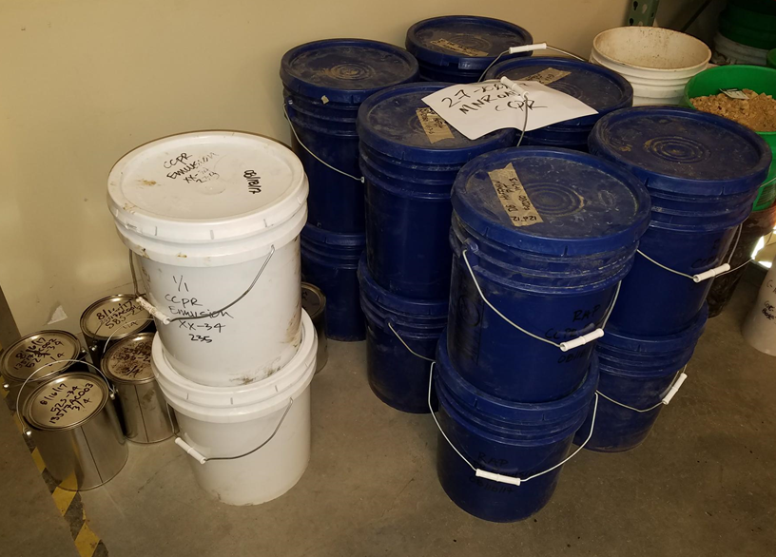
Materials for sample preparation
5/24/2018 | NRRA | 8

Slide 9
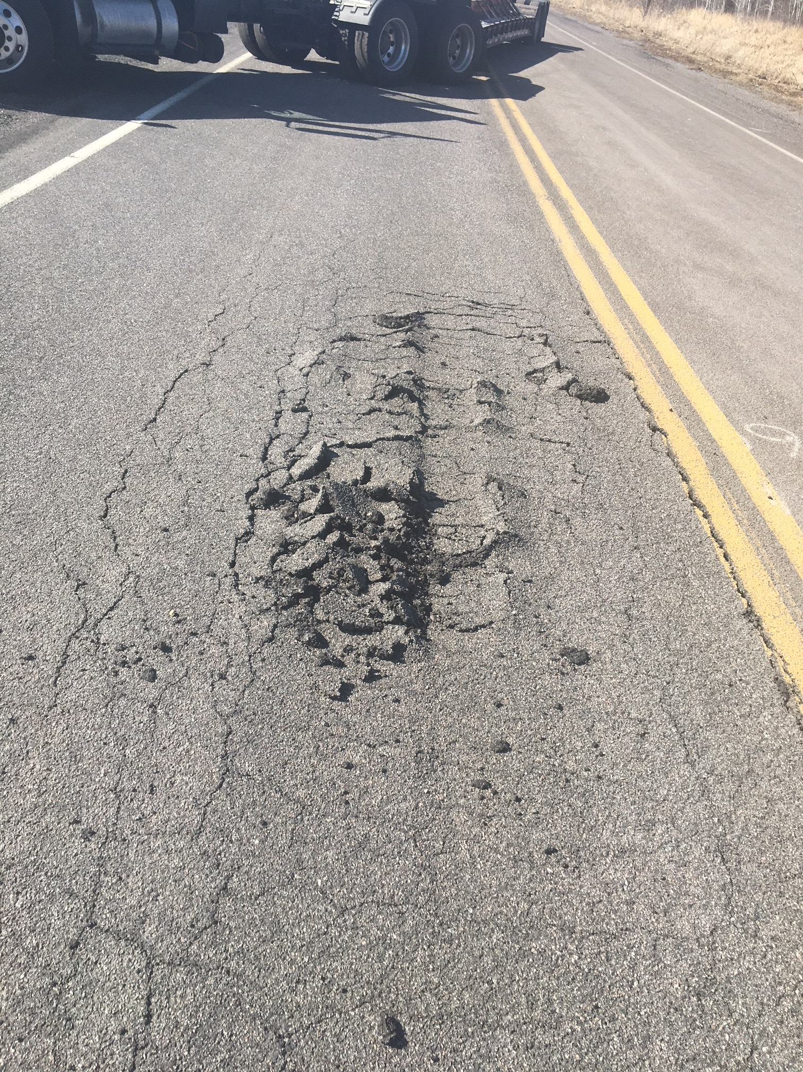
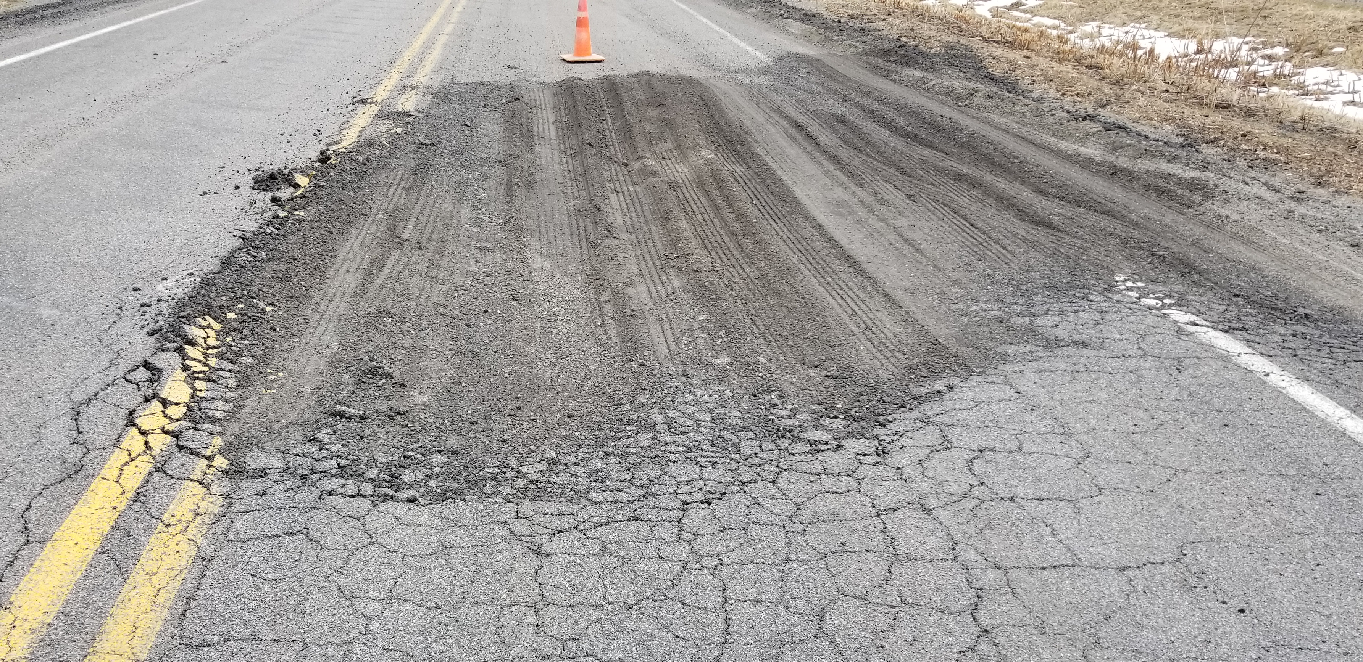
MnROAD Performance: Cell 233
Based on Cell 233, lab work started with foamed 58S-28
March 2018
April 2018
Cell 233
Foamed 58S-28, Double Chip
5/24/2018 | NRRA Pavement Workshop | 9

Slide 10
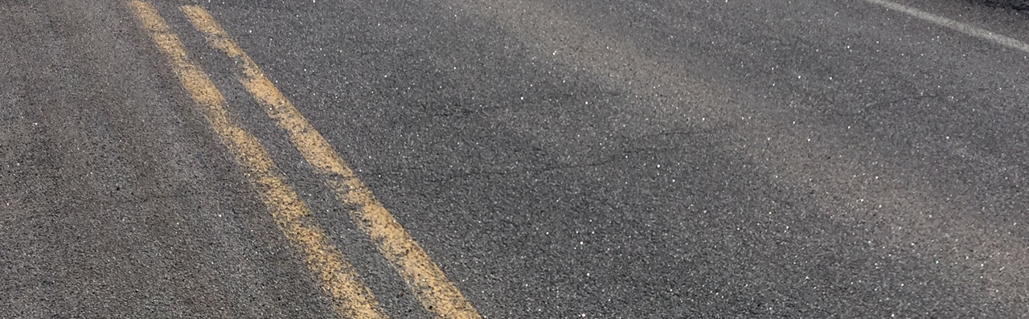
MnROAD Performance: Cell 133
May 2018
Cell 133
Emulsion 58S-28, Double Chip
5/24/2018 | NRRA Pavement Workshop | 10

Slide 11
Research products & timeline
Surveys
Summaries of
  State of practice
  Performance testing and analysis
  Spec recommendations
Final report
5/24/2018 | NRRA Workshop | 11

Slide 12


















































Principal Investigator | Technical Liaison
David Rettner, AET | Dave Van Deusen, MnDOT

