Slide 1

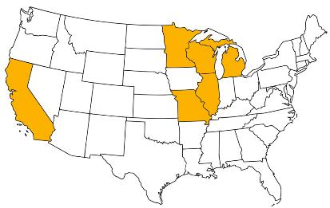
2018 Pavement Workshop
May 23-24, 2018
Reflections on 34 Years of Pavement Engineering
David Rettner
President and Principal Engineer
American Engineering Testing, Inc.
+ 46 Associate Members

Slide 2
Started Working at MnDOT in 1984 as an Intern in the Office of Materials
First Introduction to Pavement Engineering was a Course at the University of Minnesota Taught by Gene Skok.
Worked for George Cochran – MnDOT Pavement Design Engineer
Tested Highways Across the State of Minnesota with a Falling Weight Deflectometer
  Goal was to test every bituminous surfaced roadway in the state in a 4-year period
5/24/2018 | NRRA Workshop | 2

Slide 3
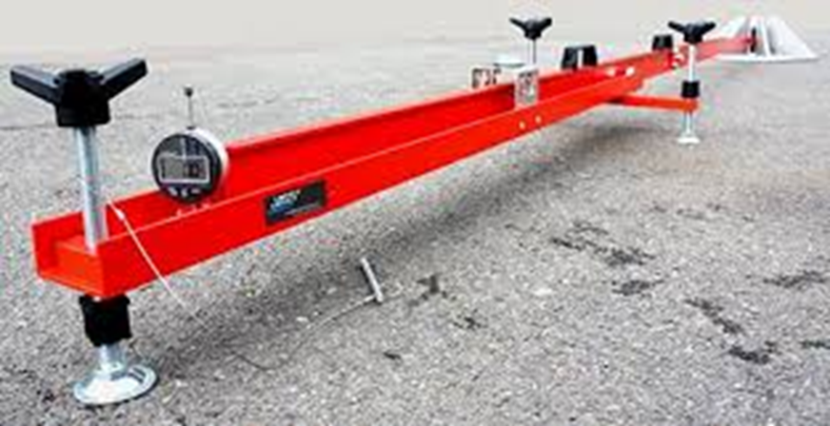
State of the Art Method of Pavement Analysis was TONN.
Based on MnDOT Investigation 603 (Benkelman Beam)
5/24/2018 | NRRA Workshop | 3

Slide 4
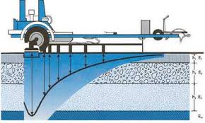
34 Years Later FWD is State of Practice for Pavement Strength Testing
  State of the Practice Method of Pavement Analysis is TONN 2010 still Based on Investigation 603 (Benkelmen Beam).
    Up to 9 measured deflection points and we’re still correlating it to a study done in 1967 with a single deflection point
5/24/2018 | NRRA Workshop | 4

Slide 5
MnDOT has always been a leader in pavement research
Started laying the groundwork to move towards mechanistic design in the 1980’s
Spring Recovery Test Sections to update TONN were tested with FWD weekly in the spring and then monthly the rest of the year in the 1980’s
  Used to assist in applying spring load restrictions
Started testing soil for resilient modulus in the 1980’s to move away from R-Value
5/24/2018 | NRRA Workshop | 5

Slide 6
1990’s MnDOT Golden Age for Pavement Design and Materials
  George Cochran Duane Young
  Doug Schwartz Jerry Rohrbach
  Mike Robinson Joe Meade
  Roger Olson Dick Sullivan
  Terry Zoller
  Mark Snyder and Dave Newcomb and the UofM
  Also had an Assistant Commissioner – Dave Ekern that was committed to research implementation
5/24/2018 | NRRA Workshop | 6

Slide 7
1990’s MnDOT Golden Age for Pavement Design and Materials
Updated Geotechnical and Pavement Manual
Superpave Implementation
  Improved asphalt binders
  Improved aggregate size and quality
High Performance Concrete Implementation
  Lower W/C ratio
  Higher cementitious substitution
  Improved aggregate quality
Contractor QC for both Concrete and Bituminous Plants
5/24/2018 | NRRA Workshop | 7

Slide 8
MnROAD was Constructed 1992-1994
Ambitious Research Program
  Became Apparent early on that we needed partners to help with research funding, staffing and implementation
  Started doing Pooled Fund Research Projects
    Large graduate program at the UofM
  Too much data to store and analyze
Lost focus on the other research we had going on
5/24/2018 | NRRA Workshop | 8

Slide 9
MnROAD
Because it was constructed prior to the major changes in Concrete and Bituminous Materials a lot of the Materials Related Research Benefits were not realized
Pavement Materials were MnDOT focused only
  Not overly attractive to outside partners
Mechanistic Pavement Performance Data is Valid
  Still a lot of information from the initial test sections that can be mined and included in ongoing and future research projects
5/24/2018 | NRRA Workshop | 9

Slide 10
MnROAD
New NRRA Format is what was Needed
Nationally Focused Research Program
  Has made partnering attractive
  Has increased the likelihood of the research being implemented on a broad scale
  Committee membership and chairs from all member organizations
5/24/2018 | NRRA Workshop | 10

Slide 11
The Challenges Moving Forward
Don’t Forget the Past when Writing new Specifications and Manuals
  There’s a lot of information that can get lost when doing major rewrites
  Manuals in particular contain directive and instructional information that can prove valuable
5/24/2018 | NRRA Workshop | 11

Slide 12
The Challenges Moving Forward
Don’t Forget the Construction Aspects Related to Pavement Performance
  Variability in materials that meet specifications
    How to include these in pavement design procedures
  Variability in construction methods, material suppliers and contractors
5/24/2018 | NRRA Workshop | 12

Slide 13
The Challenges Moving Forward
  Don’t forget that implementation efforts need to include contractors. Once they see why something is important to them they will jump in with both feet.
  Example: Intelligent Compaction
5/24/2018 | NRRA Workshop | 13

Slide 14
In Closing
  30 years after starting resilient modulus testing MnDOT still uses R-Values
  Even though they are based on 50 year old research TONN 2010 and the 1993 AASHTO Guide for the Design of Pavement Structures are still applicable procedures for analyzing pavements
  Implementation is a multi-year process with continued refinements needed along the way
5/24/2018 | NRRA Workshop | 14

Slide 15
  Thank You
5/24/2018 | NRRA Workshop | 15

Slide 16


















































Principal Investigator | Technical Liaison
David Rettner, AET | Dave Van Deusen, MnDOT

