Slide 1


2018 Pavement Workshop
May 23-24, 2018
Evaluation of Spray Applied Rejuvenators and Surface Sealers; a First Look
Phil Ruffus
Senior Pavement Specialist –MoDOT
Phillip.ruffus@modot.mo.gov
+ 46 Associate Members

Slide 2
Overview
Evaluation of Rejuvenators and Surface Sealing Products to Extend Asphalt Pavement Life
Presentation to:
NRRA Pavement Workshop
May 23, 2018

Slide 3
Objective & Goals
Objective:
  Provide MoDOT with recommendations for creating a performance-based specification for rejuvenating or surface sealing products used to extend the life of asphalt concrete mixtures.
Project Goals:
  Determine if these penetrating sealers extend asphalt pavement life and to quantify the expected length of extending pavement service life.
  If service life is extended; Determine if the added cost to apply these materials to the wearing surface is cost-effective.
  If cost is offset – quantify and prepare a draft performance based specification, as well as establish recommendations to apply the sealers in terms of selecting those projects with features that will provide the best value to Missouri.

Slide 4
Major Tasks/Activities
Request for Proposal: May 2017
Consultant Selection: Applied Research Associates
Kickoff meeting with Industry: February 2018
Data Collection: Pre-Application of Rejuvenators and Sealers: April 2018
Product Application:
  Application along mainline - May 2018, except for 3 test sections along route N.
  Application along centerline joint – September 2017
Post Application Investigation - ONGOING.
Prepare Final Report and Project Documentation.

Slide 5
Pre-Application Testing
Mainline Sections:
Distress surveys - PaVision
Friction testing; ASTM E274 using FN40R
Field permeability tests
Wear resistance
Cores
Centerline Joint Sections:
Distress surveys – PaVision
Joint width
Field permeability tests
Reflectivity tests
Wear resistance, visual

Slide 6
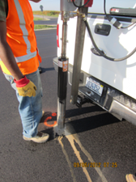
Pre-Application Testing: Cores
Mainline Sections Only:
AASHTO T 300 – Force Ductility Test
AASHTO T 315 – Dynamic Shear Rheometer Test
AASHTO T 350 – Multiple Stress Creep Recovery Test

Slide 7
Locations of Test Sections
Mainline Sections:
Route N in St. Charles County
Centerline Joint Sections:
Route 30 in Jefferson County
Route 52 in Morgan County

Slide 9
Mainline Test Section Layout - Example

Slide 10
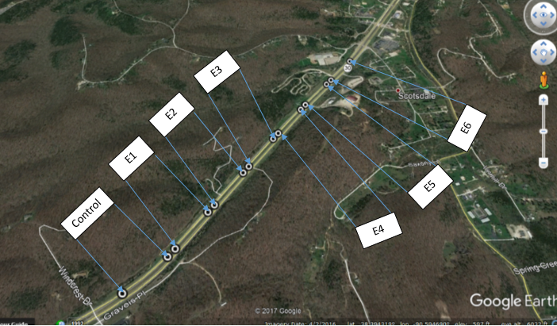
Centerline Joint Test Section Layout - Example

Slide 11
Material Suppliers Included in Study
Mainline Sections:
Asphalt Materials, Inc.; RPE
Asphalt Systems, Inc.; GSB-Friction Seal
Asphalt Systems Ohio; Biorestor
BlackRoads; MSS-P, RoadLock I, RoadLock II, and RoadLock III
Corrective Asphalt Materials; CRF Maltene Seal and Reclamite Malene
Hutchens Construction; Onyx
Unique Paving Materials; RavelCheck
Control Sections

Slide 12
Material Suppliers Included in Study
Centerline Joint Sections:
Asphalt Materials; RPE
Asphalt Systems Ohio; Biorestor
BlackRoads; LCJ 100
Corrective Asphalt Materials, Joint Bond
Unique Paving Materials; RavelCheck
Control Sections

Slide 13
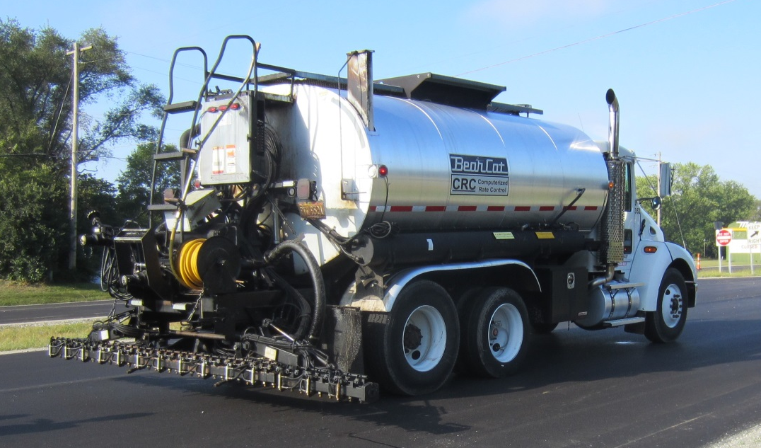
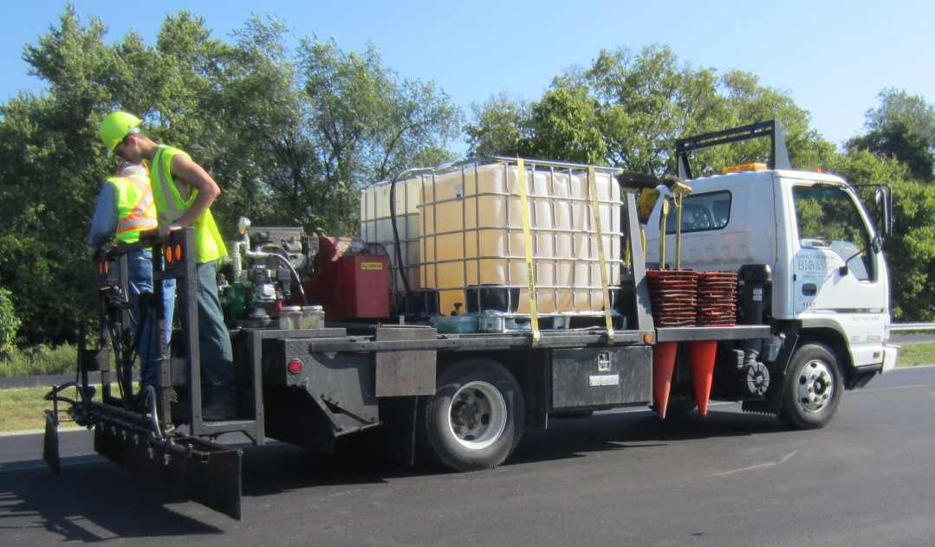
Processes Included on Mainline Project
Single step application process
Multi-step application process
Multi-Step Process
Single Step Process

Slide 14
Activities During Application
Mainline Sections:
Photographs and videos of application process.
1-gallon sample of material.
Pads for application rates.
Centerline Joint Sections:
Photographs and videos of application process.
1-gallon sample of material.
Reflectivity testing, if applicable.
Pads for application rates, only Route 30:
  Route 52 – pads were eliminated because of pending rain.

Slide 15
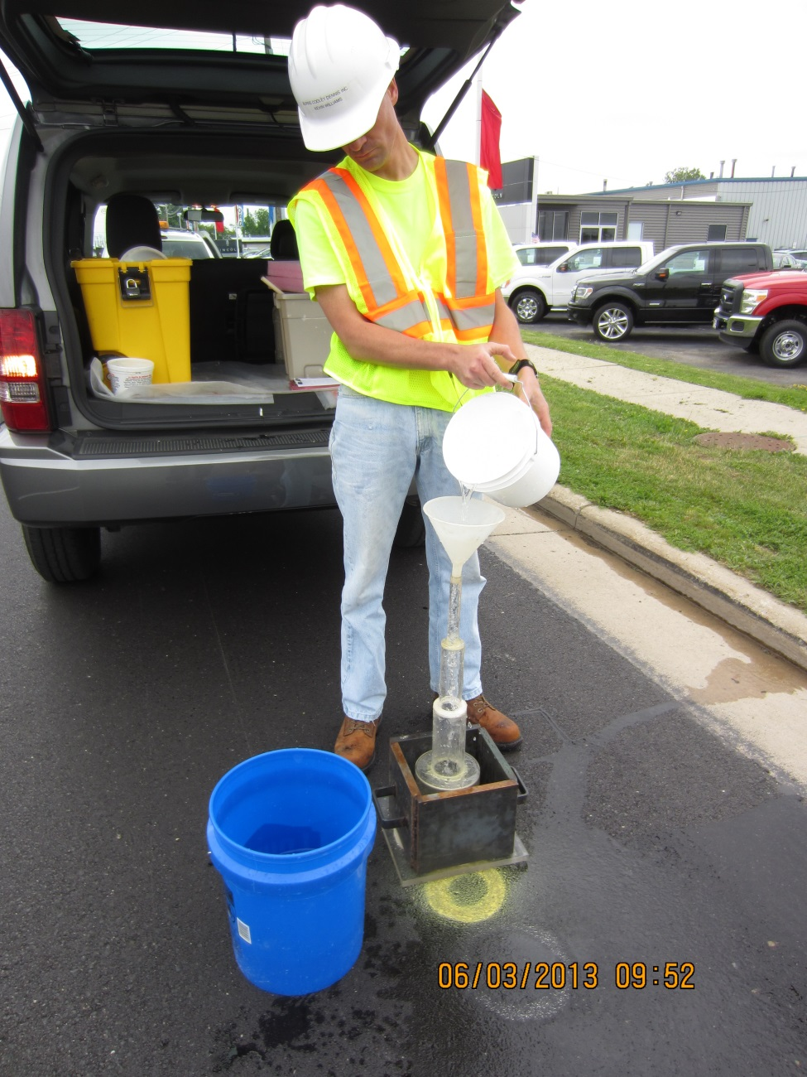
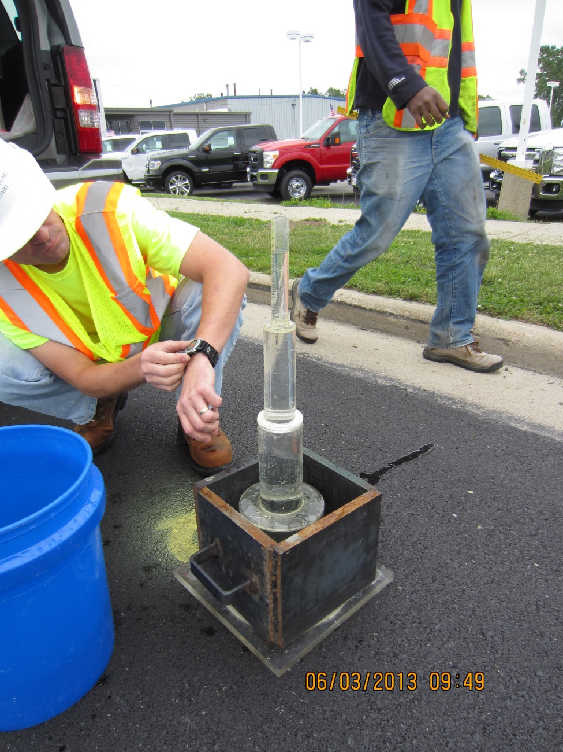
Water-Based Field Permeability Test

Slide 17
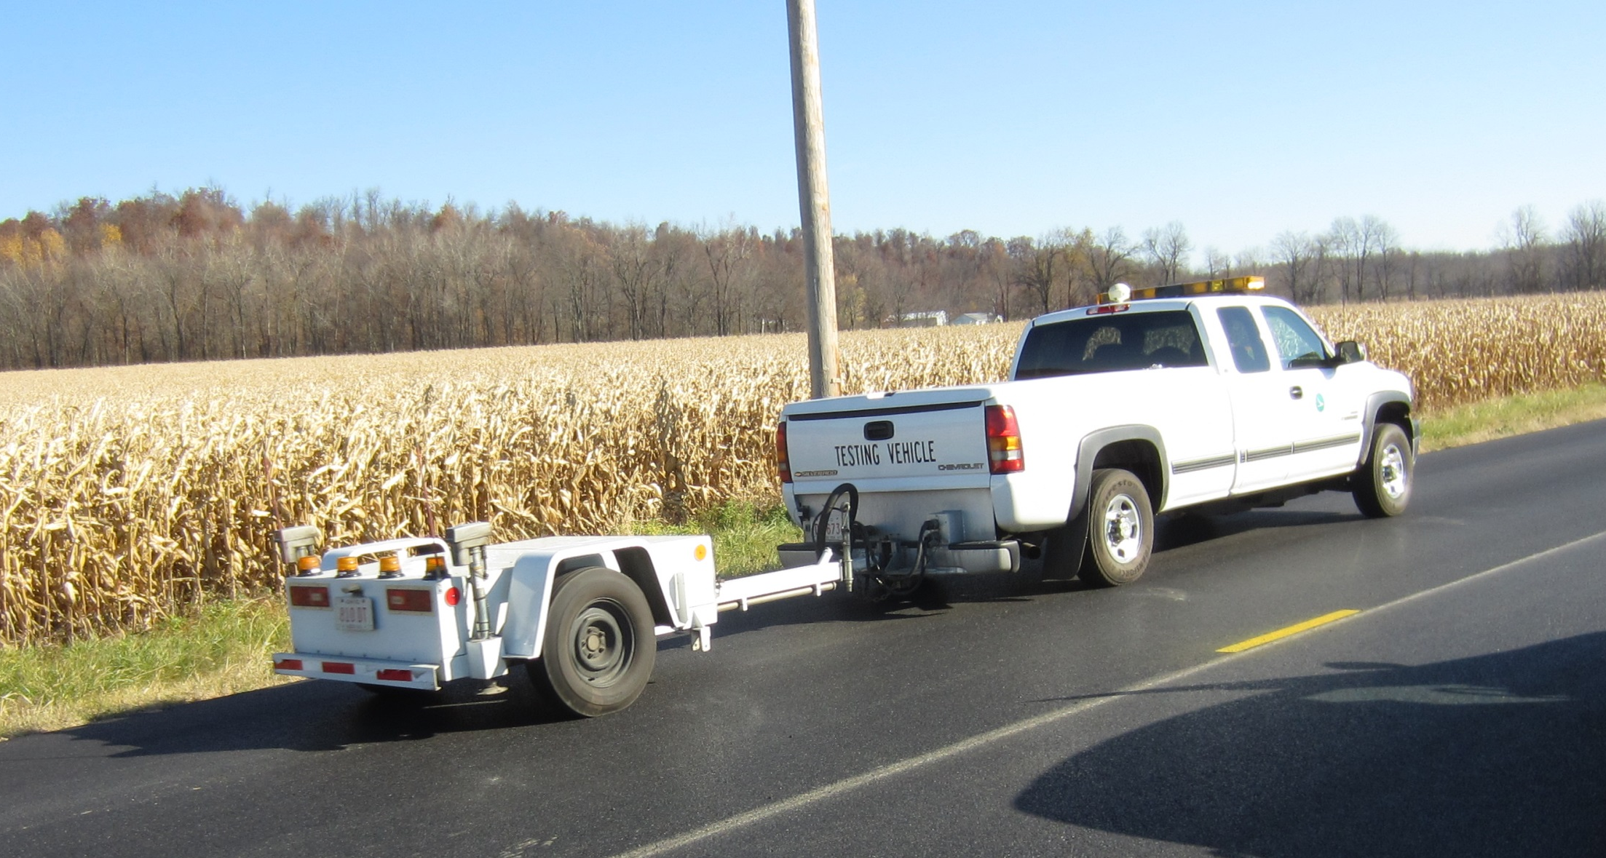
Friction Testing

Slide 18
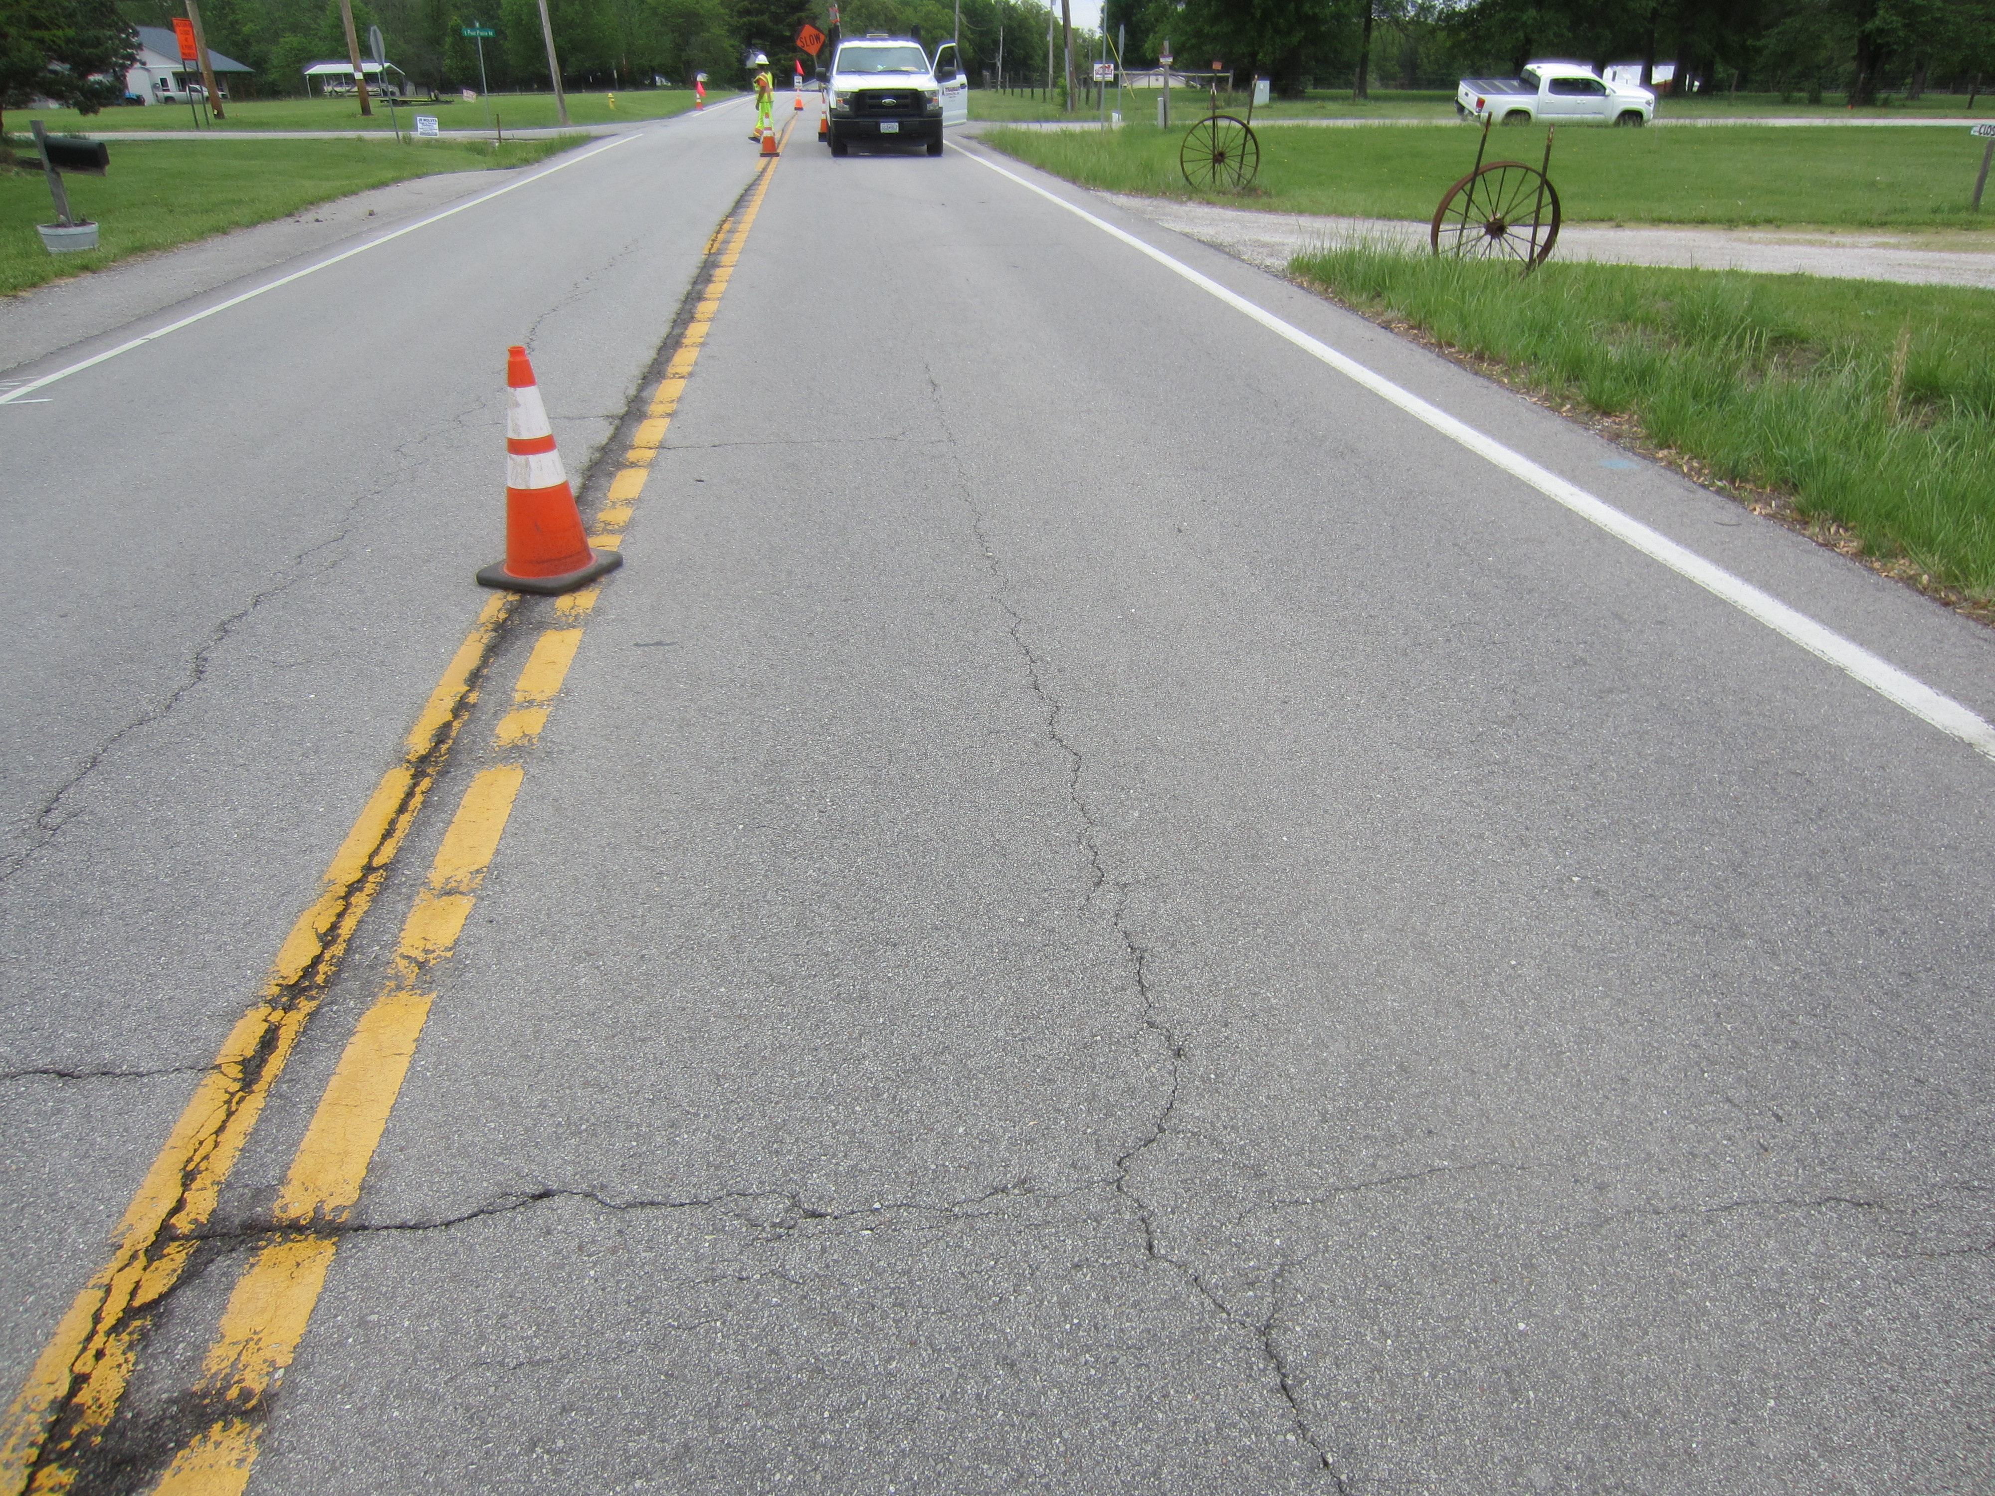
Cracking/Condition Maps
Route N, mainline
Routes 30 and 52, centerline joint

Slide 19
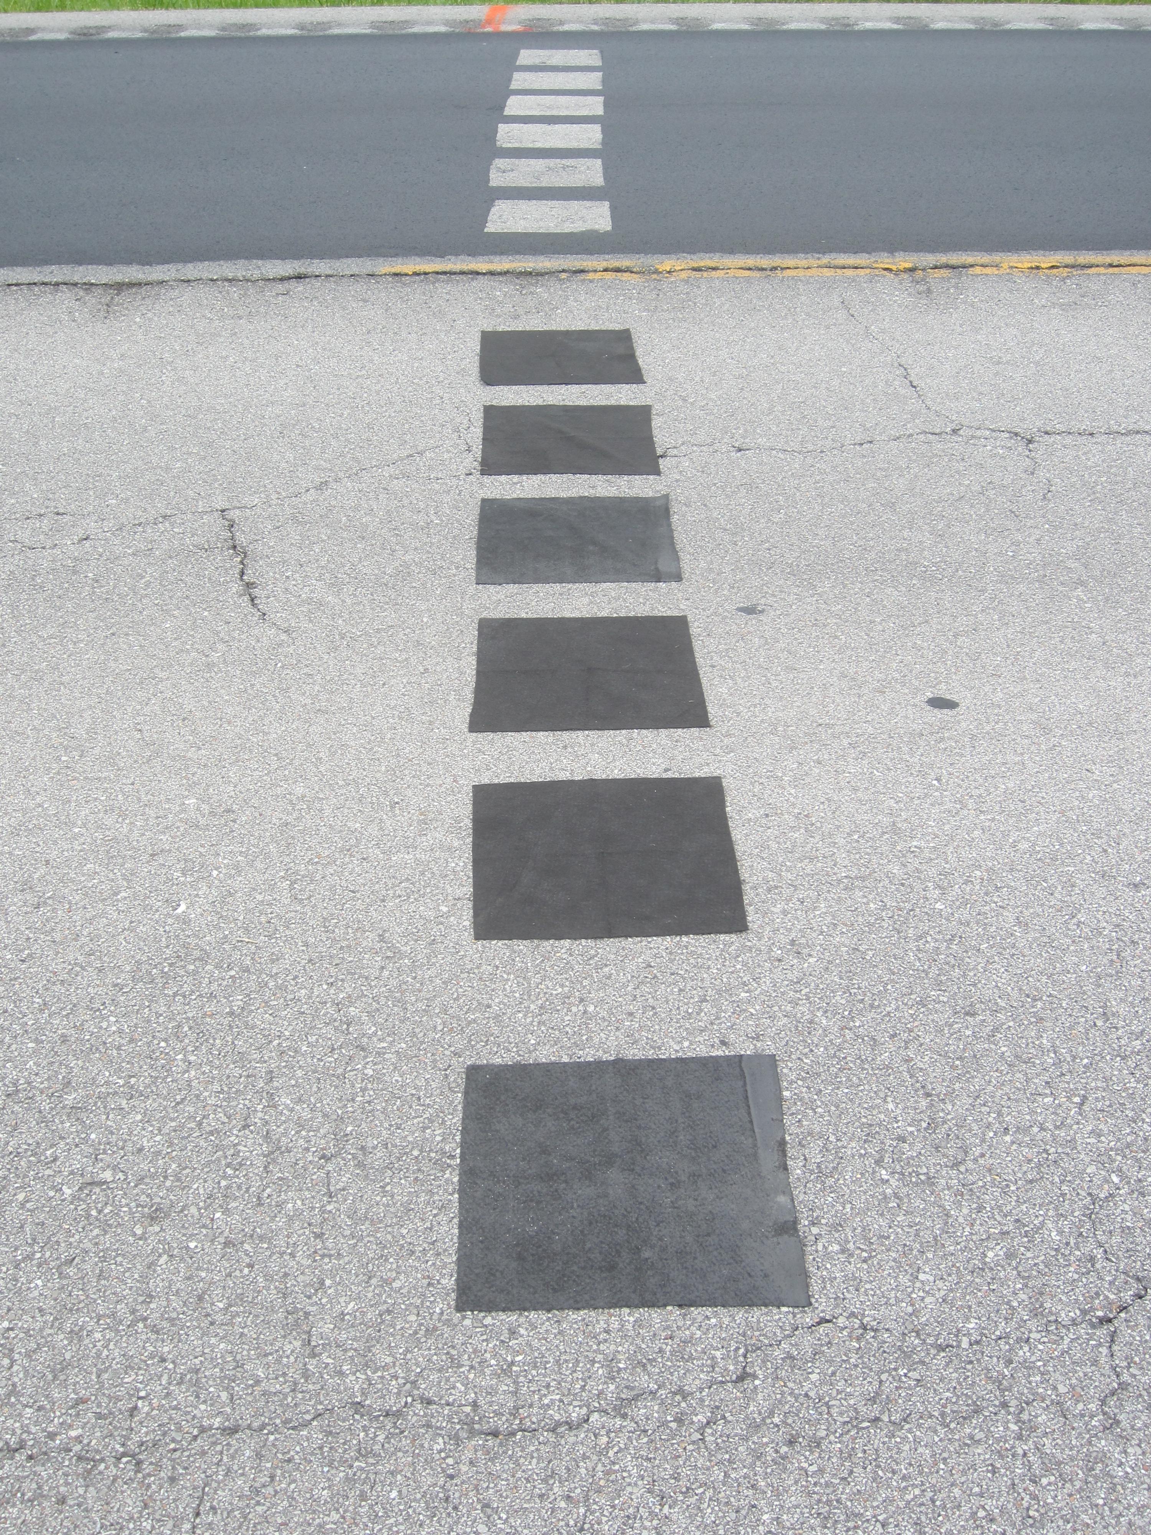
Monitoring Product Application Rates
Pads removed after product application
Pads placed prior to product application

Slide 20
Why study was sponsored by MODOT
Do rejuvenators/sealers extend the life and/or reduce the maintenance cost of asphalt pavements, and if they do, is the application expense cost effective?
How does the use of rejuvenators/sealers ultimately fit into the MoDOT Asset Management Plan?
Ultimately, can we classify these products and assign them a spot on the Prequalified Products List?

Slide 21
What questions/answers does MoDOT expect?
The following are some examples from other studies that have been completed.

Slide 22
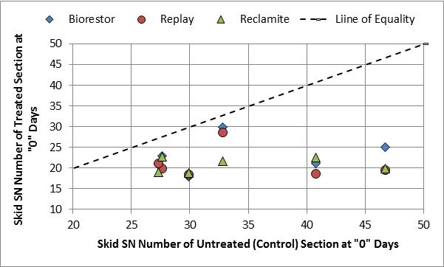
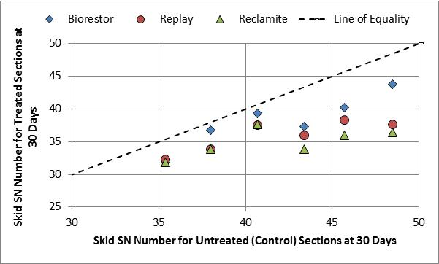
Q1: Is the friction significantly affected by applying the product to the pavement surface, and if so, what is the magnitude of the effect?

Slide 23
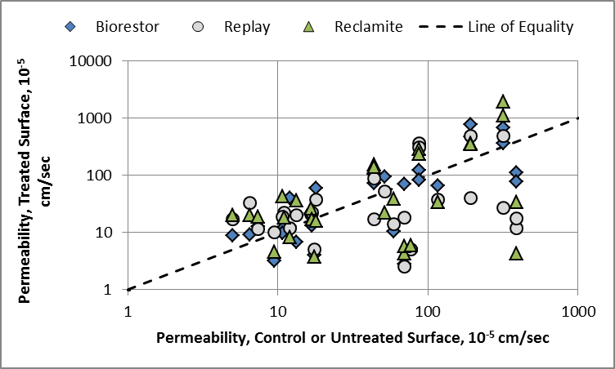
Q2: How does permeability change over time with and without the products being applied at the surface?

Slide 24
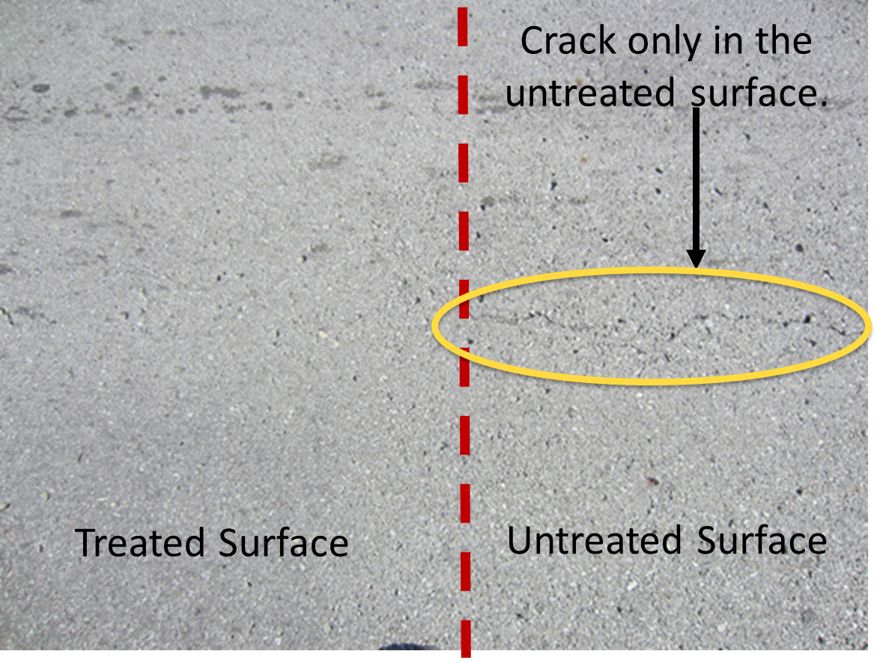
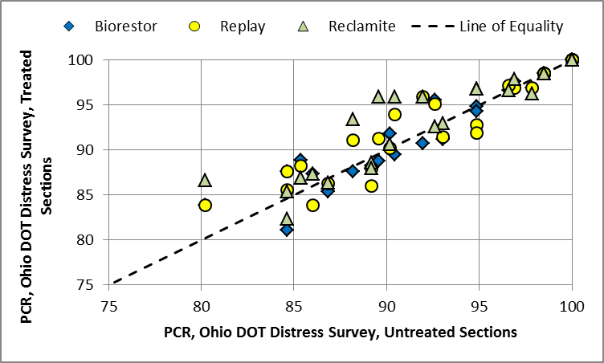
Q3: How does the surface distress change over time with and without the products in terms of cracking and other defects?

Slide 25
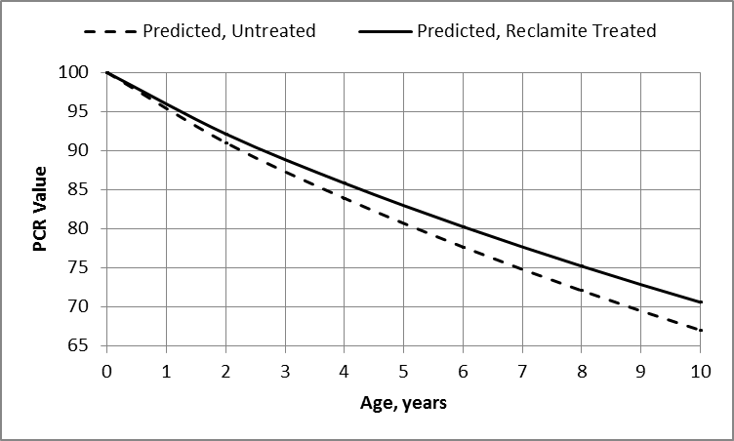
Q4: Control versus Treated Sections: Can the distress be quantified for use in predicting the overall performance of the flexible pavement for use in determining the cost benefit of the product?

Slide 26
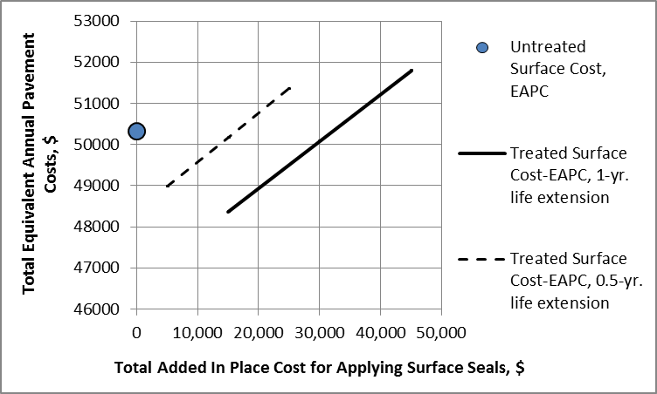
Q5: Can we realistically establish a Life Cycle Cost Analysis?
Equivalent annual pavement costs.
Cost differential for treated surface to be cost effective.

Slide 27
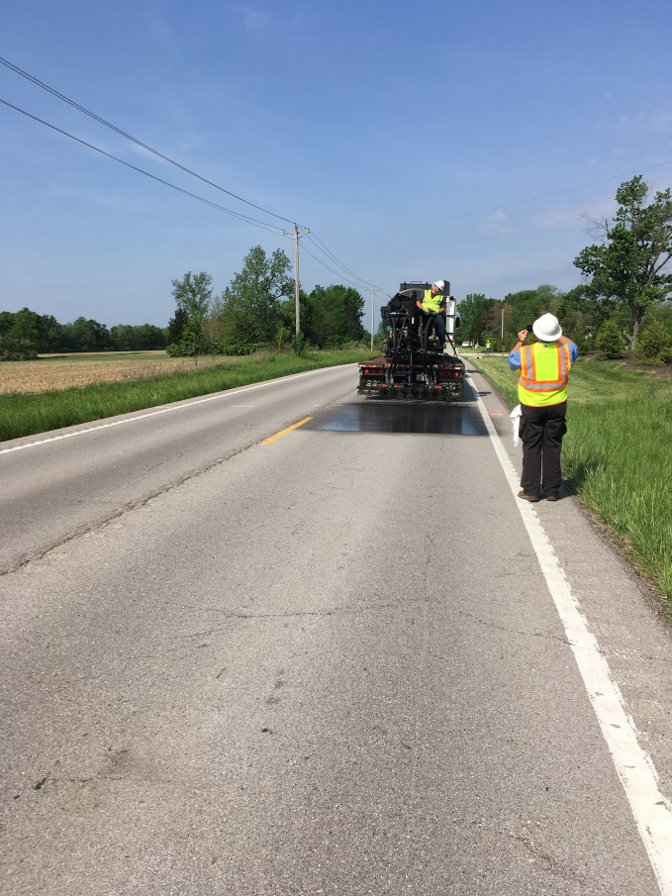
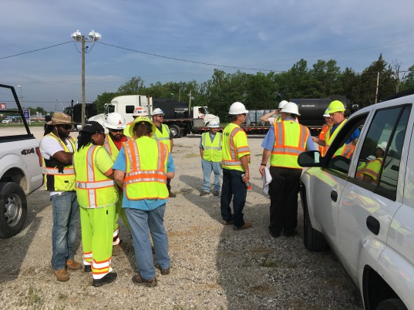
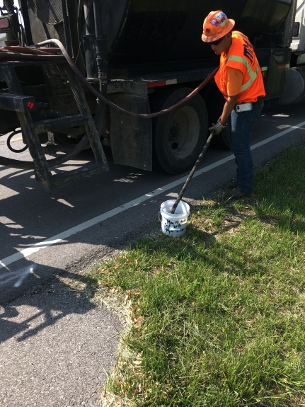
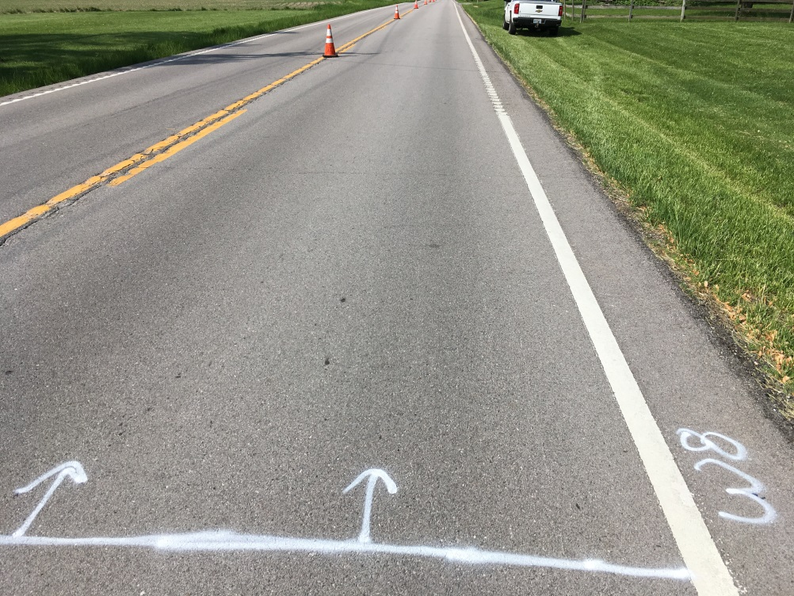
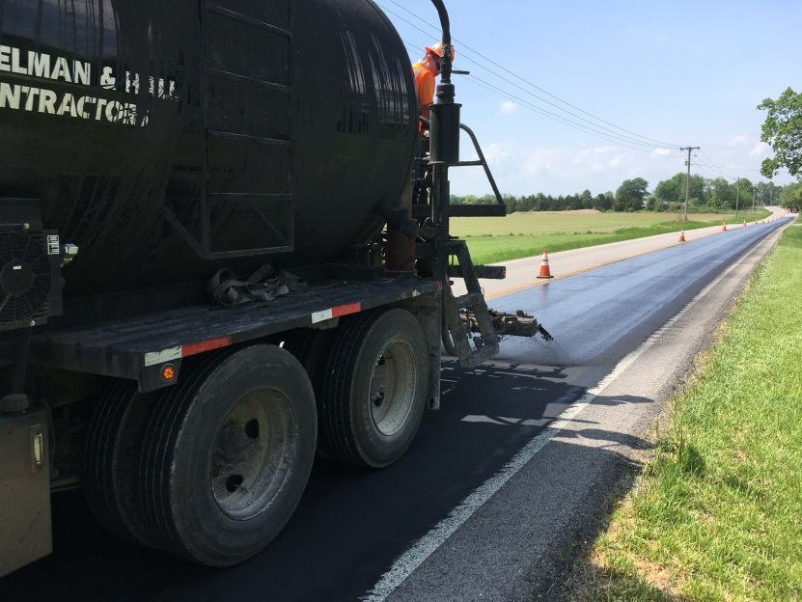
Final Thoughts

Slide 28


















































Thank You
Questions?

